Slide 1
Identities using $\tan{θ}=\frac{\sin{θ}}{\cos{θ}}$ and $\sin^{2}{θ}+\cos^{2}{θ}=1$
CONTENTS

Slide 2
Worked example
Your turn
Simplify:
$$\sin^{2}{\frac{1}{3}y}+\cos^{2}{\frac{1}{3}y}$$
$$\cos^{2}\left(3θ−10\right)+\sin^{2}{(3θ−10)}$$
Simplify:
$$\sin^{2}{3x}+\cos^{2}{3x}$$
$$1$$

Slide 3



Worked example
Your turn
Given that $\cos{θ}=\frac{12}{13}$, find the two possible values of $\sin{θ}$
Given that $\sin{θ}=\frac{3}{5}$, find the two possible values of $\cos{θ}$
$$\cos{θ}=±\frac{4}{5}$$

Slide 4
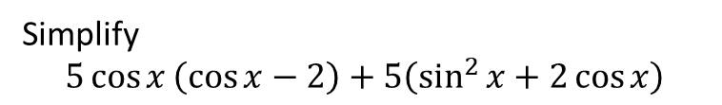
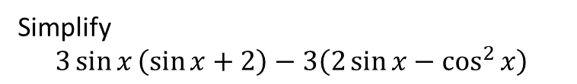
Worked example
Your turn
Simplify
$$5\cos{x}\left(\cos{x}−2\right)+5\left(\sin^{2}{x}+2\cos{x}\right)$$
Simplify
$$3\sin{x}\left(\sin{x}+2\right)−3\left(2\sin{x}−\cos^{2}{x}\right)$$
$$3$$

Slide 5
Worked example
Your turn
Prove that $1−\frac{\tan{θ}\cos^{3}{θ}}{\sin{θ}}≡\sin^{2}{θ}$
Prove that $1−\tan{θ}\sin{θ}\cos{θ}≡\cos^{2}{θ}$
Proof
$$LHS$$
$$≡1−\tan{θ\sin{θ}}\cos{θ}$$
$$≡1−\frac{\sin{θ}}{\cos{θ}}\sin{θ}\cos{θ}$$
$$≡1−\frac{\sin^{2}{θ}\cos{θ}}{\cos{θ}}$$
$$≡1−\sin^{2}{θ}$$
$$≡\cos^{2}{θ}$$
$≡RHS$

Slide 6
Worked example
Your turn
Prove that $\tan{θ}−\frac{1}{\tan{θ}}≡\frac{1−2\cos^{2}{θ}}{\sin{θ} cosθ}$
Prove that $\tan{θ}+\frac{1}{\tan{θ}}≡\frac{1}{\sin{θ}\cos{θ}}$
Proof
$$LHS$$
$$≡\tan{θ}+\frac{1}{\tan{θ}}$$
$$≡\frac{\sin{θ}}{\cos{θ}}+\frac{\cos{θ}}{\sin{θ}}$$
$$≡\frac{\sin^{2}{θ}+\cos^{2}{θ}}{\sin{θ}\cos{θ}}$$
$$≡\frac{1}{\sin{θ}\cos{θ}}$$
$$≡RHS$$

Slide 7
Worked example
Your turn
Simplify $10−10\cos^{2}{θ}$
Simplify $5−5\sin^{2}{θ}$
$$5\cos^{2}{θ}$$

Slide 8


Worked example
Your turn
Prove that
$$\frac{\cos{θ}−\cos^{3}{θ}}{\sin^{3}{θ}}≡\frac{1}{\tan{θ}}$$
Prove that
$$\frac{\sin{θ}−\sin^{3}{θ}}{\cos^{3}{θ}}≡\tan{θ}$$
$$5\cos^{2}{θ}$$

Slide 9
Worked example
Your turn
Simplify:
$$\frac{\cos{4θ}}{\sqrt{1−\sin^{2}{4θ}}}$$
Simplify:
$$\frac{\sin{2θ}}{\sqrt{1−\sin^{2}{2θ}}}$$
$$\tan{2θ}$$

Slide 10
Worked example
Your turn
Prove that
$$\frac{\sin^{4}{θ}−\cos^{4}{θ}}{\sin^{2}{θ}}≡1−\frac{1}{\tan^{2}{θ}}$$
Prove that
$$\frac{\cos^{4}{θ}−\sin^{4}{θ}}{\cos^{2}{θ}}≡1−\tan^{2}{θ}$$
Proof
$$LHS$$
$$≡\frac{\cos^{4}{θ}−\sin^{4}{θ}}{\cos^{2}{θ}}$$
$$≡\frac{\left(\cos^{2}{θ}+\sin^{2}{θ}\right)\left(\cos^{2}{θ}−\sin^{2}{θ}\right)}{\cos^{2}{θ}}$$
$$≡\frac{\cos^{2}{θ−\sin^{2}{θ}}}{\cos^{2}{θ}}$$
$$≡\frac{\cos^{2}{θ}}{\cos^{2}{θ}}−\frac{\sin^{2}{θ}}{\cos^{2}{θ}}$$
$$≡1−\tan^{2}{θ}$$
$$≡RHS$$

Slide 11
Worked example
Your turn
Prove that
$$\frac{\frac{\sin{x}}{\tan{x}}}{\sqrt{1−\sin^{2}{x}}}≡1$$
Prove that
$$\frac{\tan{x}\cos{x}}{\sqrt{1−\cos^{2}{x}}}≡1$$
Proof
$$LHS$$
$$≡\frac{\tan{x}\cos{x}}{\sqrt{1−\cos^{2}{x}}}$$
$$≡\frac{\frac{\sin{x}}{\cos{x}}\cos{x}}{\sqrt{\sin^{2}{x}}}$$
$$≡\frac{\sin{x}}{\sin{x}}$$
$$≡1$$
$$≡RHS$$

Slide 12
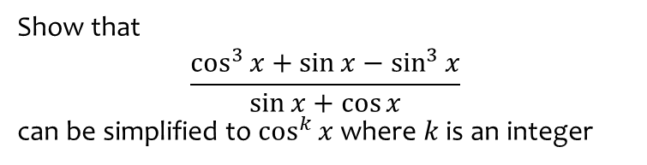
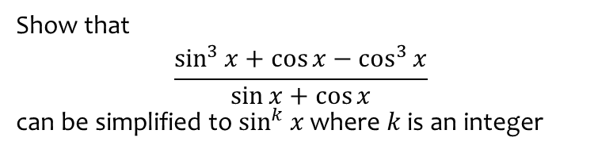
Worked example
Your turn
Show that
$$\frac{\cos^{3}{x}+\sin{x}−\sin^{3}{x}}{\sin{x}+\cos{x}}$$
can be simplified to $\cos^{k}{x}$ where $k$ is an integer
Show that
$$\frac{\sin^{3}{x}+\cos{x}−\cos^{3}{x}}{\sin{x}+\cos{x}}$$
can be simplified to $\sin^{k}{x}$ where $k$ is an integer
$$\sin^{2}{x}$$

Slide 13
Worked example
Your turn
Prove that
$$\frac{1}{\tan^{2}{θ}}≡\frac{1}{\sin^{2}{θ}}−1$$
Prove that
$$\tan^{2}{θ}≡\frac{1}{\cos^{2}{θ}}−1$$
Proof
$$RHS$$
$$≡\frac{1}{\cos^{2}{θ}}−1$$
$$≡\frac{1}{\cos^{2}{θ}}−\frac{\cos^{2}{θ}}{\cos^{2}{θ}}$$
$$≡\frac{1−\cos^{2}{θ}}{\cos^{2}{θ}}$$
$$≡\frac{\sin^{2}{θ}}{\cos^{2}{θ}}$$
$$≡\tan^{2}{θ}$$
$$≡LHS$$

Slide 14
Worked example
Your turn
Given that $\sin{θ}=\frac{3}{7}$ and that $θ$ is acute, find the exact value of $\cos{θ}$
Given that $\sin{θ}=\frac{2}{5}$ and that $θ$ is obtuse, find the exact value of $\cos{θ}$
$$−\frac{\sqrt{21}}{5}$$

Slide 15
Worked example
Your turn
Given that $\cos{θ}=−\frac{5}{13}$ and that $θ$ is obtuse, find the value of $\sin{θ}$
Given that $\cos{θ}=−\frac{3}{5}$ and that $θ$ is reflex, find the value of $\sin{θ}$
$$−\frac{4}{5}$$

Slide 16
Worked example
Your turn
Given that $\tan{θ}=−\frac{5}{12}$ and that $θ$ is reflex, find the value of $\sin{θ}$ and $\cos{θ}$
Given that $\tan{θ}=\frac{3}{4}$ and that $θ$ is acute, find the value of $\sin{θ}$ and $\cos{θ}$
$$\sin{θ}=\frac{3}{5}$$
$$\cos{θ}=\frac{4}{5}$$

