Slide 1
Transformations of the unit square: Rotations, reflections, enlargements
CONTENTS

Slide 2
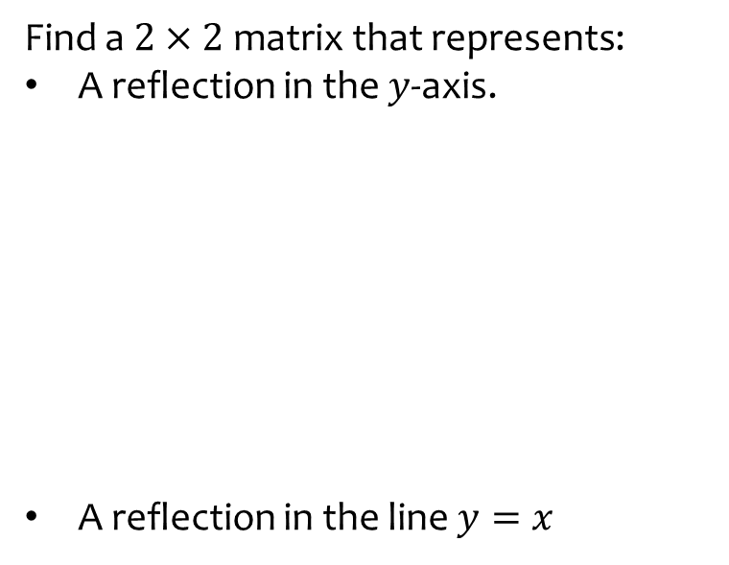
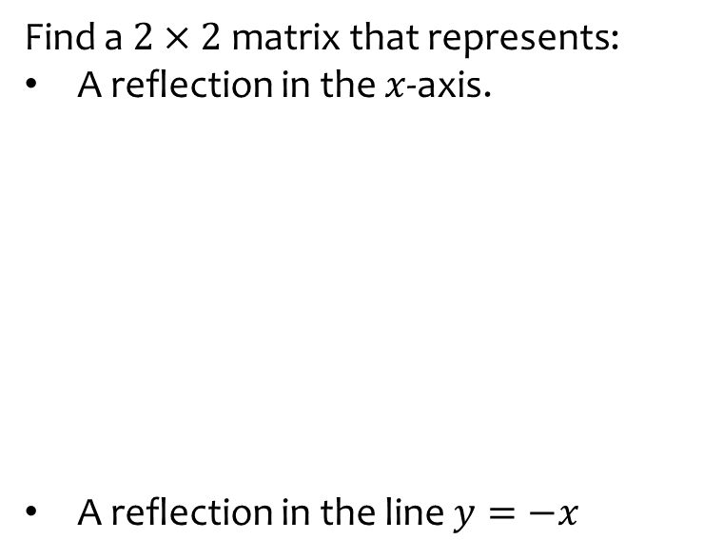
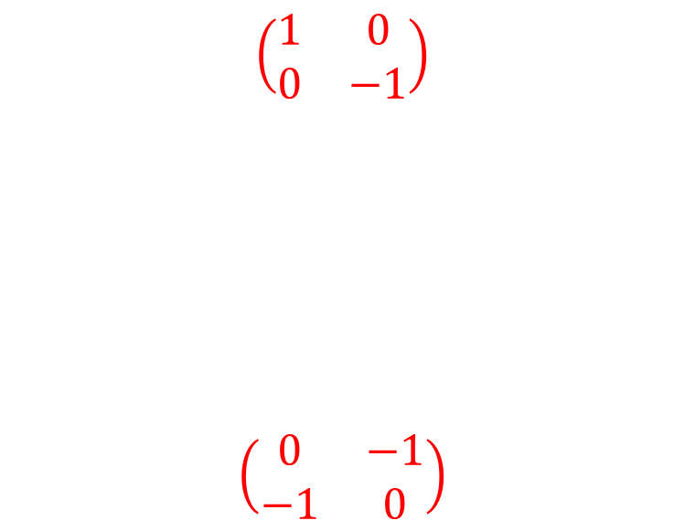
Worked example
Your turn
Find a $2×2$ matrix that represents:
A reflection in the $y$-axis.
A reflection in the line $y=x$
Find a $2×2$ matrix that represents:
A reflection in the $x$-axis.
A reflection in the line $y=−x$
$$\left(\begin{matrix}1 & 0 \\ 0 & −1\end{matrix}\right)$$
$$\left(\begin{matrix}0 & −1 \\ −1 & 0\end{matrix}\right)$$

Slide 3
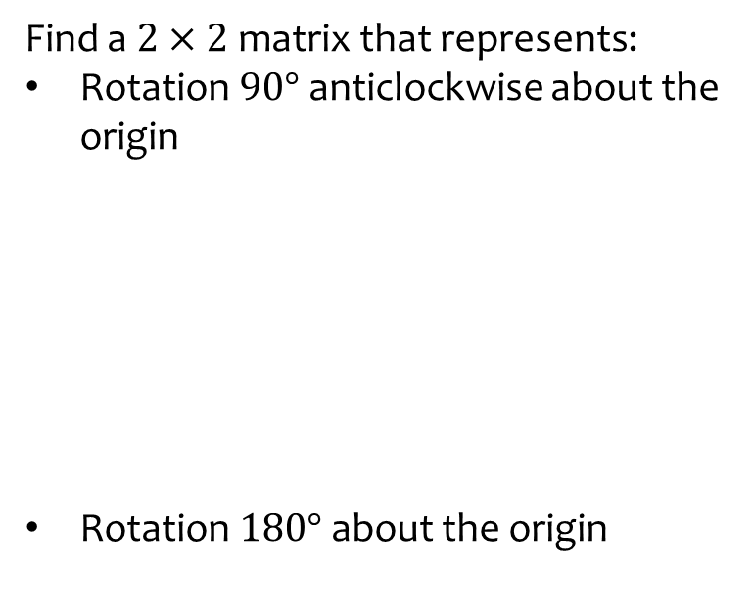
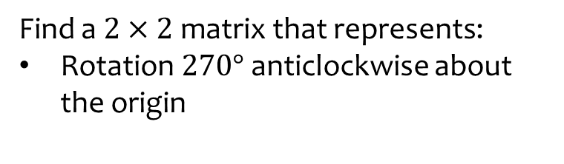

Worked example
Your turn
Find a $2×2$ matrix that represents:
Rotation $90°$ anticlockwise about the origin
Rotation $180°$ about the origin
Find a $2×2$ matrix that represents:
Rotation $270°$ anticlockwise about the origin
$$\left(\begin{matrix}0 & 1 \\ −1 & 0\end{matrix}\right)$$

Slide 4
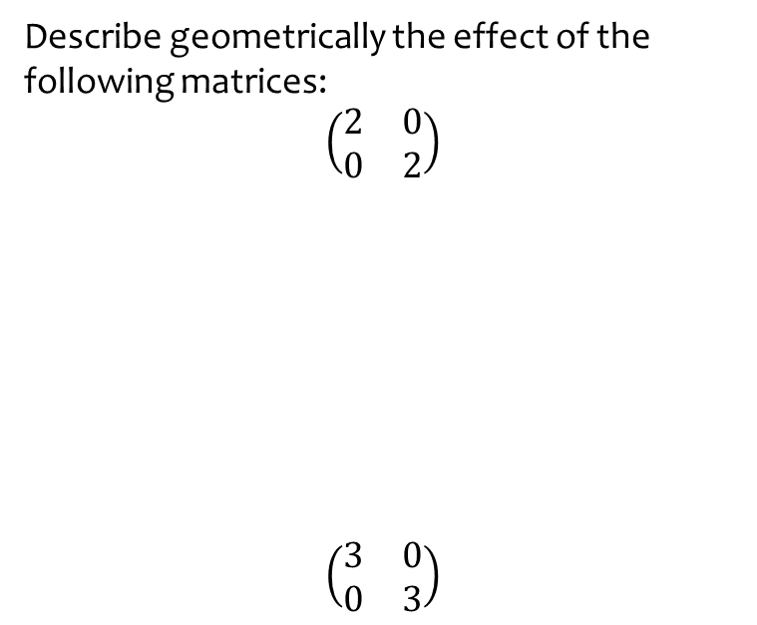
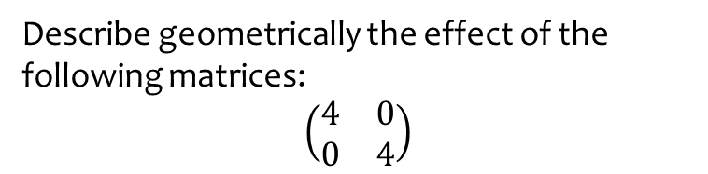
Worked example
Your turn
Describe geometrically the effect of the following matrices:
$\left(\begin{matrix}2 & 0 \\ 0 & 2\end{matrix}\right)$
$$\left(\begin{matrix}3 & 0 \\ 0 & 3\end{matrix}\right)$$
Describe geometrically the effect of the following matrices:
$\left(\begin{matrix}4 & 0 \\ 0 & 4\end{matrix}\right)$
Enlargement, centre origin, scale factor 4

Slide 5
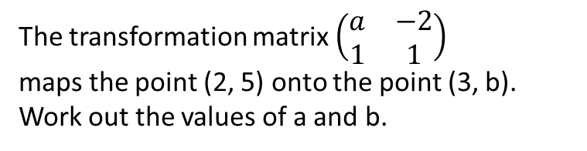
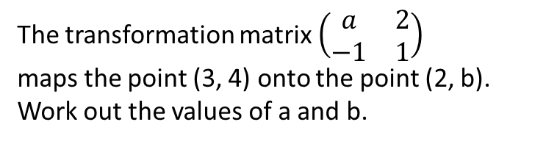
Worked example
Your turn
The transformation matrix $\left(\begin{matrix}a & −2 \\ 1 & 1\end{matrix}\right)$
maps the point (2, 5) onto the point (3, b). Work out the values of a and b.
The transformation matrix $\left(\begin{matrix}a & 2 \\ −1 & 1\end{matrix}\right)$
maps the point (3, 4) onto the point (2, b). Work out the values of a and b.
$$a=−2 , b=1$$

Slide 6
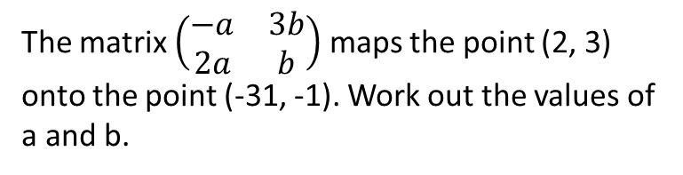
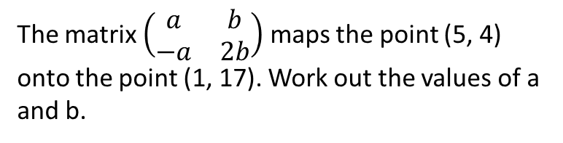

Worked example
Your turn
The matrix $\left(\begin{matrix}−a & 3b \\ 2a & b\end{matrix}\right)$ maps the point (2, 3) onto the point (-31, -1). Work out the values of a and b.
The matrix $\left(\begin{matrix}a & b \\ −a & 2b\end{matrix}\right)$ maps the point (5, 4) onto the point (1, 17). Work out the values of a and b.
$$a=−1 , b=\frac{3}{2}$$

Slide 7
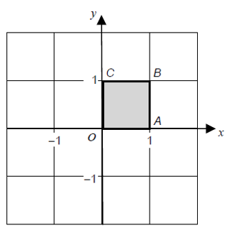
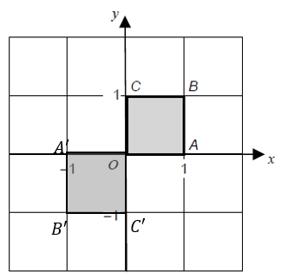
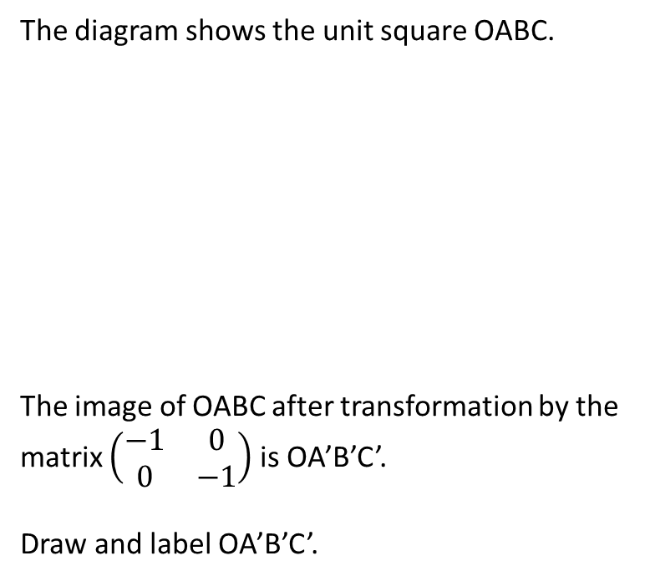
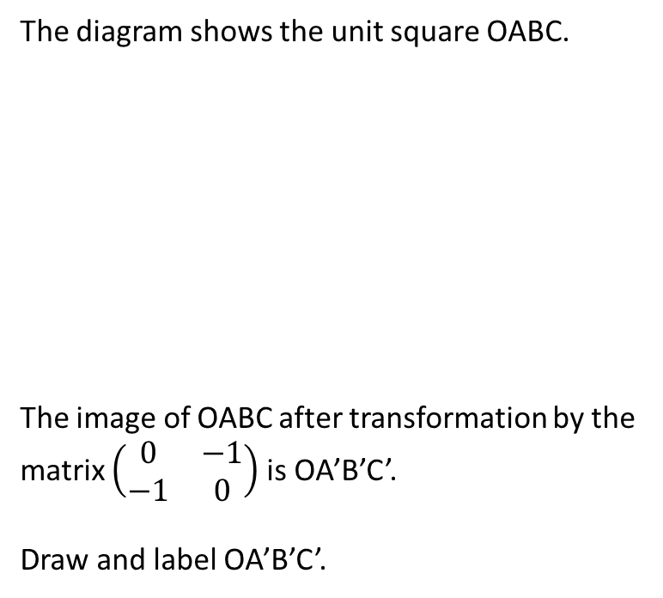
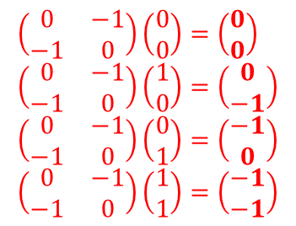
Worked example
Your turn
The diagram shows the unit square OABC.
The image of OABC after transformation by the matrix $\left(\begin{matrix}−1 & 0 \\ 0 & −1\end{matrix}\right)$ is OA’B’C’.
Draw and label OA’B’C’.
The diagram shows the unit square OABC.
The image of OABC after transformation by the matrix $\left(\begin{matrix}0 & −1 \\ −1 & 0\end{matrix}\right)$ is OA’B’C’.
Draw and label OA’B’C’.
$$\left(\begin{matrix}0 & −1 \\ −1 & 0\end{matrix}\right)\left(\begin{matrix}0 \\ 0\end{matrix}\right)=\left(\begin{matrix}0 \\ 0\end{matrix}\right) \\ \left(\begin{matrix}0 & −1 \\ −1 & 0\end{matrix}\right)\left(\begin{matrix}1 \\ 0\end{matrix}\right)=\left(\begin{matrix}0 \\ −1\end{matrix}\right) \\ \left(\begin{matrix}0 & −1 \\ −1 & 0\end{matrix}\right)\left(\begin{matrix}0 \\ 1\end{matrix}\right)=\left(\begin{matrix}−1 \\ 0\end{matrix}\right) \\ \left(\begin{matrix}0 & −1 \\ −1 & 0\end{matrix}\right)\left(\begin{matrix}1 \\ 1\end{matrix}\right)=\left(\begin{matrix}−1 \\ −1\end{matrix}\right)$$

Slide 8
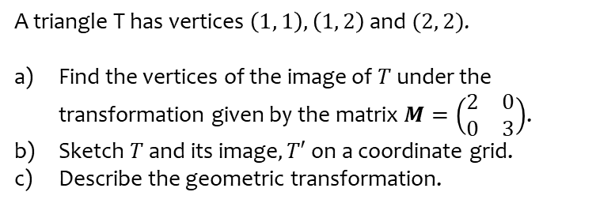
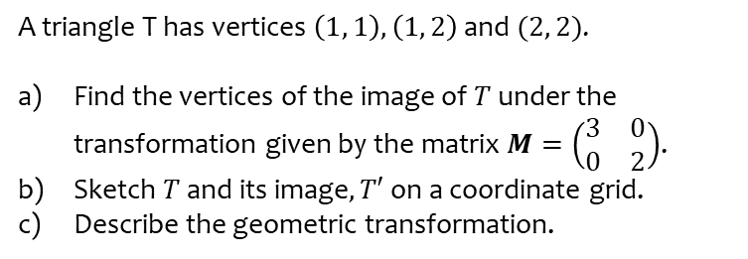
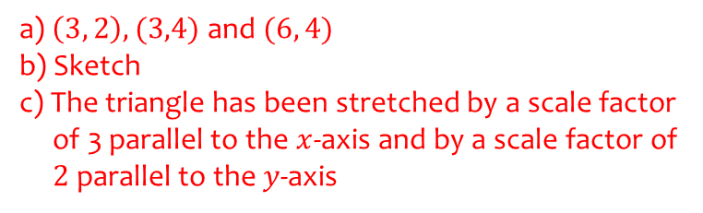
Worked example
Your turn
A triangle T has vertices $\left(1, 1\right), \left(1, 2\right)$ and $(2, 2)$.
Find the vertices of the image of $T$ under the transformation given by the matrix $M=\left(\begin{matrix}2 & 0 \\ 0 & 3\end{matrix}\right)$.
Sketch $T$ and its image$, T′$ on a coordinate grid.
Describe the geometric transformation.
A triangle T has vertices $\left(1, 1\right), \left(1, 2\right)$ and $(2, 2)$.
Find the vertices of the image of $T$ under the transformation given by the matrix $M=\left(\begin{matrix}3 & 0 \\ 0 & 2\end{matrix}\right)$.
Sketch $T$ and its image$, T′$ on a coordinate grid.
Describe the geometric transformation.
a) $\left(3, 2\right), (3,4)$ and $(6, 4)$
b) Sketch
c) The triangle has been stretched by a scale factor
of 3 parallel to the $x$-axis and by a scale factor of
$2$ parallel to the $y$-axis

