Slide 1
Equation of a tangent and normal
CONTENTS

Slide 2
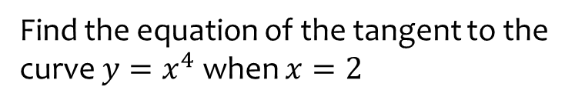
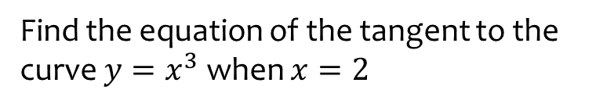
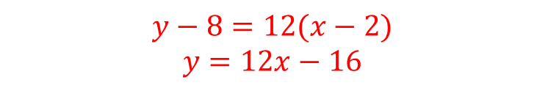
Worked example
Your turn
Find the equation of the tangent to the curve $y=x^{4}$ when $x=2$
Find the equation of the tangent to the curve $y=x^{3}$ when $x=2$
$$y−8=12(x−2)$$
$$y=12x−16$$

Slide 3
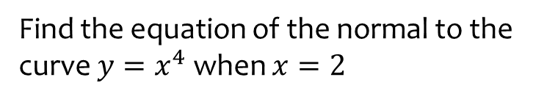
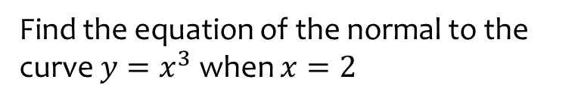
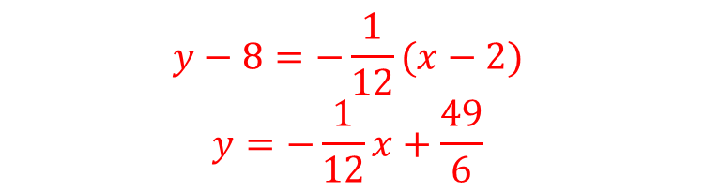
Worked example
Your turn
Find the equation of the normal to the curve $y=x^{4}$ when $x=2$
Find the equation of the normal to the curve $y=x^{3}$ when $x=2$
$$y−8=−\frac{1}{12}(x−2)$$
$$y=−\frac{1}{12}x+\frac{49}{6}$$

Slide 4
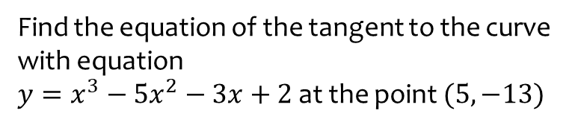
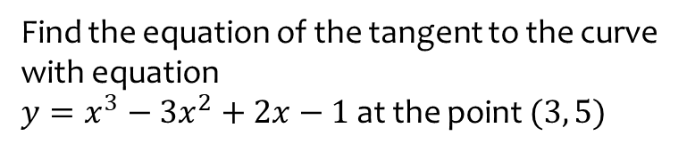
Worked example
Your turn
Find the equation of the tangent to the curve with equation
$y=x^{3}−5x^{2}−3x+2$ at the point $(5, −13)$
Find the equation of the tangent to the curve with equation
$y=x^{3}−3x^{2}+2x−1$ at the point $(3, 5)$
$$y=11x−28$$

Slide 5
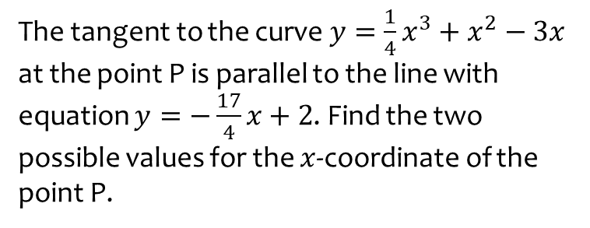
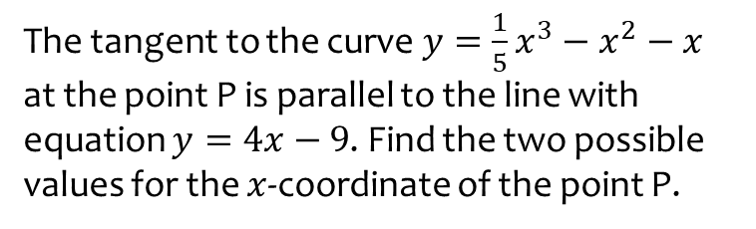
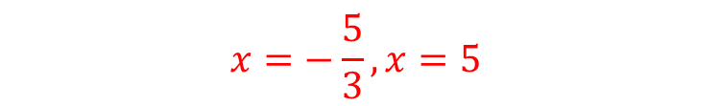
Worked example
Your turn
The tangent to the curve $y=\frac{1}{4}x^{3}+x^{2}−3x$ at the point P is parallel to the line with equation $y=−\frac{17}{4}x+2$. Find the two possible values for the $x$-coordinate of the point P.
The tangent to the curve $y=\frac{1}{5}x^{3}−x^{2}−x$ at the point P is parallel to the line with equation $y=4x−9$. Find the two possible values for the $x$-coordinate of the point P.
$$x=−\frac{5}{3}, x=5$$

Slide 6
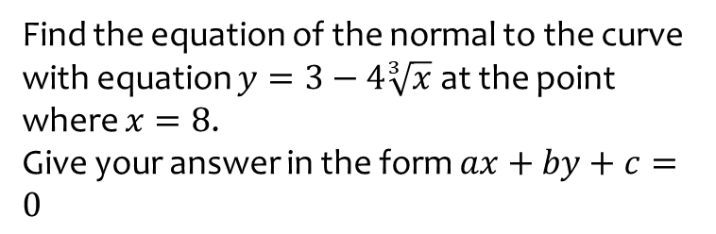
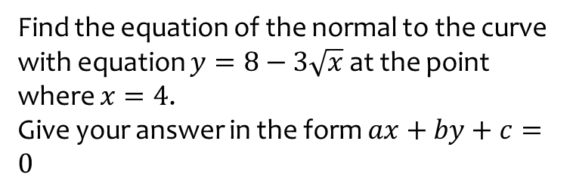
Worked example
Your turn
Find the equation of the normal to the curve with equation $y=3−4\sqrt[3]{x}$ at the point where $x=8$.
Give your answer in the form $ax+by+c=0$
Find the equation of the normal to the curve with equation $y=8−3\sqrt{x}$ at the point where $x=4$.
Give your answer in the form $ax+by+c=0$
$$3y−4x+10=0$$

Slide 7
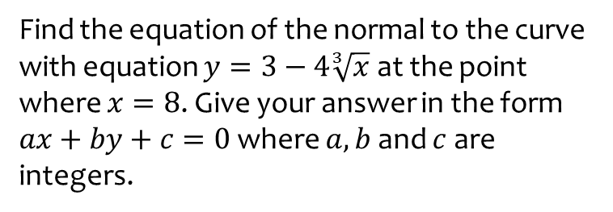
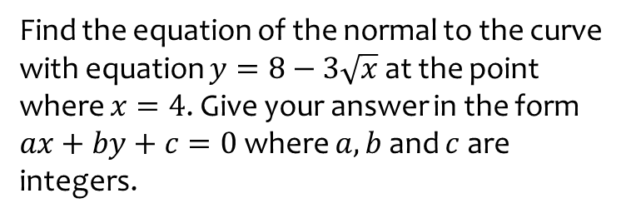
Worked example
Your turn
Find the equation of the normal to the curve with equation $y=3−4\sqrt[3]{x}$ at the point where $x=8$. Give your answer in the form
$ax+by+c=0$ where $a, b$ and $c$ are integers.
Find the equation of the normal to the curve with equation $y=8−3\sqrt{x}$ at the point where $x=4$. Give your answer in the form
$ax+by+c=0$ where $a, b$ and $c$ are integers.
$$3y−4x+10=0$$

Slide 8
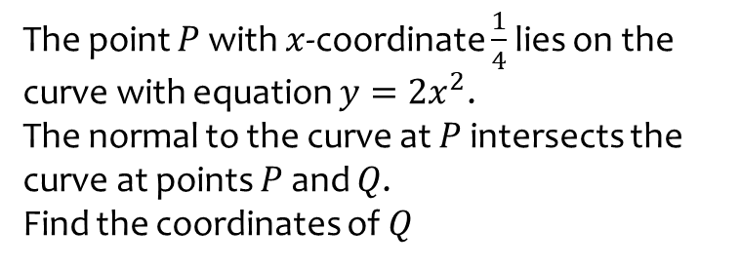
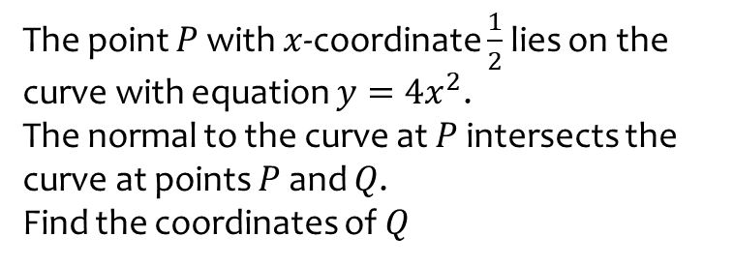
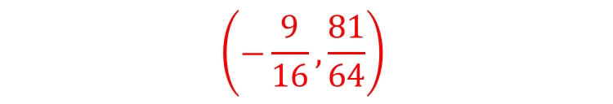
Worked example
Your turn
The point $P$ with $x$-coordinate $\frac{1}{4}$ lies on the curve with equation $y=2x^{2}$.
The normal to the curve at $P$ intersects the curve at points $P$ and $Q$.
Find the coordinates of $Q$
The point $P$ with $x$-coordinate $\frac{1}{2}$ lies on the curve with equation $y=4x^{2}$.
The normal to the curve at $P$ intersects the curve at points $P$ and $Q$.
Find the coordinates of $Q$
$$\left(−\frac{9}{16},\frac{81}{64}\right)$$

Slide 9
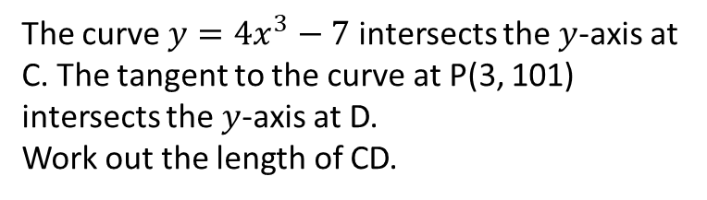
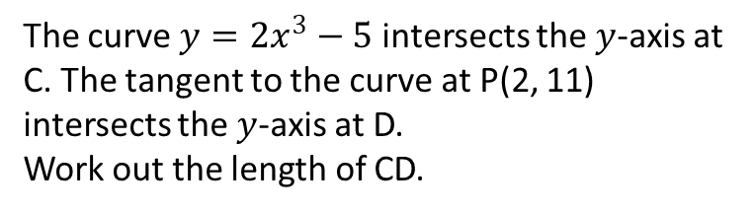
Worked example
Your turn
The curve $y=4x^{3}−7$ intersects the $y$-axis at C. The tangent to the curve at P(3, 101) intersects the $y$-axis at D.
Work out the length of CD.
The curve $y=2x^{3}−5$ intersects the $y$-axis at C. The tangent to the curve at P(2, 11) intersects the $y$-axis at D.
Work out the length of CD.
$$32$$

Slide 10
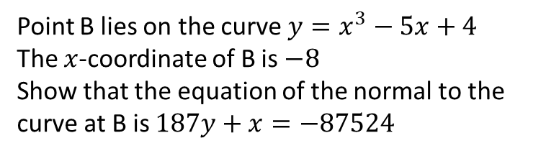
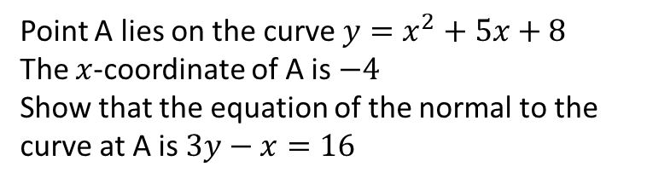
Worked example
Your turn
Point B lies on the curve $y=x^{3}−5x+4$
The $x$-coordinate of B is $−8$
Show that the equation of the normal to the curve at B is $187y+x=−87524$
Point A lies on the curve $y=x^{2}+5x+8$
The $x$-coordinate of A is $−4$
Show that the equation of the normal to the curve at A is $3y−x=16$
Shown

