Slide 1
Stationary points
CONTENTS

Slide 2
Worked example
Your turn
Find the least value of
$$f\left(x\right)=x^{2}+6x−9$$
Find the least value of
$$f\left(x\right)=x^{2}−4x+9$$
$$5$$

Slide 3
Worked example
Your turn
Find the turning point of
$$y=\sqrt[4]{x}−2x$$
Find the turning point of
$$y=\sqrt{x}−x$$
$$\left(\frac{1}{4},\frac{1}{4}\right)$$

Slide 4
Worked example
Your turn
Find the coordinates of the turning/stationary point(s) of the curves by differentiation:
$$y=x^{2}+6x−2$$
$$y=2x^{3}+6x^{2}−4$$
Find the coordinates of the turning/stationary point(s) of the curves by differentiation:
$$y=x^{3}+3x^{2}−4$$
$(−2, 0)$ and $(0, −4)$

Slide 5
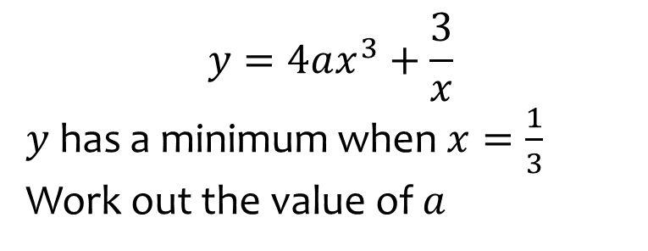
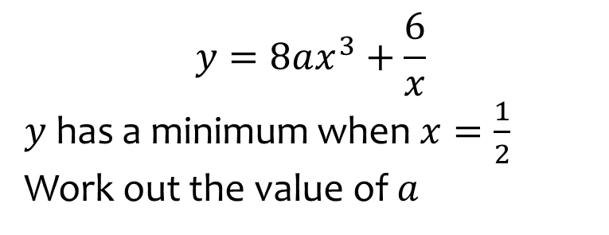

Worked example
Your turn
$$y=4ax^{3}+\frac{3}{x}$$
$y$ has a minimum when $x=\frac{1}{3}$
Work out the value of $a$
$$y=8ax^{3}+\frac{6}{x}$$
$y$ has a minimum when $x=\frac{1}{2}$
Work out the value of $a$
$$a=4$$

Slide 6
Worked example
Your turn
Find the stationary points on the curve $y={\frac{5}{3}x}^{3}−80x$
Find the stationary points on the curve $y=x^{3}−12x$
$(−2, 16)$ and $(2, −16)$

Slide 7
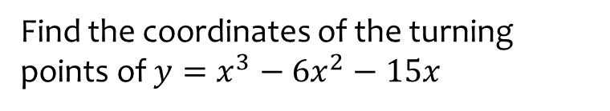
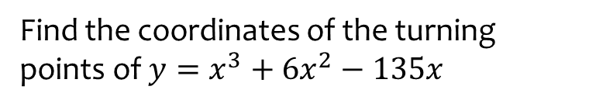

Worked example
Your turn
Find the coordinates of the turning points of $y=x^{3}−6x^{2}−15x$
Find the coordinates of the turning points of $y=x^{3}+6x^{2}−135x$
$\left(5,−400\right)$ and $(−9,972)$

Slide 8
Worked example
Your turn
Find the coordinates of the turning/stationary point(s) of the curves by differentiation:
$$y=\frac{2}{3}x^{3}−3.5x^{2}+3x+5$$
Find the coordinates of the turning/stationary point(s) of the curves by differentiation:
$$y=x^{3}+\frac{1}{2}x^{2}−2x+4$$
$(−1,\frac{11}{2})$ and $(\frac{2}{3},\frac{86}{27})$

Slide 9
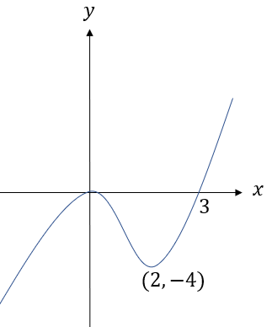
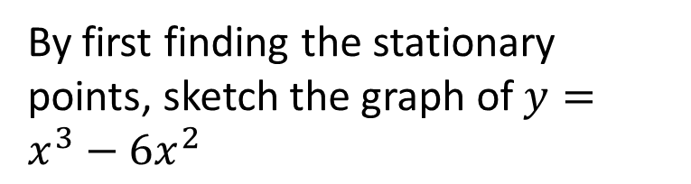
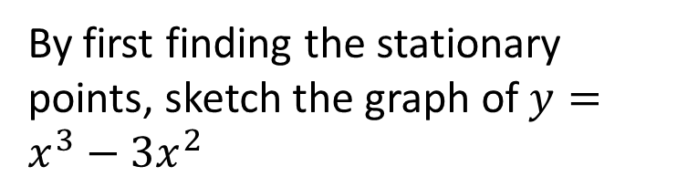
Worked example
Your turn
By first finding the stationary points, sketch the graph of $y=x^{3}−6x^{2}$
By first finding the stationary points, sketch the graph of $y=x^{3}−3x^{2}$
Diagrams/Graphs used with permission from DrFrostMaths: https://www.drfrostmaths.com/

Slide 10
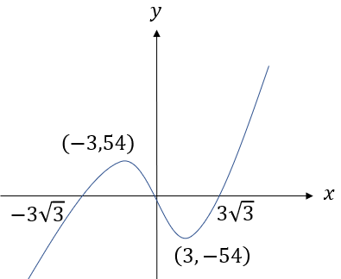
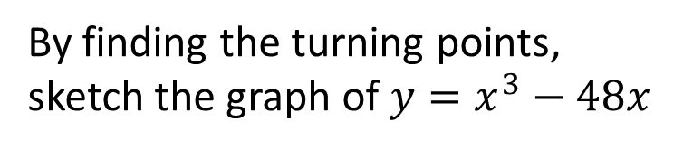
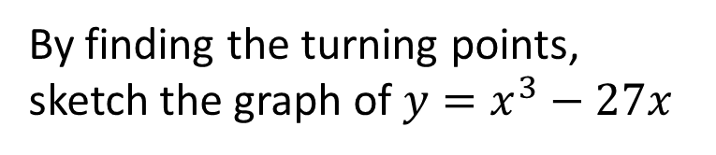
Worked example
Your turn
By finding the turning points, sketch the graph of $y=x^{3}−48x$
By finding the turning points, sketch the graph of $y=x^{3}−27x$
Diagrams/Graphs used with permission from DrFrostMaths: https://www.drfrostmaths.com/

Slide 11
Worked example
Your turn
By finding the turning points, sketch the graph of $y=x^{3}−48x$
By finding the turning points, sketch the graph of $y=x^{3}−27x$
Diagrams/Graphs used with permission from DrFrostMaths: https://www.drfrostmaths.com/

