Slide 1
Solving linear and quadratic equations
CONTENTS

Slide 2
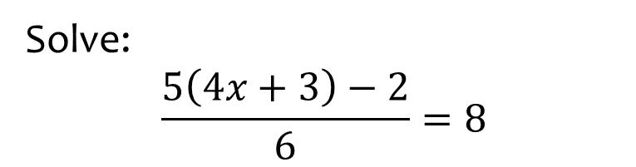
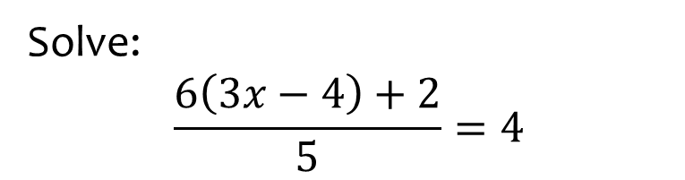

Worked example
Your turn
Solve:
$$\frac{5\left(4x+3\right)−2}{6}=8$$
Solve:
$$\frac{6\left(3x−4\right)+2}{5}=4$$
$$x=\frac{7}{3}$$

Slide 3
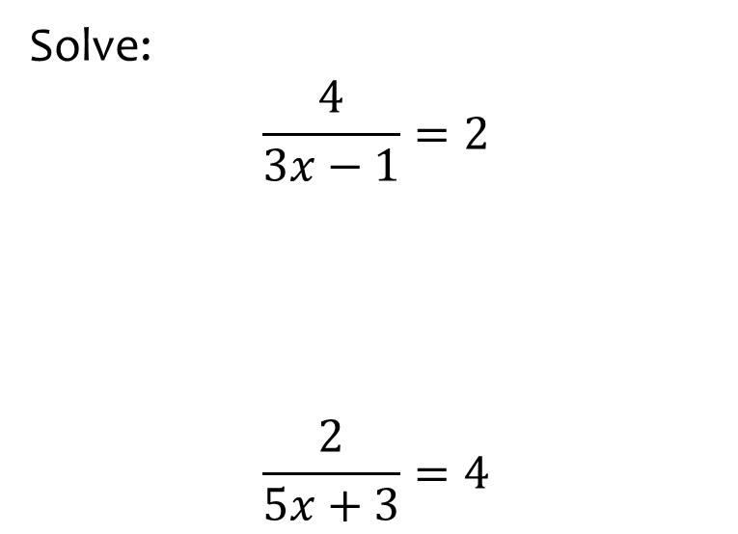
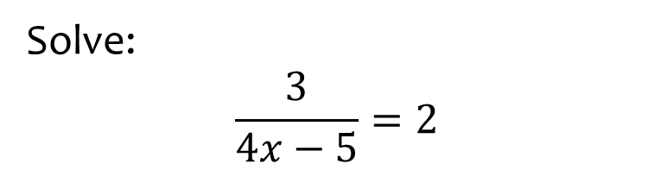

Worked example
Your turn
Solve:
$$\frac{4}{3x−1}=2$$
$$\frac{2}{5x+3}=4$$
Solve:
$$\frac{3}{4x−5}=2$$
$$x=\frac{13}{8}$$

Slide 4
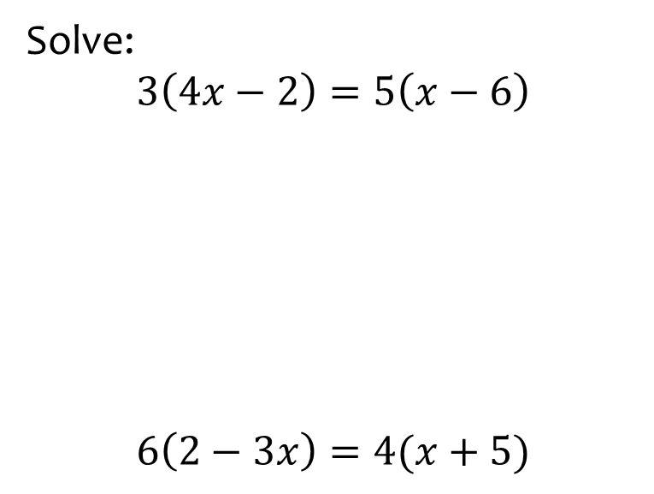
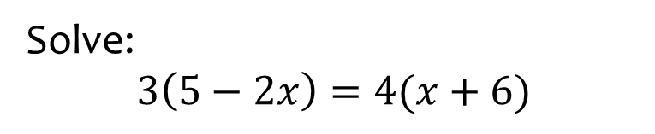

Worked example
Your turn
Solve:
$$3\left(4x−2\right)=5\left(x−6\right)$$
$$6\left(2−3x\right)=4(x+5)$$
Solve:
$$3\left(5−2x\right)=4(x+6)$$
$$x=−\frac{9}{10}$$

Slide 5
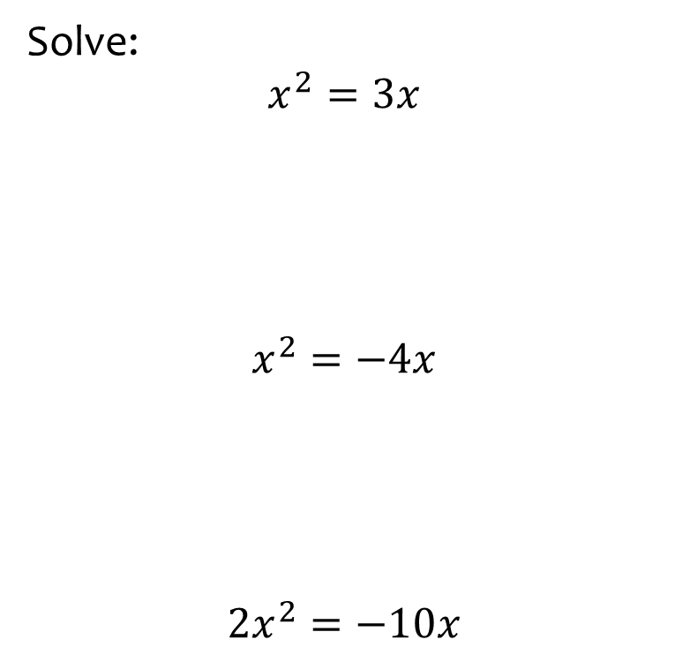
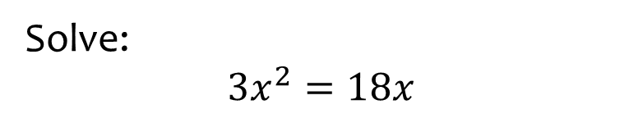

Worked example
Your turn
Solve:
$$x^{2}=3x$$
$$x^{2}=−4x$$
$$2x^{2}=−10x$$
Solve:
$$3x^{2}=18x$$
$$x=0, x=6$$

Slide 6
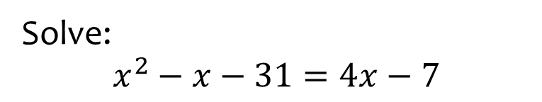
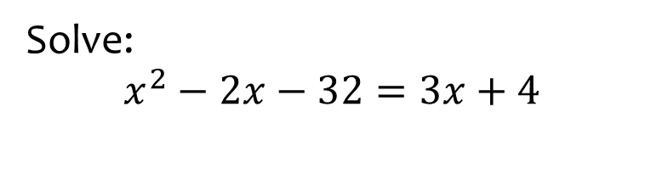

Worked example
Your turn
Solve:
$$x^{2}−x−31=4x−7$$
Solve:
$$x^{2}−2x−32=3x+4$$
$$x=9, x=−4$$

Slide 7
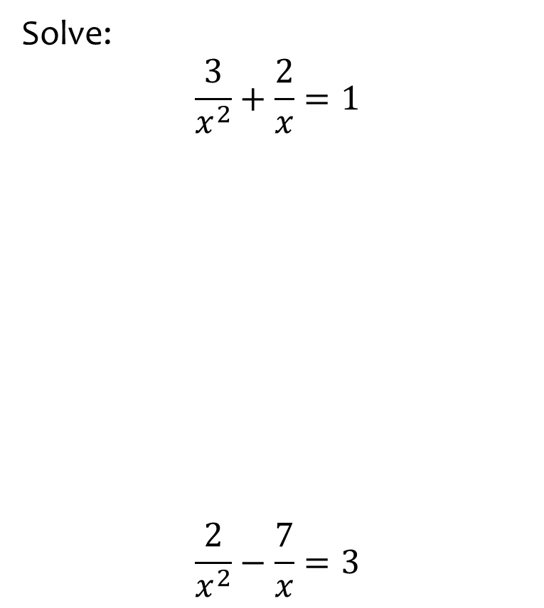
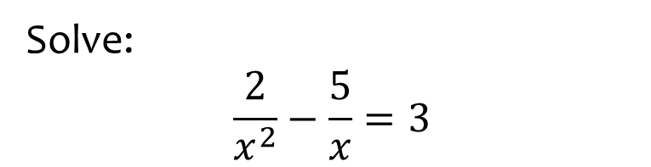

Worked example
Your turn
Solve:
$$\frac{3}{x^{2}}+\frac{2}{x}=1$$
$$\frac{2}{x^{2}}−\frac{7}{x}=3$$
Solve:
$$\frac{2}{x^{2}}−\frac{5}{x}=3$$
$$x=\frac{1}{3}, x=−2$$

Slide 8
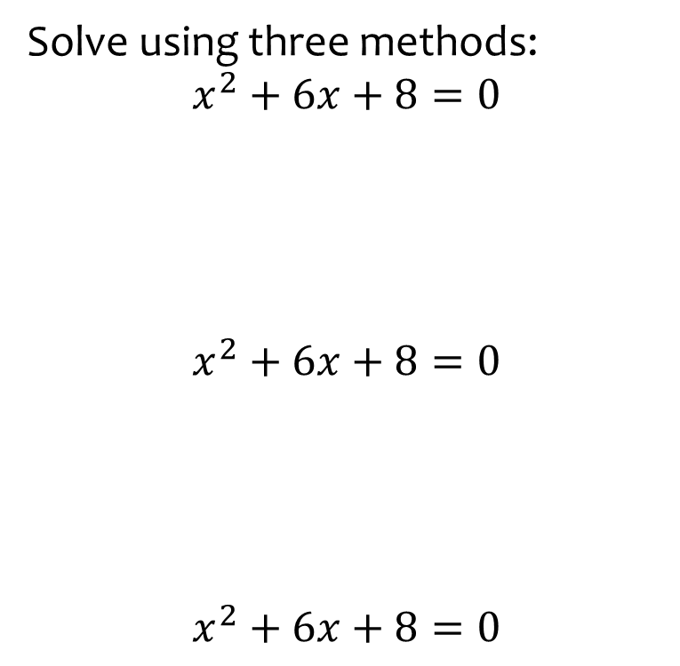
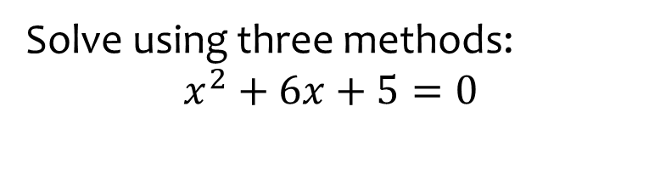

Worked example
Your turn
Solve using three methods:
$$x^{2}+6x+8=0$$
$$x^{2}+6x+8=0$$
$$x^{2}+6x+8=0$$
Solve using three methods:
$$x^{2}+6x+5=0$$
$$x=−5, x=−1$$

Slide 9
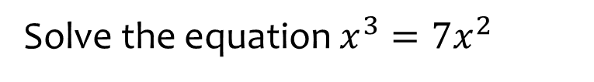
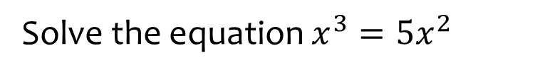

Worked example
Your turn
Solve the equation $x^{3}=7x^{2}$
Solve the equation $x^{3}=5x^{2}$
$$x=0, x=5$$

Slide 10
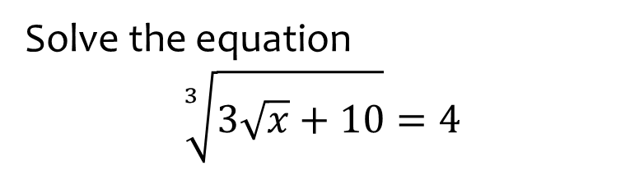
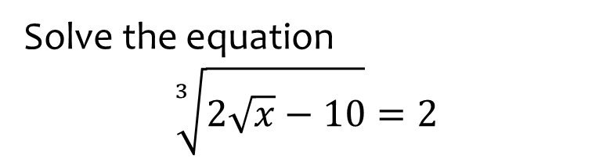

Worked example
Your turn
Solve the equation
$$\sqrt[3]{3\sqrt{x}+10}=4$$
Solve the equation
$$\sqrt[3]{2\sqrt{x}−10}=2$$
$$x=81$$

