Slide 1
Sketch trigonometric graphs
CONTENTS

Slide 2
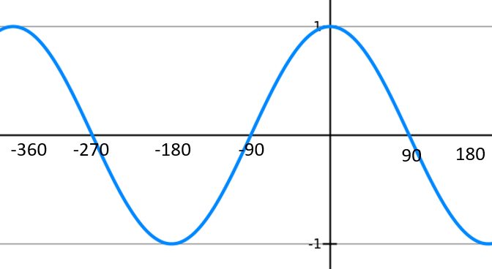
Worked example
Your turn
Sketch the graph of $y=\sin{x}, −180≤x≤360°$
Sketch the graph of $y=\cos{x}, −360≤x≤180°$
Diagrams/Graphs used with permission from DrFrostMaths: https://www.drfrostmaths.com/

Slide 3
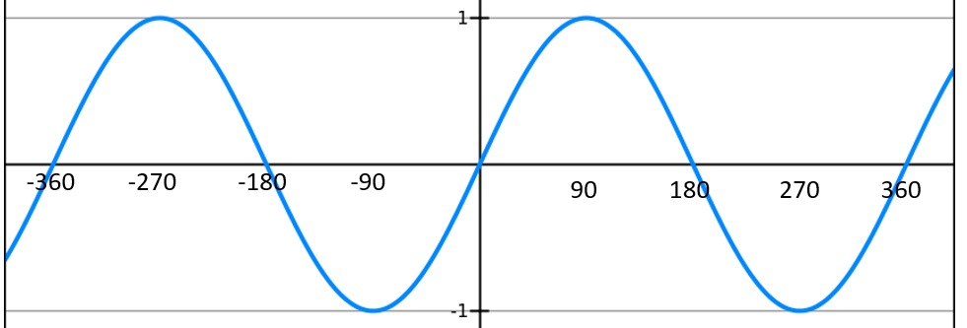
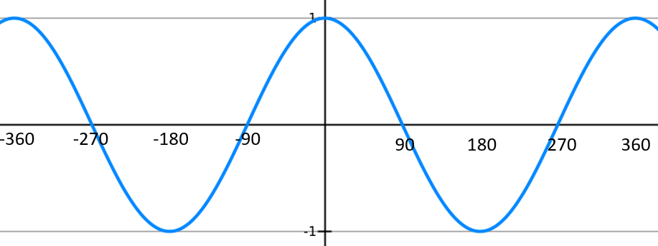
Worked example
Your turn
A sketch of $y=\sin{x}, −360°≤x≤360°$ is shown.
Given that $\sin{30}=\frac{1}{2}$, find:
a) $\sin{(150°)}$
b) $\sin{(−300°)}$
c) $\sin{(330°)}$
d) $\sin{(−210°})$
A sketch of $y=\cos{x}, −360°≤x≤360°$ is shown.
Given that $\cos{30}=\frac{\sqrt{3}}{2}$, find:
a) $\cos{(−30°)}$
b) $\cos{(330°)}$
c) $\cos{(150°)}$
d) $\cos{(−210°})$
a) $\frac{\sqrt{3}}{2}$
b) $\frac{\sqrt{3}}{2}$
c) $−\frac{\sqrt{3}}{2}$
d)$−\frac{\sqrt{3}}{2}$
Diagrams/Graphs used with permission from DrFrostMaths: https://www.drfrostmaths.com/

Slide 4
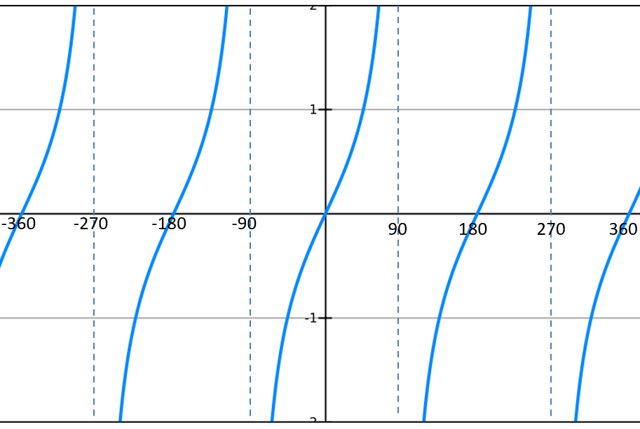
Worked example
Your turn
A sketch of $y=\tan{x}, −360°≤x≤360°$ is shown.
Given that $\tan{60}=\sqrt{3}$, find:
a) $\tan{(−60°)}$
b) $\tan{(−300°)}$
c) $\tan{(120°)}$
A sketch of $y=\tan{x}, −360°≤x≤360°$ is shown.
Given that $\tan{30}=\frac{\sqrt{3}}{3}$, find:
a) $\tan{(−30°)}$
b) $\tan{(−330°)}$
c) $\tan{(150°)}$
a) $−\frac{\sqrt{3}}{3}$
b) $\frac{\sqrt{3}}{3}$
c) $−\frac{\sqrt{3}}{3}$
Diagrams/Graphs used with permission from DrFrostMaths: https://www.drfrostmaths.com/

Slide 5
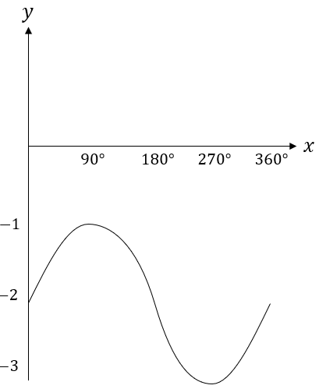
Worked example
Your turn
Sketch $y=\cos{x}+1$, $0≤x≤360°$
Sketch $y=\sin{x}−2$, $0≤x≤360°$
Diagrams/Graphs used with permission from DrFrostMaths: https://www.drfrostmaths.com/

Slide 6
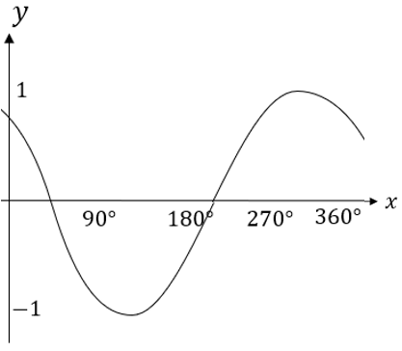
Worked example
Your turn
Sketch $y=\sin{(x−45°)}$, $0≤x≤360°$
Sketch $y=\cos\left(x+45°\right)$, $0≤x≤360°$
Diagrams/Graphs used with permission from DrFrostMaths: https://www.drfrostmaths.com/

Slide 7
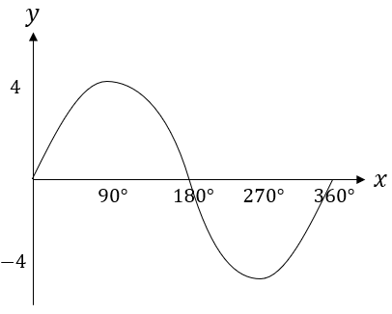
Worked example
Your turn
Sketch $y=3\cos{x}$, $0≤x≤360°$
Sketch $y=4\sin{x}$, $0≤x≤360°$
Diagrams/Graphs used with permission from DrFrostMaths: https://www.drfrostmaths.com/

Slide 8
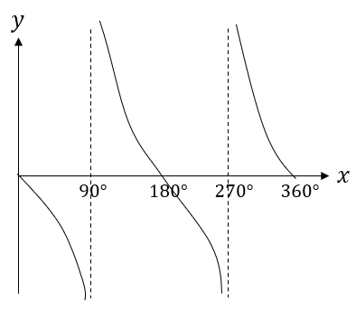
Worked example
Your turn
Sketch $y=−\sin{x}$, $0≤x≤360°$
Sketch $y=\cos{(−x)}$, $0≤x≤360°$
Sketch $y=−\tan{x}$, $0≤x≤360°$
Diagrams/Graphs used with permission from DrFrostMaths: https://www.drfrostmaths.com/

Slide 9
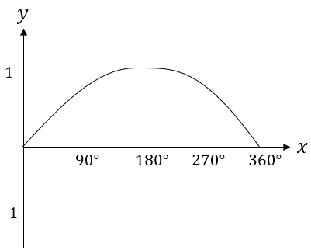
Worked example
Your turn
Sketch $y=\cos\left(2x\right)$, $0≤x≤360°$
Sketch $y=\sin\left(\frac{x}{2}\right)$, $0≤x≤360°$
Diagrams/Graphs used with permission from DrFrostMaths: https://www.drfrostmaths.com/

