Slide 1
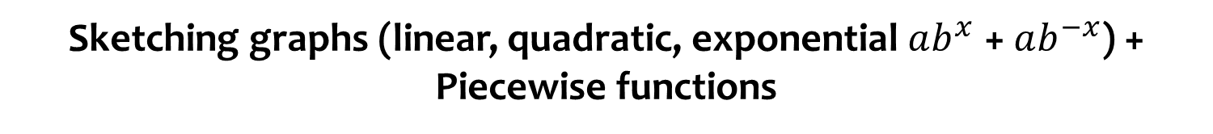
Sketching graphs (linear, quadratic, exponential $ab^{x}$ + $ab^{−x}$) + Piecewise functions
CONTENTS

Slide 2
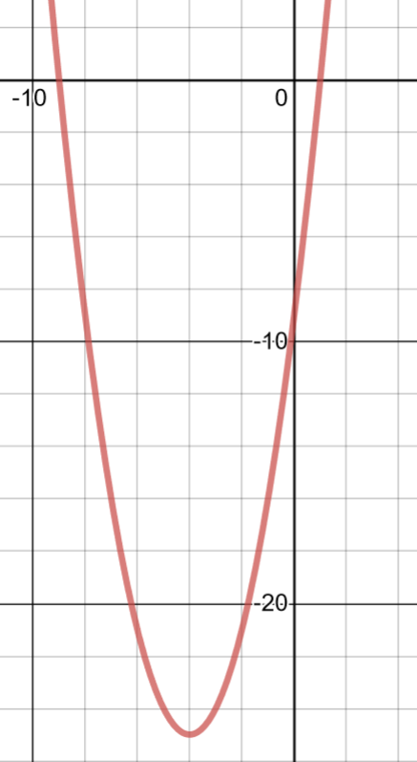





Worked example
Your turn
Sketch $y=x^{2}+6x−7$, labelling the intercepts with the axes and the turning points.
Sketch $y=x^{2}+8x−9$, labelling the intercepts with the axes and the turning points.
$$−9$$
$$1$$
$$(−4, −25)$$
Graph used with permission from DESMOS: https://www.desmos.com/

Slide 3
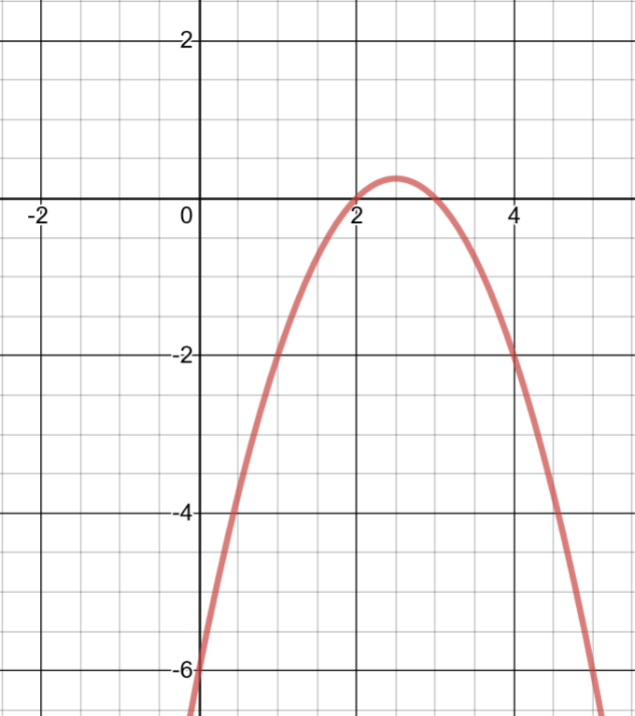

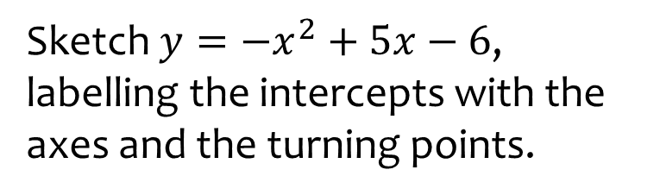


Worked example
Your turn
Sketch $y=−x^{2}+3x−2$, labelling the intercepts with the axes and the turning points.
Sketch $y=−x^{2}+5x−6$, labelling the intercepts with the axes and the turning points.
$$(\frac{5}{2},\frac{1}{4})$$
$$3$$
Graph used with permission from DESMOS: https://www.desmos.com/

Slide 4
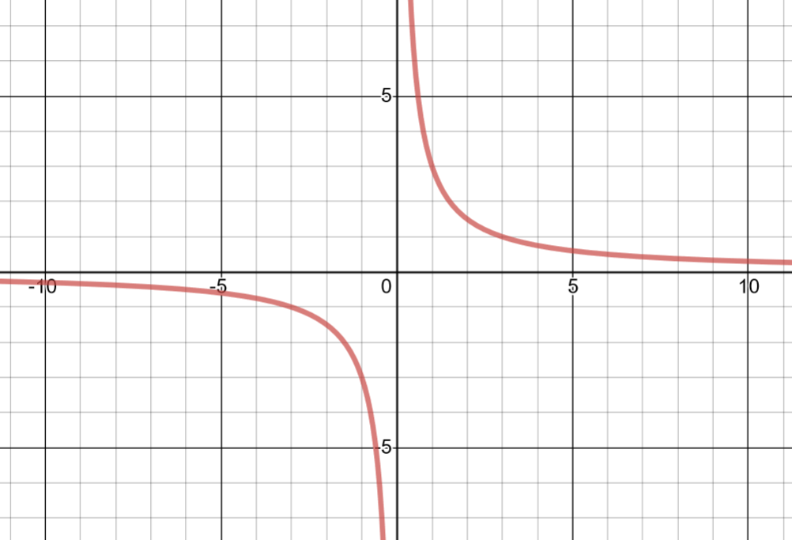
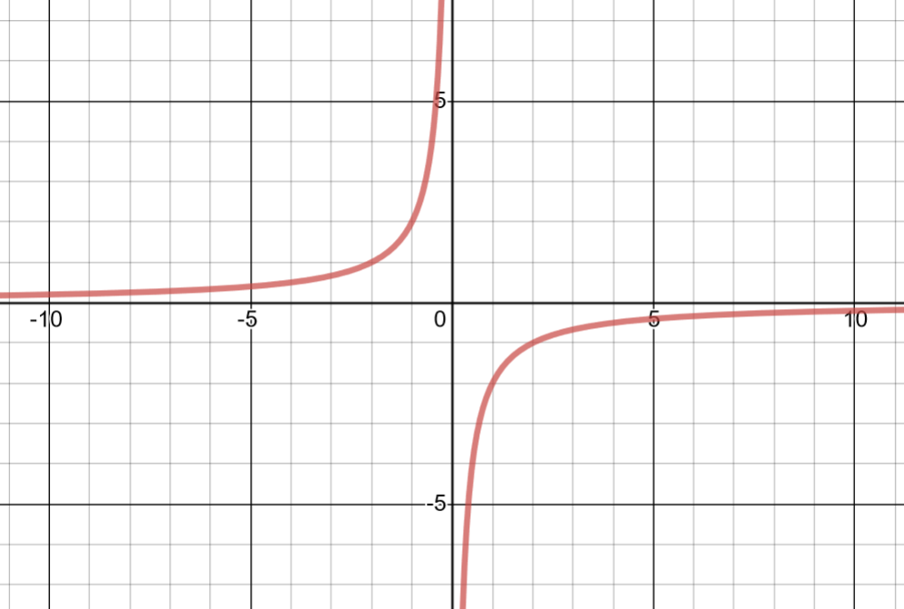
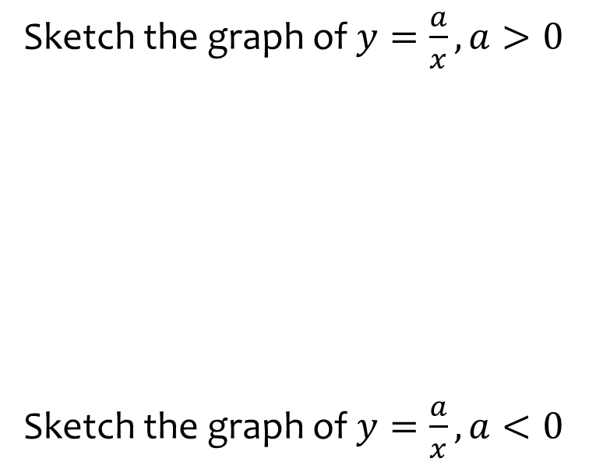
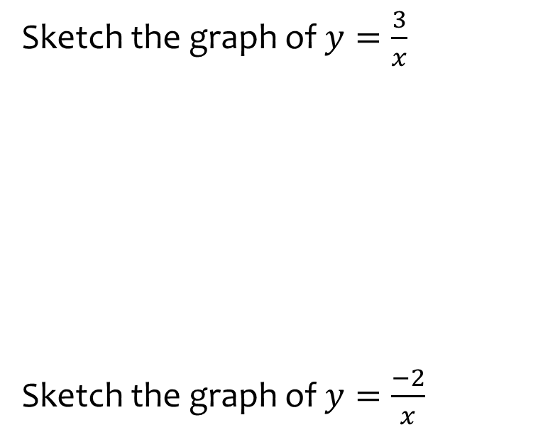
Worked example
Your turn
Sketch the graph of $y=\frac{a}{x}, a>0$
Sketch the graph of $y=\frac{a}{x}, a<0$
Sketch the graph of $y=\frac{3}{x}$
Sketch the graph of $y=\frac{−2}{x}$
Graphs used with permission from DESMOS: https://www.desmos.com/

Slide 5
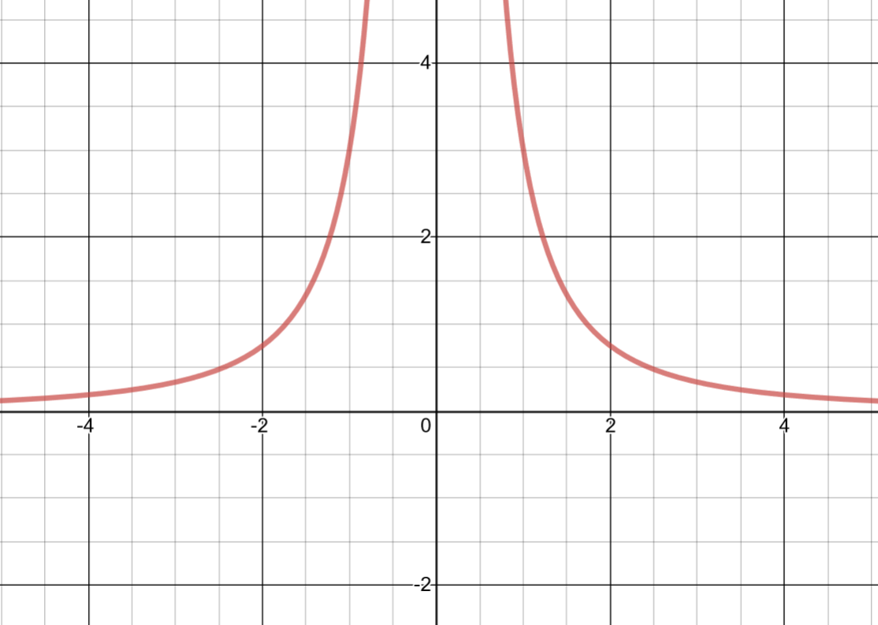
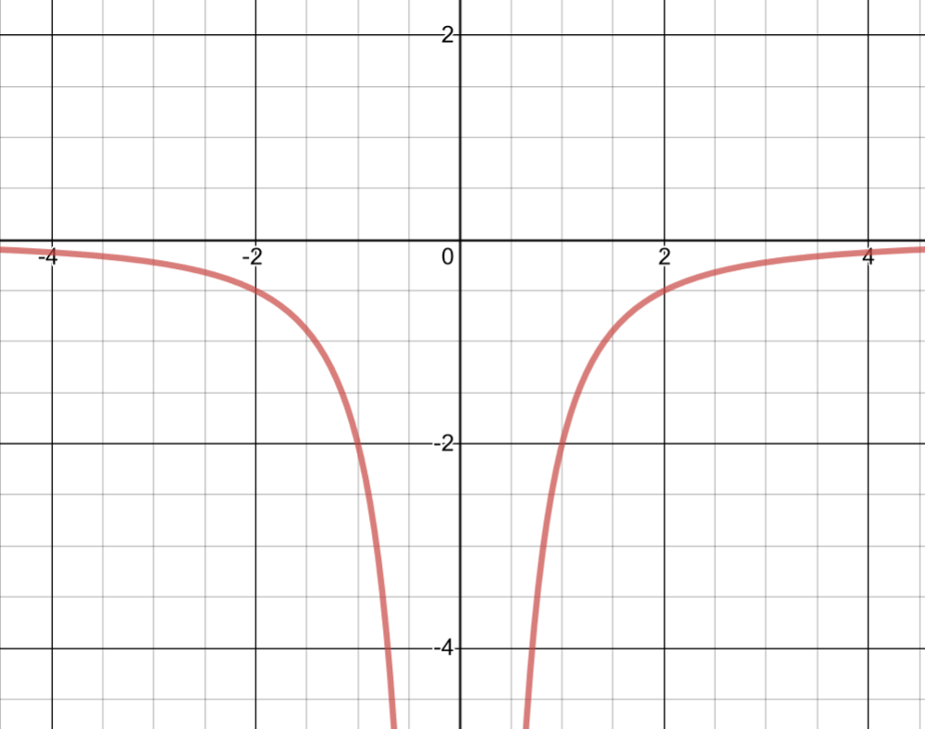
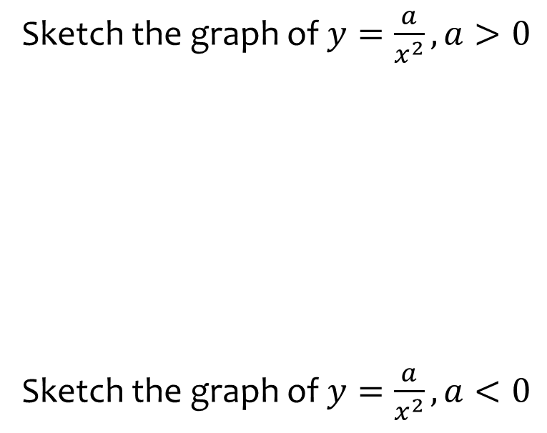
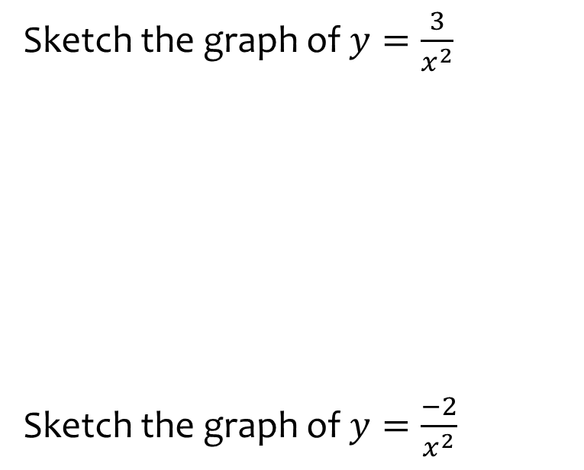
Worked example
Your turn
Sketch the graph of $y=\frac{a}{x^{2}}, a>0$
Sketch the graph of $y=\frac{a}{x^{2}}, a<0$
Sketch the graph of $y=\frac{3}{x^{2}}$
Sketch the graph of $y=\frac{−2}{x^{2}}$
Graphs used with permission from DESMOS: https://www.desmos.com/

Slide 6
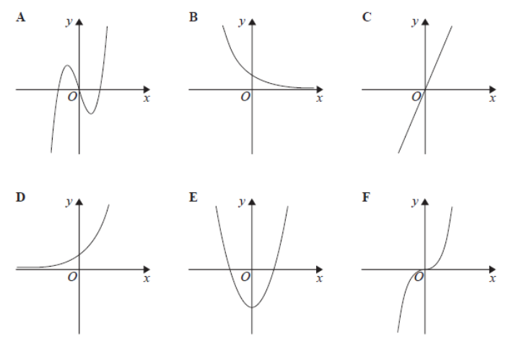
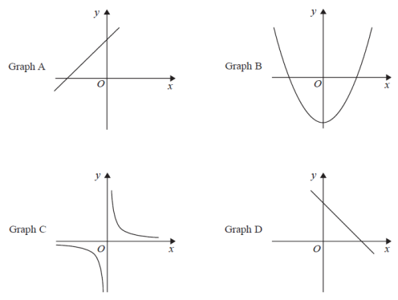
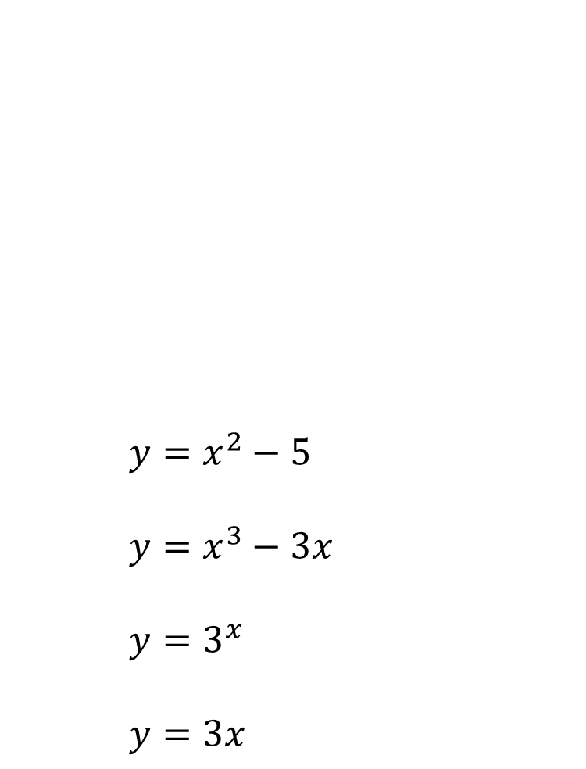
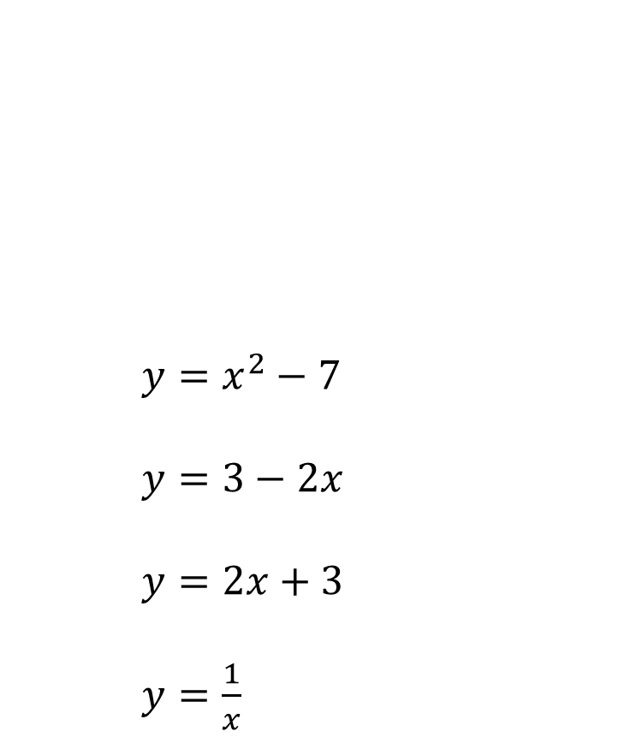




Worked example
Your turn
$y=x^{2}−5$
$y=x^{3}−3x$
$y=3^{x}$
$y=3x$
$$y=2x−3$$
$$y=x^{2}−7$$
$y=x^{2}−7$
$y=3−2x$
$y=2x+3$
$y=\frac{1}{x}$
$$y=\frac{1}{x}$$
$$y=3−2x$$

Slide 7
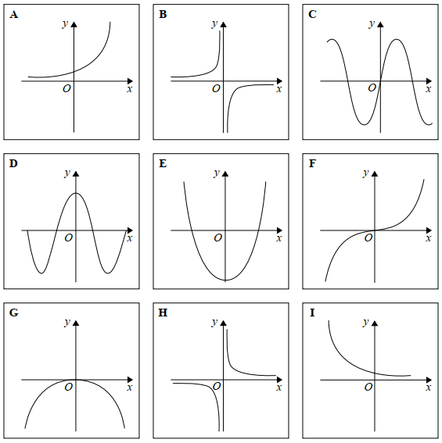
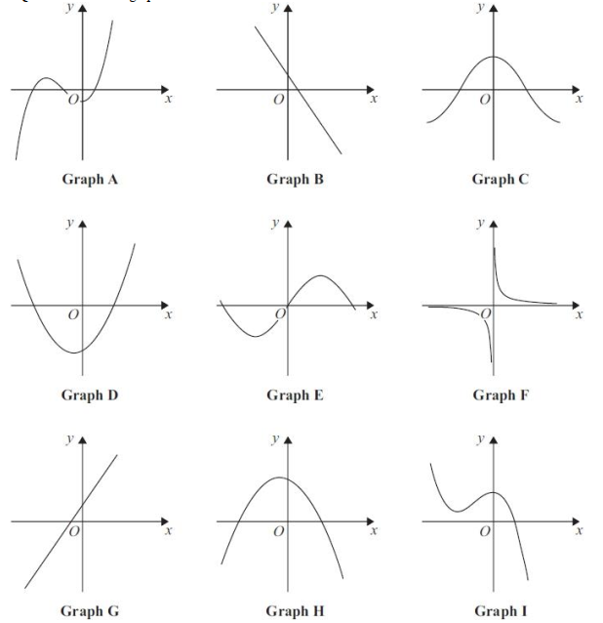
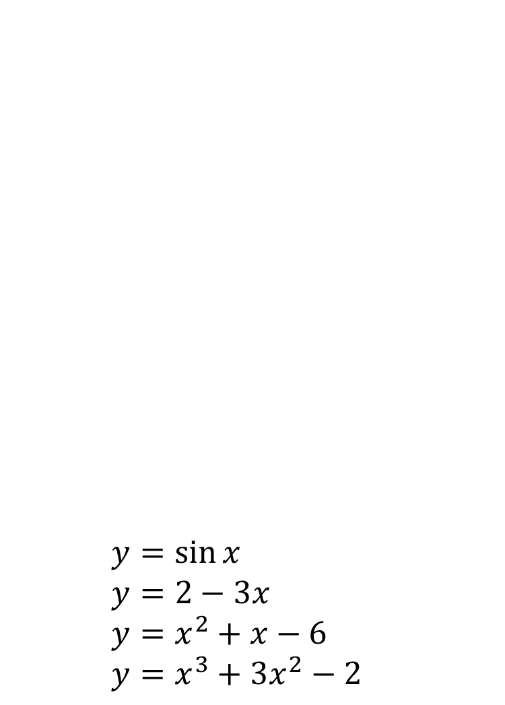
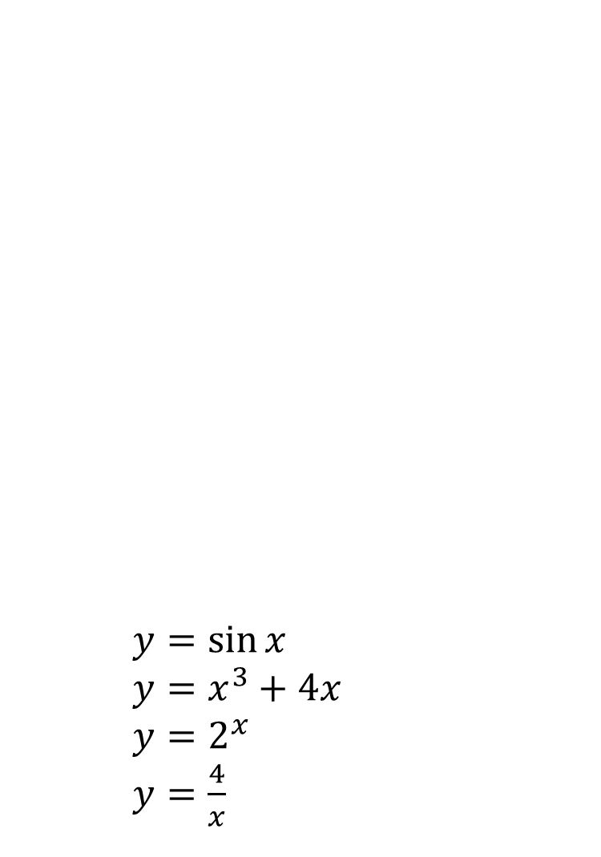




Worked example
Your turn
$y=\sin{x}$
$y=x^{3}+4x$
$y=2^{x}$
$y=\frac{4}{x}$
$y=\sin{x}$
$y=2−3x$
$y=x^{2}+x−6$
$y=x^{3}+3x^{2}−2$
$$y=x^{3}+3x^{2}−2$$
$$y=2−3x$$
$$y=x^{2}+x−6$$
$$y=\sin{x}$$

Slide 8
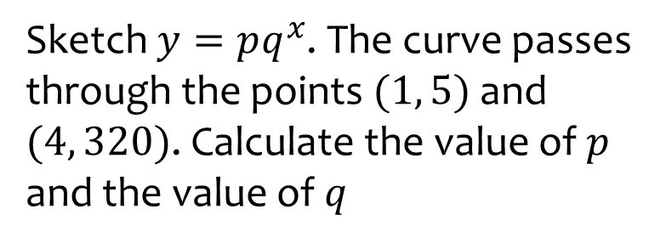
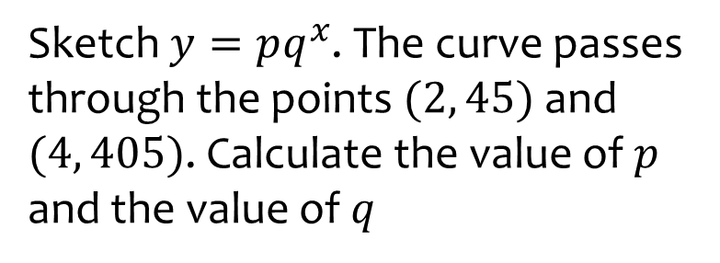

Worked example
Your turn
Sketch $y=pq^{x}$. The curve passes through the points $(2, 45)$ and $(4, 405)$. Calculate the value of $p$ and the value of $q$
Sketch $y=pq^{x}$. The curve passes through the points $(1, 5)$ and $(4, 320)$. Calculate the value of $p$ and the value of $q$
$$p=\frac{5}{4}, q=4$$

Slide 9
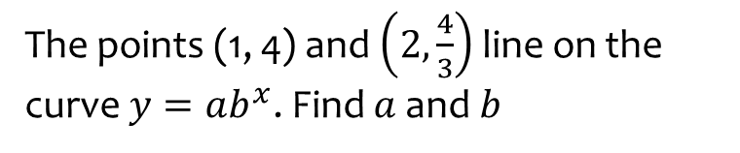
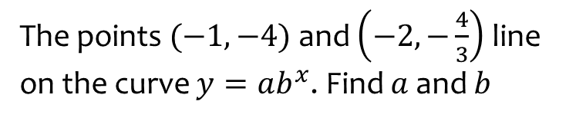
Worked example
Your turn
The points (1, 4) and $\left(2,\frac{4}{3}\right)$ line on the curve $y=ab^{x}$. Find $a$ and $b$
The points $(−1, −4)$ and $\left(−2,−\frac{4}{3}\right)$ line on the curve $y=ab^{x}$. Find $a$ and $b$
$$a=−12 , b=3$$

Slide 10
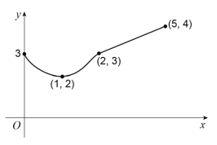
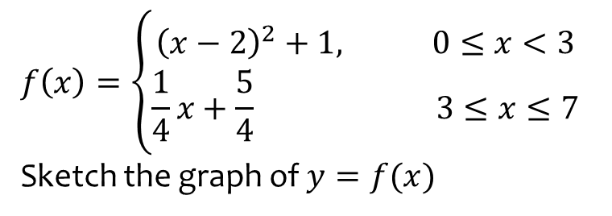
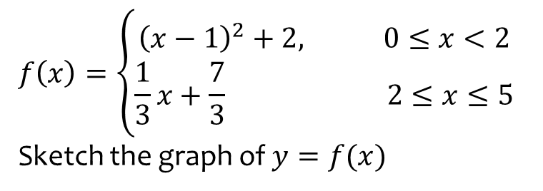
Worked example
Your turn
$$f\left(x\right)=\left\{\begin{aligned}{\left(x−2\right)}^{2}+1, 0≤x<3 \\ \frac{1}{4}x+\frac{5}{4} 3≤x≤7\end{aligned}\right.$$
Sketch the graph of $y=f(x)$
$$f\left(x\right)=\left\{\begin{aligned}{\left(x−1\right)}^{2}+2, 0≤x<2 \\ \frac{1}{3}x+\frac{7}{3} 2≤x≤5\end{aligned}\right.$$
Sketch the graph of $y=f(x)$
Diagrams/Graphs used with permission from DrFrostMaths: https://www.drfrostmaths.com/

Slide 11
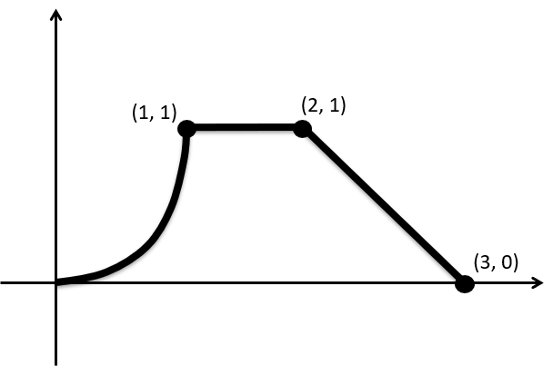
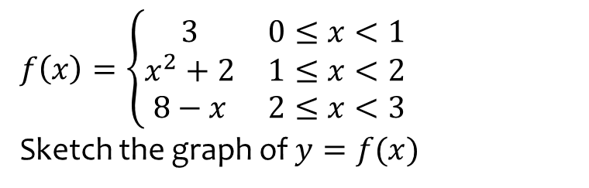
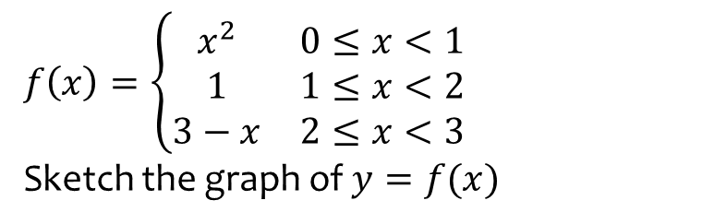
Worked example
Your turn
$$f\left(x\right)=\left\{\begin{matrix}3 & 0≤x<1 \\ x^{2}+2 & 1≤x<2 \\ 8−x & 2≤x<3\end{matrix}\right.$$
Sketch the graph of $y=f(x)$
$$f\left(x\right)=\left\{\begin{matrix}x^{2} & 0≤x<1 \\ 1 & 1≤x<2 \\ 3−x & 2≤x<3\end{matrix}\right.$$
Sketch the graph of $y=f(x)$
Diagrams/Graphs used with permission from DrFrostMaths: https://www.drfrostmaths.com/

