Slide 1
Simultaneous equations (Two unknowns)
CONTENTS

Slide 2
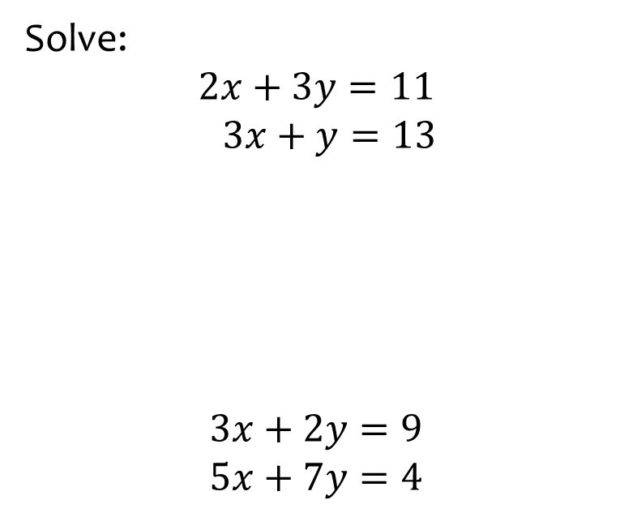
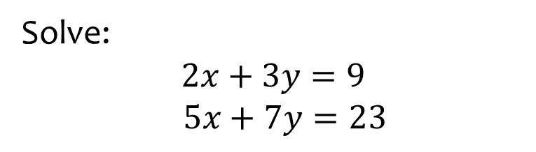

Worked example
Your turn
Solve:
$$2x+3y=11$$
$$3x+y=13$$
$$3x+2y=9$$
$$5x+7y=4$$
Solve:
$$2x+3y=9$$
$$5x+7y=23$$
$$x=6 , y=−1$$

Slide 3
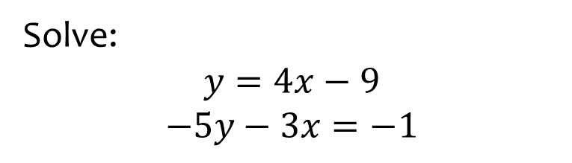
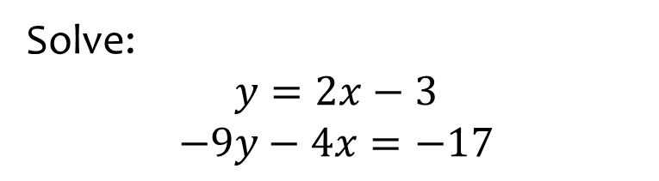

Worked example
Your turn
Solve:
$$y=4x−9$$
$$−5y−3x=−1$$
Solve:
$$y=2x−3$$
$$−9y−4x=−17$$
$$x=2, y=1$$

Slide 4
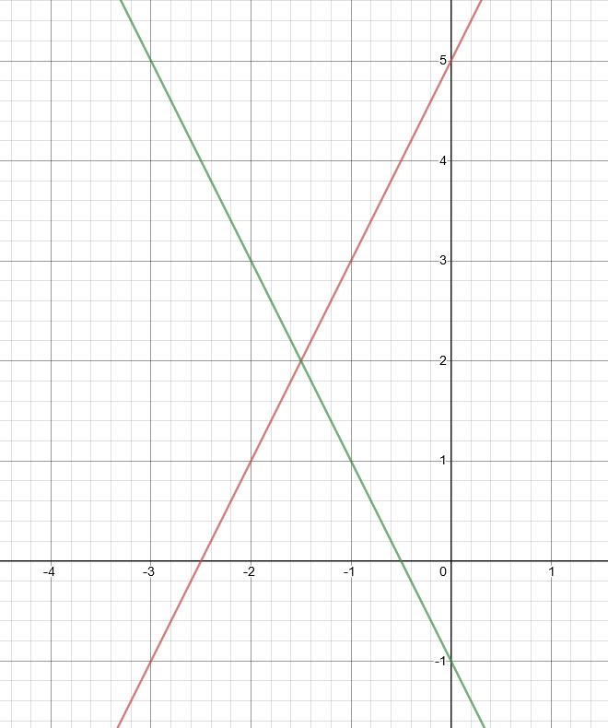
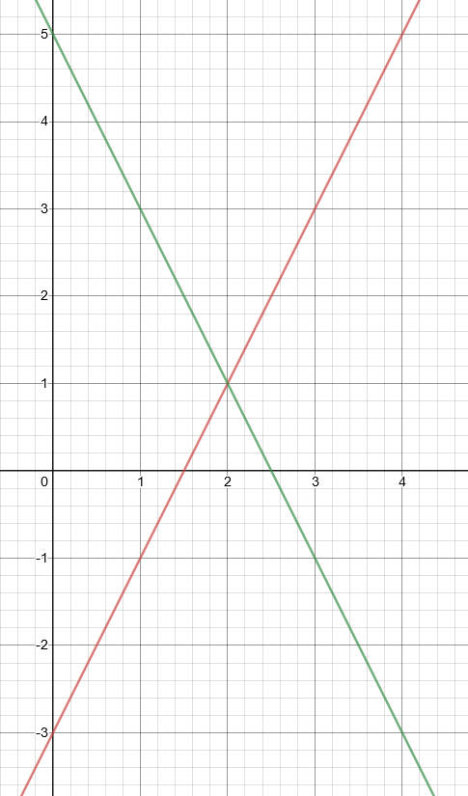
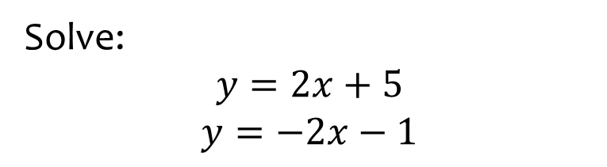
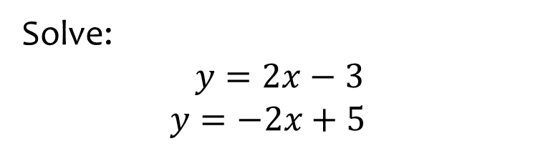

Worked example
Your turn
Solve:
$$y=2x+5$$
$$y=−2x−1$$
Solve:
$$y=2x−3$$
$$y=−2x+5$$
$$x=2, y=1$$
Graph used with permission from DESMOS: https://www.desmos.com/

Slide 5
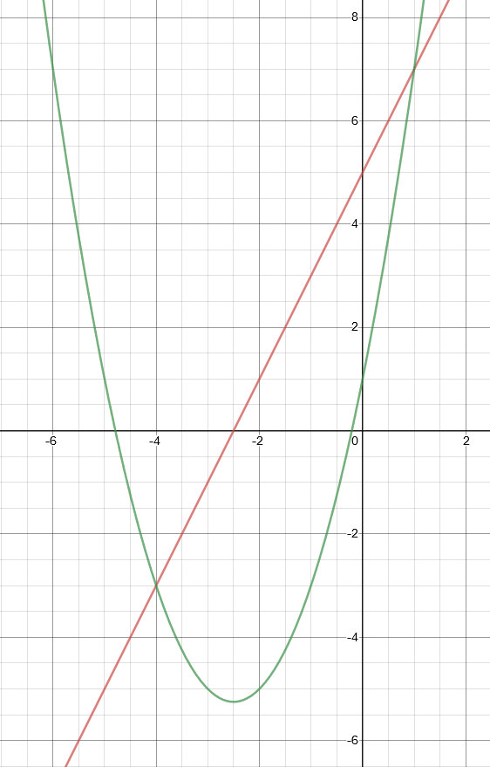
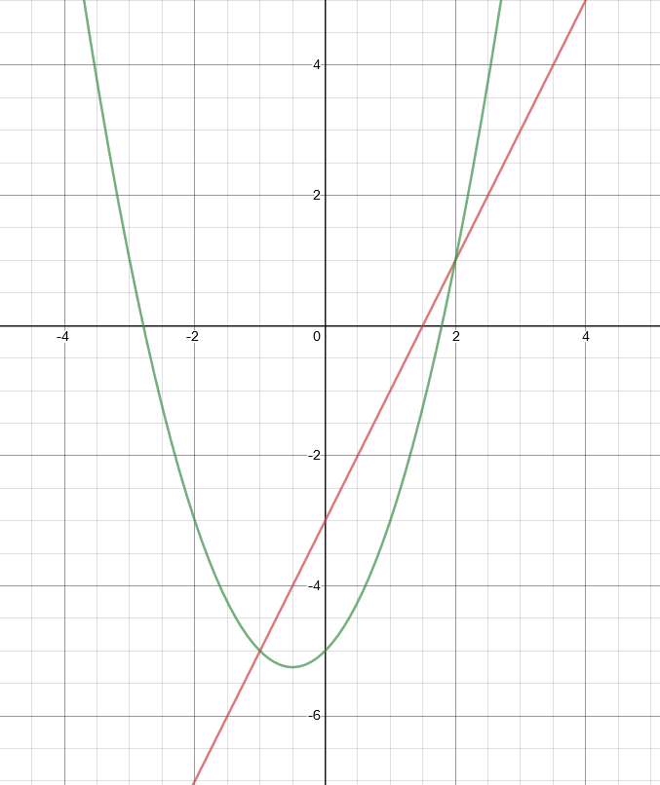
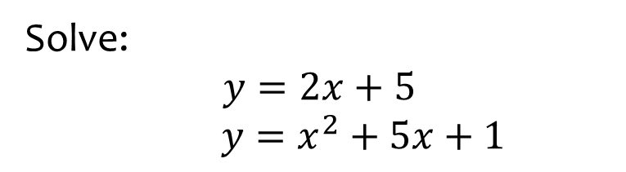
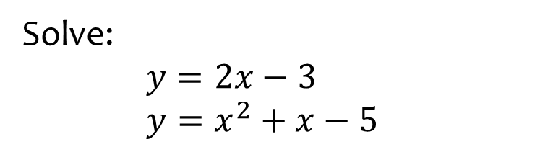

Worked example
Your turn
Solve:
$$y=2x+5$$
$y=x^{2}+5x+1$
Solve:
$y=2x−3$
$y=x^{2}+x−5$
$$x=2, y=1$$
$$x=−1, y=−5$$
Graph used with permission from DESMOS: https://www.desmos.com/

Slide 6
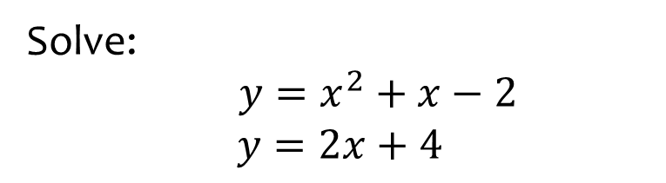
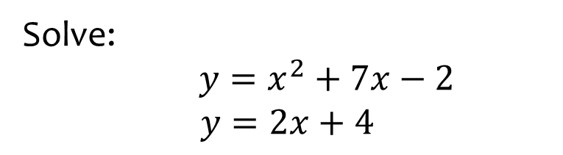

Worked example
Your turn
Solve:
$y=x^{2}+x−2$
$$y=2x+4$$
Solve:
$y=x^{2}+7x−2$
$$y=2x+4$$
$$x=1, y=6$$
$$x=−6, y=−8$$

Slide 7
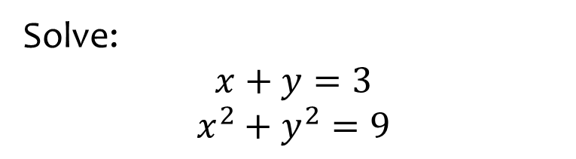
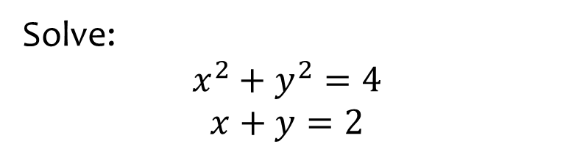

Worked example
Your turn
Solve:
$$x+y=3$$
$$x^{2}+y^{2}=9$$
Solve:
$$x^{2}+y^{2}=4$$
$$x+y=2$$
$$x=0, y=2$$
$$x=2, y=0$$

Slide 8
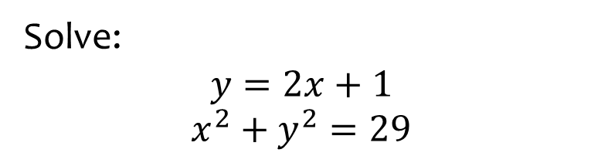
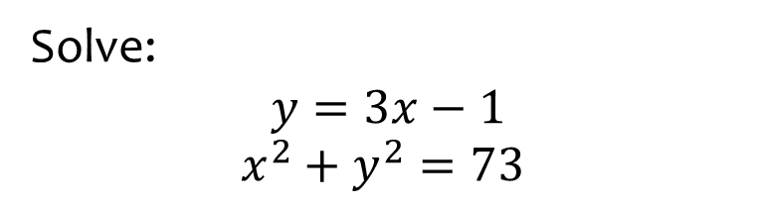
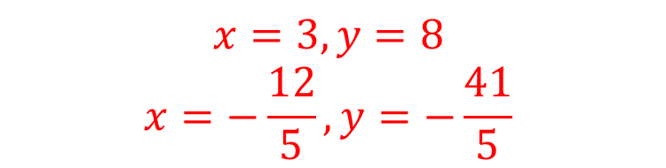
Worked example
Your turn
Solve:
$$y=2x+1$$
$$x^{2}+y^{2}=29$$
Solve:
$$y=3x−1$$
$$x^{2}+y^{2}=73$$
$$x=3, y=8$$
$$x=−\frac{12}{5}, y=−\frac{41}{5}$$

Slide 9
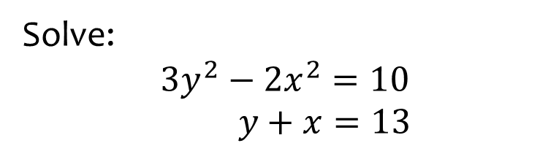
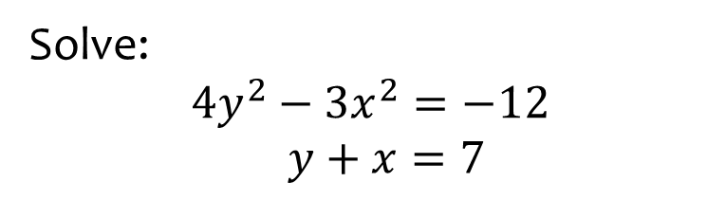

Worked example
Your turn
Solve:
$$3y^{2}−2x^{2}=10$$
$y+x=13$
Solve:
$$4y^{2}−3x^{2}=−12$$
$y+x=7$
$$x=4, y=3$$
$$x=52, y=−45$$

Slide 10
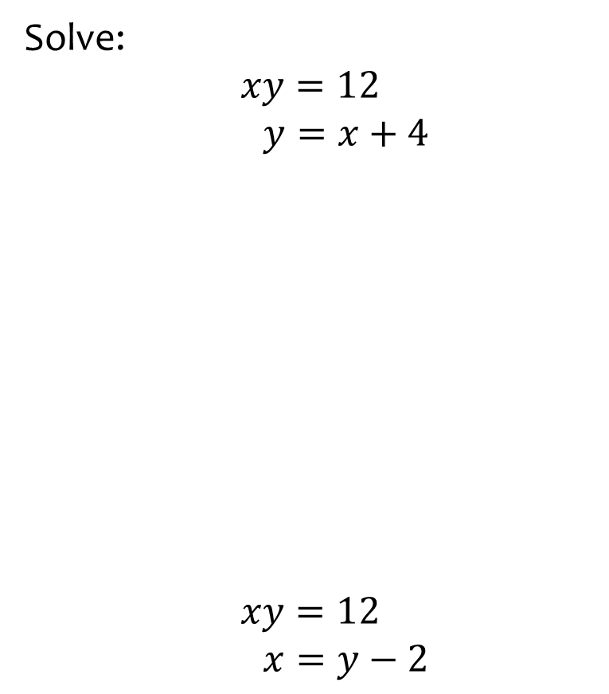
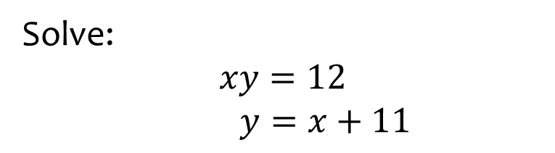

Worked example
Your turn
Solve:
$$xy=12$$
$y=x+4$
$$xy=12$$
$x=y−2$
Solve:
$$xy=12$$
$y=x+11$
$$x=1, y=12$$
$$x=−12, y=−1$$

Slide 11
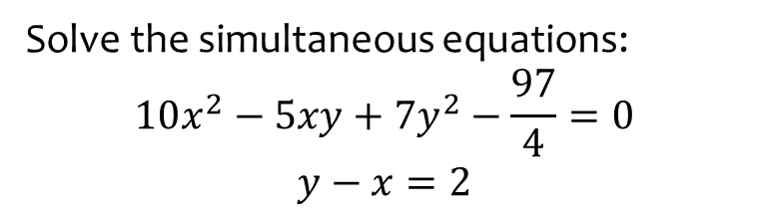
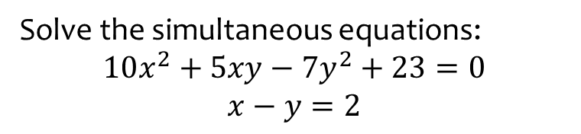

Worked example
Your turn
Solve the simultaneous equations:
$$10x^{2}−5xy+7y^{2}−\frac{97}{4}=0$$
$$y−x=2$$
Solve the simultaneous equations:
$$10x^{2}+5xy−7y^{2}+23=0$$
$$x−y=2$$
$$x=\frac{1}{4}, y=−\frac{7}{4}$$
$$x=−\frac{5}{2}, y=−\frac{9}{2}$$

Slide 12
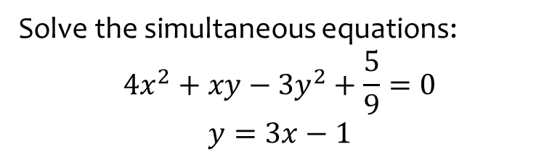
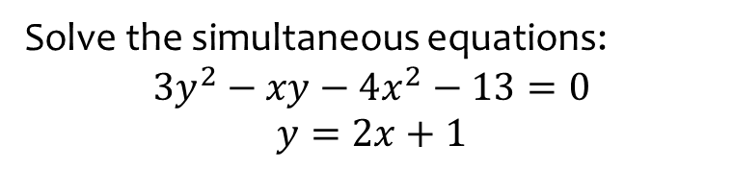

Worked example
Your turn
Solve the simultaneous equations:
$$4x^{2}+xy−3y^{2}+\frac{5}{9}=0$$
$$y=3x−1$$
Solve the simultaneous equations:
$$3y^{2}−xy−4x^{2}−13=0$$
$$y=2x+1$$
$$x=\frac{2}{3}, y=\frac{7}{3}$$
$$x=−\frac{5}{2}, y=−4$$

