Slide 1
Simultaneous equations (Three unknowns)
CONTENTS

Slide 2
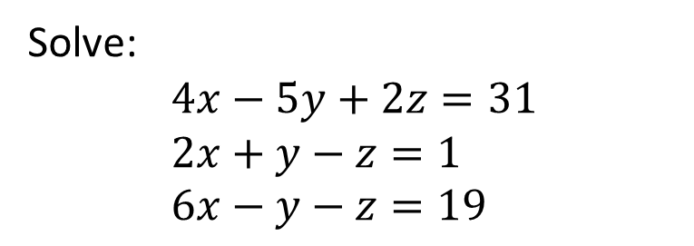
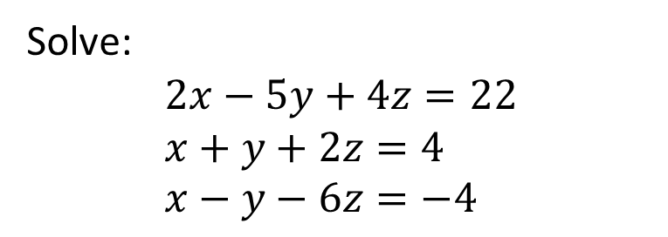

Worked example
Your turn
Solve:
$$4x−5y+2z=31 \\ 2x+y−z=1 \\ 6x−y−z=19$$
Solve:
$$2x−5y+4z=22 \\ x+y+2z=4 \\ x−y−6z=−4$$
$$x=2,y=−2,z=3$$

Slide 3
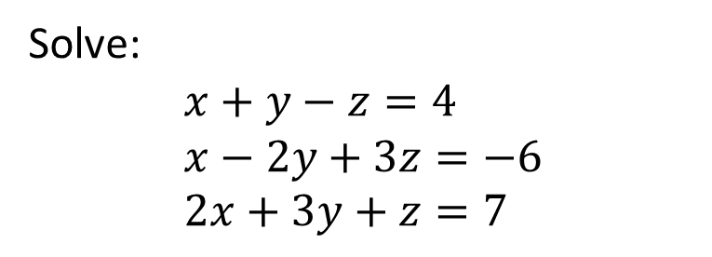
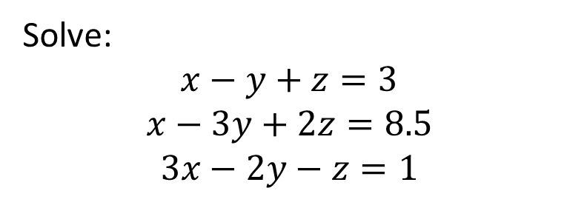

Worked example
Your turn
Solve:
$$x+y−z=4 \\ x−2y+3z=−6 \\ 2x+3y+z=7$$
Solve:
$$x−y+z=3$$
$$x−3y+2z=8.5$$
$$3x−2y−z=1$$
$$x=−\frac{1}{2}, y=−2, z=\frac{3}{2}$$

