Slide 1
Sequences: n^{th} term and limiting values
CONTENTS

Slide 2



Worked example
Your turn
Find the n^{th} term of the sequence:
$$\frac{1}{5},\frac{8}{9},\frac{27}{13},\frac{64}{17} …$$
Find the n^{th} term of the sequence:
$$\frac{1}{3},\frac{4}{7},\frac{9}{11},\frac{16}{15} …$$
$$\frac{n^{2}}{4n−1}$$

Slide 3
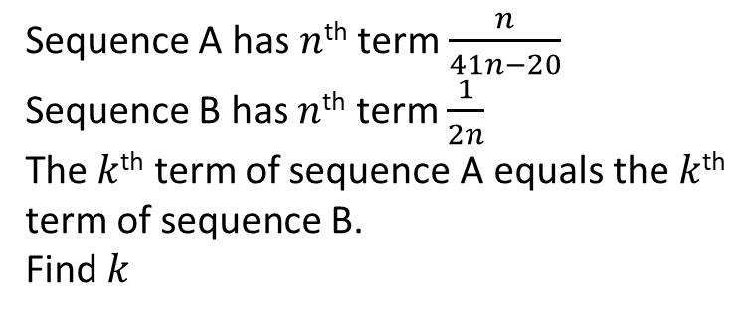
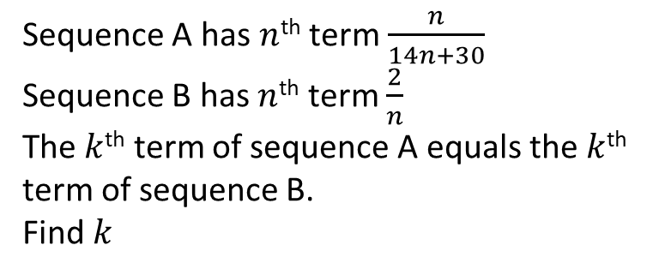
Worked example
Your turn
Sequence A has $n$^{th} term $\frac{n}{41n−20}$
Sequence B has $n$^{th} term $\frac{1}{2n}$
The $k$^{th} term of sequence A equals the $k$^{th} term of sequence B.
Find $k$
Sequence A has $n$^{th} term $\frac{n}{14n+30}$
Sequence B has $n$^{th} term $\frac{2}{n}$
The $k$^{th} term of sequence A equals the $k$^{th} term of sequence B.
Find $k$
$$k=30$$

Slide 4
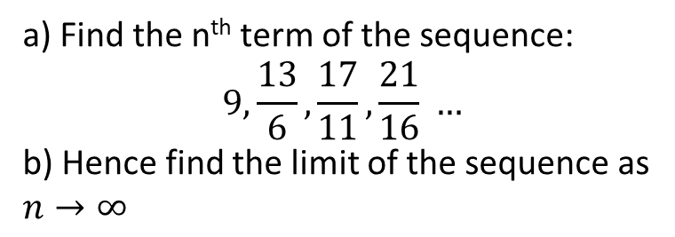
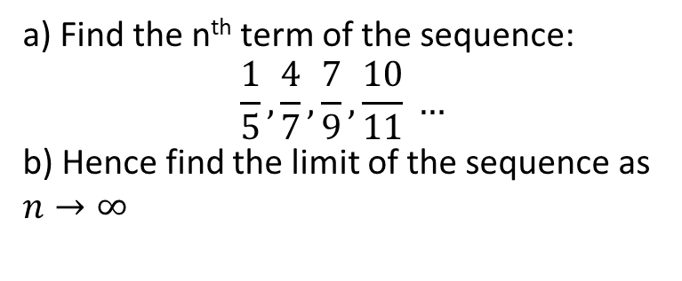
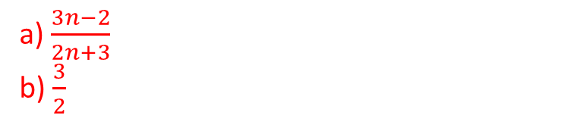
Worked example
Your turn
a) Find the n^{th} term of the sequence:
$$9,\frac{13}{6},\frac{17}{11},\frac{21}{16} …$$
b) Hence find the limit of the sequence as $n→∞$
a) Find the n^{th} term of the sequence:
$$\frac{1}{5},\frac{4}{7},\frac{7}{9},\frac{10}{11} …$$
b) Hence find the limit of the sequence as $n→∞$
a) $\frac{3n−2}{2n+3}$
b) $\frac{3}{2}$

Slide 5
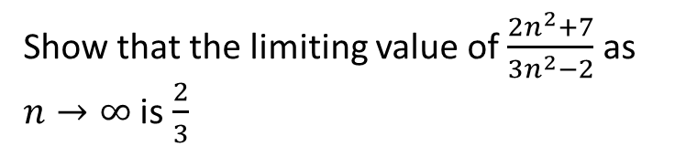
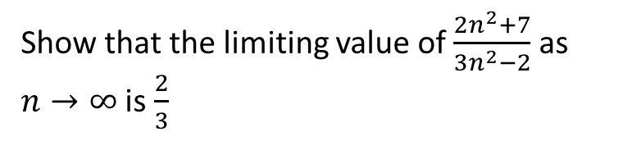
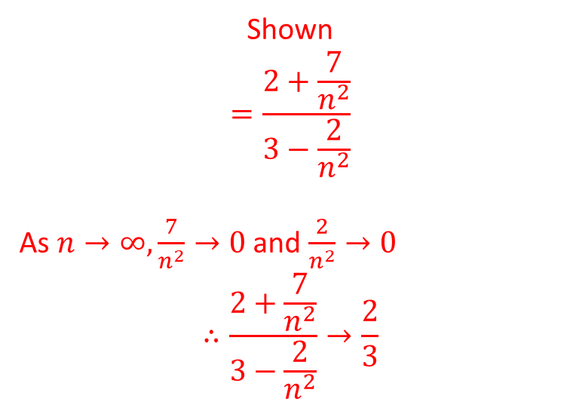
Worked example
Your turn
Show that the limiting value of $\frac{2n^{2}+7}{3n^{2}−2}$ as $n→∞$ is $\frac{2}{3}$
Show that the limiting value of $\frac{2n^{2}+7}{3n^{2}−2}$ as $n→∞$ is $\frac{2}{3}$
Shown
$$=\frac{2+\frac{7}{n^{2}}}{3−\frac{2}{n^{2}}}$$
As $n→∞,\frac{7}{n^{2}}→0$ and $\frac{2}{n^{2}}→0$
$$∴\frac{2+\frac{7}{n^{2}}}{3−\frac{2}{n^{2}}}→\frac{2}{3}$$

Slide 6
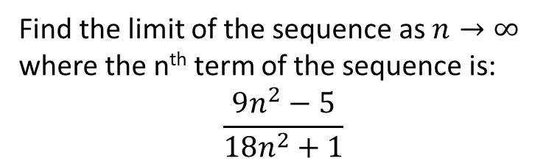
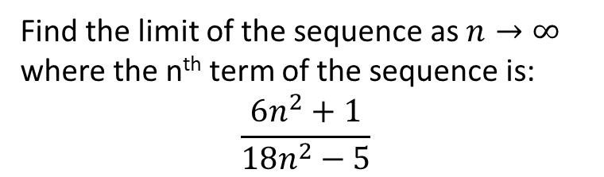

Worked example
Your turn
Find the limit of the sequence as $n→∞$ where the n^{th} term of the sequence is:
$$\frac{9n^{2}−5}{18n^{2}+1}$$
Find the limit of the sequence as $n→∞$ where the n^{th} term of the sequence is:
$$\frac{6n^{2}+1}{18n^{2}−5}$$
$$\frac{1}{3}$$

Slide 7
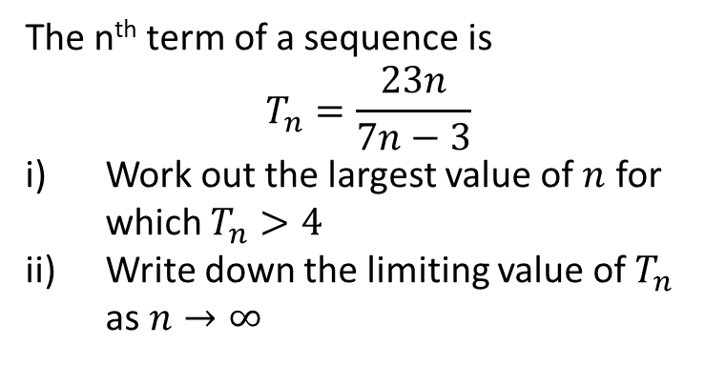
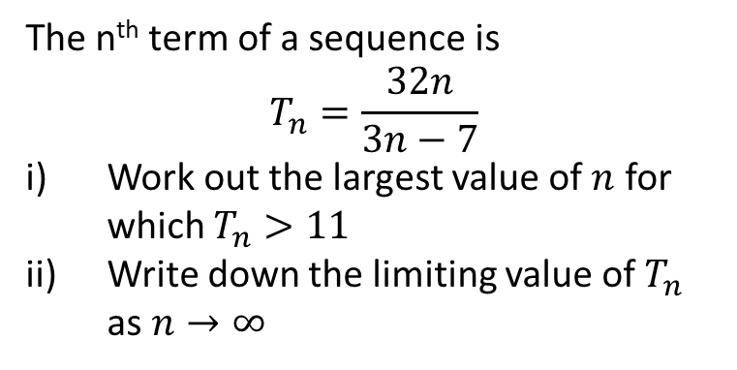
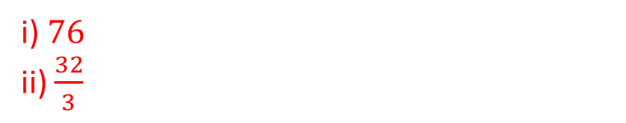
Worked example
Your turn
The n^{th} term of a sequence is
$$T_{n}=\frac{23n}{7n−3}$$
Work out the largest value of $n$ for which $T_{n}>4$
Write down the limiting value of $T_{n}$ as $n→∞$
The n^{th} term of a sequence is
$$T_{n}=\frac{32n}{3n−7}$$
Work out the largest value of $n$ for which $T_{n}>11$
Write down the limiting value of $T_{n}$ as $n→∞$
i) $76$
ii) $\frac{32}{3}$

Slide 8
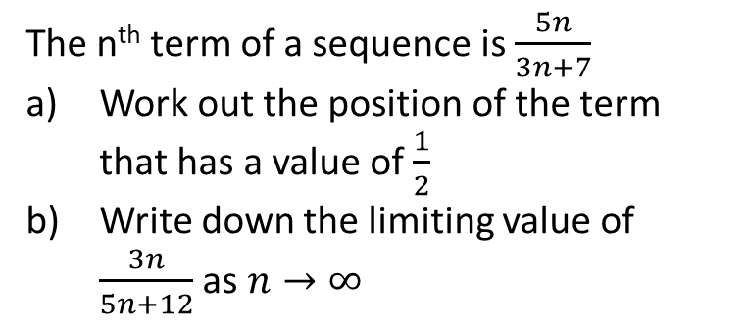
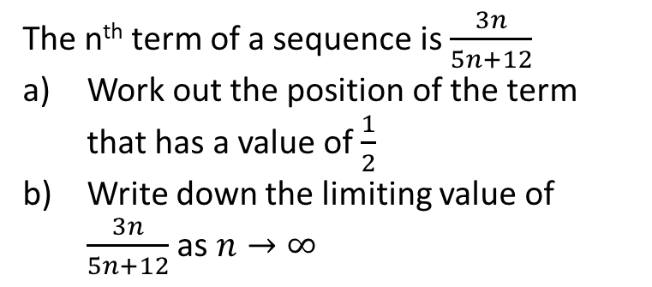
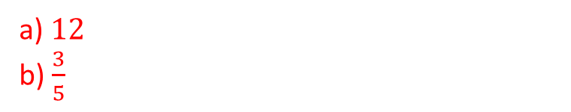
Worked example
Your turn
The n^{th} term of a sequence is $\frac{5n}{3n+7}$
Work out the position of the term that has a value of $\frac{1}{2}$
Write down the limiting value of $\frac{3n}{5n+12}$ as $n→∞$
The n^{th} term of a sequence is $\frac{3n}{5n+12}$
Work out the position of the term that has a value of $\frac{1}{2}$
Write down the limiting value of $\frac{3n}{5n+12}$ as $n→∞$
a) $12$
b) $\frac{3}{5}$

Slide 9
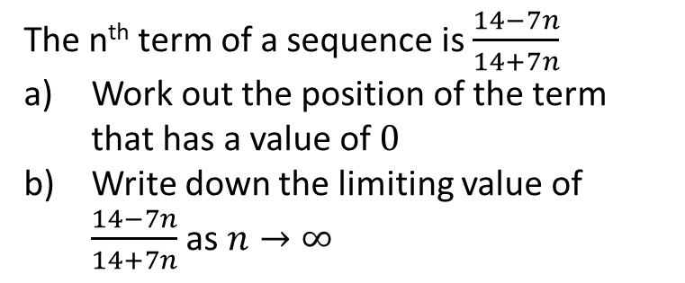
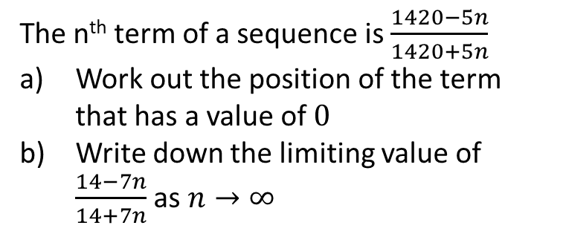
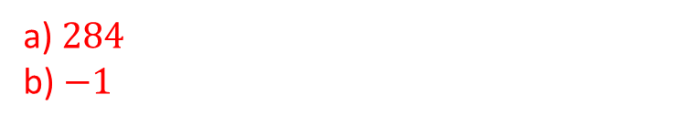
Worked example
Your turn
The n^{th} term of a sequence is $\frac{14−7n}{14+7n}$
Work out the position of the term that has a value of $0$
Write down the limiting value of $\frac{14−7n}{14+7n}$ as $n→∞$
The n^{th} term of a sequence is $\frac{1420−5n}{1420+5n}$
Work out the position of the term that has a value of $0$
Write down the limiting value of $\frac{14−7n}{14+7n}$ as $n→∞$
a) $284$
b) $−1$

