Slide 1
Second derivative and maxima/minima
CONTENTS

Slide 2


Worked example
Your turn
$$y=5x^{3}−7x^{2}−x+4$$
Find the value of $\frac{d^{2}y}{dx^{2}}$ when $x=2$
$$y=2x^{3}−3x^{2}+x+9$$
Find the value of $\frac{d^{2}y}{dx^{2}}$ when $x=2$
$$18$$

Slide 3

Worked example
Your turn
Find the stationary point on the curve with equation
$y=x^{4}−108x$, and determine whether it is a local maximum, a local minimum or a point of inflection.
Find the stationary point on the curve with equation
$y=x^{4}−32x$, and determine whether it is a local maximum, a local minimum or a point of inflection.
$(2, −48)$ Local minimum

Slide 4
Worked example
Your turn
Find the coordinates of the stationary points on the curve with equation $y=4x^{3}+30x^{2}+48x−3$ and use the second derivative to determine their nature
Find the coordinates of the stationary points on the curve with equation $y=2x^{3}−15x^{2}+24x+6$ and use the second derivative to determine their nature
$(1, 17)$ Local maximum
$\left(4, −10\right)$ Local minimum

Slide 5
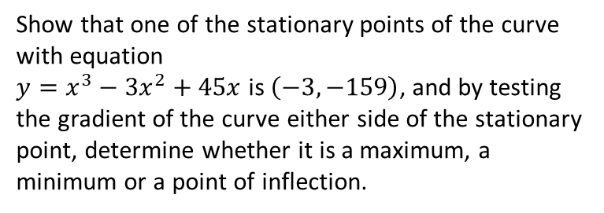
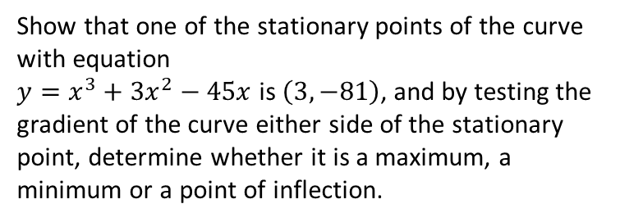
Worked example
Your turn
Show that one of the stationary points of the curve with equation
$y=x^{3}−3x^{2}+45x$ is $\left(−3,−159\right)$, and by testing the gradient of the curve either side of the stationary point, determine whether it is a maximum, a minimum or a point of inflection.
Show that one of the stationary points of the curve with equation
$y=x^{3}+3x^{2}−45x$ is $\left(3,−81\right)$, and by testing the gradient of the curve either side of the stationary point, determine whether it is a maximum, a minimum or a point of inflection.
Minimum

Slide 6
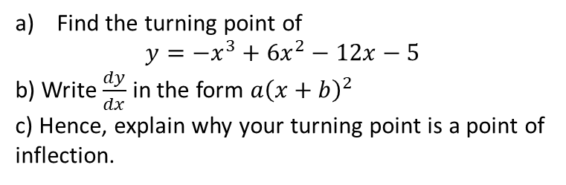
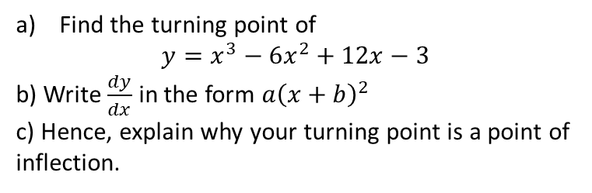
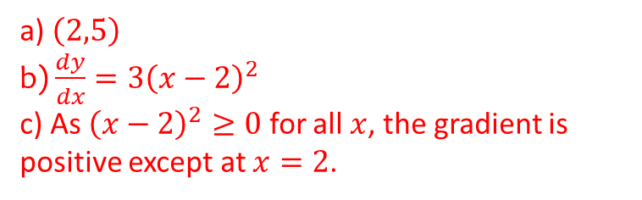
Worked example
Your turn
Find the turning point of
$$y=−x^{3}+6x^{2}−12x−5$$
b) Write $\frac{dy}{dx}$ in the form $a{\left(x+b\right)}^{2}$
c) Hence, explain why your turning point is a point of inflection.
Find the turning point of
$$y=x^{3}−6x^{2}+12x−3$$
b) Write $\frac{dy}{dx}$ in the form $a{\left(x+b\right)}^{2}$
c) Hence, explain why your turning point is a point of inflection.
a) $\left(2,5\right)$
b) $\frac{dy}{dx}=3{\left(x−2\right)}^{2}$
c) As ${\left(x−2\right)}^{2}≥0$ for all $x$, the gradient is positive except at $x=2$.

Slide 7
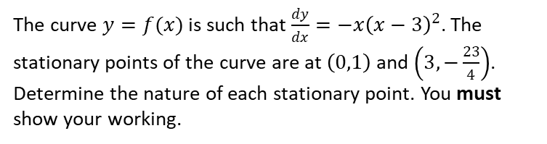
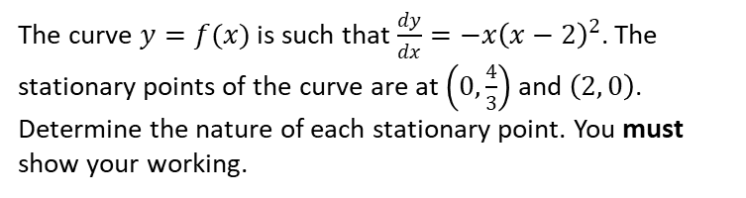
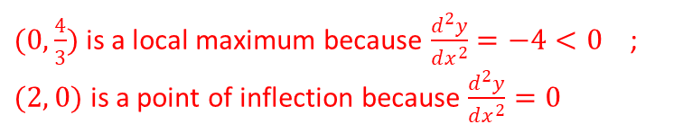
Worked example
Your turn
The curve $y=f(x)$ is such that $\frac{dy}{dx}=−x{\left(x−3\right)}^{2}$. The stationary points of the curve are at $\left(0,1\right)$ and $\left(3, −\frac{23}{4}\right)$. Determine the nature of each stationary point. You must show your working.
The curve $y=f(x)$ is such that $\frac{dy}{dx}=−x{\left(x−2\right)}^{2}$. The stationary points of the curve are at $\left(0,\frac{4}{3}\right)$ and $\left(2, 0\right)$.
Determine the nature of each stationary point. You must show your working.
$(0,\frac{4}{3})$ is a local maximum because $\frac{d^{2}y}{dx^{2}}=−4<0$ ; $(2, 0)$ is a point of inflection because $\frac{d^{2}y}{dx^{2}}=0$

