Slide 1
Rearranging formulae
CONTENTS

Slide 2

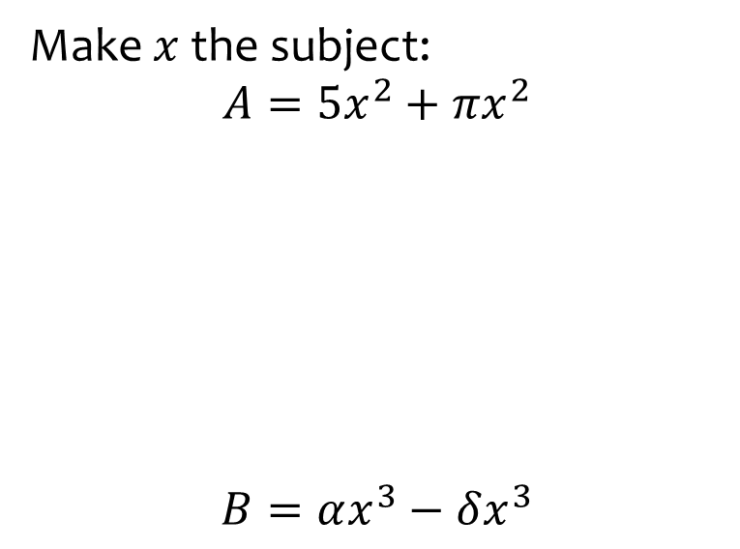

Worked example
Your turn
Make $x$ the subject:
$$A=5x^{2}+πx^{2}$$
$$B=αx^{3}−δx^{3}$$
Make $x$ the subject:
$$C=πx^{2}−3x^{2}$$
$$x=±\sqrt{\frac{C}{π−3}}$$

Slide 3
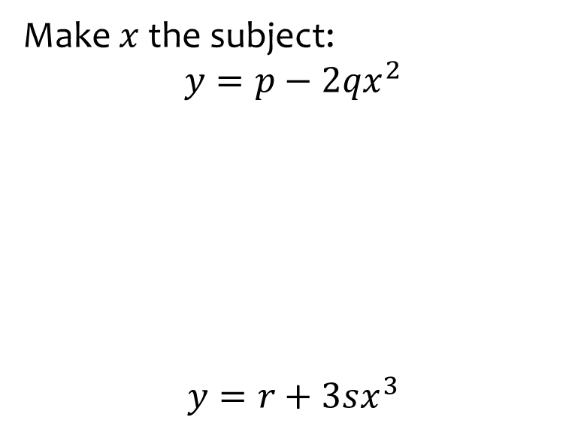


Worked example
Your turn
Make $x$ the subject:
$$y=p−2qx^{2}$$
$$y=r+3sx^{3}$$
Make $x$ the subject:
$$y=t−5ux^{3}$$
$$x=\sqrt[3]{\frac{\left(t−y\right)}{5u}}$$

Slide 4
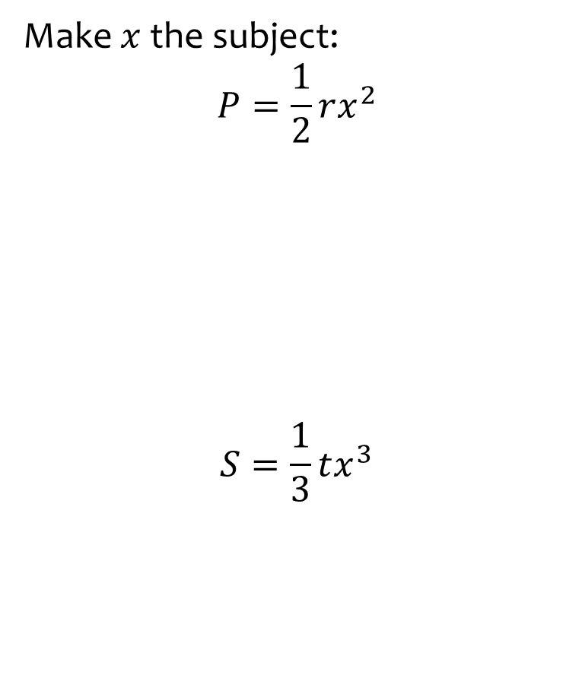


Worked example
Your turn
Make $x$ the subject:
$$P=\frac{1}{2}rx^{2}$$
$$S=\frac{1}{3}tx^{3}$$
Make $x$ the subject:
$$Q=\frac{1}{4}ux^{2}$$
$$x=±\sqrt{\frac{4Q}{u}}$$

Slide 5
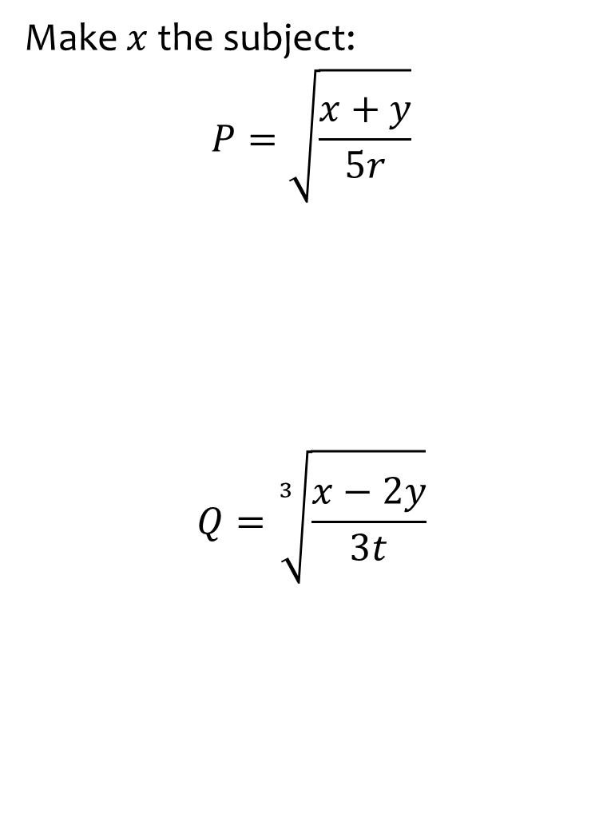
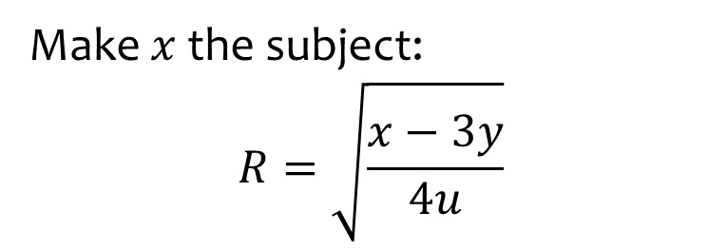

Worked example
Your turn
Make $x$ the subject:
$$P=\sqrt{\frac{x+y}{5r}}$$
$$Q=\sqrt[3]{\frac{x−2y}{3t}}$$
Make $x$ the subject:
$$R=\sqrt{\frac{x−3y}{4u}}$$
$$x=4uR^{2}+3y$$

Slide 6



Worked example
Your turn
Make $x$ the subject:
$$P=\frac{n^{2}−x}{n+x}$$
Make $x$ the subject:
$$R=\frac{s^{2}+x}{s−x}$$
$$x=\frac{Rs−s^{2}}{R+1}$$

Slide 7



Worked example
Your turn
Make $x$ the subject:
$$y=3+\frac{ax^{2}}{5}$$
Make $x$ the subject:
$$y=2+\frac{bx^{2}}{3}$$
$$x=±\sqrt{\frac{3\left(y−2\right)}{b}}$$

Slide 8
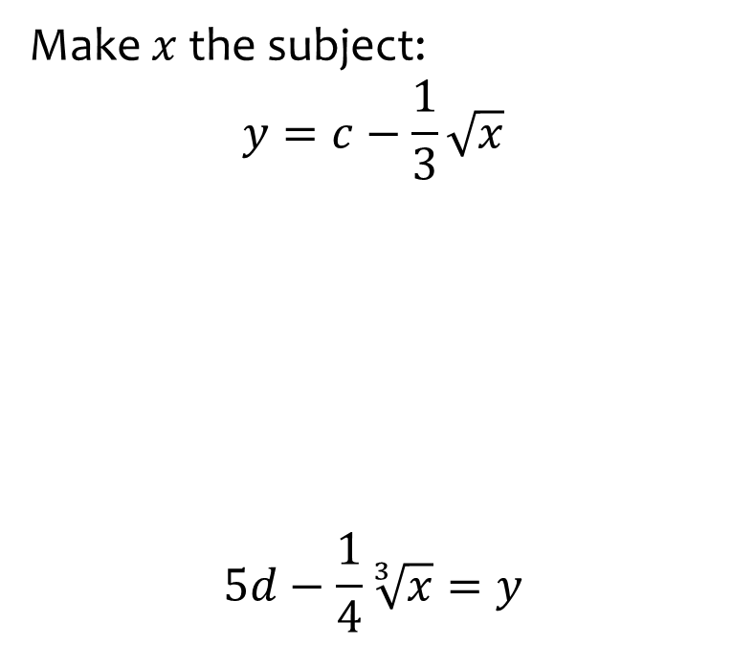


Worked example
Your turn
Make $x$ the subject:
$$y=c−\frac{1}{3}\sqrt{x}$$
$$5d−\frac{1}{4}\sqrt[3]{x}=y$$
Make $x$ the subject:
$$y=4e−\frac{1}{5}\sqrt{x}$$
$$x=25{\left(4e−y\right)}^{2}$$

Slide 9



Worked example
Your turn
Make $x$ the subject:
$$\frac{1}{x}−\frac{1}{y}=\frac{1}{z}$$
Make $p$ the subject:
$$\frac{1}{p}+\frac{1}{q}=\frac{1}{r}$$
$$p=\frac{rq}{q−r}$$

Slide 10
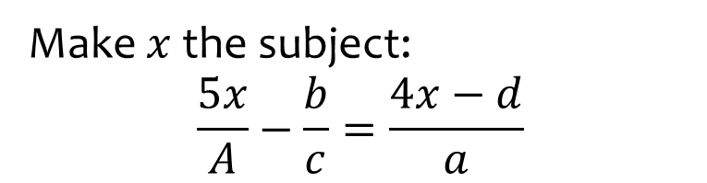
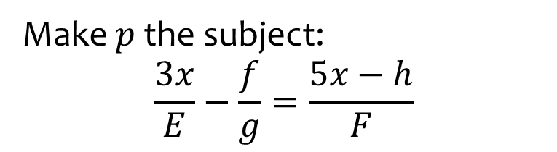

Worked example
Your turn
Make $x$ the subject:
$$\frac{5x}{A}−\frac{b}{c}=\frac{4x−d}{a}$$
Make $p$ the subject:
$$\frac{3x}{E}−\frac{f}{g}=\frac{5x−h}{F}$$
$$x=\frac{EfF−Egh}{3fg−5eg}$$

Slide 11
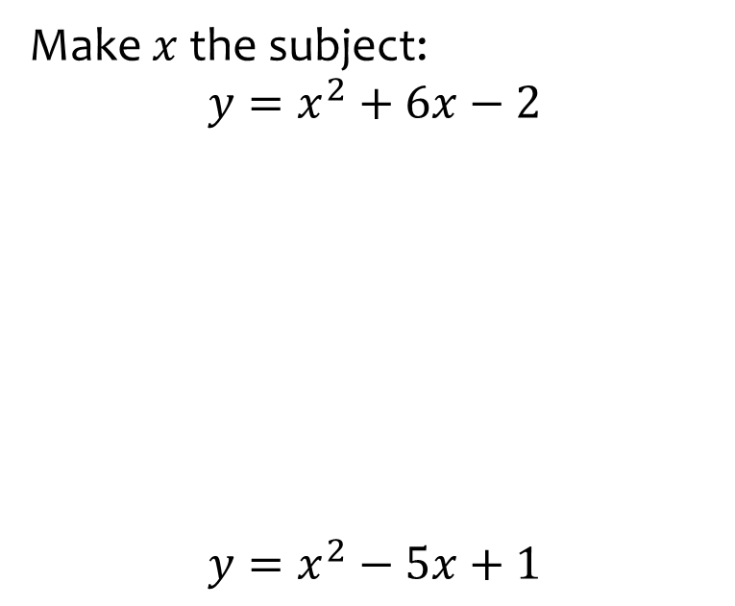


Worked example
Your turn
Make $x$ the subject:
$$y=x^{2}+6x−2$$
$$y=x^{2}−5x+1$$
Make $x$ the subject:
$$y=x^{2}+8x−3$$
$$x=−4±\sqrt{y+19}$$

Slide 12
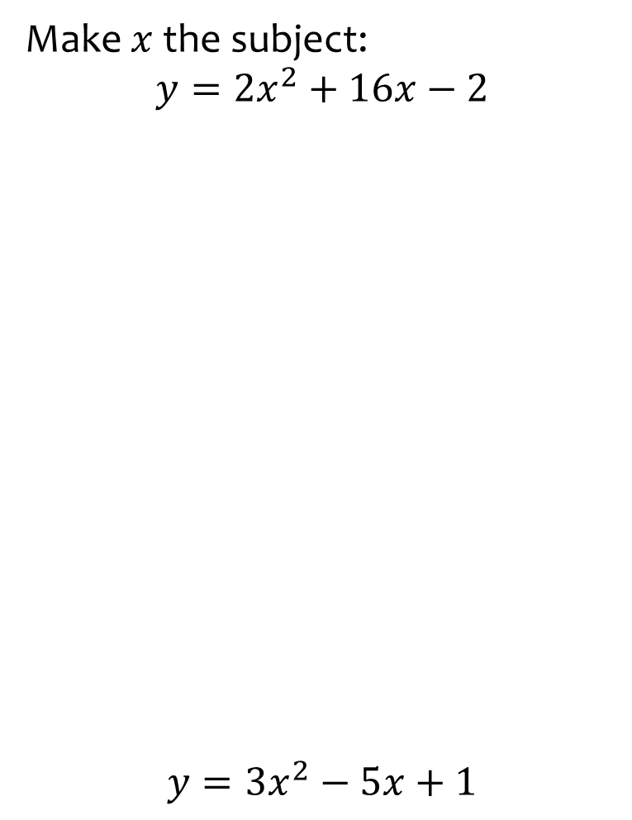

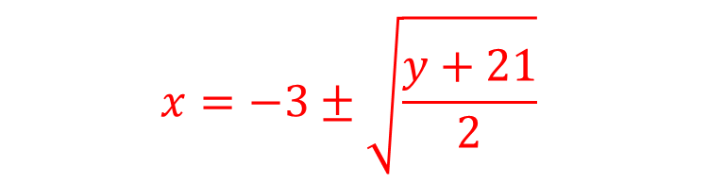
Worked example
Your turn
Make $x$ the subject:
$$y={2x}^{2}+16x−2$$
$$y={3x}^{2}−5x+1$$
Make $x$ the subject:
$$y={2x}^{2}+12x−3$$
$$x=−3±\sqrt{\frac{y+21}{2}}$$

Slide 13
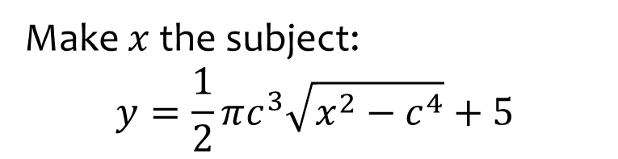
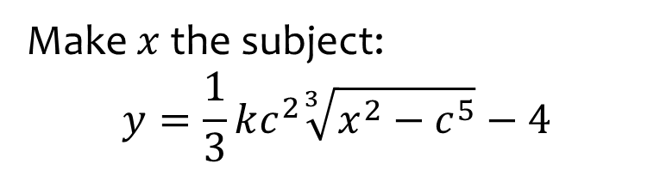
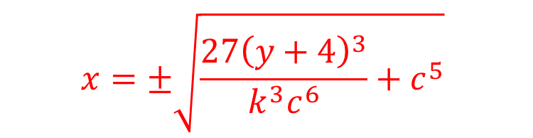
Worked example
Your turn
Make $x$ the subject:
$$y=\frac{1}{2}πc^{3}\sqrt{x^{2}−c^{4}}+5$$
Make $x$ the subject:
$$y=\frac{1}{3}kc^{2}\sqrt[3]{x^{2}−c^{5}}−4$$
$$x=±\sqrt{\frac{27{\left(y+4\right)}^{3}}{k^{3}c^{6}}+c^{5}}$$

