Slide 1
Ratio with straight lines
CONTENTS

Slide 2
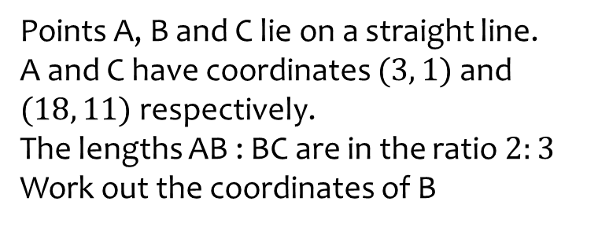
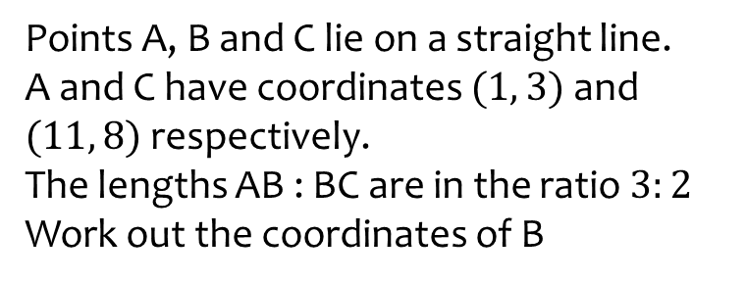

Worked example
Your turn
Points A, B and C lie on a straight line.
A and C have coordinates $(3, 1)$ and $(18, 11)$ respectively.
The lengths AB : BC are in the ratio $2:3$
Work out the coordinates of B
Points A, B and C lie on a straight line.
A and C have coordinates $(1, 3)$ and $(11, 8)$ respectively.
The lengths AB : BC are in the ratio $3:2$
Work out the coordinates of B
$$(7, 6)$$

Slide 3
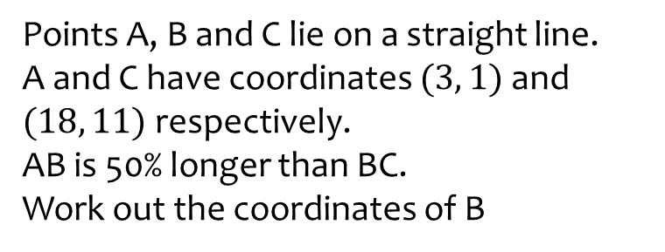
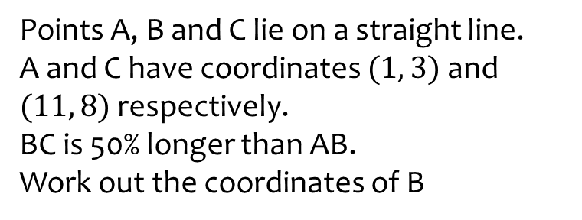

Worked example
Your turn
Points A, B and C lie on a straight line.
A and C have coordinates $(3, 1)$ and $(18, 11)$ respectively.
AB is 50% longer than BC.
Work out the coordinates of B
Points A, B and C lie on a straight line.
A and C have coordinates $(1, 3)$ and $(11, 8)$ respectively.
BC is 50% longer than AB.
Work out the coordinates of B
$$(5, 9)$$

Slide 4
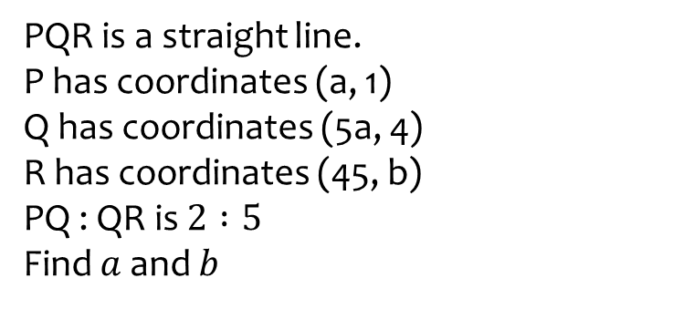
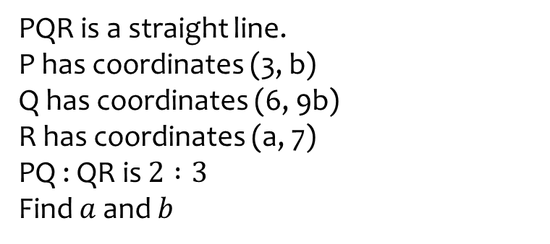

Worked example
Your turn
PQR is a straight line.
P has coordinates (a, 1)
Q has coordinates (5a, 4)
R has coordinates (45, b)
PQ : QR is $2 :5$
Find $a$ and $b$
PQR is a straight line.
P has coordinates (3, b)
Q has coordinates (6, 9b)
R has coordinates (a, 7)
PQ : QR is $2 :3$
Find $a$ and $b$
$$a=10.5, b=\frac{1}{3}$$

