Slide 1
Sequences: Quadratic
CONTENTS

Slide 2
Worked example
Your turn
Generate the first 5 terms of the sequence with n^{th} term:
$2n^{2}−3n+1$:
Generate the first 5 terms of the sequence with n^{th} term:
$3n^{2}+4n−2$:
$5, 18, 37, 62, 93$

Slide 3
Worked example
Your turn
Find the n^{th} term:
$$1, 4, 9, 16,…$$
$$0, 3, 8, 15,…$$
$$3, 6, 11, 18,…$$
Find the n^{th} term:
$$1, 8, 27, 64,…$$
$$−1, 6, 25, 62,…$$
$$4, 11, 30, 67,…$$
$$n^{3}$$
$$n^{3}−2$$
$$n^{3}+3$$

Slide 4
Worked example
Your turn
Find the n^{th} term:
$$4, 10, 20, 34,…$$
$2, 5, 14, 29,…$
Find the n^{th} term:
$$2, 5, 16, 35,…$$
$$4n^{2}−9n+7$$

Slide 5
Worked example
Your turn
Find the n^{th} term:
$$8, 4, −6, −22,−44,…$$
$$12, 11, 6, −3, −16…$$
Find the n^{th} term:
$$6, 5, 0, −9,−22,…$$
$$−2n^{2}+5n+3$$

Slide 6
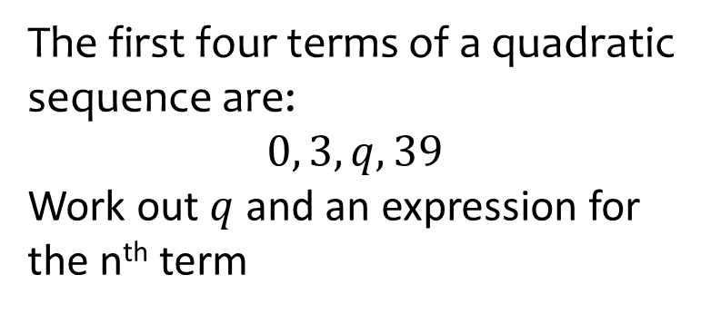
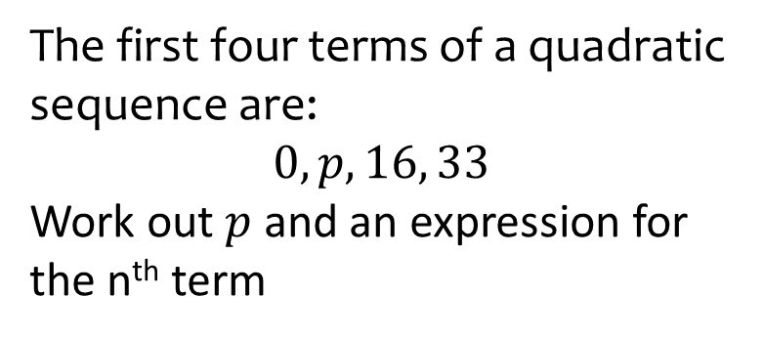

Worked example
Your turn
The first four terms of a quadratic sequence are:
$$0, 3, q, 39$$
Work out $q$ and an expression for the n^{th} term
The first four terms of a quadratic sequence are:
$$0, p, 16, 33$$
Work out $p$ and an expression for the n^{th} term
$$p=5$$
$$3n^{2}−4n+1$$

