Slide 1
Pythagoras’ Theorem 2D and 3D (recognise triples)
CONTENTS

Slide 2
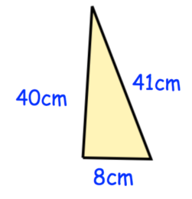
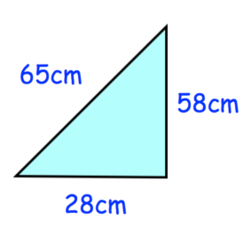
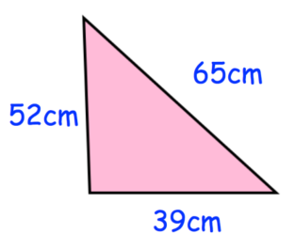
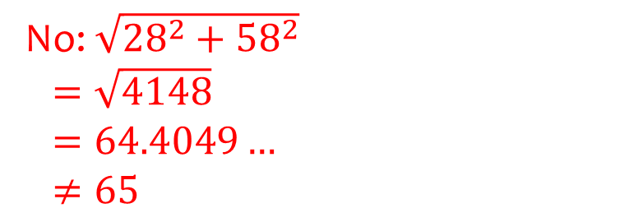
Worked example
Your turn
The triangle has been drawn inaccurately. Is the triangle right-angled?
The triangle has been drawn inaccurately. Is the triangle right-angled?
No: $\sqrt{{28}^{2}+{58}^{2}}$
$=\sqrt{4148}$
$=64.4049…$
$$≠65$$
Questions used with permission from Corbettmaths: https://corbettmaths.com/

Slide 3
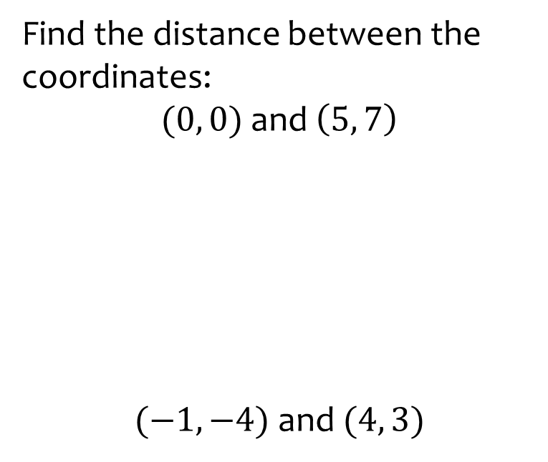
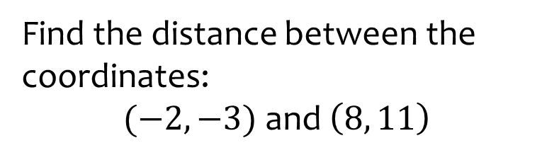

Worked example
Your turn
Find the distance between the coordinates:
$(0, 0)$ and $\left(5, 7\right)$
$(−1, −4)$ and $(4, 3)$
Find the distance between the coordinates:
$(−2, −3)$ and $\left(8, 11\right)$
$17.20$ (2 dp)

Slide 4





Worked example
Your turn
Calculate the area of this triangle:
Calculate the area of this triangle:
$$8cm$$
$$7cm$$
$$6cm$$
$$5cm$$
$12.25 cm^{2}$ (2 dp)

Slide 5







Worked example
Your turn
Find the area of this triangle:
Find the area of this triangle:
$$12 cm$$
$$12 cm$$
$$6 cm$$
$$6 cm$$
$$10 cm$$
$$5 cm$$
$13.64 cm^{2}$ (2 dp)

Slide 6
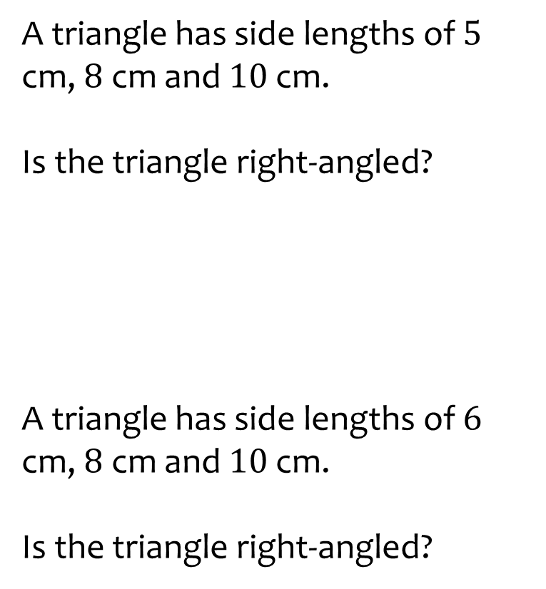
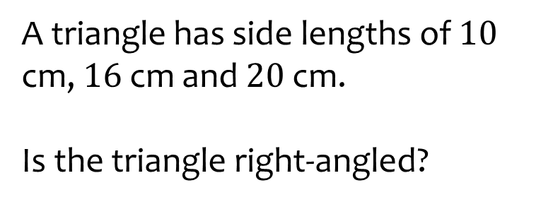

Worked example
Your turn
A triangle has side lengths of $5$ cm, $8$ cm and $10$ cm.
Is the triangle right-angled?
A triangle has side lengths of $6$ cm, $8$ cm and $10$ cm.
Is the triangle right-angled?
A triangle has side lengths of $10$ cm, $16$ cm and $20$ cm.
Is the triangle right-angled?
No, ${10}^{2}+{16}^{2}≠{20}^{2}$

Slide 7











Worked example
Your turn
Calculate $x$
Calculate $y$
$$x cm$$
$$8 cm$$
$$9 cm$$
$$y cm$$
$$13 cm$$
$$12 cm$$
$$11 cm$$
$$10 cm$$
$y=13.42$ (2 dp)

Slide 8
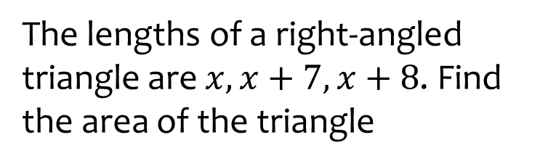
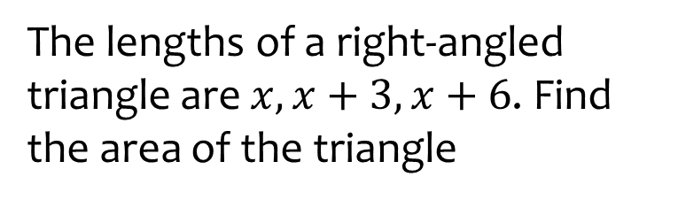

Worked example
Your turn
The lengths of a right-angled triangle are $x, x+7, x+8$. Find the area of the triangle
The lengths of a right-angled triangle are $x, x+3, x+6$. Find the area of the triangle
$24$square units

Slide 9
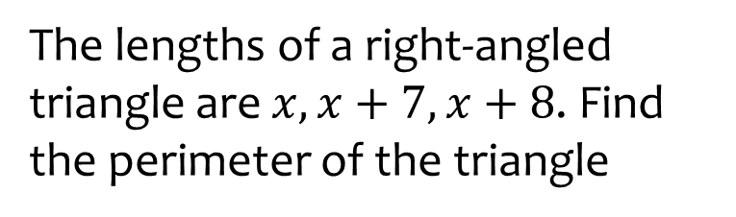
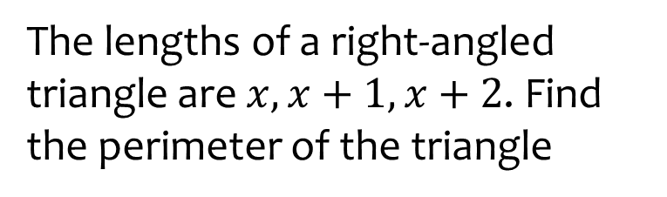

Worked example
Your turn
The lengths of a right-angled triangle are $x, x+7, x+8$. Find the perimeter of the triangle
The lengths of a right-angled triangle are $x, x+1, x+2$. Find the perimeter of the triangle
$12$ units

Slide 10
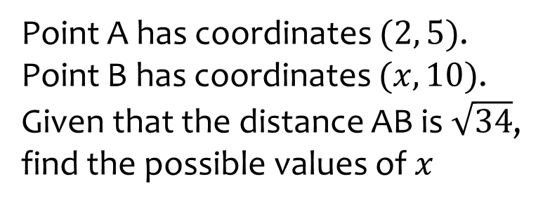
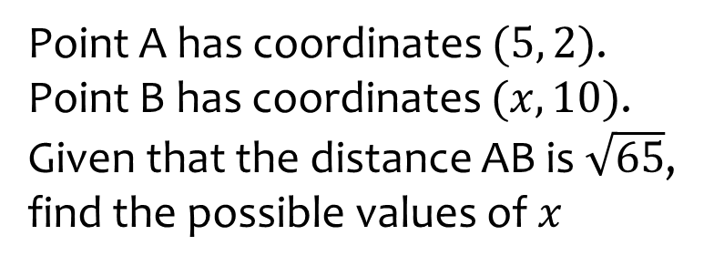

Worked example
Your turn
Point A has coordinates $(2, 5)$.
Point B has coordinates $(x, 10)$.
Given that the distance AB is $\sqrt{34}$, find the possible values of $x$
Point A has coordinates $(5, 2)$.
Point B has coordinates $(x, 10)$.
Given that the distance AB is $\sqrt{65}$, find the possible values of $x$
$$x=4 or 6$$

Slide 11

Worked example
Your turn
Find the length of the longest diagonal in a cuboid measuring 6 by 8 by 10 cm
Find the length of the longest diagonal in a cuboid measuring 3 by 4 by 5 cm
$7.07 cm$ (2 dp)

Slide 12
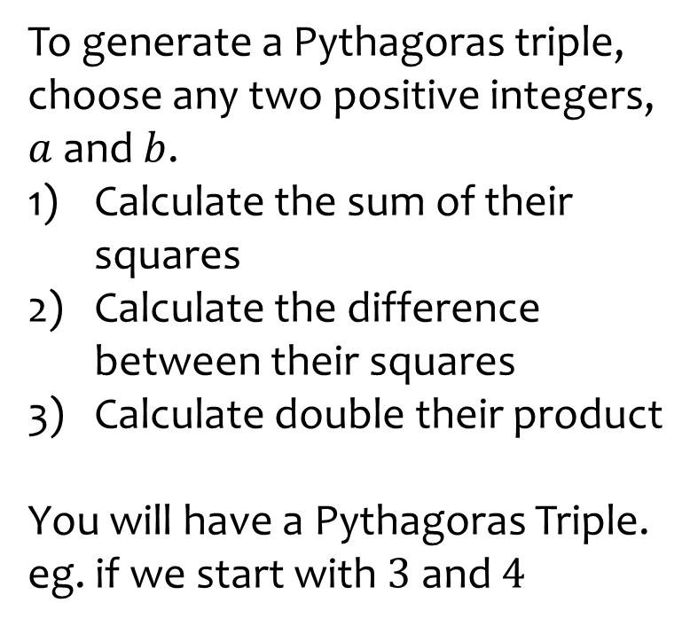
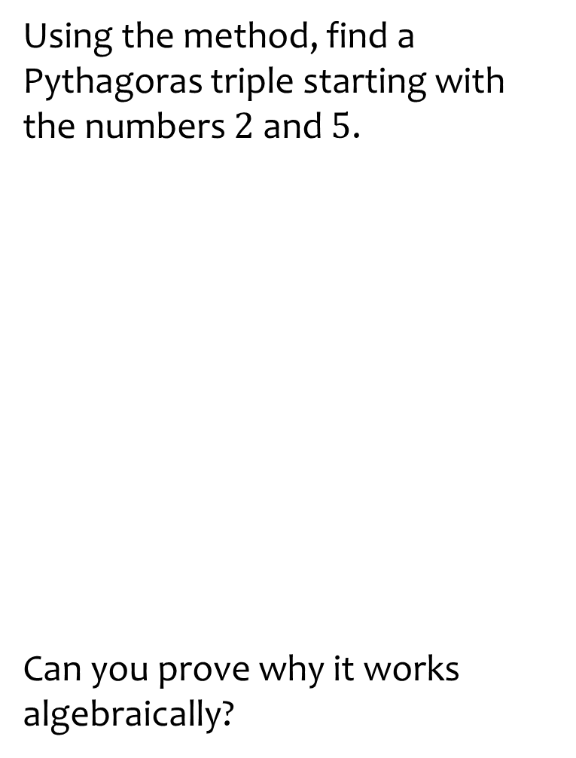

Worked example
Your turn
To generate a Pythagoras triple, choose any two positive integers, $a$ and $b$.
Calculate the sum of their squares
Calculate the difference between their squares
Calculate double their product
You will have a Pythagoras Triple.
eg. if we start with $3$ and $4$
Using the method, find a Pythagoras triple starting with the numbers $2$ and $5$.
Can you prove why it works algebraically?
$${20}^{2}+{21}^{2}={29}^{2}$$

Slide 13
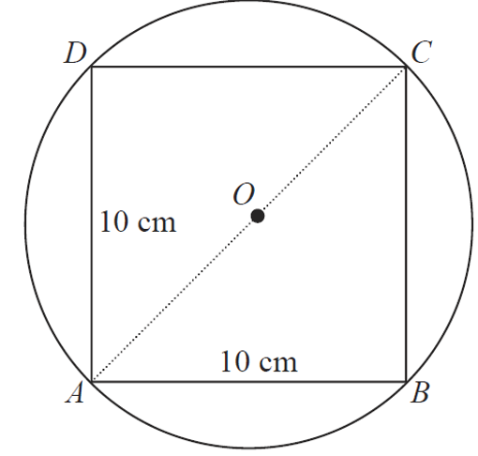



Worked example
Your turn
Calculate the area of the circle
Calculate the area of the circle
$$5 cm$$
$$5 cm$$
$44.4 cm^{2}$(1 dp)

Slide 14
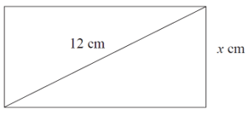
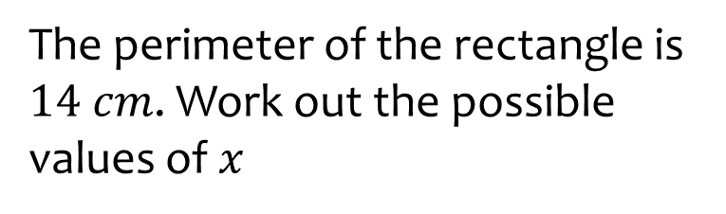
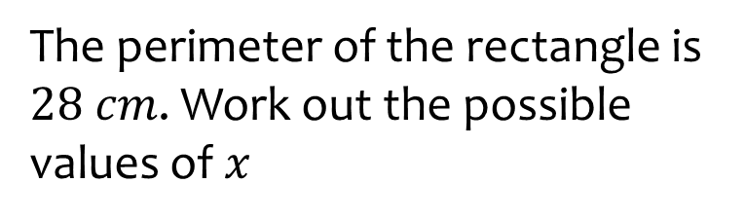


Worked example
Your turn
The perimeter of the rectangle is $14 cm$. Work out the possible values of $x$
The perimeter of the rectangle is $28 cm$. Work out the possible values of $x$
$$6 cm$$
$x=11.8$ or $2.2$ (1 dp)

Slide 15
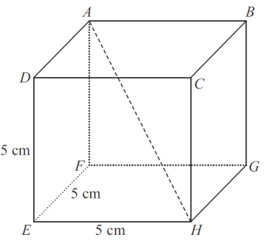
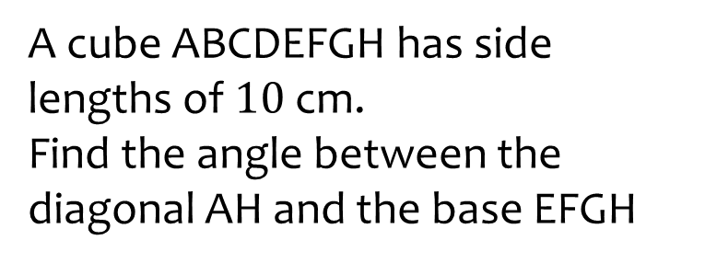
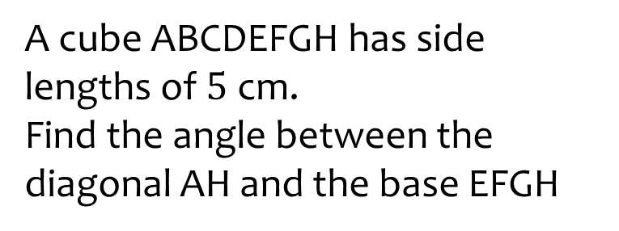

Worked example
Your turn
A cube ABCDEFGH has side lengths of $10$ cm.
Find the angle between the diagonal AH and the base EFGH
A cube ABCDEFGH has side lengths of $5$ cm.
Find the angle between the diagonal AH and the base EFGH
$35.26°$(2 dp)

Slide 16
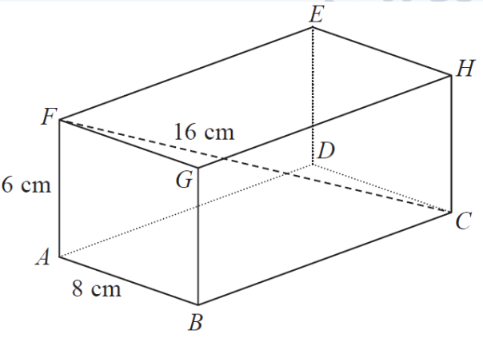
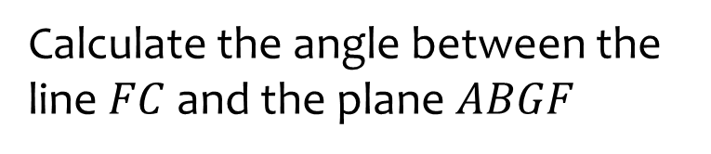
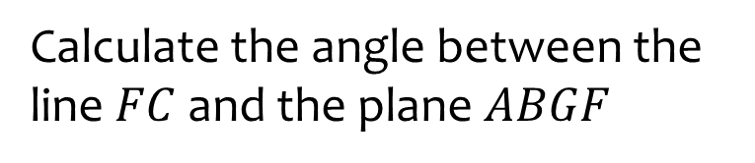




Worked example
Your turn
Calculate the angle between the line $FC$ and the plane $ABGF$
Calculate the angle between the line $FC$ and the plane $ABGF$
$$8 cm$$
$$3 cm$$
$$4 cm$$
$51.32°$(2 dp)

Slide 17
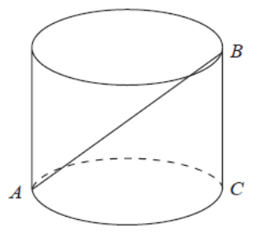
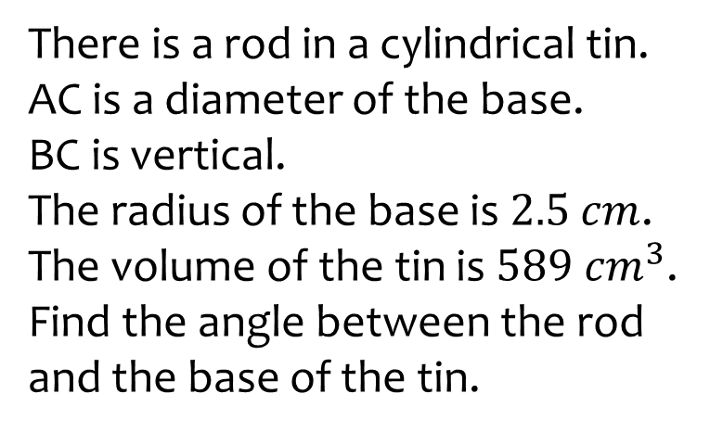
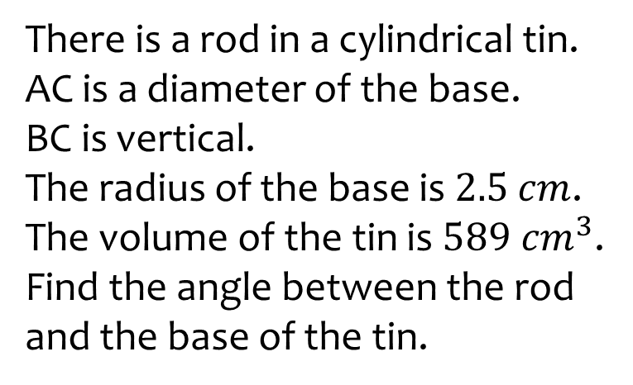

Worked example
Your turn
There is a rod in a cylindrical tin.
AC is a diameter of the base.
BC is vertical.
The radius of the base is $2.5$ $cm$.
The volume of the tin is $589 cm^{3}$.
Find the angle between the rod and the base of the tin.
There is a rod in a cylindrical tin.
AC is a diameter of the base.
BC is vertical.
The radius of the base is $2.5$ $cm$.
The volume of the tin is $589 cm^{3}$.
Find the angle between the rod and the base of the tin.
$$56°$$

