Slide 1
Proof
CONTENTS

Slide 2
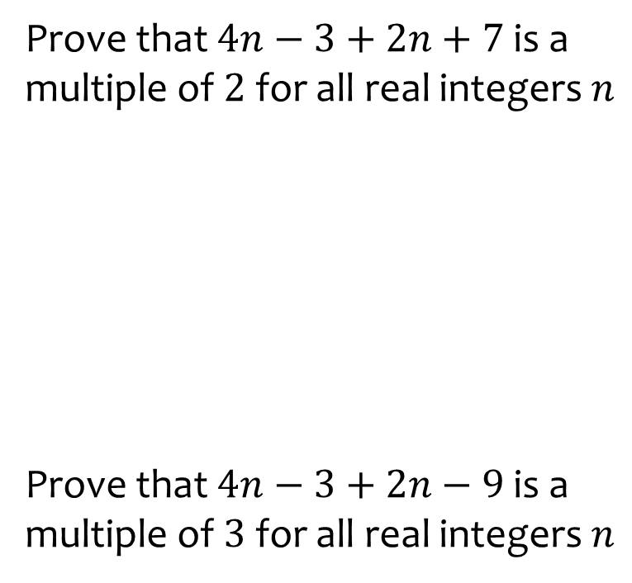
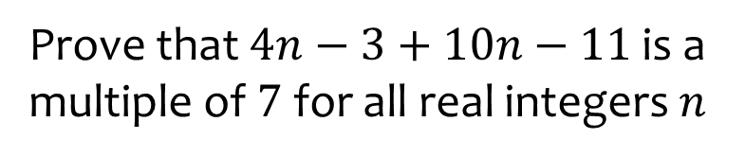

Worked example
Your turn
Prove that $4n−3+2n+7$ is a multiple of $2$ for all real integers $n$
Prove that $4n−3+2n−9$ is a multiple of $3$ for all real integers $n$
Prove that $4n−3+10n−11$ is a multiple of $7$ for all real integers $n$
$14n−14$
$$≡7\left(2n−2\right)$$
$$≡7k$$

Slide 3
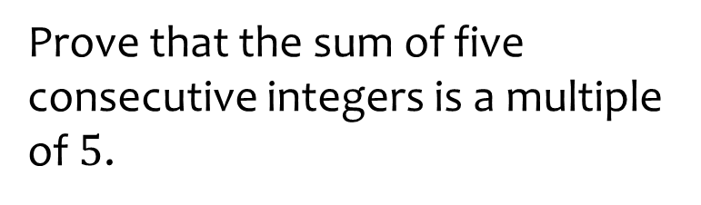
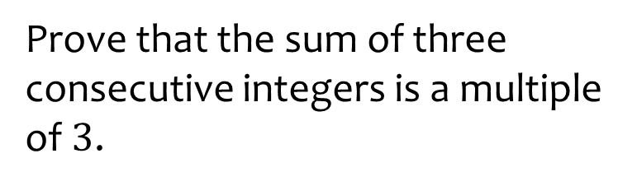
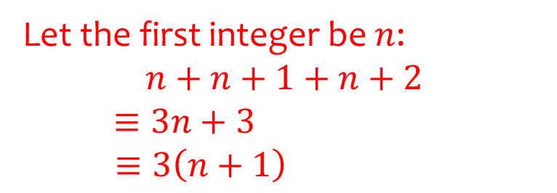
Worked example
Your turn
Prove that the sum of five consecutive integers is a multiple of $5$.
Prove that the sum of three consecutive integers is a multiple of $3$.
Let the first integer be $n$:
$$n+n+1+n+2$$
$≡3n+3$
$$≡3\left(n+1\right)$$

Slide 4
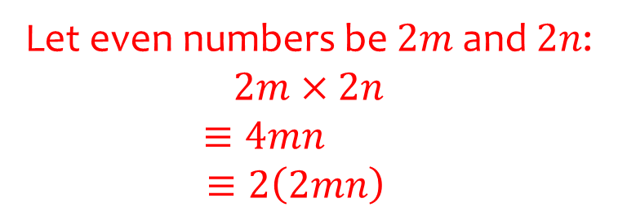
Worked example
Your turn
Prove that the product of two odd numbers is an odd number.
Prove that the product of two even numbers is an even number.
Let even numbers be $2m$ and $2n$: $2m×2n$
$$≡4mn$$
$$≡2\left(2mn\right)$$

Slide 5
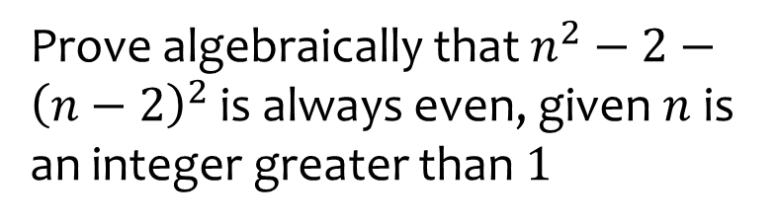
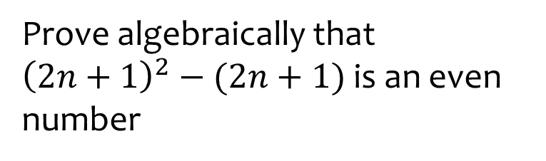
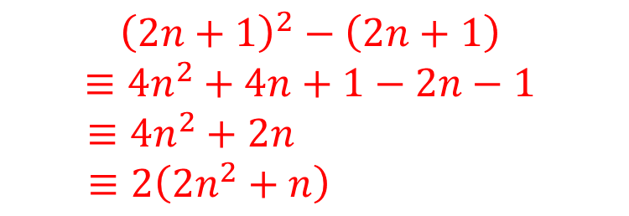
Worked example
Your turn
Prove algebraically that $n^{2}−2−{\left(n−2\right)}^{2}$ is always even, given $n$ is an integer greater than $1$
Prove algebraically that ${\left(2n+1\right)}^{2}−(2n+1)$ is an even number
$${\left(2n+1\right)}^{2}−\left(2n+1\right)$$
$$≡4n^{2}+4n+1−2n−1$$
$$≡4n^{2}+2n$$
$$≡2\left(2n^{2}+n\right)$$

Slide 6
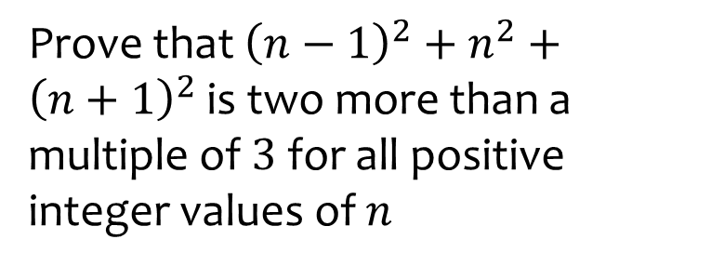
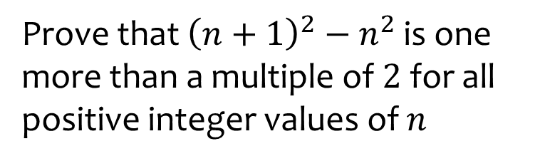
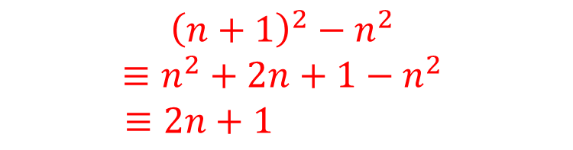
Worked example
Your turn
Prove that ${\left(n−1\right)}^{2}+n^{2}+{\left(n+1\right)}^{2}$ is two more than a multiple of $3$ for all positive integer values of $n$
Prove that ${\left(n+1\right)}^{2}−n^{2}$ is one more than a multiple of $2$ for all positive integer values of $n$
$${\left(n+1\right)}^{2}−n^{2}$$
$$≡n^{2}+2n+1−n^{2}$$
$$≡2n+1$$

Slide 7
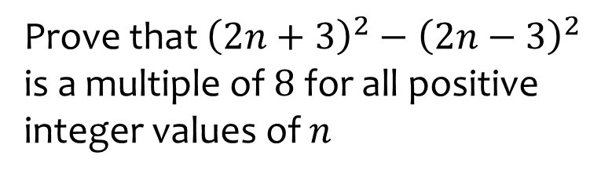
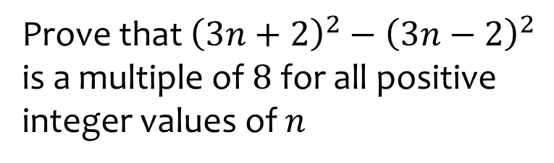
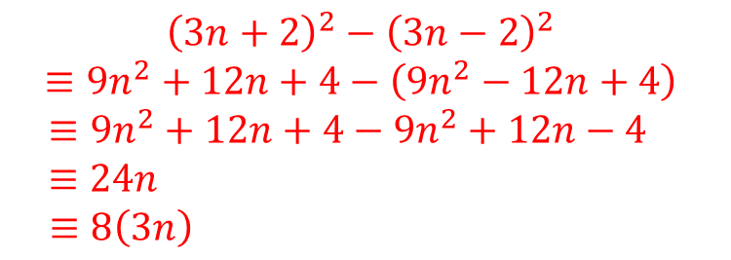
Worked example
Your turn
Prove that ${\left(2n+3\right)}^{2}−{\left(2n−3\right)}^{2}$ is a multiple of $8$ for all positive integer values of $n$
Prove that ${\left(3n+2\right)}^{2}−{\left(3n−2\right)}^{2}$ is a multiple of $8$ for all positive integer values of $n$
$${\left(3n+2\right)}^{2}−{\left(3n−2\right)}^{2}$$
$$≡9n^{2}+12n+4−\left(9n^{2}−12n+4\right)$$
$$≡9n^{2}+12n+4−9n^{2}+12n−4$$
$$≡24n$$
$$≡8\left(3n\right)$$

Slide 8

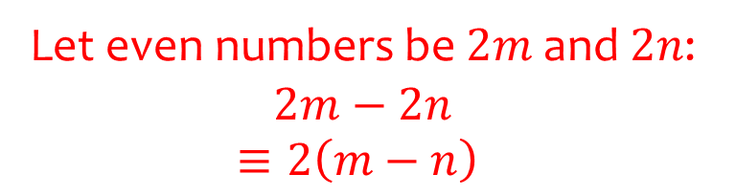
Worked example
Your turn
Prove algebraically that the difference between two different odd numbers is an even number.
Prove algebraically that the difference between two different even numbers is an even number.
Let even numbers be $2m$ and $2n$: $2m−2n$
$$≡2\left(m−n\right)$$

Slide 9
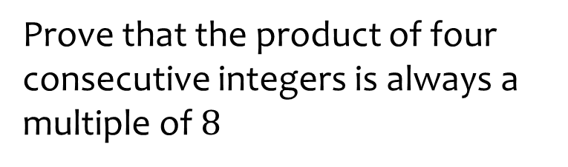
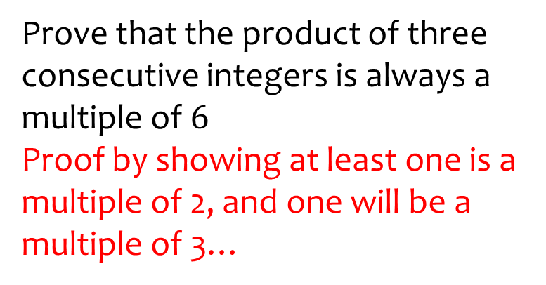
Worked example
Your turn
Prove that the product of four consecutive integers is always a multiple of $8$
Prove that the product of three consecutive integers is always a multiple of $6$
Proof by showing at least one is a multiple of 2, and one will be a multiple of 3…

Slide 10
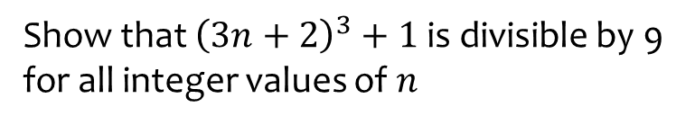
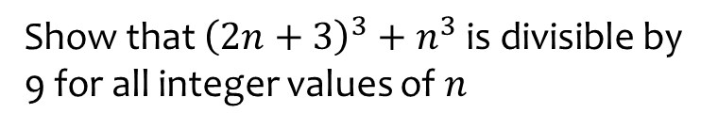
Worked example
Your turn
Show that ${\left(3n+2\right)}^{3}+1$ is divisible by 9 for all integer values of $n$
Show that ${\left(2n+3\right)}^{3}+n^{3}$ is divisible by 9 for all integer values of $n$
Proof

Slide 11
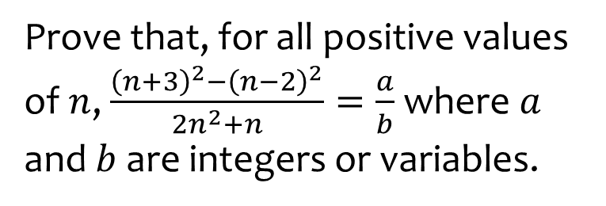
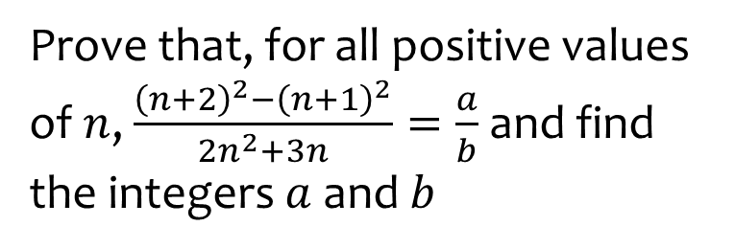

Worked example
Your turn
Prove that, for all positive values of $n$, $\frac{{\left(n+3\right)}^{2}−{\left(n−2\right)}^{2}}{2n^{2}+n}=\frac{a}{b}$ where $a$ and $b$ are integers or variables.
Prove that, for all positive values of $n$, $\frac{{\left(n+2\right)}^{2}−{\left(n+1\right)}^{2}}{2n^{2}+3n}=\frac{a}{b}$ and find the integers $a$ and $b$
$$a=1, b=n$$

