Slide 1
Product rule
CONTENTS

Slide 2
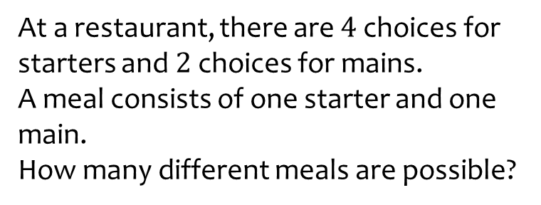
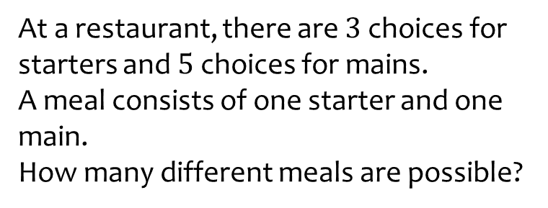
Worked example
Your turn
At a restaurant, there are $4$ choices for starters and $2$ choices for mains.
A meal consists of one starter and one main.
How many different meals are possible?
At a restaurant, there are $3$ choices for starters and $5$ choices for mains.
A meal consists of one starter and one main.
How many different meals are possible?
$$15$$

Slide 3
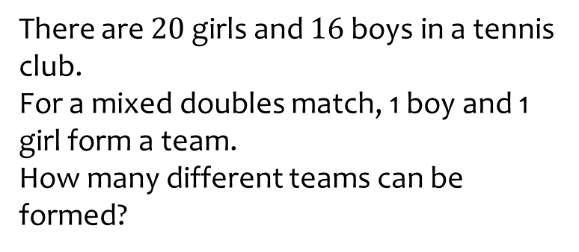
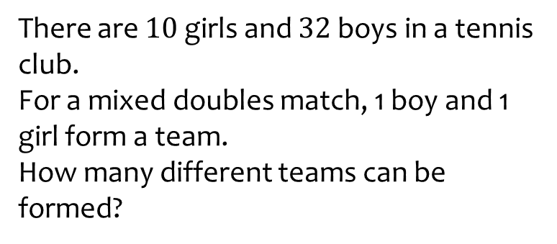
Worked example
Your turn
There are $20$ girls and $16$ boys in a tennis club.
For a mixed doubles match, 1 boy and 1 girl form a team.
How many different teams can be formed?
There are $10$ girls and $32$ boys in a tennis club.
For a mixed doubles match, 1 boy and 1 girl form a team.
How many different teams can be formed?
$$320$$

Slide 4
Worked example
Your turn
There are $24$ boys and $20$ girls in a class.
The teacher will pick three students from the class and write their names in a list in order.
The order will be either:
Boy, girl, boy
Girl, boy, girl
How many different lists can be written?
There are $12$ boys and $10$ girls in a class.
The teacher will pick three students from the class and write their names in a list in order.
The order will be either:
Boy, girl, boy
Girl, boy, girl
How many different lists can be written?
$$2400$$

Slide 5

Worked example
Your turn
Integers are made using some of the digits 0, 1, 2, 3, 4, 5
Each integer made:
Has 3 digits
Is greater than 2000
Has no digit repeated
Is a multiple of 2
How many integers can be made?
Integers are made using some of the digits 0, 1, 2, 3, 4, 5
Each integer made:
Has 4 digits
Is less than 3000
Has no digit repeated
Is a multiple of 5
How many integers can be made?
$$48$$

Slide 6
Worked example
Your turn
There are $34$ men in a group.
How many different pairs can be formed?
There are $17$ men in a group.
How many different pairs can be formed?
$$136$$

Slide 7
Worked example
Your turn
There are $59$ girls and $78$ boys in Year 13 at a school.
One girl is chosen for the role of Head Girl.
A different girl is chosen for the role of Deputy Head Girl.
One boy is chosen for the role of Head Boy.
A different boy is chosen for the role of Deputy Head boy.
How many different ways can this be done?
There are $95$ girls and $87$ boys in Year 13 at a school.
One girl is chosen for the role of Head Girl.
A different girl is chosen for the role of Deputy Head Girl.
One boy is chosen for the role of Head Boy.
A different boy is chosen for the role of Deputy Head boy.
How many different ways can this be done?
$$66814260$$

