Slide 1
Optimisation
CONTENTS

Slide 2
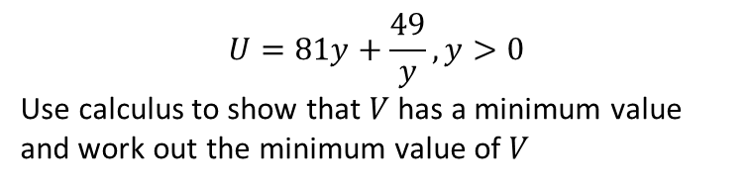
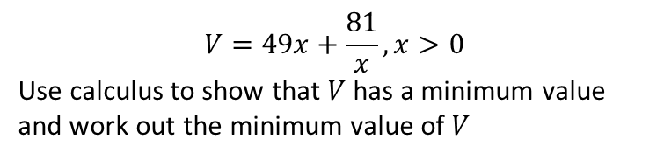
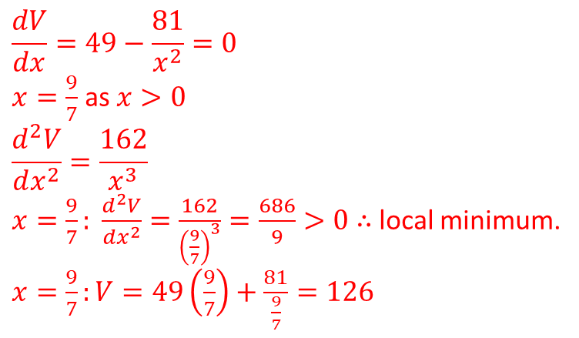
Worked example
Your turn
$$U=81y+\frac{49}{y}, y>0$$
Use calculus to show that $V$ has a minimum value and work out the minimum value of $V$
$$V=49x+\frac{81}{x}, x>0$$
Use calculus to show that $V$ has a minimum value and work out the minimum value of $V$
$$\frac{dV}{dx}=49−\frac{81}{x^{2}}=0$$
$x=\frac{9}{7}$ as $x>0$
$$\frac{d^{2}V}{dx^{2}}=\frac{162}{x^{3}}$$
$x=\frac{9}{7}: \frac{d^{2}V}{dx^{2}}=\frac{162}{{\left(\frac{9}{7}\right)}^{3}}=\frac{686}{9}>0$ $∴$ local minimum.
$x=\frac{9}{7}:V=49\left(\frac{9}{7}\right)+\frac{81}{\frac{9}{7}}=126$

Slide 3
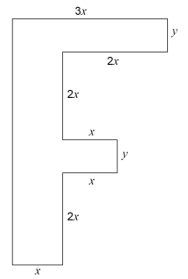
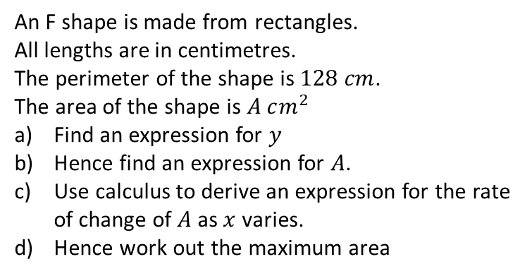
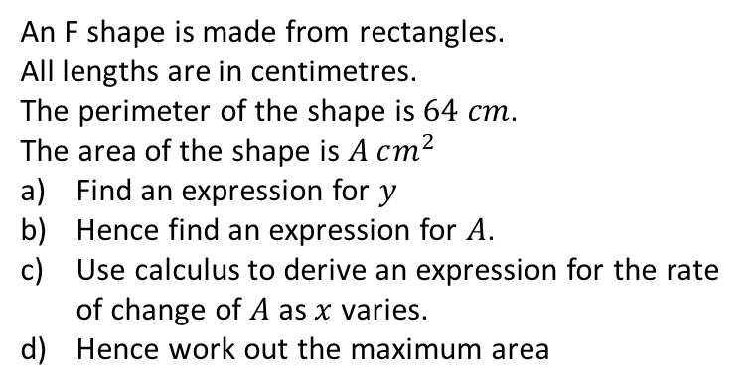
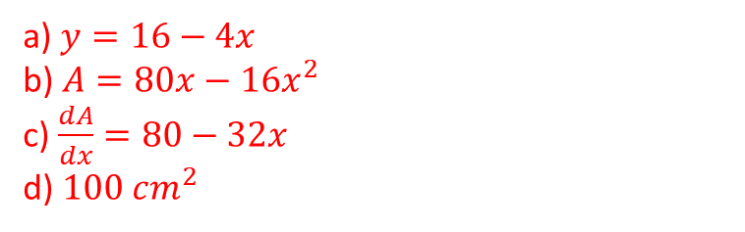
Worked example
Your turn
An F shape is made from rectangles.
All lengths are in centimetres.
The perimeter of the shape is $128 cm$.
The area of the shape is $A cm^{2}$
Find an expression for $y$
Hence find an expression for $A$.
Use calculus to derive an expression for the rate of change of $A$ as $x$ varies.
Hence work out the maximum area
An F shape is made from rectangles.
All lengths are in centimetres.
The perimeter of the shape is $64 cm$.
The area of the shape is $A cm^{2}$
Find an expression for $y$
Hence find an expression for $A$.
Use calculus to derive an expression for the rate of change of $A$ as $x$ varies.
Hence work out the maximum area
a) $y=16−4x$
b) $A=80x−16x^{2}$
c) $\frac{dA}{dx}=80−32x$
d) $100 cm^{2}$

Slide 4
Worked example
Your turn
A cuboid is to be made with volume $81 cm^{3}$.
The cuboid has a rectangular cross-section where the length of the rectangle is equal to twice its width, $x$ cm.
The volume of the cuboid is $81 cm^{3}$.
a) Show that the total length, $L$, of the twelve edges of the cuboid is given by $L=12x+\frac{162}{x^{2}}$
b) Given that $x$ can vary, use differentiation to find the maximum or minimum value of $L$
c) Justify that the value of $L$ you have found is a minimum
A cuboid is to be made from 54m² of sheet metal.
The cuboid has a horizontal base and no top.
The height of the cuboid is $x$ metres.
Two of the opposite vertical faces are squares.
a) Show that the volume, V m³, of the tank is given by
$V=18x−\frac{2}{3}x^{3}$.
b) Given that $x$ can vary, use differentiation to find the maximum or minimum value of $V$.
c) Justify that the value of $V$ you have found is a maximum
a) Shown
b) $V=36$
c) $\frac{d^{2}V}{dx^{2}}=−4x$ ; $x=3,\frac{d^{2}V}{dx^{2}}=−12<0$

