Slide 1
Multiplication of matrices (2 x 2)
CONTENTS

Slide 2



Worked example
Your turn
Find:
$$5\left(\begin{matrix}−1 & 2 \\ 3 & −4\end{matrix}\right)$$
Find:
$$4\left(\begin{matrix}3 & 4 \\ −2 & −5\end{matrix}\right)$$
$$\left(\begin{matrix}12 & 16 \\ −8 & −20\end{matrix}\right)$$

Slide 3



Worked example
Your turn
Find:
$$\left(\begin{matrix}−1 & 2 \\ 3 & −4\end{matrix}\right)\left(\begin{matrix}5 \\ −6\end{matrix}\right)$$
Find:
$\left(\begin{matrix}3 & 4 \\ −2 & −5\end{matrix}\right)$ $\left(\begin{matrix}5 \\ −6\end{matrix}\right)$
$$\left(\begin{matrix}−9 \\ 20\end{matrix}\right)$$

Slide 4
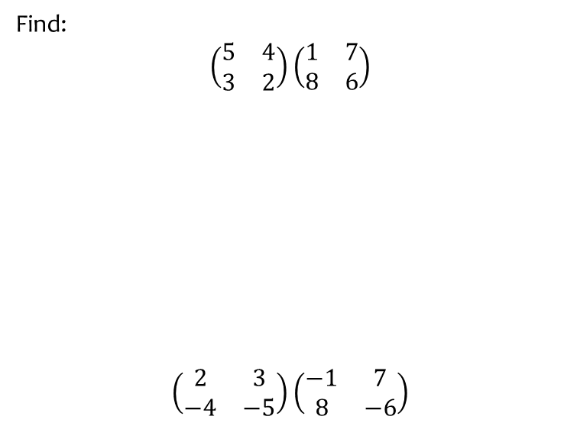


Worked example
Your turn
Find:
$$\left(\begin{matrix}5 & 4 \\ 3 & 2\end{matrix}\right)\left(\begin{matrix}1 & 7 \\ 8 & 6\end{matrix}\right)$$
$$\left(\begin{matrix}2 & 3 \\ −4 & −5\end{matrix}\right)\left(\begin{matrix}−1 & 7 \\ 8 & −6\end{matrix}\right)$$
Find:
$$\left(\begin{matrix}5 & −3 \\ −2 & −4\end{matrix}\right)\left(\begin{matrix}1 & 0 \\ −7 & 6\end{matrix}\right)$$
$$\left(\begin{matrix}26 & −18 \\ 26 & −24\end{matrix}\right)$$

Slide 5



Worked example
Your turn
Find:
$${\left(\begin{matrix}4 & 3 \\ 2 & 1\end{matrix}\right)}^{4}$$
Find:
$${\left(\begin{matrix}1 & 2 \\ 3 & 4\end{matrix}\right)}^{4}$$
$$\left(\begin{matrix}199 & 290 \\ 435 & 634\end{matrix}\right)$$

Slide 6


Worked example
Your turn
Find the value of $t$, given that
$$\left(\begin{matrix}−5 & 3 \\ 7 & −4\end{matrix}\right)\left(\begin{matrix}4 & t \\ 7 & 5\end{matrix}\right)=I$$
Find the value of $t$, given that
$$\left(\begin{matrix}−7 & 4 \\ 5 & −3\end{matrix}\right)\left(\begin{matrix}−3 & −4 \\ −5 & t\end{matrix}\right)=I$$
$$t=−7$$

Slide 7


Worked example
Your turn
$$2\left(\begin{matrix}5 & 0 \\ −3 & 1\end{matrix}\right)\left(\begin{matrix}3 \\ −4\end{matrix}\right)=\left(\begin{matrix}a \\ b\end{matrix}\right)$$
Find the values of $a$ and $b$
$$3\left(\begin{matrix}2 & 1 \\ −5 & 0\end{matrix}\right)\left(\begin{matrix}4 \\ −3\end{matrix}\right)=\left(\begin{matrix}a \\ b\end{matrix}\right)$$
Find the values of $a$ and $b$
$$a=15, b=−60$$

Slide 8


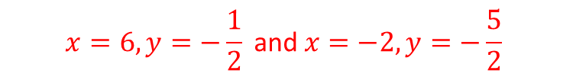
Worked example
Your turn
Work out all solutions for $x$ and $y$, given that
$$\left(\begin{matrix}x & 1 \\ −4 & y\end{matrix}\right)\left(\begin{matrix}x \\ −3\end{matrix}\right)=\left(\begin{matrix}2x \\ 9\end{matrix}\right)$$
Work out all solutions for $x$ and $y$, given that
$$\left(\begin{matrix}x & 3 \\ 1 & y\end{matrix}\right)\left(\begin{matrix}x \\ −4\end{matrix}\right)=\left(\begin{matrix}4x \\ 8\end{matrix}\right)$$
$$x=6, y=−\frac{1}{2} \text{and} x=−2, y=−\frac{5}{2}$$

Slide 9
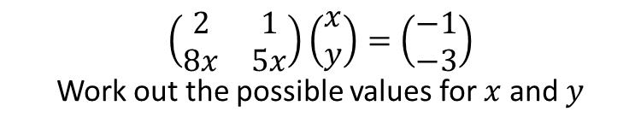
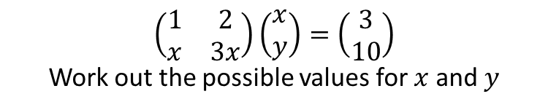

Worked example
Your turn
$$\left(\begin{matrix}2 & 1 \\ 8x & 5x\end{matrix}\right)\left(\begin{matrix}x \\ y\end{matrix}\right)=\left(\begin{matrix}−1 \\ −3\end{matrix}\right)$$
Work out the possible values for $x$ and $y$
$$\left(\begin{matrix}1 & 2 \\ x & 3x\end{matrix}\right)\left(\begin{matrix}x \\ y\end{matrix}\right)=\left(\begin{matrix}3 \\ 10\end{matrix}\right)$$
Work out the possible values for $x$ and $y$
$$x=4, y=−\frac{1}{2}$$
$$x=5, y=−1$$

Slide 10


Worked example
Your turn
$$M=\left(\begin{matrix}0 & 1 \\ −1 & −1\end{matrix}\right)$$
Show that $M^{3}=I$
$$M=\left(\begin{matrix}−2 & −1 \\ 3 & 1\end{matrix}\right)$$
Show that $M^{3}=I$
Shown

