Slide 1
Solving linear and quadratic inequalities
CONTENTS

Slide 2
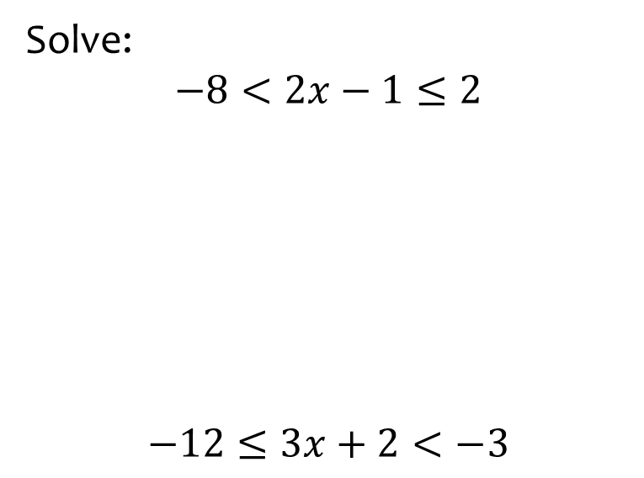


Worked example
Your turn
Solve:
$$−8<2x−1≤2$$
$$−12≤3x+2<−3$$
Solve:
$$−4<4x−3<20$$
$$−\frac{1}{4}<x<\frac{23}{4}$$

Slide 3
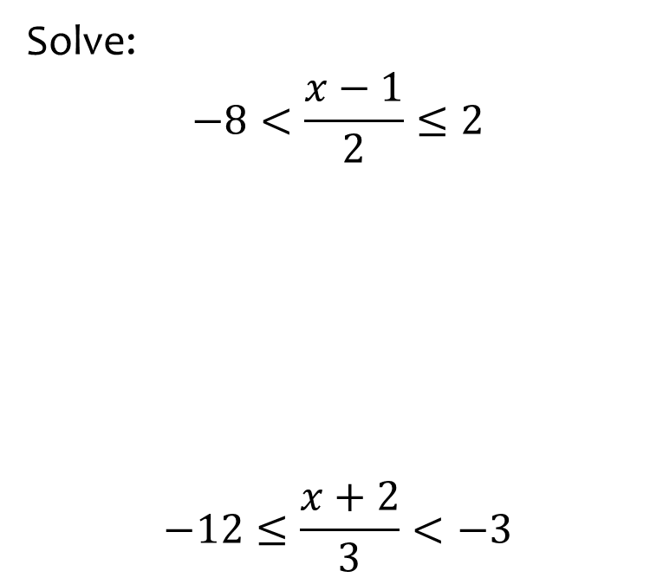
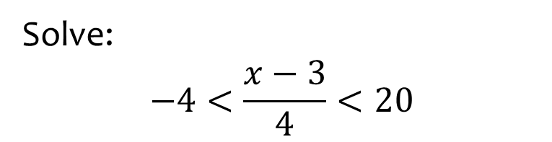

Worked example
Your turn
Solve:
$$−8<\frac{x−1}{2}≤2$$
$$−12≤\frac{x+2}{3}<−3$$
Solve:
$$−4<\frac{x−3}{4}<20$$
$$−13<x<83$$

Slide 4
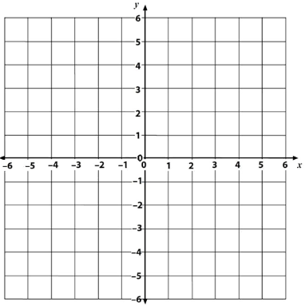
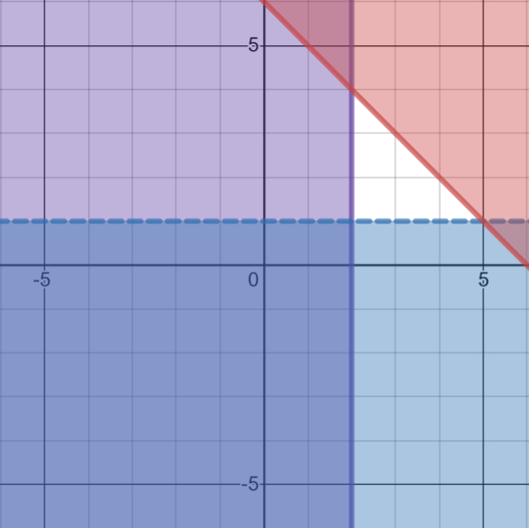
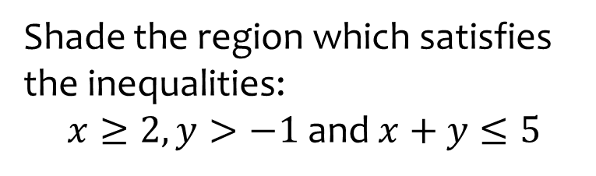
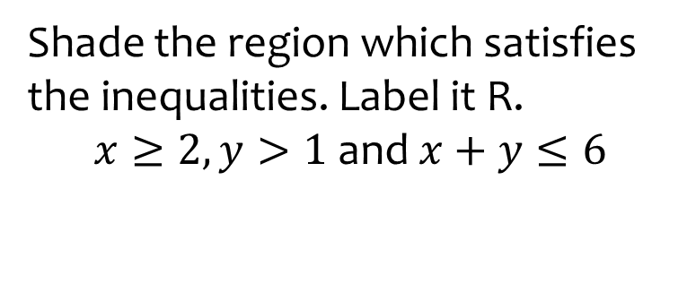

Worked example
Your turn
Shade the region which satisfies the inequalities:
$x≥2,y>−1$ and $x+y≤5$
Shade the region which satisfies the inequalities. Label it R.
$x≥2,y>1$ and $x+y≤6$
$$R$$
Graphs used with permission from DESMOS: https://www.desmos.com/

Slide 5
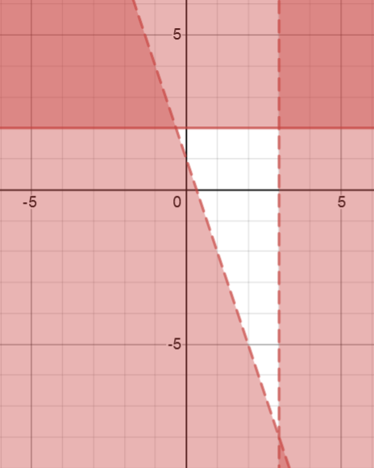
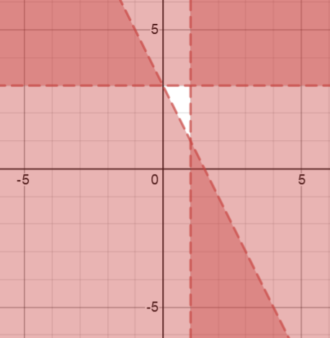

Worked example
Your turn
Write the inequalities that define the unshaded region:
Write the inequalities that define the unshaded region:
$$x<1$$
$$y<3$$
$$y>−2x+3$$
Graphs used with permission from DESMOS: https://www.desmos.com/

Slide 6
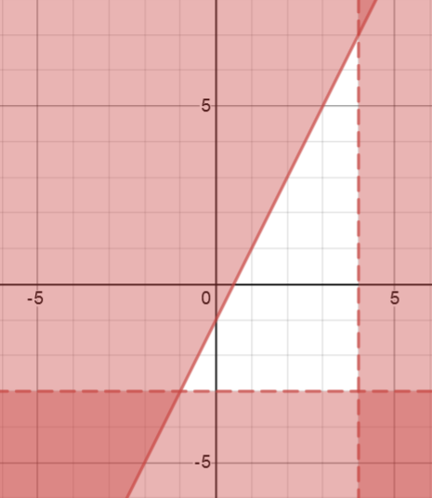
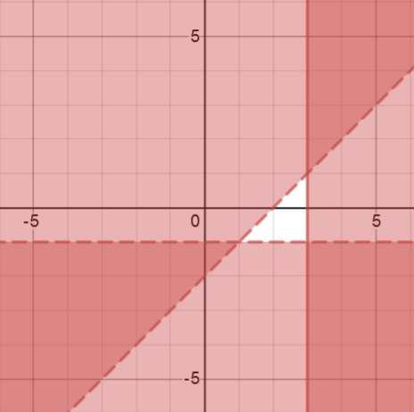

Worked example
Your turn
Write the inequalities that define the unshaded region:
Write the inequalities that define the unshaded region:
$$x≤3$$
$$y>−1$$
$$y<x−2$$
Graphs used with permission from DESMOS: https://www.desmos.com/

Slide 7
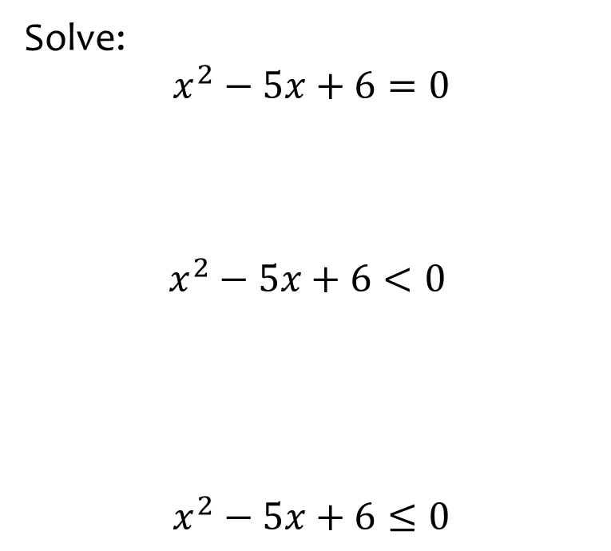


Worked example
Your turn
Solve:
$$x^{2}−5x+6=0$$
$$x^{2}−5x+6<0$$
$$x^{2}−5x+6≤0$$
Solve:
$$x^{2}−4x+3<0$$
$$1<x<3$$

Slide 8
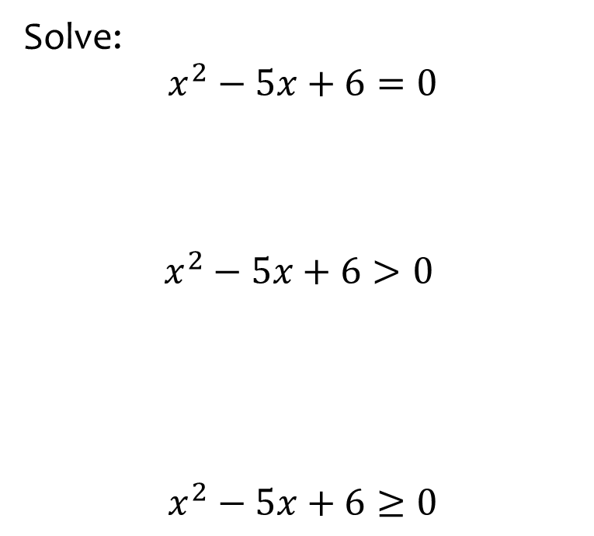


Worked example
Your turn
Solve:
$$x^{2}−5x+6=0$$
$$x^{2}−5x+6>0$$
$$x^{2}−5x+6≥0$$
Solve:
$$x^{2}−4x+3>0$$
$$x<1∪x>3$$

Slide 9
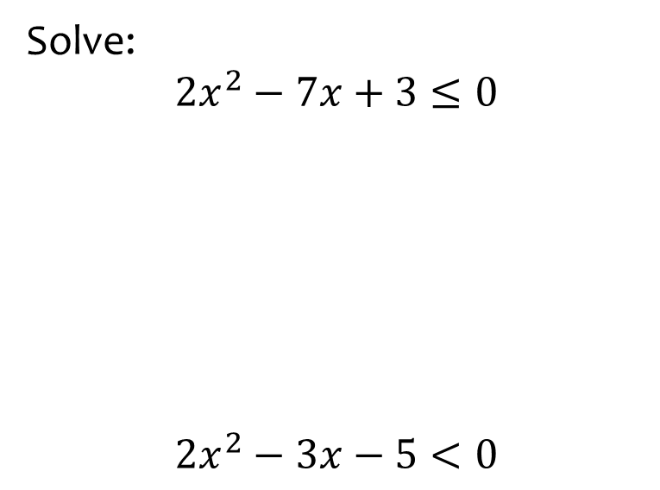


Worked example
Your turn
Solve:
$$2x^{2}−7x+3≤0$$
$$2x^{2}−3x−5<0$$
Solve:
$$2x^{2}−7x+6≤0$$
$$\frac{3}{2}≤x≤2$$

Slide 10
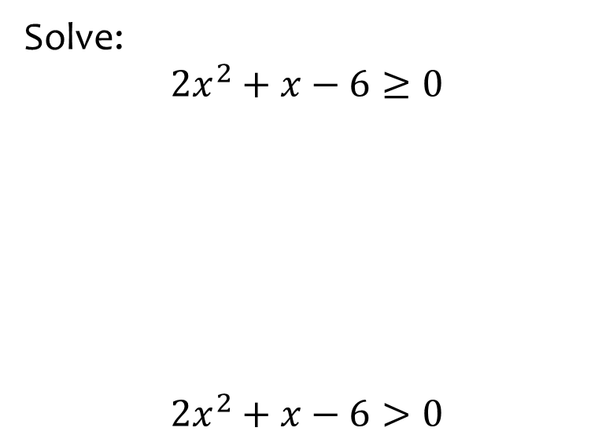


Worked example
Your turn
Solve:
$$2x^{2}+x−6≥0$$
$$2x^{2}+x−6>0$$
Solve:
$$3x^{2}+x−2≥0$$
$$x≤−1∪x≥\frac{2}{3}$$

Slide 11
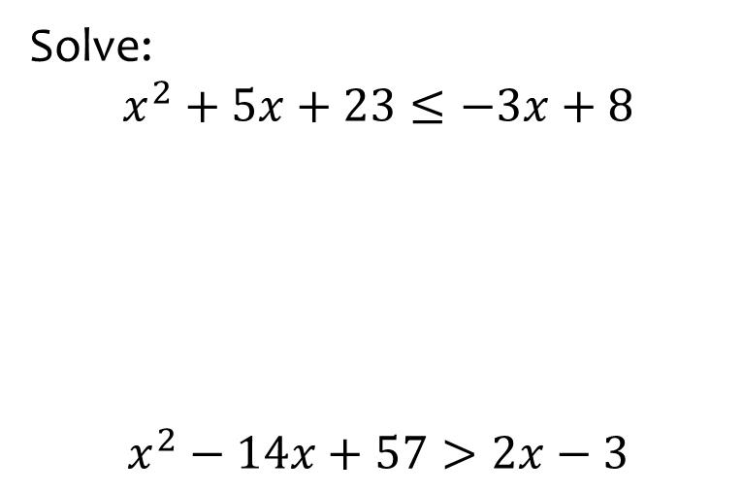
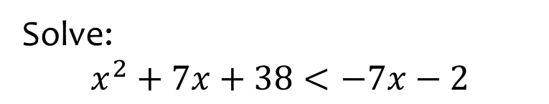

Worked example
Your turn
Solve:
$$x^{2}+5x+23≤−3x+8$$
$$x^{2}−14x+57>2x−3$$
Solve:
$$x^{2}+7x+38<−7x−2$$
$$−10<x<−4$$

Slide 12
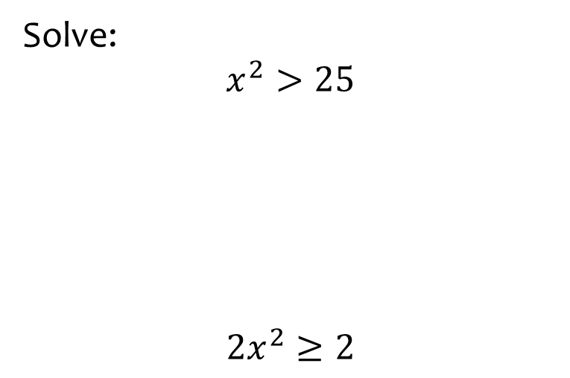


Worked example
Your turn
Solve:
$$x^{2}>25$$
$${2x}^{2}≥2$$
Solve:
$$x^{2}>36$$
$$x<−6∪x>6$$

Slide 13



Worked example
Your turn
Solve:
$$44<5x^{2}−1<79$$
Solve:
$$76<3x^{2}+1<148$$
$$−7<x<−5∪5<x<7$$

