Slide 1
Indices
CONTENTS

Slide 2
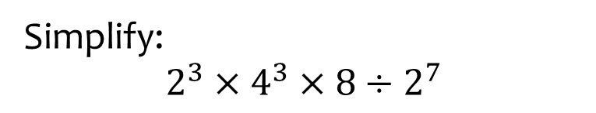
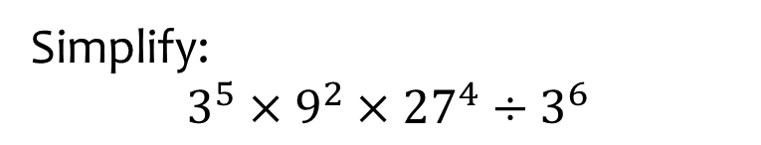

Worked example
Your turn
Simplify:
$$2^{3}×4^{3}×8÷2^{7}$$
Simplify:
$$3^{5}×9^{2}×{27}^{4}÷3^{6}$$
$$3^{15}$$

Slide 3
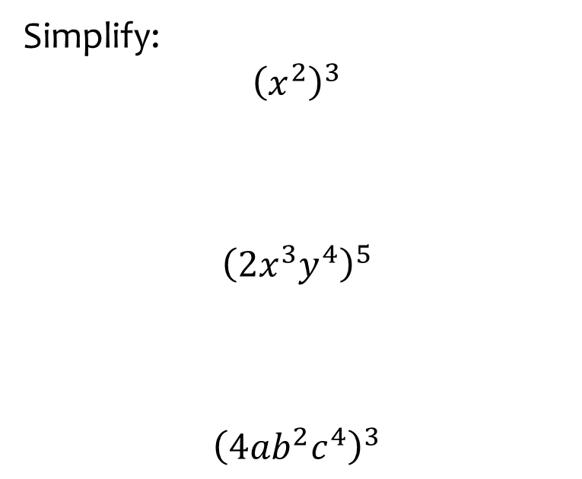
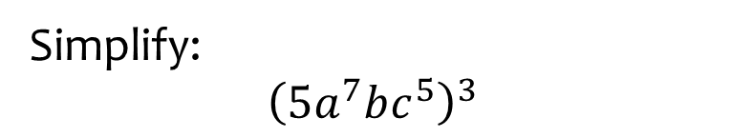

Worked example
Your turn
Simplify:
$${\left(x^{2}\right)}^{3}$$
$${\left(2x^{3}y^{4}\right)}^{5}$$
$${\left(4ab^{2}c^{4}\right)}^{3}$$
Simplify:
$${\left(5a^{7}bc^{5}\right)}^{3}$$
$$125a^{21}b^{3}c^{15}$$

Slide 4
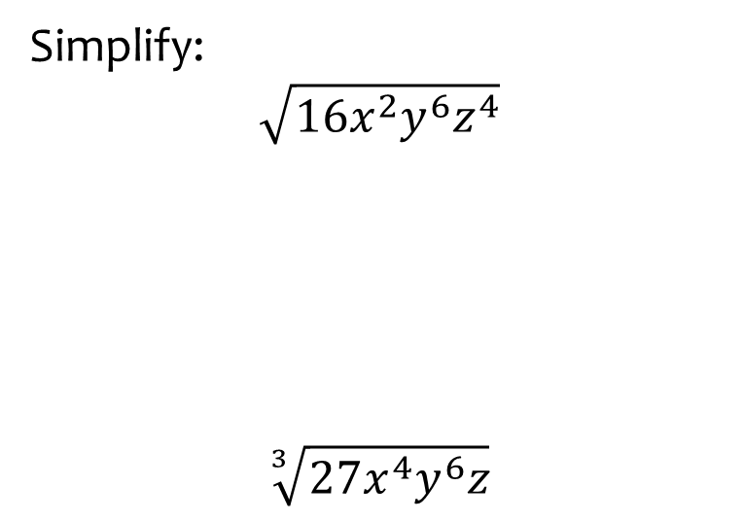
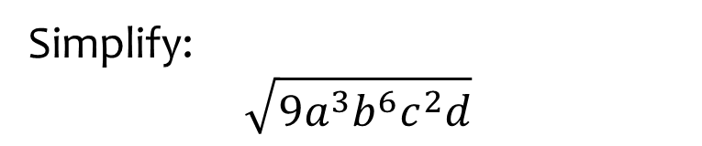

Worked example
Your turn
Simplify:
$$\sqrt{16x^{2}y^{6}z^{4}}$$
$$\sqrt[3]{27x^{4}y^{6}z}$$
Simplify:
$$\sqrt{9a^{3}b^{6}c^{2}d}$$
$$3a^{\frac{3}{2}}b^{3}cd^{\frac{1}{2}}$$

Slide 5
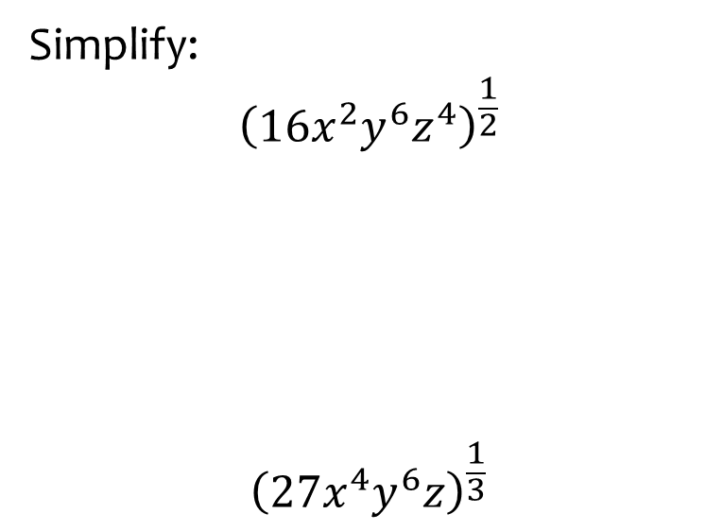
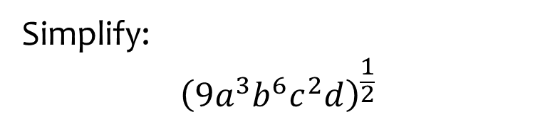
Worked example
Your turn
Simplify:
$${\left(16x^{2}y^{6}z^{4}\right)}^{\frac{1}{2}}$$
$${\left(27x^{4}y^{6}z\right)}^{\frac{1}{3}}$$
Simplify:
$${\left(9a^{3}b^{6}c^{2}d\right)}^{\frac{1}{2}}$$
$$3a^{\frac{3}{2}}b^{3}cd^{\frac{1}{2}}$$

Slide 6
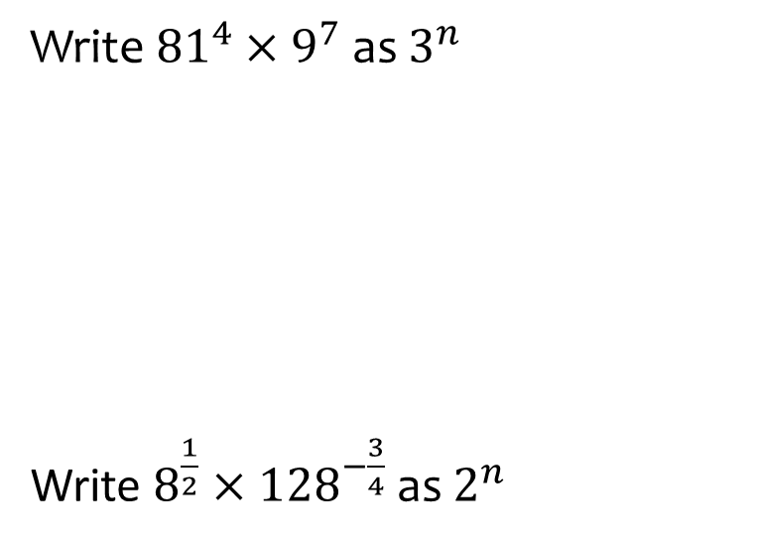


Worked example
Your turn
Write ${81}^{4}×9^{7}$ as $3^{n}$
Write $8^{\frac{1}{2}}×{128}^{−\frac{3}{4}}$ as $2^{n}$
Write ${25}^{\frac{1}{3}}×{125}^{−\frac{2}{5}}$ as $5^{n}$
$$5^{−\frac{8}{15}}$$

Slide 7
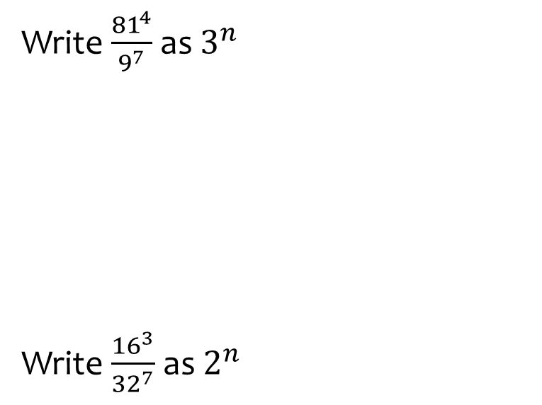


Worked example
Your turn
Write $\frac{{81}^{4}}{9^{7}}$ as $3^{n}$
Write $\frac{{16}^{3}}{{32}^{7}}$ as $2^{n}$
Write $\frac{{25}^{4}}{{125}^{6}}$ as $5^{n}$
$$5^{−10}$$

Slide 8
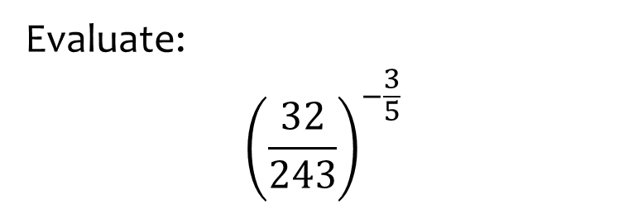
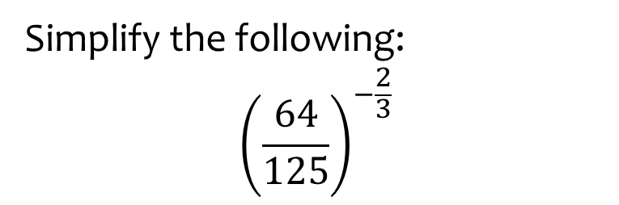

Worked example
Your turn
Evaluate:
$${\left(\frac{32}{243}\right)}^{−\frac{3}{5}}$$
Simplify the following:
$${\left(\frac{64}{125}\right)}^{−\frac{2}{3}}$$
$$\frac{25}{16}$$

Slide 9
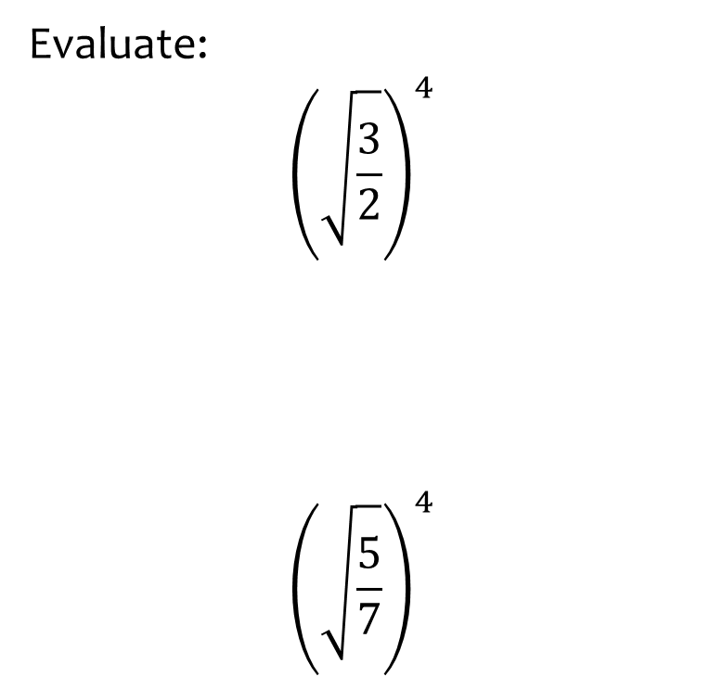
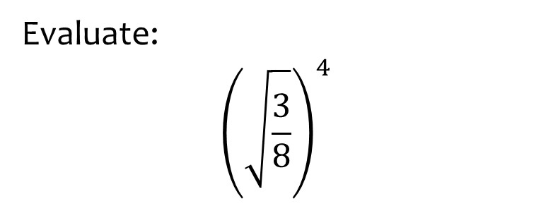

Worked example
Your turn
Evaluate:
$${\left(\sqrt{\frac{3}{2}}\right)}^{4}$$
$${\left(\sqrt{\frac{5}{7}}\right)}^{4}$$
Evaluate:
$${\left(\sqrt{\frac{3}{8}}\right)}^{4}$$
$$\frac{9}{64}$$

Slide 10
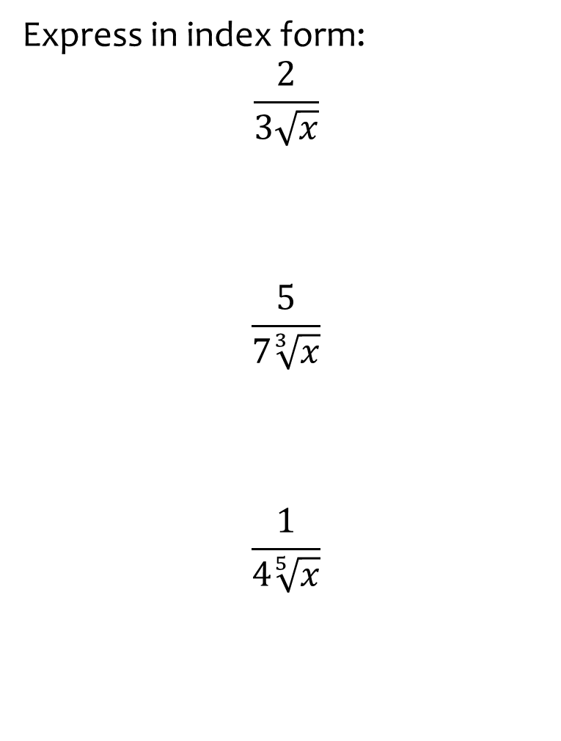
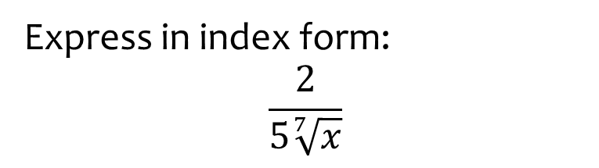

Worked example
Your turn
Express in index form:
$$\frac{2}{3\sqrt{x}}$$
$$\frac{5}{7\sqrt[3]{x}}$$
$$\frac{1}{4\sqrt[5]{x}}$$
Express in index form:
$$\frac{2}{5\sqrt[7]{x}}$$
$$\frac{2}{5}x^{−\frac{1}{7}}$$

Slide 11
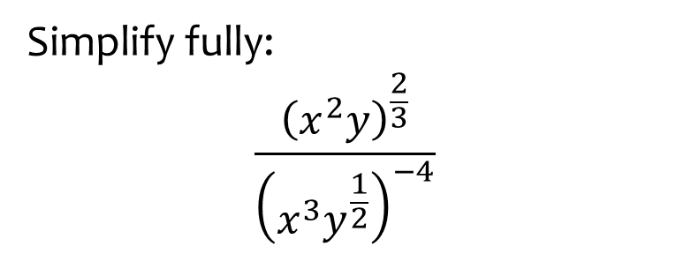
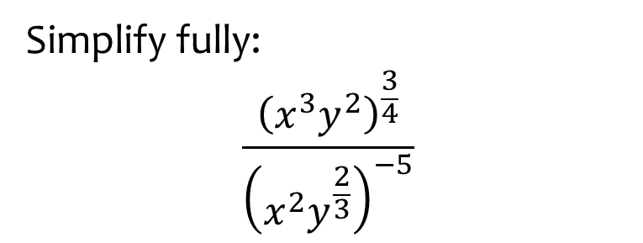

Worked example
Your turn
Simplify fully:
$$\frac{{\left(x^{2}y\right)}^{\frac{2}{3}}}{{\left(x^{3}y^{\frac{1}{2}}\right)}^{−4}}$$
Simplify fully:
$$\frac{{\left(x^{3}y^{2}\right)}^{\frac{3}{4}}}{{\left(x^{2}y^{\frac{2}{3}}\right)}^{−5}}$$
$$x^{\frac{49}{4}}y^{\frac{29}{6}}$$

Slide 12
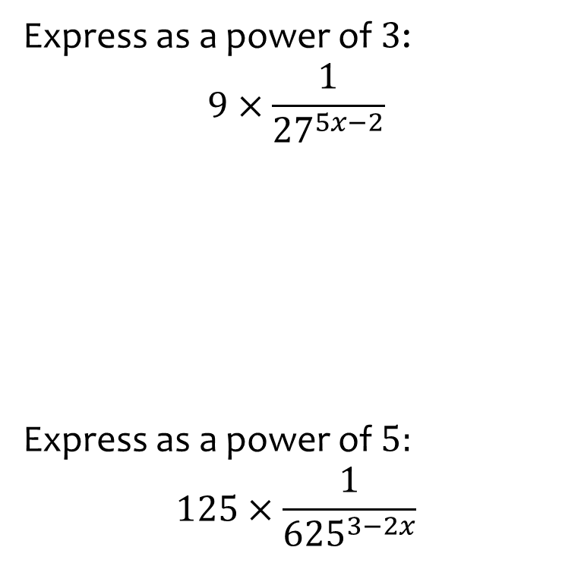
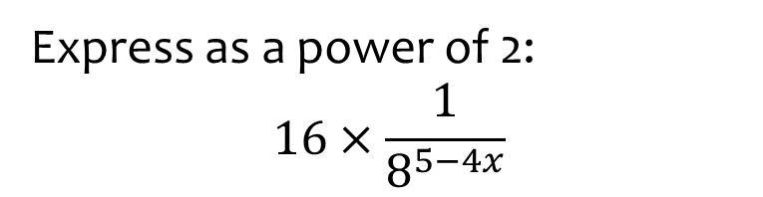

Worked example
Your turn
Express as a power of $3$:
$$9×\frac{1}{{27}^{5x−2}}$$
Express as a power of $5:$
$$125×\frac{1}{{625}^{3−2x}}$$
Express as a power of 2:
$$16×\frac{1}{8^{5−4x}}$$
$$2^{12x−11}$$

Slide 13
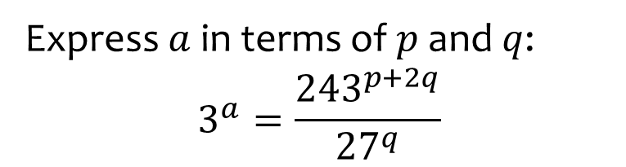
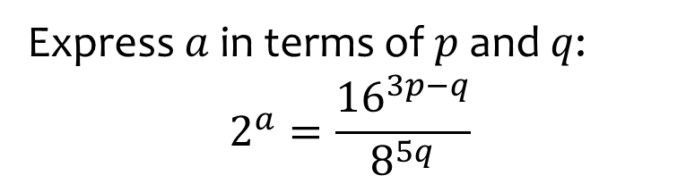

Worked example
Your turn
Express $a$ in terms of $p$ and $q$:
$$3^{a}=\frac{{243}^{p+2q}}{{27}^{q}}$$
Express $a$ in terms of $p$ and $q$:
$$2^{a}=\frac{{16}^{3p−q}}{8^{5q}}$$
$$a=12p−19q$$

Slide 14
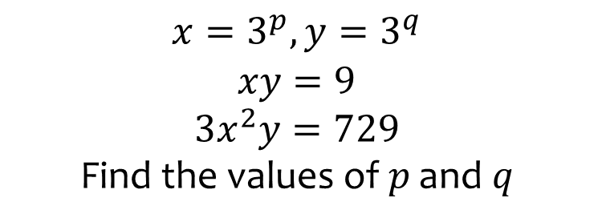
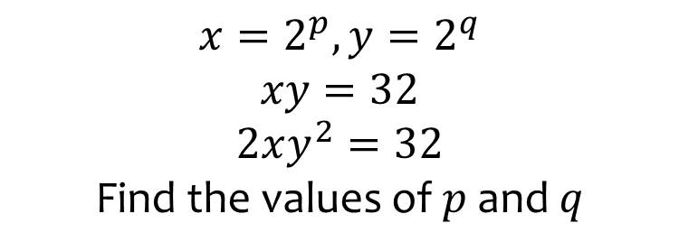

Worked example
Your turn
$$x=3^{p}, y=3^{q}$$
$$xy=9$$
$$3x^{2}y=729$$
$$\text{Find} \text{the} \text{values} \text{of} p \text{and} q$$
$$x=2^{p}, y=2^{q}$$
$$xy=32$$
$$2xy^{2}=32$$
Find the values of $p$ and $q$
$$p=6, q=−1$$

Slide 15
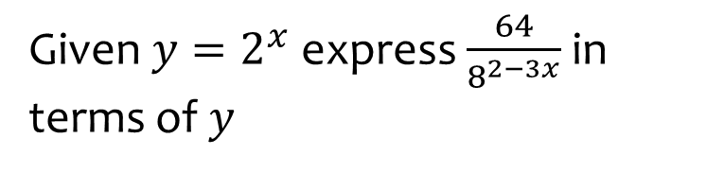
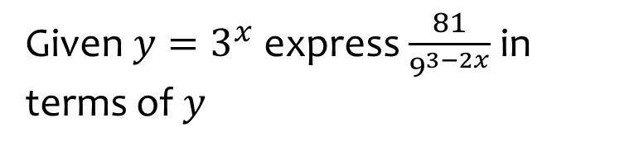

Worked example
Your turn
Given $y=2^{x}$ express $\frac{64}{8^{2−3x}}$ in terms of $y$
Given $y=3^{x}$ express $\frac{81}{9^{3−2x}}$ in terms of $y$
$$\frac{y^{4}}{9}$$

Slide 16
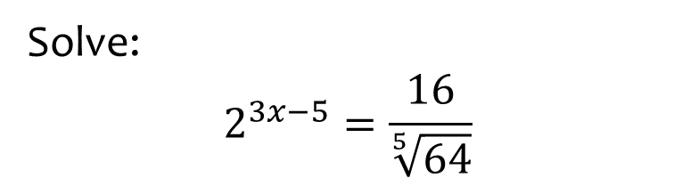
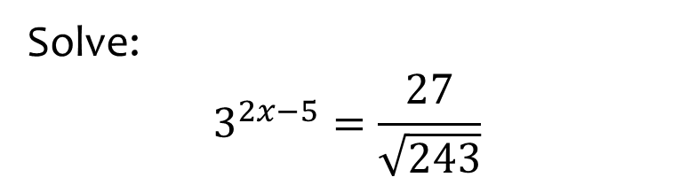

Worked example
Your turn
Solve:
$$2^{3x−5}=\frac{16}{\sqrt[5]{64}}$$
Solve:
$$3^{2x−5}=\frac{27}{\sqrt{243}}$$
$$x=\frac{11}{4}$$

Slide 17
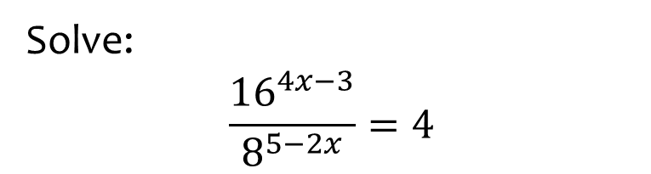
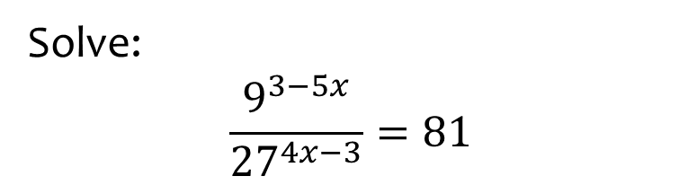

Worked example
Your turn
Solve:
$$\frac{{16}^{4x−3}}{8^{5−2x}}=4$$
Solve:
$$\frac{9^{3−5x}}{{27}^{4x−3}}=81$$
$$x=\frac{1}{2}$$

Slide 18
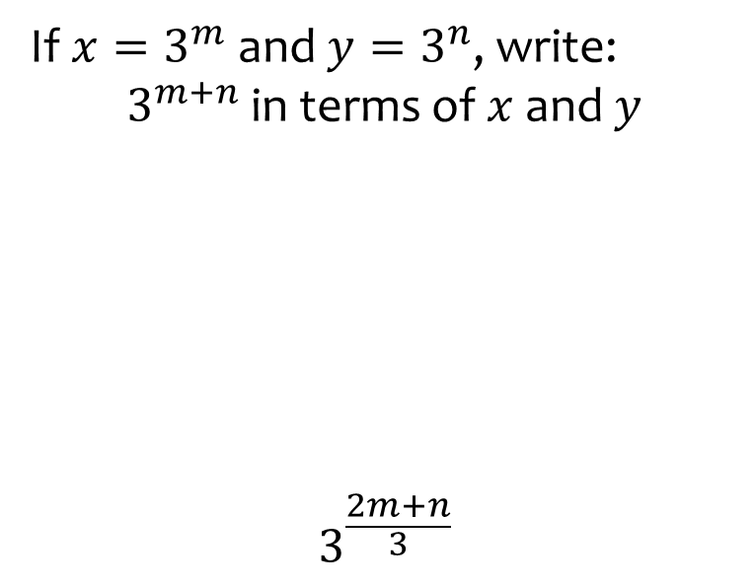
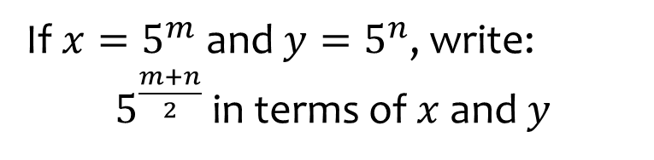

Worked example
Your turn
If $x=3^{m}$ and $y=3^{n}$, write:
$3^{m+n}$ in terms of $x$ and $y$
$$3^{\frac{2m+n}{3}}$$
If $x=5^{m}$ and $y=5^{n}$, write:
$5^{\frac{m+n}{2}}$ in terms of $x$ and $y$
$$x^{\frac{1}{2}}y^{\frac{1}{2}}$$

Slide 19
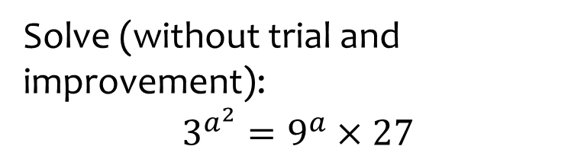
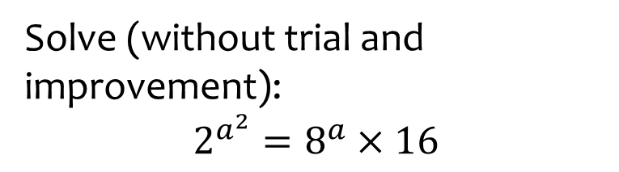

Worked example
Your turn
Solve (without trial and improvement):
$$3^{a^{2}}=9^{a}×27$$
Solve (without trial and improvement):
$$2^{a^{2}}=8^{a}×16$$
$a=−1$ or $a=4$

Slide 20
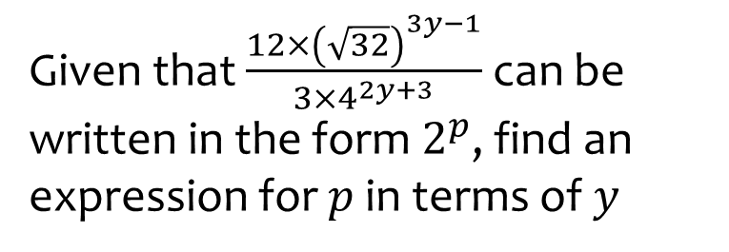
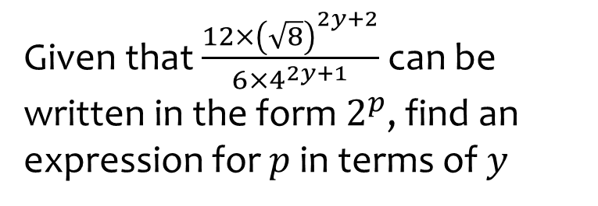

Worked example
Your turn
Given that $\frac{12×{\left(\sqrt{32}\right)}^{3y−1}}{3×4^{2y+3}}$ can be written in the form $2^{p}$, find an expression for $p$ in terms of $y$
Given that $\frac{12×{\left(\sqrt{8}\right)}^{2y+2}}{6×4^{2y+1}}$ can be written in the form $2^{p}$, find an expression for $p$ in terms of $y$
$$p=2−y$$

Slide 21
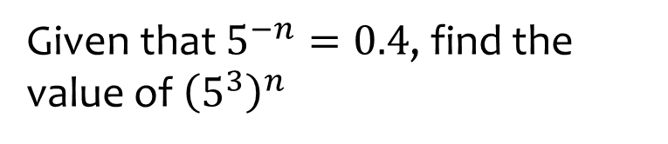
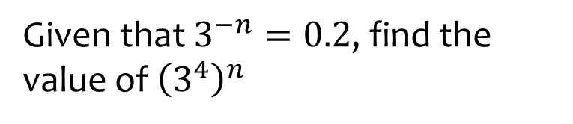

Worked example
Your turn
Given that $5^{−n}=0.4$, find the value of ${\left(5^{3}\right)}^{n}$
Given that $3^{−n}=0.2$, find the value of ${\left(3^{4}\right)}^{n}$
$$625$$

Slide 22
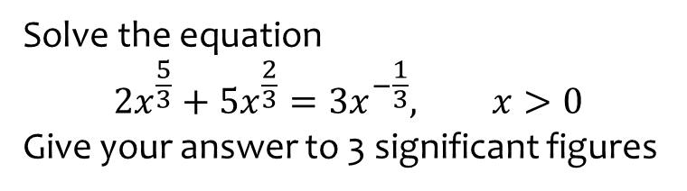
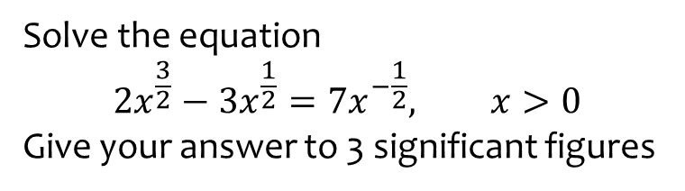

Worked example
Your turn
Solve the equation
$$2x^{\frac{5}{3}}+5x^{\frac{2}{3}}=3x^{−\frac{1}{3}}, x>0$$
Give your answer to 3 significant figures
Solve the equation
$$2x^{\frac{3}{2}}−3x^{\frac{1}{2}}=7x^{−\frac{1}{2}}, x>0$$
Give your answer to 3 significant figures
$$x=2.77$$

Slide 23



Worked example
Your turn
Work out the value of $p$ when
$${25}^{0.25q}×625={125}^{3q+1}$$
Work out the value of $p$ when
$$9^{0.5p}×81={27}^{2p−1}$$
$$p=\frac{7}{5}$$

