Slide 1
Increasing/decreasing functions
CONTENTS

Slide 2
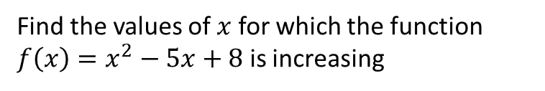
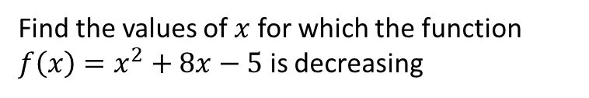
Worked example
Your turn
Find the values of $x$ for which the function $f\left(x\right)=x^{2}−5x+8$ is increasing
Find the values of $x$ for which the function $f\left(x\right)=x^{2}+8x−5$ is decreasing
$$x<−4$$

Slide 3
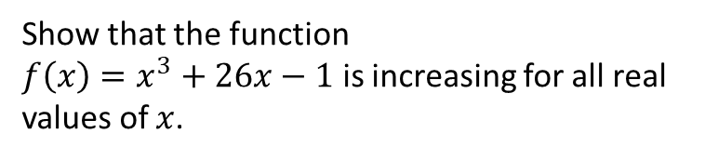
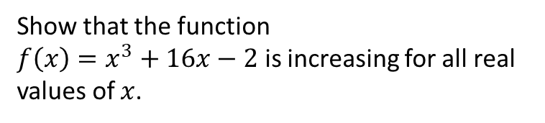
Worked example
Your turn
Show that the function
$f\left(x\right)=x^{3}+26x−1$ is increasing for all real values of $x$.
Show that the function
$f\left(x\right)=x^{3}+16x−2$ is increasing for all real values of $x$.
Shown

Slide 4
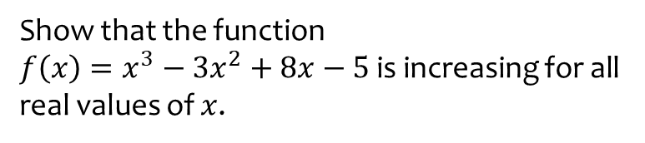
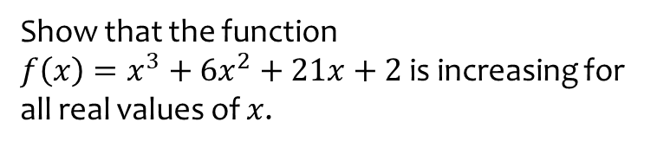
Worked example
Your turn
Show that the function
$f\left(x\right)=x^{3}−3x^{2}+8x−5$ is increasing for all real values of $x$.
Show that the function
$f\left(x\right)=x^{3}+6x^{2}+21x+2$ is increasing for all real values of $x$.
Shown

Slide 5
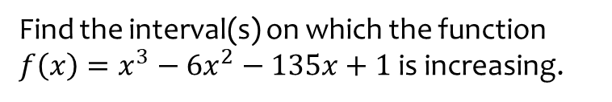
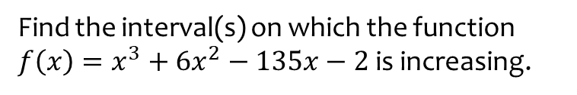

Worked example
Your turn
Find the interval(s) on which the function
$f\left(x\right)=x^{3}−6x^{2}−135x+1$ is increasing.
Find the interval(s) on which the function
$f\left(x\right)=x^{3}+6x^{2}−135x−2$ is increasing.
$x≤−9$ and $x≥5$

Slide 6
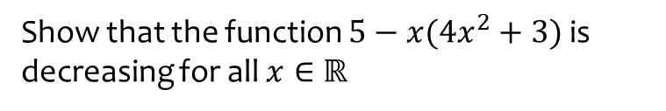
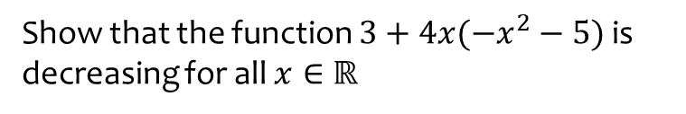
Worked example
Your turn
Show that the function $5−x(4x^{2}+3)$ is decreasing for all $x∈ℝ$
Show that the function $3+4x(−x^{2}−5)$ is decreasing for all $x∈ℝ$
Shown

Slide 7
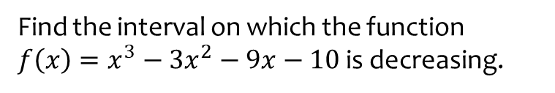
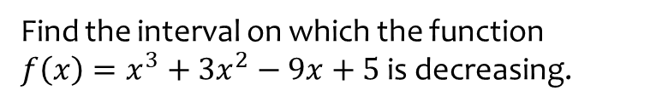

Worked example
Your turn
Find the interval on which the function
$f\left(x\right)=x^{3}−3x^{2}−9x−10$ is decreasing.
Find the interval on which the function
$f\left(x\right)=x^{3}+3x^{2}−9x+5$ is decreasing.
$$[−3, 1]$$

