Slide 1
Graph sketching
CONTENTS

Slide 2
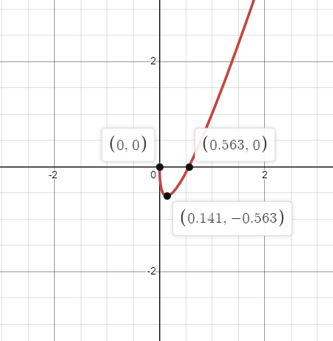
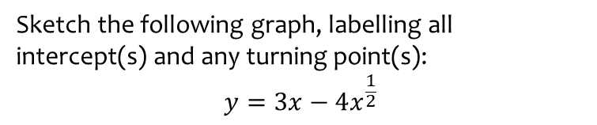
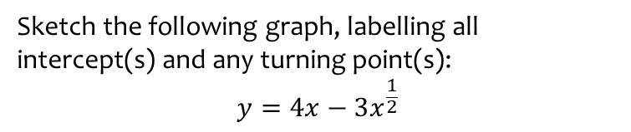
Worked example
Your turn
Sketch the following graph, labelling all intercept(s) and any turning point(s):
$$y=3x−4x^{\frac{1}{2}}$$
Sketch the following graph, labelling all intercept(s) and any turning point(s):
$$y=4x−3x^{\frac{1}{2}}$$
Graph used with permission from DESMOS: https://www.desmos.com/

Slide 3
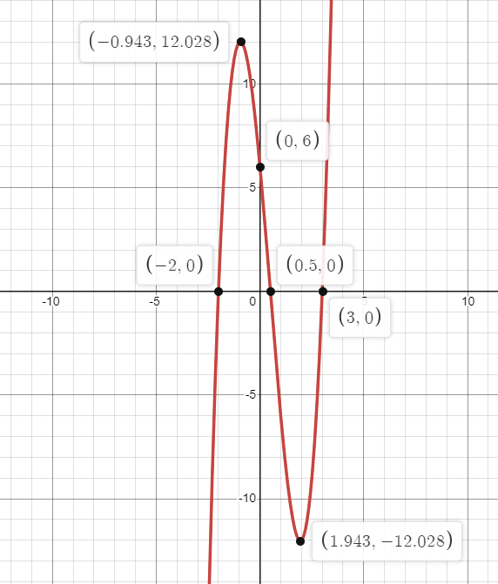

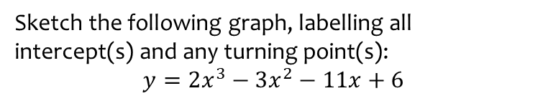
Worked example
Your turn
Sketch the following graph, labelling all intercept(s) and any turning point(s):
$$y=2x^{3}−3x^{2}−11x+6$$
Sketch the following graph, labelling all intercept(s) and any turning point(s):
$$y=2x^{3}−3x^{2}−11x+6$$
Graph used with permission from DESMOS: https://www.desmos.com/

Slide 4
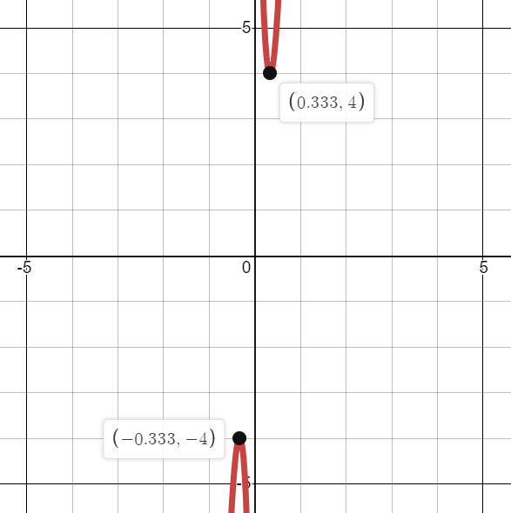
Worked example
Your turn
Sketch the graph of $y=\frac{1}{x}+\frac{256}{3}x^{3}$ labelling the stationary points.
Sketch the graph of $y=\frac{1}{x}+27x^{3}$ labelling the stationary points.
Graph used with permission from DESMOS: https://www.desmos.com/

