Slide 1
Functions: Domain, Range, composite, inverse
CONTENTS

Slide 2



Worked example
Your turn
$$f\left(x\right)=\frac{x−3}{5x−6}$$
State the value of $x$ that cannot be in the domain of $f(x)$
$$f\left(x\right)=\frac{3−x}{6x−5}$$
State the value of $x$ that cannot be in the domain of $f(x)$
$$x=\frac{5}{6}$$

Slide 3
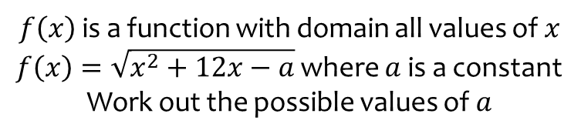
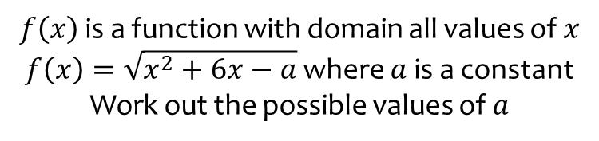

Worked example
Your turn
$f\left(x\right)$ is a function with domain all values of $x$
$f\left(x\right)=\sqrt{x^{2}+12x−a}$ where $a$ is a constant
Work out the possible values of $a$
$f\left(x\right)$ is a function with domain all values of $x$
$f\left(x\right)=\sqrt{x^{2}+6x−a}$ where $a$ is a constant
Work out the possible values of $a$
$a≤−9$ or

Slide 4
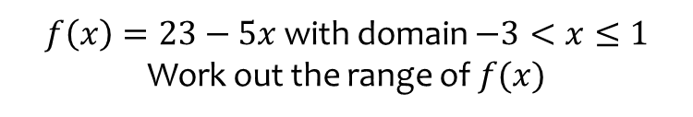
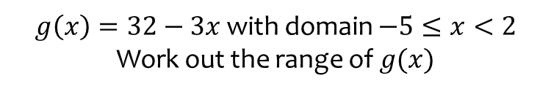
Worked example
Your turn
$f\left(x\right)=23−5x$ with domain $−3<x≤1$
Work out the range of $f(x)$
$g\left(x\right)=32−3x$ with domain $−5≤x<2$
Work out the range of $g(x)$
$$27<g\left(x\right)≤47$$

Slide 5



Worked example
Your turn
$g\left(x\right)=x^{2}−6x+5$, $x∈ℝ$
Determine the range of $g(x)$
$$f\left(x\right)=x^{2}−4x+7\text{, }x∈ℝ$$
Determine the range of $f(x)$
$$f\left(x\right)≥3$$

Slide 6



Worked example
Your turn
$g\left(x\right)=14+2x−x^{2}$, $x∈ℝ$
Determine the range of $g(x)$.
$f\left(x\right)=21+4x−x^{2}$, $x∈ℝ$
Determine the range of $f(x)$.
$$f\left(x\right)≤25$$

Slide 7



Worked example
Your turn
$$g\left(x\right)=x^{2}+6x+5, x≥2$$
Determine the range of $g(x)$.
$$f\left(x\right)=x^{2}+4x+3, x≥1$$
Determine the range of $f(x)$.
$$f\left(x\right)≥8$$

Slide 8
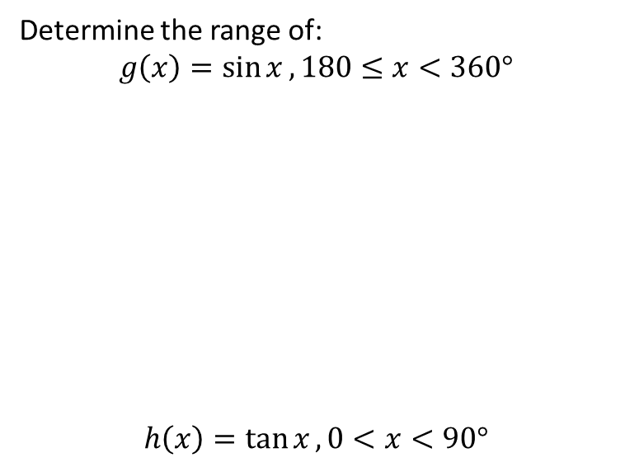


Worked example
Your turn
Determine the range of:
$$g\left(x\right)=\sin{x}, 180≤x<360°$$
$$h\left(x\right)=\tan{x}, 0<x<90°$$
Determine the range of:
$$f\left(x\right)=\cos{x}, 180<x≤360°$$
$$−1<f\left(x\right)≤1$$

Slide 9
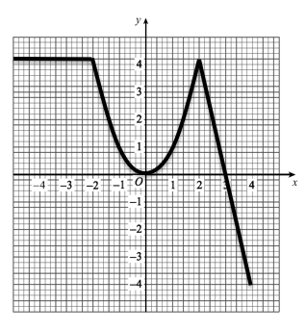
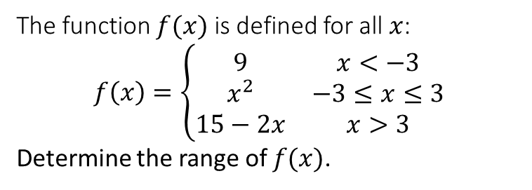
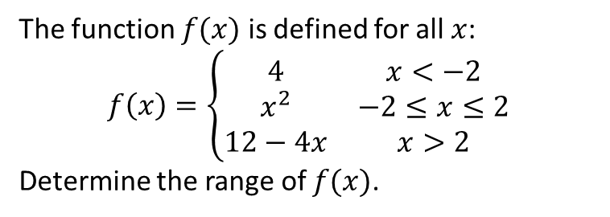

Worked example
Your turn
The function $f(x)$ is defined for all $x$:
$$f\left(x\right)=\left\{\begin{matrix}9 & x<−3 \\ x^{2} & −3≤x≤3 \\ 15−2x & x>3\end{matrix}\right.$$
Determine the range of $f(x)$.
The function $f(x)$ is defined for all $x$:
$$f\left(x\right)=\left\{\begin{matrix}4 & x<−2 \\ x^{2} & −2≤x≤2 \\ 12−4x & x>2\end{matrix}\right.$$
Determine the range of $f(x)$.
$$f\left(x\right)≤4$$
Diagrams/Graphs used with permission from DrFrostMaths: https://www.drfrostmaths.com/

Slide 10
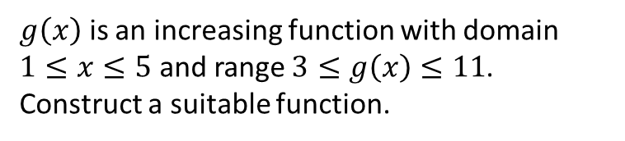
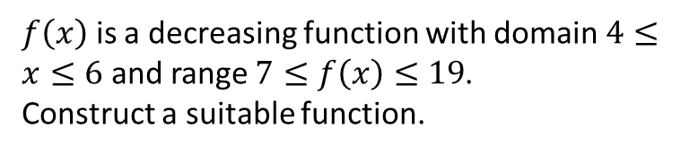

Worked example
Your turn
$g\left(x\right)$ is an increasing function with domain $1≤x≤5$ and range $3≤g\left(x\right)≤11$.
Construct a suitable function.
$f\left(x\right)$ is a decreasing function with domain $4≤x≤6$ and range $7≤f\left(x\right)≤19$.
Construct a suitable function.
$$f\left(x\right)=43−6x$$

Slide 11
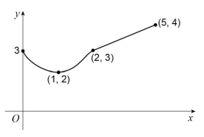
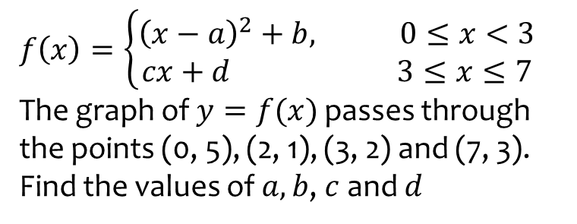
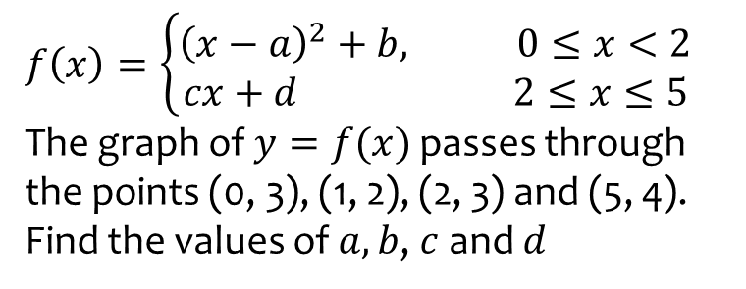

Worked example
Your turn
$$f\left(x\right)=\left\{\begin{aligned}{\left(x−a\right)}^{2}+b, 0≤x<3 \\ cx+d 3≤x≤7\end{aligned}\right.$$
The graph of $y=f(x)$ passes through the points (0, 5), (2, 1), (3, 2) and (7, 3).
Find the values of $a, b$, $c$ and $d$
$$f\left(x\right)=\left\{\begin{aligned}{\left(x−a\right)}^{2}+b, 0≤x<2 \\ cx+d 2≤x≤5\end{aligned}\right.$$
The graph of $y=f(x)$ passes through the points (0, 3), (1, 2), (2, 3) and (5, 4).
Find the values of $a, b$, $c$ and $d$
$$a=1, b=2, c=\frac{1}{3}, d=\frac{7}{3}$$

Slide 12


Worked example
Your turn
$$h\left(x\right)=4x(x−5)$$
Solve the equation
$$2h\left(x\right)=h(3x)$$
$$h\left(x\right)=5x(x−4)$$
Solve the equation
$$3h\left(x\right)=h(2x)$$
$$x=0, x=−4$$

Slide 13
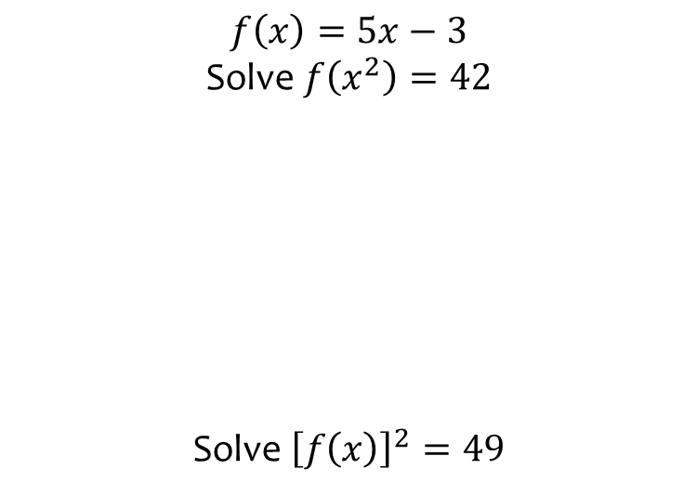
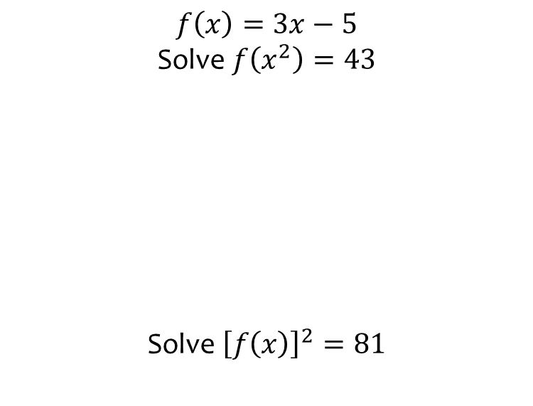
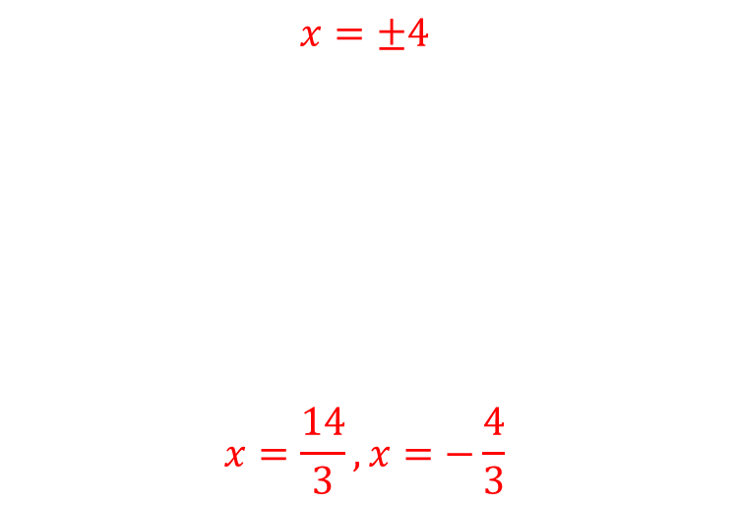
Worked example
Your turn
$$f\left(x\right)=5x−3$$
Solve $f\left(x^{2}\right)=42$
Solve ${\left[f\left(x\right)\right]}^{2}=49$
$$f\left(x\right)=3x−5$$
Solve $f\left(x^{2}\right)=43$
Solve ${\left[f\left(x\right)\right]}^{2}=81$
$$x=±4$$
$$x=\frac{14}{3},x=−\frac{4}{3}$$

