Slide 1
Factorising
CONTENTS

Slide 2



Worked example
Your turn
Factorise:
$$\left(x^{2}−y^{2}\right)−{\left(x−y\right)}^{2}$$
Factorise:
$$\left(n^{2}−a^{2}\right)−{\left(n−a\right)}^{2}$$
$$2a(n−a)$$

Slide 3
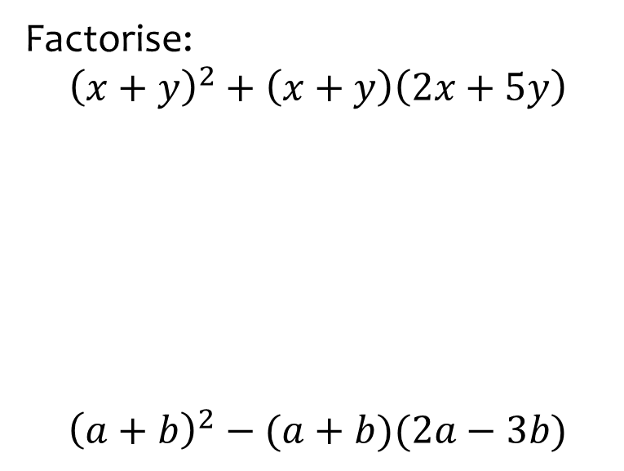
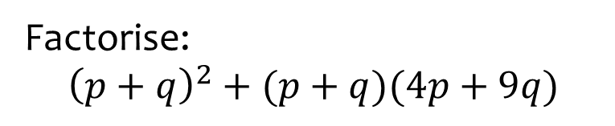

Worked example
Your turn
Factorise:
$${\left(x+y\right)}^{2}+\left(x+y\right)\left(2x+5y\right)$$
$${\left(a+b\right)}^{2}−(a+b)(2a−3b)$$
Factorise:
$${\left(p+q\right)}^{2}+(p+q)(4p+9q)$$
$$5(p+q)(p+2q)$$

Slide 4
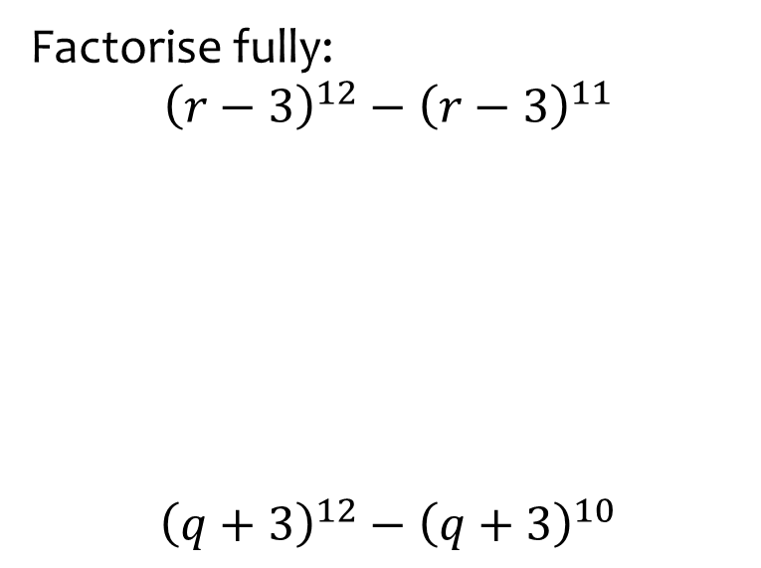


Worked example
Your turn
Factorise fully:
$${\left(r−3\right)}^{12}−{\left(r−3\right)}^{11}$$
$${\left(q+3\right)}^{12}−{\left(q+3\right)}^{10}$$
Factorise fully:
$${\left(p+6\right)}^{11}−{\left(p+6\right)}^{10}$$
$${\left(p+6\right)}^{10}(p+5)$$

Slide 5
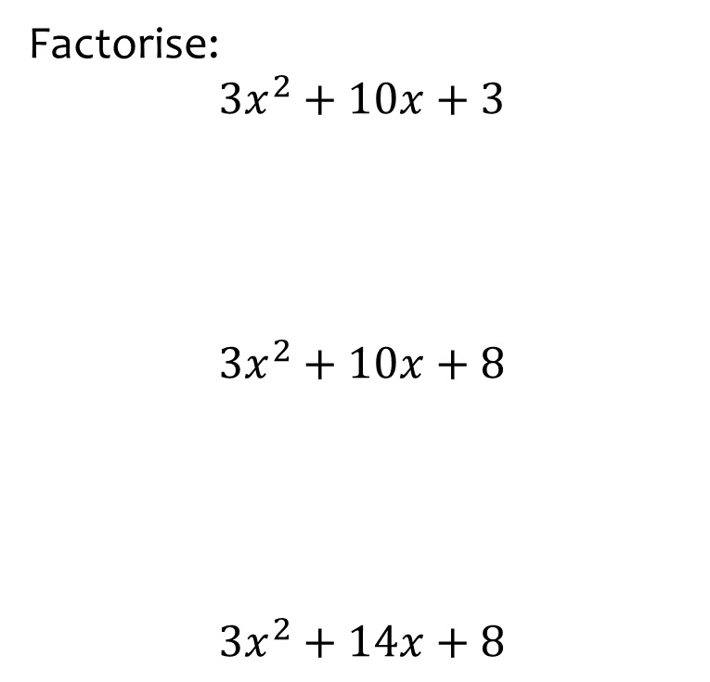
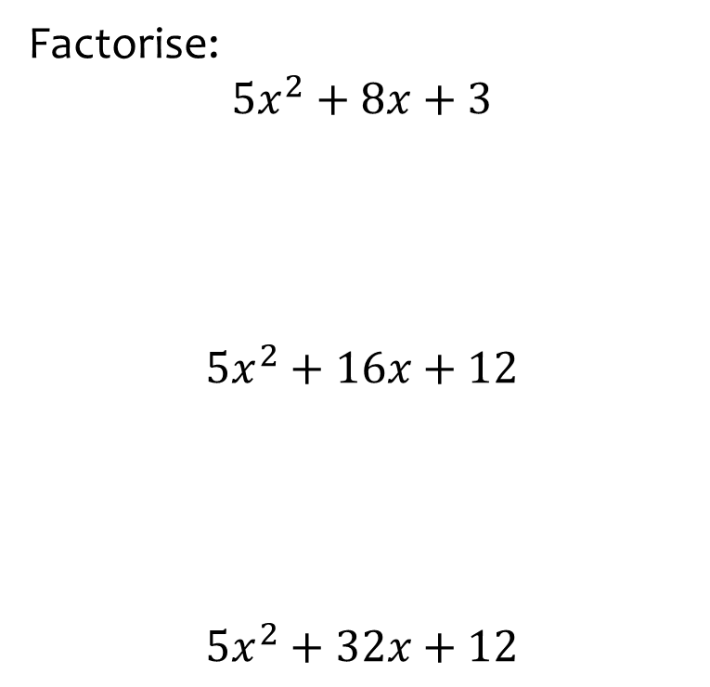
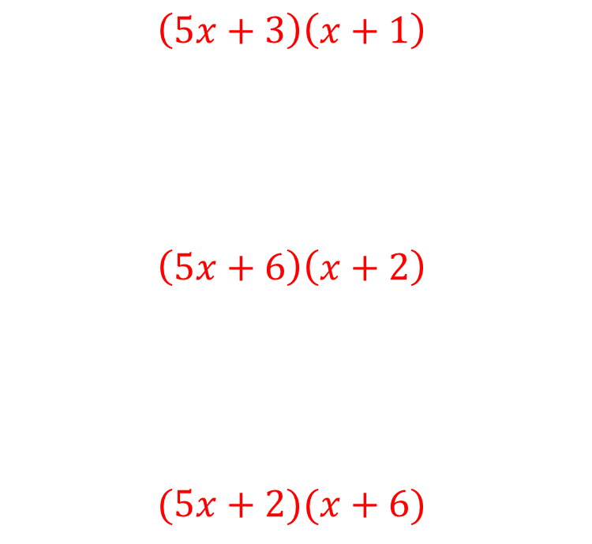
Worked example
Your turn
Factorise:
$$3x^{2}+10x+3$$
$$3x^{2}+10x+8$$
$$3x^{2}+14x+8$$
Factorise:
$$5x^{2}+8x+3$$
$$5x^{2}+16x+12$$
$$5x^{2}+32x+12$$
$$\left(5x+3\right)\left(x+1\right)$$
$$\left(5x+6\right)\left(x+2\right)$$
$$(5x+2)(x+6)$$

Slide 6
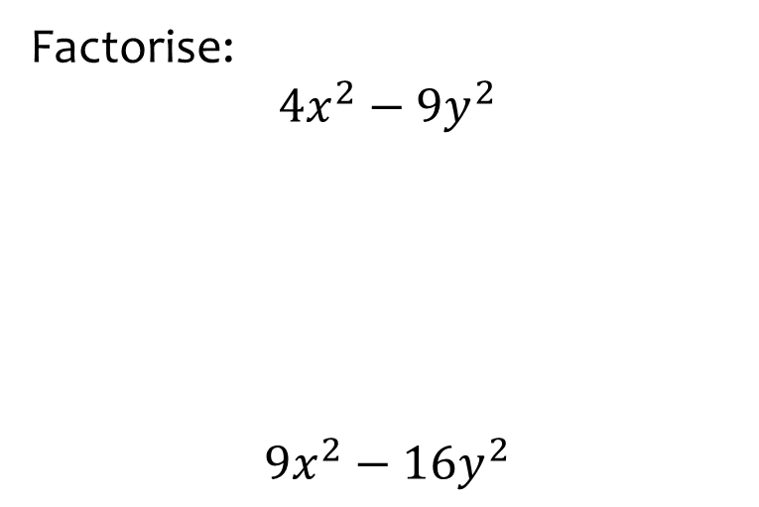


Worked example
Your turn
Factorise:
$$4x^{2}−9y^{2}$$
$$9x^{2}−16y^{2}$$
Factorise:
$$25x^{2}−36y^{2}$$
$$\left(5x+6y\right)(5x−6y)$$

Slide 7
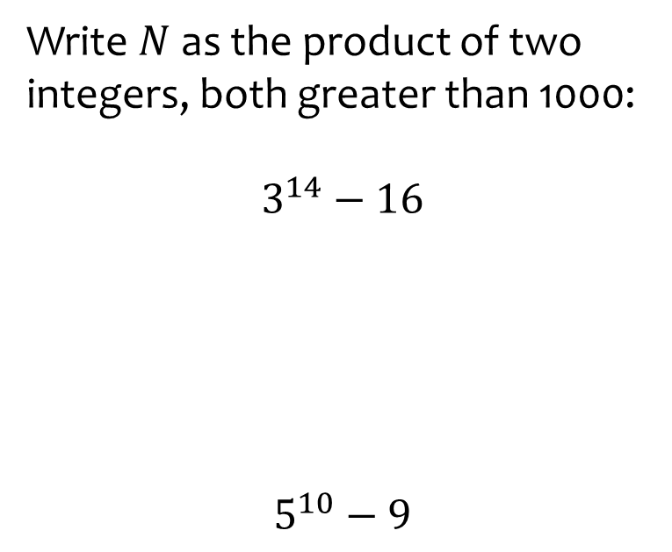
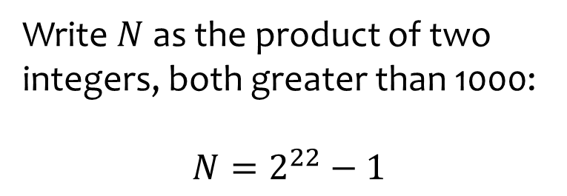

Worked example
Your turn
Write $N$as the product of two integers, both greater than 1000:
$$3^{14}−16$$
$$5^{10}−9$$
Write $N$as the product of two integers, both greater than 1000:
$$N=2^{22}−1$$
$$2049×2047$$

Slide 8
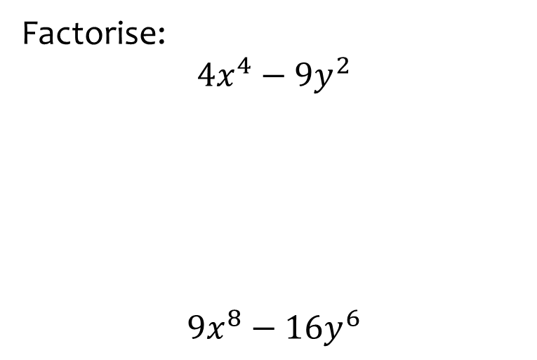


Worked example
Your turn
Factorise:
$$4x^{4}−9y^{2}$$
$$9x^{8}−16y^{6}$$
Factorise:
$$25x^{12}−36y^{6}$$
$$(5x^{6}+6y^{3})(5x^{6}−6y^{3})$$

Slide 9



Worked example
Your turn
Factorise fully
$$y^{4}−16$$
Factorise fully
$$x^{4}−1$$
$$(x^{2}+1)(x+1)(x−1)$$

Slide 10
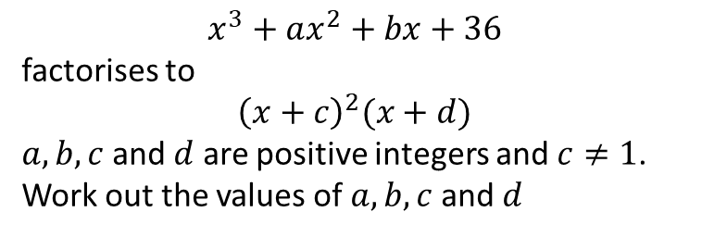
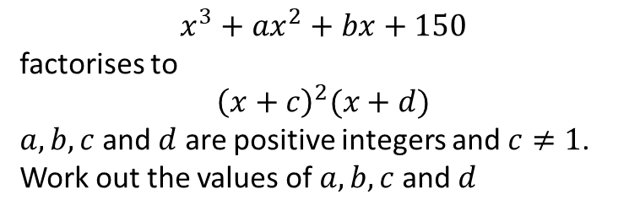
Worked example
Your turn
$$x^{3}+ax^{2}+bx+36$$
factorises to
$${\left(x+c\right)}^{2}(x+d)$$
$a, b, c$ and $d$ are positive integers and $c≠1$.
Work out the values of $a, b, c$ and $d$
$$x^{3}+ax^{2}+bx+150$$
factorises to
$${\left(x+c\right)}^{2}(x+d)$$
$a, b, c$ and $d$ are positive integers and $c≠1$.
Work out the values of $a, b, c$ and $d$
$$a=,16 b=85, c=5, d=6$$

