Slide 1
Factor theorem + using FT to factorise/solve cubic equations
CONTENTS

Slide 2


Worked example
Your turn
Show that $(x−3)$ is a factor of
$$x^{3}−2x^{2}−5x+6$$
Show that $(x−2)$ is a factor of
$$x^{3}+x^{2}−4x−4$$
Shown

Slide 3
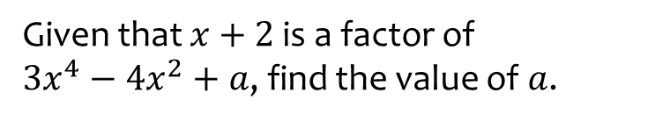
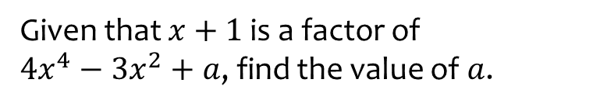

Worked example
Your turn
Given that $x+2$ is a factor of
$3x^{4}−4x^{2}+a$, find the value of $a$.
Given that $x+1$ is a factor of
$4x^{4}−3x^{2}+a$, find the value of $a$.
$$a=−1$$

Slide 4
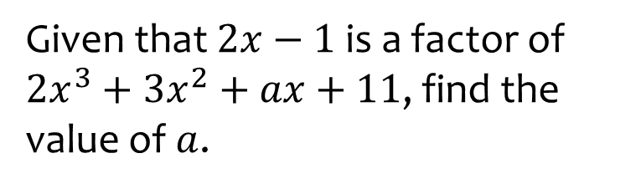
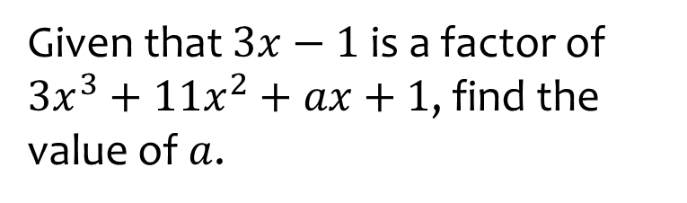

Worked example
Your turn
Given that $2x−1$ is a factor of
$2x^{3}+3x^{2}+ax+11$, find the value of $a$.
Given that $3x−1$ is a factor of
$3x^{3}+11x^{2}+ax+1$, find the value of $a$.
$$a=−7$$

Slide 5



Worked example
Your turn
Fully factorise $3x^{3}+x^{2}−12x−4$
Fully factorise $2x^{3}+x^{2}−18x−9$
$$(x−3)(2x+1)(x+3)$$

Slide 6
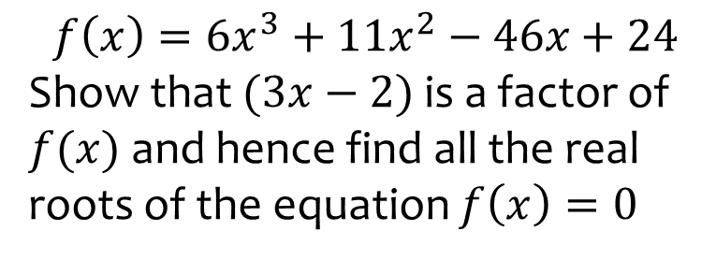
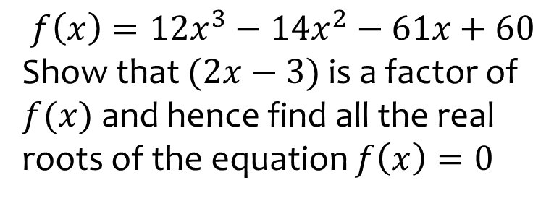

Worked example
Your turn
$$f\left(x\right)=6x^{3}+11x^{2}−46x+24$$
Show that $(3x−2)$ is a factor of $f(x)$ and hence find all the real roots of the equation $f\left(x\right)=0$
$$f\left(x\right)=12x^{3}−14x^{2}−61x+60$$
Show that $(2x−3)$ is a factor of $f(x)$ and hence find all the real roots of the equation $f\left(x\right)=0$
$$x=−\frac{5}{2},x=\frac{3}{2}, x=\frac{4}{3}$$

Slide 7
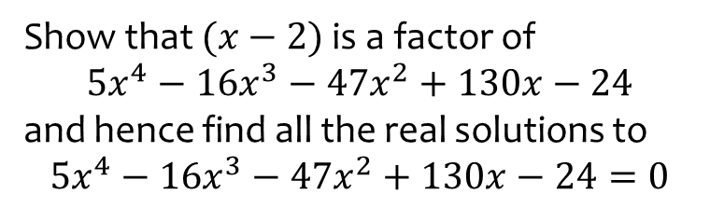
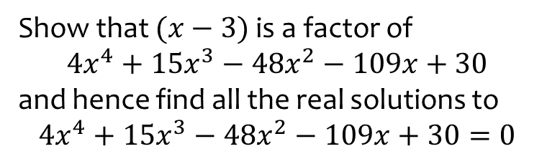
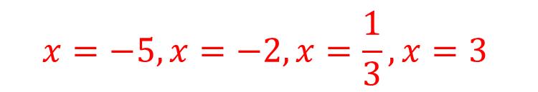
Worked example
Your turn
Show that $(x−2)$ is a factor of
$$5x^{4}−16x^{3}−47x^{2}+130x−24$$
and hence find all the real solutions to
$$5x^{4}−16x^{3}−47x^{2}+130x−24=0$$
Show that $(x−3)$ is a factor of
$$4x^{4}+15x^{3}−48x^{2}−109x+30$$
and hence find all the real solutions to
$$4x^{4}+15x^{3}−48x^{2}−109x+30=0$$
$$x=−5, x=−2, x=\frac{1}{3}, x=3$$

Slide 8
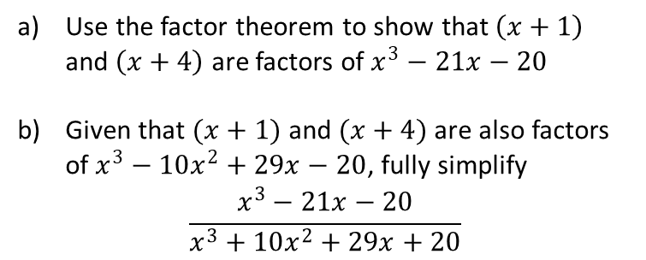
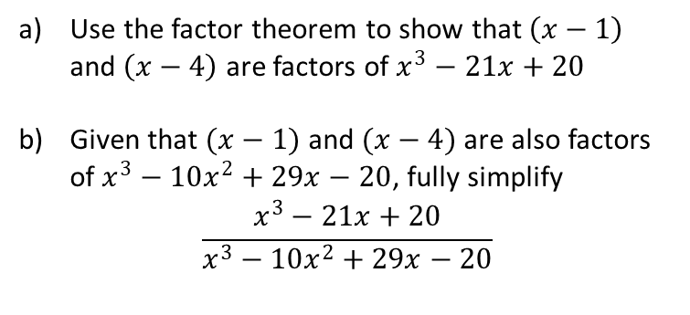
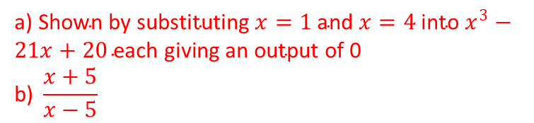
Worked example
Your turn
Use the factor theorem to show that $\left(x+1\right)$ and $\left(x+4\right)$ are factors of $x^{3}−21x−20$
Given that $(x+1)$ and $(x+4)$ are also factors of $x^{3}−10x^{2}+29x−20$, fully simplify
$$\frac{x^{3}−21x−20}{x^{3}+10x^{2}+29x+20}$$
Use the factor theorem to show that $\left(x−1\right)$ and $\left(x−4\right)$ are factors of $x^{3}−21x+20$
Given that $(x−1)$ and $(x−4)$ are also factors of $x^{3}−10x^{2}+29x−20$, fully simplify
$$\frac{x^{3}−21x+20}{x^{3}−10x^{2}+29x−20}$$
a) S$\text{hown} \text{by} \text{substituting} x=1 \text{and} x=4 \text{into} x^{3}−21x+20 \text{each} \text{giving} \text{an} \text{output} \text{of}\text{ 0 }$
$$\text{b}\text{) }\frac{x+5}{x−5}$$

Slide 9
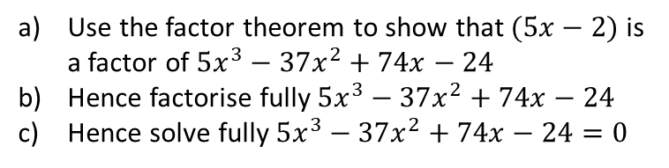
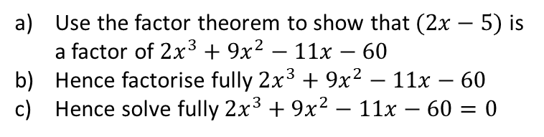
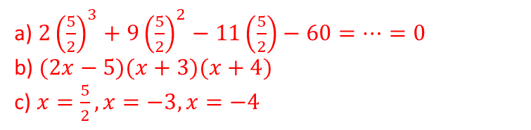
Worked example
Your turn
Use the factor theorem to show that $(5x−2)$ is a factor of $5x^{3}−37x^{2}+74x−24$
Hence factorise fully$5x^{3}−37x^{2}+74x−24$
Hence solve fully $5x^{3}−37x^{2}+74x−24=0$
Use the factor theorem to show that $(2x−5)$ is a factor of $2x^{3}+9x^{2}−11x−60$
Hence factorise fully $2x^{3}+9x^{2}−11x−60$
Hence solve fully $2x^{3}+9x^{2}−11x−60=0$
a) $2{\left(\frac{5}{2}\right)}^{3}+9{\left(\frac{5}{2}\right)}^{2}−11\left(\frac{5}{2}\right)−60=…=0$
b) $(2x−5)(x+3)(x+4)$
c) $x=\frac{5}{2}, x=−3, x=−4$

Slide 10
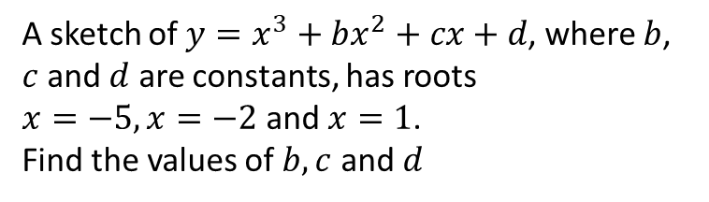
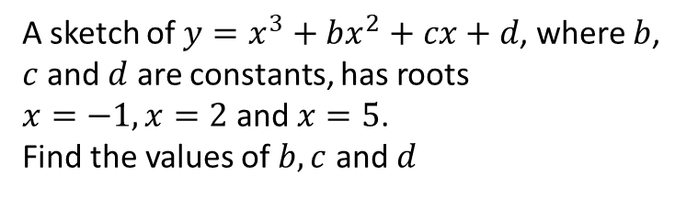
Worked example
Your turn
A sketch of $y=x^{3}+bx^{2}+cx+d$, where $b$, $c$ and $d$ are constants, has roots
$x=−5, x=−2$ and $x=1$.
Find the values of $b, c$ and $d$
A sketch of $y=x^{3}+bx^{2}+cx+d$, where $b$, $c$ and $d$ are constants, has roots
$x=−1, x=2$ and $x=5$.
Find the values of $b, c$ and $d$
$$b=−6, c=3, d=10$$

