Slide 1
Expanding brackets + Use of Pascal’s triangle to find coefficients
CONTENTS

Slide 2
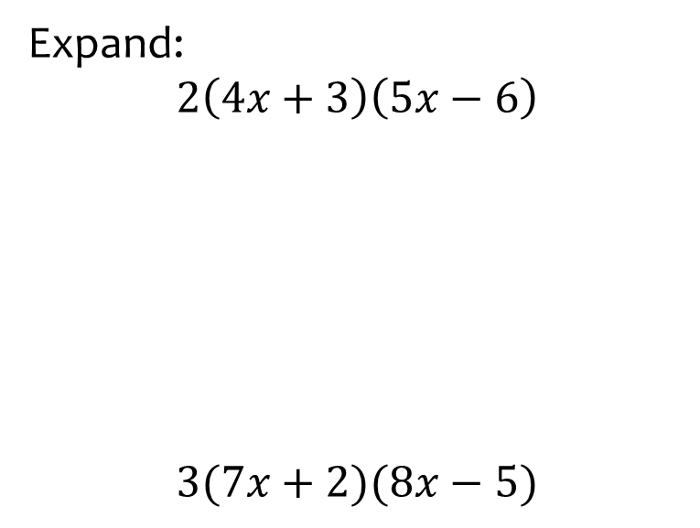


Worked example
Your turn
Expand:
$$2\left(4x+3\right)\left(5x−6\right)$$
$$3(7x+2)(8x−5)$$
Expand:
$$4(5x+6)(3x−2)$$
$$60x^{2}+32x−48$$

Slide 3
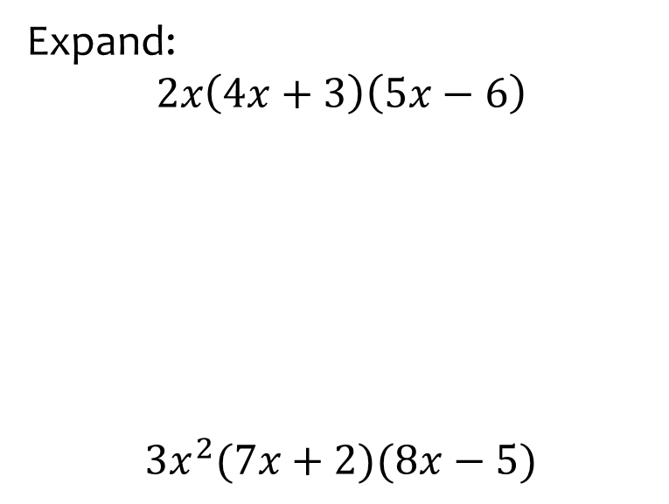


Worked example
Your turn
Expand:
$$2x\left(4x+3\right)\left(5x−6\right)$$
$$3x^{2}(7x+2)(8x−5)$$
Expand:
$$4x^{2}(5x+6)(3x−2)$$
$$60x^{4}+32x^{3}−48x^{2}$$

Slide 4



Worked example
Your turn
Expand:
$$(x+5)(x+6)(x+7)$$
Expand:
$$(x+2)(x+3)(x+4)$$
$$x^{3}+9x^{2}+26x+24$$

Slide 5
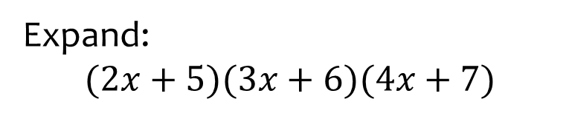
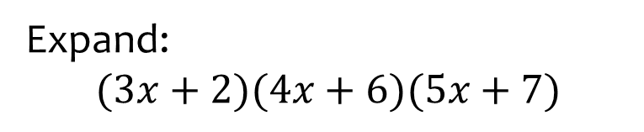

Worked example
Your turn
Expand:
$$(2x+5)(3x+6)(4x+7)$$
Expand:
$$(3x+2)(4x+6)(5x+7)$$
$$60x^{3}+214x^{2}+242x+84$$

Slide 6



Worked example
Your turn
Expand:
$$(x+5)(x−6)(x−7)$$
Expand:
$$(x+2)(x−3)(x−4)$$
$$x^{3}−5x^{2}−2x+24$$

Slide 7



Worked example
Your turn
Expand:
$$(x−5)(x−6)(x−7)$$
Expand:
$$(x−2)(x−3)(x−4)$$
$$x^{3}−9x^{2}+26x−24$$

Slide 8



Worked example
Your turn
Expand:
$$\left(x+5\right){\left(x+6\right)}^{2}$$
Expand:
$$\left(x+2\right){\left(x+3\right)}^{2}$$
$$x^{3}+8x^{2}+21x+18$$

Slide 9



Worked example
Your turn
Expand:
$$\left(x−5\right){\left(x−6\right)}^{2}$$
Expand:
$$\left(x−2\right){\left(x−3\right)}^{2}$$
$$x^{3}−8x^{2}+21x−18$$

Slide 10
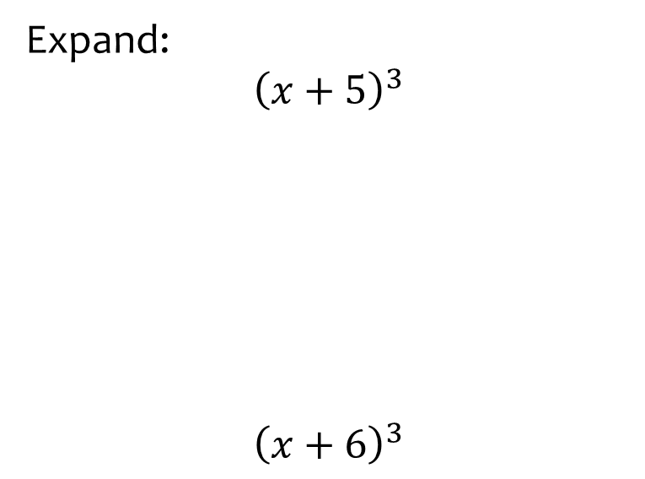


Worked example
Your turn
Expand:
$${\left(x+5\right)}^{3}$$
$${\left(x+6\right)}^{3}$$
Expand:
$${\left(x+4\right)}^{3}$$
$$x^{3}+12x^{2}+48x+64$$

Slide 11
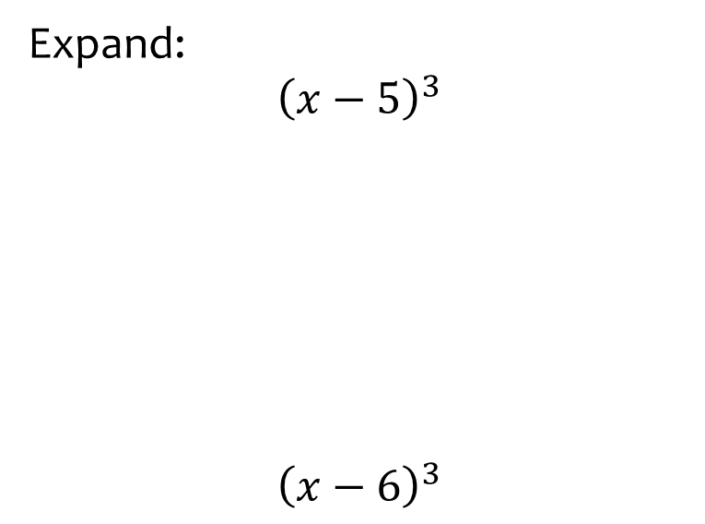


Worked example
Your turn
Expand:
$${\left(x−5\right)}^{3}$$
$${\left(x−6\right)}^{3}$$
Expand:
$${\left(x−4\right)}^{3}$$
$$x^{3}−12x^{2}+48x−64$$

Slide 12



Worked example
Your turn
Expand:
$$\left(5−2x\right){\left(3x−4\right)}^{2}$$
Expand:
$$\left(7−3x\right){\left(4x−5\right)}^{2}$$
$$−48x^{3}+232x^{2}−355x+175$$

Slide 13


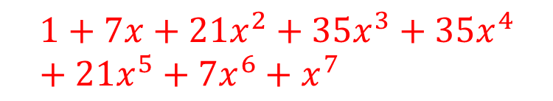
Worked example
Your turn
Use Pascal’s triangle to find the expansion of
$${\left(1+x\right)}^{6}$$
Use Pascal’s triangle to find the expansion of
$${\left(1+x\right)}^{7}$$
$$1+7x+21x^{2}+35x^{3}+35x^{4}+21x^{5}+7x^{6}+x^{7}$$

Slide 14



Worked example
Your turn
Use Pascal’s triangle to find the expansion of
$${\left(1+2x\right)}^{5}$$
Use Pascal’s triangle to find the expansion of
$${\left(1+3x\right)}^{4}$$
$$1+12x+54x^{2}+108x^{3}+81x^{4}$$

Slide 15



Worked example
Your turn
Use Pascal’s triangle to find the expansion of
$${\left(1−2x\right)}^{5}$$
Use Pascal’s triangle to find the expansion of
$${\left(1−3x\right)}^{4}$$
$$1−12x+54x^{2}−108x^{3}+81x^{4}$$

Slide 16


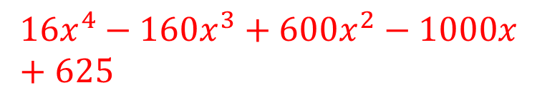
Worked example
Your turn
Use Pascal’s triangle to find the expansion of
$${\left(5x−2\right)}^{4}$$
Use Pascal’s triangle to find the expansion of
$${\left(2x−5\right)}^{4}$$
$$16x^{4}−160x^{3}+600x^{2}−1000x+625$$

Slide 17
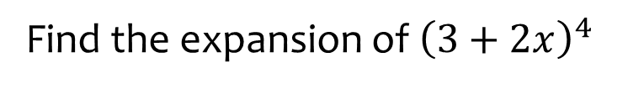
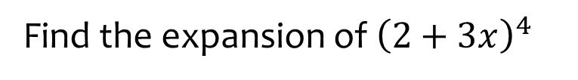
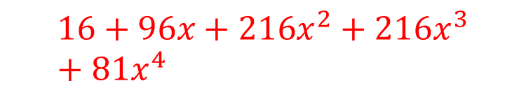
Worked example
Your turn
Find the expansion of ${\left(3+2x\right)}^{4}$
Find the expansion of ${\left(2+3x\right)}^{4}$
$$16+96x+216x^{2}+216x^{3}+81x^{4}$$

Slide 18


Worked example
Your turn
Find the expansion of
$${\left(2x−3y^{2}\right)}^{5}$$
Find the expansion of
$${\left(3x^{2}−2y\right)}^{4}$$
$$81x^{8}−216x^{6}y+216x^{4}y^{2}−96x^{2}y^{3}+16y^{4}$$

Slide 19



Worked example
Your turn
Find the coefficient of $x^{3}$ in the expansion of ${\left(3+2x\right)}^{5}$
Find the coefficient of $x^{3}$ in the expansion of ${\left(2+3x\right)}^{4}$
$$216$$

Slide 20



Worked example
Your turn
Find the coefficient of $x^{3}$ in the expansion of ${\left(2−3x\right)}^{4}$
Find the coefficient of $x^{4}$ in the expansion of ${\left(3−2x\right)}^{5}$
$$240$$

Slide 21
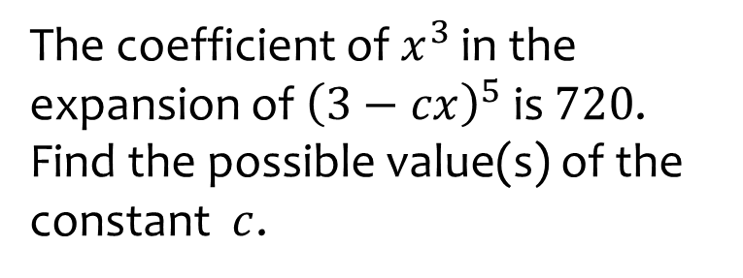
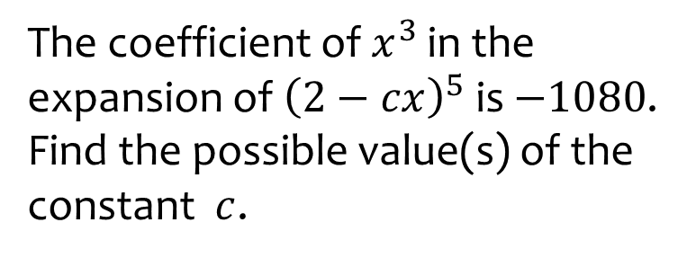

Worked example
Your turn
The coefficient of $x^{3}$ in the expansion of ${\left(3−cx\right)}^{5}$ is $720$.
Find the possible value(s) of the constant $c$.
The coefficient of $x^{3}$ in the expansion of ${\left(2−cx\right)}^{5}$ is $−1080$.
Find the possible value(s) of the constant $c$.
$$c=3$$

Slide 22
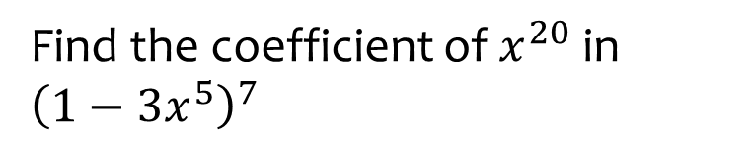
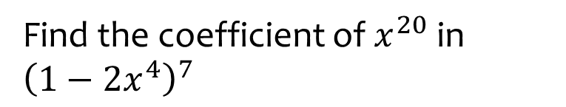

Worked example
Your turn
Find the coefficient of $x^{20}$ in ${\left(1−3x^{5}\right)}^{7}$
Find the coefficient of $x^{20}$ in ${\left(1−2x^{4}\right)}^{7}$
$$−672$$

Slide 23



Worked example
Your turn
Find the third term in the expansion of
$${\left(1−2x^{3}\right)}^{5}$$
Find the fourth term in the expansion of
$${\left(1−5x^{3}\right)}^{3}$$
$$−125x^{9}$$

Slide 24
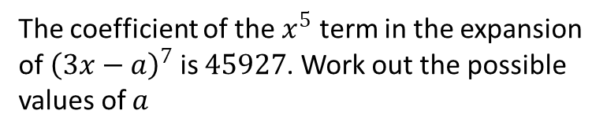
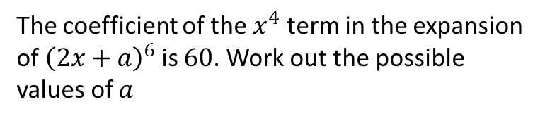

Worked example
Your turn
The coefficient of the $x^{5}$ term in the expansion of ${\left(3x−a\right)}^{7}$ is $45927$. Work out the possible values of $a$
The coefficient of the $x^{4}$ term in the expansion of ${\left(2x+a\right)}^{6}$ is $60$. Work out the possible values of $a$
$$a=±\frac{1}{2}$$

