Slide 1
Equation of a tangent to a circle
CONTENTS

Slide 2
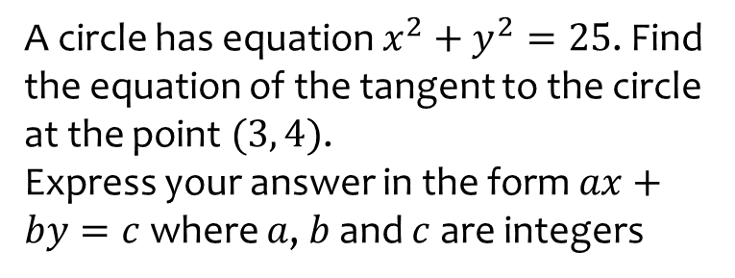
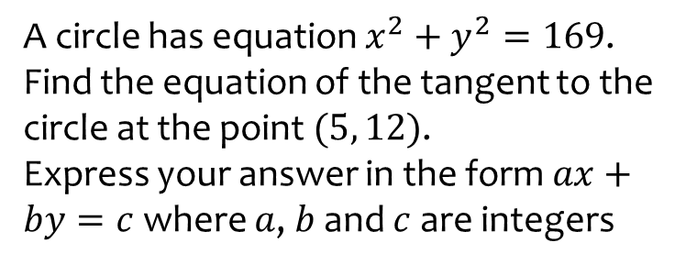

Worked example
Your turn
A circle has equation $x^{2}+y^{2}=169$. Find the equation of the tangent to the circle at the point $(5, 12)$.
Express your answer in the form $ax+by=c$ where $a$, $b$ and $c$ are integers
A circle has equation $x^{2}+y^{2}=25$. Find the equation of the tangent to the circle at the point $(3, 4)$.
Express your answer in the form $ax+by=c$ where $a$, $b$ and $c$ are integers
$$3x+4y=25$$

