Slide 1
Equation of a straight line
CONTENTS

Slide 2
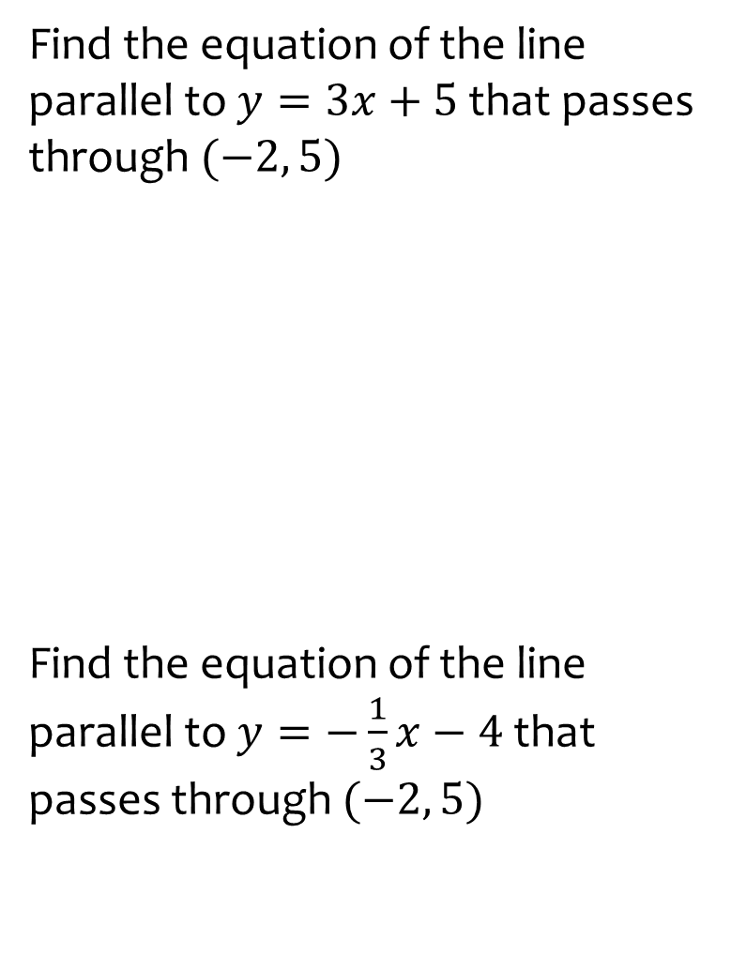
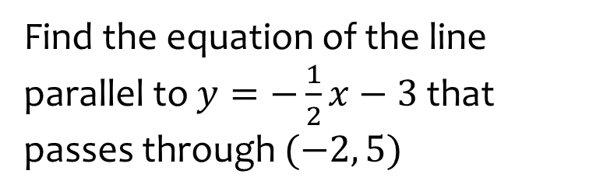

Worked example
Your turn
Find the equation of the line parallel to $y=3x+5$ that passes through $(−2, 5)$
Find the equation of the line parallel to $y=−\frac{1}{3}x−4$ that passes through $(−2, 5)$
Find the equation of the line parallel to $y=−\frac{1}{2}x−3$ that passes through $(−2, 5)$
$$y=−\frac{1}{2}x+4$$

Slide 3
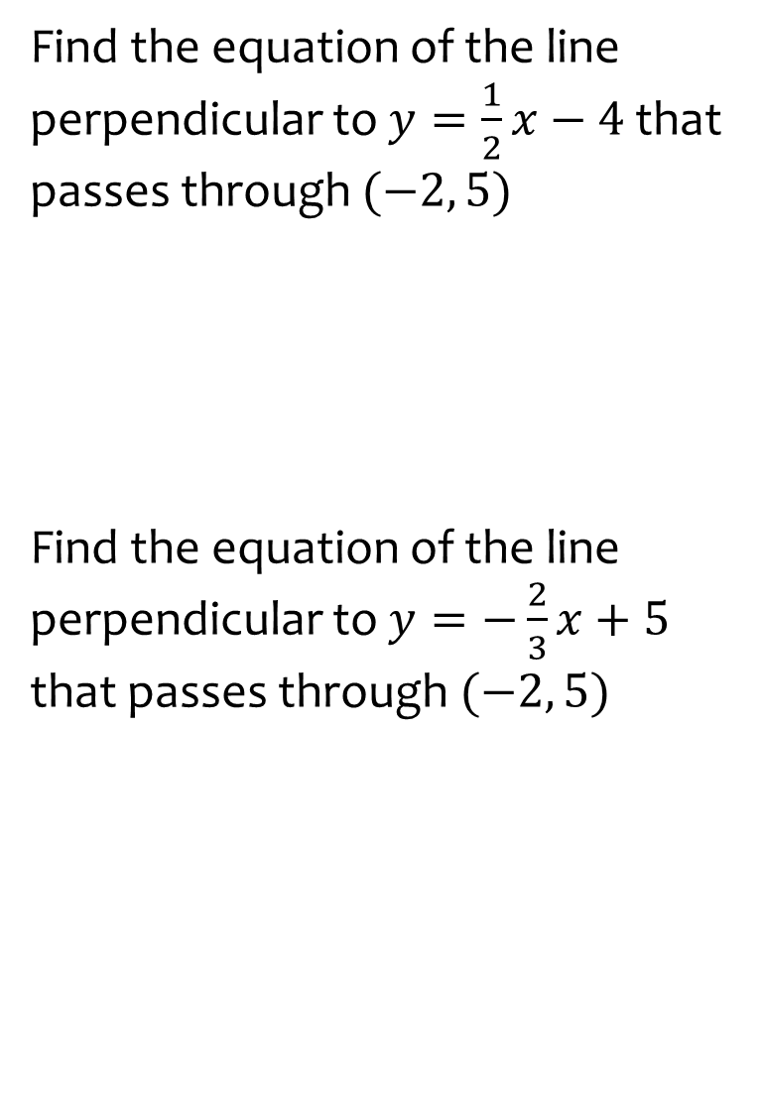
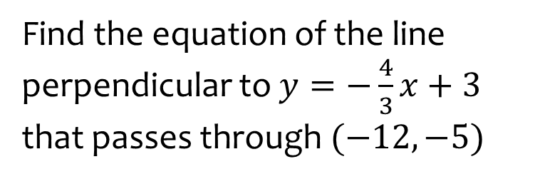

Worked example
Your turn
Find the equation of the line perpendicular to $y=\frac{1}{2}x−4$ that passes through $(−2, 5)$
Find the equation of the line perpendicular to $y=−\frac{2}{3}x+5$ that passes through $(−2, 5)$
Find the equation of the line perpendicular to $y=−\frac{4}{3}x+3$ that passes through $(−12, −5)$
$$y=\frac{3}{4}x+4$$

Slide 4
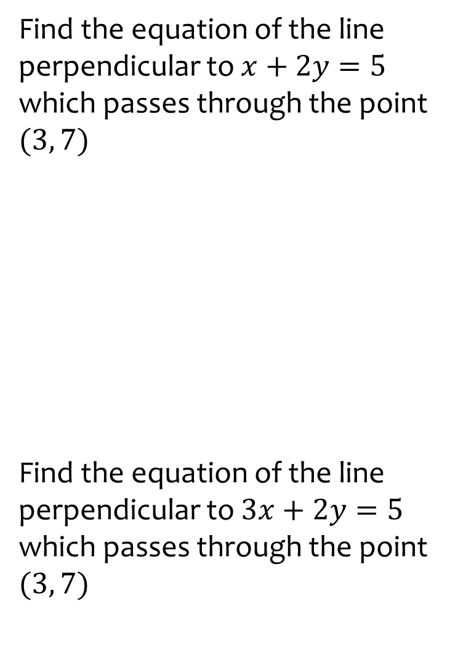
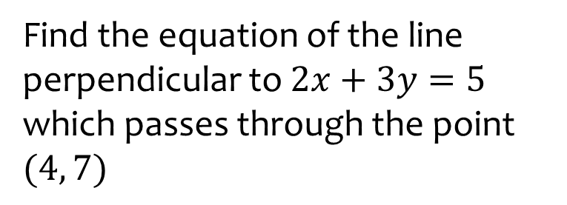

Worked example
Your turn
Find the equation of the line perpendicular to $x+2y=5$ which passes through the point $(3, 7)$
Find the equation of the line perpendicular to $3x+2y=5$ which passes through the point $(3, 7)$
Find the equation of the line perpendicular to $2x+3y=5$ which passes through the point $(4, 7)$
$$y=\frac{3}{2}x+1$$

Slide 5
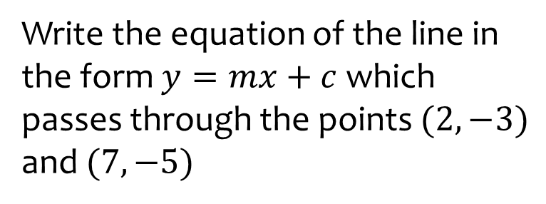
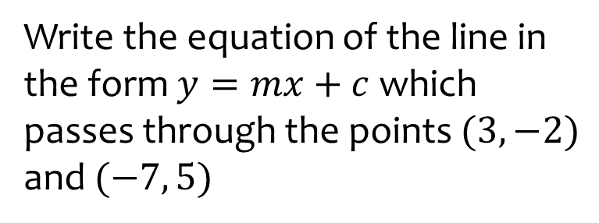

Worked example
Your turn
Write the equation of the line in the form $y=mx+c$ which passes through the points $(2, −3)$ and $(7, −5)$
Write the equation of the line in the form $y=mx+c$ which passes through the points $(3, −2)$ and $(−7, 5)$
$$y=−\frac{3}{10}x−\frac{11}{10}$$

