Slide 1
Equating coefficients
CONTENTS

Slide 2
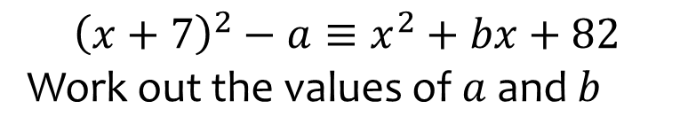
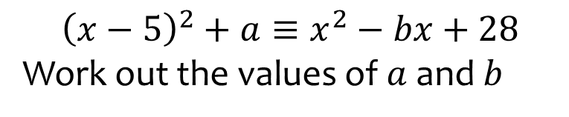

Worked example
Your turn
$${\left(x+7\right)}^{2}−a≡x^{2}+bx+82$$
Work out the values of $a$ and $b$
$${\left(x−5\right)}^{2}+a≡x^{2}−bx+28$$
Work out the values of $a$ and $b$
$$a=3, b=10$$

Slide 3
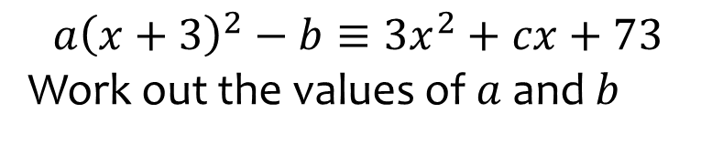
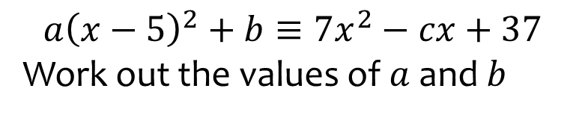

Worked example
Your turn
$$a{\left(x+3\right)}^{2}−b≡3x^{2}+cx+73$$
Work out the values of $a$ and $b$
$${a\left(x−5\right)}^{2}+b≡{7x}^{2}−cx+37$$
Work out the values of $a$ and $b$
$$a=7, b=−138,c=70$$

Slide 4
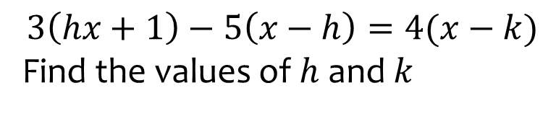
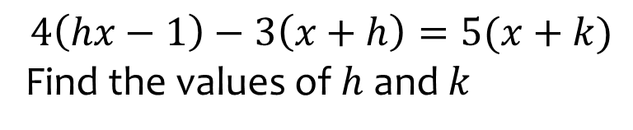

Worked example
Your turn
$$3\left(hx+1\right)−5\left(x−h\right)=4(x−k)$$
Find the values of $h$ and $k$
$$4\left(hx−1\right)−3\left(x+h\right)=5(x+k)$$
Find the values of $h$ and $k$
$$h=2, k=−2$$

Slide 5
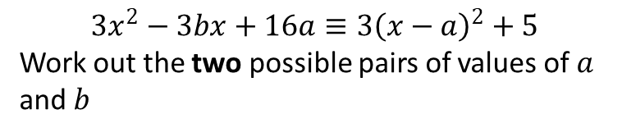
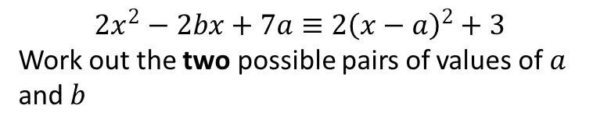

Worked example
Your turn
$$3x^{2}−3bx+16a≡3{\left(x−a\right)}^{2}+5$$
Work out the two possible pairs of values of $a$ and $b$
$$2x^{2}−2bx+7a≡2{\left(x−a\right)}^{2}+3$$
Work out the two possible pairs of values of $a$ and $b$
$$a=\frac{1}{2}, b=1 \text{and} a=3, b=6$$

