Slide 1
Distance between two points
CONTENTS

Slide 2
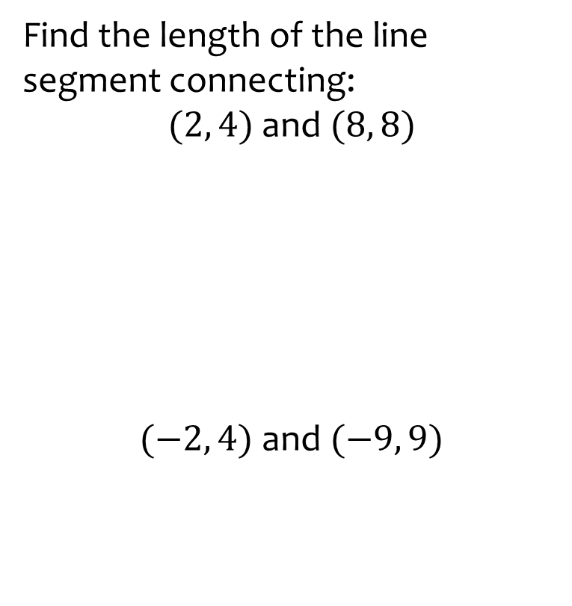
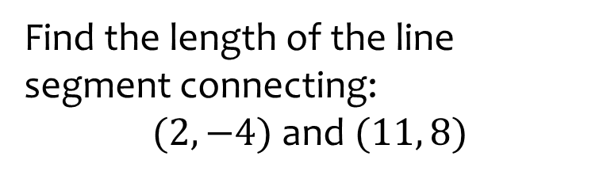

Worked example
Your turn
Find the length of the line segment connecting:
$(2, 4)$and$(8, 8)$
$(−2, 4)$ and $(−9, 9)$
Find the length of the line segment connecting:
$(2, −4)$ and $(11, 8)$
$$15$$

