Slide 1
Completing the square
CONTENTS

Slide 2
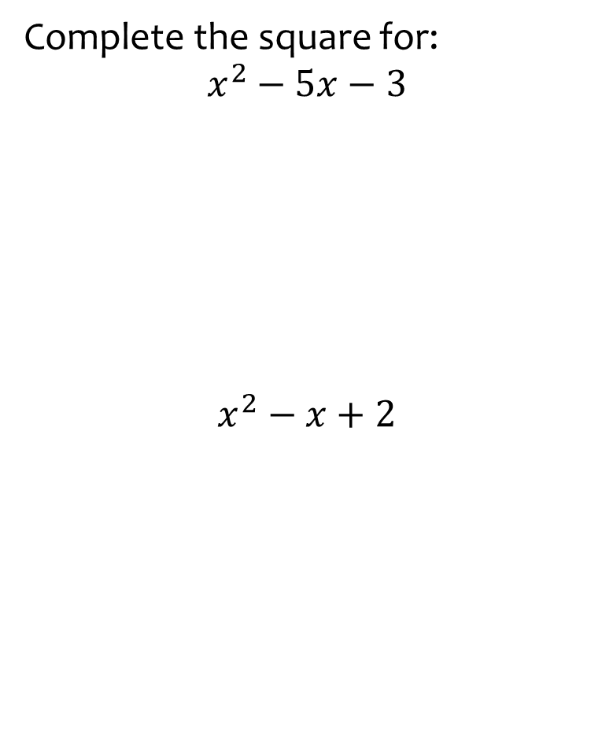


Worked example
Your turn
Complete the square for:
$$x^{2}−5x−3$$
$$x^{2}−x+2$$
Complete the square for:
$$x^{2}−3x−2$$
$${\left(x−\frac{3}{2}\right)}^{2}−\frac{17}{4}$$

Slide 3
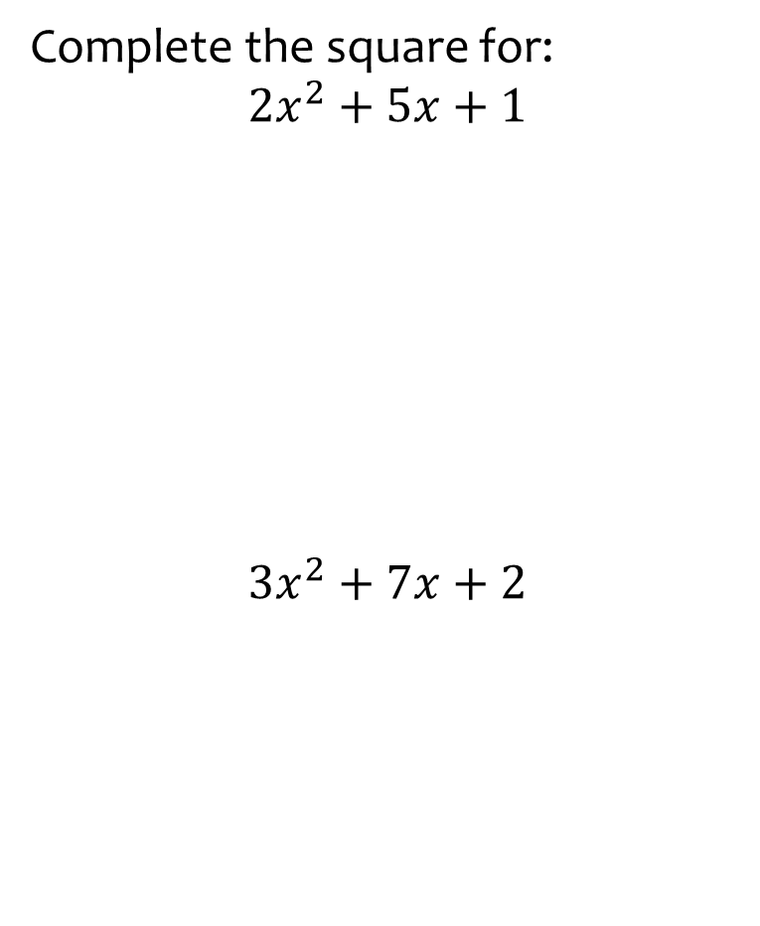


Worked example
Your turn
Complete the square for:
$${2x}^{2}+5x+1$$
$$3x^{2}+7x+2$$
Complete the square for:
$$5x^{2}+9x+3$$
$$5{\left(x+\frac{9}{10}\right)}^{2}−\frac{21}{20}$$

Slide 4
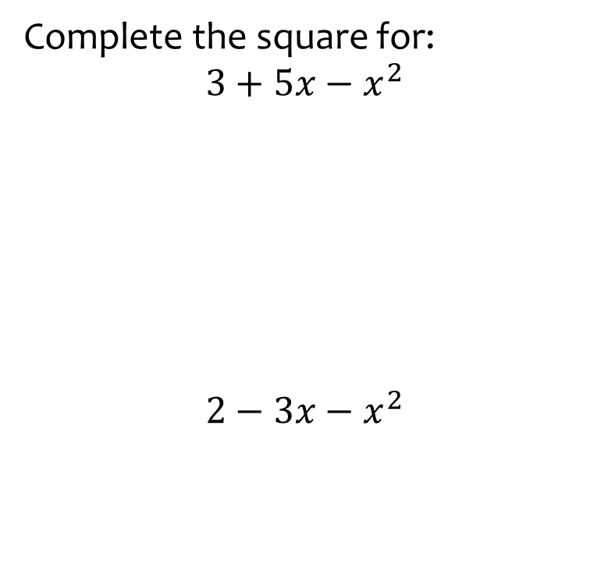


Worked example
Your turn
Complete the square for:
$$3+5x−x^{2}$$
$$2−3x−x^{2}$$
Complete the square for:
$$5−7x−x^{2}$$
$$−{\left(x+\frac{7}{2}\right)}^{2}+\frac{69}{4}$$

Slide 5



Worked example
Your turn
Complete the square for:
$$−3x^{2}−5x+4$$
Complete the square for:
$$−5x^{2}+4x+3$$
$$\frac{19}{5}−5{\left(x−\frac{2}{5}\right)}^{2}$$

Slide 6
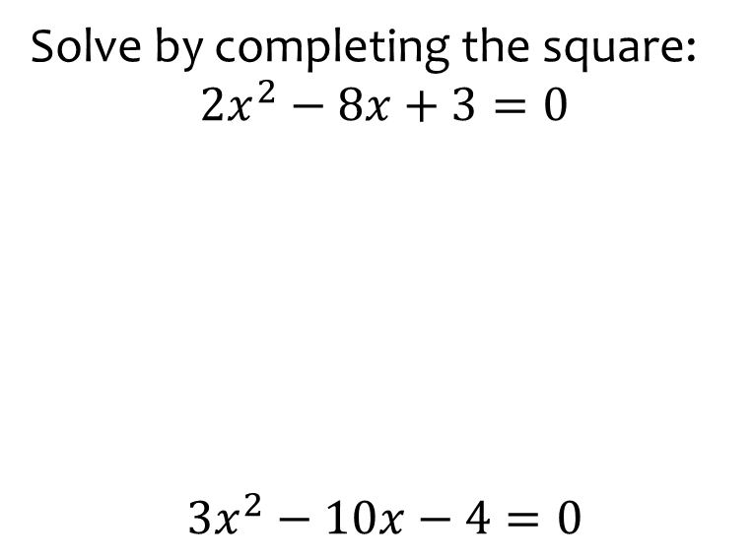


Worked example
Your turn
Solve by completing the square:
$$2x^{2}−8x+3=0$$
$${3x}^{2}−10x−4=0$$
Solve by completing the square:
$${5x}^{2}−6x−2=0$$
$$x=\frac{3+\sqrt{19}}{5}, x=\frac{3−\sqrt{19}}{5}$$

Slide 7
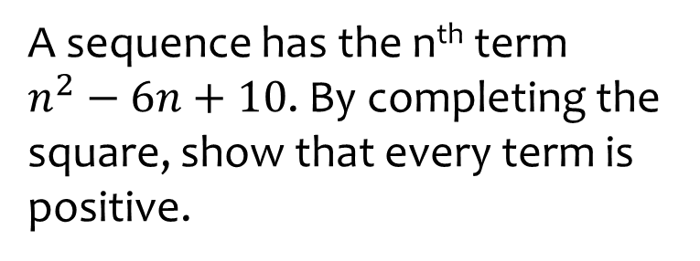
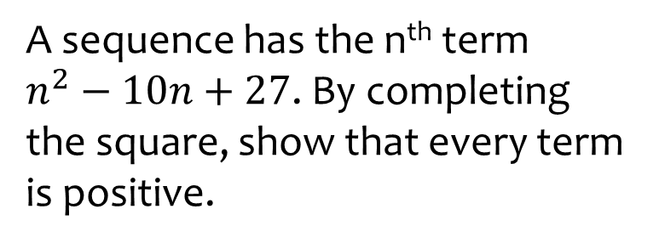
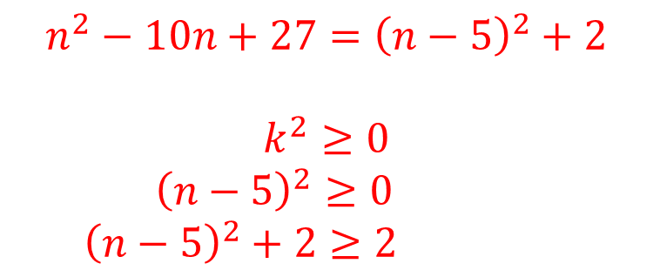
Worked example
Your turn
A sequence has the n^{th} term
$n^{2}−6n+10$. By completing the square, show that every term is positive.
A sequence has the n^{th} term
$n^{2}−10n+27$. By completing the square, show that every term is positive.
$$n^{2}−10n+27={\left(n−5\right)}^{2}+2$$
$$k^{2}≥0$$
$${\left(n−5\right)}^{2}≥0$$
$${\left(n−5\right)}^{2}+2≥2$$

