Slide 1
Combinations of transformations
CONTENTS

Slide 2
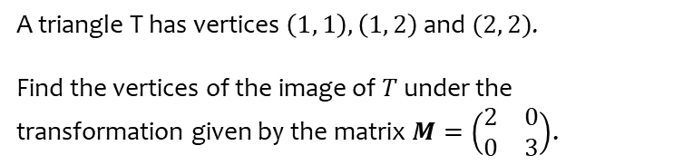
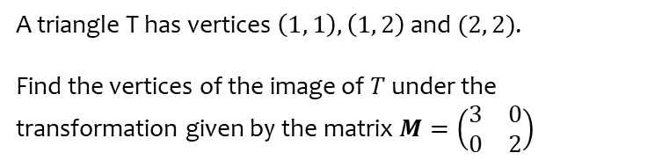

Worked example
Your turn
A triangle T has vertices $\left(1, 1\right), \left(1, 2\right)$ and $(2, 2)$.
Find the vertices of the image of $T$ under the transformation given by the matrix $M=\left(\begin{matrix}2 & 0 \\ 0 & 3\end{matrix}\right)$.
A triangle T has vertices $\left(1, 1\right), \left(1, 2\right)$ and $(2, 2)$.
Find the vertices of the image of $T$ under the transformation given by the matrix $M=\left(\begin{matrix}3 & 0 \\ 0 & 2\end{matrix}\right)$
$\left(3, 2\right), (3,4)$ and $(6, 4)$

Slide 3
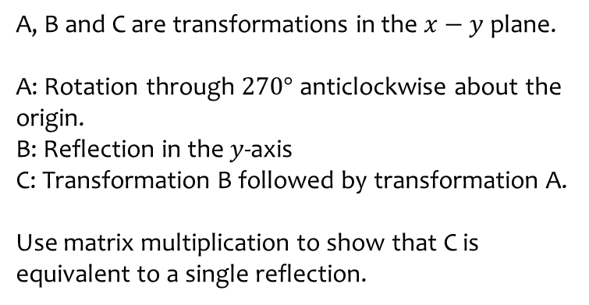
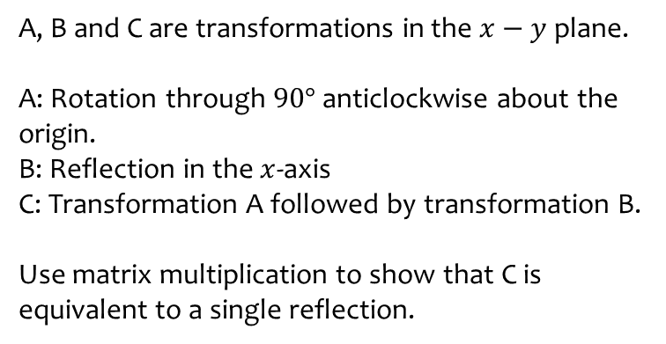
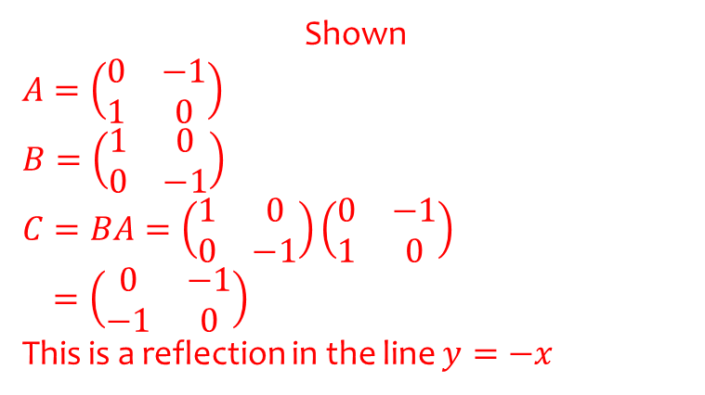
Worked example
Your turn
A, B and C are transformations in the $x−y$ plane.
A: Rotation through $270°$ anticlockwise about the origin.
B: Reflection in the $y$-axis
C: Transformation B followed by transformation A.
Use matrix multiplication to show that C is equivalent to a single reflection.
A, B and C are transformations in the $x−y$ plane.
A: Rotation through $90°$ anticlockwise about the origin.
B: Reflection in the $x$-axis
C: Transformation A followed by transformation B.
Use matrix multiplication to show that C is equivalent to a single reflection.
Shown
$$A=\left(\begin{matrix}0 & −1 \\ 1 & 0\end{matrix}\right)$$
$$B=\left(\begin{matrix}1 & 0 \\ 0 & −1\end{matrix}\right)$$
$$C=BA=\left(\begin{matrix}1 & 0 \\ 0 & −1\end{matrix}\right)\left(\begin{matrix}0 & −1 \\ 1 & 0\end{matrix}\right)$$
$$=\left(\begin{matrix}0 & −1 \\ −1 & 0\end{matrix}\right)$$
This is a reflection in the line $y=−x$

Slide 4
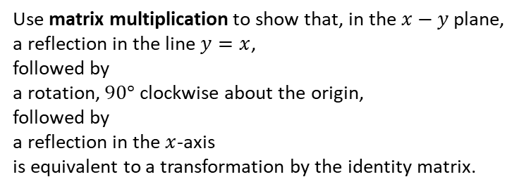
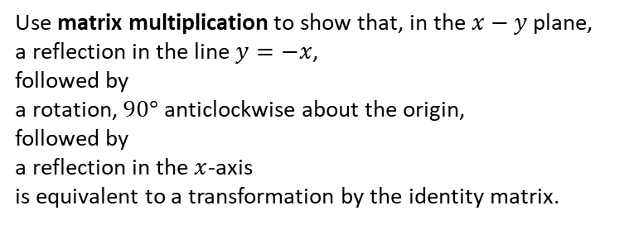
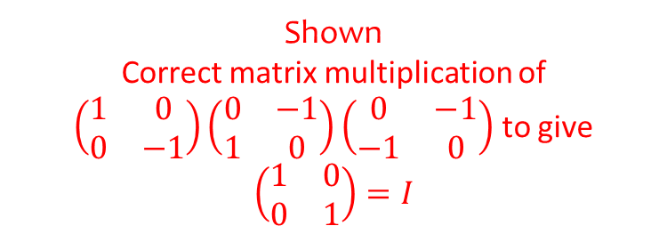
Worked example
Your turn
Use matrix multiplication to show that, in the $x−y$ plane,
a reflection in the line $y=x$,
followed by
a rotation, $90°$ clockwise about the origin,
followed by
a reflection in the $x$-axis
is equivalent to a transformation by the identity matrix.
Use matrix multiplication to show that, in the $x−y$ plane,
a reflection in the line $y=−x$,
followed by
a rotation, $90°$ anticlockwise about the origin,
followed by
a reflection in the $x$-axis
is equivalent to a transformation by the identity matrix.
Shown
Correct matrix multiplication of $\left(\begin{matrix}1 & 0 \\ 0 & −1\end{matrix}\right)\left(\begin{matrix}0 & −1 \\ 1 & 0\end{matrix}\right)\left(\begin{matrix}0 & −1 \\ −1 & 0\end{matrix}\right)$ to give $\left(\begin{matrix}1 & 0 \\ 0 & 1\end{matrix}\right)=I$

