Slide 1
Basic differentiation
CONTENTS

Slide 2
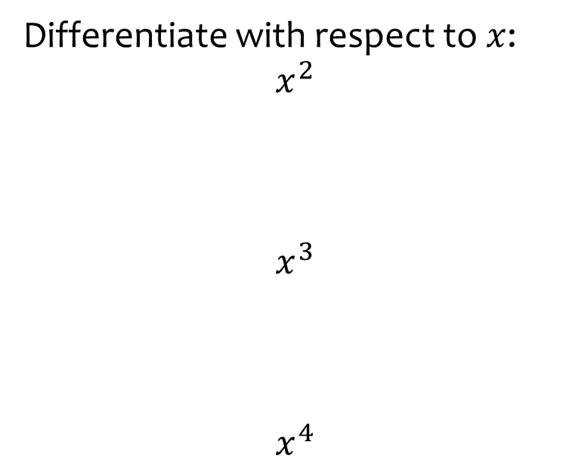
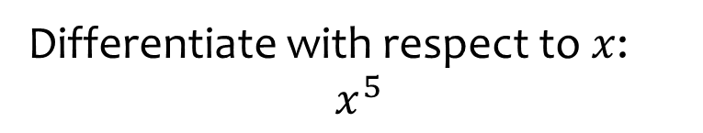

Worked example
Your turn
Differentiate with respect to $x$:
$$x^{2}$$
$$x^{3}$$
$$x^{4}$$
Differentiate with respect to $x$:
$$x^{5}$$
$$5x^{4}$$

Slide 3
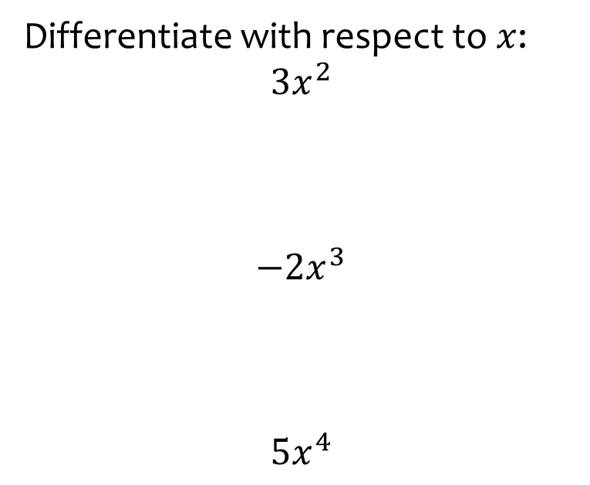
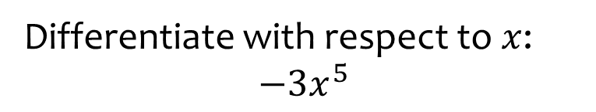

Worked example
Your turn
Differentiate with respect to $x$:
$$3x^{2}$$
$$−2x^{3}$$
$$5x^{4}$$
Differentiate with respect to $x$:
$${−3x}^{5}$$
$$−15x^{4}$$

Slide 4
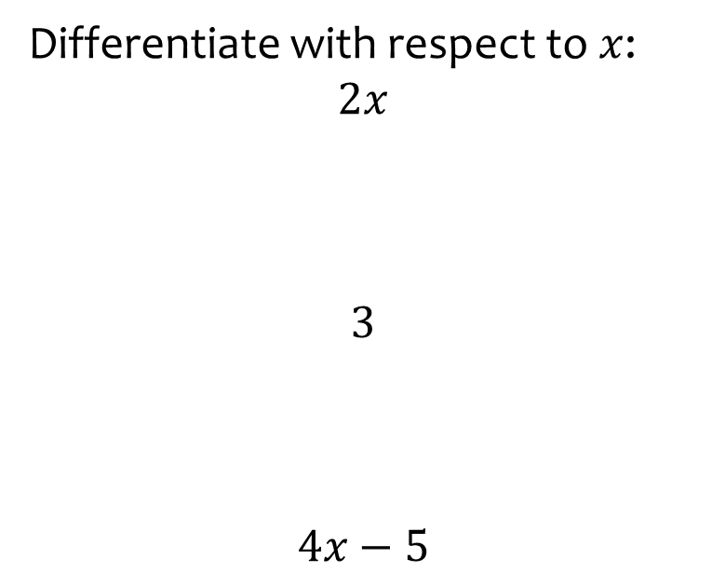
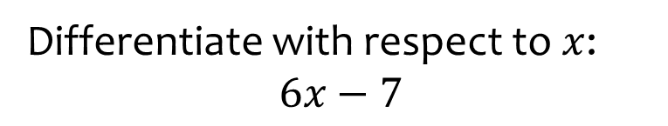

Worked example
Your turn
Differentiate with respect to $x$:
$$2x$$
$$3$$
$$4x−5$$
Differentiate with respect to $x$:
$$6x−7$$
$$6$$

Slide 5
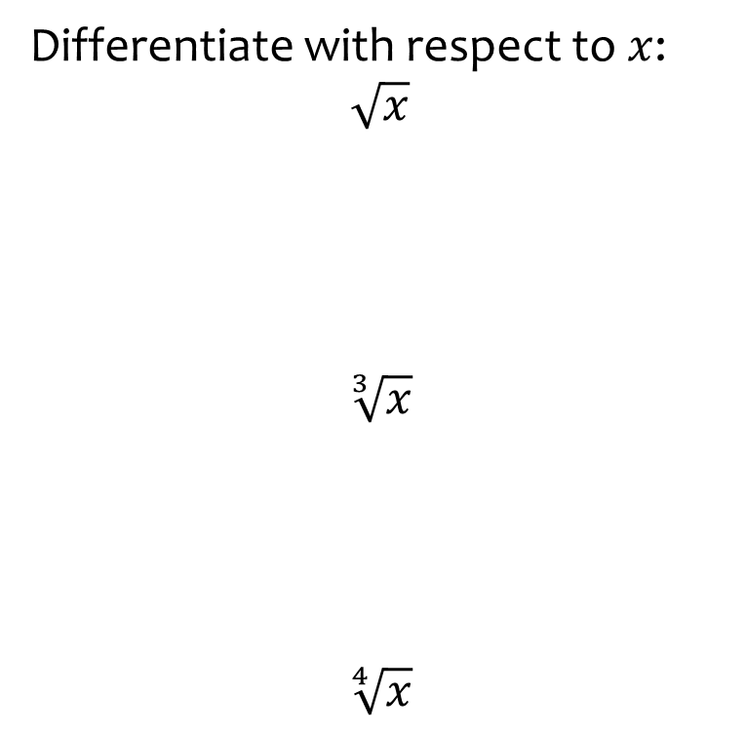
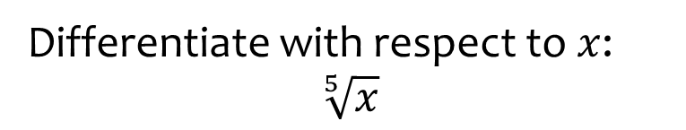

Worked example
Your turn
Differentiate with respect to $x$:
$$\sqrt{x}$$
$$\sqrt[3]{x}$$
$$\sqrt[4]{x}$$
Differentiate with respect to $x$:
$$\sqrt[5]{x}$$
$$\frac{1}{5}x^{−\frac{4}{5}}$$

Slide 6
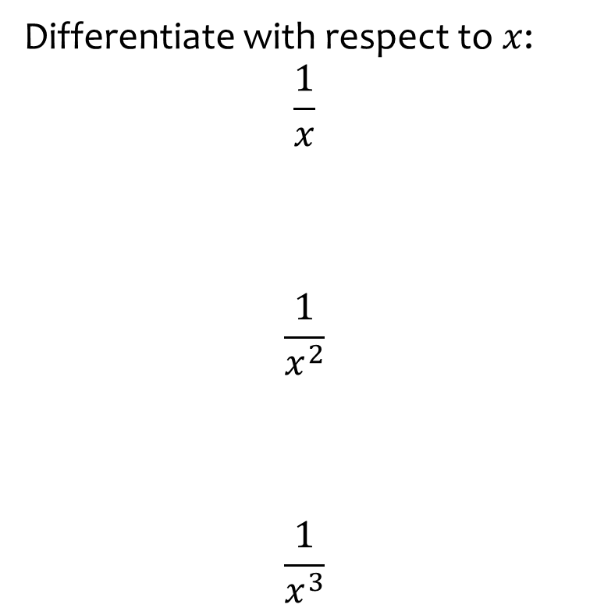
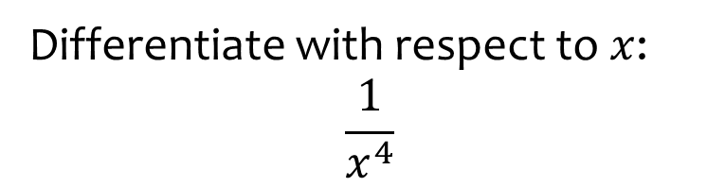

Worked example
Your turn
Differentiate with respect to $x$:
$$\frac{1}{x}$$
$$\frac{1}{x^{2}}$$
$$\frac{1}{x^{3}}$$
Differentiate with respect to $x$:
$$\frac{1}{x^{4}}$$
$$−4x^{−5}=−\frac{4}{x^{5}}$$

Slide 7
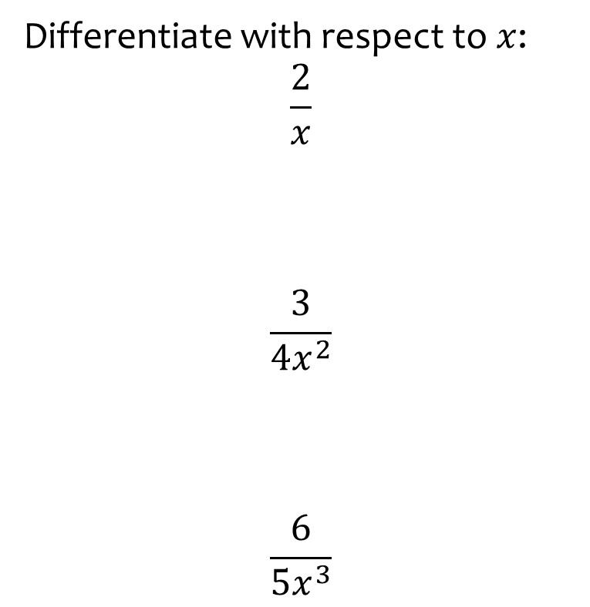
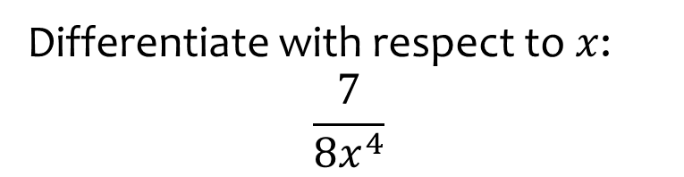

Worked example
Your turn
Differentiate with respect to $x$:
$$\frac{2}{x}$$
$$\frac{3}{{4x}^{2}}$$
$$\frac{6}{{5x}^{3}}$$
Differentiate with respect to $x$:
$$\frac{7}{{8x}^{4}}$$
$$−\frac{7}{2}x^{−5}=−\frac{7}{2x^{5}}$$

Slide 8
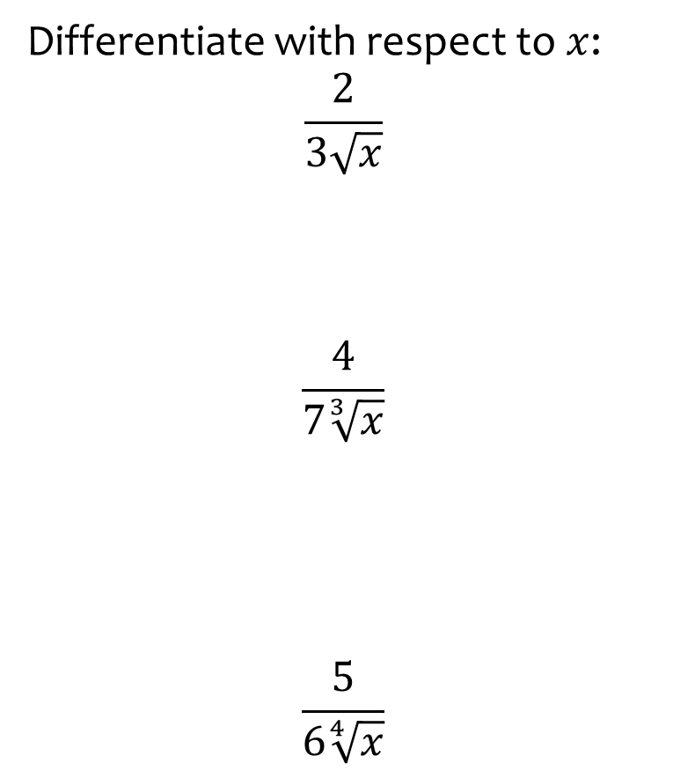
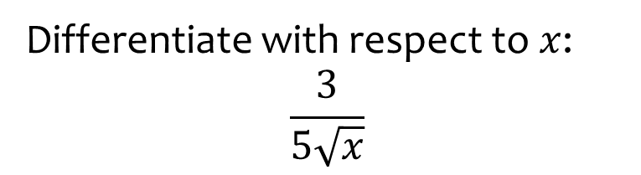

Worked example
Your turn
Differentiate with respect to $x$:
$$\frac{2}{3\sqrt{x}}$$
$$\frac{4}{7\sqrt[3]{x}}$$
$$\frac{5}{6\sqrt[4]{x}}$$
Differentiate with respect to $x$:
$$\frac{3}{5\sqrt{x}}$$
$$−\frac{3}{10}x^{−\frac{3}{2}}=−\frac{3}{10x\sqrt{x}}$$

Slide 9
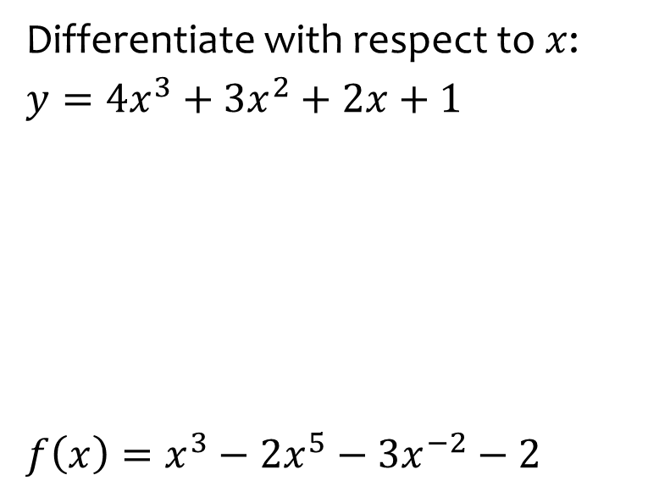
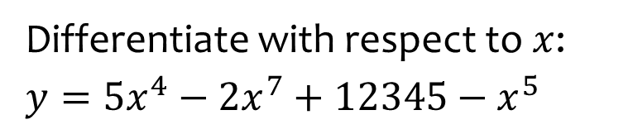
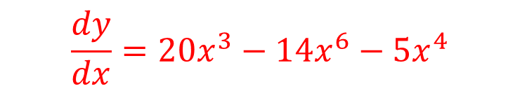
Worked example
Your turn
Differentiate with respect to $x$:
$$y=4x^{3}+3x^{2}+2x+1$$
$$f\left(x\right)=x^{3}−2x^{5}−3x^{−2}−2$$
Differentiate with respect to $x$:
$$y=5x^{4}−2x^{7}+12345−x^{5}$$
$$\frac{dy}{dx}=20x^{3}−14x^{6}−5x^{4}$$

Slide 10
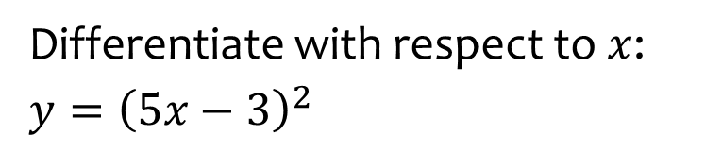
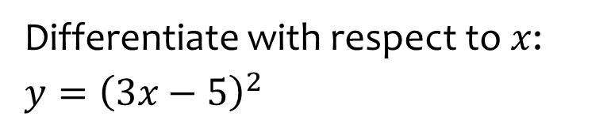

Worked example
Your turn
Differentiate with respect to $x$:
$$y={\left(5x−3\right)}^{2}$$
Differentiate with respect to $x$:
$$y={\left(3x−5\right)}^{2}$$
$$\frac{dy}{dx}=18x−30$$

Slide 11
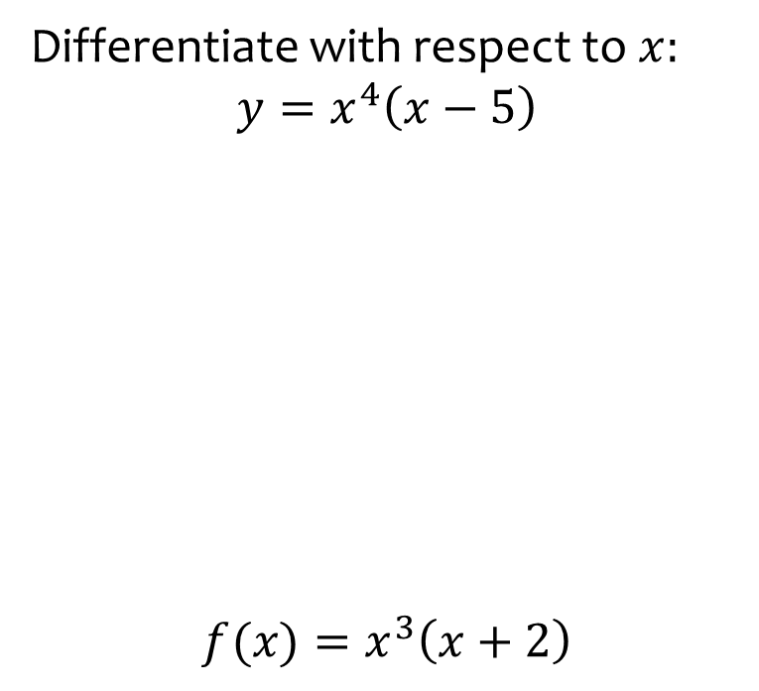
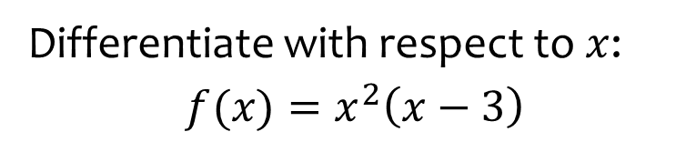

Worked example
Your turn
Differentiate with respect to $x:$
$$y=x^{4}\left(x−5\right)$$
$$f(x)=x^{3}\left(x+2\right)$$
Differentiate with respect to $x$:
$$f(x)=x^{2}\left(x−3\right)$$
$$f^{′}\left(x\right)=3x^{2}−6x$$

Slide 12
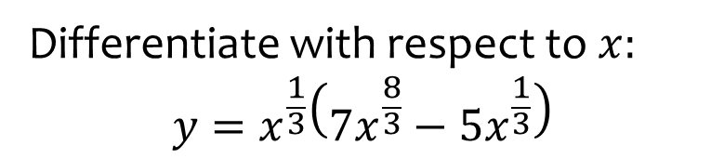
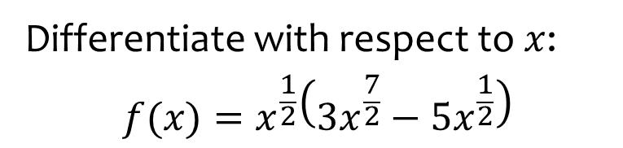

Worked example
Your turn
Differentiate with respect to $x:$
$$y=x^{\frac{1}{3}}\left({7x}^{\frac{8}{3}}−5x^{\frac{1}{3}}\right)$$
Differentiate with respect to $x$:
$$f(x)=x^{\frac{1}{2}}\left({3x}^{\frac{7}{2}}−{5x}^{\frac{1}{2}}\right)$$
$$f^{′}\left(x\right)=12x^{3}−5$$

Slide 13
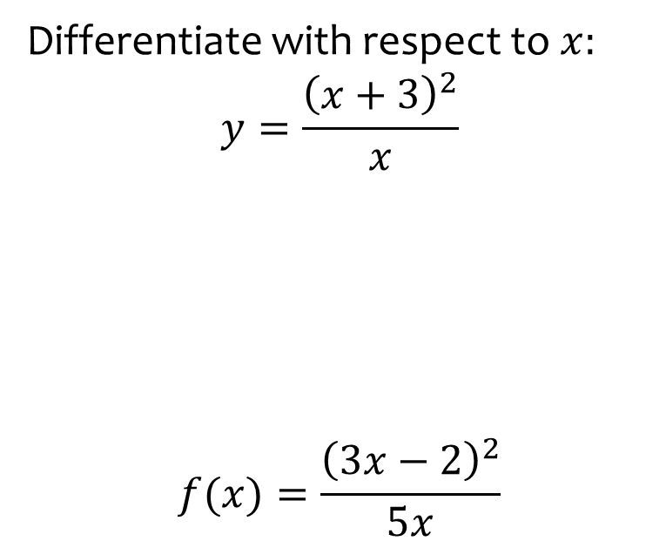
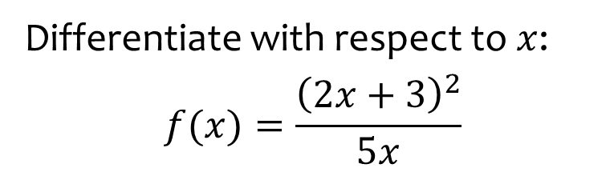
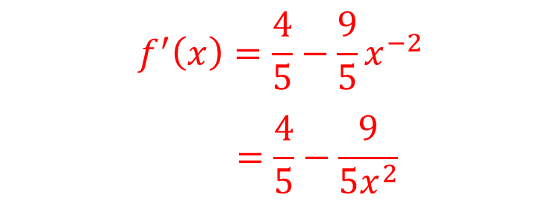
Worked example
Your turn
Differentiate with respect to $x:$
$$y=\frac{{\left(x+3\right)}^{2}}{x}$$
$$f(x)=\frac{{\left(3x−2\right)}^{2}}{5x}$$
Differentiate with respect to $x$:
$$f(x)=\frac{{\left(2x+3\right)}^{2}}{5x}$$
$$f^{′}\left(x\right)=\frac{4}{5}−\frac{9}{5}x^{−2}$$
$$=\frac{4}{5}−\frac{9}{5x^{2}}$$

Slide 14
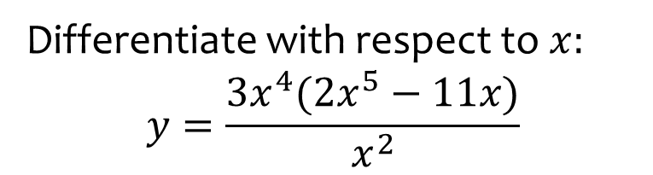
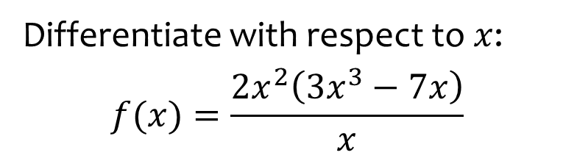

Worked example
Your turn
Differentiate with respect to $x:$
$$y=\frac{3x^{4}(2x^{5}−11x)}{x^{2}}$$
Differentiate with respect to $x$:
$$f(x)=\frac{2x^{2}\left(3x^{3}−7x\right)}{x}$$
$$f^{′}\left(x\right)=24x^{3}−28x$$

Slide 15
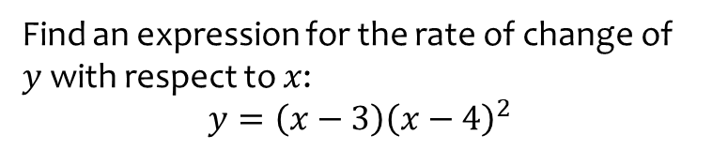
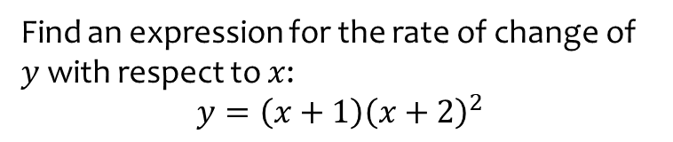

Worked example
Your turn
Find an expression for the rate of change of $y$ with respect to $x$:
$$y=\left(x−3\right){\left(x−4\right)}^{2}$$
Find an expression for the rate of change of $y$ with respect to $x$:
$$y=\left(x+1\right){\left(x+2\right)}^{2}$$
$$\frac{dy}{dx}=3x^{2}+6x+3=3{\left(x+1\right)}^{2}$$

Slide 16
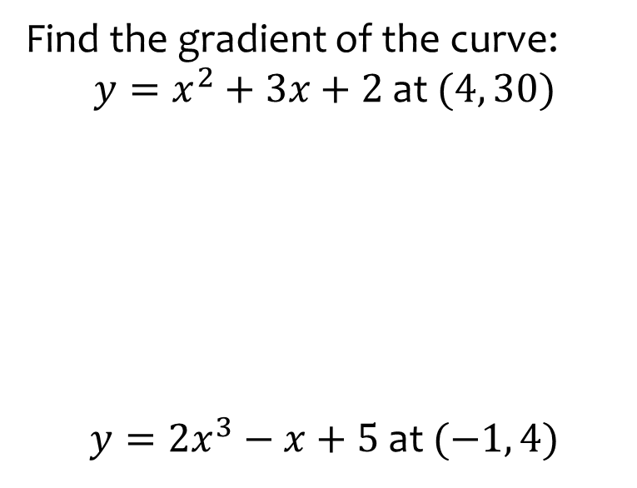
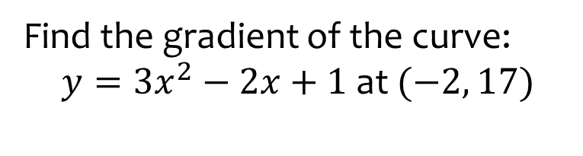

Worked example
Your turn
Find the gradient of the curve:
$y=x^{2}+3x+2$ at $(4, 30)$
$y=2x^{3}−x+5$ at $(−1, 4)$
Find the gradient of the curve:
$y=3x^{2}−2x+1$ at $(−2, 17)$
$$−14$$

Slide 17
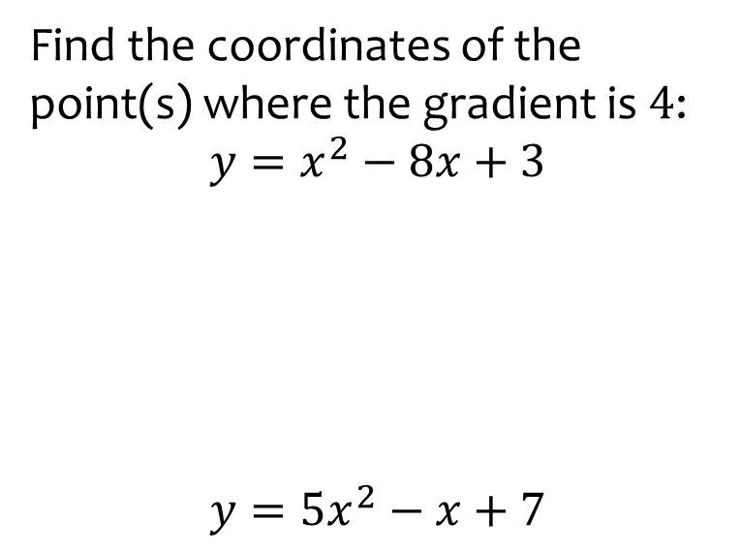
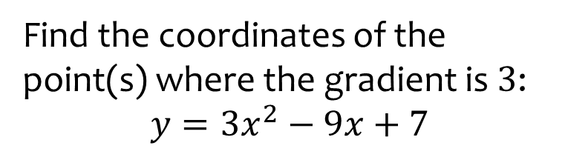

Worked example
Your turn
Find the coordinates of the point(s) where the gradient is $4$:
$$y=x^{2}−8x+3$$
$$y=5x^{2}−x+7$$
Find the coordinates of the point(s) where the gradient is $3$:
$$y=3x^{2}−9x+7$$
$$(2, 1)$$

Slide 18
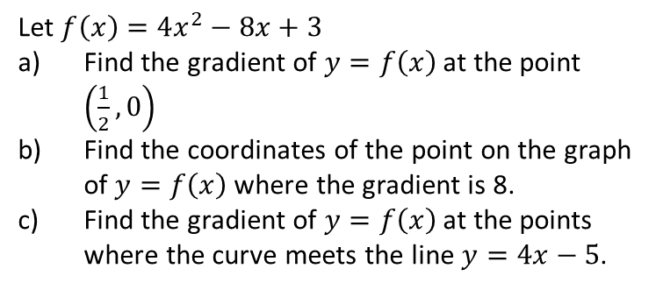
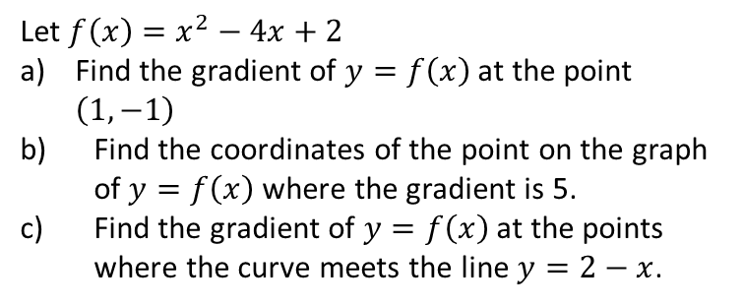
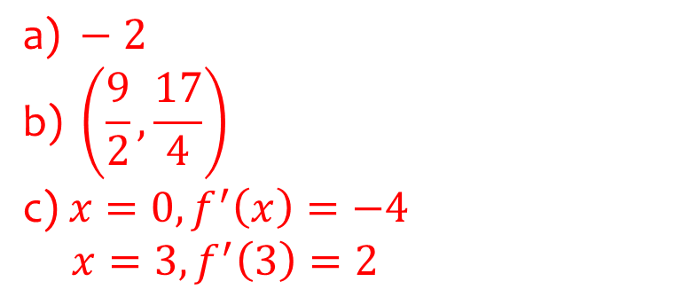
Worked example
Your turn
Let $f\left(x\right)=4x^{2}−8x+3$
Find the gradient of $y=f\left(x\right)$ at the point $\left(\frac{1}{2},0\right)$
Find the coordinates of the point on the graph of $y=f\left(x\right)$ where the gradient is 8.
Find the gradient of $y=f\left(x\right)$ at the points where the curve meets the line $y=4x−5$.
Let $f\left(x\right)=x^{2}−4x+2$
Find the gradient of $y=f\left(x\right)$ at the point $\left(1,−1\right)$
Find the coordinates of the point on the graph of $y=f\left(x\right)$ where the gradient is 5.
Find the gradient of $y=f\left(x\right)$ at the points where the curve meets the line $y=2−x$.
$$\text{a}\text{) }−2$$
$$\text{b}\text{) }\left(\frac{9}{2},\frac{17}{4}\right)$$
$$\text{c}\text{) }x=0, f^{′}\left(x\right)=−4$$
$$x=3, f^{′}\left(3\right)=2$$

Slide 19
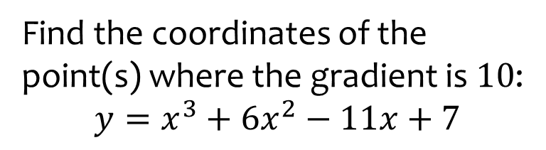
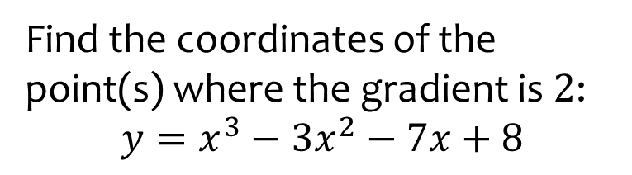

Worked example
Your turn
Find the coordinates of the point(s) where the gradient is $10$:
$$y=x^{3}+6x^{2}−11x+7$$
Find the coordinates of the point(s) where the gradient is $2$:
$$y=x^{3}−3x^{2}−7x+8$$
$$(−1, 11) \text{and} (3, −13)$$

Slide 20
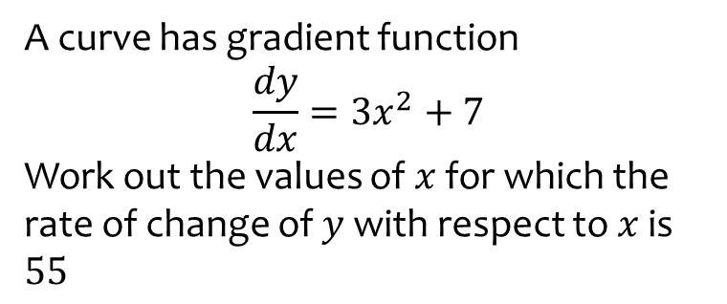
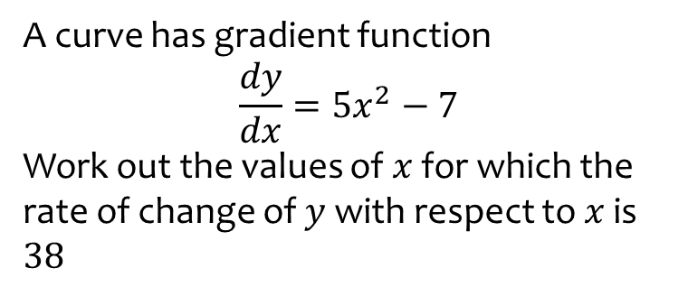

Worked example
Your turn
A curve has gradient function
$$\frac{dy}{dx}=3x^{2}+7$$
Work out the values of $x$ for which the rate of change of $y$ with respect to $x$ is $55$
A curve has gradient function
$$\frac{dy}{dx}=5x^{2}−7$$
Work out the values of $x$ for which the rate of change of $y$ with respect to $x$ is $38$
$$x=±3$$

Slide 21
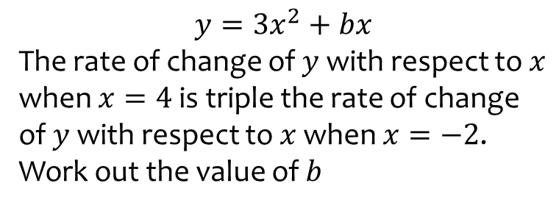
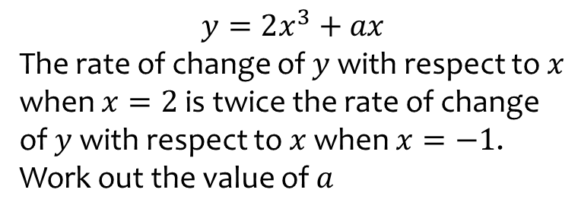

Worked example
Your turn
$$y=3x^{2}+bx$$
The rate of change of $y$ with respect to $x$ when $x=4$ is triple the rate of change of $y$ with respect to $x$ when $x=−2$.
Work out the value of $b$
$$y=2x^{3}+ax$$
The rate of change of $y$ with respect to $x$ when $x=2$ is twice the rate of change of $y$ with respect to $x$ when $x=−1$.
Work out the value of $a$
$$a=12$$

