Slide 1
Algebraic fractions
CONTENTS

Slide 2
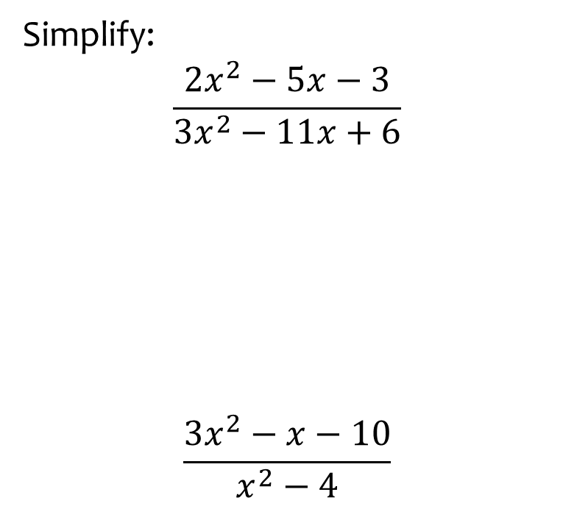
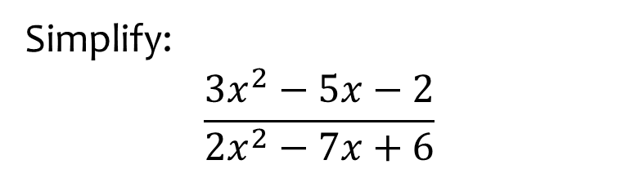

Worked example
Your turn
Simplify:
$$\frac{2x^{2}−5x−3}{3x^{2}−11x+6}$$
$$\frac{3x^{2}−x−10}{x^{2}−4}$$
Simplify:
$$\frac{3x^{2}−5x−2}{2x^{2}−7x+6}$$
$$\frac{3x+1}{2x−3}$$

Slide 3
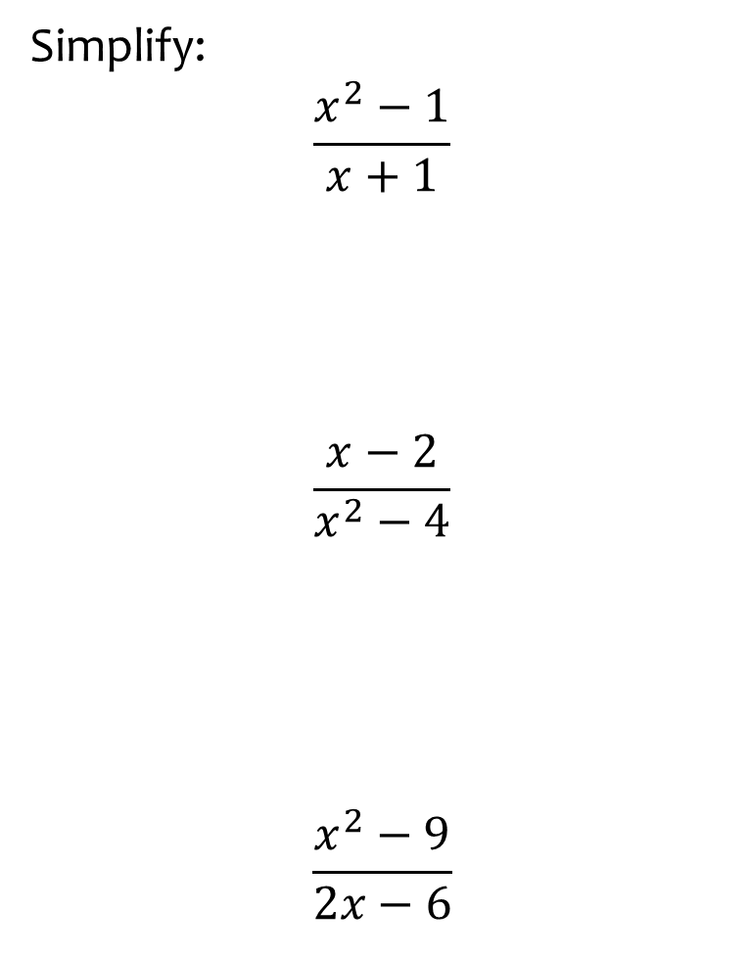
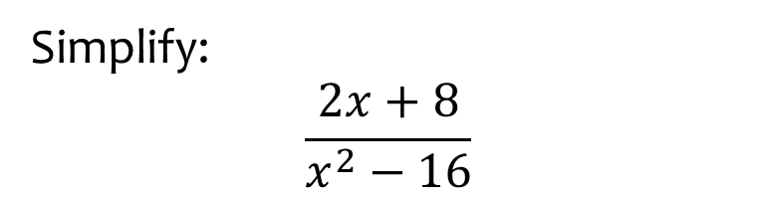

Worked example
Your turn
Simplify:
$$\frac{x^{2}−1}{x+1}$$
$$\frac{x−2}{x^{2}−4}$$
$$\frac{x^{2}−9}{2x−6}$$
Simplify:
$$\frac{2x+8}{x^{2}−16}$$
$$\frac{2}{x−4}$$

Slide 4
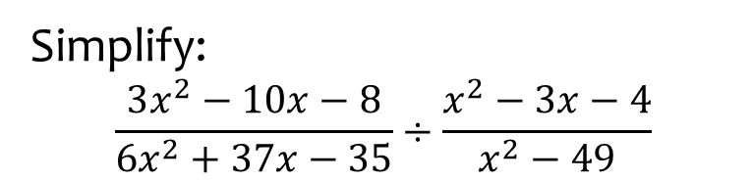
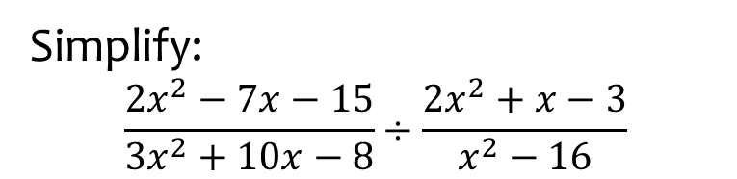

Worked example
Your turn
Simplify:
$$\frac{3x^{2}−10x−8}{6x^{2}+37x−35}÷\frac{x^{2}−3x−4}{x^{2}−49}$$
Simplify:
$$\frac{2x^{2}−7x−15}{3x^{2}+10x−8}÷\frac{2x^{2}+x−3}{x^{2}−16}$$
$$\frac{\left(x−5\right)\left(x−4\right)}{\left(3x−2\right)\left(x−1\right)}$$

Slide 5
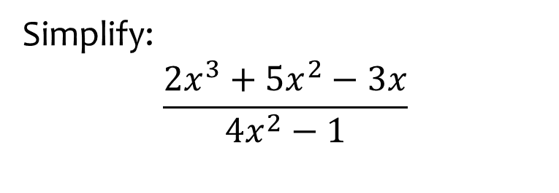
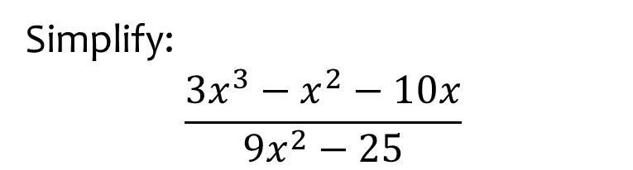

Worked example
Your turn
Simplify:
$$\frac{2x^{3}+5x^{2}−3x}{4x^{2}−1}$$
Simplify:
$$\frac{3x^{3}−x^{2}−10x}{9x^{2}−25}$$
$$\frac{x\left(x−2\right)}{3x−5}$$

Slide 6
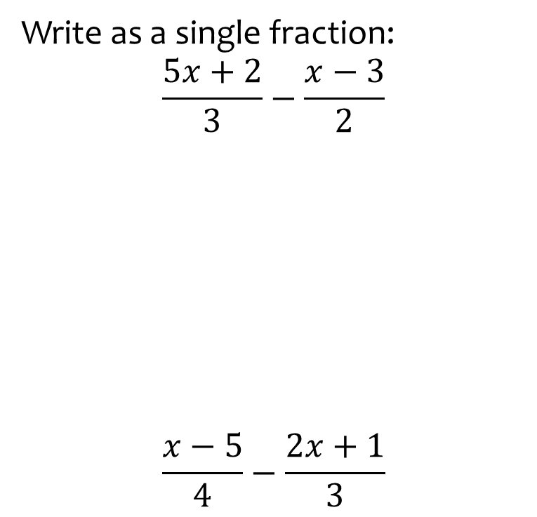
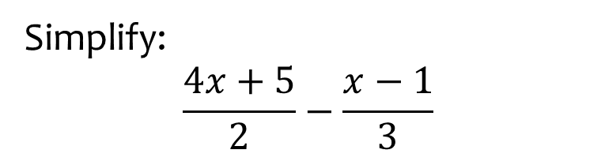

Worked example
Your turn
Write as a single fraction:
$$\frac{5x+2}{3}−\frac{x−3}{2}$$
$$\frac{x−5}{4}−\frac{2x+1}{3}$$
Simplify:
$$\frac{4x+5}{2}−\frac{x−1}{3}$$
$$\frac{10x+17}{6}$$

Slide 7
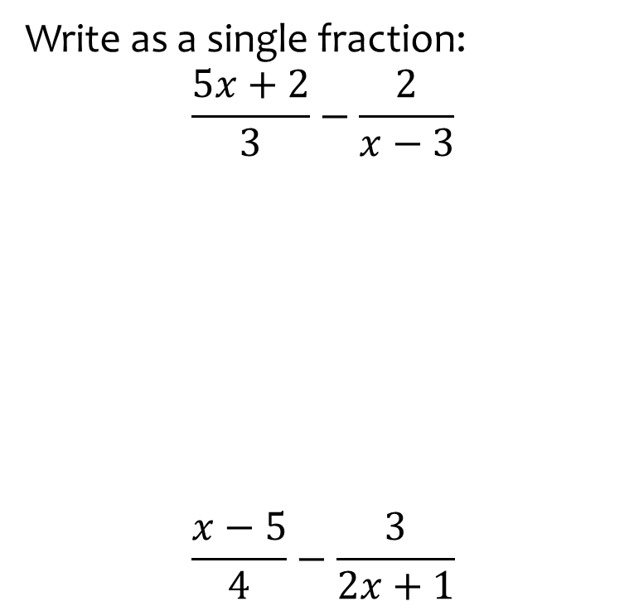
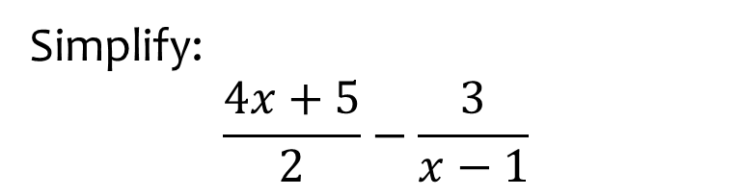

Worked example
Your turn
Write as a single fraction:
$$\frac{5x+2}{3}−\frac{2}{x−3}$$
$$\frac{x−5}{4}−\frac{3}{2x+1}$$
Simplify:
$$\frac{4x+5}{2}−\frac{3}{x−1}$$
$$\frac{4x^{2}+x−11}{2\left(x−1\right)}$$

Slide 8
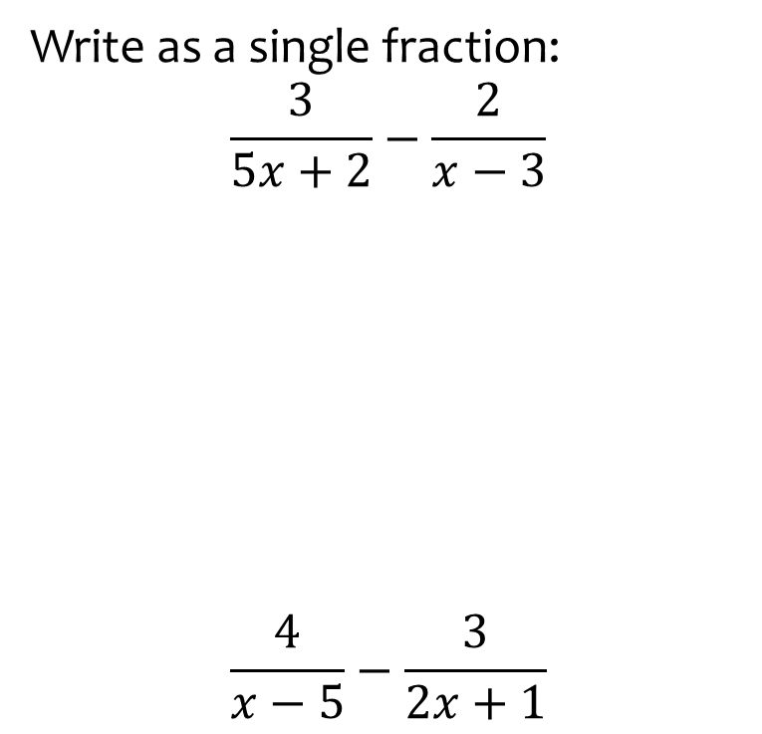
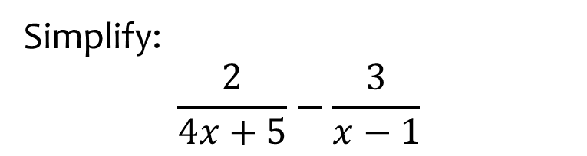

Worked example
Your turn
Write as a single fraction:
$$\frac{3}{5x+2}−\frac{2}{x−3}$$
$$\frac{4}{x−5}−\frac{3}{2x+1}$$
Simplify:
$$\frac{2}{4x+5}−\frac{3}{x−1}$$
$$\frac{−10x−17}{\left(4x+5\right)\left(x−1\right)}$$

Slide 9
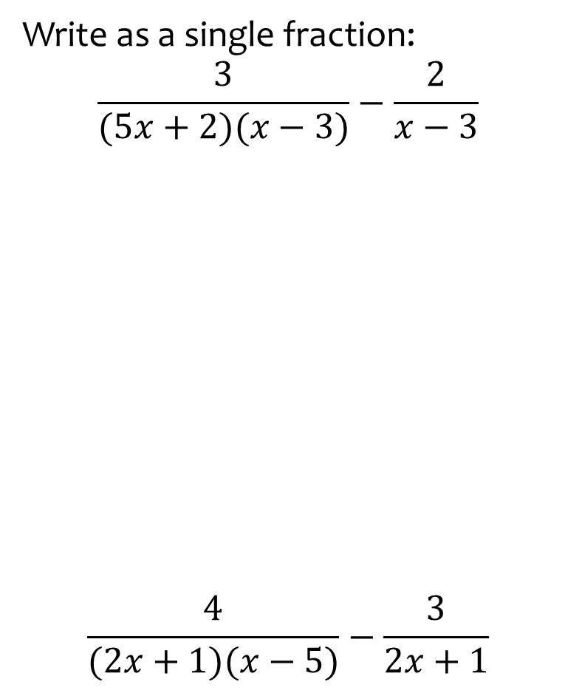
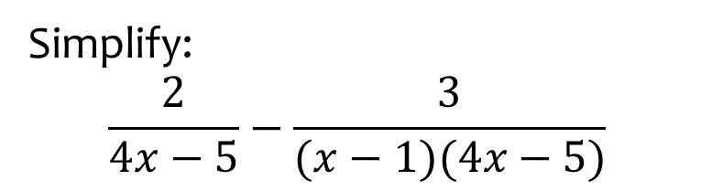

Worked example
Your turn
Write as a single fraction:
$$\frac{3}{(5x+2)(x−3)}−\frac{2}{x−3}$$
$$\frac{4}{(2x+1)(x−5)}−\frac{3}{2x+1}$$
Simplify:
$$\frac{2}{4x−5}−\frac{3}{(x−1)(4x−5)}$$
$$\frac{2x−5}{\left(x−1\right)\left(4x−5\right)}$$

Slide 10
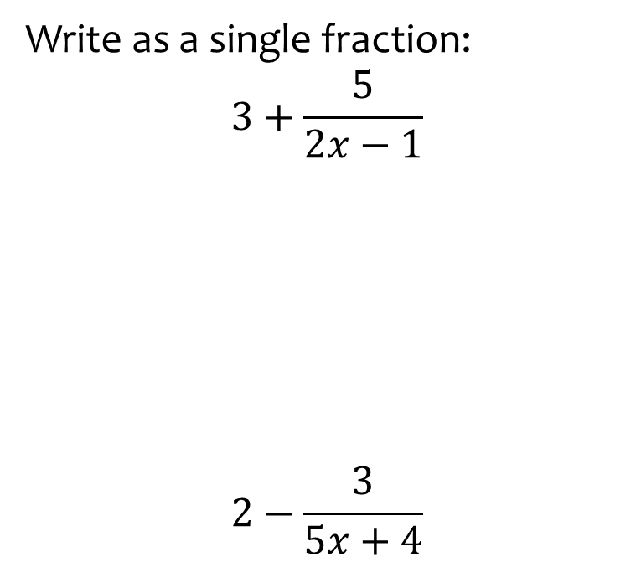


Worked example
Your turn
Write as a single fraction:
$$3+\frac{5}{2x−1}$$
$$2−\frac{3}{5x+4}$$
Write as a single fraction:
$$5−\frac{3}{x+2}$$
$$\frac{5x+7}{x+2}$$

Slide 11
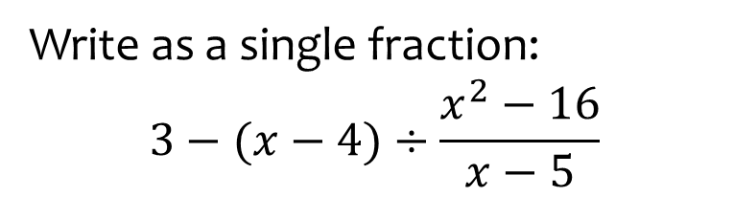
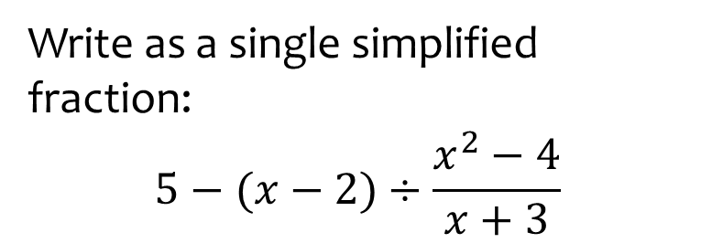

Worked example
Your turn
Write as a single fraction:
$$3−(x−4)÷\frac{x^{2}−16}{x−5}$$
Write as a single simplified fraction:
$$5−(x−2)÷\frac{x^{2}−4}{x+3}$$
$$\frac{4x+7}{x−2}$$

Slide 12
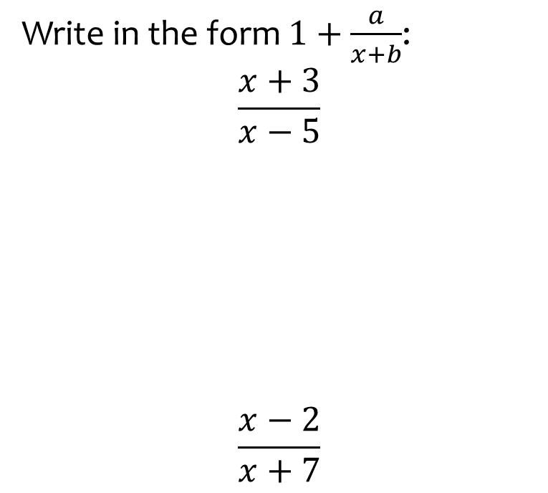
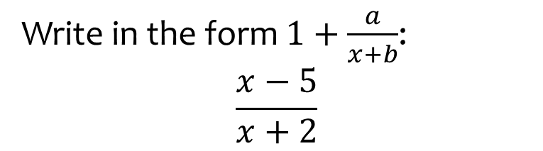

Worked example
Your turn
Write in the form $1+\frac{a}{x+b}$:
$$\frac{x+3}{x−5}$$
$$\frac{x−2}{x+7}$$
Write in the form $1+\frac{a}{x+b}$:
$$\frac{x−5}{x+2}$$
$$1−\frac{7}{x+2}$$

Slide 13
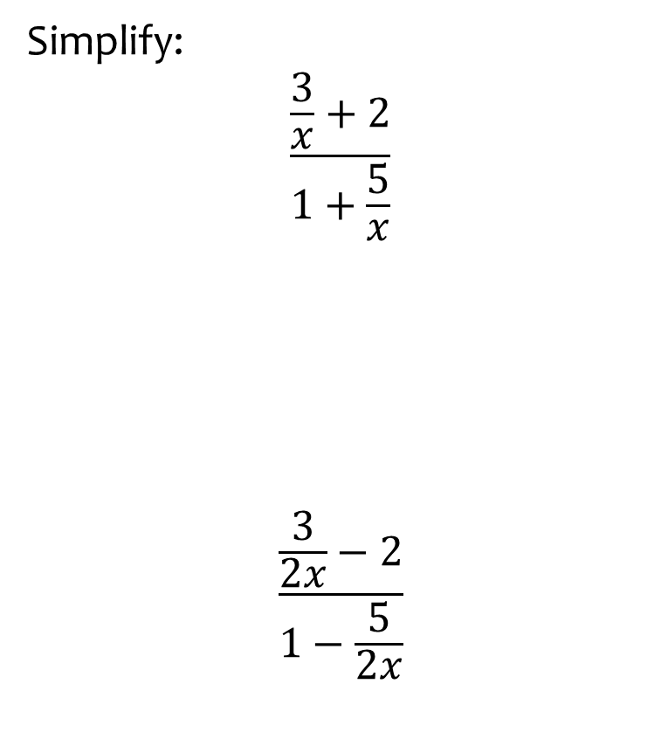
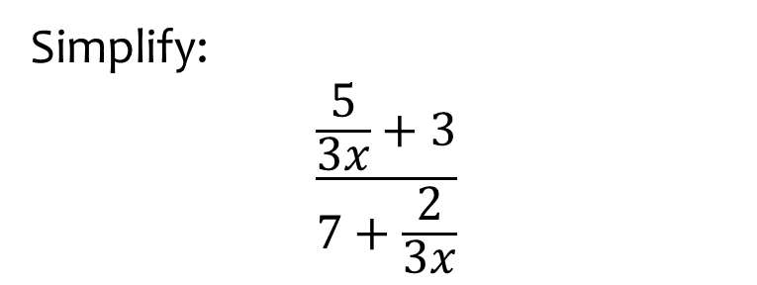

Worked example
Your turn
Simplify:
$$\frac{\frac{3}{x}+2}{1+\frac{5}{x}}$$
$$\frac{\frac{3}{2x}−2}{1−\frac{5}{2x}}$$
Simplify:
$$\frac{\frac{5}{3x}+3}{7+\frac{2}{3x}}$$
$$\frac{9x+5}{21x+2}$$

Slide 14
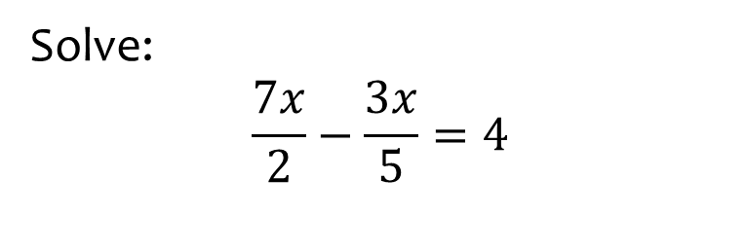
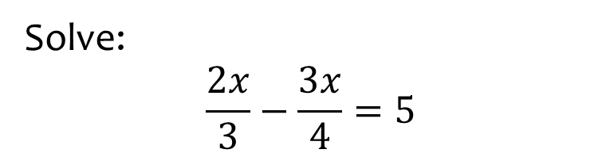

Worked example
Your turn
Solve:
$$\frac{7x}{2}−\frac{3x}{5}=4$$
Solve:
$$\frac{2x}{3}−\frac{3x}{4}=5$$
$$x=−60$$

Slide 15
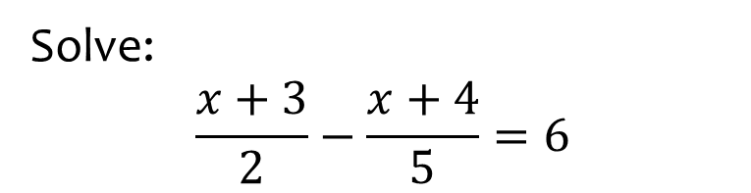
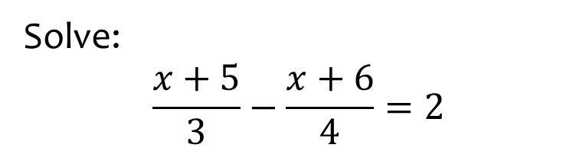

Worked example
Your turn
Solve:
$$\frac{x+3}{2}−\frac{x+4}{5}=6$$
Solve:
$$\frac{x+5}{3}−\frac{x+6}{4}=2$$
$$x=\frac{22}{7}$$

Slide 16
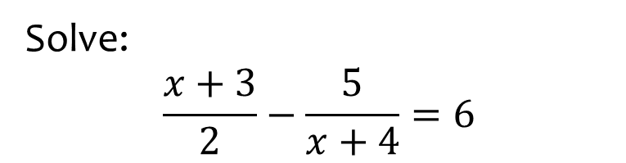
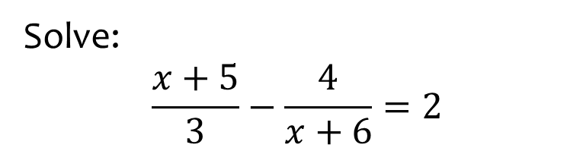
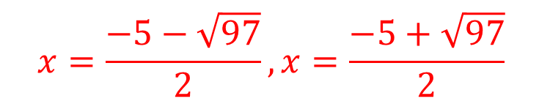
Worked example
Your turn
Solve:
$$\frac{x+3}{2}−\frac{5}{x+4}=6$$
Solve:
$$\frac{x+5}{3}−\frac{4}{x+6}=2$$
$$x=\frac{−5−\sqrt{97}}{2}, x=\frac{−5+\sqrt{97}}{2}$$

Slide 17
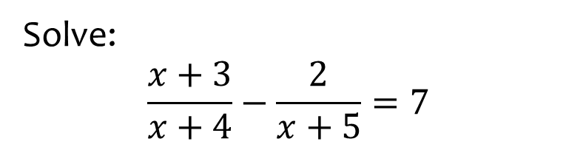
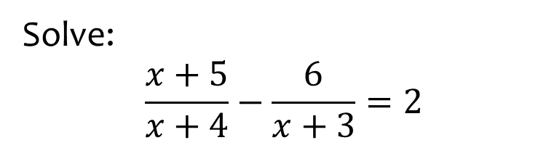

Worked example
Your turn
Solve:
$$\frac{x+3}{x+4}−\frac{2}{x+5}=7$$
Solve:
$$\frac{x+5}{x+4}−\frac{6}{x+3}=2$$
$$x=−6−\sqrt{3}, x=−6+\sqrt{3}$$

