Slide 1
Venn diagrams
CONTENTS

Slide 2





Worked example
Your turn
A number is picked from the Venn diagram. Calculate the probability of picking:
A prime number
An even number
A number greater than 5
A number less than or equal to 5
A number is picked from the Venn diagram. Calculate the probability of picking:
A prime number
An even number
A number greater than 5
A number less than or equal to 5
$$\frac{2}{3}$$
$$\frac{1}{3}$$
$$\frac{1}{6}$$
$$\frac{5}{6}$$
$$ξ$$
$$ξ$$
$$A$$
$$B$$
$$A$$
$$B$$
$$5$$
$$0$$
$$2$$
$$1$$
$$2$$
$$3$$
$$4$$
$$5$$
$$1$$
$$3$$
$$7$$
$$4$$

Slide 3




Worked example
Your turn
In a group of 28 scientists:
20 have degrees in Physics.
18 have degrees in Chemistry.
Some have degrees in both
4 scientists have degrees which are neither Physics nor Chemistry.
A scientist is chosen at random.
Find the probability that the scientist has a degree in:
Physics
Chemistry
Both Physics and Chemistry
Neither Physics nor Chemistry
In a group of 30 mathematicians:
15 have studied Calculus.
22 have studied Topology.
Some have studied both.
3 mathematicians have not yet studied either Calculus or topology
A mathematician is chosen at random. Find the probability that the mathematician has studied:
Calculus
Topology
Both Calculus and Topology
Neither Calculus nor topology
$$\frac{1}{2}$$
$$\frac{11}{15}$$
$$\frac{1}{3}$$
$$\frac{1}{10}$$

Slide 4

Worked example
Your turn
There are 150 pupils. The examinations available are: English, Maths and Science.
15 pupils are sitting English and Maths but not science
20 pupils are sitting Science and Maths but not English
18 pupils are sitting Science and English but not Maths
8 pupils are sitting all three exams.
55 are sitting English in total
72 are sitting Maths in total
65 are sitting Science in total
A pupil is chosen at random. What is the probability that they are sitting no exams?
There are 130 pupils. The examinations available are: English, Maths and Science.
10 pupils are sitting English and Maths but not science
20 pupils are sitting Science and Maths but not English
9 pupils are sitting Science and English but not Maths
13 pupils are sitting all three exams.
49 are sitting English in total
83 are sitting Maths in total
62 are sitting Science in total
A pupil is chosen at random. What is the probability that they are sitting no exams?
$$\frac{1}{130}$$

Slide 5
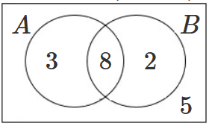
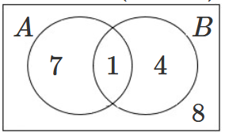
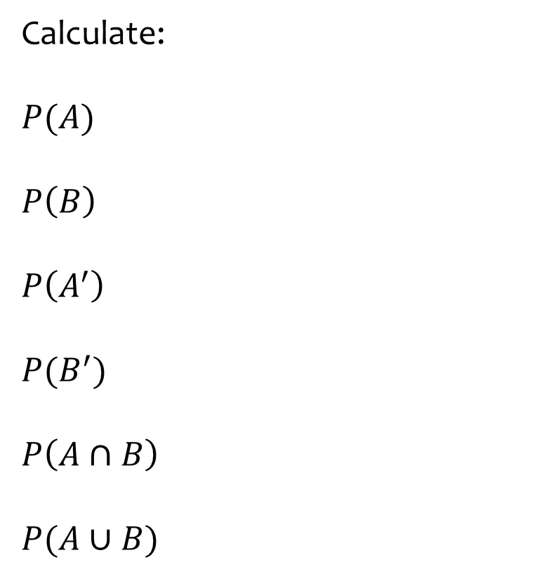
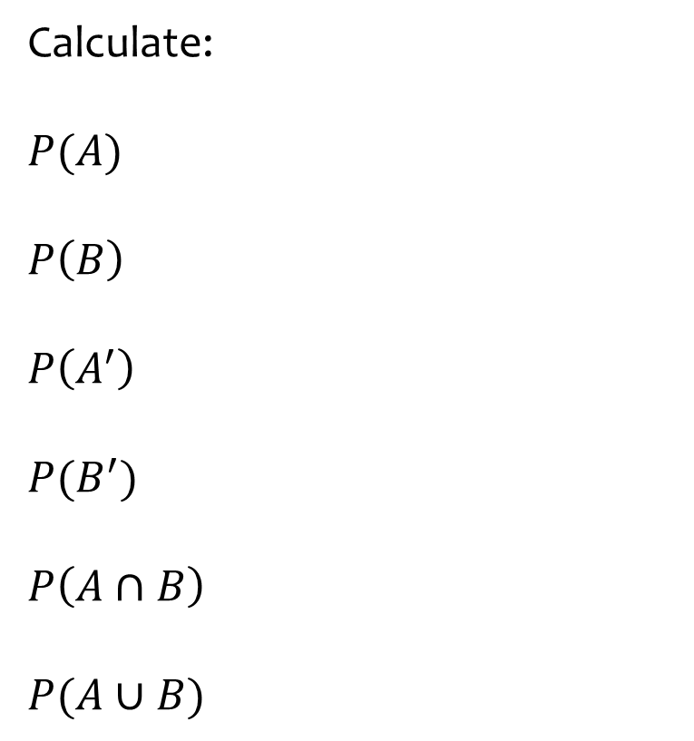
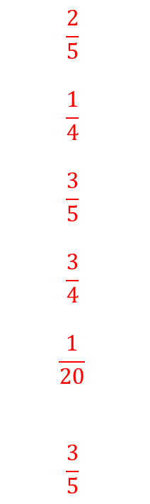
Worked example
Your turn
Calculate:
$$P(A)$$
$$P\left(B\right)$$
$$P\left(A^{′}\right)$$
$$P(B^{′})$$
$$P\left(A∩B\right)$$
$$P(A∪B)$$
Calculate:
$$P(A)$$
$$P\left(B\right)$$
$$P\left(A^{′}\right)$$
$$P(B^{′})$$
$$P\left(A∩B\right)$$
$$P(A∪B)$$
$$\frac{2}{5}$$
$$\frac{1}{4}$$
$$\frac{3}{5}$$
$$\frac{3}{4}$$
$$\frac{1}{20}$$
$$\frac{3}{5}$$

Slide 6
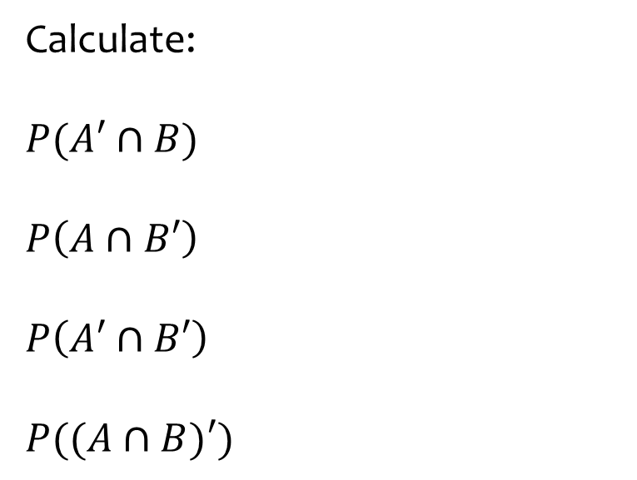
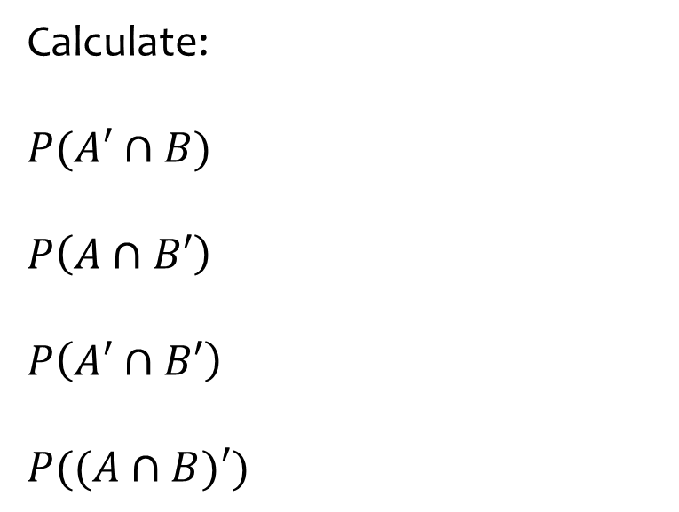
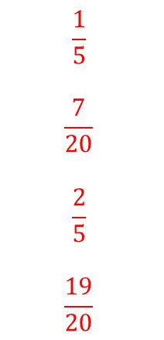
Worked example
Your turn
Calculate:
$$P(A′∩B)$$
$$P\left(A∩B′\right)$$
$$P\left(A′∩B′\right)$$
$$P((A∩B)′)$$
Calculate:
$$P(A′∩B)$$
$$P\left(A∩B′\right)$$
$$P\left(A′∩B′\right)$$
$$P((A∩B)′)$$
$$\frac{1}{5}$$
$$\frac{7}{20}$$
$$\frac{2}{5}$$
$$\frac{19}{20}$$

Slide 7
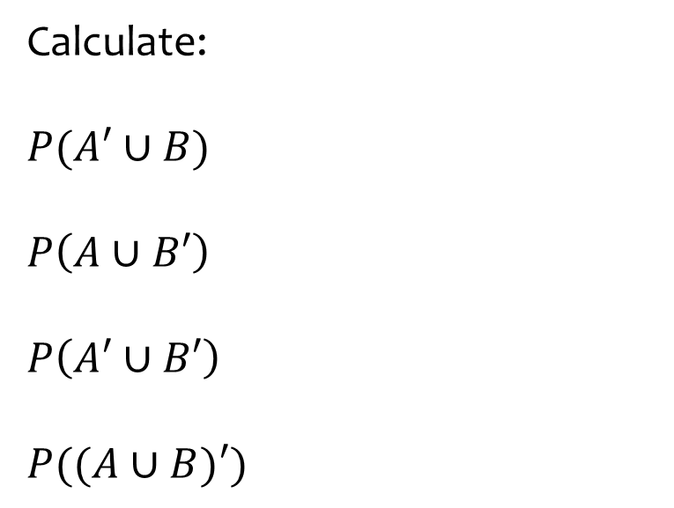
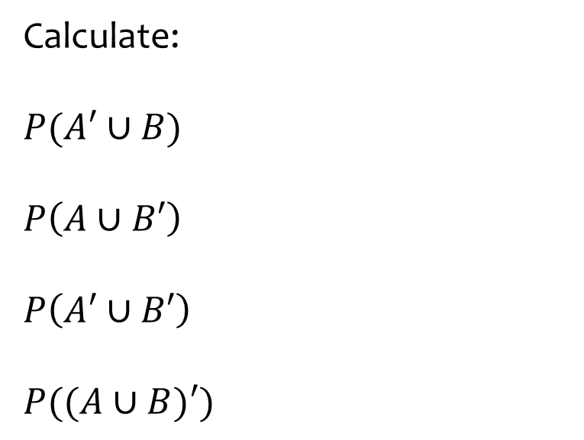
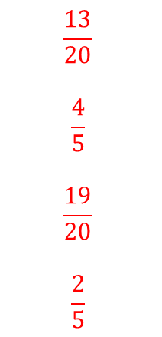
Worked example
Your turn
Calculate:
$$P(A′∪B)$$
$$P\left(A∪B′\right)$$
$$P\left(A′∪B′\right)$$
$$P((A∪B)′)$$
Calculate:
$$P(A′∪B)$$
$$P\left(A∪B′\right)$$
$$P\left(A′∪B′\right)$$
$$P((A∪B)′)$$
$$\frac{13}{20}$$
$$\frac{4}{5}$$
$$\frac{19}{20}$$
$$\frac{2}{5}$$

