Slide 1
Sampling
CONTENTS

Slide 2
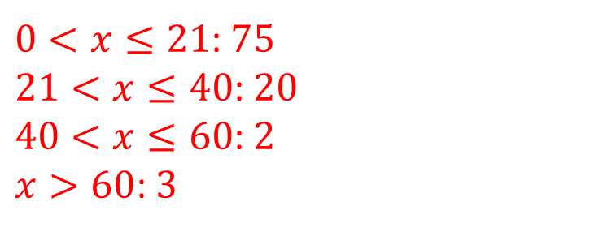
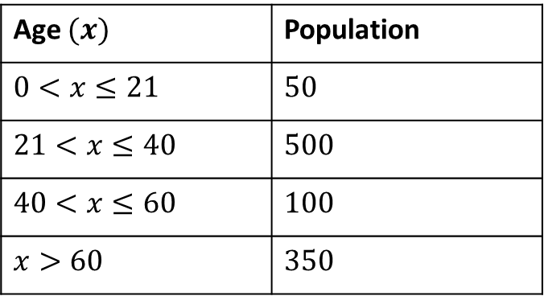
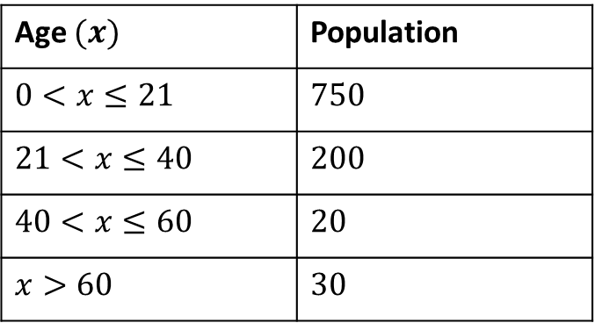
Worked example
Your turn
A stratified sample of 100 people is taken from the following information.
How many of each age group should be chosen in the sample?
A stratified sample of 100 people is taken from the following information.
How many of each age group should be chosen in the sample?
Age $(x)$ | Population
$$0<x≤21$$ | $$50$$
$$21<x≤40$$ | $$500$$
$$40<x≤60$$ | $$100$$
$$x>60$$ | $$350$$
Age $(x)$ | Population
$$0<x≤21$$ | $$750$$
$$21<x≤40$$ | $$200$$
$$40<x≤60$$ | $$20$$
$$x>60$$ | $$30$$
$0<x≤21$: $75$
$21<x≤40$: $20$
$40<x≤60$: $2$
$x>60$: $3$

Slide 3
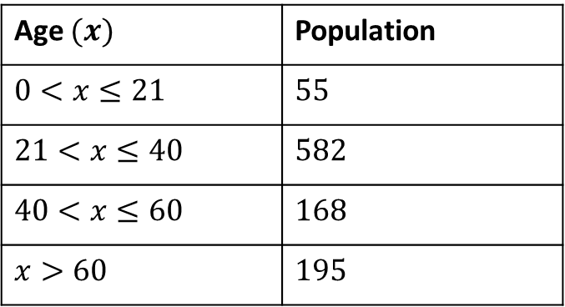
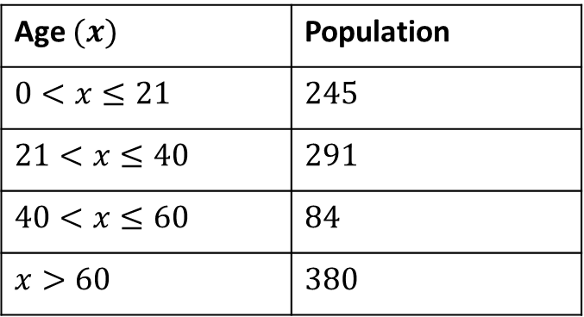
Worked example
Your turn
A stratified sample of 100 people is taken from the following information.
How many of each age group should be chosen in the sample?
A stratified sample of 100 people is taken from the following information.
How many of each age group should be chosen in the sample?
Age $(x)$ | Population
$$0<x≤21$$ | $$55$$
$$21<x≤40$$ | $$582$$
$$40<x≤60$$ | $$168$$
$$x>60$$ | $$195$$
Age $(x)$ | Population
$$0<x≤21$$ | $$245$$
$$21<x≤40$$ | $$291$$
$$40<x≤60$$ | $$84$$
$$x>60$$ | $$380$$
$0<x≤21$: $75$
$21<x≤40$: $20$
$40<x≤60$: $2$
$x>60$: $3$

Slide 4
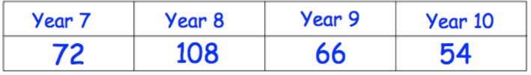

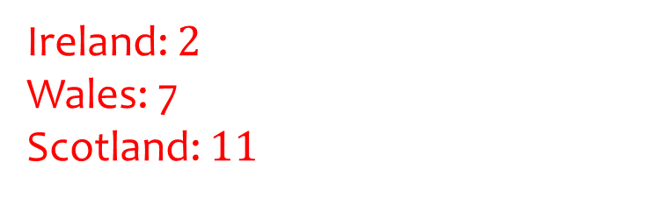
Worked example
Your turn
A stratified sample of 50 is taken from the following information
How many of each year group should be sampled?
A stratified sample of 20 is taken from the following information
How many people of each nationality should be sampled?
Ireland: $2$
Wales: 7
Scotland: $11$
Questions used with permission from Corbettmaths: https://corbettmaths.com/

Slide 5
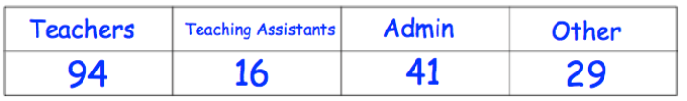

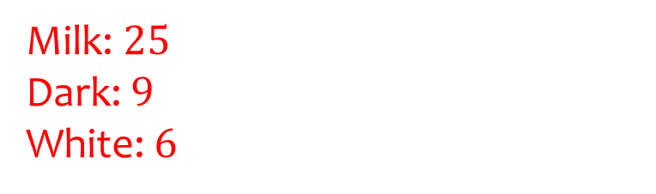
Worked example
Your turn
A stratified sample of 50 is taken from the following information
How many of each type of employee should be sampled?
A stratified sample of 40 is taken from the following information
How many of each chocolate should be sampled?
Milk: $25$
Dark: $9$
White: $6$
Questions used with permission from Corbettmaths: https://corbettmaths.com/

Slide 6
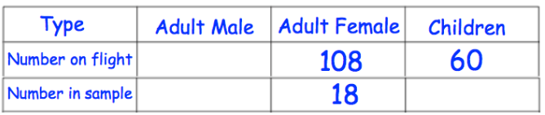
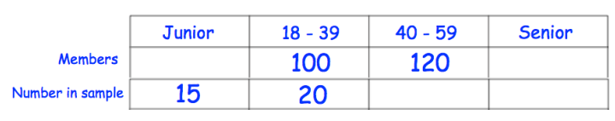
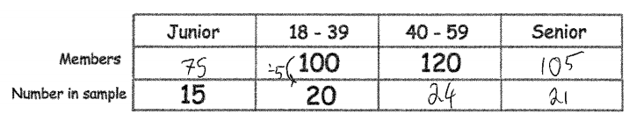
Worked example
Your turn
There are 300 passengers on a flight.
A stratified sample is taken by type of passenger
Complete the table.
There are 400 members of a sports club.
A stratified sample is taken by age group.
Complete the table.
Questions used with permission from Corbettmaths: https://corbettmaths.com/

Slide 7
Worked example
Your turn
Describe a method for taking a random sample of 5 students from a class of 30
Describe a method for taking a random sample of 10 students from a class of 50
Assign each student a number from 1 to 50.
Pick a random number using a random number generator.
Ignore any time a number appears twice.
Repeat until 10 numbers have been chosen.

Slide 8
Worked example
Your turn
A student wants to estimate the number of slugs in a greenhouse.
They catch and mark 20 slugs.
The eels are returned to the lake.
The next day the student catches 300 slugs.
Of these 300 slugs, 5 are ringed.
Estimate how many slugs there are in total in the greenhouse
A student wants to estimate the number of eels in a lake.
They catch and ring 50 eels.
The eels are returned to the lake.
The next day the student catches 400 eels.
Of these 400 eels, 10 are ringed.
Estimate how many eels there are in total in the lake
2000

