Slide 1
Probability
CONTENTS

Slide 2
Worked example
Your turn
Describe using impossible, unlikely, even chance, likely or certain the probability that:
You will walk to Mars.
The day after Monday is Tuesday.
You roll a three on a fair die.
You flip a tails on a fair coin.
Describe using impossible, unlikely, even chance, likely or certain the probability that:
You roll an even number on a fair die
The day after Monday is Wednesday.
You roll a number between 1 and 6 on a fair die.
You will go to space in your life.
Even chance
Impossible
Certain
Unlikely

Slide 3
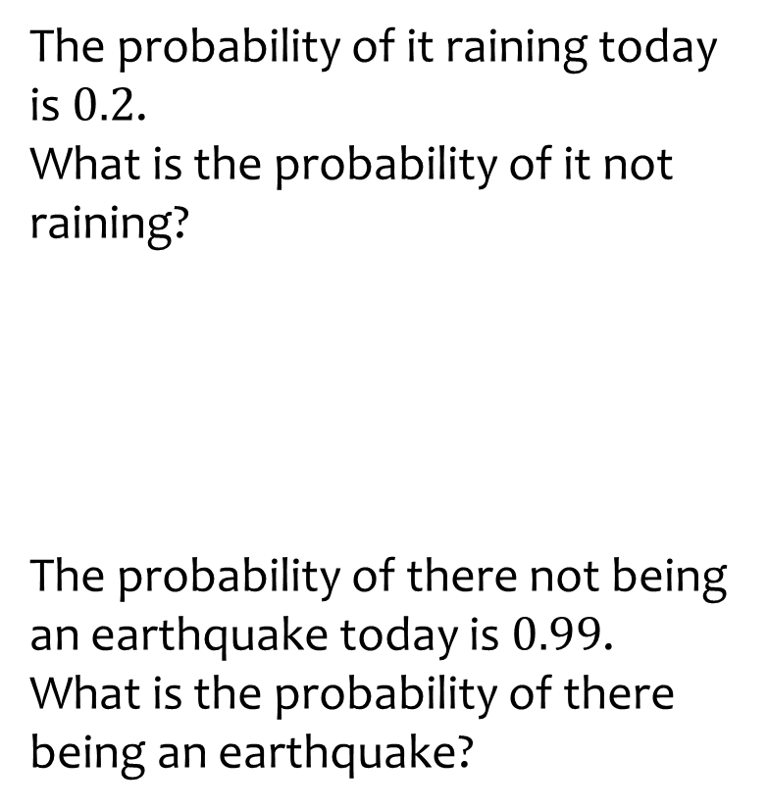
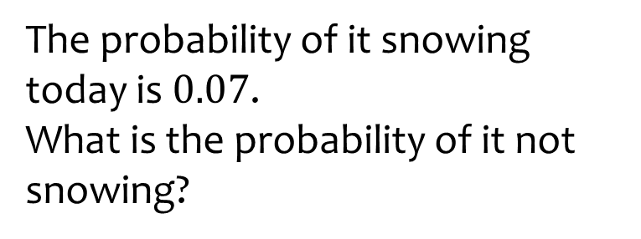

Worked example
Your turn
The probability of it raining today is $0.2$.
What is the probability of it not raining?
The probability of there not being an earthquake today is $0.99$.
What is the probability of there being an earthquake?
The probability of it snowing today is $0.07$.
What is the probability of it not snowing?
$$0.93$$

Slide 4
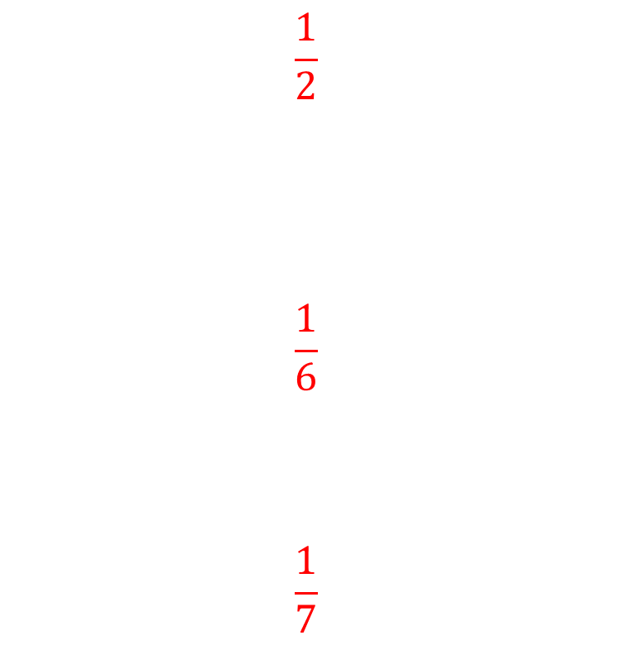
Worked example
Your turn
Calculate the probability of:
Flipping a tails from one toss of a fair coin
Rolling a 5 on a fair 6-sided die
Being born on a Monday
Calculate the probability of:
Flipping a heads from one toss of a fair coin
Rolling a 5 on a fair 6-sided die
Being born on a Monday
$$\frac{1}{2}$$
$$\frac{1}{6}$$
$$\frac{1}{7}$$

Slide 5
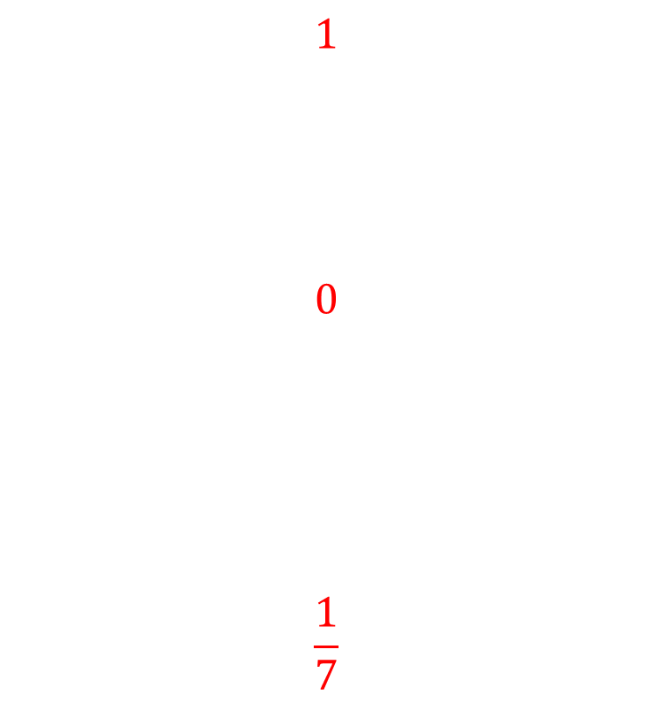
Worked example
Your turn
Calculate the probability of:
Flipping a tails or a heads from one toss of a fair coin
Rolling an odd number on a fair 6-sided die
Being born on a day beginning with S
Calculate the probability of:
Rolling a number from 1 to 6 on a fair 6-sided die
Rolling a 7 on a fair 6-sided die
Being born on a day beginning with W
$$1$$
$$0$$
$$\frac{1}{7}$$

Slide 6
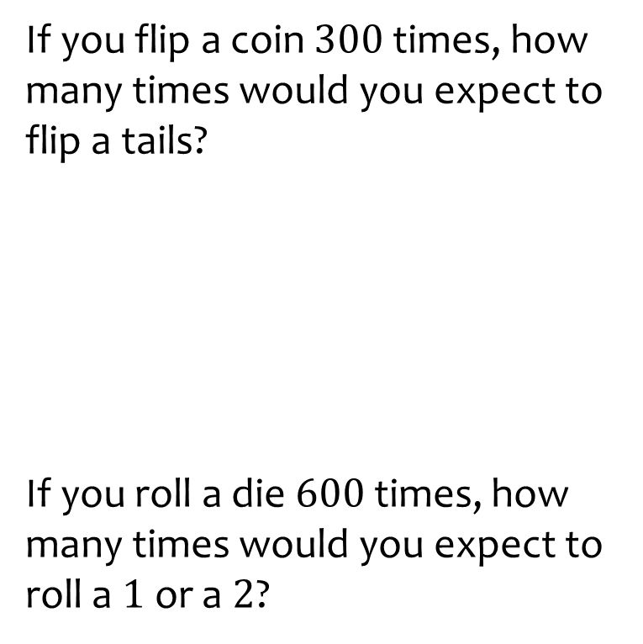
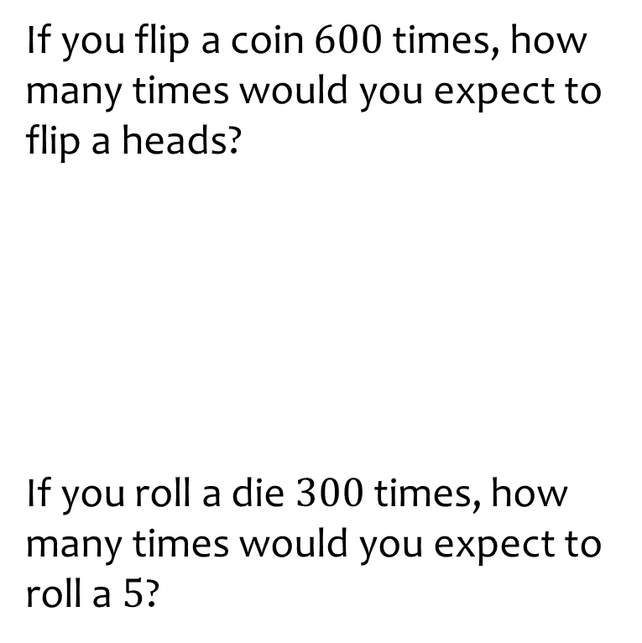
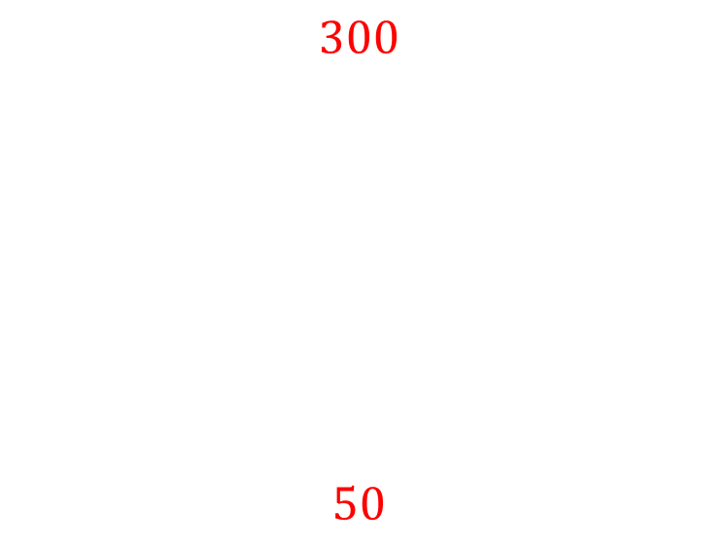
Worked example
Your turn
If you flip a coin $300$ times, how many times would you expect to flip a tails?
If you roll a die $600$ times, how many times would you expect to roll a $1$ or a $2$?
If you flip a coin $600$ times, how many times would you expect to flip a heads?
If you roll a die $300$times, how many times would you expect to roll a $5$?
$$300$$
$$50$$

Slide 7
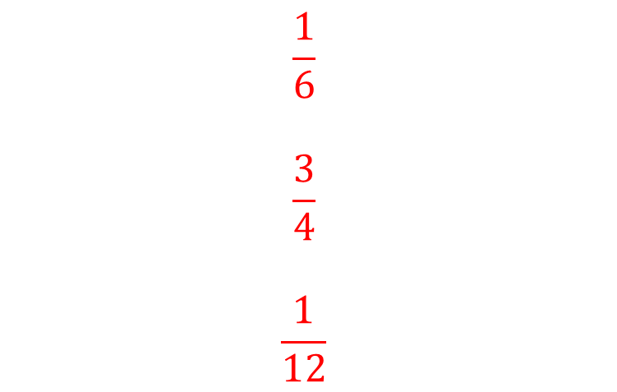
Worked example
Your turn
There are counters in a bag.
One counter is taken out the bag.
Find the probability that it is:
Red
Blue
Yellow
There are counters in a bag.
One counter is taken out the bag.
Find the probability that it is:
Purple
Orange
Green
Colour | Red | Blue | Yellow
Number | 5 | 10 | 15
Colour | Purple | Orange | Green
Number | 10 | 45 | 5
$$\frac{1}{6}$$
$$\frac{3}{4}$$
$$\frac{1}{12}$$

Slide 8
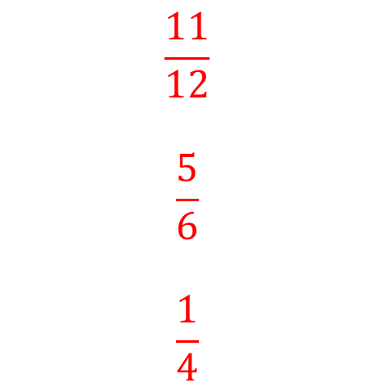
Worked example
Your turn
There are counters in a bag.
One counter is taken out the bag.
Find the probability that it is:
Red or blue
Blue or yellow
Red or yellow
There are counters in a bag.
One counter is taken out the bag.
Find the probability that it is:
Purple or orange
Orange or green
Purple or green
Colour | Red | Blue | Yellow
Number | 5 | 10 | 15
Colour | Purple | Orange | Green
Number | 10 | 45 | 5
$$\frac{11}{12}$$
$$\frac{5}{6}$$
$$\frac{1}{4}$$

Slide 9
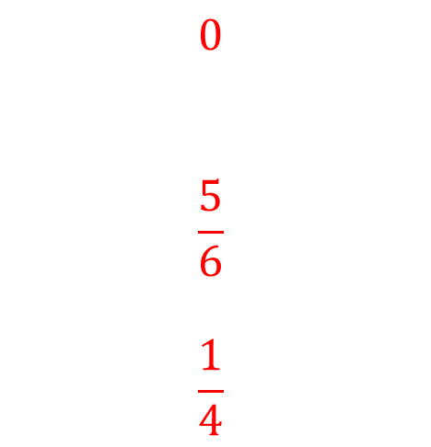
Worked example
Your turn
There are counters in a bag.
One counter is taken out the bag.
Find the probability that it is:
Red and blue
Blue and yellow
Red and yellow
There are counters in a bag.
One counter is taken out the bag.
Find the probability that it is:
Purple and orange
Orange or green
Purple or green
Colour | Red | Blue | Yellow
Number | 5 | 10 | 15
Colour | Purple | Orange | Green
Number | 10 | 45 | 5
$$0$$
$$\frac{5}{6}$$
$$\frac{1}{4}$$

Slide 10
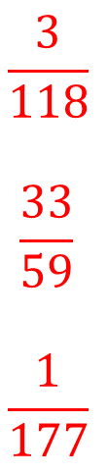
Worked example
Your turn
There are counters in a bag.
One counter is taken out the bag.
It is not replaced.
Then another counter is taken out the bag.
Find the probability that:
Both counters are red
Both counters are blue
Both counters are yellow
There are counters in a bag.
One counter is taken out the bag.
It is not replaced.
Then another counter is taken out the bag.
Find the probability that:
Both counters are purple
Both counters are orange
Both counters are green
Colour | Red | Blue | Yellow
Number | 5 | 10 | 15
Colour | Purple | Orange | Green
Number | 10 | 45 | 5
$$\frac{3}{118}$$
$$\frac{33}{59}$$
$$\frac{1}{177}$$

Slide 11
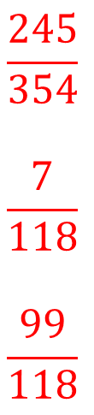
Worked example
Your turn
There are counters in a bag.
One counter is taken out the bag.
It is not replaced.
Then another counter is taken out the bag.
Find the probability that:
Neither counter is red
Neither counter is blue
Neither counter is yellow
There are counters in a bag.
One counter is taken out the bag.
It is not replaced.
Then another counter is taken out the bag.
Find the probability that:
Neither counter is purple
Neither counter is orange
Neither counter is green
Colour | Red | Blue | Yellow
Number | 5 | 10 | 15
Colour | Purple | Orange | Green
Number | 10 | 45 | 5
$$\frac{245}{354}$$
$$\frac{7}{118}$$
$$\frac{99}{118}$$

Slide 12

Worked example
Your turn
There are counters in a bag.
One counter is taken out the bag.
It is not replaced.
Then another counter is taken out the bag.
Find the probability that:
The counters are different colours
There are counters in a bag.
One counter is taken out the bag.
It is not replaced.
Then another counter is taken out the bag.
Find the probability that:
The counters are different colours
Colour | Red | Blue | Yellow
Number | 5 | 10 | 15
Colour | Purple | Orange | Green
Number | 10 | 45 | 5
$$\frac{145}{354}$$

Slide 13
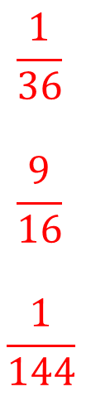
Worked example
Your turn
There are counters in a bag.
One counter is taken out the bag.
The colour is recorded and it is put back into the bag, then another counter is taken out.
Find the probability that:
Both counters are red
Both counters are blue
Both counters are yellow
There are counters in a bag.
One counter is taken out the bag.
The colour is recorded and it is put back into the bag, then another counter is taken out.
Find the probability that:
Both counters are purple
Both counters are orange
Both counters are green
Colour | Red | Blue | Yellow
Number | 5 | 10 | 15
Colour | Purple | Orange | Green
Number | 10 | 45 | 5
$$\frac{1}{36}$$
$$\frac{9}{16}$$
$$\frac{1}{144}$$

Slide 14
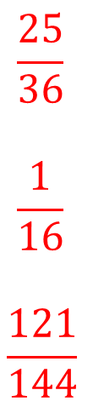
Worked example
Your turn
There are counters in a bag.
One counter is taken out the bag.
The colour is recorded and it is put back into the bag, then another counter is taken out.
Find the probability that:
Neither counter is red
Neither counter is blue
Neither counter is yellow
There are counters in a bag.
One counter is taken out the bag.
The colour is recorded and it is put back into the bag, then another counter is taken out.
Find the probability that:
Neither counter is purple
Neither counter is orange
Neither counter is green
Colour | Red | Blue | Yellow
Number | 5 | 10 | 15
Colour | Purple | Orange | Green
Number | 10 | 45 | 5
$$\frac{25}{36}$$
$$\frac{1}{16}$$
$$\frac{121}{144}$$

Slide 15

Worked example
Your turn
There are counters in a bag.
A counter is taken out at random.
The colour is recorded and it is put back into the bag.
This is repeated two more times.
Find the probability that:
The counters are the same colour
There are counters in a bag.
A counter is taken out at random.
The colour is recorded and it is put back into the bag.
This is repeated two more times.
Find the probability that:
The counters are the same colour
Colour | Red | Blue | Yellow
Number | 5 | 10 | 15
Colour | Purple | Orange | Green
Number | 10 | 45 | 5
$$\frac{41}{96}$$

Slide 16

Worked example
Your turn
There are counters in a bag.
A counter is taken out at random.
The colour is recorded and it is put back into the bag.
This is repeated two more times.
Find the probability that:
The counters are different colours
There are counters in a bag.
A counter is taken out at random.
The colour is recorded and it is put back into the bag.
This is repeated two more times.
Find the probability that:
The counters are different colours
Colour | Red | Blue | Yellow
Number | 5 | 10 | 15
Colour | Purple | Orange | Green
Number | 10 | 45 | 5
$$\frac{29}{72}$$

Slide 17
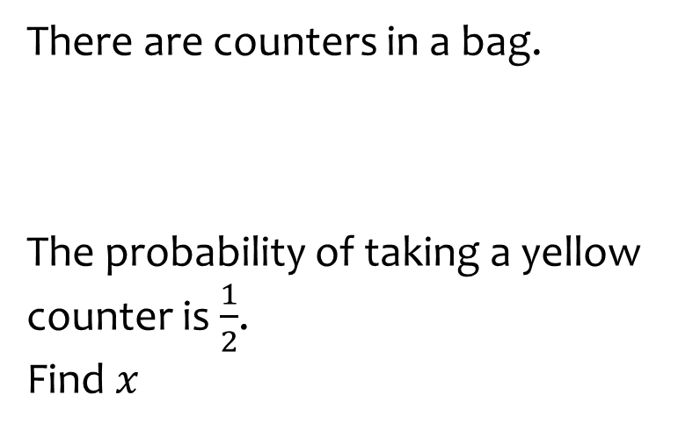
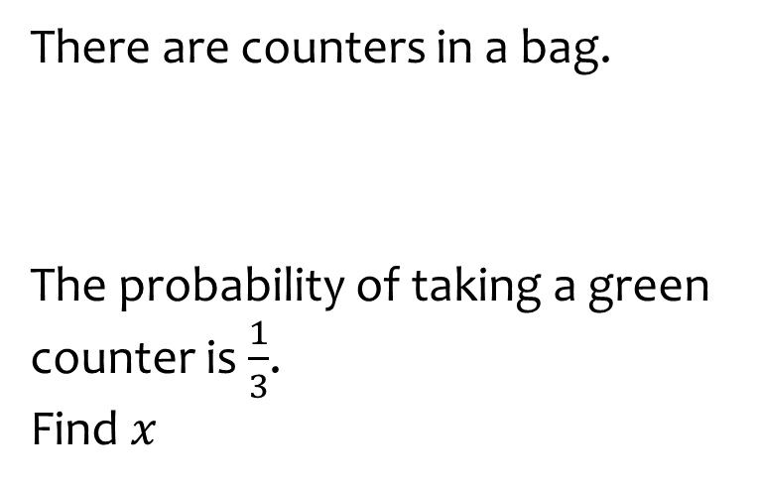

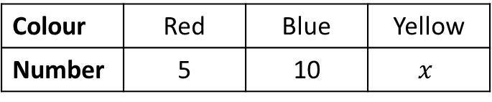
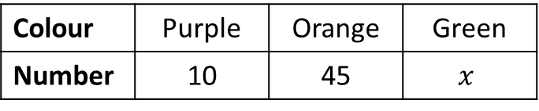
Worked example
Your turn
There are counters in a bag.
The probability of taking a yellow counter is $\frac{1}{2}$.
Find $x$
There are counters in a bag.
The probability of taking a green counter is $\frac{1}{3}$.
Find $x$
Colour | Red | Blue | Yellow
Number | 5 | 10 | $$x$$
Colour | Purple | Orange | Green
Number | 10 | 45 | $$x$$
$$x=30$$

Slide 18
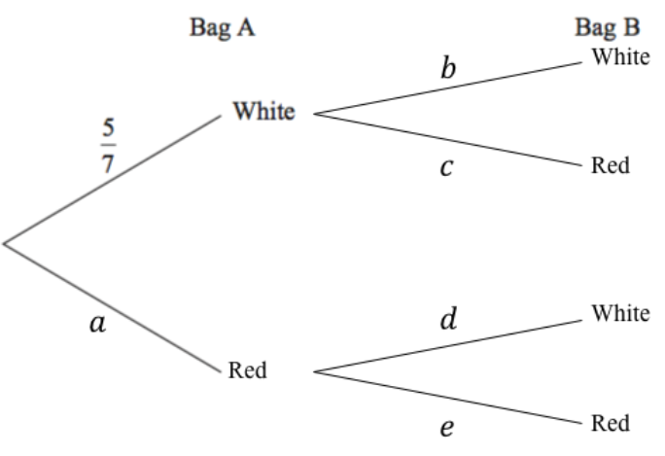






Worked example
Your turn
In bag A there are 2 white and 5 red counters.
In bag B there are 7 white counters and 3 red counters.
A person takes at random one counter from A and one counter from B.
Draw a probability tree diagram to represent the situation:
In bag A there are 5 white and 2 red counters.
In bag B there are 3 white counters and 7 red counters.
A person takes at random one counter from A and one counter from B.
Draw a probability tree diagram to represent the situation:
$$\frac{3}{10}$$
$$\frac{5}{7}$$
$$\frac{7}{10}$$
$$\frac{3}{10}$$
$$\frac{2}{7}$$
$$\frac{7}{10}$$

Slide 19

Worked example
Your turn
In bag A there are 2 white and 5 red counters.
In bag B there are 7 white counters and 3 red counters.
A person takes at random one counter from A and one counter from B.
Find the probability that the counters are the same colour
In bag A there are 5 white and 2 red counters.
In bag B there are 3 white counters and 7 red counters.
A person takes at random one counter from A and one counter from B.
Find the probability that the counters are the same colour
$$\frac{29}{70}$$

Slide 20

Worked example
Your turn
In bag A there are 2 white and 5 red counters.
In bag B there are 7 white counters and 3 red counters.
A person takes at random one counter from A and one counter from B.
Find the probability that the counters are different colours
In bag A there are 5 white and 2 red counters.
In bag B there are 3 white counters and 7 red counters.
A person takes at random one counter from A and one counter from B.
Find the probability that the counters are different colours
$$\frac{41}{70}$$

Slide 21
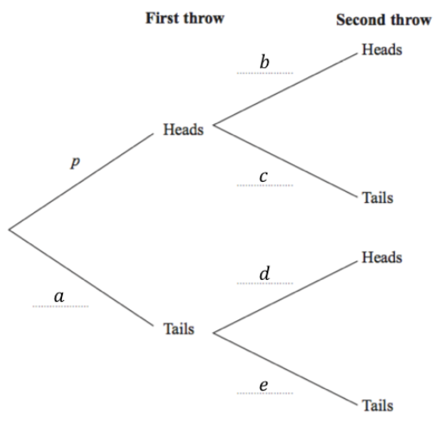
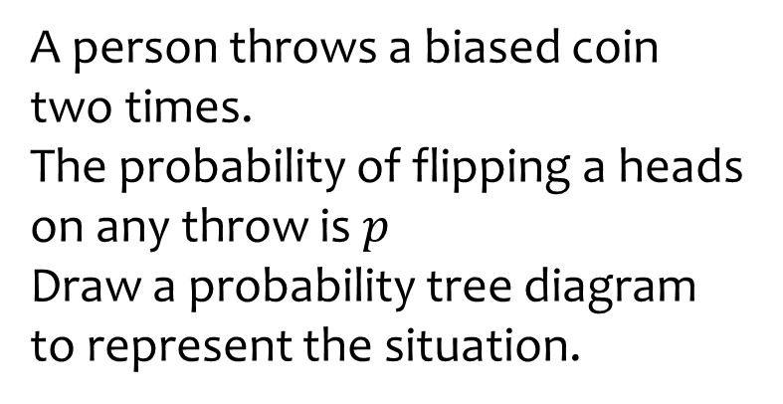
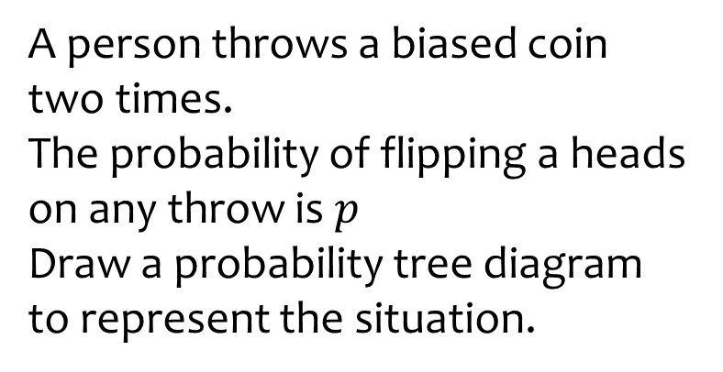





Worked example
Your turn
A person throws a biased coin two times.
The probability of flipping a heads on any throw is $p$
Draw a probability tree diagram to represent the situation.
A person throws a biased coin two times.
The probability of flipping a heads on any throw is $p$
Draw a probability tree diagram to represent the situation.
$$p$$
$$p$$
$$1−p$$
$$p$$
$$1−p$$
$$1−p$$

Slide 22
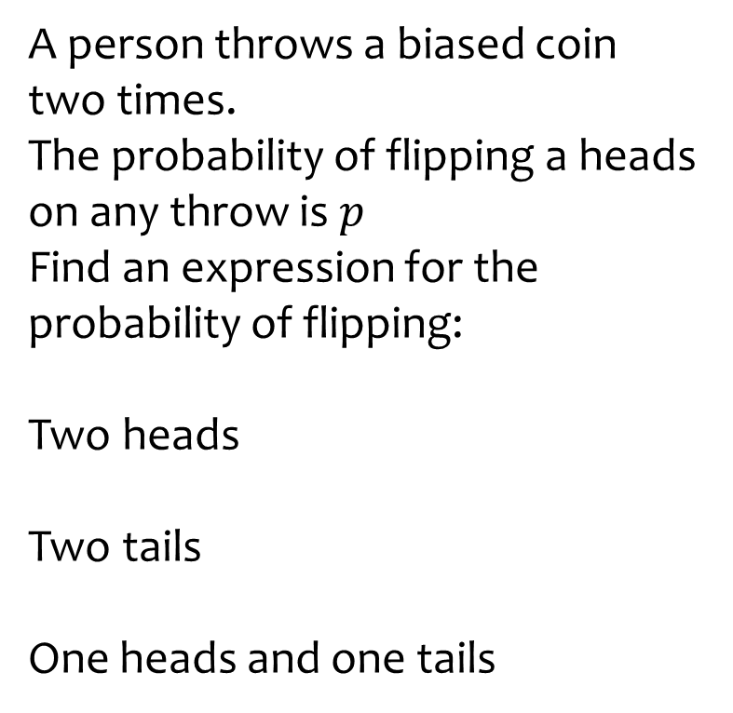
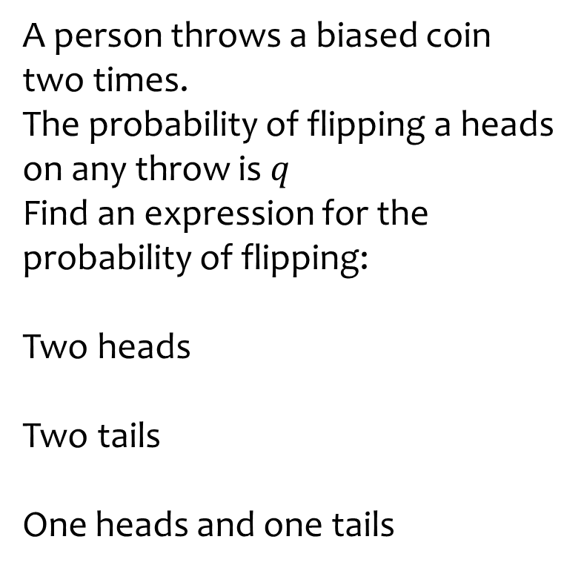
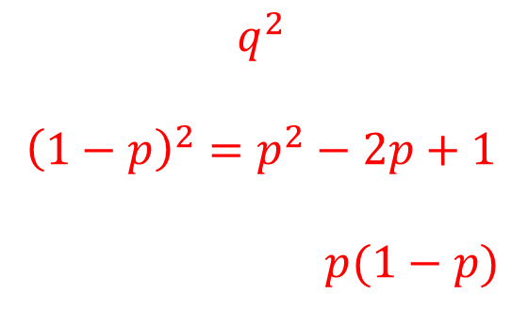
Worked example
Your turn
A person throws a biased coin two times.
The probability of flipping a heads on any throw is $p$
Find an expression for the probability of flipping:
Two heads
Two tails
One heads and one tails
A person throws a biased coin two times.
The probability of flipping a heads on any throw is $q$
Find an expression for the probability of flipping:
Two heads
Two tails
One heads and one tails
$$q^{2}$$
$${\left(1−p\right)}^{2}=p^{2}−2p+1$$
$p(1−p)$

Slide 23

Worked example
Your turn
Four fair 6-sided dice are thrown.
Work out the probability that a 5 is scored on at least two of the four dice.
Four fair 6-sided dice are thrown.
Work out the probability that a 5 is scored on at least one of the four dice.
$$\frac{671}{1296}$$

Slide 24

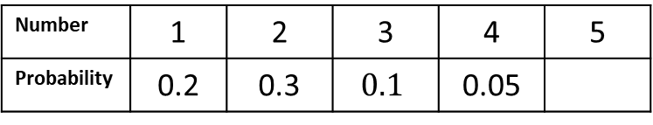
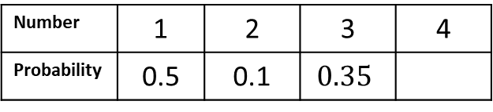
Worked example
Your turn
A biased 5-sided spinner can land on 1, 2, 3, 4 or 5
The spinner is spun 200 times.
Calculate the expected number of times the spinner will land on:
4
5
1 or 2
A biased 4-sided spinner can land on 1, 2, 3, 4
The spinner is spun 200 times.
Calculate the expected number of times the spinner will land on:
3
4
1 or 2
Number | 1 | 2 | 3 | 4 | 5
Probability | 0.2 | 0.3 | $$0.1$$ | 0.05
Number | 1 | 2 | 3 | 4
Probability | 0.5 | 0.1 | $$0.35$$
$$70$$
$$10$$
$$120$$

Slide 25
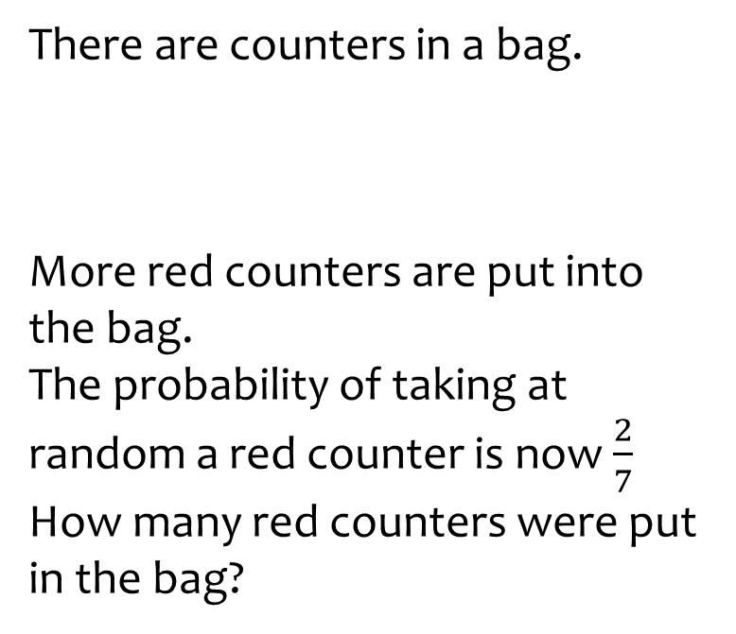
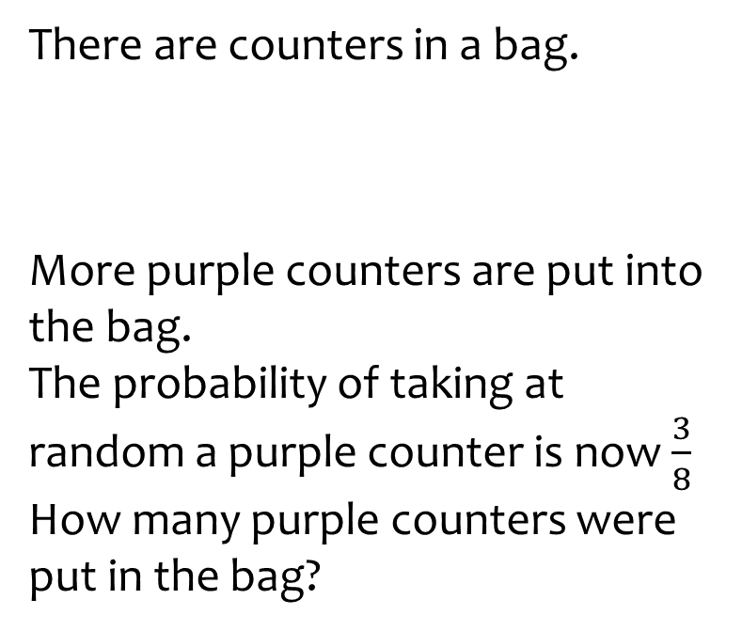

Worked example
Your turn
There are counters in a bag.
More red counters are put into the bag.
The probability of taking at random a red counter is now $\frac{2}{7}$
How many red counters were put in the bag?
There are counters in a bag.
More purple counters are put into the bag.
The probability of taking at random a purple counter is now $\frac{3}{8}$
How many purple counters were put in the bag?
Colour | Red | Blue | Yellow
Number | 5 | 10 | 15
Colour | Purple | Orange | Green
Number | 10 | 45 | 5
$$20$$

Slide 26

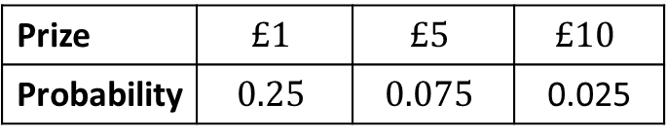
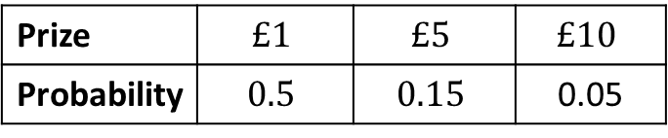
Worked example
Your turn
A person plays a game 40 times.
The game is either win or lose.
Estimate the total value of the prizes they win.
A person plays a game 40 times.
The game is either win or lose.
Estimate the total value of the prizes they win.
Prize | $$£1$$ | $$£5$$ | $$£10$$
Probability | $$0.25$$ | $$0.075$$ | 0.025
Prize | $$£1$$ | $$£5$$ | $$£10$$
Probability | $$0.5$$ | $$0.15$$ | 0.05
$$£70$$

Slide 27
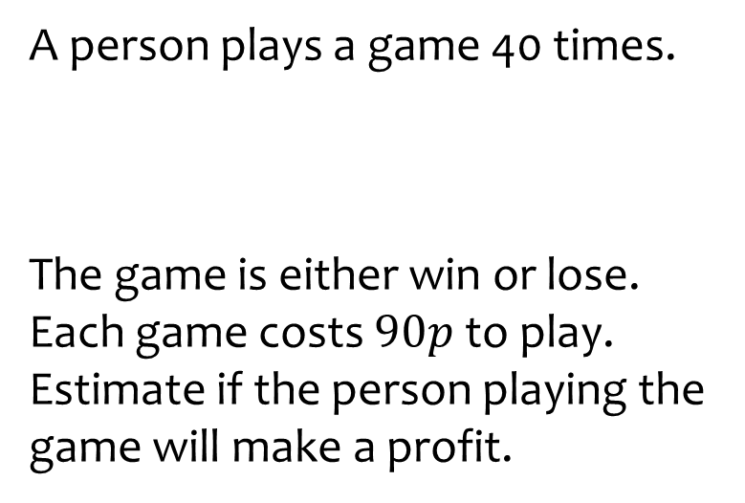
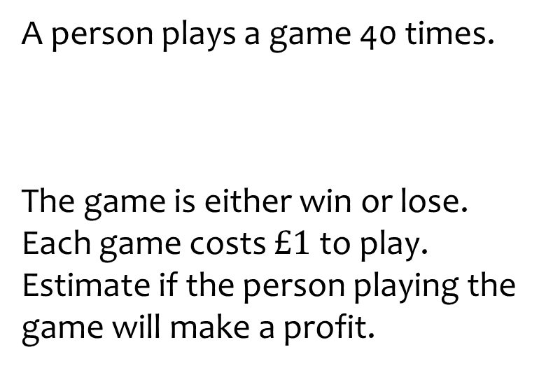

Worked example
Your turn
A person plays a game 40 times.
The game is either win or lose.
Each game costs $90p$ to play.
Estimate if the person playing the game will make a profit.
A person plays a game 40 times.
The game is either win or lose.
Each game costs $£1$ to play.
Estimate if the person playing the game will make a profit.
Prize | $$£1$$ | $$£5$$ | $$£10$$
Probability | $$0.25$$ | $$0.075$$ | 0.025
Prize | $$£1$$ | $$£5$$ | $$£10$$
Probability | $$0.5$$ | $$0.15$$ | 0.05
Yes: $£30$

Slide 28
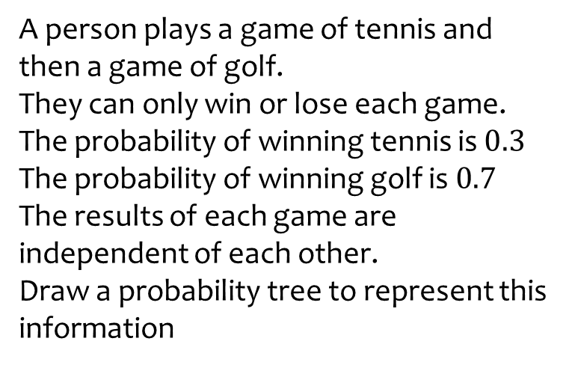
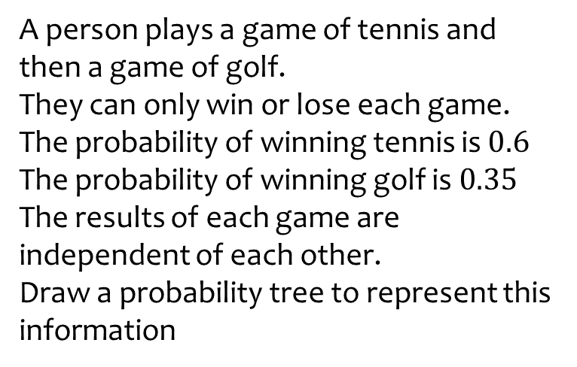






Worked example
Your turn
A person plays a game of tennis and then a game of golf.
They can only win or lose each game.
The probability of winning tennis is $0.3$
The probability of winning golf is $0.7$
The results of each game are independent of each other.
Draw a probability tree to represent this information
A person plays a game of tennis and then a game of golf.
They can only win or lose each game.
The probability of winning tennis is $0.6$
The probability of winning golf is $0.35$
The results of each game are independent of each other.
Draw a probability tree to represent this information
Rugby Golf
Win
Win
Lose
Win
Lose
Lose
$$0.35$$
$$0.6$$
$$0.65$$
$$0.4$$
$$0.35$$
$$0.65$$

Slide 29
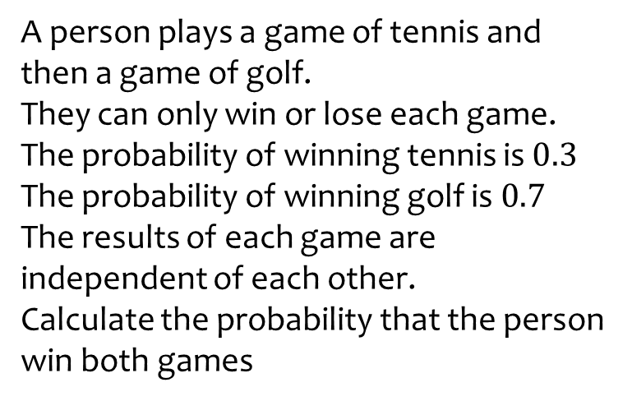
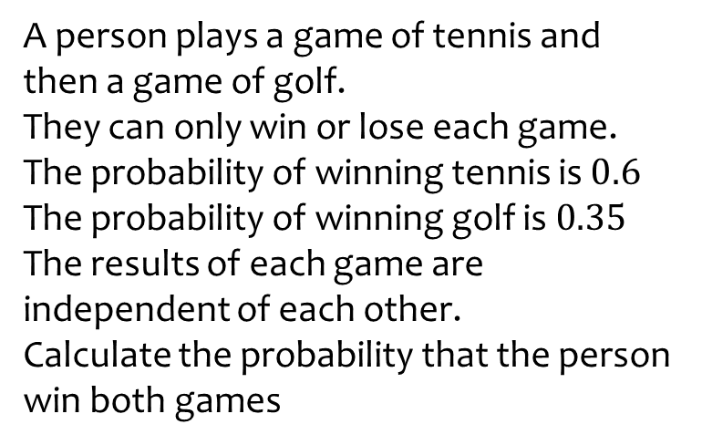

Worked example
Your turn
A person plays a game of tennis and then a game of golf.
They can only win or lose each game.
The probability of winning tennis is $0.3$
The probability of winning golf is $0.7$
The results of each game are independent of each other.
Calculate the probability that the person win both games
A person plays a game of tennis and then a game of golf.
They can only win or lose each game.
The probability of winning tennis is $0.6$
The probability of winning golf is $0.35$
The results of each game are independent of each other.
Calculate the probability that the person win both games
$$\frac{21}{100}=0.21$$

Slide 30
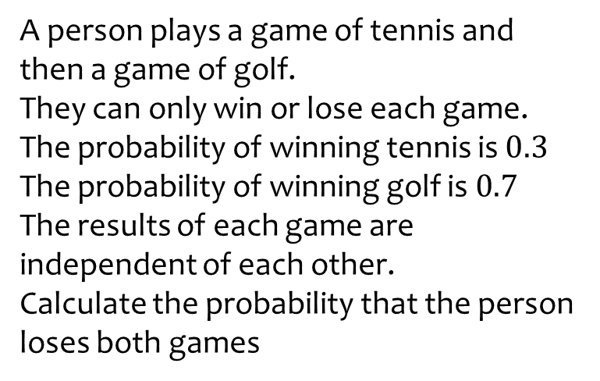
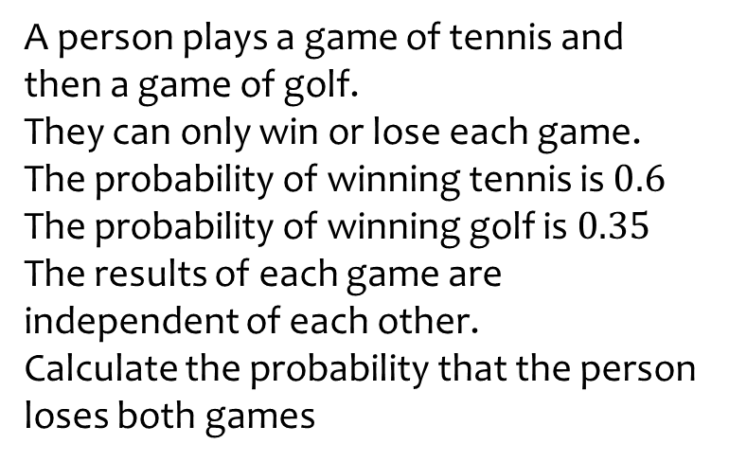

Worked example
Your turn
A person plays a game of tennis and then a game of golf.
They can only win or lose each game.
The probability of winning tennis is $0.3$
The probability of winning golf is $0.7$
The results of each game are independent of each other.
Calculate the probability that the person loses both games
A person plays a game of tennis and then a game of golf.
They can only win or lose each game.
The probability of winning tennis is $0.6$
The probability of winning golf is $0.35$
The results of each game are independent of each other.
Calculate the probability that the person loses both games
$$\frac{13}{50}=0.26$$

Slide 31
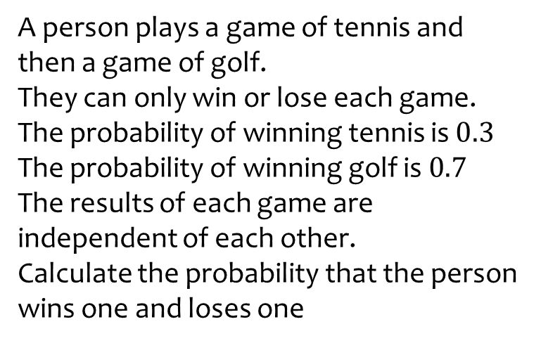
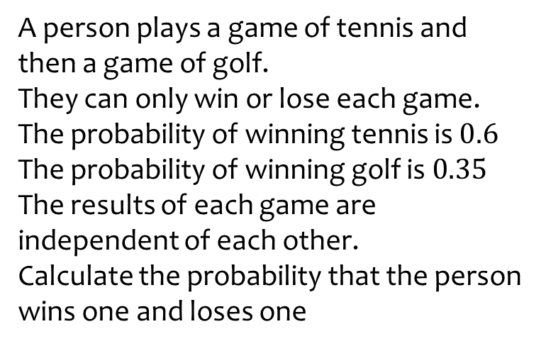

Worked example
Your turn
A person plays a game of tennis and then a game of golf.
They can only win or lose each game.
The probability of winning tennis is $0.3$
The probability of winning golf is $0.7$
The results of each game are independent of each other.
Calculate the probability that the person wins one and loses one
A person plays a game of tennis and then a game of golf.
They can only win or lose each game.
The probability of winning tennis is $0.6$
The probability of winning golf is $0.35$
The results of each game are independent of each other.
Calculate the probability that the person wins one and loses one
$$\frac{53}{100}=0.53$$

Slide 32
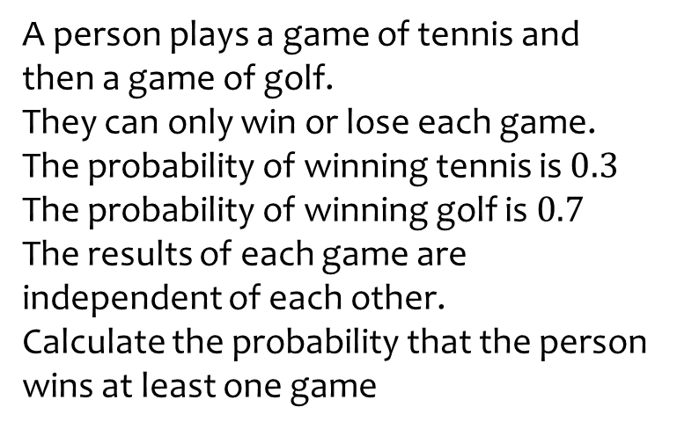
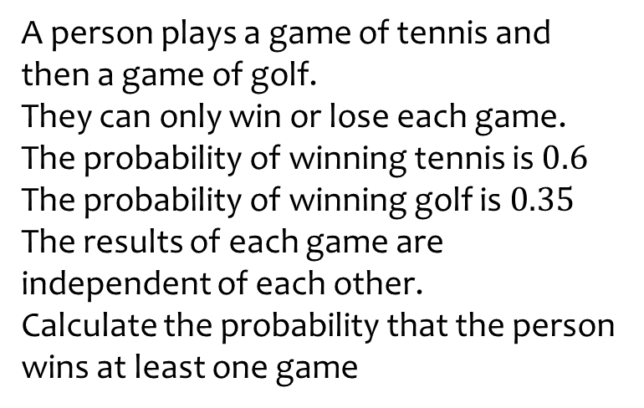

Worked example
Your turn
A person plays a game of tennis and then a game of golf.
They can only win or lose each game.
The probability of winning tennis is $0.3$
The probability of winning golf is $0.7$
The results of each game are independent of each other.
Calculate the probability that the person wins at least one game
A person plays a game of tennis and then a game of golf.
They can only win or lose each game.
The probability of winning tennis is $0.6$
The probability of winning golf is $0.35$
The results of each game are independent of each other.
Calculate the probability that the person wins at least one game
$$\frac{37}{50}=0.74$$

Slide 33
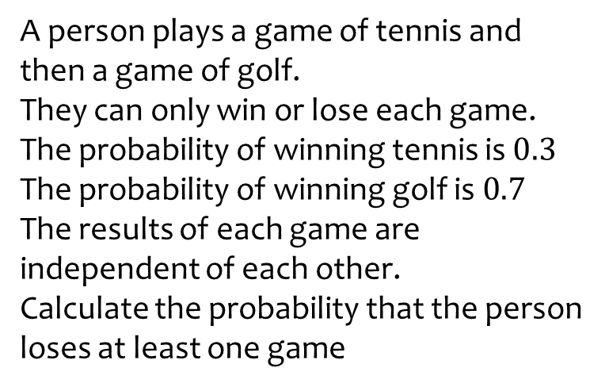
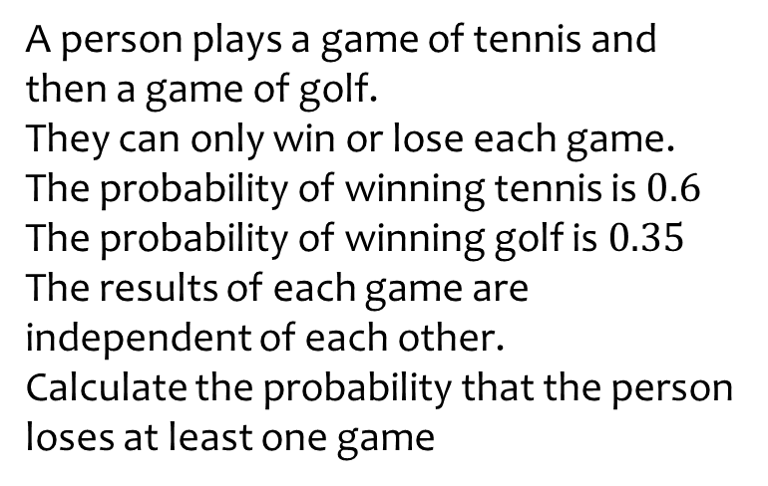

Worked example
Your turn
A person plays a game of tennis and then a game of golf.
They can only win or lose each game.
The probability of winning tennis is $0.3$
The probability of winning golf is $0.7$
The results of each game are independent of each other.
Calculate the probability that the person loses at least one game
A person plays a game of tennis and then a game of golf.
They can only win or lose each game.
The probability of winning tennis is $0.6$
The probability of winning golf is $0.35$
The results of each game are independent of each other.
Calculate the probability that the person loses at least one game
$$\frac{79}{100}=0.79$$

Slide 34
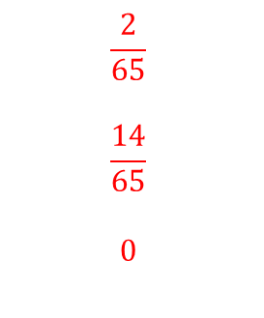
Worked example
Your turn
The table shows the number of students in a group who study each subject.
A student is chosen at random.
Write down the probability that the student is:
Male and studies English
Female and studies Science
Female and studies Music
The table shows the number of students in a group who study each subject.
A student is chosen at random.
Write down the probability that the student is:
Female and studies English
Male and studies Maths
Male and studies Geography
 | Maths | English | Science
Male | 7 | 6 | 3
Female | 8 | 4 | 12
 | Maths | English | Science
Male | 14 | 3 | 6
Female | 16 | 2 | 24
$$\frac{2}{65}$$
$$\frac{14}{65}$$
$$0$$

Slide 35

Worked example
Your turn
The table shows the number of students in a group who study each subject.
A student is chosen at random.
Write down the probability that the student is:
Male and studies Maths or English
Female and studies Maths or Science
Female and studies English or French
The table shows the number of students in a group who study each subject.
A student is chosen at random.
Write down the probability that the student is:
Female and studies English or Science
Male and studies Maths or Science
Male and studies Science or German
 | Maths | English | Science
Male | 7 | 6 | 3
Female | 8 | 4 | 12
 | Maths | English | Science
Male | 14 | 3 | 6
Female | 16 | 2 | 24
$$\frac{2}{5}$$
$$\frac{4}{13}$$
$$\frac{6}{65}$$

Slide 36
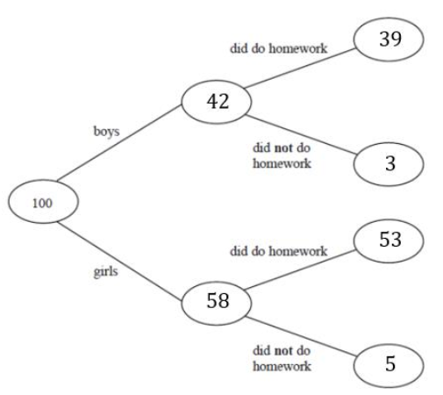







Worked example
Your turn
100 students had some homework.
The frequency tree shows the number of students who did the homework.
A student is chosen at random.
Write down the probability that this student:
Did their homework
Did not do their homework
100 students had some homework.
The frequency tree shows the number of students who did the homework.
A student is chosen at random.
Write down the probability that this student did their homework
$$71$$
$$85$$
$$14$$
$$13$$
$$15$$
$$2$$
$$\frac{23}{25}=0.92$$

Slide 37

Worked example
Your turn
100 students had some homework.
The frequency tree shows the number of students who did the homework.
A boy is chosen at random.
Write down the probability that they did not do their homework.
100 students had some homework.
The frequency tree shows the number of students who did the homework.
A girl is chosen at random.
Write down the probability that they did do their homework.
$$71$$
$$85$$
$$14$$
$$13$$
$$15$$
$$2$$
$$\frac{53}{58}$$

Slide 38
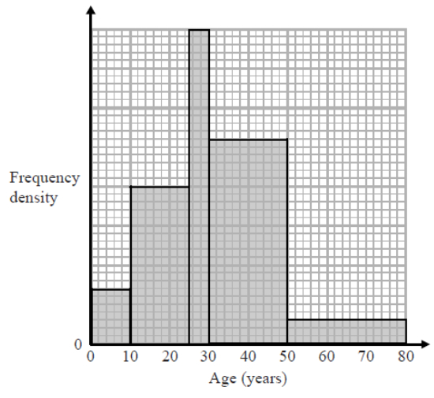
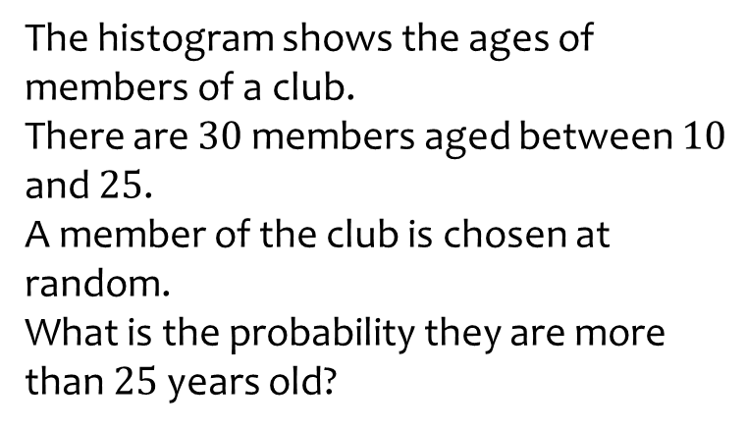
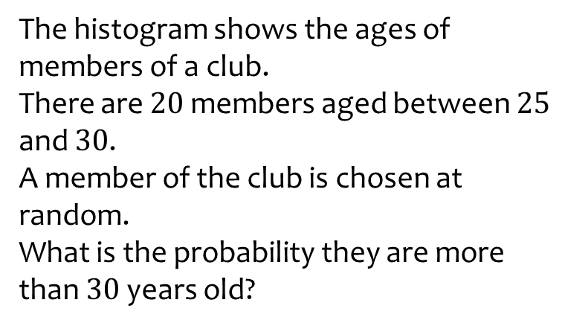
Worked example
Your turn
The histogram shows the ages of members of a club.
There are $30$ members aged between $10$ and $25$.
A member of the club is chosen at random.
What is the probability they are more than $25$ years old?
The histogram shows the ages of members of a club.
There are $20$ members aged between $25$ and $30$.
A member of the club is chosen at random.
What is the probability they are more than $30$ years old?
$$\frac{61}{118}$$

Slide 39





Worked example
Your turn
There are counters in two bags
Bag A
Bag B
A person takes a counter from A then a counter from B.
The probability of taking two red discs is $\frac{1}{15}$. Find the value of $n$
There are counters in two bags
Bag A
Bag B
A person takes a counter from A then a counter from B.
The probability of taking two red discs is $\frac{2}{15}$. Find the value of $n$
Colour | Red | Blue | Yellow
Number | 5 | 10 | 15
Colour | Red | Blue | Yellow
Number | 5 | 6 | 1
Colour | Red | Blue | Yellow
Number | $$n$$ | 25 | 5
Colour | Red | Blue | Yellow
Number | $$n$$ | 17 | 0
$$8$$

Slide 40


Worked example
Your turn
The nine counters are in a bag.
A person takes at random a counter from the bag and does not replace the counter.
They then take at random a second counter from the bag.
Work out the probability that the number on the first counter added to the number on the second counter gives an even number.
The nine counters are in a bag.
A person takes at random a counter from the bag and does not replace the counter.
They then take at random a second counter from the bag.
Work out the probability that the number on the first counter added to the number on the second counter gives an odd number.
$$\frac{5}{9}$$
Notes:
Draw tree as odd/even rather than all possibilities – make point here about thinking before starting to draw out branches

Slide 41



Worked example
Your turn
There are $n$ sweets in a bag.
$4$ of the sweets are orange.
The rest are yellow.
Hannah takes at random a sweet from the bag. She eats the sweet.
Hannah then takes at random another sweet from the bag, and eats it.
The probability that Hannah eats two orange sweets is $\frac{2}{5}$.
Find $n$
There are $n$ sweets in a bag.
$6$ of the sweets are orange.
The rest are yellow.
Hannah takes at random a sweet from the bag. She eats the sweet.
Hannah then takes at random another sweet from the bag, and eats it.
The probability that Hannah eats two orange sweets is $\frac{1}{3}$.
Find $n$
$$n=10$$

Slide 42


Worked example
Your turn
There are counters in a bag.
At the start, $7$ are red and the rest are blue.
A person takes at random a counter from the bag. They do not put it back in the bag. Then they take another counter at random.
The probability that the first counter is blue and the second counter is red is $\frac{21}{90}$
Work out the number of blue counters in the bag at the start.
There are counters in a bag.
At the start, $7$ are red and the rest are blue.
A person takes at random a counter from the bag. They do not put it back in the bag. Then they take another counter at random.
The probability that the first counter is blue and the second counter is red is $\frac{21}{80}$
Work out the number of blue counters in the bag at the start.
$$9$$
Notes:
Two options for the worked example (21 or 10)

Slide 43

Worked example
Your turn
The table shows 100 students, who each study one language.
Two students are chosen at random.
Calculate the probability that the two chosen students study the same language.
The table shows 50 students, who each study one language.
Two students are chosen at random.
Calculate the probability that the two chosen students study the same language.
 | French | German
Female | 26 | 30
Male | 10 | 34
 | Japanese | Spanish
Female | 13 | 15
Male | 5 | 17
$$\frac{64}{245}$$

Slide 44


Worked example
Your turn
There are two bags with numbered discs as shown.
A person chooses a disc at random from bag 1.
If it is labelled 2, he puts the disc in bag 2.
If it is labelled 1, he does not put the disc in bag 2.
He then chooses a disc at random from bag 2.
He then adds the numbers of the two discs he selected to give his score.
Find the probability that his score is 5.
There are two bags with numbered discs as shown.
A person chooses a disc at random from bag 1.
If it is labelled 1, he puts the disc in bag 2.
If it is labelled 2, he does not put the disc in bag 2.
He then chooses a disc at random from bag 2.
He then adds the numbers of the two discs he selected to give his score.
Find the probability that his score is 4.
$$\frac{23}{80}$$

Slide 45




Worked example
Your turn
A football team plays two matches.
Calculate the probability that they win at least one match.
A football team plays two matches.
Calculate the probability that they win at least one match.
$$0.5$$
$$0.2$$
$$0.99$$

Slide 46

Worked example
Your turn
A coin is flipped 30 times. The results are:
H T H H H H H H T T T H H T T
T T T H H H T T H H T H T H H
What are the relative frequencies for heads and tails?
The coin is flipped 300 more times. Estimate how many times the coin will land on tails.
A coin is flipped 20 times. The results are:
T H T T T T T H H H
H H T H T H H H H H
What are the relative frequencies for heads and tails?
The coin is flipped 100 more times. Estimate how many times the coin will land on tails.
Heads: $\frac{12}{20}=\frac{3}{5}$
Tails: $\frac{8}{20}=\frac{2}{5}$
$$40$$

Slide 47

Worked example
Your turn
The numbers 1 to 10 are in a bag.
A number is taken out, then replaced.
Another number is then taken out.
Calculate the probability that the two numbers taken out were different.
The numbers 1 to 20 are in a bag.
A number is taken out, then replaced.
Another number is then taken out.
Calculate the probability that the two numbers taken out were different.
$$\frac{19}{20}=0.95$$

Slide 48



Worked example
Your turn
A and B are two events.
$$P\left(A\right)=0.5$$
$$P\left(B\right)=0.6$$
$$P\left(A∪B\right)=0.8$$
Calculate $P(A∩B)$
A and B are two events.
$$P\left(A\right)=0.6$$
$$P\left(B\right)=0.7$$
$$P\left(A∪B\right)=0.9$$
Calculate $P(A∩B)$
$$0.4$$

Slide 49



Worked example
Your turn
A and B are two events.
$$P\left(A\right)=0.4$$
$$P\left(B\right)=0.6$$
$$P\left(A∩B\right)=0.3$$
Calculate $P(A∪B)$
A and B are two events.
$$P\left(A\right)=0.3$$
$$P\left(B\right)=0.5$$
$$P\left(A∩B\right)=0.2$$
Calculate $P(A∪B)$
$$0.6$$

Slide 50

Worked example
Your turn
Two six-sided dice are rolled and the scores added together.
Find the probability that:
A 3 was rolled, given that the total was 6
The total was greater than 6, given that a 3 was rolled
Two six-sided dice are rolled and the scores added together.
Find the probability that the total is greater than 3, given that a 2 was rolled
$$\frac{5}{7}$$

Slide 51


Worked example
Your turn
The Venn diagram shows a sample of people who play the guitar (G) or piano (P).
Find the probability that a student plays the guitar, given that they play the piano
Find the probability that a student plays the piano, given that they play the guitar
$$\frac{3}{7}$$

Slide 52

Worked example
Your turn
Five coins are flipped. Find the number of ways of flipping four tails using Pascal’s triangle.
Seven coins are flipped. Find the number of ways of flipping four tails using Pascal’s triangle.
$$35$$

