Slide 1
Listing outcomes + Permutations/combinations
CONTENTS

Slide 2
Worked example
Your turn
There are $2$ ways of doing task $A$.
There are $5$ ways of doing task $B$.
I want to do both tasks.
Find the total number of ways the two tasks can be done.
There are $3$ ways of doing task $A$.
There are $4$ ways of doing task $B$.
I want to do both tasks.
Find the total number of ways the two tasks can be done.
$$12$$

Slide 3
Worked example
Your turn
List all the ways of arranging the letters in the word:
$$CAT$$
List all the ways of arranging the letters in the word:
$$DOG$$
$$DOG$$
$$DGO$$
$$GDO$$
$$GOD$$
$$ODG$$
$$OGD$$

Slide 4
Worked example
Your turn
List all the ways of arranging the letters in the word:
$$BEAR$$
List all the ways of arranging the letters in the word:
$$FISH$$
$$FISH$$
$$FIHS$$
$$FSHI$$
$$FSIH$$
$$FHIS$$
$$FHSI$$
$$IFSH$$
$$IFHS$$
$$IHFS$$
$$IHSF$$
$$ISHF$$
$$ISFH$$
$$SFIH$$
$$SFHI$$
$$SHFI$$
$$SHIF$$
$$SIFH$$
$$SIHF$$
$$HFIS$$
$$HFSI$$
$$HIFS$$
$$HISF$$
$$HSFI$$
$$HSIF$$

Slide 5
Worked example
Your turn
I flip a coin and then roll a six-sided die.
List the possible outcomes.
I flip a coin and then roll a 4-sided die.
List the possible outcomes.
$$H1$$
$$H2$$
$$H3$$
$$H4$$
$$T1$$
$$T2$$
$$T3$$
$$T4$$

Slide 6
Worked example
Your turn
I flip a coin and then roll a six-sided die.
How many possible combinations are there?
I flip a coin and then roll a 4-sided die.
How many possible combinations are there?
$$8$$

Slide 7
Worked example
Your turn
The first five positive integers are $1, 2, 3, 4, 5$.
I choose two numbers from this list.
Write down all possible combinations of two numbers I can choose.
The four square numbers are $1, 4, 9, 16$.
I choose two numbers from this list.
Write down all possible combinations of two numbers I can choose.
$$1, 4$$
$$1, 9$$
$$1, 16$$
$$4, 9$$
$$4, 16$$
$$9, 16$$

Slide 8
Worked example
Your turn
At a restaurant, there are $4$ choices for starters and $2$ choices for mains.
A meal consists of one starter and one main.
How many different meals are possible?
At a restaurant, there are $3$ choices for starters and $5$ choices for mains.
A meal consists of one starter and one main.
How many different meals are possible?
$$15$$

Slide 9
Worked example
Your turn
There are $20$ girls and $16$ boys in a tennis club.
For a mixed doubles match, 1 boy and 1 girl form a team.
How many different teams can be formed?
There are $10$ girls and $32$ boys in a tennis club.
For a mixed doubles match, 1 boy and 1 girl form a team.
How many different teams can be formed?
$$320$$

Slide 10
Worked example
Your turn
There are $59$ girls and $78$ boys in Year 13 at a school.
One girl is chosen for the role of Head Girl.
A different girl is chosen for the role of Deputy Head Girl.
One boy is chosen for the role of Head Boy.
A different boy is chosen for the role of Deputy Head boy.
How many different ways can this be done?
There are $95$ girls and $87$ boys in Year 13 at a school.
One girl is chosen for the role of Head Girl.
A different girl is chosen for the role of Deputy Head Girl.
One boy is chosen for the role of Head Boy.
A different boy is chosen for the role of Deputy Head boy.
How many different ways can this be done?
$$66814260$$

Slide 11
Worked example
Your turn
There are $24$ boys and $20$ girls in a class.
The teacher will pick three students from the class and write their names in a list in order.
The order will be either:
Boy, girl, boy
Girl, boy, girl
How many different lists can be written?
There are $12$ boys and $10$ girls in a class.
The teacher will pick three students from the class and write their names in a list in order.
The order will be either:
Boy, girl, boy
Girl, boy, girl
How many different lists can be written?
$$2400$$

Slide 12
Worked example
Your turn
There are $34$ men in a group.
How many different pairs can be formed?
There are $17$ men in a group.
How many different pairs can be formed?
$$136$$

Slide 13
Worked example
Your turn
I have a line of $10$ light bulbs.
Each bulb can be ON or OFF.
How many different possibilities are there for the line of lights?
I have a line of $5$ light bulbs.
Each bulb can be ON or OFF.
How many different possibilities are there for the line of lights?
$$32$$

Slide 14
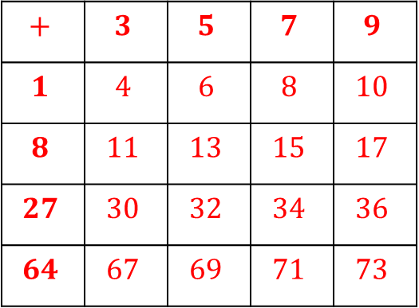
Worked example
Your turn
Bag A contains four counters, labelled 2, 3, 5 and 7
Bag B contains five counters, labelled 1, 4, 9 and 16 and 25
A counter is taken from each bag at random and the numbers are added together.
Draw a sample space to show all possible scores.
Bag A contains four counters, labelled 3, 5, 7 and 9
Bag B contains five counters, labelled 1, 8, 27 and 64
A counter is taken from each bag at random and the numbers are added together.
Draw a sample space to show all possible scores.
Bag A
$$+$$ | $$3$$ | $$5$$ | $$7$$ | $$9$$
$$1$$ | $$4$$ | $$6$$ | $$8$$ | $$10$$
$$8$$ | $$11$$ | $$13$$ | $$15$$ | $$17$$
$$27$$ | $$30$$ | $$32$$ | $$34$$ | $$36$$
$$64$$ | $$67$$ | $$69$$ | $$71$$ | $$73$$
Bag B

Slide 15
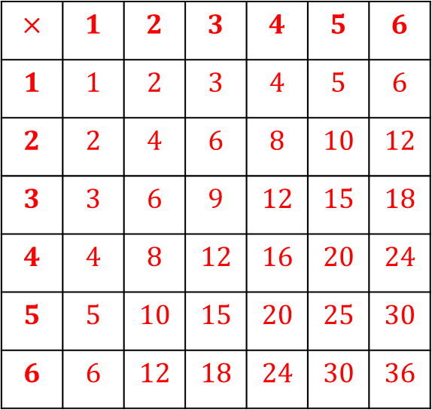
Worked example
Your turn
Two four-sided dice are rolled.
The numbers on the two dice are multiplied together.
Draw a sample space of the all the possible products.
Two six-sided dice are rolled.
The numbers on the two dice are multiplied together.
Draw a sample space of the all the possible products.
Roll 1
$$×$$ | $$1$$ | $$2$$ | $$3$$ | $$4$$ | $$5$$ | $$6$$
$$1$$ | $$1$$ | $$2$$ | $$3$$ | $$4$$ | $$5$$ | $$6$$
$$2$$ | $$2$$ | $$4$$ | $$6$$ | $$8$$ | $$10$$ | $$12$$
$$3$$ | $$3$$ | $$6$$ | $$9$$ | $$12$$ | $$15$$ | $$18$$
$$4$$ | $$4$$ | $$8$$ | $$12$$ | $$16$$ | $$20$$ | $$24$$
$$5$$ | $$5$$ | $$10$$ | $$15$$ | $$20$$ | $$25$$ | $$30$$
$$6$$ | $$6$$ | $$12$$ | $$18$$ | $$24$$ | $$30$$ | $$36$$
Roll 2

Slide 16
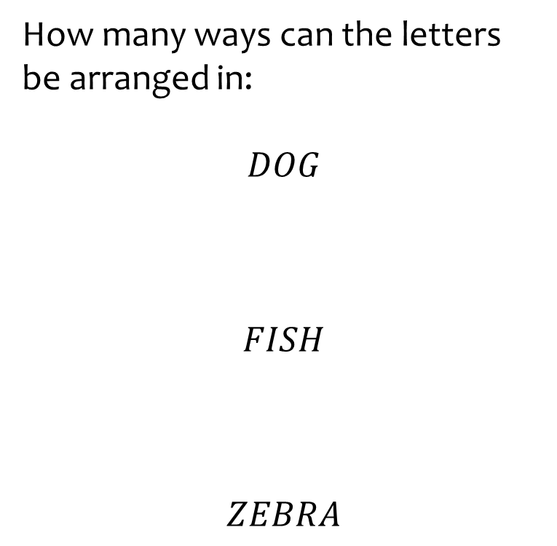
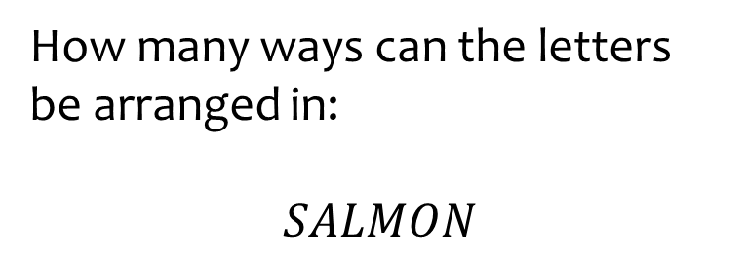

Worked example
Your turn
How many ways can the letters be arranged in:
$$DOG$$
$$FISH$$
$$ZEBRA$$
How many ways can the letters be arranged in:
$$SALMON$$
$$720$$

Slide 17
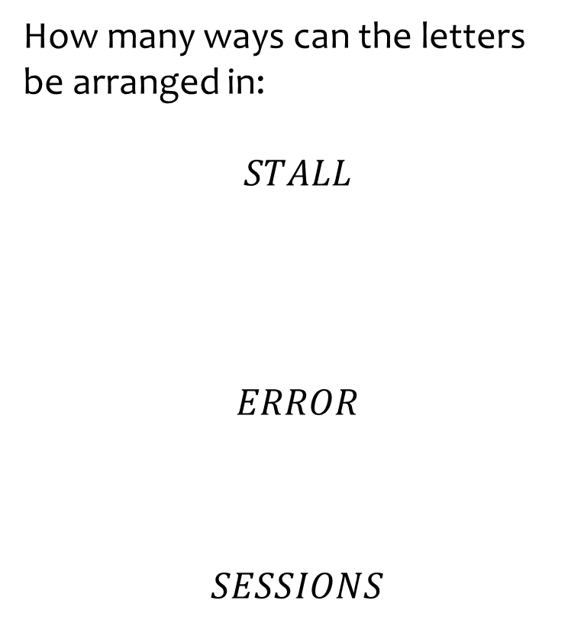
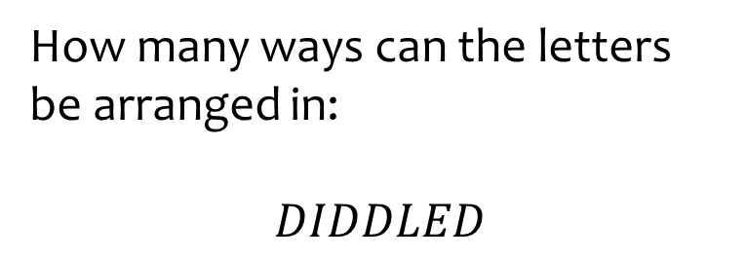

Worked example
Your turn
How many ways can the letters be arranged in:
$$STALL$$
$$ERROR$$
$$SESSIONS$$
How many ways can the letters be arranged in:
$$DIDDLED$$
$$210$$

Slide 18
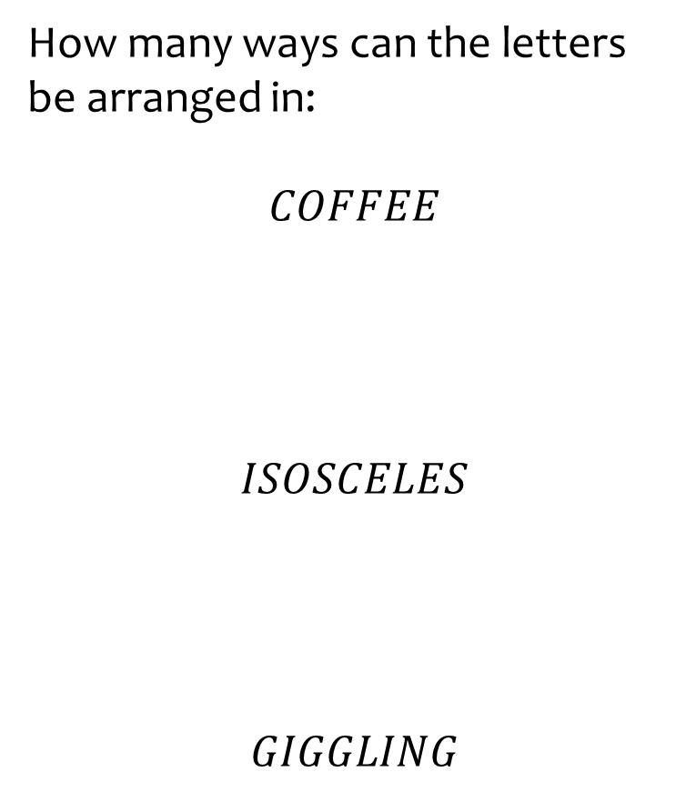
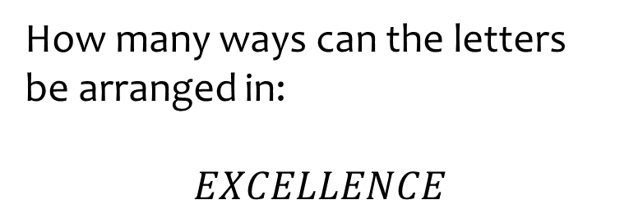

Worked example
Your turn
How many ways can the letters be arranged in:
$$COFFEE$$
$$ISOSCELES$$
$$GIGGLING$$
How many ways can the letters be arranged in:
$$EXCELLENCE$$
$$37800$$

Slide 19
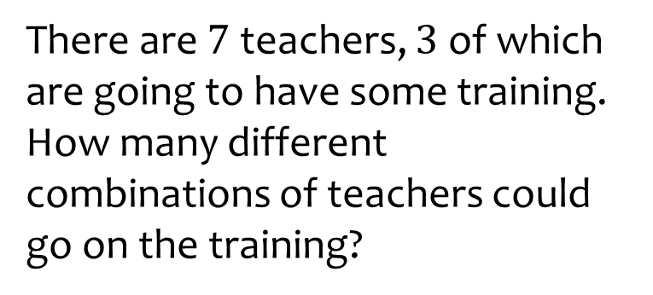
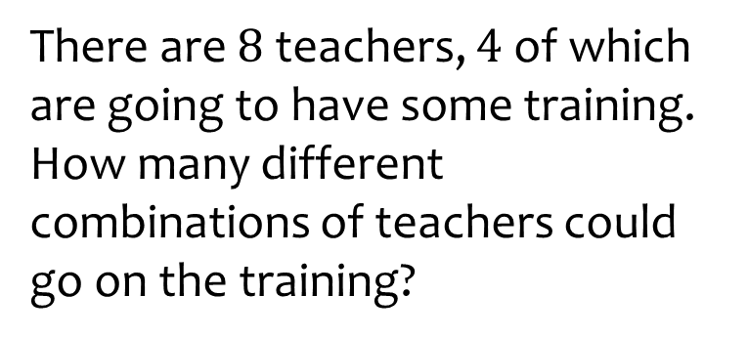

Worked example
Your turn
There are $7$ teachers, $3$of which are going to have some training. How many different combinations of teachers could go on the training?
There are $8$ teachers, $4$ of which are going to have some training. How many different combinations of teachers could go on the training?
$$70$$

