Slide 1
Histograms
CONTENTS

Slide 2
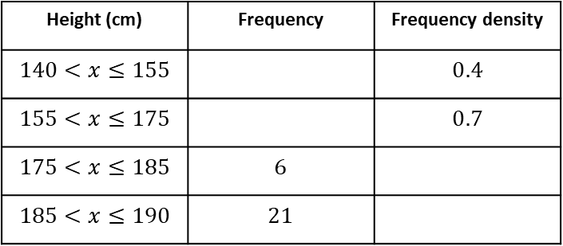
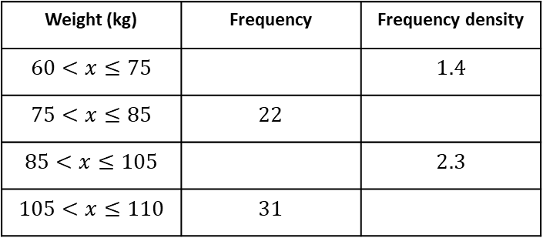
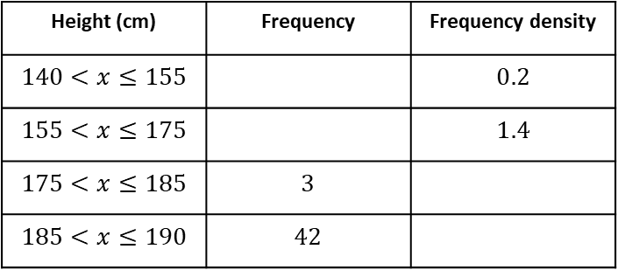




Worked example
Your turn
Complete the table
Complete the table
Height (cm) | Frequency | Frequency density
$$140<x≤155$$ |  | $$0.4$$
$$155<x≤175$$ |  | $$0.7$$
$$175<x≤185$$ | $$6$$
$$185<x≤190$$ | $$21$$
Height (cm) | Frequency | Frequency density
$$140<x≤155$$ |  | $$0.2$$
$$155<x≤175$$ |  | $$1.4$$
$$175<x≤185$$ | $$3$$
$$185<x≤190$$ | $$42$$
$$3$$
$$14$$
$$0.3$$
$$8.4$$
Weight (kg) | Frequency | Frequency density
$$60<x≤75$$ |  | $$1.4$$
$$75<x≤85$$ | $$22$$
$$85<x≤105$$ |  | $$2.3$$
$$105<x≤110$$ | $$31$$

Slide 3
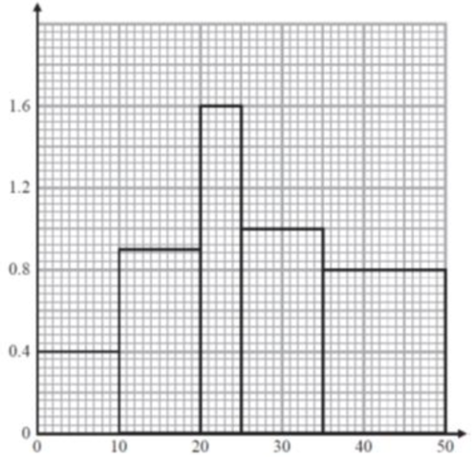
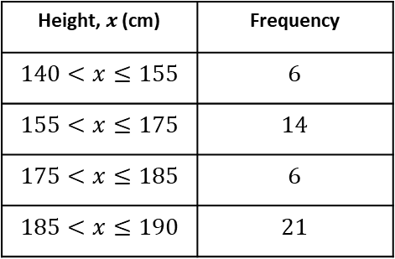
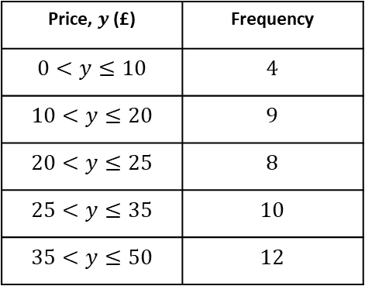
Worked example
Your turn
Plot a histogram
Plot a histogram
Height, $x$ (cm) | Frequency
$$140<x≤155$$ | $$6$$
$$155<x≤175$$ | $$14$$
$$175<x≤185$$ | $$6$$
$$185<x≤190$$ | $$21$$
Price, $y$ (£) | Frequency
$$0<y≤10$$ | $$4$$
$$10<y≤20$$ | $$9$$
$$20<y≤25$$ | $$8$$
$$25<y≤35$$ | $$10$$
$$35<y≤50$$ | $$12$$
Frequency Density
Price (£)

Slide 4
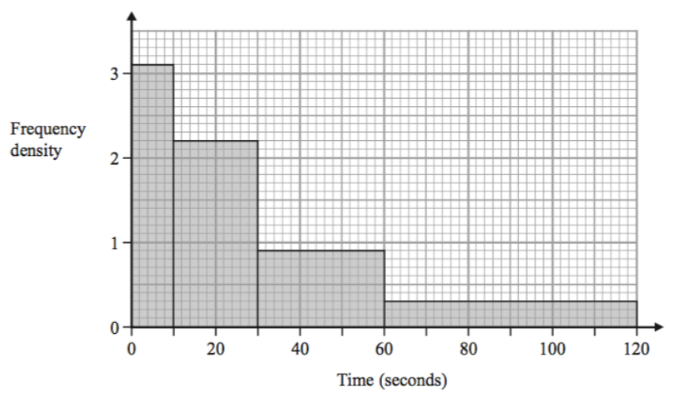
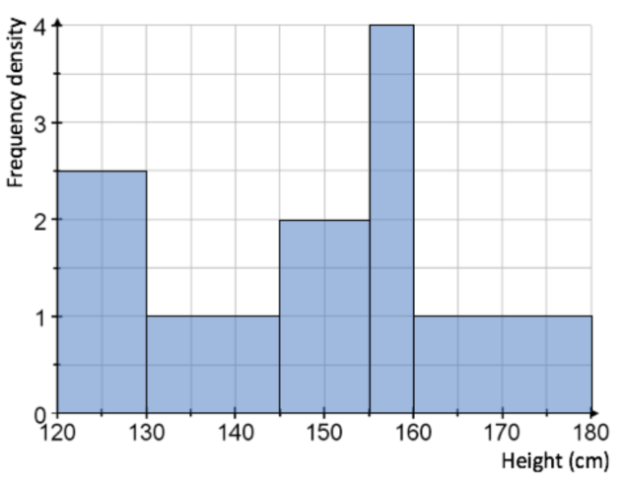
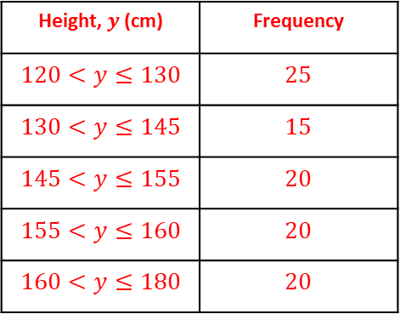
Worked example
Your turn
Draw a frequency table from the histogram
Draw a frequency table from the histogram
Height, $y$(cm) | Frequency
$$120<y≤130$$ | $$25$$
$$130<y≤145$$ | $$15$$
$$145<y≤155$$ | $$20$$
$$155<y≤160$$ | $$20$$
$$160<y≤180$$ | $$20$$

Slide 5
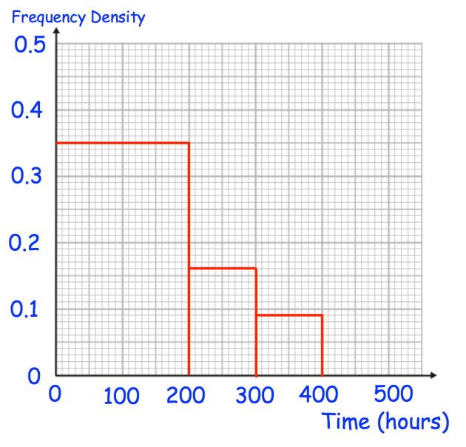
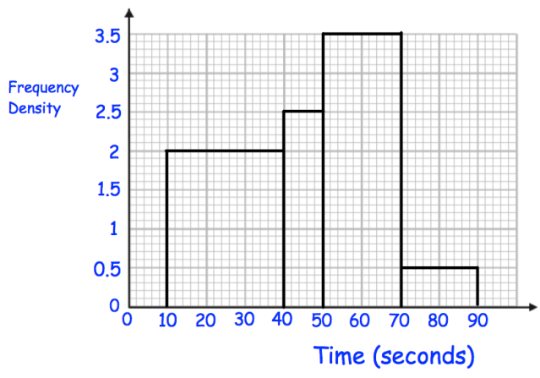

Worked example
Your turn
Estimate the number of pilots who have flown under 350 hours.
Estimate the number of students who took less than 60 seconds to complete the puzzle
$$120$$
Questions used with permission from Corbettmaths: https://corbettmaths.com/

Slide 6
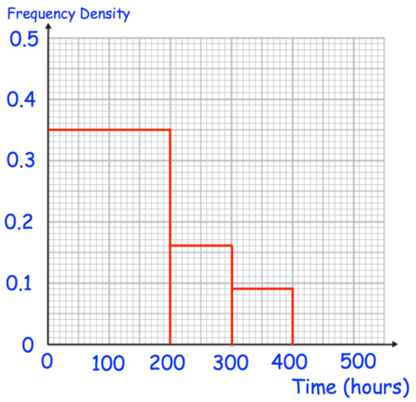
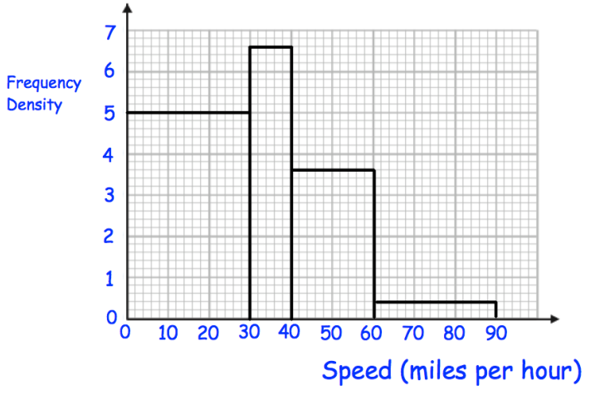
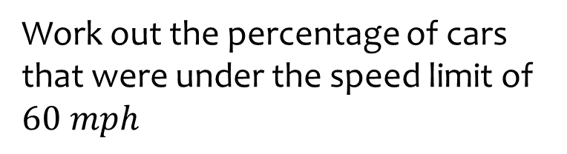

Worked example
Your turn
Work out the percentage of pilots who have flown under 250 hours.
Work out the percentage of cars that were under the speed limit of $60 mph$
$$96\%$$
Questions used with permission from Corbettmaths: https://corbettmaths.com/

Slide 7

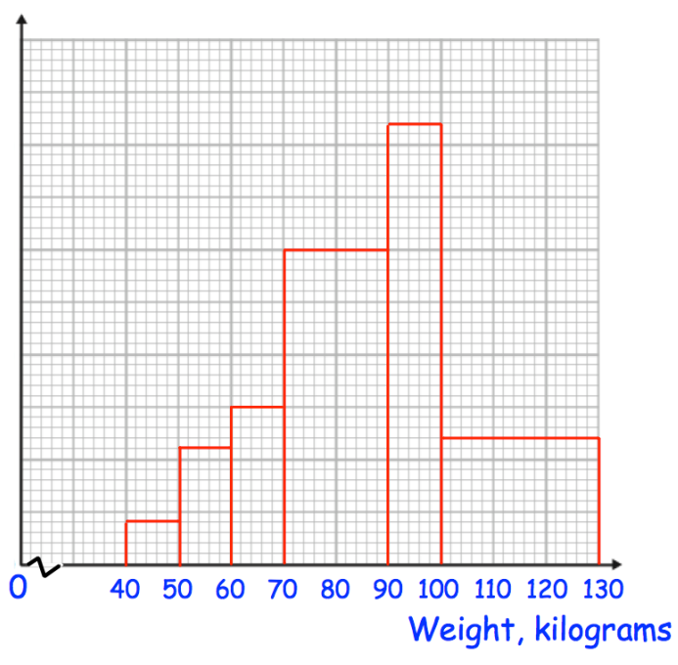
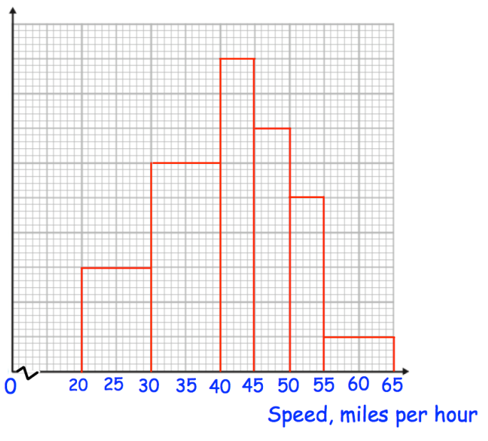
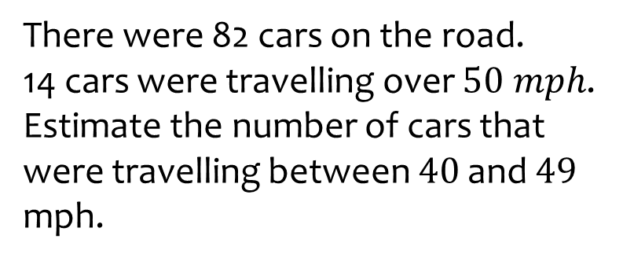
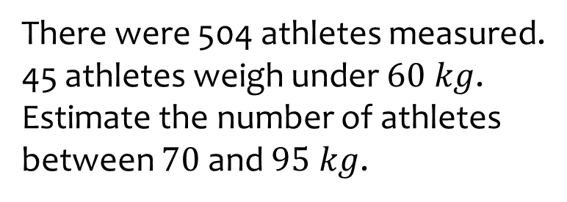

Worked example
Your turn
There were 82 cars on the road.
14 cars were travelling over $50 mph$.
Estimate the number of cars that were travelling between $40$ and $49$ mph.
There were 504 athletes measured.
45 athletes weigh under $60 kg$.
Estimate the number of athletes between $70$ and $95 kg$.
$$243$$
Questions used with permission from Corbettmaths: https://corbettmaths.com/

Slide 8
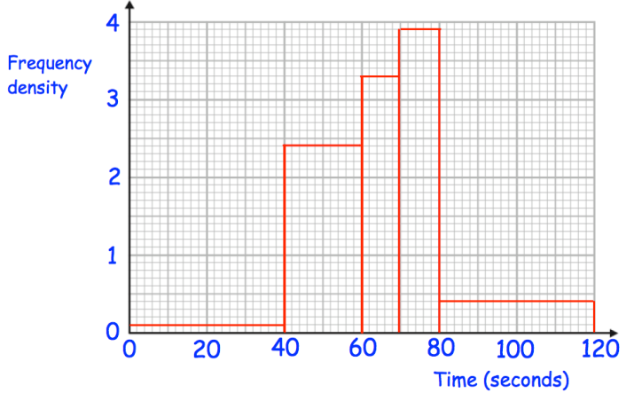
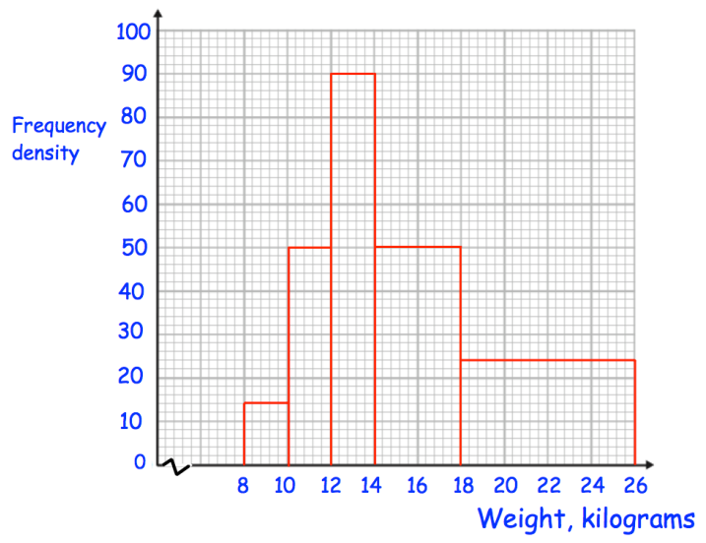

Worked example
Your turn
Estimate the median time
Estimate the median weight
$14.84$(2 dp)
Questions used with permission from Corbettmaths: https://corbettmaths.com/

Slide 9
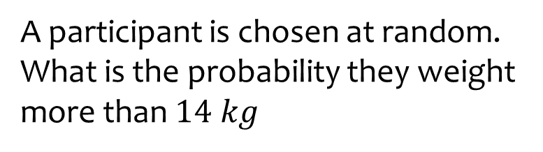

Worked example
Your turn
A participant is chosen at random.
What is the probability they took longer than 60 seconds?
A participant is chosen at random.
What is the probability they weight more than $14 kg$
$$\frac{14}{25}=0.56$$
Questions used with permission from Corbettmaths: https://corbettmaths.com/

