Slide 1
Graphs and charts
CONTENTS

Slide 2
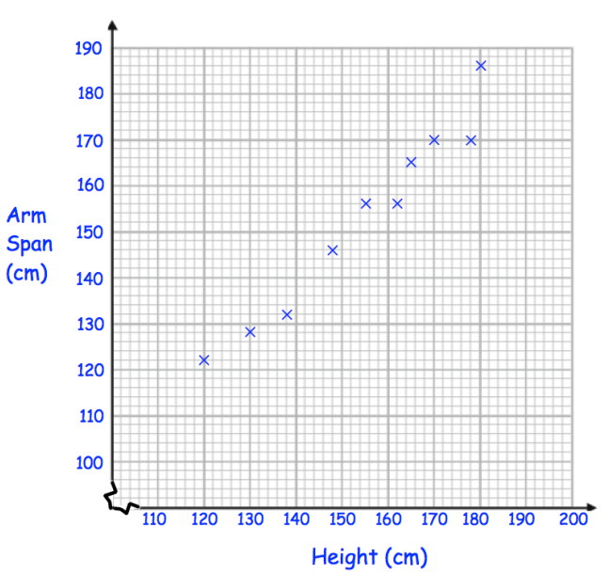
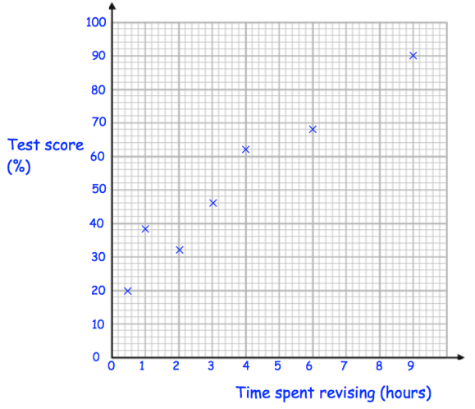
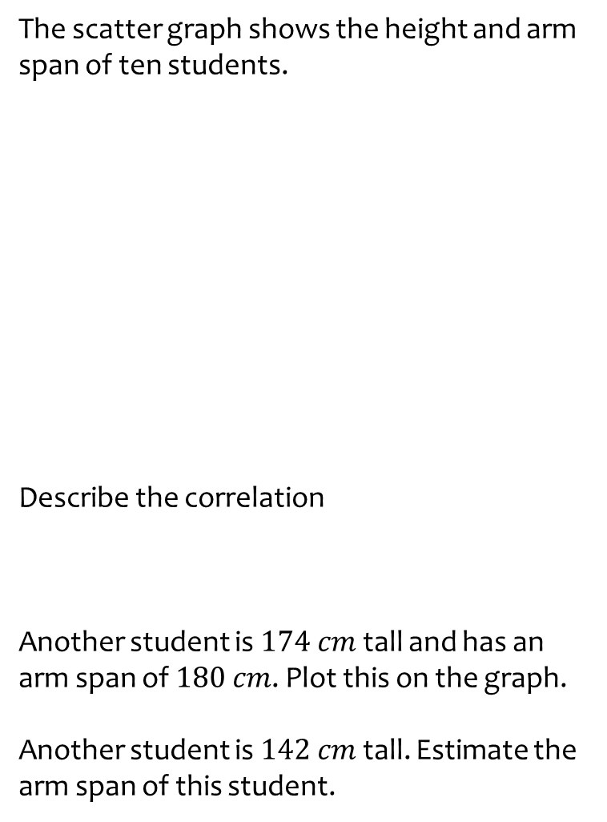
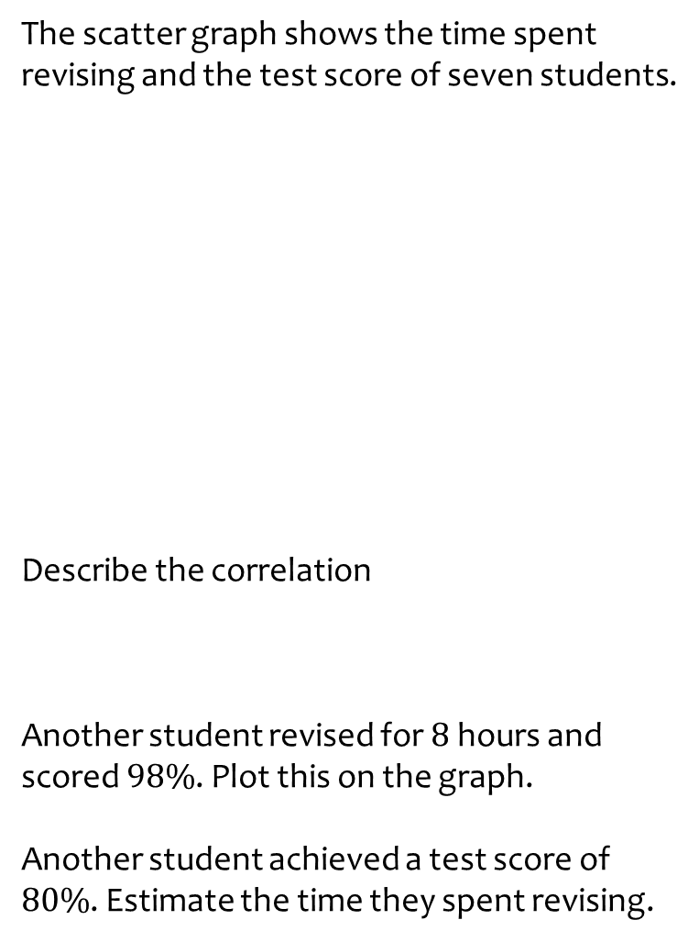
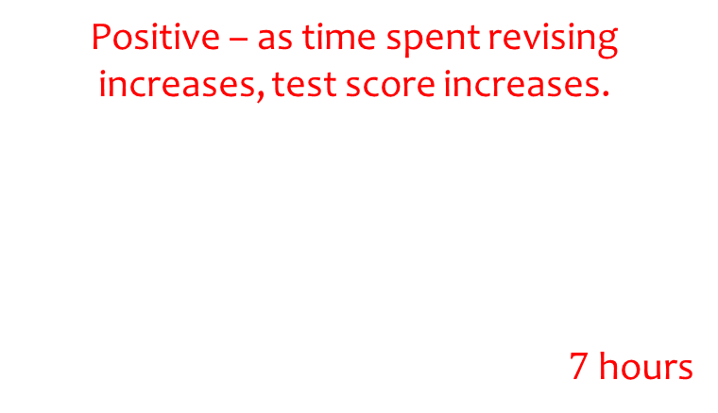
Worked example
Your turn
The scatter graph shows the height and arm span of ten students.
Describe the correlation
Another student is $174 cm$ tall and has an arm span of $180 cm$. Plot this on the graph.
Another student is $142 cm$ tall. Estimate the arm span of this student.
The scatter graph shows the time spent revising and the test score of seven students.
Describe the correlation
Another student revised for $8$ hours and scored $98\%$. Plot this on the graph.
Another student achieved a test score of $80\%$. Estimate the time they spent revising.
x
Positive – as time spent revising increases, test score increases.
$7$hours
Questions used with permission from Corbettmaths: https://corbettmaths.com/
Notes:
Corbettmaths graphic

Slide 3
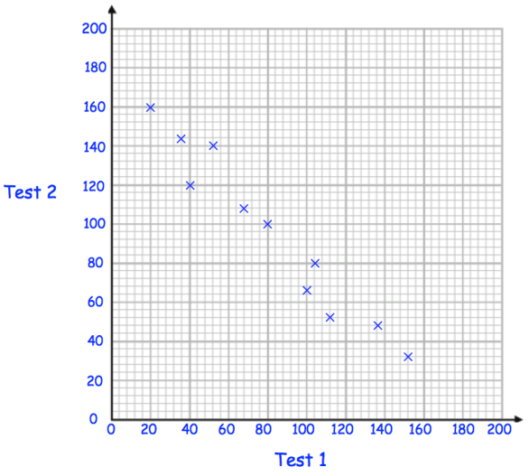
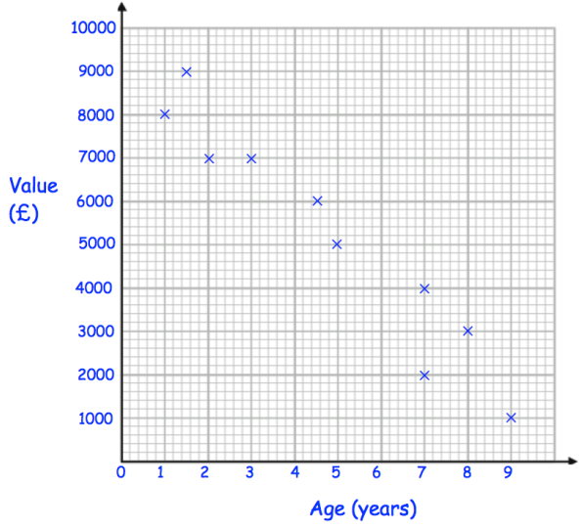
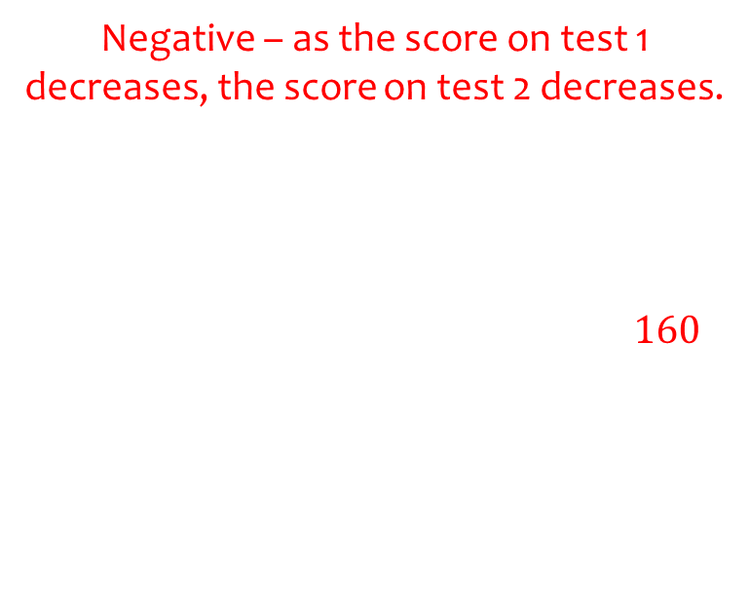
Worked example
Your turn
The scatter graph shows the value of cars and their age.
Describe the correlation
Another car is 6 years old and worth £1500. Plot this on the graph.
Another car is 4 years old. Estimate its value.
The scatter graph shows the scores on two tests
Describe the correlation
Another student scores 80 on test 1 and 120 on test 2. Plot this on the graph.
Another student scored 20 on test 2. Estimate the student’s score on test 1.
x
Negative – as the score on test 1 decreases, the score on test 2 decreases.
$160$
Questions used with permission from Corbettmaths: https://corbettmaths.com/
Notes:
Corbettmaths graphic

Slide 4
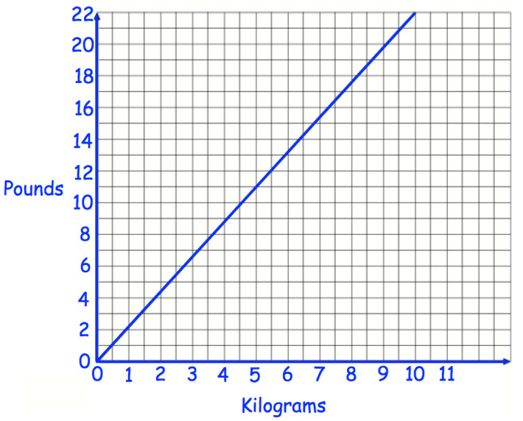
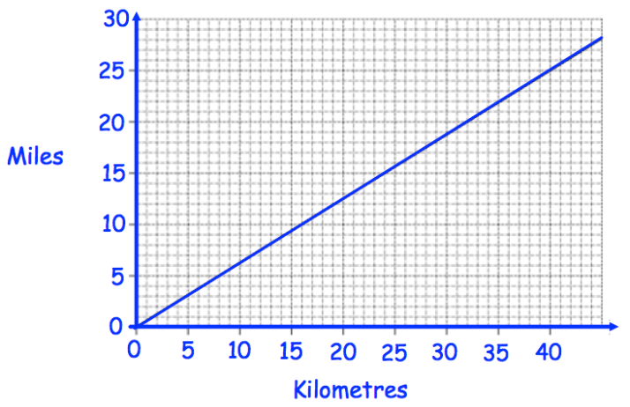
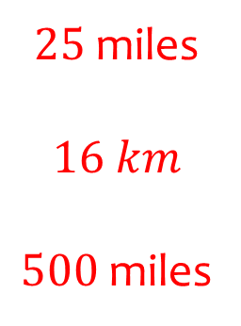
Worked example
Your turn
Use the graph to convert:
5 kilograms to pounds
8 pounds to kilograms
150 kilograms to pounds
Use the graph to convert:
40 kilometres to miles
10 miles to kilometres
800 kilometres to miles
$25$miles
$$16 km$$
$500$miles
Questions used with permission from Corbettmaths: https://corbettmaths.com/
Notes:
Corbettmaths graphic

Slide 5
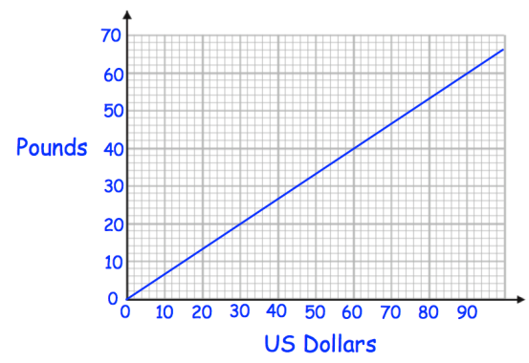
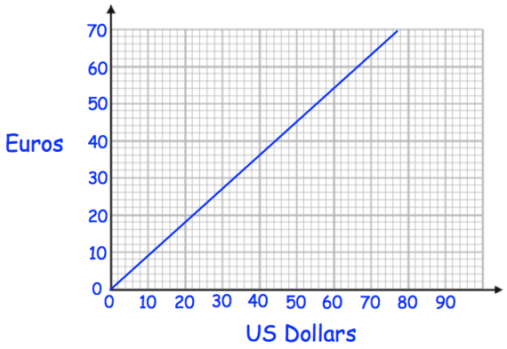
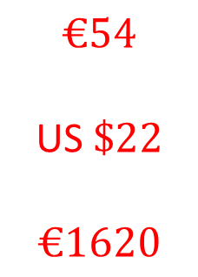
Worked example
Your turn
Use the graph to convert:
60 US Dollars to Pounds
20 Pounds to US Dollars
1800 US dollars to Pounds
Use the graph to convert:
60 US Dollars to Euros
20 Euros to US Dollars
1800 US dollars to Euros
$$€54$$
US $\$22$
$$€1620$$
Questions used with permission from Corbettmaths: https://corbettmaths.com/
Notes:
Corbettmaths graphic

Slide 6
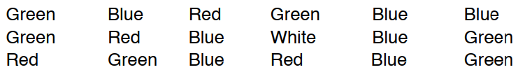
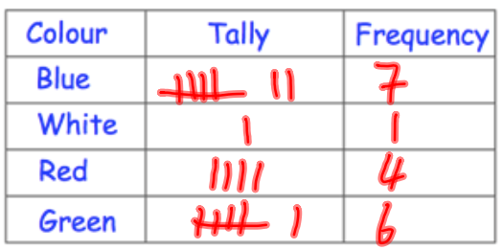
Worked example
Your turn
Students were asked their favourite subject. The results were:
Maths Maths Maths English Science
English French PE PE English
Maths Maths Maths Maths Maths
Draw a frequency table for the results
A person asked their friends for their favourite colour.
Draw a frequency table for the results.
Questions used with permission from Corbettmaths: https://corbettmaths.com/
Notes:
Corbettmaths graphic

Slide 7
Worked example
Your turn
Students were asked their favourite subject. The results were:
Maths Maths Maths English Science
English French PE PE English
Maths Maths Maths Maths Maths
Write down the mode
A person asked their friends for their favourite colour.
Write down the mode
Blue
Notes:
Corbettmaths graphic

Slide 8
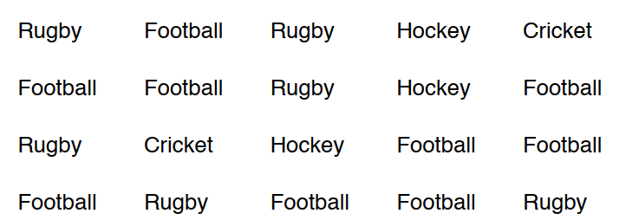
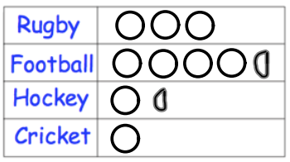
Worked example
Your turn
Students were asked their favourite subject. The results were:
Maths Maths Maths English Science
English French PE PE English
Maths Maths Maths Maths Maths
Draw a pictogram for the results
A person asked their friends for their favourite sport.
Draw a pictogram for the results, where a circle represents 2 people
Questions used with permission from Corbettmaths: https://corbettmaths.com/
Notes:
Corbettmaths graphic

Slide 9
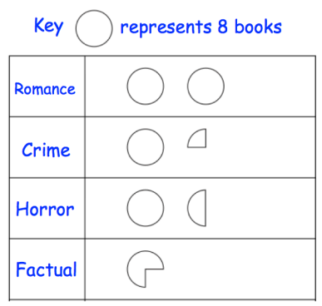
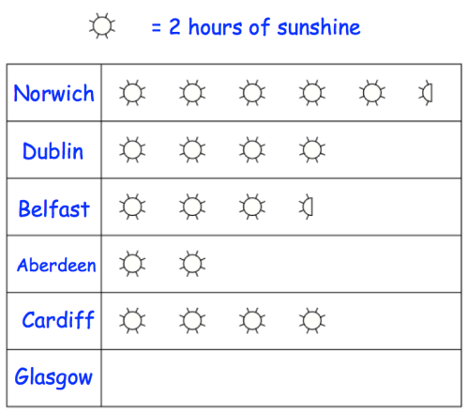


Worked example
Your turn
The pictogram shows the type of books a person read last year.
How many books were:
Romance
Crime
Horror
Factual
The pictogram shows the number of hours of sunshine in a day across various cities
How many hours of sunshine were there in:
Belfast
Glasgow
$$7$$
$$2.5$$
Questions used with permission from Corbettmaths: https://corbettmaths.com/
Notes:
Corbettmaths graphic

Slide 10
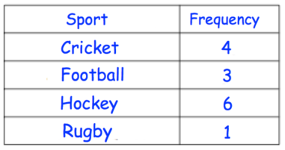
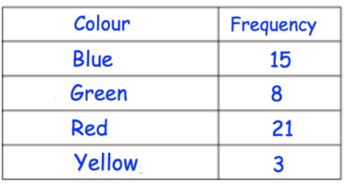
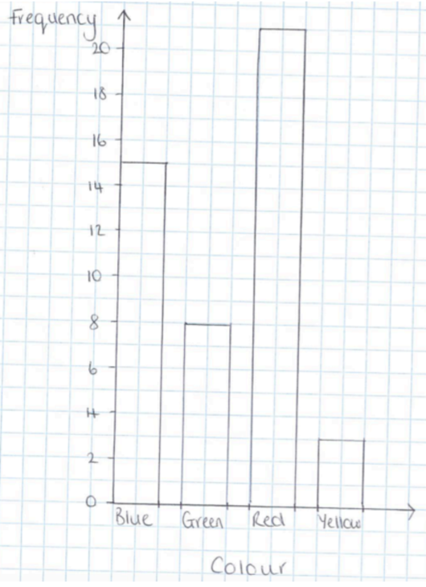
Worked example
Your turn
Draw a bar chart for the data:
Draw a bar chart for the data:
Questions used with permission from Corbettmaths: https://corbettmaths.com/
Notes:
Mrcartermaths graphic

Slide 11
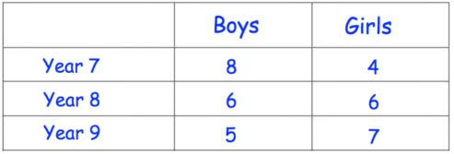
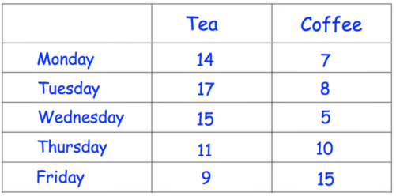
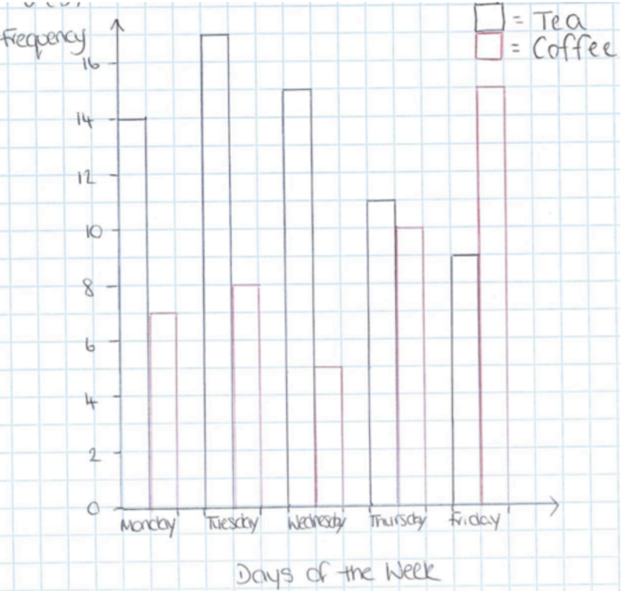
Worked example
Your turn
Draw a dual bar chart for the data:
Draw a dual bar chart for the data:
Questions used with permission from Corbettmaths: https://corbettmaths.com/
Notes:
Mrcartermaths graphic

Slide 12
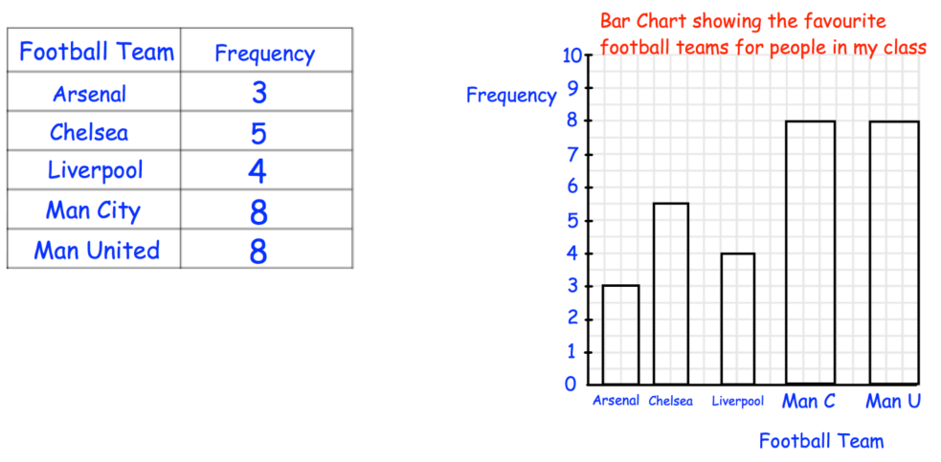
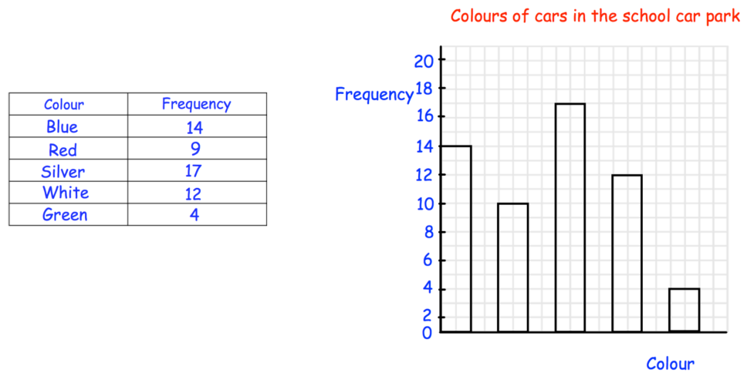
Worked example
Your turn
Spot the mistakes in the bar chart:
Spot the mistakes in the bar chart:
The scale is not consistent throughout the y-axis
There are no labels on the x-axis
The height of the red car bar is incorrect
Questions used with permission from Corbettmaths: https://corbettmaths.com/
Notes:
Mrcartermaths graphic

Slide 13
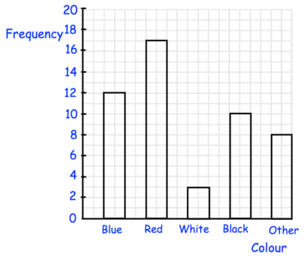
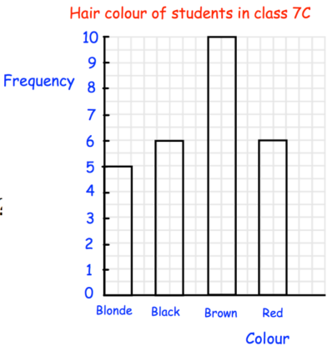
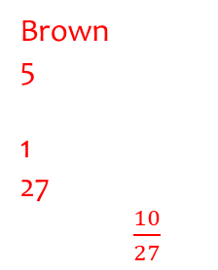
Worked example
Your turn
The bar chart shows the colour of cars in a car park:
What is the most common colour?
How many cars were blue?
How many cars were white?
How many more cars were red than other?
How many cars were there in total?
What fraction of the cars are black?
Seven grey cars arrive to the car park. Add this to the bar chart.
The bar chart shows hair colour of students in a class:
What is the most common hair colour?
How many students had black hair?
How many more students had red hair than blonde hair?
How many students are in the class?
What fraction of the students have brown hair?
Nine students with green hair join the class. Add this to the bar chart.
Green
Brown
5
1
27
$\frac{10}{27}$
Questions used with permission from Corbettmaths: https://corbettmaths.com/
Notes:
Mrcartermaths graphic

Slide 14

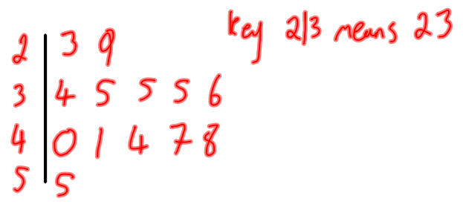
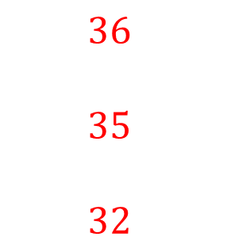
Worked example
Your turn
Draw an ordered stem and leaf diagram for this data:
12 21 13 31 53
47 29 21 18 46
21 53 45
Work out the median
Write down the mode
Work out the range
Draw an ordered stem and leaf diagram for this data:
Work out the median
Write down the mode
Work out the range
$$36$$
$$35$$
$$32$$
Notes:
Corbettmaths graphic

Slide 15
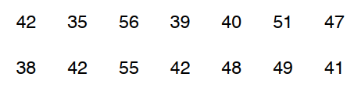
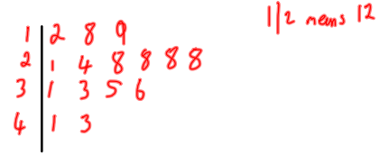
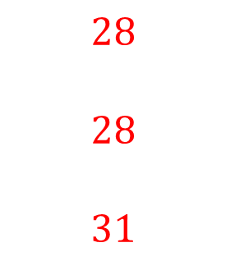
Worked example
Your turn
Draw an ordered stem and leaf diagram for this data:
12 21 13 31 53
47 29 21 18 46
21 53 45 21
Work out the median
Write down the mode
Work out the range
Draw an ordered stem and leaf diagram for this data:
Work out the median
Write down the mode
Work out the range
$$28$$
$$28$$
$$31$$
Questions used with permission from Corbettmaths: https://corbettmaths.com/
Notes:
Corbettmaths graphic

Slide 16
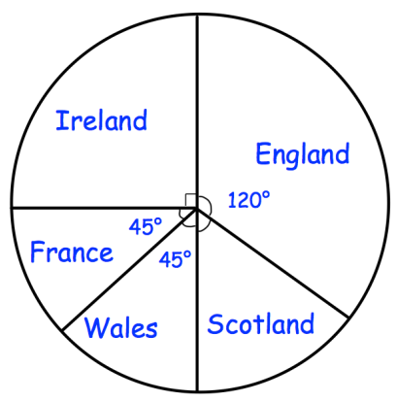
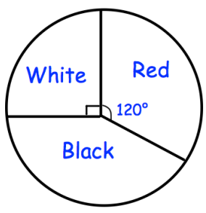
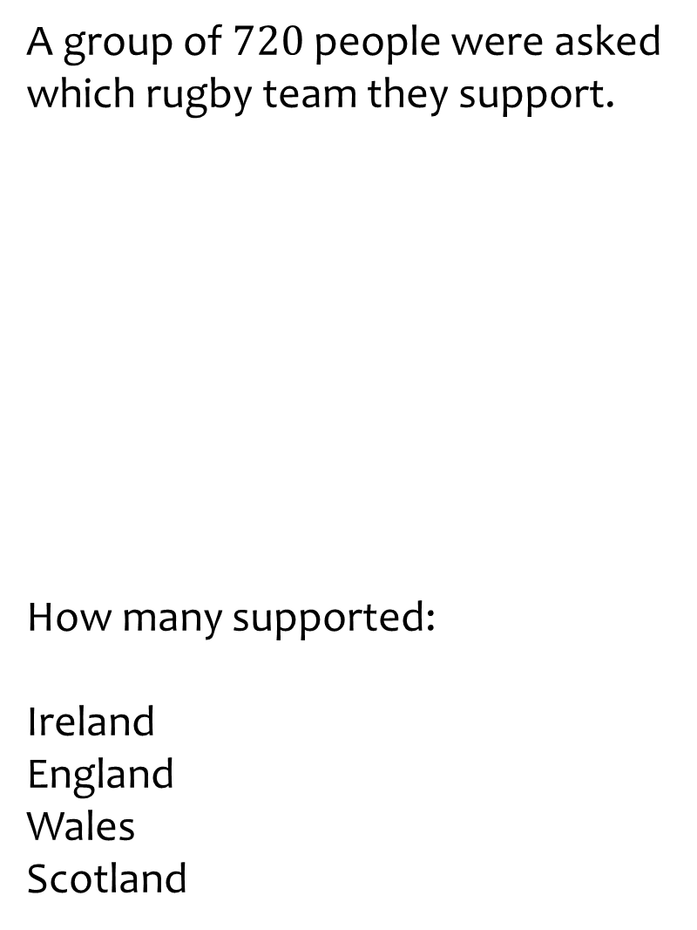
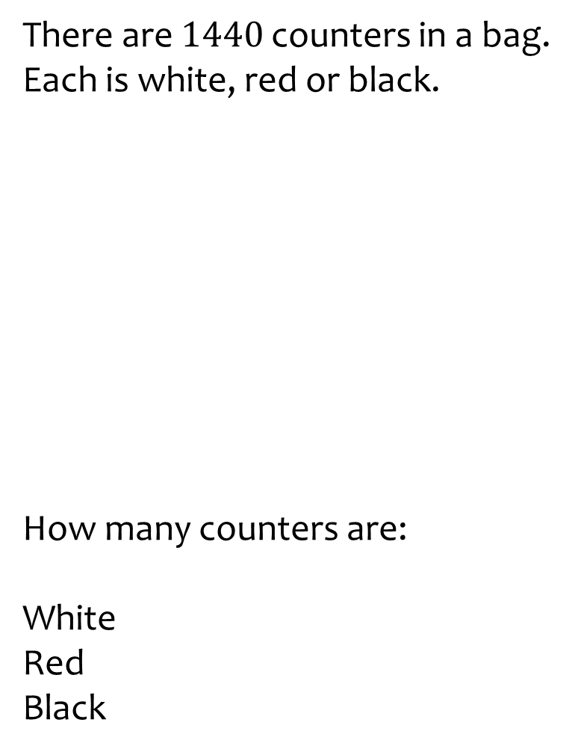
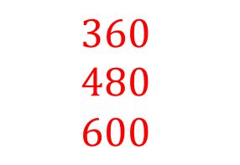
Worked example
Your turn
A group of $720$people were asked which rugby team they support.
How many supported:
Ireland
England
Wales
Scotland
There are $1440$ counters in a bag. Each is white, red or black.
How many counters are:
White
Red
Black
$$360$$
$$480$$
$$600$$
Questions used with permission from Corbettmaths: https://corbettmaths.com/
Notes:
Corbettmaths graphic

Slide 17
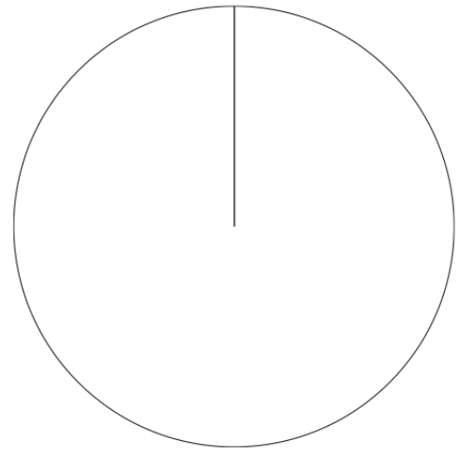
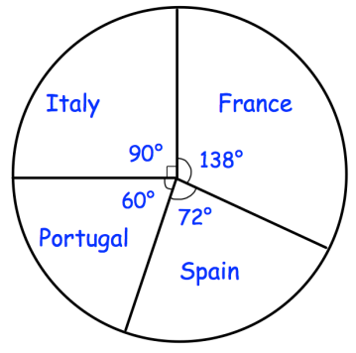
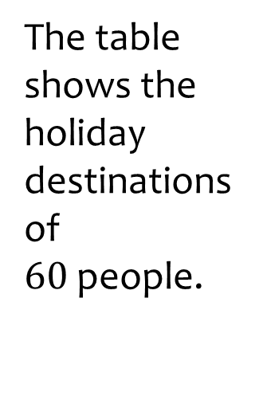
Worked example
Your turn
The table shows the number of ice creams sold in a day. In total 120 were sold.
The table shows the holiday destinations of $60$people.
Flavour | Number sold
Vanilla | 20
Chocolate | 40
Strawberry | 24
Honeycomb | 24
Mint | 12
Destination | Number of people
Italy | 15
Portugal | 10
Spain | 12
France | 23
Draw a pie chart to represent this information
Draw a pie chart to represent this information
Questions used with permission from Corbettmaths: https://corbettmaths.com/
Notes:
Corbettmaths graphic

Slide 18
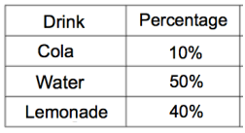
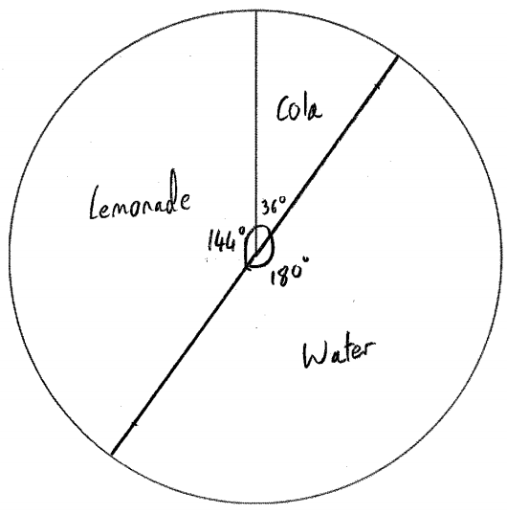
Worked example
Your turn
Draw a pie chart for the data
Draw a pie chart for the data
Flavour | Number sold
Vanilla | 20%
Chocolate | 10%
Strawberry | 50%
Honeycomb | 5%
Lemon | 15%
Questions used with permission from Corbettmaths: https://corbettmaths.com/
Notes:
Corbettmaths graphic

Slide 19
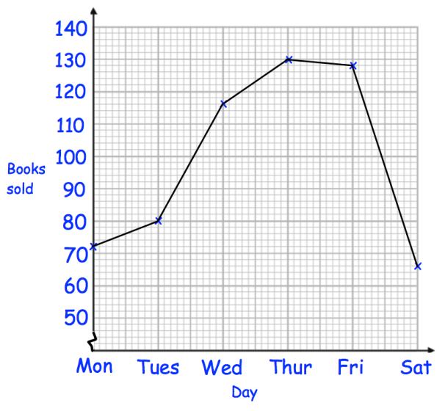
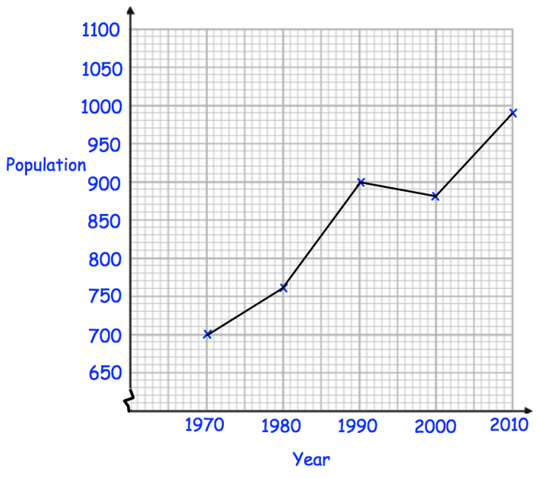
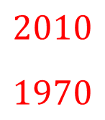

Worked example
Your turn
The line graph shows the number of books sold in a charity shop over one week.
When did the charity shop sell:
The most books
The least books
How many books were sold on Friday?
The line graph shows the population of a village over time.
When was the population:
Highest?
Lowest?
What was the population in 2000?
$$2010$$
$$1970$$
$$870$$
Questions used with permission from Corbettmaths: https://corbettmaths.com/
Notes:
Corbettmaths graphic

Slide 20
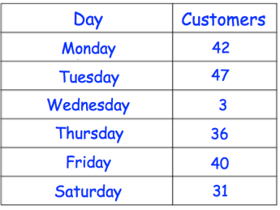




Worked example
Your turn
The table shows the number of customers to a shop over several days.
Draw a line graph for the data
The table shows the value of a share in a mobile phone company over one day.
Draw a line graph for the data
Questions used with permission from Corbettmaths: https://corbettmaths.com/
Notes:
Corbettmaths graphic

Slide 21




Worked example
Your turn
Draw a frequency polygon for the information
Draw a frequency polygon for the information

Slide 22




Worked example
Your turn
Draw a frequency polygon for the information
Draw a frequency polygon for the information
Questions used with permission from Corbettmaths: https://corbettmaths.com/

Slide 23



Worked example
Your turn
Estimate the mean length:
Estimate the mean time
$49.09$minutes (2 dp)
Questions used with permission from Corbettmaths: https://corbettmaths.com/

