Slide 1
Cumulative frequency
CONTENTS

Slide 2
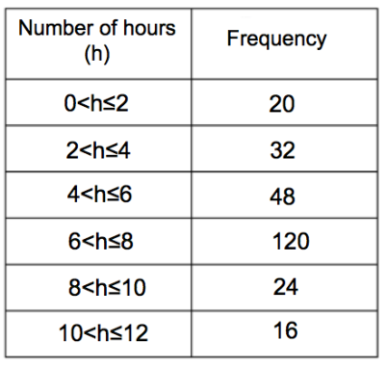
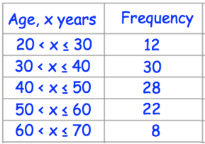
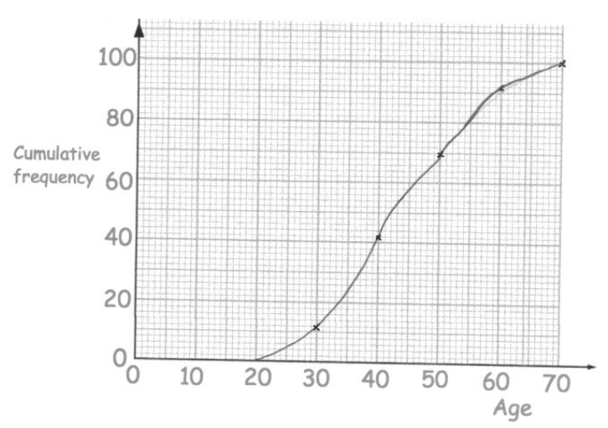
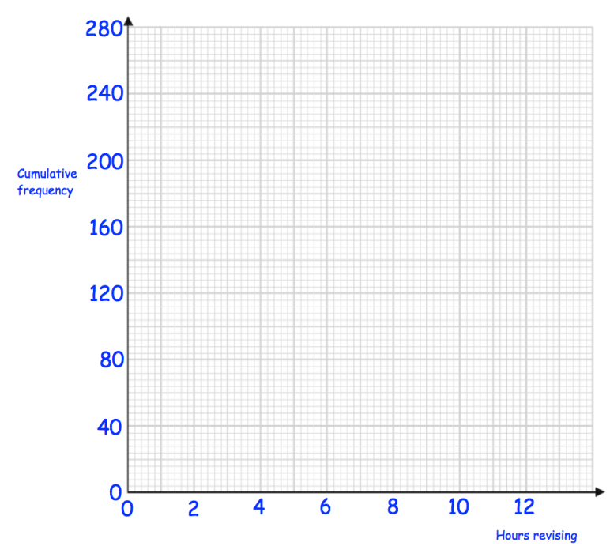
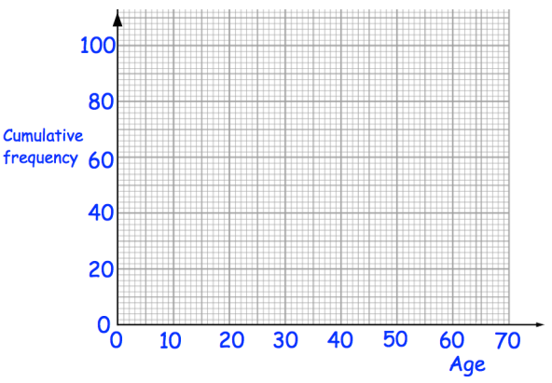
Worked example
Your turn
Plot a cumulative frequency graph
Plot a cumulative frequency graph
Questions used with permission from Corbettmaths: https://corbettmaths.com/

Slide 3
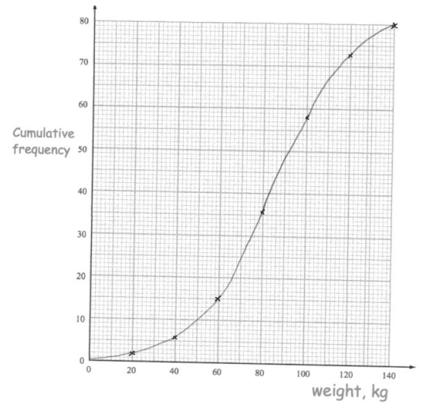
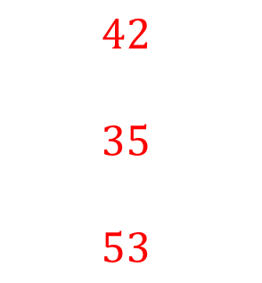
Worked example
Your turn
Using the cumulative frequency graph, estimate the:
Median Weight
Lower quartile weight
Upper quartile weight
Using the cumulative frequency graph, estimate the:
Median age
Lower quartile age
Upper quartile age
$$42$$
$$35$$
$$53$$
Questions used with permission from Corbettmaths: https://corbettmaths.com/

Slide 4

Worked example
Your turn
Using the cumulative frequency graph, estimate the:
Interquartile range of the weights
Using the cumulative frequency graph, estimate the:
Interquartile range of the ages
$$18$$
Questions used with permission from Corbettmaths: https://corbettmaths.com/

Slide 5
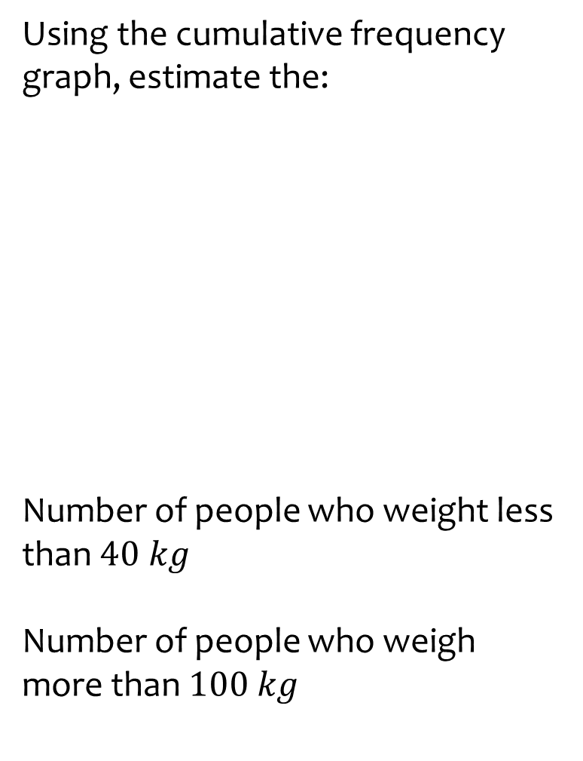
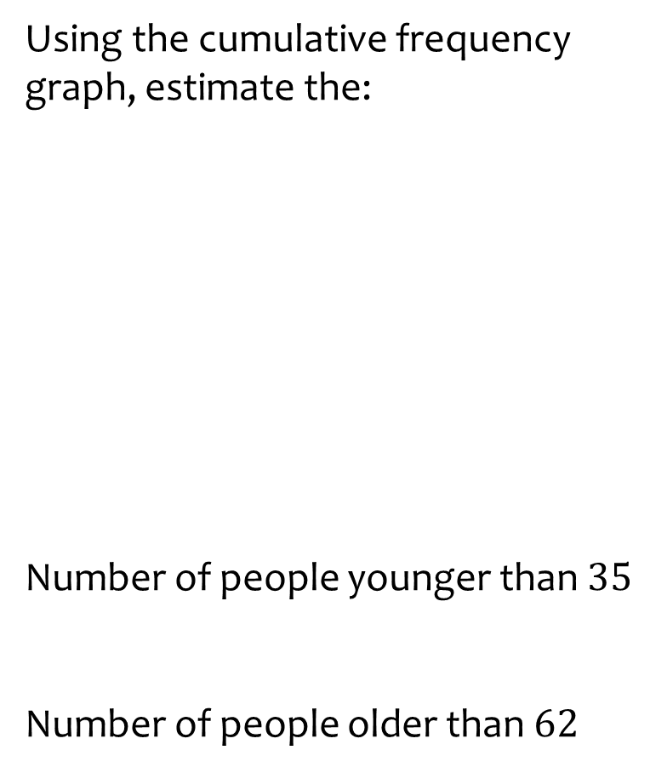

Worked example
Your turn
Using the cumulative frequency graph, estimate the:
Number of people who weight less than $40 kg$
Number of people who weigh more than $100 kg$
Using the cumulative frequency graph, estimate the:
Number of people younger than $35$
Number of people older than $62$
$$25$$
$$7$$
Questions used with permission from Corbettmaths: https://corbettmaths.com/

Slide 6
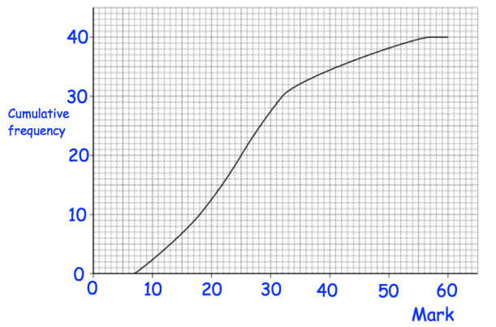
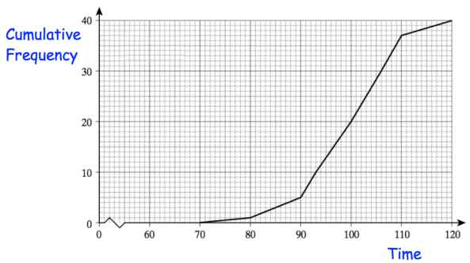
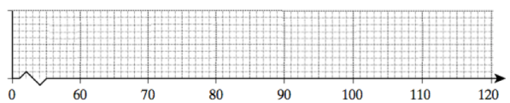
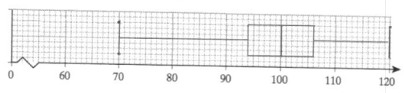
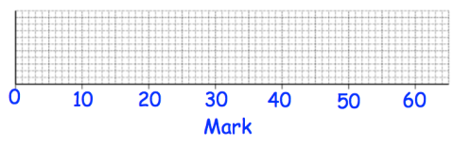
Worked example
Your turn
Using the cumulative frequency graph, draw a box plot
Using the cumulative frequency graph, draw a box plot
Questions used with permission from Corbettmaths: https://corbettmaths.com/

Slide 7
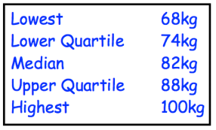
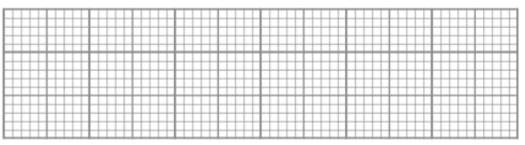
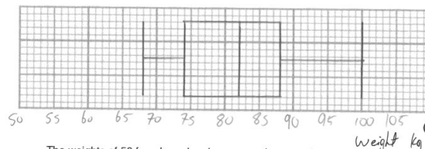
Worked example
Your turn
Draw a box plot to show this information.
Draw a box plot to show this information.
51 kg
60 kg
71 kg
74 kg
83 kg
Questions used with permission from Corbettmaths: https://corbettmaths.com/

Slide 8
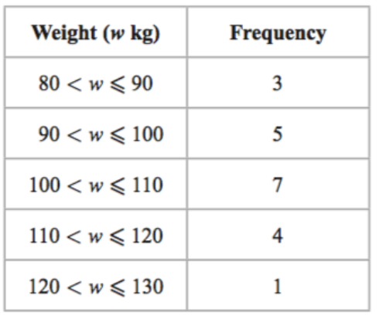
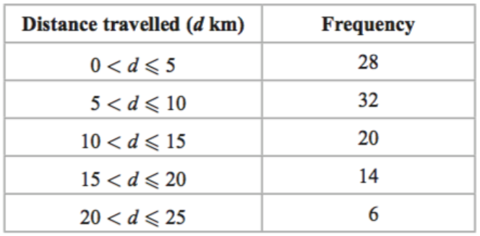
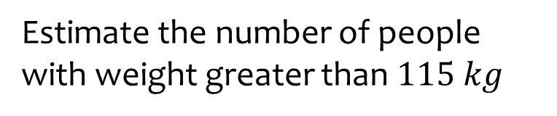
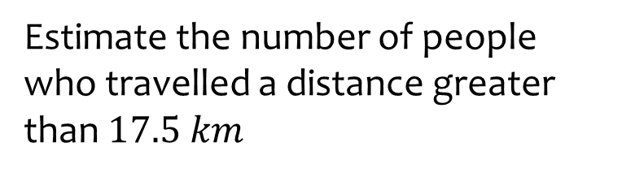

Worked example
Your turn
Estimate the number of people with weight greater than $115 kg$
Estimate the number of people who travelled a distance greater than $17.5 km$
$$13$$

Slide 9
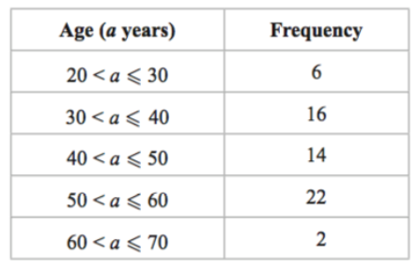
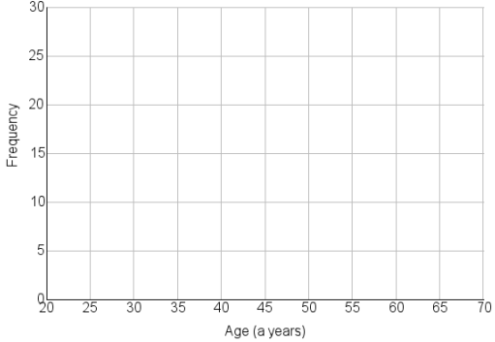
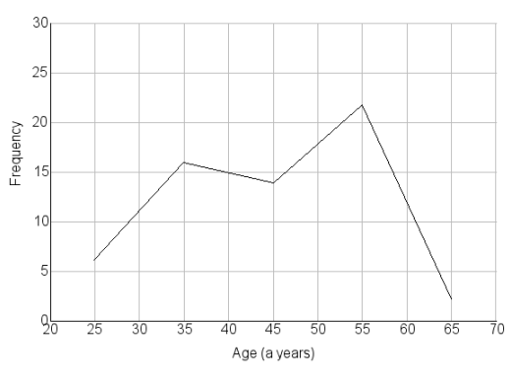
Worked example
Your turn
Draw a frequency polygon for the information
Draw a frequency polygon for the information

