Slide 1
Averages and the range
CONTENTS

Slide 2
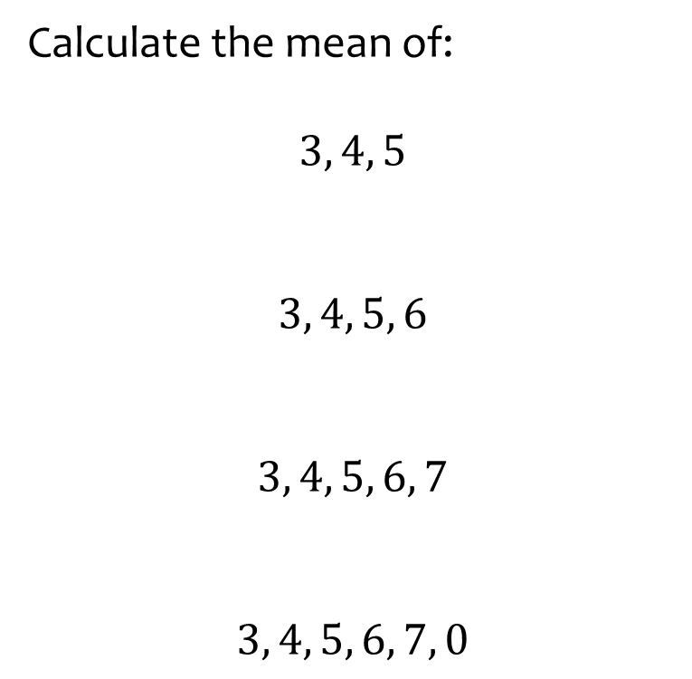
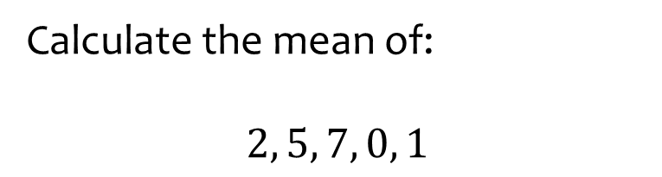

Worked example
Your turn
Calculate the mean of:
$$3, 4, 5$$
$$3, 4, 5, 6$$
$$3, 4, 5, 6, 7$$
$$3, 4, 5, 6, 7, 0$$
Calculate the mean of:
$$2, 5, 7, 0, 1$$
$$3$$

Slide 3
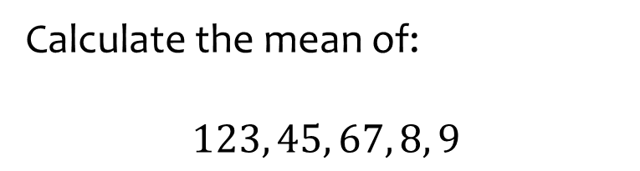
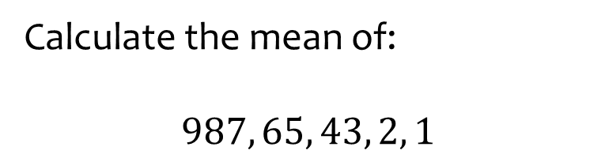

Worked example
Your turn
Calculate the mean of:
$$123, 45, 67, 8, 9$$
Calculate the mean of:
$$987, 65, 43, 2, 1$$
$$219.6$$

Slide 4
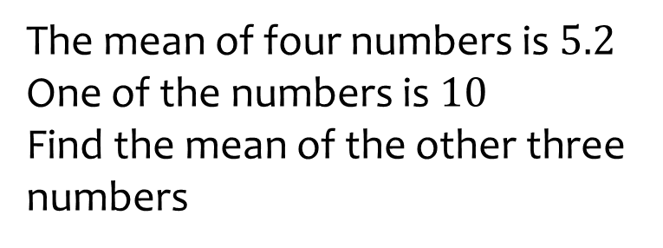
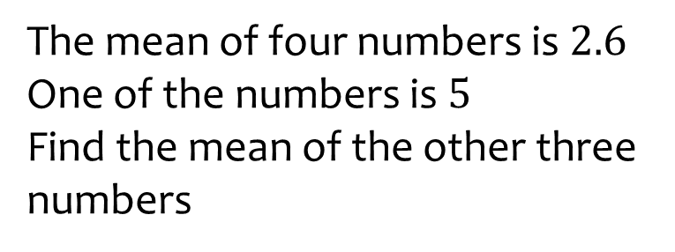

Worked example
Your turn
The mean of four numbers is $5.2$
One of the numbers is $10$
Find the mean of the other three numbers
The mean of four numbers is $2.6$
One of the numbers is $5$
Find the mean of the other three numbers
$$1.8$$

Slide 5
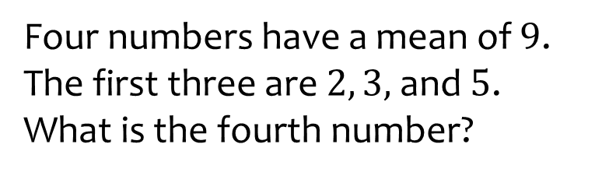
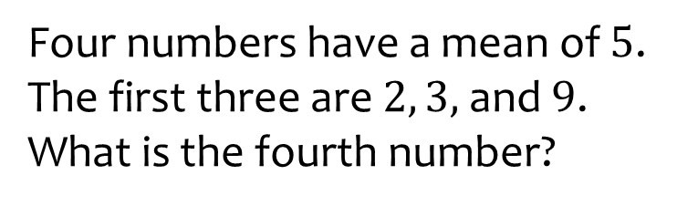

Worked example
Your turn
Four numbers have a mean of $9$. The first three are $2, 3,$ and $5$.
What is the fourth number?
Four numbers have a mean of $5$. The first three are $2, 3,$ and $9$.
What is the fourth number?
$$6$$

Slide 6
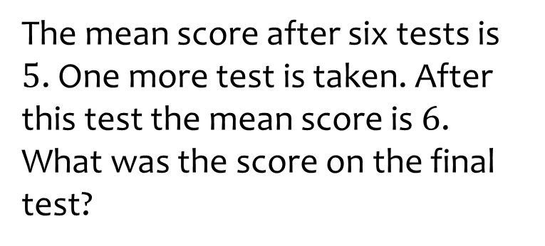
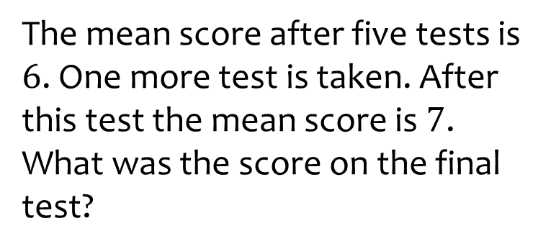

Worked example
Your turn
The mean score after six tests is $5$. One more test is taken. After this test the mean score is $6$.
What was the score on the final test?
The mean score after five tests is $6$. One more test is taken. After this test the mean score is $7$.
What was the score on the final test?
$$12$$

Slide 7
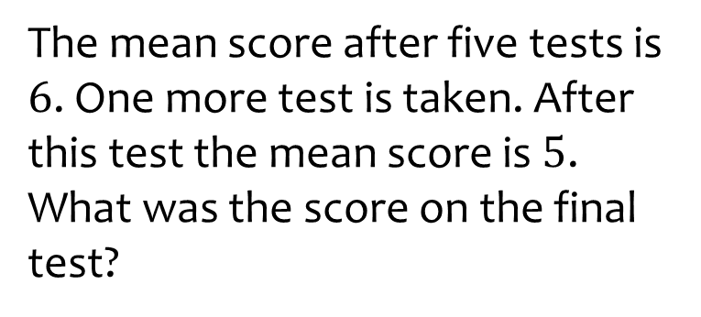

Worked example
Your turn
The mean score after six tests is $5$. One more test is taken. After this test the mean score is $6$.
What was the score on the final test?
The mean score after five tests is $6$. One more test is taken. After this test the mean score is $5$.
What was the score on the final test?
$$0$$

Slide 8

Worked example
Your turn
The mean of five numbers is 8.
Three of the numbers are chosen and the mean is found to be 5.
What is the mean of the remaining two numbers?
The mean of five numbers is 6.
Three of the numbers are chosen and the mean is found to be 8.
What is the mean of the remaining two numbers?
$$3$$

Slide 9
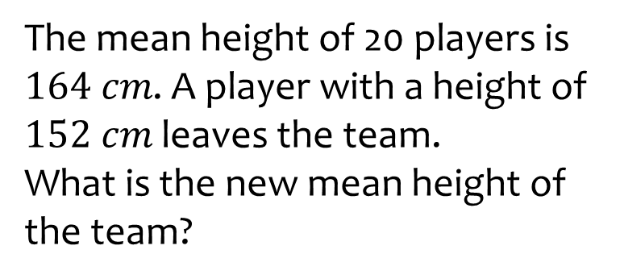
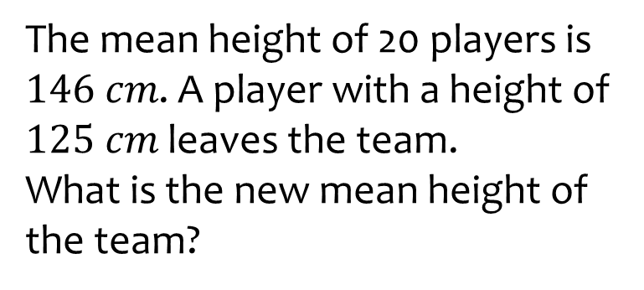

Worked example
Your turn
The mean height of 20 players is $164 cm$. A player with a height of $152 cm$ leaves the team.
What is the new mean height of the team?
The mean height of 20 players is $146 cm$. A player with a height of $125 cm$ leaves the team.
What is the new mean height of the team?
$147.1 cm$(1 dp)

Slide 10
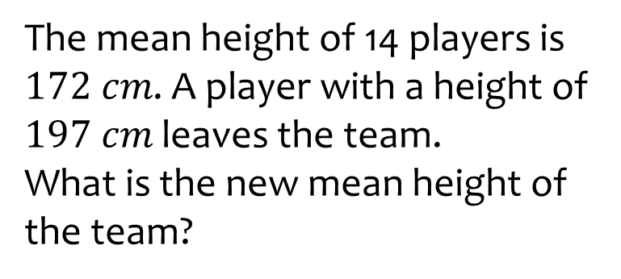
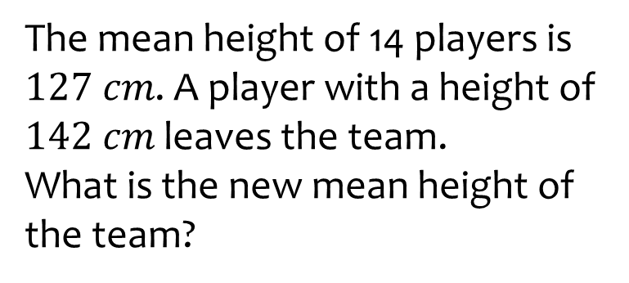

Worked example
Your turn
The mean height of 14 players is $172 cm$. A player with a height of $197 cm$ leaves the team.
What is the new mean height of the team?
The mean height of 14 players is $127 cm$. A player with a height of $142 cm$ leaves the team.
What is the new mean height of the team?
$125.8 cm$(1 dp)

Slide 11

Worked example
Your turn
A group of students take a test.
The group consists of 24 boys and 16 girls.
The mean mark for the boys is 36.
The mean mark for the girls is 33.
Calculate the mean mark for the whole group
A group of students take a test.
The group consists of 12 boys and 8 girls.
The mean mark for the boys is 18.
The mean mark for the girls is 16.5.
Calculate the mean mark for the whole group
$$17.4$$

Slide 12

Worked example
Your turn
A group of men, women and children take a test.
The mean score for women is 31.2
The mean score for children is 18.4
The mean score for all 80 people is 22.4.
Work out the mean score for men
A group of men, women and children take a test.
The mean score for women is 15.6
The mean score for children is 9.2
The mean score for all 40 people is 11.2.
Work out the mean score for men
$$10$$

Slide 13
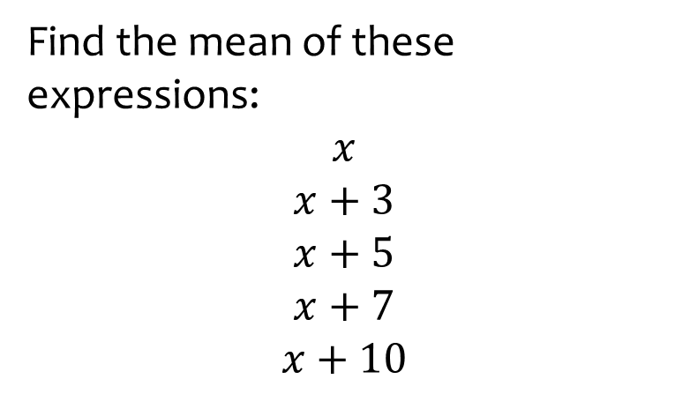
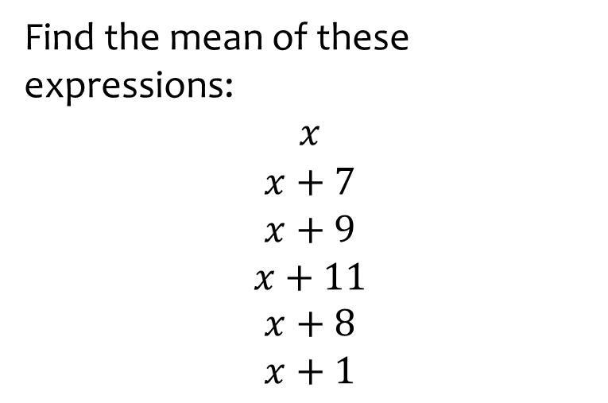

Worked example
Your turn
Find the mean of these expressions:
$$x$$
$$x+3$$
$$x+5$$
$$x+7$$
$$x+10$$
Find the mean of these expressions:
$$x$$
$$x+7$$
$$x+9$$
$$x+11$$
$$x+8$$
$$x+1$$
$$x+6$$

Slide 14

Worked example
Your turn
Calculate the mean score
Calculate the mean score
Score | Frequency
0 | 2
1 | 3
2 | 1
3 | 2
4 | 2
5 | 4
Score | Frequency
0 | 4
1 | 6
2 | 2
3 | 4
4 | 4
5 | 8
$2.8$(1 dp)

Slide 15

Worked example
Your turn
Calculate the mean age
Calculate the mean age
Age | Frequency
6 | 5
7 | 3
8 | 2
9 | 7
Age | Frequency
6 | 10
7 | 6
8 | 4
9 | 14
$7.6$(1 dp)

Slide 16

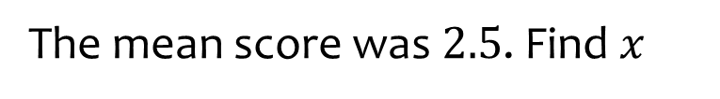

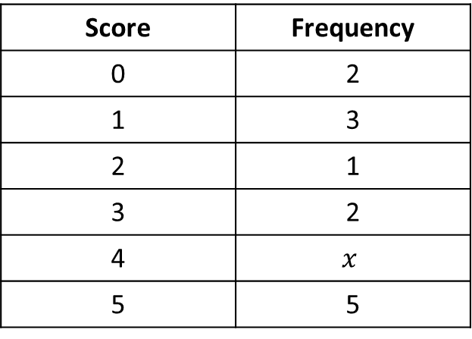
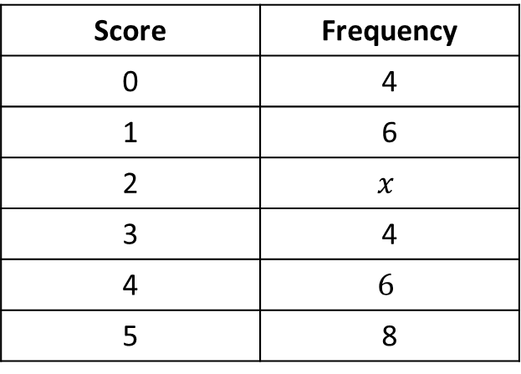
Worked example
Your turn
The mean score was $3$. Find $x$
The mean score was $2.5$. Find $x$
Score | Frequency
0 | 2
1 | 3
2 | 1
3 | 2
4 | $$x$$
5 | 5
Score | Frequency
0 | 4
1 | 6
2 | $$x$$
3 | 4
4 | $$6$$
5 | 8
$$x=24$$

Slide 17

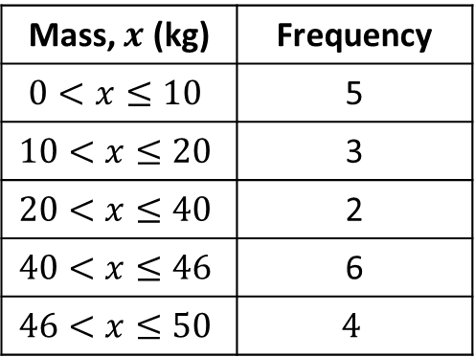
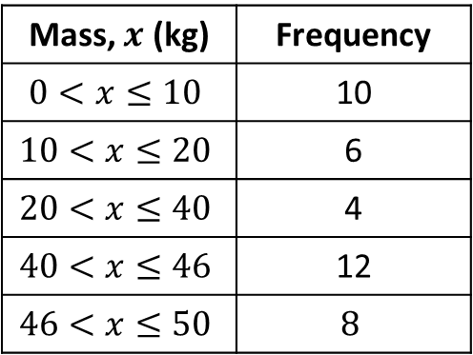
Worked example
Your turn
Calculate an estimate for the mean mass:
Calculate an estimate for the mean mass:
Mass, $x$ (kg) | Frequency
$$0<x≤10$$ | 5
$$10<x≤20$$ | 3
$$20<x≤40$$ | 2
$$40<x≤46$$ | 6
$$46<x≤50$$ | $$4$$
Mass, $x$ (kg) | Frequency
$$0<x≤10$$ | 10
$$10<x≤20$$ | 6
$$20<x≤40$$ | 4
$$40<x≤46$$ | 12
$$46<x≤50$$ | $$8$$
$$29 kg$$

Slide 18

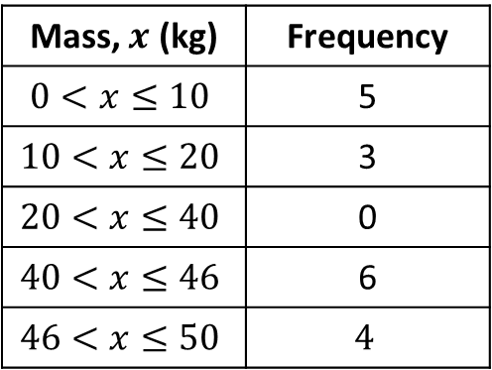
Worked example
Your turn
Calculate an estimate for the mean mass:
Calculate an estimate for the mean mass:
Mass, $x$ (kg) | Frequency
$$0<x≤10$$ | 5
$$10<x≤20$$ | 3
$$20<x≤40$$ | 2
$$40<x≤46$$ | 6
$$46<x≤50$$ | $$4$$
Mass, $x$ (kg) | Frequency
$$0<x≤10$$ | 5
$$10<x≤20$$ | 3
$$20<x≤40$$ | 0
$$40<x≤46$$ | 6
$$46<x≤50$$ | $$4$$
$28.9 kg$ (1 dp)

Slide 19

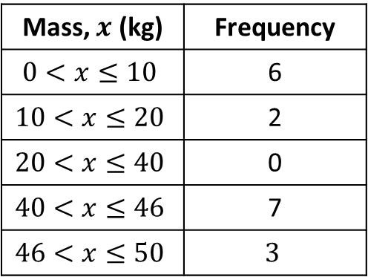
Worked example
Your turn
Calculate an estimate for the mean mass:
Calculate an estimate for the mean mass:
Mass, $x$ (kg) | Frequency
$$0<x≤10$$ | 5
$$10<x≤20$$ | 3
$$20<x≤40$$ | 2
$$40<x≤46$$ | 6
$$46<x≤50$$ | $$4$$
Mass, $x$ (kg) | Frequency
$$0<x≤10$$ | 6
$$10<x≤20$$ | 2
$$20<x≤40$$ | 0
$$40<x≤46$$ | 7
$$46<x≤50$$ | $$3$$
$28.1 kg$(1 dp)

Slide 20
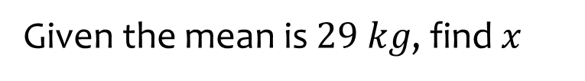


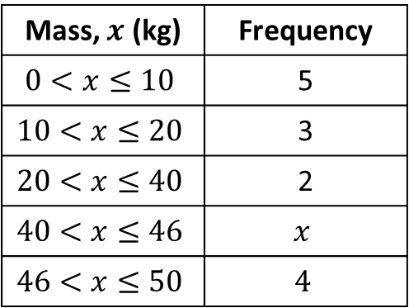
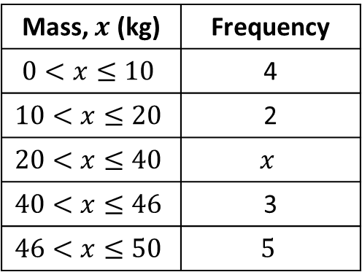
Worked example
Your turn
Given the mean is $29 kg$, find $x$
Given the mean is $\frac{449}{15}kg$
Mass, $x$ (kg) | Frequency
$$0<x≤10$$ | 5
$$10<x≤20$$ | 3
$$20<x≤40$$ | 2
$$40<x≤46$$ | $$x$$
$$46<x≤50$$ | $$4$$
Mass, $x$ (kg) | Frequency
$$0<x≤10$$ | 4
$$10<x≤20$$ | 2
$$20<x≤40$$ | $$x$$
$$40<x≤46$$ | 3
$$46<x≤50$$ | $$5$$
$$x=1$$

Slide 21
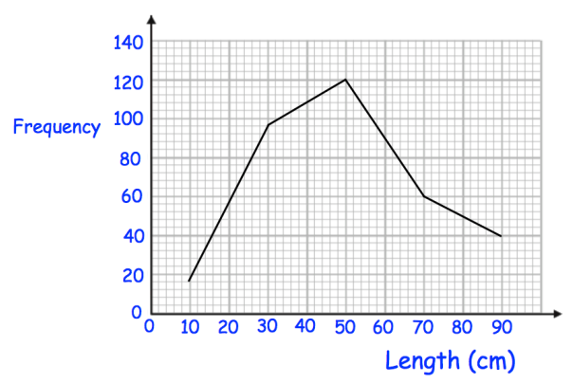
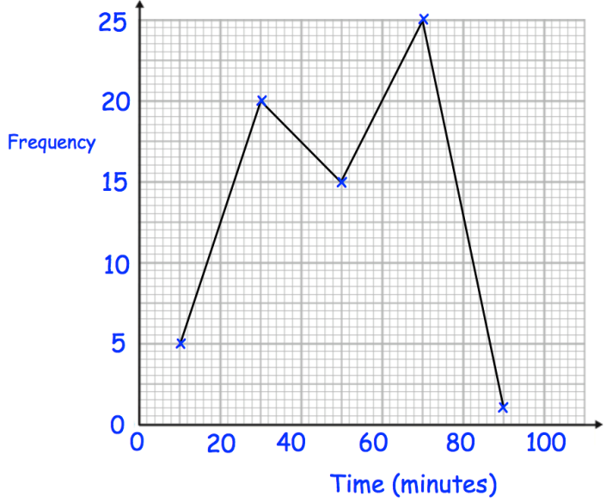

Worked example
Your turn
Estimate the mean length:
Estimate the mean time
$49.09$minutes (2 dp)
Questions used with permission from Corbettmaths: https://corbettmaths.com/

Slide 22
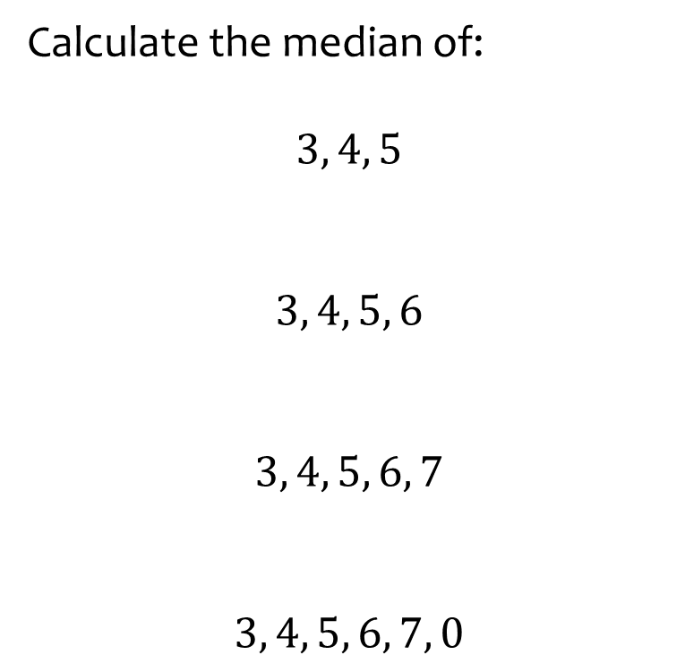
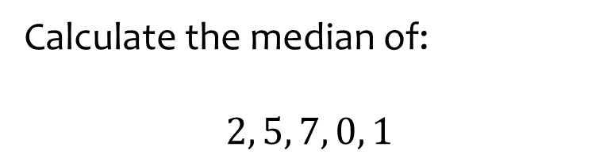

Worked example
Your turn
Calculate the median of:
$$3, 4, 5$$
$$3, 4, 5, 6$$
$$3, 4, 5, 6, 7$$
$$3, 4, 5, 6, 7, 0$$
Calculate the median of:
$$2, 5, 7, 0, 1$$
$$2$$

Slide 23
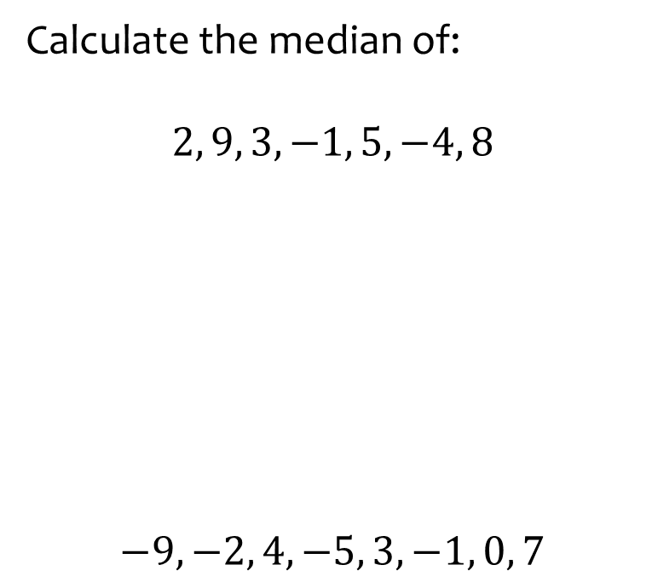
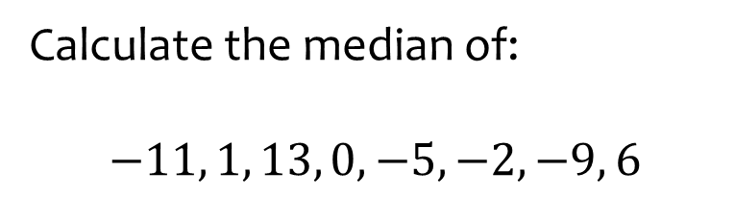

Worked example
Your turn
Calculate the median of:
$$2, 9, 3, −1, 5, −4, 8$$
$$−9, −2, 4, −5, 3, −1, 0, 7$$
Calculate the median of:
$$−11, 1, 13, 0, −5, −2, −9, 6$$
$$−1$$

Slide 24

Worked example
Your turn
Calculate the median score
Calculate the median score
Score | Frequency
0 | 2
1 | 3
2 | 1
3 | 2
4 | 2
5 | 4
Score | Frequency
0 | 4
1 | 6
2 | 2
3 | 4
4 | 4
5 | 8
$$3$$

Slide 25

Worked example
Your turn
Calculate the median score
Calculate the median score
Score | Frequency
0 | 2
1 | 3
2 | 1
3 | 2
4 | 2
5 | 7
Score | Frequency
0 | 9
1 | 6
2 | 2
3 | 4
4 | 4
5 | 8
$$2$$

Slide 26

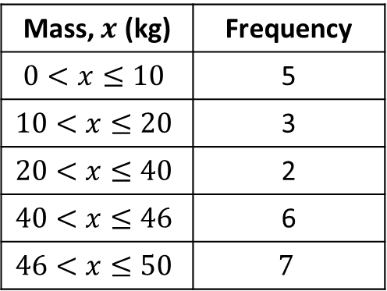
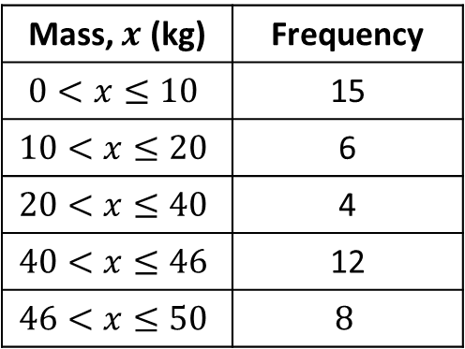
Worked example
Your turn
Determine the median class interval
Determine the median class interval
Mass, $x$ (kg) | Frequency
$$0<x≤10$$ | 5
$$10<x≤20$$ | 3
$$20<x≤40$$ | 2
$$40<x≤46$$ | 6
$$46<x≤50$$ | $$7$$
Mass, $x$ (kg) | Frequency
$$0<x≤10$$ | 15
$$10<x≤20$$ | 6
$$20<x≤40$$ | 4
$$40<x≤46$$ | 12
$$46<x≤50$$ | $$8$$
$$20<x≤40$$

Slide 27

Worked example
Your turn
Estimate the median by linear interpolation
Estimate the median by linear interpolation
Mass, $x$ (kg) | Frequency
$$0<x≤10$$ | 5
$$10<x≤20$$ | 3
$$20<x≤40$$ | 2
$$40<x≤46$$ | 6
$$46<x≤50$$ | $$7$$
Mass, $x$ (kg) | Frequency
$$0<x≤10$$ | 15
$$10<x≤20$$ | 6
$$20<x≤40$$ | 4
$$40<x≤46$$ | 12
$$46<x≤50$$ | $$8$$
$$30 kg$$

Slide 28

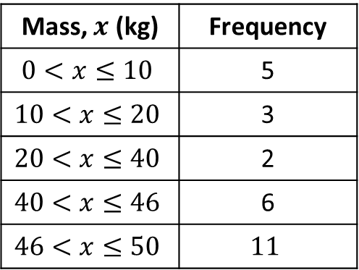
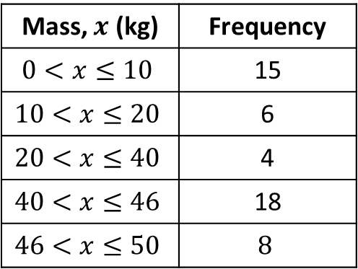
Worked example
Your turn
Estimate the median by linear interpolation
Estimate the median by linear interpolation
Mass, $x$ (kg) | Frequency
$$0<x≤10$$ | 5
$$10<x≤20$$ | 3
$$20<x≤40$$ | 2
$$40<x≤46$$ | 6
$$46<x≤50$$ | $$11$$
Mass, $x$ (kg) | Frequency
$$0<x≤10$$ | 15
$$10<x≤20$$ | 6
$$20<x≤40$$ | 4
$$40<x≤46$$ | 18
$$46<x≤50$$ | $$8$$
$40.17 kg$(2 dp)

Slide 29
Worked example
Your turn
Estimate the interquartile range by linear interpolation
Estimate the median by linear interpolation
Mass, $x$ (kg) | Frequency
$$0<x≤10$$ | 5
$$10<x≤20$$ | 3
$$20<x≤40$$ | 2
$$40<x≤46$$ | 6
$$46<x≤50$$ | $$11$$
Mass, $x$ (kg) | Frequency
$$0<x≤10$$ | 15
$$10<x≤20$$ | 6
$$20<x≤40$$ | 4
$$40<x≤46$$ | 18
$$46<x≤50$$ | $$8$$
$40.17 kg$(2 dp)

Slide 30
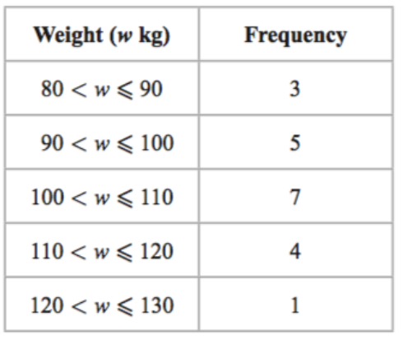
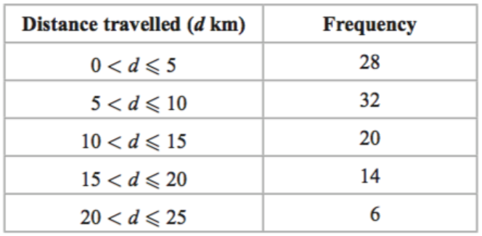

Worked example
Your turn
Estimate the interquartile range by linear interpolation
Estimate the interquartile range by linear interpolation
$9.29 km$(2 dp)

Slide 31
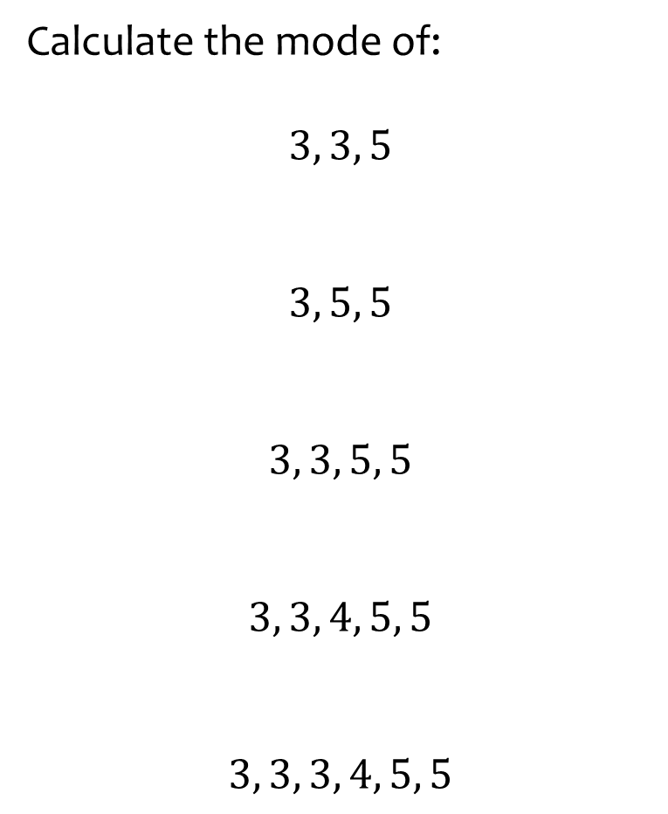
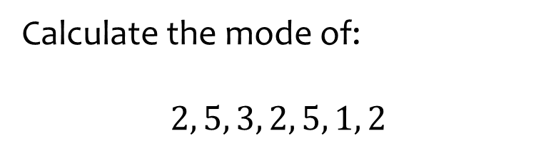
Worked example
Your turn
Calculate the mode of:
$$3, 3, 5$$
$$3, 5, 5$$
$$3, 3, 5, 5$$
$$3, 3, 4, 5, 5$$
$$3, 3, 3, 4, 5, 5$$
Calculate the mode of:
$$2, 5, 3, 2, 5, 1, 2$$
$$2$$

Slide 32

Worked example
Your turn
Determine the modal class interval
Determine the modal class interval
Mass, $x$ (kg) | Frequency
$$0<x≤10$$ | 5
$$10<x≤20$$ | 3
$$20<x≤40$$ | 2
$$40<x≤46$$ | 6
$$46<x≤50$$ | $$7$$
Mass, $x$ (kg) | Frequency
$$0<x≤10$$ | 15
$$10<x≤20$$ | 6
$$20<x≤40$$ | 4
$$40<x≤46$$ | 12
$$46<x≤50$$ | $$8$$
$$0<x≤10$$

Slide 33
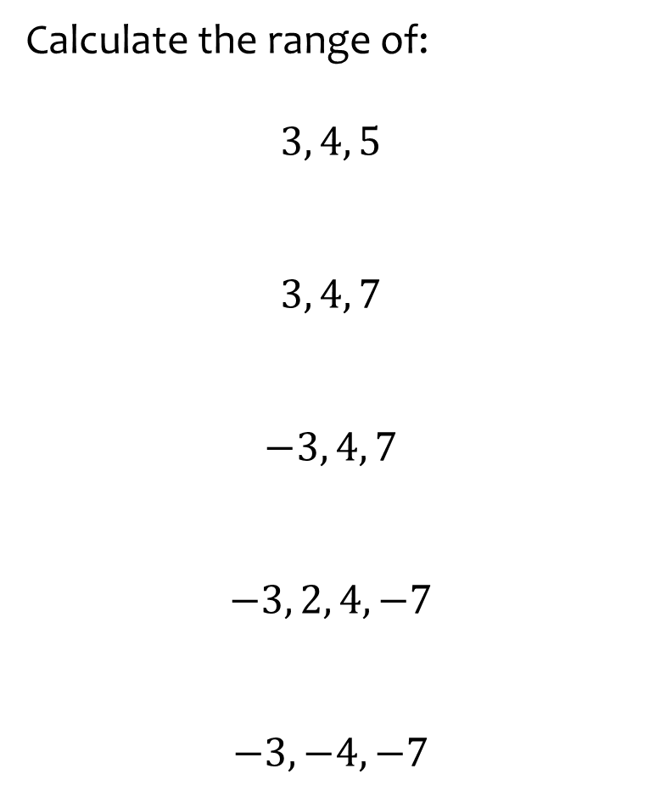
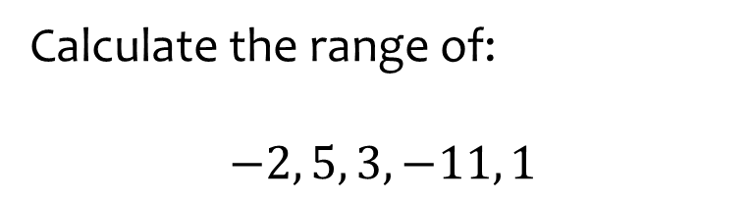

Worked example
Your turn
Calculate the range of:
$$3, 4, 5$$
$$3, 4, 7$$
$$−3, 4, 7$$
$$−3, 2, 4, −7$$
$$−3,−4, −7$$
Calculate the range of:
$$−2, 5, 3, −11, 1$$
$$16$$

Slide 34
Worked example
Your turn
Calculate the range of:
$$3, 4, 5$$
$$3, 4, 7$$
$$−3, 4, 7$$
$$−3, 2, 4, −7$$
$$−3,−4, −7$$
Calculate the range of:
$$−2, 5, 3, −11, 1$$
$$16$$

Slide 35
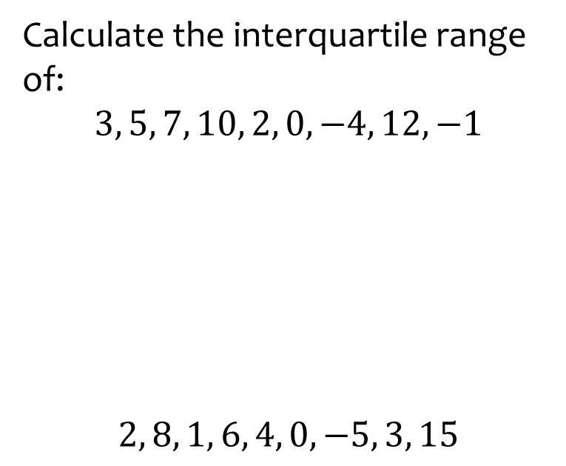
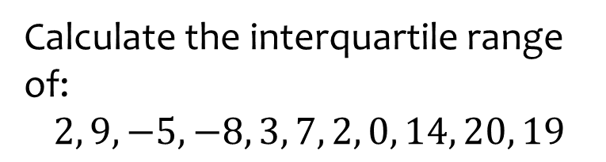

Worked example
Your turn
Calculate the interquartile range of:
$$3, 5, 7, 10, 2, 0, −4, 12, −1$$
$$2, 8, 1, 6, 4, 0, −5, 3, 15$$
Calculate the interquartile range of:
$$2, 9, −5, −8, 3, 7, 2, 0, 14, 20, 19$$
$$14$$

Slide 36
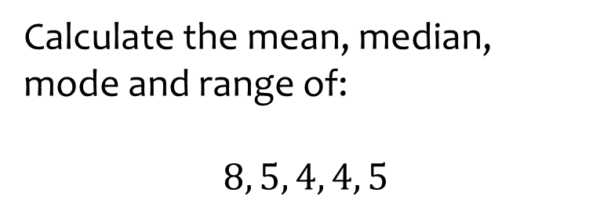
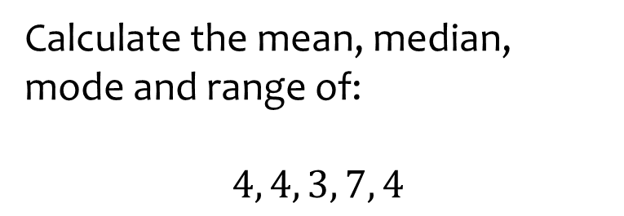

Worked example
Your turn
Calculate the mean, median, mode and range of:
$$8, 5, 4, 4, 5$$
Calculate the mean, median, mode and range of:
$$4, 4, 3, 7, 4$$
All $4$

Slide 37
Worked example
Your turn
Write a list of five numbers with a:
Mean of 4
Median of 4
Mode of 4
Range of 4
Write a list of five numbers with a:
Mean of 5
Median of 5
Mode of 5
Range of 5
Sum to 25
3rd term is 5
5 occurs most often
Highest – Lowest is 5

Slide 38
Worked example
Your turn
Write a list of four numbers with a:
Mean of 4
Median of 4
Mode of 4
Range of 4
Write a list of four numbers with a:
Mean of 5
Median of 5
Mode of 5
Range of 5
Sum to 20
Mean of 2nd and 3rd term is 5
5 occurs most often
Highest – Lowest is 5

Slide 39
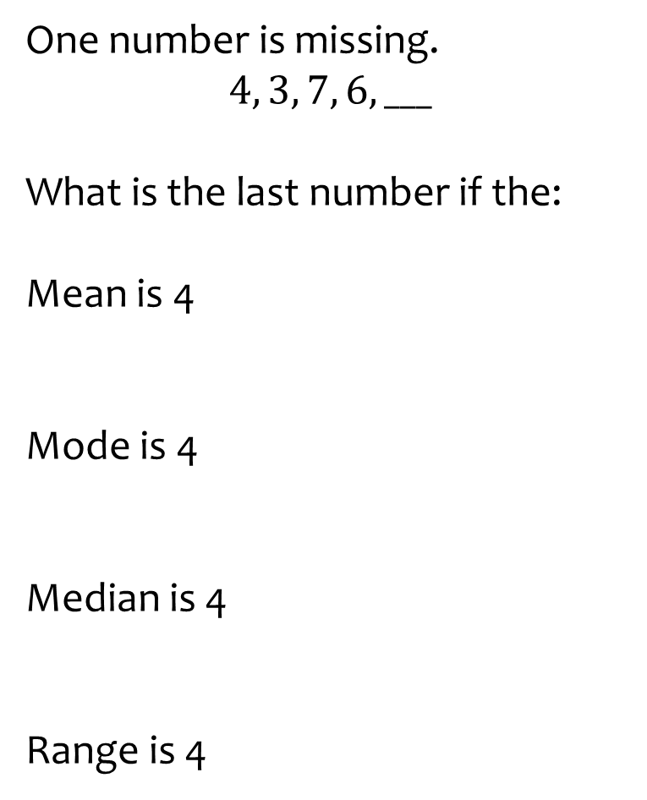
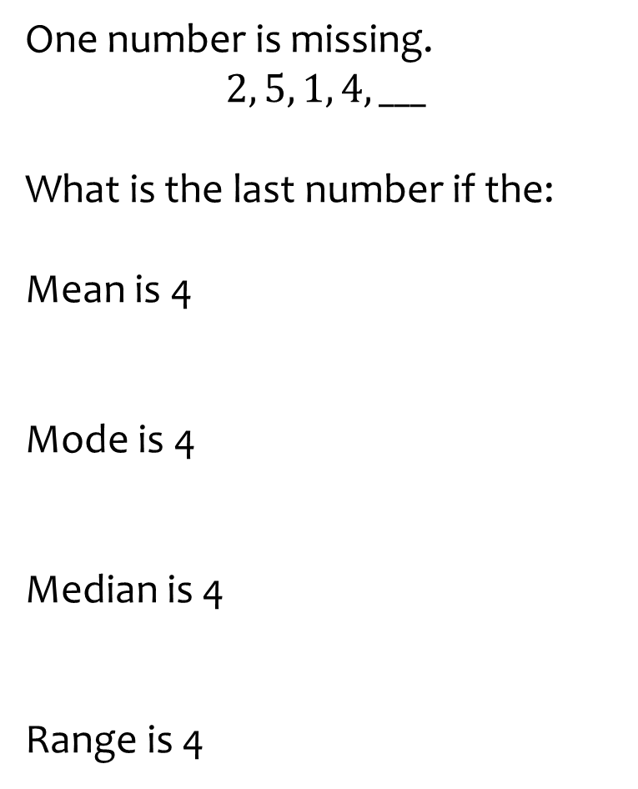
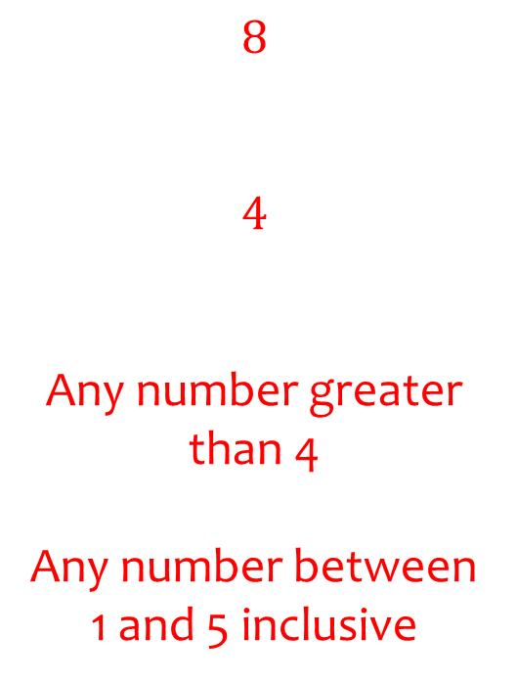
Worked example
Your turn
One number is missing.
$$4, 3, 7, 6, ___$$
What is the last number if the:
Mean is 4
Mode is 4
Median is 4
Range is 4
One number is missing.
$$2, 5, 1, 4, ___$$
What is the last number if the:
Mean is 4
Mode is 4
Median is 4
Range is 4
$$8$$
$$4$$
Any number greater than 4
Any number between 1 and 5 inclusive

