Slide 1
Surds
CONTENTS

Slide 2
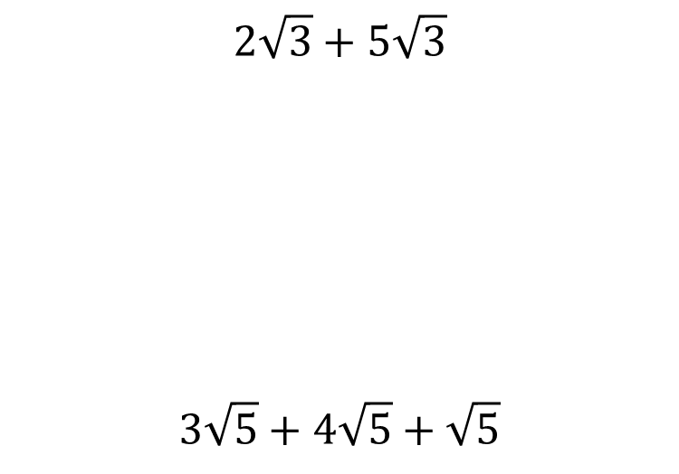


Worked example
Your turn
$$2\sqrt{3}+5\sqrt{3}$$
$$3\sqrt{5}+4\sqrt{5}+\sqrt{5}$$
$$8\sqrt{2}+6\sqrt{2}+\sqrt{2}+3\sqrt{2}$$
$$18\sqrt{2}$$

Slide 3
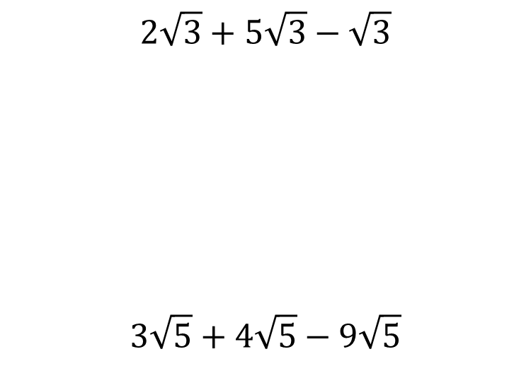


Worked example
Your turn
$$2\sqrt{3}+5\sqrt{3}−\sqrt{3}$$
$$3\sqrt{5}+4\sqrt{5}−9\sqrt{5}$$
$$8\sqrt{2}+6\sqrt{2}−17\sqrt{2}$$
$$−3\sqrt{2}$$

Slide 4
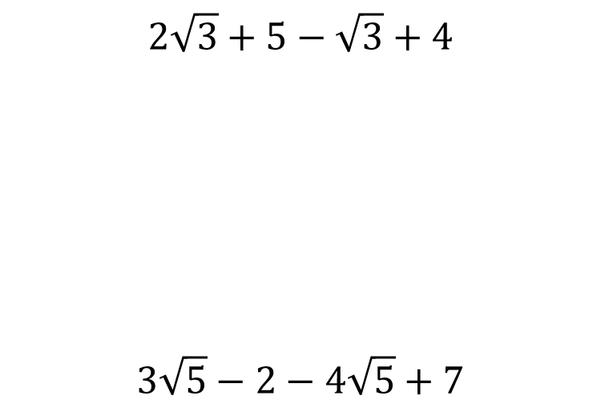


Worked example
Your turn
$$2\sqrt{3}+5−\sqrt{3}+4$$
$$3\sqrt{5}−2−4\sqrt{5}+7$$
$$8\sqrt{2}−9−6\sqrt{2}+5$$
$$2\sqrt{2}−4$$

Slide 5
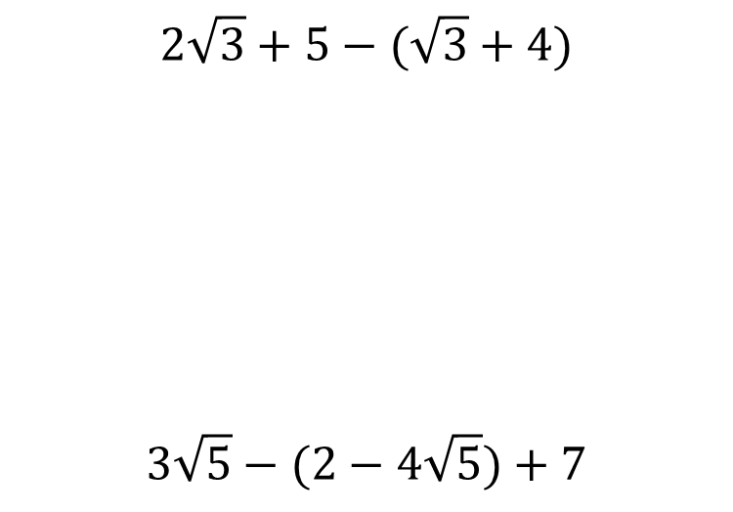


Worked example
Your turn
$$2\sqrt{3}+5−(\sqrt{3}+4)$$
$$3\sqrt{5}−(2−4\sqrt{5})+7$$
$$8\sqrt{2}−(9−6\sqrt{2})+5$$
$$14\sqrt{2}−4$$

Slide 6
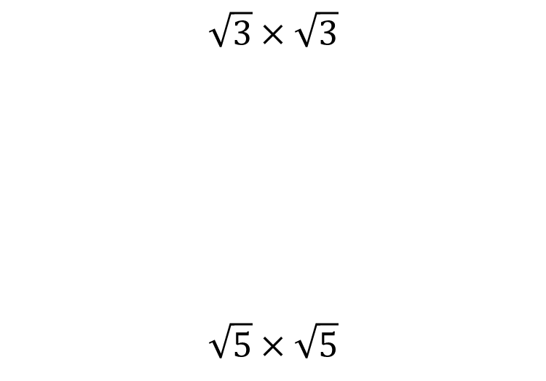


Worked example
Your turn
$$\sqrt{3}×\sqrt{3}$$
$$\sqrt{5}×\sqrt{5}$$
$$\sqrt{2}×\sqrt{2}$$
$$2$$

Slide 7
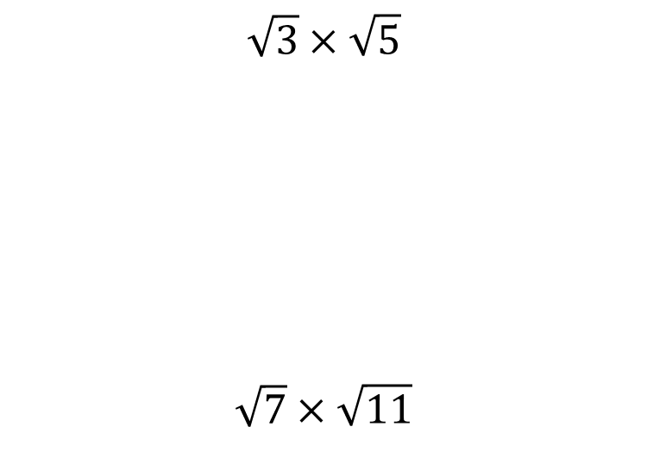


Worked example
Your turn
$$\sqrt{3}×\sqrt{5}$$
$$\sqrt{7}×\sqrt{11}$$
$$\sqrt{2}×\sqrt{13}$$
$$\sqrt{26}$$

Slide 8
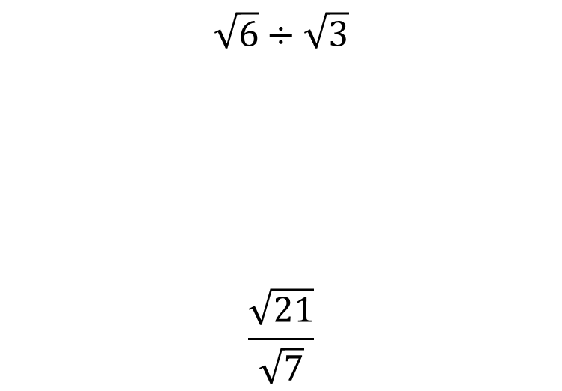


Worked example
Your turn
$$\sqrt{6}÷\sqrt{3}$$
$$\frac{\sqrt{21}}{\sqrt{7}}$$
$$\frac{\sqrt{56}}{\sqrt{8}}$$
$$\sqrt{7}$$

Slide 9
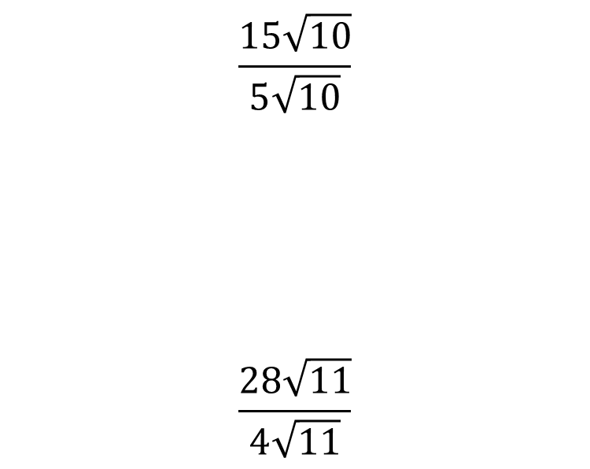


Worked example
Your turn
$$\frac{15\sqrt{10}}{5\sqrt{10}}$$
$$\frac{28\sqrt{11}}{4\sqrt{11}}$$
$$\frac{48\sqrt{13}}{6\sqrt{13}}$$
$$8$$

Slide 10
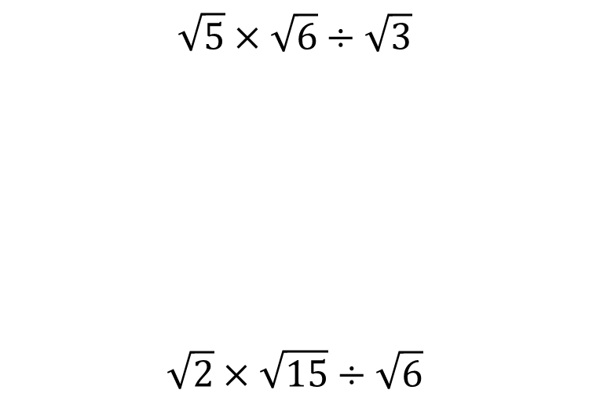


Worked example
Your turn
$$\sqrt{5}×\sqrt{6}÷\sqrt{3}$$
$$\sqrt{2}×\sqrt{15}÷\sqrt{6}$$
$$\sqrt{3}×\sqrt{10}÷\sqrt{2}$$
$$\sqrt{15}$$

Slide 11
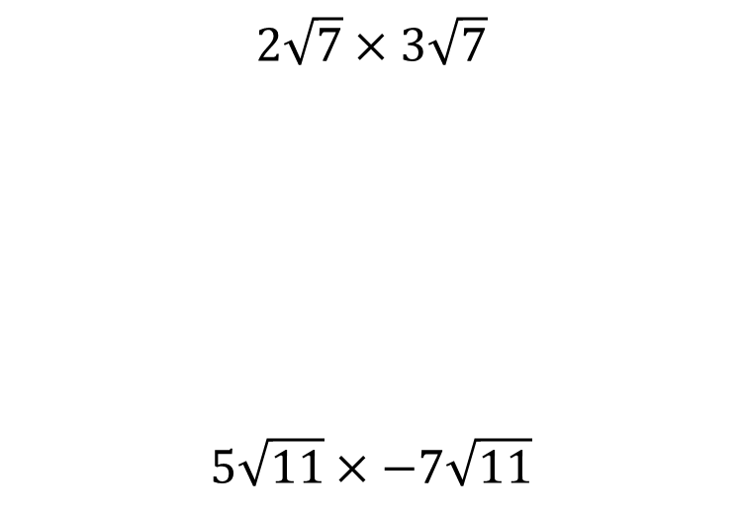


Worked example
Your turn
$$2\sqrt{7}×3\sqrt{7}$$
$$5\sqrt{11}×−7\sqrt{11}$$
$$7\sqrt{3}×−4\sqrt{3}$$
$$−84$$

Slide 12
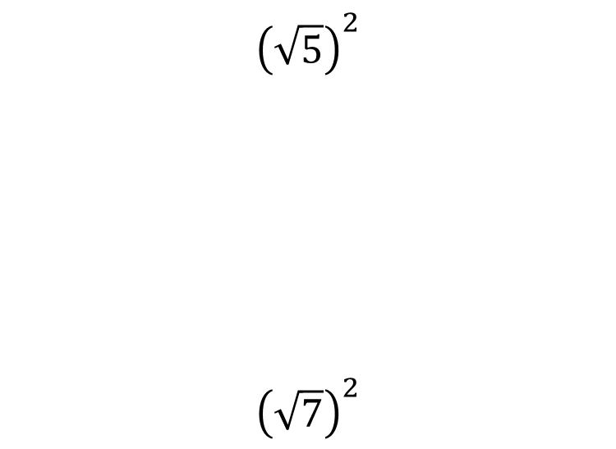


Worked example
Your turn
$${\left(\sqrt{5}\right)}^{2}$$
$${\left(\sqrt{7}\right)}^{2}$$
$${\left(\sqrt{11}\right)}^{2}$$
$$11$$

Slide 13
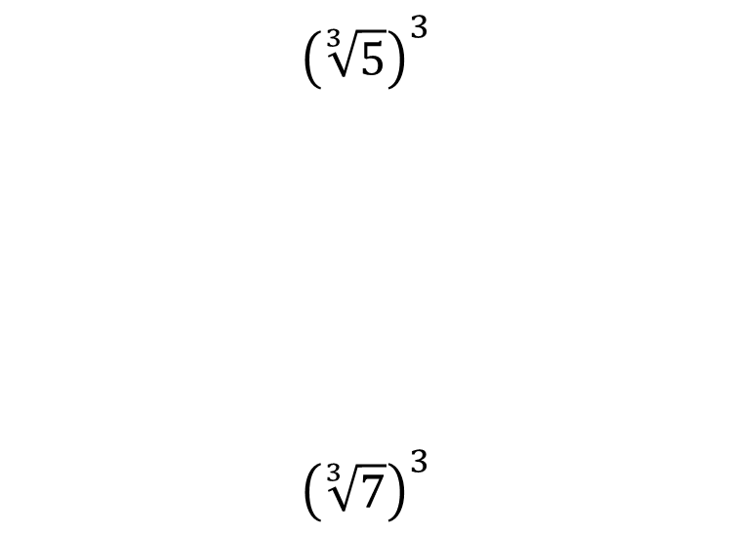

Worked example
Your turn
$${\left(\sqrt[3]{5}\right)}^{3}$$
$${\left(\sqrt[3]{7}\right)}^{3}$$
$${\left(\sqrt[3]{11}\right)}^{3}$$
$$11$$

Slide 14
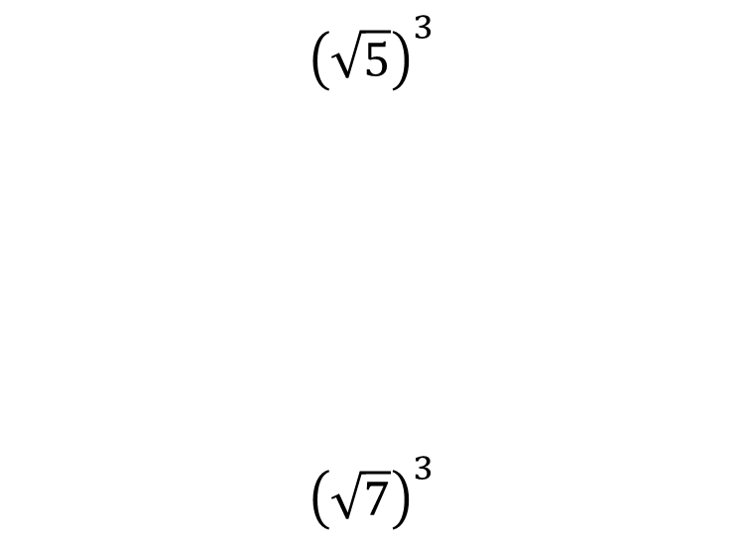


Worked example
Your turn
$${\left(\sqrt{5}\right)}^{3}$$
$${\left(\sqrt{7}\right)}^{3}$$
$${\left(\sqrt{11}\right)}^{3}$$
$$11\sqrt{11}$$

Slide 15
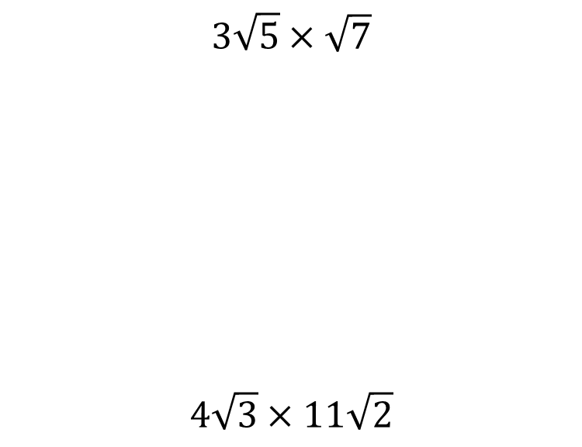


Worked example
Your turn
$$3\sqrt{5}×\sqrt{7}$$
$$4\sqrt{3}×11\sqrt{2}$$
$$5\sqrt{11}×2\sqrt{7}$$
$$10\sqrt{77}$$

Slide 16
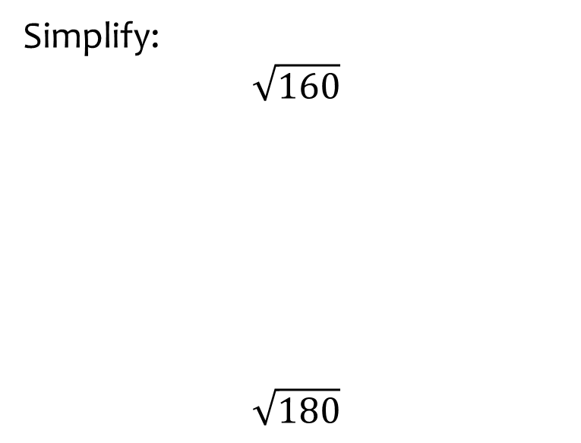
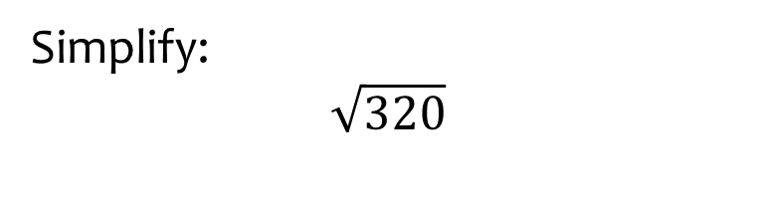

Worked example
Your turn
Simplify:
$$\sqrt{160}$$
$$\sqrt{180}$$
Simplify:
$$\sqrt{320}$$
$$4\sqrt{2}$$

Slide 17
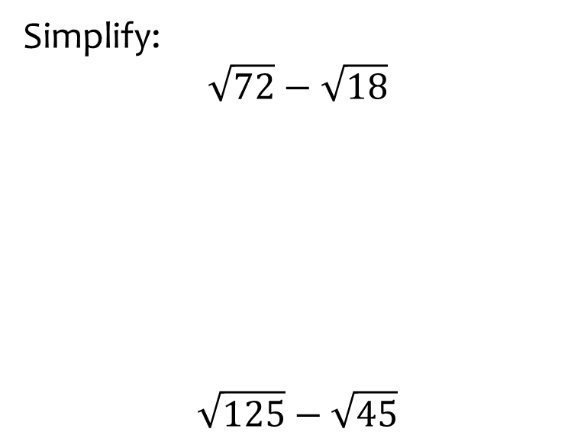
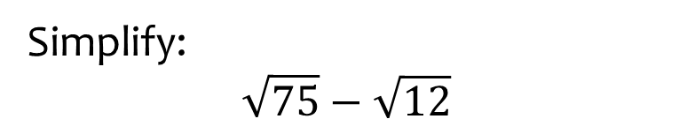

Worked example
Your turn
Simplify:
$$\sqrt{72}−\sqrt{18}$$
$$\sqrt{125}−\sqrt{45}$$
Simplify:
$$\sqrt{75}−\sqrt{12}$$
$$3\sqrt{3}$$

Slide 18
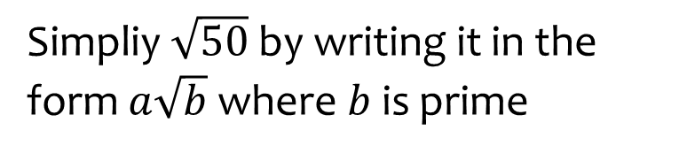
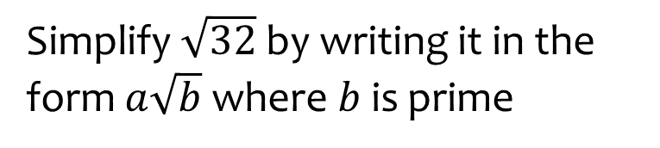
Worked example
Your turn
Simpliy $\sqrt{50}$ by writing it in the form $a\sqrt{b}$ where $b$ is prime
Simplify $\sqrt{32}$ by writing it in the form $a\sqrt{b}$ where $b$ is prime
$$4\sqrt{2}$$

Slide 19
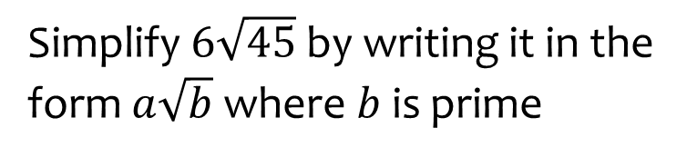
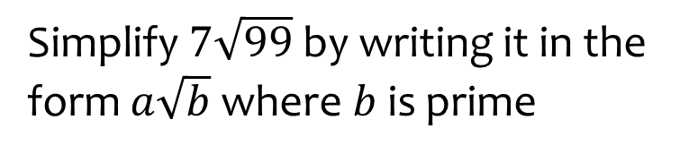

Worked example
Your turn
Simplify $6\sqrt{45}$ by writing it in the form $a\sqrt{b}$ where $b$ is prime
Simplify $7\sqrt{99}$ by writing it in the form $a\sqrt{b}$ where $b$ is prime
$$21\sqrt{11}$$

Slide 20
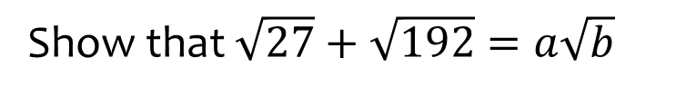


Worked example
Your turn
Show that $\sqrt{27}+\sqrt{192}=a\sqrt{b}$
Show that $\sqrt{28}+\sqrt{63}=a\sqrt{b}$
$$5\sqrt{7}$$

Slide 21



Worked example
Your turn
Evaluate $\sqrt{2}(\sqrt{8}+\sqrt{50})$
Evaluate $\sqrt{3}(\sqrt{12}+\sqrt{27})$
$$15$$

Slide 22
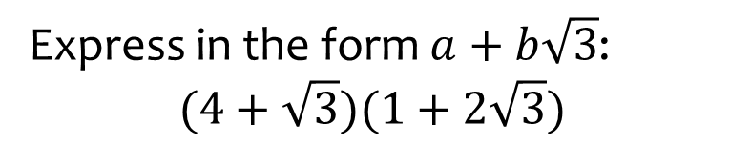
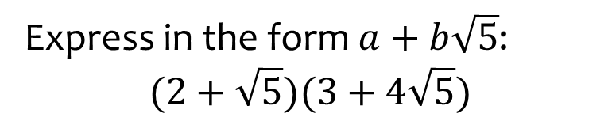

Worked example
Your turn
Express in the form $a+b\sqrt{3}$:
$$(4+\sqrt{3})(1+2\sqrt{3})$$
Express in the form $a+b\sqrt{5}$:
$$(2+\sqrt{5})(3+4\sqrt{5})$$
$$26+11\sqrt{5}$$

Slide 23
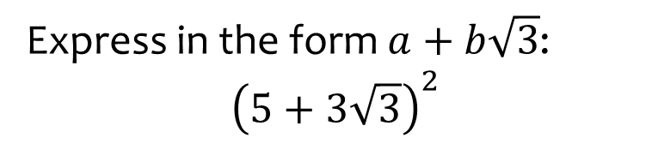
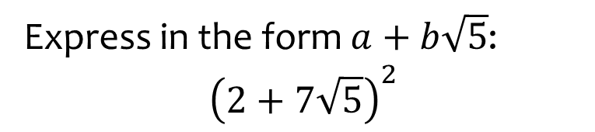

Worked example
Your turn
Express in the form $a+b\sqrt{3}$:
$${\left(5+3\sqrt{3}\right)}^{2}$$
Express in the form $a+b\sqrt{5}$:
$${\left(2+7\sqrt{5}\right)}^{2}$$
$$249+28\sqrt{5}$$

Slide 24
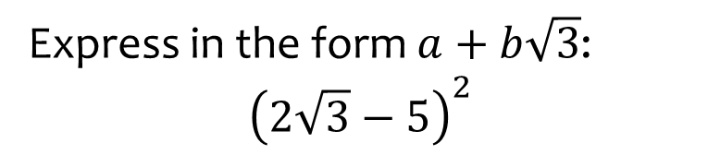
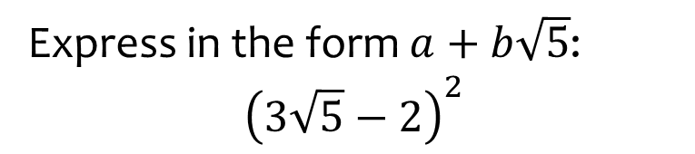

Worked example
Your turn
Express in the form $a+b\sqrt{3}$:
$${\left(2\sqrt{3}−5\right)}^{2}$$
Express in the form $a+b\sqrt{5}$:
$${\left(3\sqrt{5}−2\right)}^{2}$$
$$49−12\sqrt{5}$$

Slide 25
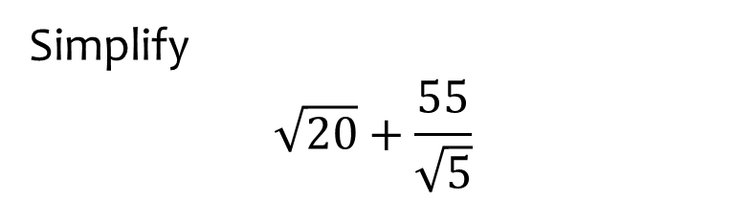
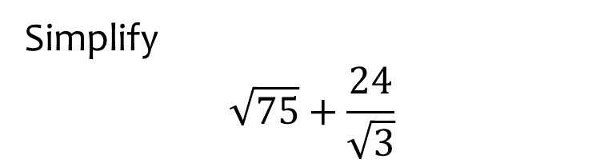

Worked example
Your turn
Simplify
$$\sqrt{20}+\frac{55}{\sqrt{5}}$$
Simplify
$$\sqrt{75}+\frac{24}{\sqrt{3}}$$
$$13\sqrt{3}$$

Slide 26
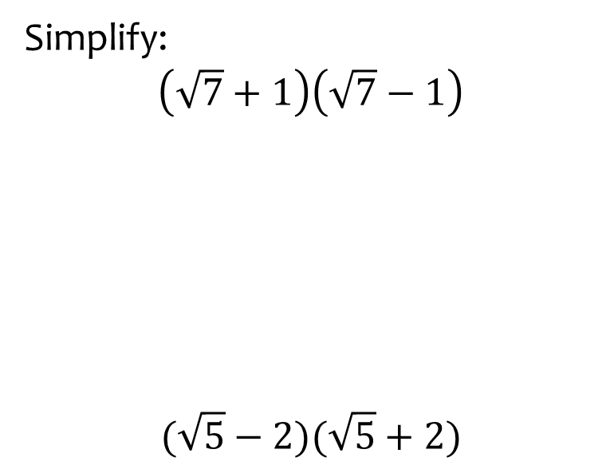
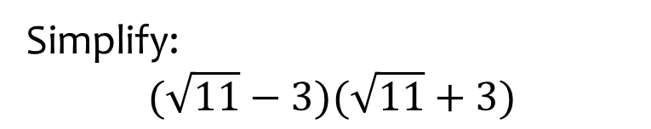

Worked example
Your turn
Simplify:
$$\left(\sqrt{7}+1\right)\left(\sqrt{7}−1\right)$$
$$(\sqrt{5}−2)(\sqrt{5}+2)$$
Simplify:
$$(\sqrt{11}−3)(\sqrt{11}+3)$$
$$2$$

Slide 27
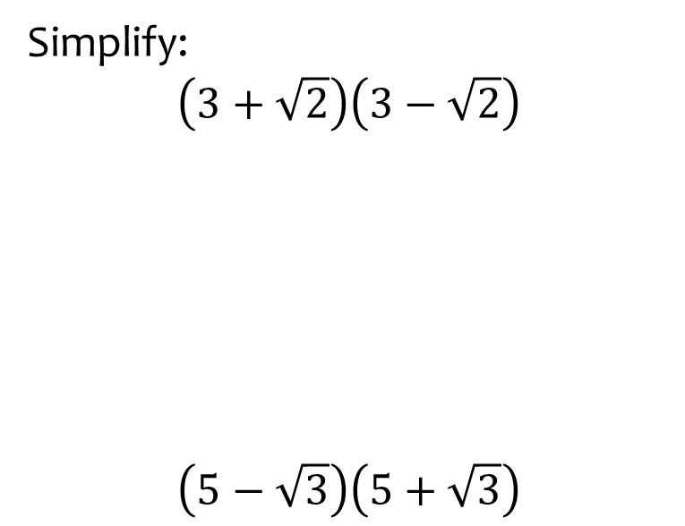
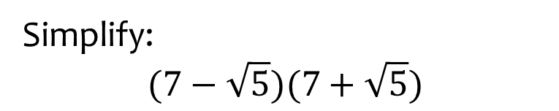

Worked example
Your turn
Simplify:
$$\left(3+\sqrt{2}\right)\left(3−\sqrt{2}\right)$$
$$\left(5−\sqrt{3}\right)\left(5+\sqrt{3}\right)$$
Simplify:
$$(7−\sqrt{5})(7+\sqrt{5})$$
$$44$$

Slide 28
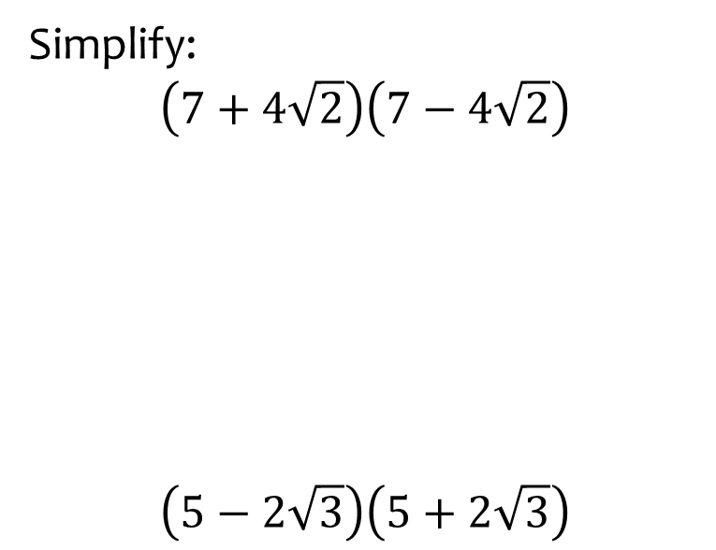


Worked example
Your turn
Simplify:
$$\left(7+4\sqrt{2}\right)\left(7−4\sqrt{2}\right)$$
$$\left(5−2\sqrt{3}\right)\left(5+2\sqrt{3}\right)$$
Simplify:
$$\left(9−3\sqrt{5}\right)\left(9+3\sqrt{5}\right)$$
$$36$$

Slide 29
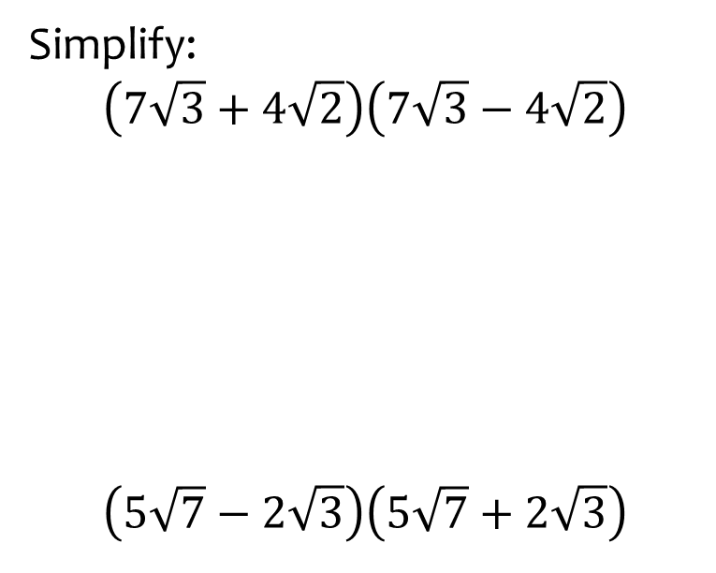
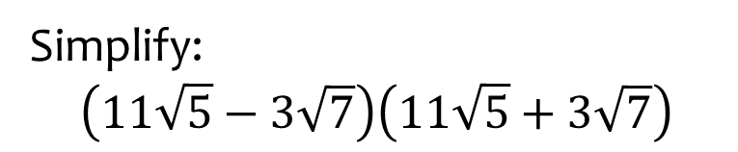

Worked example
Your turn
Simplify:
$$\left(7\sqrt{3}+4\sqrt{2}\right)\left(7\sqrt{3}−4\sqrt{2}\right)$$
$$\left(5\sqrt{7}−2\sqrt{3}\right)\left(5\sqrt{7}+2\sqrt{3}\right)$$
Simplify:
$$\left(11\sqrt{5}−3\sqrt{7}\right)\left(11\sqrt{5}+3\sqrt{7}\right)$$
$$542$$

Slide 30
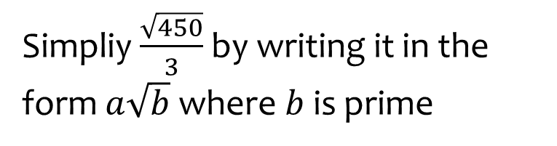
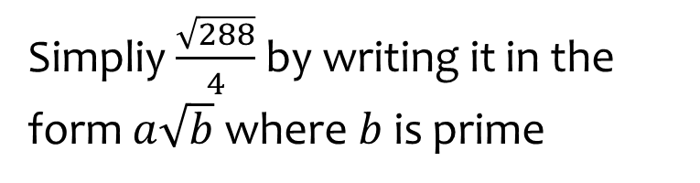

Worked example
Your turn
Simpliy $\frac{\sqrt{450}}{3}$ by writing it in the form $a\sqrt{b}$ where $b$ is prime
Simpliy $\frac{\sqrt{288}}{4}$ by writing it in the form $a\sqrt{b}$ where $b$ is prime
$$3\sqrt{2}$$

Slide 31
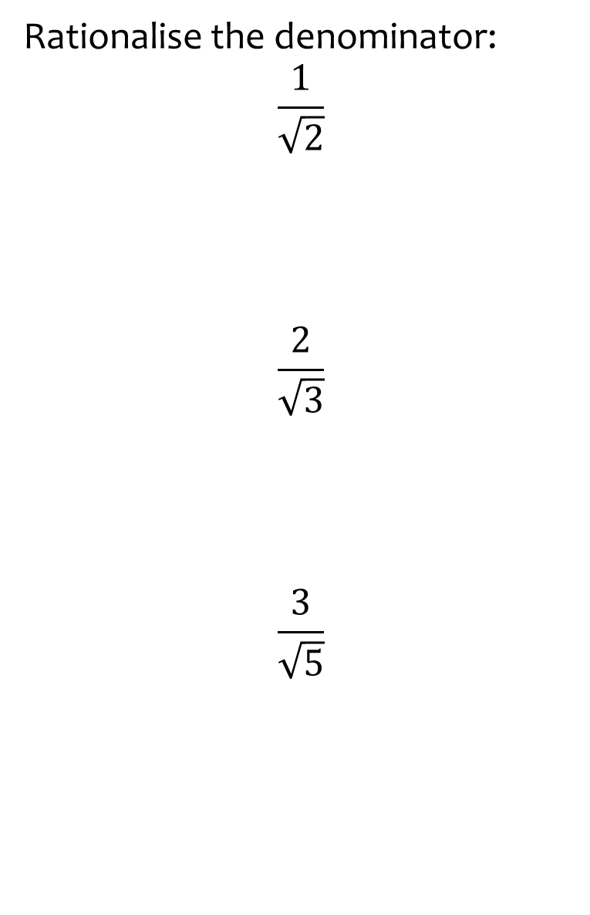
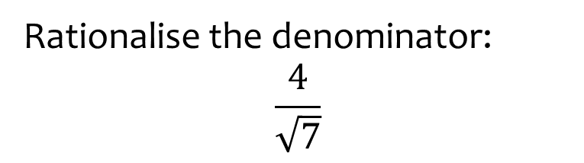

Worked example
Your turn
Rationalise the denominator:
$$\frac{1}{\sqrt{2}}$$
$$\frac{2}{\sqrt{3}}$$
$$\frac{3}{\sqrt{5}}$$
Rationalise the denominator:
$$\frac{4}{\sqrt{7}}$$
$$\frac{4\sqrt{7}}{7}$$

Slide 32
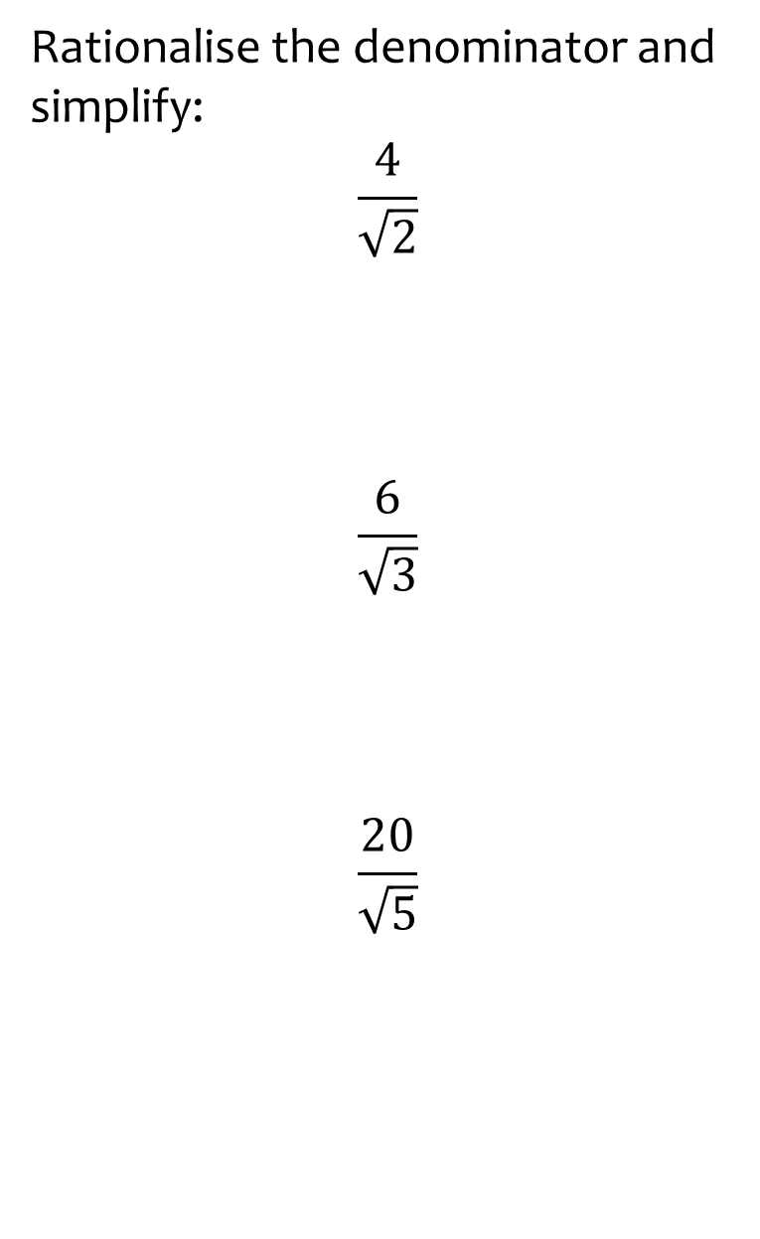
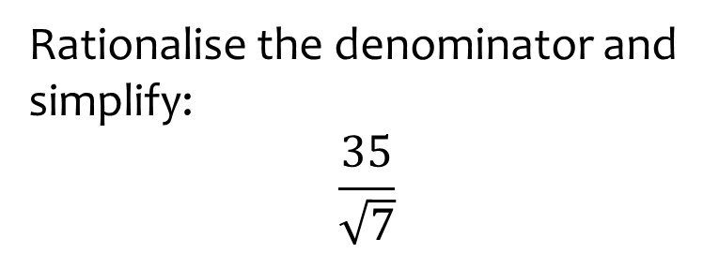

Worked example
Your turn
Rationalise the denominator and simplify:
$$\frac{4}{\sqrt{2}}$$
$$\frac{6}{\sqrt{3}}$$
$$\frac{20}{\sqrt{5}}$$
Rationalise the denominator and simplify:
$$\frac{35}{\sqrt{7}}$$
$$5\sqrt{7}$$

Slide 33
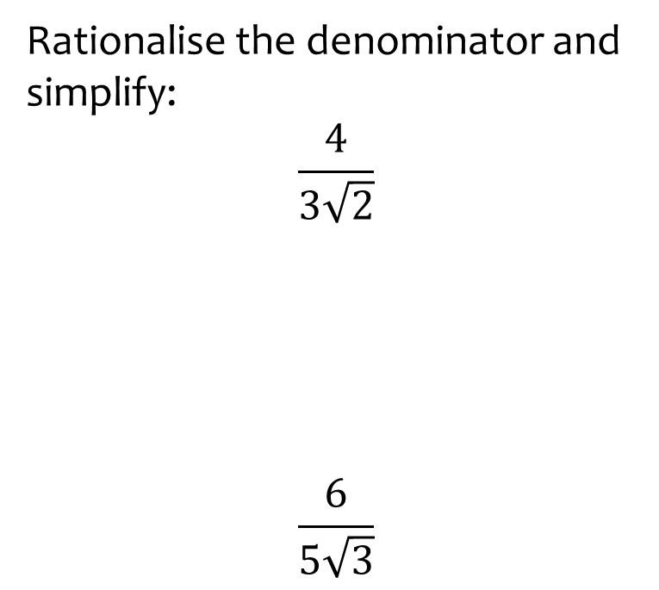
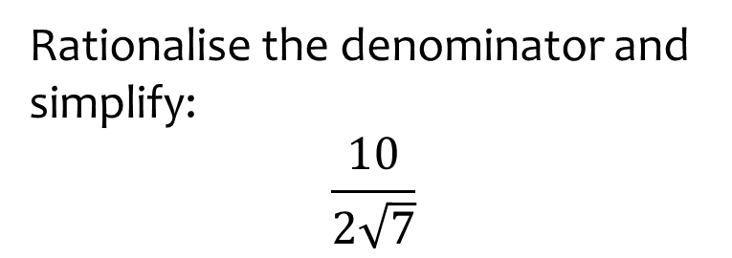

Worked example
Your turn
Rationalise the denominator and simplify:
$$\frac{4}{3\sqrt{2}}$$
$$\frac{6}{5\sqrt{3}}$$
Rationalise the denominator and simplify:
$$\frac{10}{2\sqrt{7}}$$
$$\frac{5\sqrt{7}}{7}$$

Slide 34
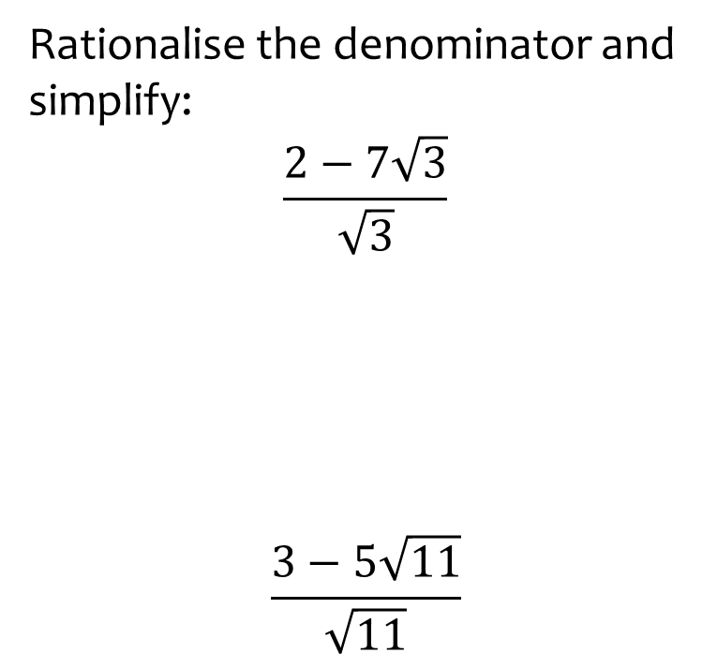
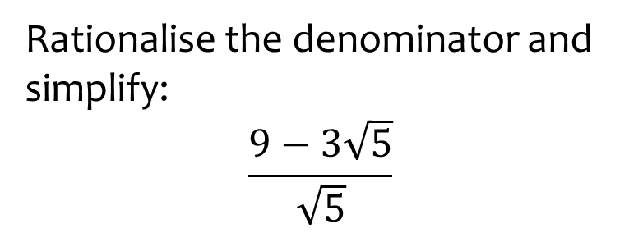

Worked example
Your turn
Rationalise the denominator and simplify:
$$\frac{2−7\sqrt{3}}{\sqrt{3}}$$
$$\frac{3−5\sqrt{11}}{\sqrt{11}}$$
Rationalise the denominator and simplify:
$$\frac{9−3\sqrt{5}}{\sqrt{5}}$$
$$\frac{9\sqrt{5}−15}{5}$$

Slide 35
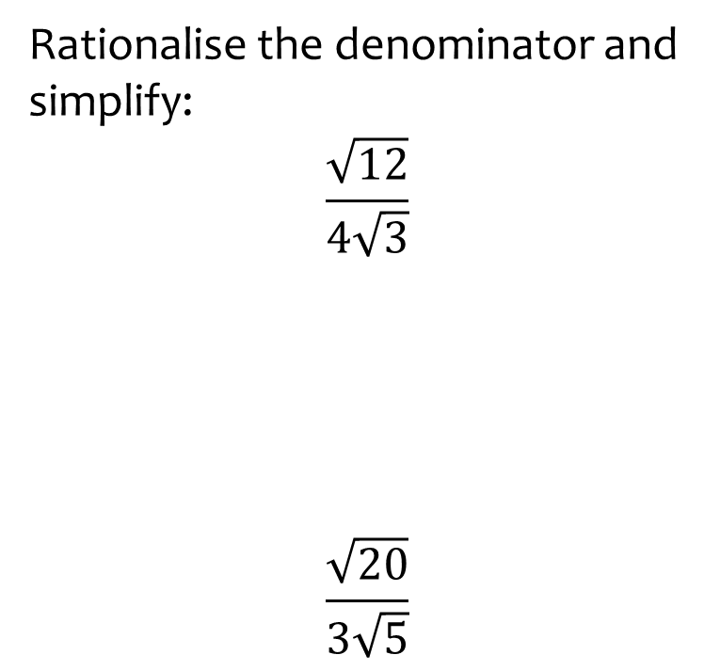
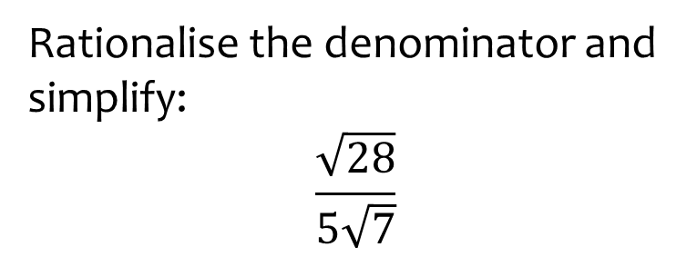

Worked example
Your turn
Rationalise the denominator and simplify:
$$\frac{\sqrt{12}}{4\sqrt{3}}$$
$$\frac{\sqrt{20}}{3\sqrt{5}}$$
Rationalise the denominator and simplify:
$$\frac{\sqrt{28}}{5\sqrt{7}}$$
$$\frac{2}{5}$$

Slide 36



Worked example
Your turn
Rationalise the denominator and simplify:
$$\frac{3}{5+\sqrt{2}}$$
$$\frac{4}{1+\sqrt{3}}$$
Rationalise the denominator and simplify:
$$\frac{18}{1+\sqrt{7}}$$
$$−3+3\sqrt{7}$$

Slide 37



Worked example
Your turn
Rationalise the denominator and simplify:
$$\frac{3}{5−\sqrt{2}}$$
$$\frac{4}{1−\sqrt{3}}$$
Rationalise the denominator and simplify:
$$\frac{18}{1−\sqrt{7}}$$
$$−3−3\sqrt{7}$$

Slide 38



Worked example
Your turn
Rationalise the denominator and simplify:
$$\frac{3}{\sqrt{2}−5}$$
$$\frac{4}{−1+\sqrt{3}}$$
Rationalise the denominator and simplify:
$$\frac{18}{\sqrt{7}−1}$$
$$3+3\sqrt{7}$$

Slide 39



Worked example
Your turn
Rationalise the denominator and simplify:
$$\frac{3+\sqrt{2}}{\sqrt{2}−5}$$
$$\frac{5−\sqrt{3}}{−1+\sqrt{3}}$$
Rationalise the denominator and simplify:
$$\frac{2−\sqrt{7}}{\sqrt{7}−1}$$
$$\frac{−5+\sqrt{7}}{6}$$

Slide 40



Worked example
Your turn
Rationalise the denominator and simplify:
$$\frac{2\sqrt{3}+5}{\sqrt{3}−2}$$
Rationalise the denominator and simplify:
$$\frac{2\sqrt{2}+1}{\sqrt{2}−3}$$
$$−1−\sqrt{2}$$

Slide 41



Worked example
Your turn
Rationalise the denominator and simplify:
$$\frac{3\sqrt{3}−5}{2\sqrt{3}−7}$$
Rationalise the denominator and simplify:
$$\frac{5\sqrt{5}−2}{2\sqrt{5}−3}$$
$$4+\sqrt{5}$$

Slide 42



Worked example
Your turn
Rationalise the denominator and simplify:
$$\frac{11+3\sqrt{2}}{3\sqrt{7}+5}$$
Rationalise:
$$\frac{7+2\sqrt{3}}{11\sqrt{5}+2}$$
$$\frac{77\sqrt{5}+22\sqrt{15}−4\sqrt{3}−14}{601}$$

Slide 43



Worked example
Your turn
Rationalise the denominator and simplify:
$$\frac{1}{12\sqrt{27}}$$
$$\frac{1}{16\sqrt{32}}$$
Rationalise the denominator and simplify:
$$\frac{1}{8\sqrt{8}}$$
$$\frac{\sqrt{2}}{32}$$

Slide 44



Worked example
Your turn
Rationalise the denominator and simplify:
$$\frac{\left(3+\sqrt{2}\right)\left(3−\sqrt{2}\right)}{\sqrt{7}}$$
$$\frac{\left(7+\sqrt{5}\right)\left(7−\sqrt{5}\right)}{\sqrt{11}}$$
Rationalise the denominator and simplify:
$$\frac{\left(5+\sqrt{3}\right)\left(5−\sqrt{3}\right)}{\sqrt{22}}$$
$$\sqrt{22}$$

Slide 45



Worked example
Your turn
Simplify, giving your answer in the form $a\sqrt{b}$:
$$\frac{\sqrt{54}}{3}+\frac{12}{\sqrt{6}}$$
Simplify, giving your answer in the form $a\sqrt{b}$:
$$\frac{\sqrt{63}}{3}+\frac{21}{\sqrt{7}}$$
$$4\sqrt{7}$$

Slide 46



Worked example
Your turn
Show that $\frac{1}{\frac{1}{\sqrt{3}}+1}=\frac{3}{2}−\frac{1}{2}\sqrt{3}$
Show that $\frac{1}{1+\frac{1}{\sqrt{2}}}=2−\sqrt{2}$
$$=\frac{\sqrt{2}}{\sqrt{2}+1}$$
$$=\frac{\sqrt{2}}{\sqrt{2}+1}×\frac{\sqrt{2}−1}{\sqrt{2}−1}$$
$$=\frac{2−\sqrt{2}}{2+\sqrt{2}−\sqrt{2}−1}$$
$$=\frac{2−\sqrt{2}}{1}$$
$$=2−\sqrt{2}$$

Slide 47



Worked example
Your turn
A rectangle has area $60 cm^{2}$ and a width of $\sqrt{12}$ $cm$. Find the length of the rectangle in the form $a\sqrt{b}$
A rectangle has area $64 cm^{2}$ and a width of $\sqrt{32}$ $cm$. Find the length of the rectangle in the form $a\sqrt{b}$
$8\sqrt{2}$ $cm$

Slide 48



Worked example
Your turn
A rectangle has an area of $\left(15−6\sqrt{3}\right) cm^{2}$ and a width of $(2\sqrt{3}−3)$ $cm$. Find the length of the rectangle in the form $a+b\sqrt{3}$
A rectangle has an area of $\left(2+\sqrt{2}\right) cm^{2}$ and a width of $(3\sqrt{2}−4)$ $cm$. Find the length of the rectangle in the form $a+b\sqrt{2}$
$7+5\sqrt{2}$ $cm$

Slide 49



Worked example
Your turn
Simplify
$${\left(\sqrt{8}−\sqrt{2}\right)}^{2}$$
$${\left(\sqrt{20}−\sqrt{5}\right)}^{2}$$
Simplify
$${\left(\sqrt{12}−\sqrt{3}\right)}^{2}$$
$$3$$

Slide 50



Worked example
Your turn
Simplify
$$\left(3\sqrt{5}−1\right)\left(2\sqrt{5}+6\right)$$
Simplify
$$\left(2\sqrt{3}−4\right)\left(4\sqrt{3}+2\right)$$
$$16−12\sqrt{3}$$

Slide 51



Worked example
Your turn
Simplify
$${\left(3+\sqrt{2}\right)}^{2}−{\left(3−\sqrt{2}\right)}^{2}$$
$${\left(4+\sqrt{5}\right)}^{2}−{\left(4−\sqrt{5}\right)}^{2}$$
Simplify
$${\left(2+\sqrt{3}\right)}^{2}−{\left(2−\sqrt{3}\right)}^{2}$$
$$8\sqrt{3}$$

Slide 52



Worked example
Your turn
Simplify
$$(\sqrt{3}+5)(\sqrt{3}−3)(\sqrt{3}+2)$$
Simplify
$$(\sqrt{5}+3)(\sqrt{5}−2)(\sqrt{5}+1)$$
$$4$$

Slide 53



Worked example
Your turn
Express $b$ and $c$ in terms of $a$
$${\left(a+\sqrt{12}\right)}^{2}=b+c\sqrt{3}$$
$${\left(a+\sqrt{20}\right)}^{2}=b+c\sqrt{5}$$
Express $b$ and $c$ in terms of $a$
$${\left(a+\sqrt{8}\right)}^{2}=b+c\sqrt{2}$$
$$b=a^{2}+8$$
$$c=4a$$

Slide 54



Worked example
Your turn
Find the value of $a$ and $b$:
$${\left(a−3\sqrt{5}\right)}^{2}=b−42\sqrt{5}$$
Express $b$ and $c$ in terms of $a$
$${\left(a−2\sqrt{3}\right)}^{2}=b−20\sqrt{3}$$
$$a=5, b=37$$

Slide 55



Worked example
Your turn
Find in its simplest form $a:b$, given:
$$a=\sqrt{5}+\sqrt{c}$$
$$b=\sqrt{80}+\sqrt{d}$$
$c$ and $d$ are positive integers
$$c:d=1:16$$
Find in its simplest form $a:b$, given:
$$a=\sqrt{7}+\sqrt{c}$$
$$b=\sqrt{63}+\sqrt{d}$$
$c$ and $d$ are positive integers
$$c:d=1:9$$
$$a:b=1:3$$

