Slide 1
Standard form
CONTENTS

Slide 2
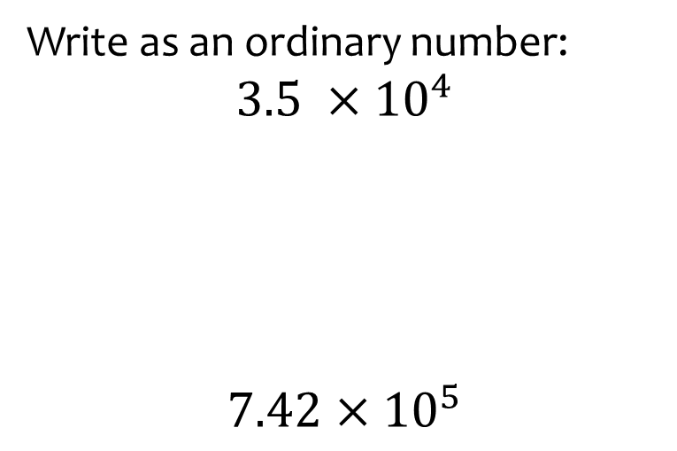
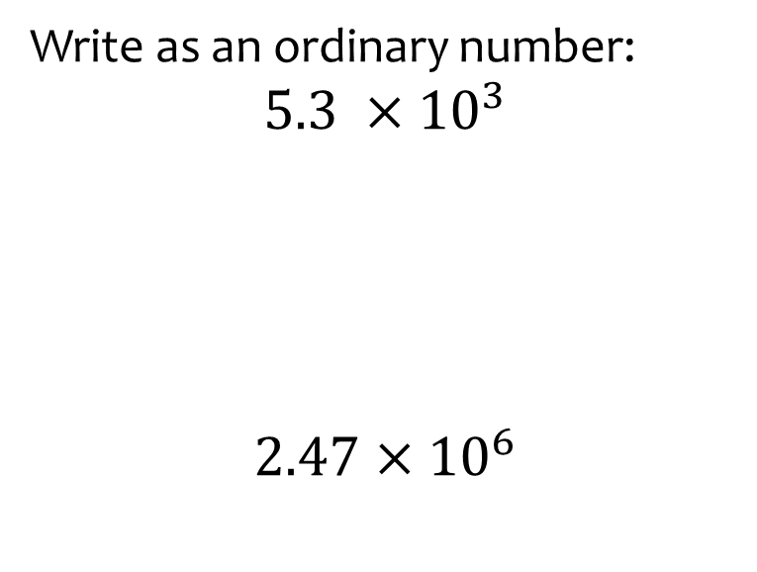
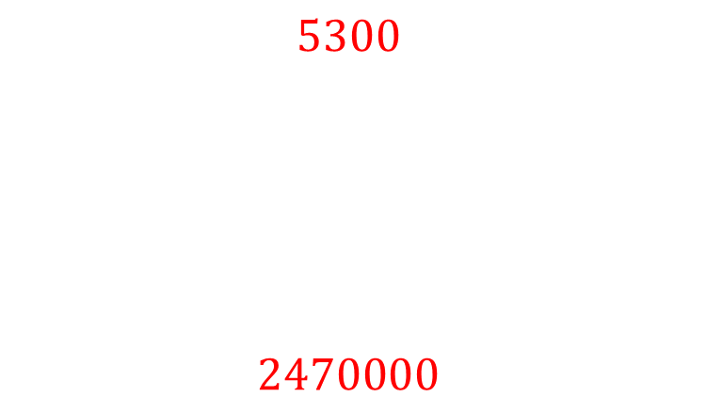
Worked example
Your turn
Write as an ordinary number:
$$3.5 ×{10}^{4}$$
$$7.42×{10}^{5}$$
Write as an ordinary number:
$$5.3 ×{10}^{3}$$
$$2.47×{10}^{6}$$
$$5300$$
$$2470000$$

Slide 3
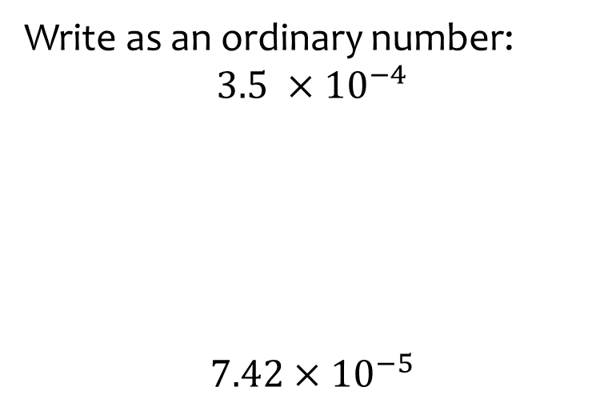
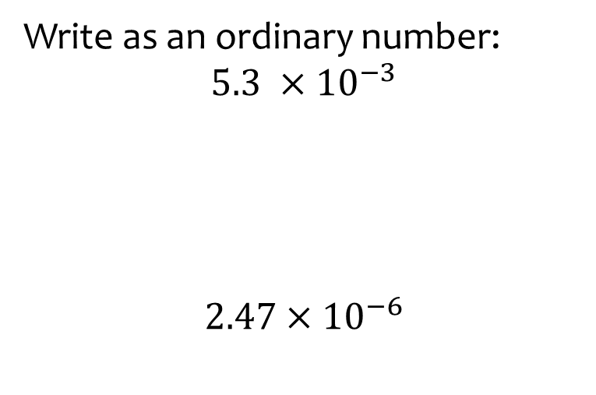
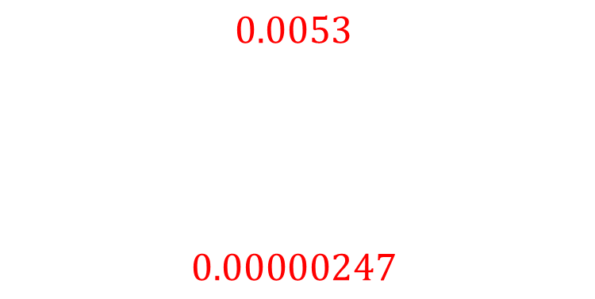
Worked example
Your turn
Write as an ordinary number:
$$3.5 ×{10}^{−4}$$
$$7.42×{10}^{−5}$$
Write as an ordinary number:
$$5.3 ×{10}^{−3}$$
$$2.47×{10}^{−6}$$
$$0.0053$$
$$0.00000247$$

Slide 4
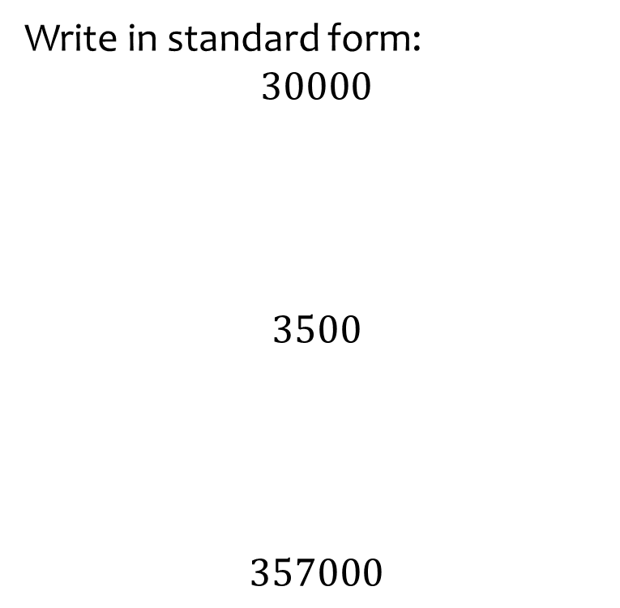
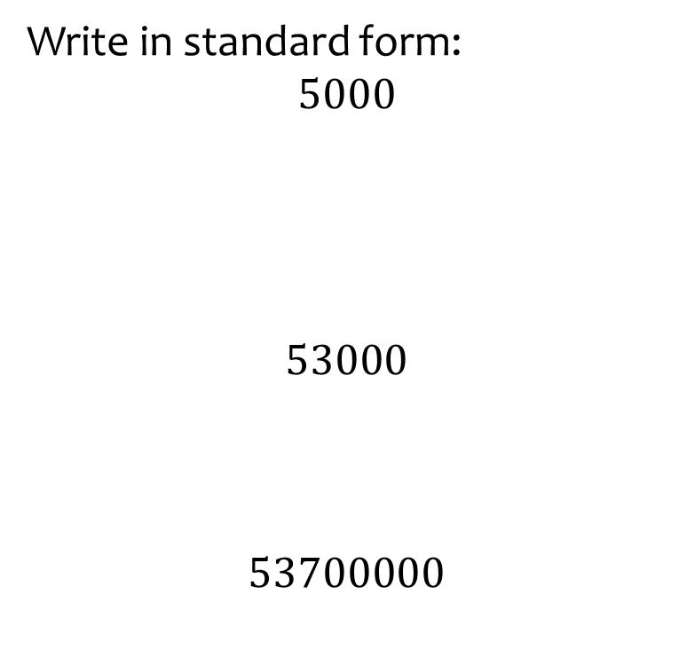
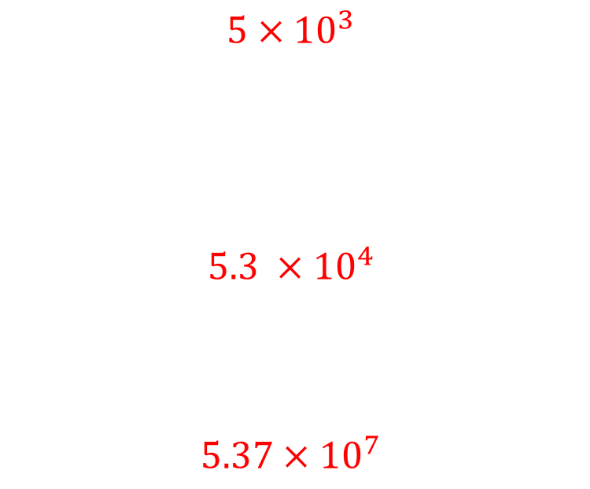
Worked example
Your turn
Write in standard form:
$$30000$$
$$3500$$
$$357000$$
Write in standard form:
$$5000$$
$$53000$$
$$53700000$$
$$5×{10}^{3}$$
$$5.3 ×{10}^{4}$$
$$5.37×{10}^{7}$$

Slide 5
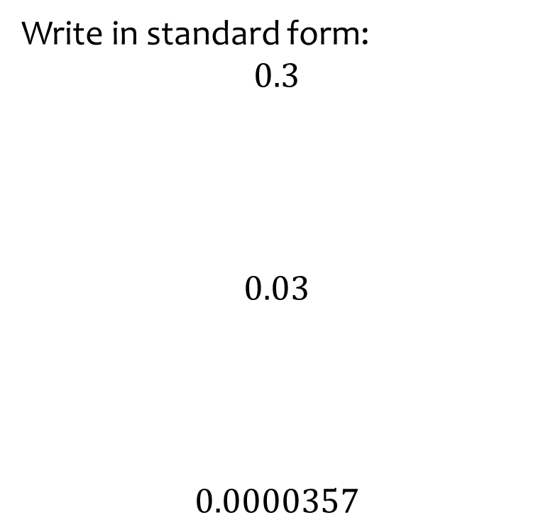
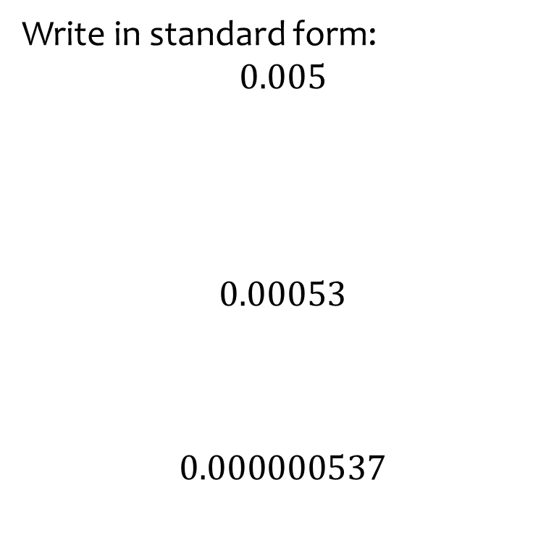
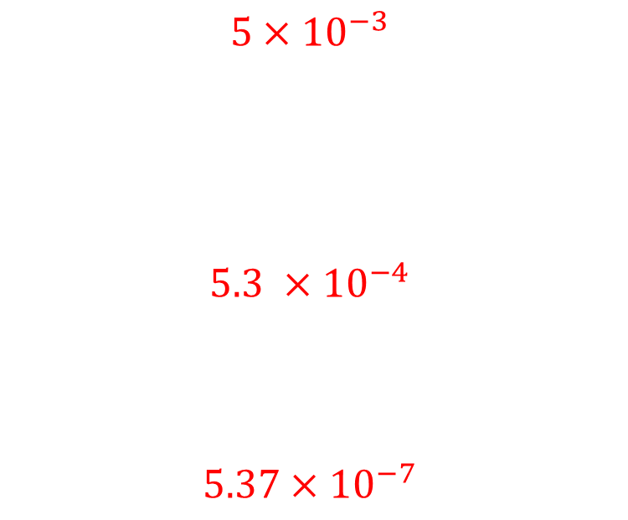
Worked example
Your turn
Write in standard form:
$$0.3$$
$$0.03$$
$$0.0000357$$
Write in standard form:
$$0.005$$
$$0.00053$$
$$0.000000537$$
$$5×{10}^{−3}$$
$$5.3 ×{10}^{−4}$$
$$5.37×{10}^{−7}$$

Slide 6
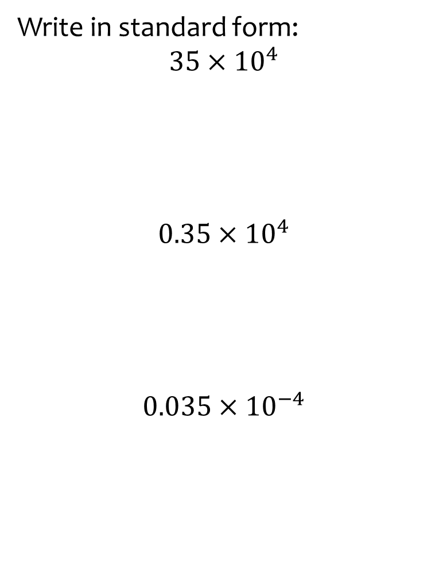
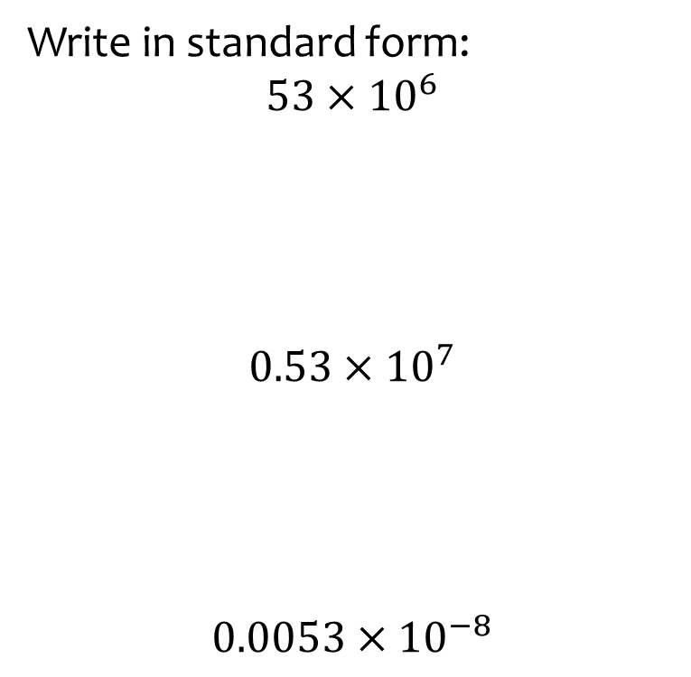
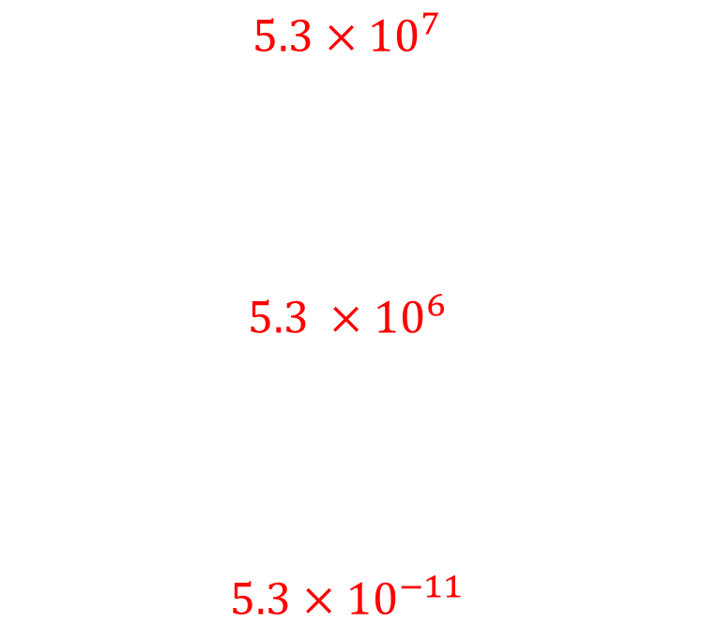
Worked example
Your turn
Write in standard form:
$$35×{10}^{4}$$
$$0.35×{10}^{4}$$
$$0.035×{10}^{−4}$$
Write in standard form:
$$53×{10}^{6}$$
$$0.53×{10}^{7}$$
$$0.0053×{10}^{−8}$$
$$5.3×{10}^{7}$$
$$5.3 ×{10}^{6}$$
$$5.3×{10}^{−11}$$

Slide 7
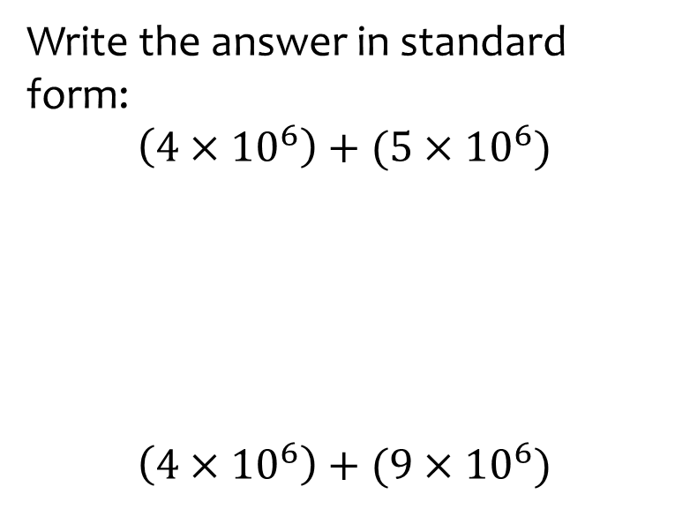
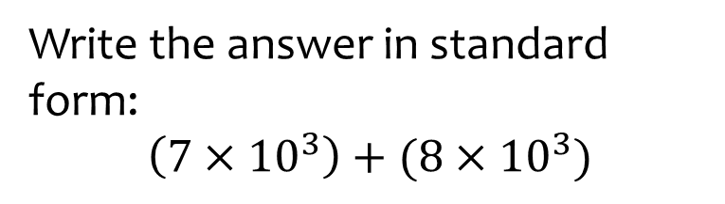

Worked example
Your turn
Write the answer in standard form:
$$\left(4×{10}^{6}\right)+(5×{10}^{6})$$
$$\left(4×{10}^{6}\right)+(9×{10}^{6})$$
Write the answer in standard form:
$$\left(7×{10}^{3}\right)+(8×{10}^{3})$$
$$1.5×{10}^{4}$$

Slide 8
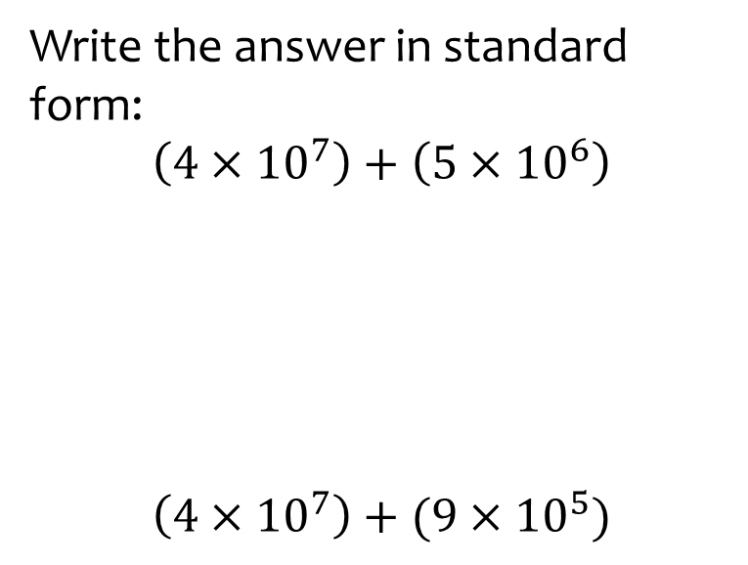
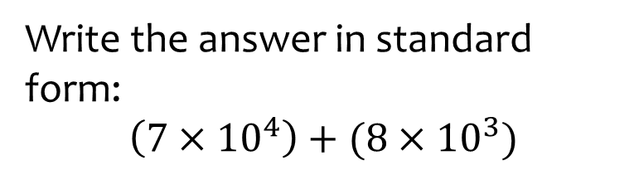

Worked example
Your turn
Write the answer in standard form:
$$\left(4×{10}^{7}\right)+\left(5×{10}^{6}\right)$$
$$\left(4×{10}^{7}\right)+(9×{10}^{5})$$
Write the answer in standard form:
$$\left(7×{10}^{4}\right)+(8×{10}^{3})$$
$$7.8×{10}^{4}$$

Slide 9
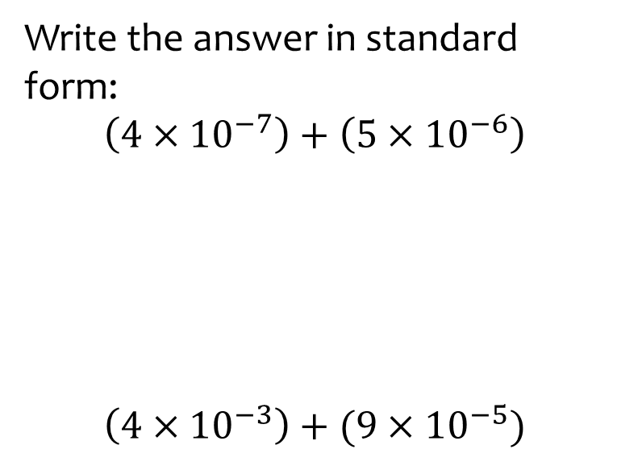
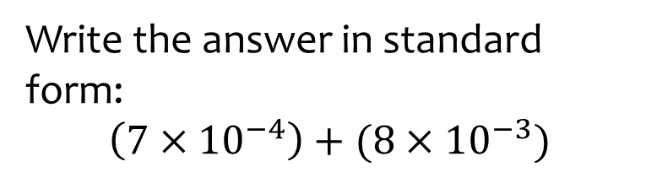

Worked example
Your turn
Write the answer in standard form:
$$\left(4×{10}^{−7}\right)+\left(5×{10}^{−6}\right)$$
$$\left(4×{10}^{−3}\right)+(9×{10}^{−5})$$
Write the answer in standard form:
$$\left(7×{10}^{−4}\right)+(8×{10}^{−3})$$
$$8.7×{10}^{−3}$$

Slide 10
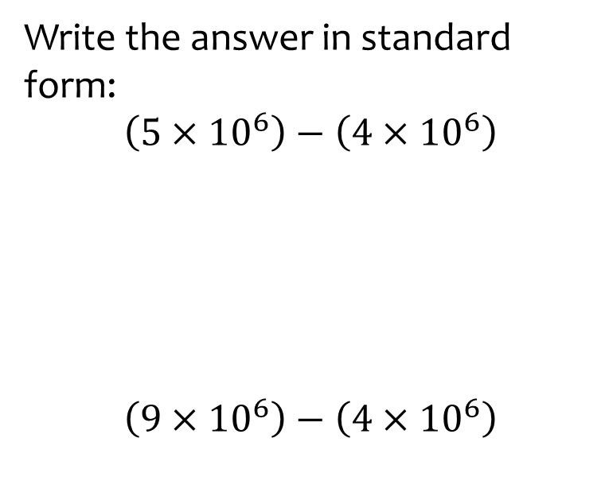
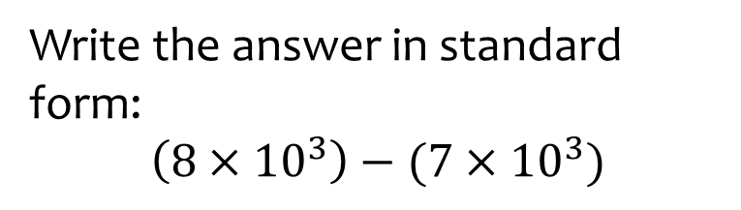

Worked example
Your turn
Write the answer in standard form:
$$\left(5×{10}^{6}\right)−\left(4×{10}^{6}\right)$$
$$\left(9×{10}^{6}\right)−\left(4×{10}^{6}\right)$$
Write the answer in standard form:
$$\left(8×{10}^{3}\right)−(7×{10}^{3})$$
$$1×{10}^{3}$$

Slide 11
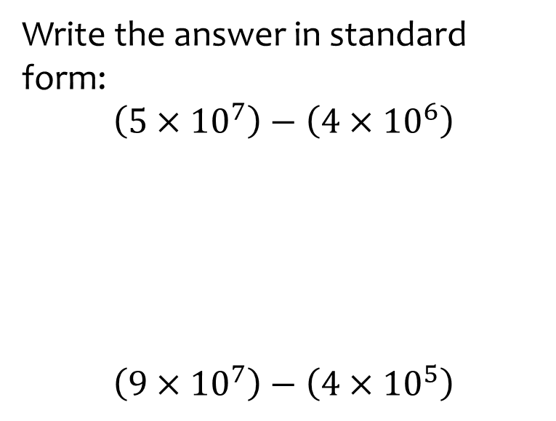
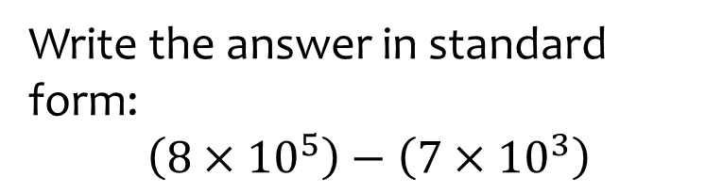

Worked example
Your turn
Write the answer in standard form:
$$\left(5×{10}^{7}\right)−\left(4×{10}^{6}\right)$$
$$\left(9×{10}^{7}\right)−\left(4×{10}^{5}\right)$$
Write the answer in standard form:
$$\left(8×{10}^{5}\right)−\left(7×{10}^{3}\right)$$
$$7.93×{10}^{5}$$

Slide 12
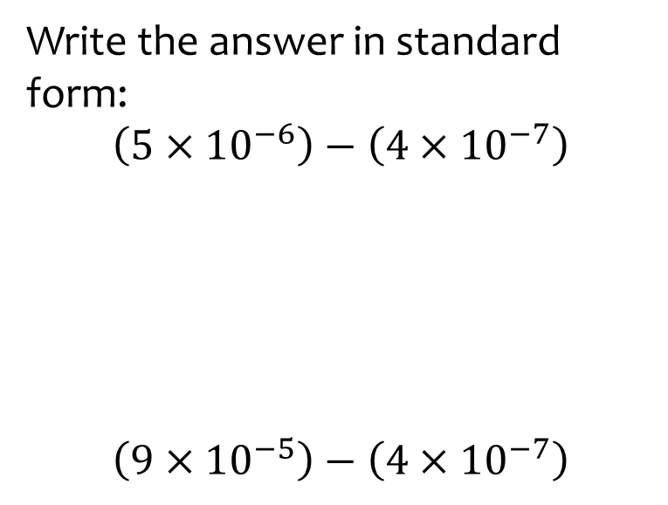
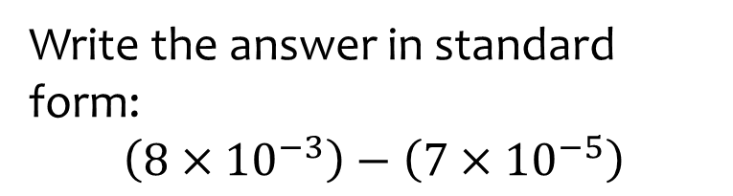

Worked example
Your turn
Write the answer in standard form:
$$\left(5×{10}^{−6}\right)−\left(4×{10}^{−7}\right)$$
$$\left(9×{10}^{−5}\right)−\left(4×{10}^{−7}\right)$$
Write the answer in standard form:
$$\left(8×{10}^{−3}\right)−\left(7×{10}^{−5}\right)$$
$$7.93×{10}^{−3}$$

Slide 13
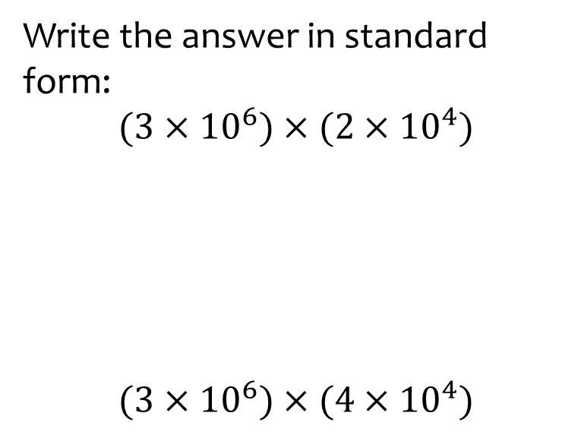
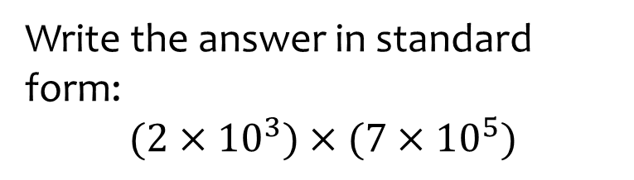

Worked example
Your turn
Write the answer in standard form:
$$(3×{10}^{6})×(2×{10}^{4})$$
$$(3×{10}^{6})×(4×{10}^{4})$$
Write the answer in standard form:
$$(2×{10}^{3})×(7×{10}^{5})$$
$$1.4×{10}^{9}$$

Slide 14
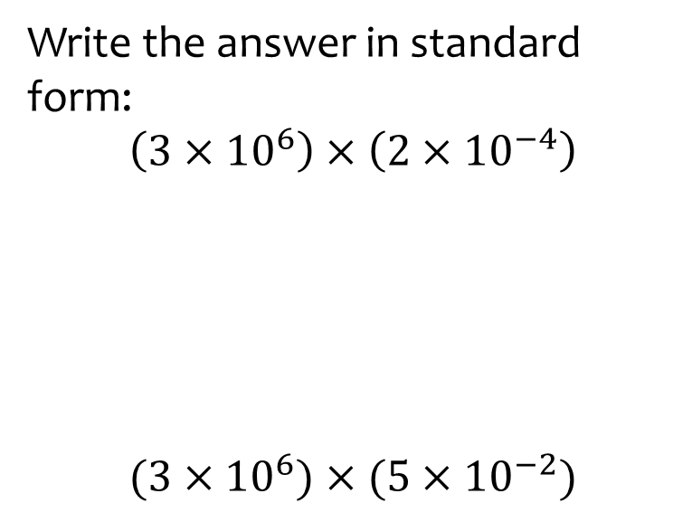
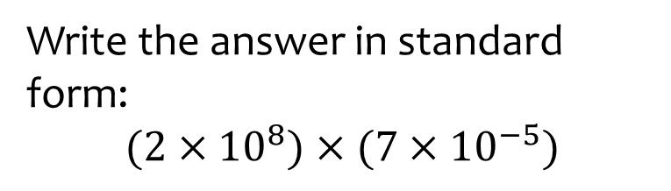

Worked example
Your turn
Write the answer in standard form:
$$\left(3×{10}^{6}\right)×\left(2×{10}^{−4}\right)$$
$$(3×{10}^{6})×(5×{10}^{−2})$$
Write the answer in standard form:
$$(2×{10}^{8})×(7×{10}^{−5})$$
$$1.4×{10}^{4}$$

Slide 15
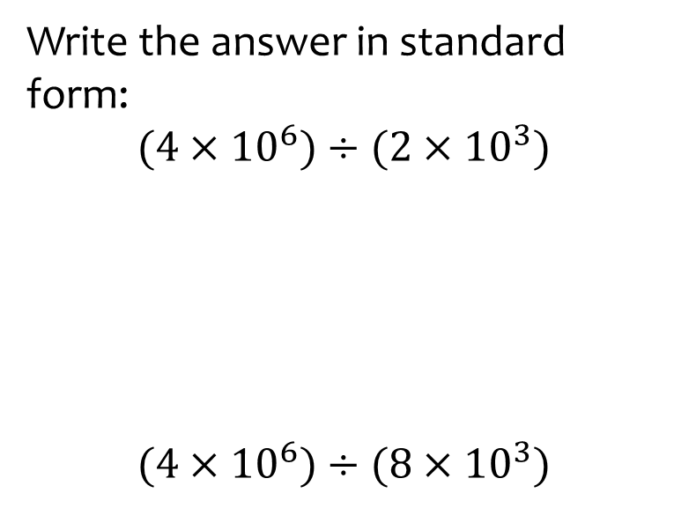
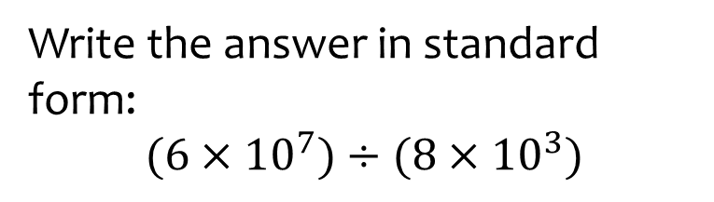

Worked example
Your turn
Write the answer in standard form:
$$(4×{10}^{6})÷(2×{10}^{3})$$
$$(4×{10}^{6})÷(8×{10}^{3})$$
Write the answer in standard form:
$$(6×{10}^{7})÷(8×{10}^{3})$$
$$7.5×{10}^{3}$$

Slide 16
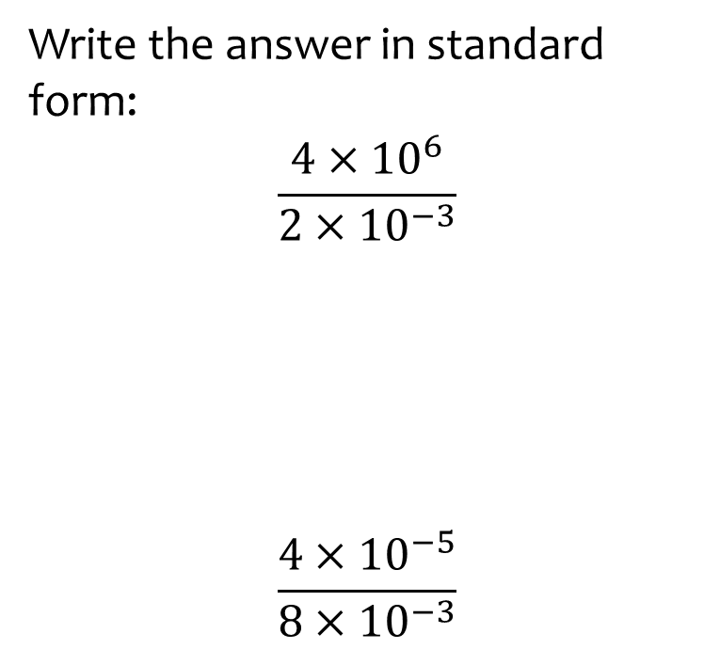
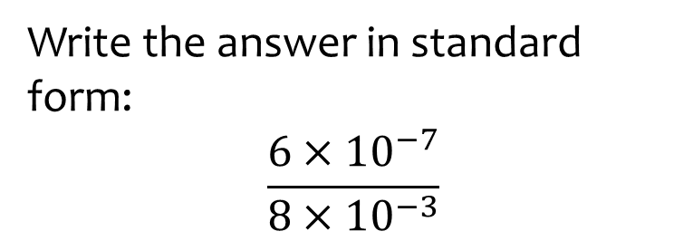

Worked example
Your turn
Write the answer in standard form:
$$\frac{4×{10}^{6}}{2×{10}^{−3}}$$
$$\frac{4×{10}^{−5}}{8×{10}^{−3}}$$
Write the answer in standard form:
$$\frac{6×{10}^{−7}}{8×{10}^{−3}}$$
$$7.5×{10}^{−5}$$

Slide 17
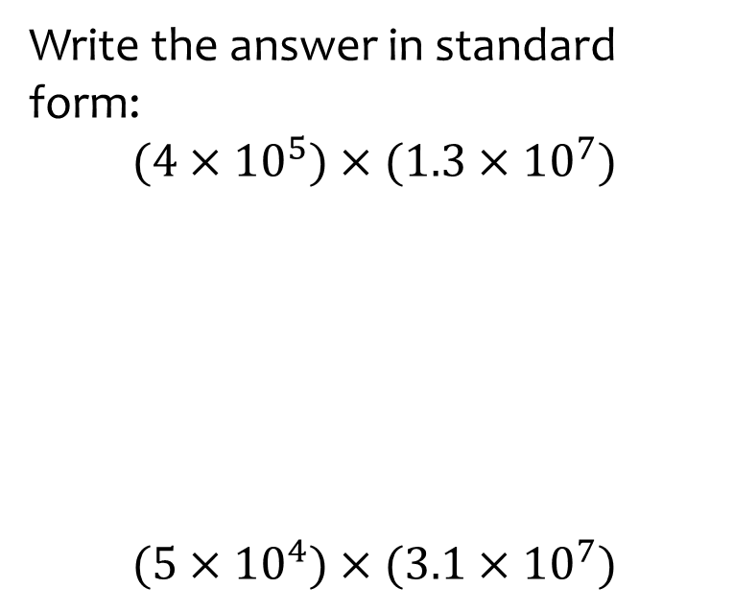
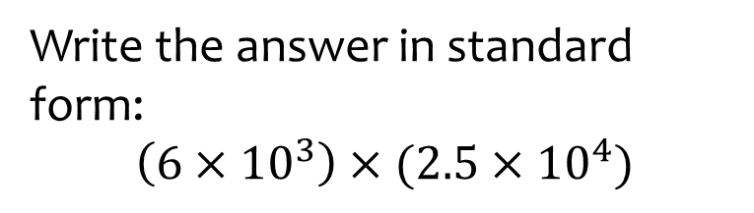

Worked example
Your turn
Write the answer in standard form:
$$(4×{10}^{5})×(1.3×{10}^{7})$$
$$(5×{10}^{4})×(3.1×{10}^{7})$$
Write the answer in standard form:
$$\left(6×{10}^{3}\right)×(2.5×{10}^{4})$$
$$1.5×{10}^{8}$$

Slide 18
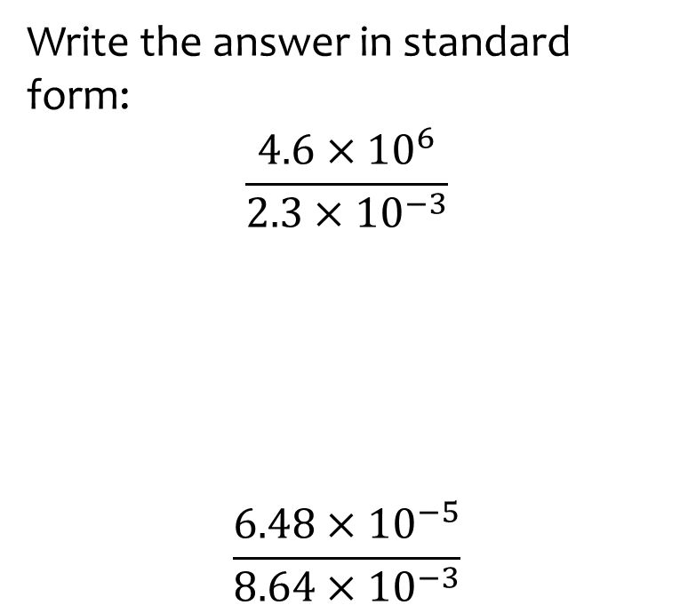
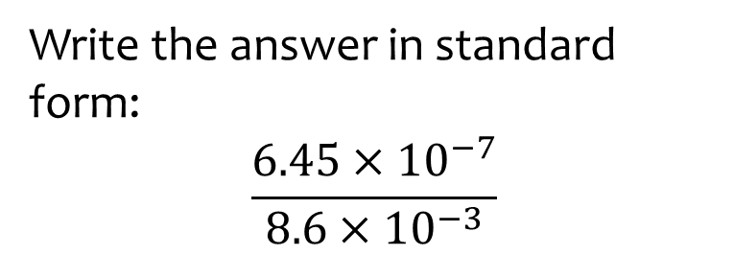
Worked example
Your turn
Write the answer in standard form:
$$\frac{4.6×{10}^{6}}{2.3×{10}^{−3}}$$
$$\frac{6.48×{10}^{−5}}{8.64×{10}^{−3}}$$
Write the answer in standard form:
$$\frac{6.45×{10}^{−7}}{8.6×{10}^{−3}}$$
$$7.5×{10}^{−5}$$

Slide 19
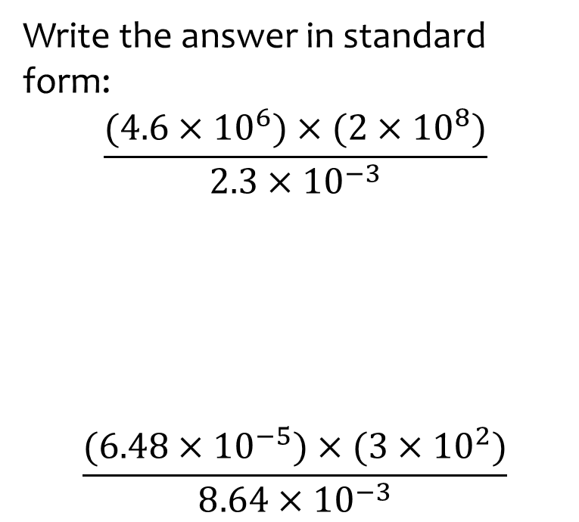
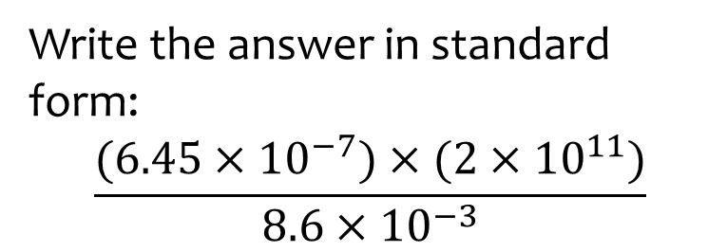

Worked example
Your turn
Write the answer in standard form:
$$\frac{(4.6×{10}^{6})×(2×{10}^{8})}{2.3×{10}^{−3}}$$
$$\frac{(6.48×{10}^{−5})×(3×{10}^{2})}{8.64×{10}^{−3}}$$
Write the answer in standard form:
$$\frac{(6.45×{10}^{−7})×(2×{10}^{11})}{8.6×{10}^{−3}}$$
$$1.5×{10}^{7}$$

