Slide 1
Sets
CONTENTS

Slide 2
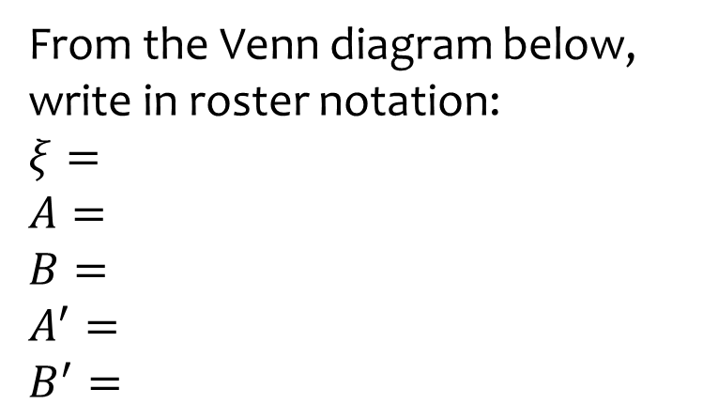
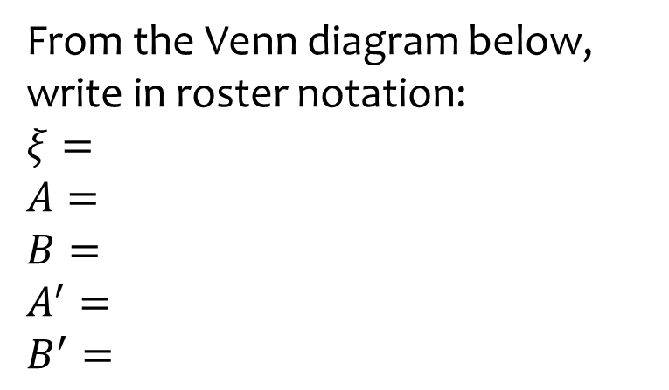
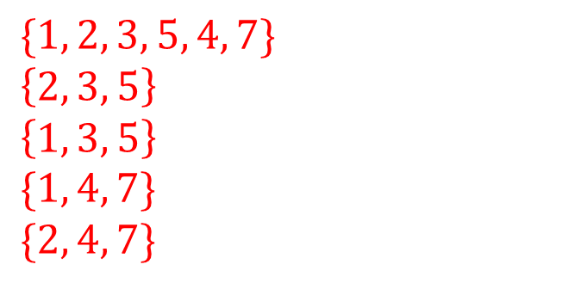
















Worked example
Your turn
From the Venn diagram below, write in roster notation:
$$ξ=$$
$$A=$$
$$B=$$
$$A^{′}=$$
$$B^{′}=$$
From the Venn diagram below, write in roster notation:
$$ξ=$$
$$A=$$
$$B=$$
$$A^{′}=$$
$$B^{′}=$$
$$\{1, 2, 3, 5, 4, 7\}$$
$$\left\{2, 3, 5\right\}$$
$$\left\{1, 3, 5\right\}$$
$$\{1, 4, 7\}$$
$$\{2, 4, 7\}$$
$$ξ$$
$$ξ$$
$$A$$
$$B$$
$$A$$
$$B$$
$$5$$
$$0$$
$$2$$
$$1$$
$$2$$
$$3$$
$$4$$
$$5$$
$$1$$
$$3$$
$$7$$
$$4$$

Slide 3
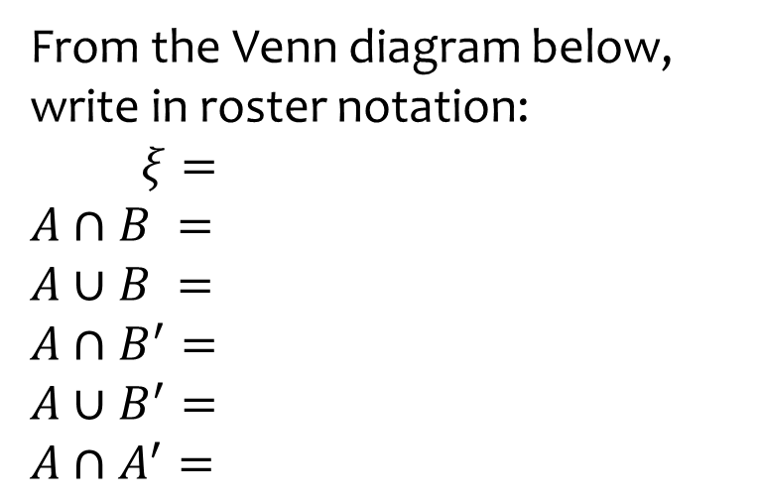
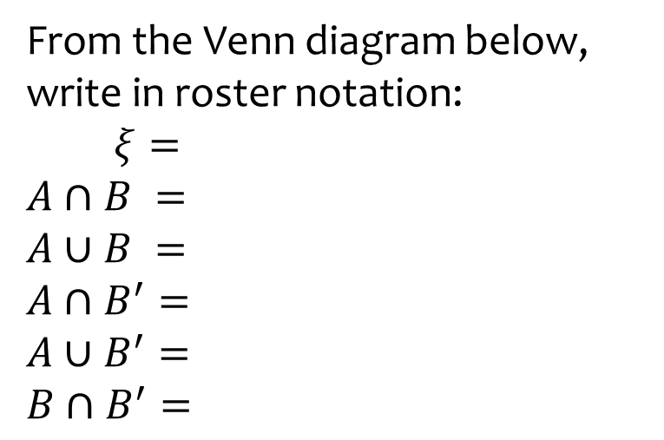
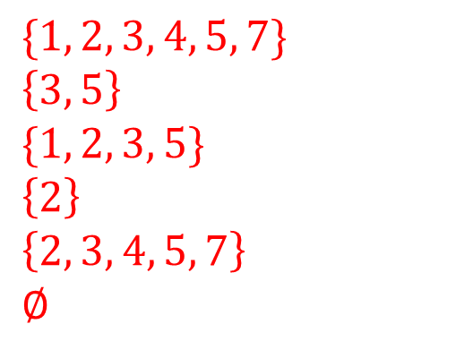









Worked example
Your turn
From the Venn diagram below, write in roster notation:
$ξ=$
$$A∩B =$$
$$A∪B =$$
$$A∩B^{′}=$$
$$A∪B^{′}=$$
$$A∩A^{′}=$$
From the Venn diagram below, write in roster notation:
$ξ=$
$$A∩B =$$
$$A∪B =$$
$$A∩B^{′}=$$
$$A∪B^{′}=$$
$$B∩B^{′}=$$
$$\{1, 2, 3, 4, 5, 7\}$$
$$\left\{3, 5\right\}$$
$$\{1, 2, 3, 5\}$$
$$\left\{2\right\}$$
$$\left\{2, 3, 4, 5, 7\right\}$$
$$∅$$
$$ξ$$
$$ξ$$
$$A$$
$$B$$
$$A$$
$$B$$
$$5$$
$$0$$
$$2$$
$$1$$
$$2$$
$$3$$
$$4$$
$$5$$
$$1$$
$$3$$
$$7$$
$$4$$

Slide 4
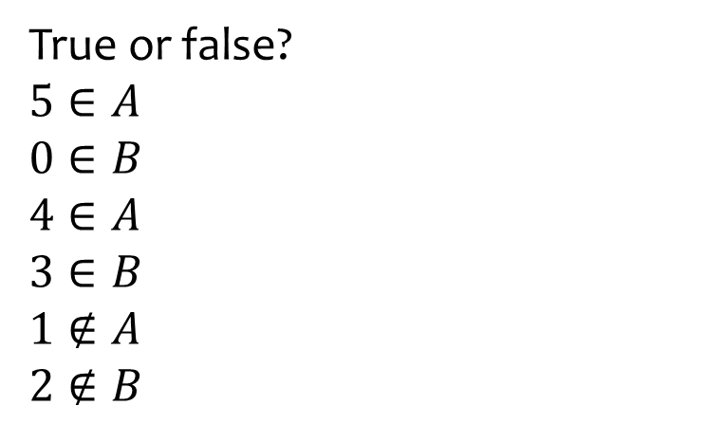
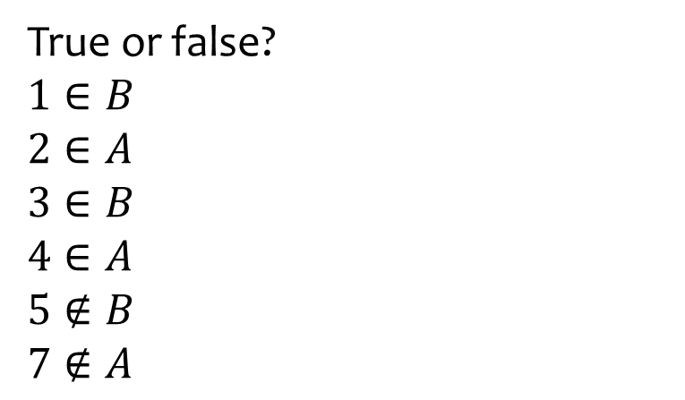






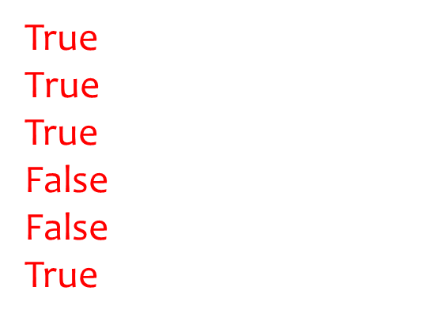



Worked example
Your turn
True or false?
$$5∈A$$
$$0∈B$$
$$4∈A$$
$$3∈B$$
$$1∉A$$
$$2∉B$$
True or false?
$$1∈B$$
$$2∈A$$
$$3∈B$$
$$4∈A$$
$$5∉B$$
$$7∉A$$
True
$$\text{True}$$
True
False
False
True
$$ξ$$
$$ξ$$
$$A$$
$$B$$
$$A$$
$$B$$
$$5$$
$$0$$
$$2$$
$$1$$
$$2$$
$$3$$
$$4$$
$$5$$
$$1$$
$$3$$
$$7$$
$$4$$

Slide 5
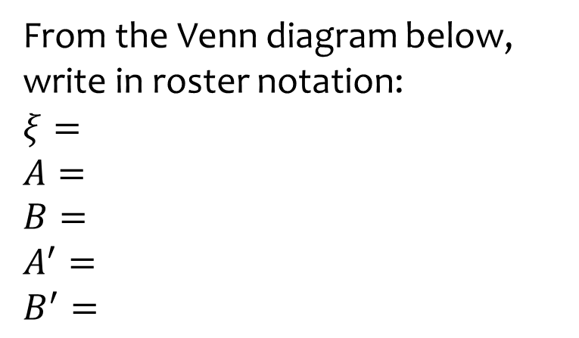
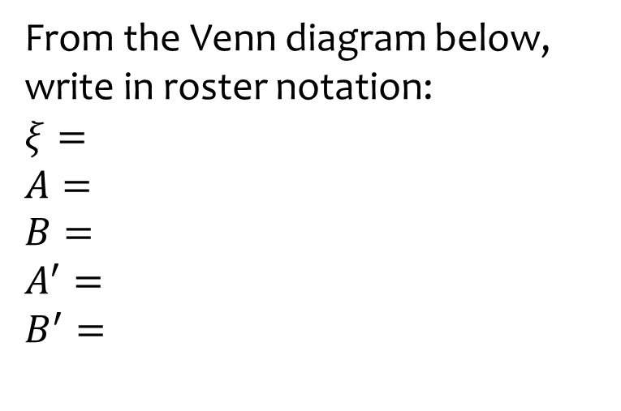
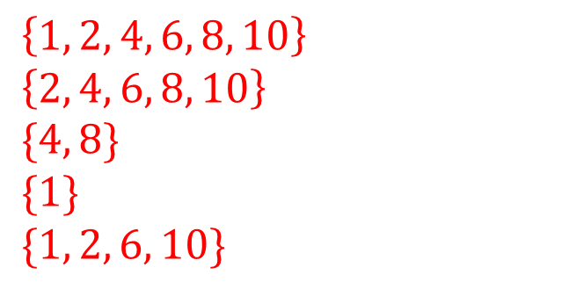
















Worked example
Your turn
From the Venn diagram below, write in roster notation:
$$ξ=$$
$$A=$$
$$B=$$
$$A^{′}=$$
$$B^{′}=$$
From the Venn diagram below, write in roster notation:
$$ξ=$$
$$A=$$
$$B=$$
$$A^{′}=$$
$$B^{′}=$$
$$\left\{1, 2, 4, 6, 8, 10\right\}$$
$$\left\{2, 4, 6, 8, 10\right\}$$
$$\{4, 8\}$$
$$\{1\}$$
$$\{1, 2, 6, 10\}$$
$$ξ$$
$$ξ$$
$$A$$
$$A$$
$$0$$
$$1$$
$$9$$
$$1$$
$$2$$
$$6$$
$$10$$
$$B$$
$$B$$
$$3$$
$$4$$
$$8$$
$$5$$
$$7$$

Slide 6
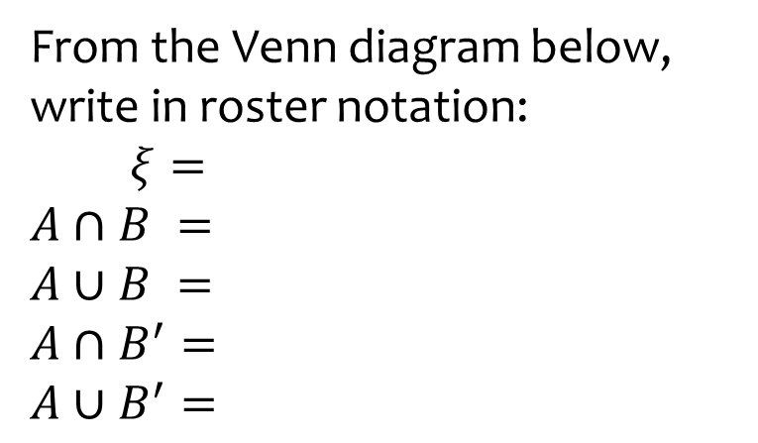
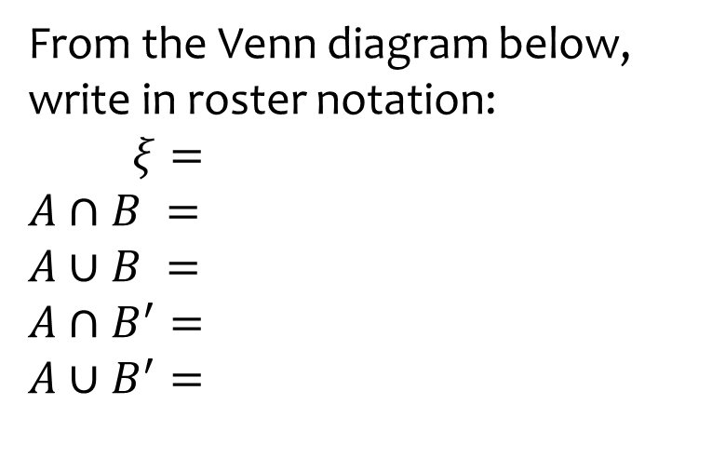
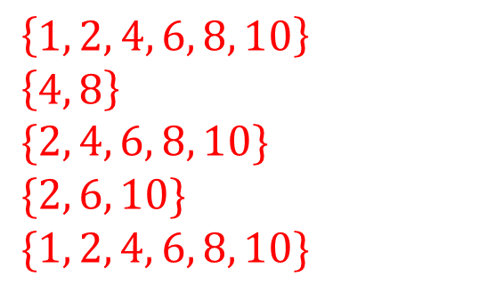

Worked example
Your turn
From the Venn diagram below, write in roster notation:
$ξ=$
$$A∩B =$$
$$A∪B =$$
$$A∩B^{′}=$$
$$A∪B^{′}=$$
From the Venn diagram below, write in roster notation:
$ξ=$
$$A∩B =$$
$$A∪B =$$
$$A∩B^{′}=$$
$$A∪B^{′}=$$
$$\left\{1, 2, 4, 6, 8, 10\right\}$$
$$\left\{4, 8\right\}$$
$$\{2, 4, 6, 8, 10\}$$
$$\{2, 6, 10\}$$
$$\{1, 2, 4, 6, 8, 10\}$$
$$ξ$$
$$ξ$$
$$A$$
$$A$$
$$0$$
$$1$$
$$9$$
$$1$$
$$2$$
$$6$$
$$10$$
$$B$$
$$B$$
$$3$$
$$4$$
$$8$$
$$5$$
$$7$$

Slide 7
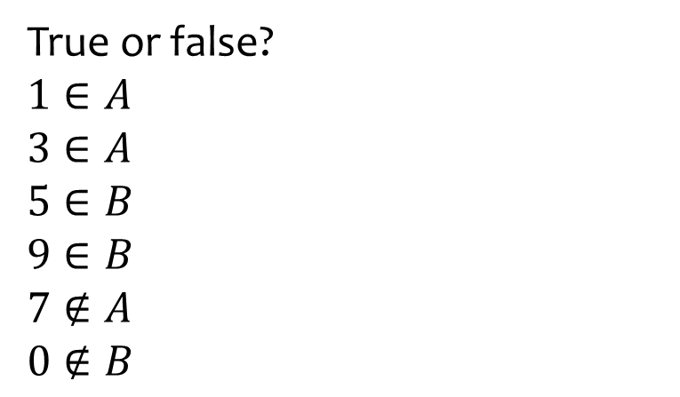
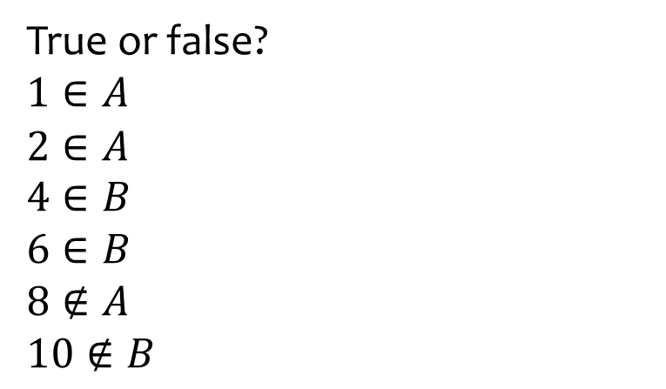

Worked example
Your turn
True or false?
$$1∈A$$
$$3∈A$$
$$5∈B$$
$$9∈B$$
$$7∉A$$
$$0∉B$$
True or false?
$$1∈A$$
$$2∈A$$
$$4∈B$$
$$6∈B$$
$$8∉A$$
$$10∉B$$
False
True
True
False
False
True
$$ξ$$
$$ξ$$
$$A$$
$$A$$
$$0$$
$$1$$
$$9$$
$$1$$
$$2$$
$$6$$
$$10$$
$$B$$
$$B$$
$$3$$
$$4$$
$$8$$
$$5$$
$$7$$

Slide 8
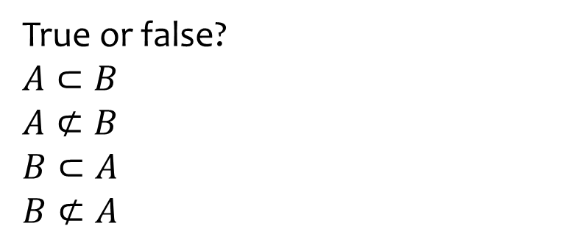
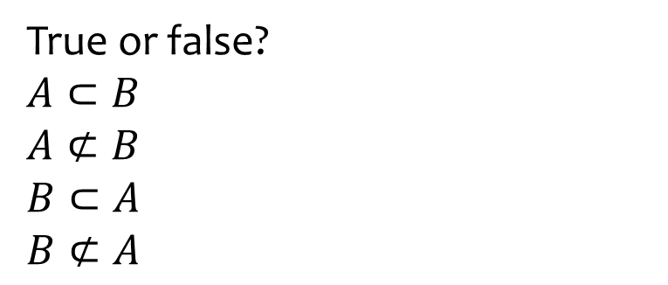

Worked example
Your turn
True or false?
$$A⊂B$$
$$A⊄B$$
$$B⊂A$$
$$B⊄A$$
True or false?
$$A⊂B$$
$$A⊄B$$
$$B⊂A$$
$$B⊄A$$
False
True
True
False
$$ξ$$
$$A$$
$$ξ$$
$$A$$
$$0$$
$$1$$
$$9$$
$$1$$
$$2$$
$$6$$
$$10$$
$$B$$
$$B$$
$$3$$
$$4$$
$$8$$
$$5$$
$$7$$

Slide 9
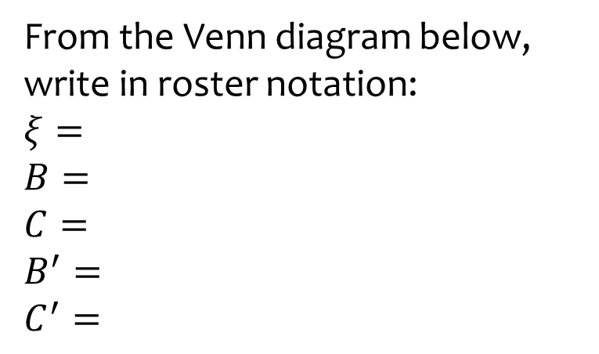
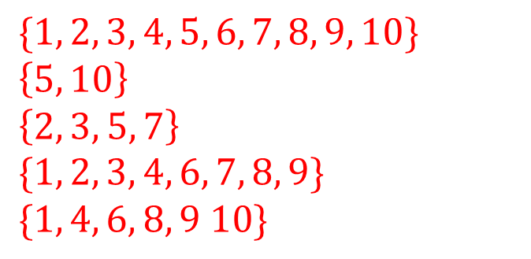



























Worked example
Your turn
From the Venn diagram below, write in roster notation:
$$ξ=$$
$$A=$$
$$B=$$
$$A^{′}=$$
$$B^{′}=$$
From the Venn diagram below, write in roster notation:
$$ξ=$$
$$B=$$
$$C=$$
$$B^{′}=$$
$$C^{′}=$$
$$\{1, 2, 3, 4, 5, 6, 7, 8, 9, 10\}$$
$$\left\{5, 10\right\}$$
$$\left\{2, 3, 5, 7\right\}$$
$$\{1, 2, 3, 4, 6, 7, 8, 9\}$$
$$\{1, 4, 6, 8, 9 10\}$$
$$ξ$$
$$A$$
$$B$$
$$ξ$$
$$A$$
$$B$$
$$1$$
$$6$$
$$4$$
$$6$$
$$9$$
$$10$$
$$3$$
$$8$$
$$7$$
$$2$$
$$5$$
$$5$$
$$2$$
$$3$$
$$7$$
$$1$$
$$4$$
$$9$$
$$C$$
$$8$$
$$C$$

Slide 10
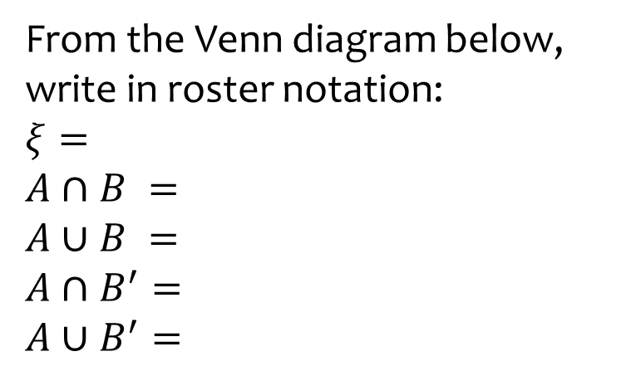
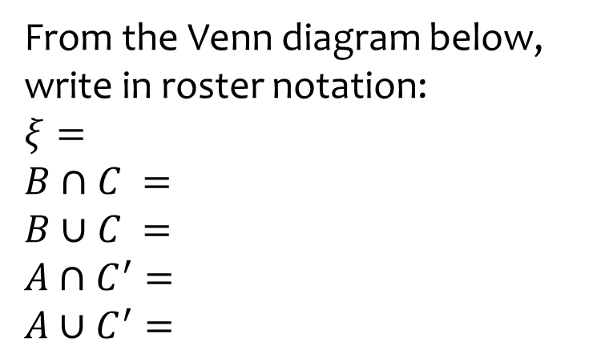
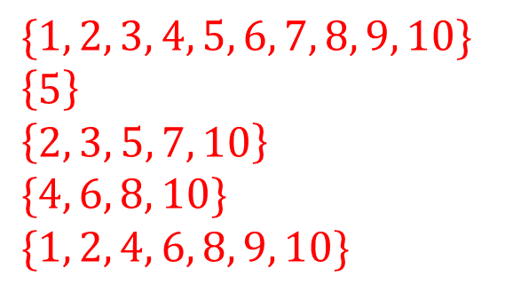

Worked example
Your turn
From the Venn diagram below, write in roster notation:
$$ξ=$$
$$A∩B =$$
$$A∪B =$$
$$A∩B^{′}=$$
$$A∪B^{′}=$$
From the Venn diagram below, write in roster notation:
$$ξ=$$
$$B∩C =$$
$$B∪C =$$
$$A∩C^{′}=$$
$$A∪C^{′}=$$
$$\{1, 2, 3, 4, 5, 6, 7, 8, 9, 10\}$$
$$\left\{5\right\}$$
$$\left\{2, 3, 5, 7, 10\right\}$$
$$\{4, 6, 8, 10\}$$
$$\{1, 2, 4, 6, 8, 9, 10\}$$
$$ξ$$
$$A$$
$$B$$
$$ξ$$
$$A$$
$$B$$
$$1$$
$$6$$
$$4$$
$$6$$
$$9$$
$$10$$
$$3$$
$$8$$
$$7$$
$$2$$
$$5$$
$$5$$
$$2$$
$$3$$
$$7$$
$$1$$
$$4$$
$$9$$
$$C$$
$$8$$
$$C$$

Slide 11
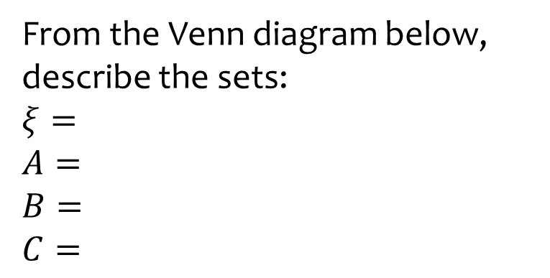
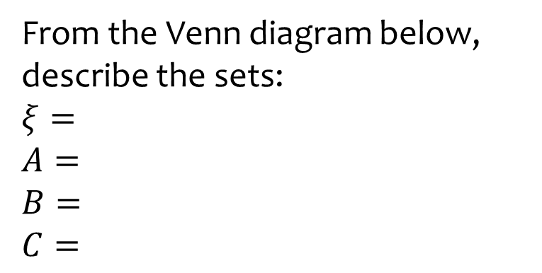

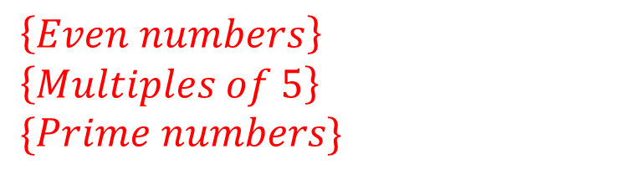
Worked example
Your turn
From the Venn diagram below, describe the sets:
$$ξ=$$
$$A=$$
$$B=$$
$$C=$$
From the Venn diagram below, describe the sets:
$$ξ=$$
$$A=$$
$$B=$$
$$C=$$
$$\{Integers from 1 to 10 inclusive\}$$
$$\left\{Even numbers\right\}$$
$$\left\{Multiples of 5\right\}$$
$$\{Prime numbers\}$$
$$ξ$$
$$A$$
$$B$$
$$ξ$$
$$A$$
$$B$$
$$1$$
$$6$$
$$4$$
$$6$$
$$9$$
$$10$$
$$3$$
$$8$$
$$7$$
$$2$$
$$5$$
$$5$$
$$2$$
$$3$$
$$7$$
$$1$$
$$4$$
$$9$$
$$C$$
$$8$$
$$C$$

Slide 12
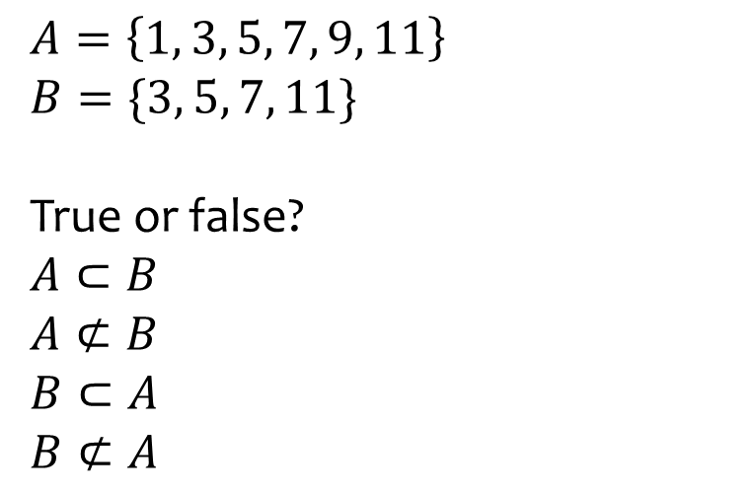
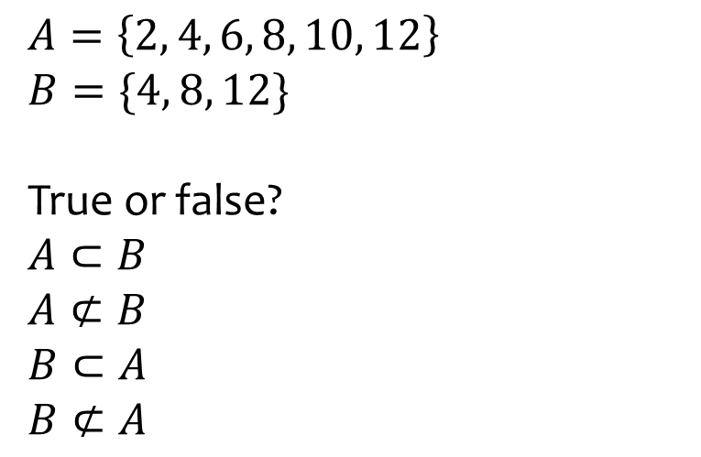
Worked example
Your turn
$$A=\left\{1, 3, 5, 7, 9, 11\right\}$$
$$B=\{3, 5, 7, 11\}$$
True or false?
$$A⊂B$$
$$A⊄B$$
$$B⊂A$$
$$B⊄A$$
$$A=\left\{2, 4, 6, 8, 10, 12\right\}$$
$$B=\{4, 8, 12\}$$
True or false?
$$A⊂B$$
$$A⊄B$$
$$B⊂A$$
$$B⊄A$$
False
True
True
False

Slide 13
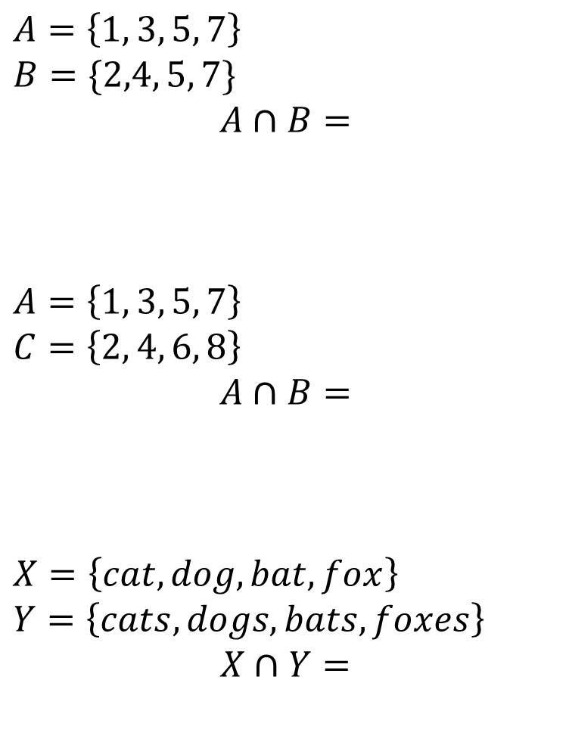
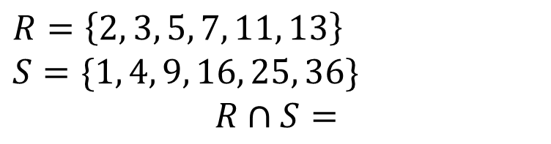

Worked example
Your turn
$$A=\left\{1, 3, 5, 7\right\}$$
$$B=\{2,4, 5, 7\}$$
$$A∩B=$$
$$A=\left\{1, 3, 5, 7\right\}$$
$$C=\left\{2, 4, 6, 8\right\}$$
$$A∩B=$$
$$X=\left\{cat, dog, bat, fox\right\}$$
$$Y=\left\{cats, dogs, bats, foxes\right\}$$
$$X∩Y=$$
$$R=\left\{2, 3, 5, 7, 11, 13\right\}$$
$$S=\{1, 4, 9, 16, 25, 36\}$$
$$R∩S=$$
$$∅$$

Slide 14
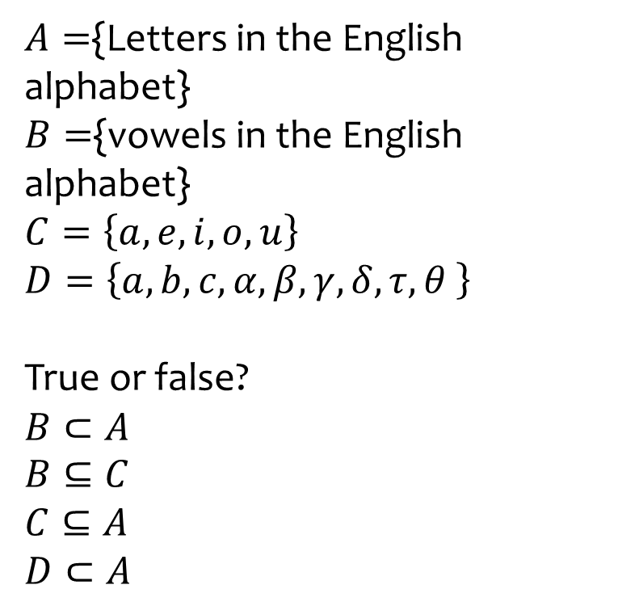
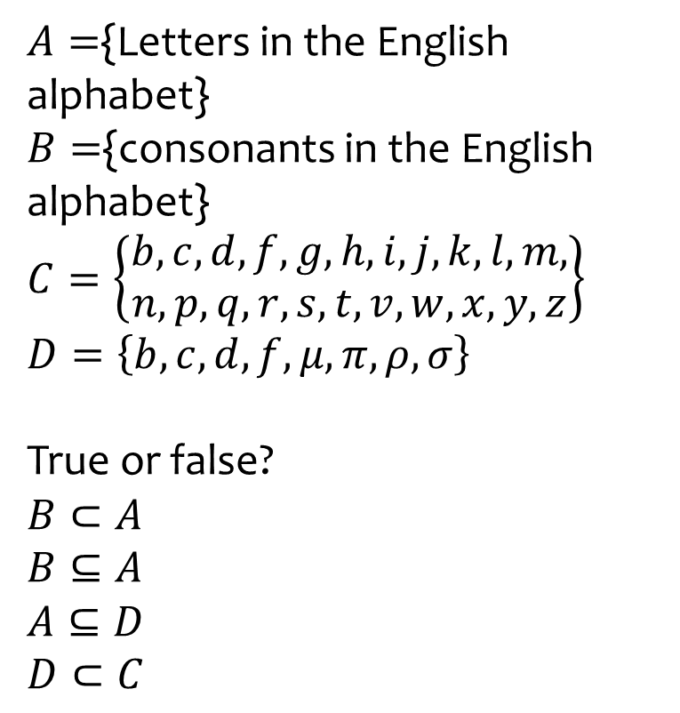
Worked example
Your turn
$A=${Letters in the English alphabet}
$B=${vowels in the English alphabet}
$$C=\left\{a, e, i, o, u\right\}$$
$$D=\left\{a, b, c, α,β,γ,δ,τ,θ \right\}$$
True or false?
$$B⊂A$$
$$B⊆C$$
$$C⊆A$$
$$D⊂A$$
$A=${Letters in the English alphabet}
$B=${consonants in the English alphabet}
$$C=\left\{\begin{aligned}b, c,d, f,g,h,i,j,k,l,m, \\ n,p,q,r,s,t,v,w,x,y,z\end{aligned}\right\}$$
$$D=\left\{b, c, d, f,μ,π,ρ,σ\right\}$$
True or false?
$$B⊂A$$
$$B⊆A$$
$$A⊆D$$
$$D⊂C$$
True
False
False
False

Slide 15
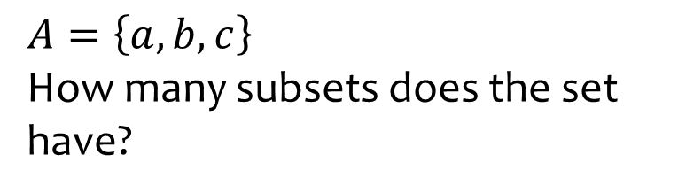
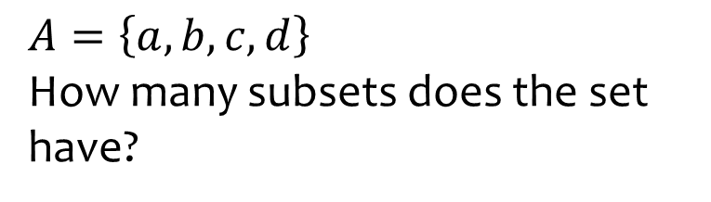
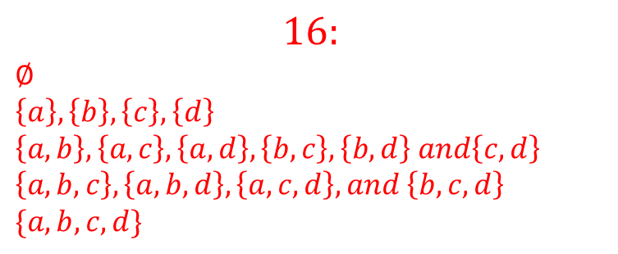
Worked example
Your turn
$$A=\left\{a, b, c\right\}$$
How many subsets does the set have?
$$A=\left\{a, b, c, d\right\}$$
How many subsets does the set have?
$$16:$$
$$∅$$
$$\left\{a\right\}, \left\{b\right\}, \left\{c\right\}, \left\{d\right\}$$
$$\left\{a, b\right\}, \left\{a, c\right\}, \left\{a, d\right\}, \left\{b, c\right\}, \left\{b, d\right\} and\left\{c, d\right\}$$
$$\left\{a, b, c\right\}, \left\{a, b, d\right\}, \left\{a, c, d\right\}, and \left\{b, c, d\right\}$$
$$\{a, b, c, d\}$$

Slide 16
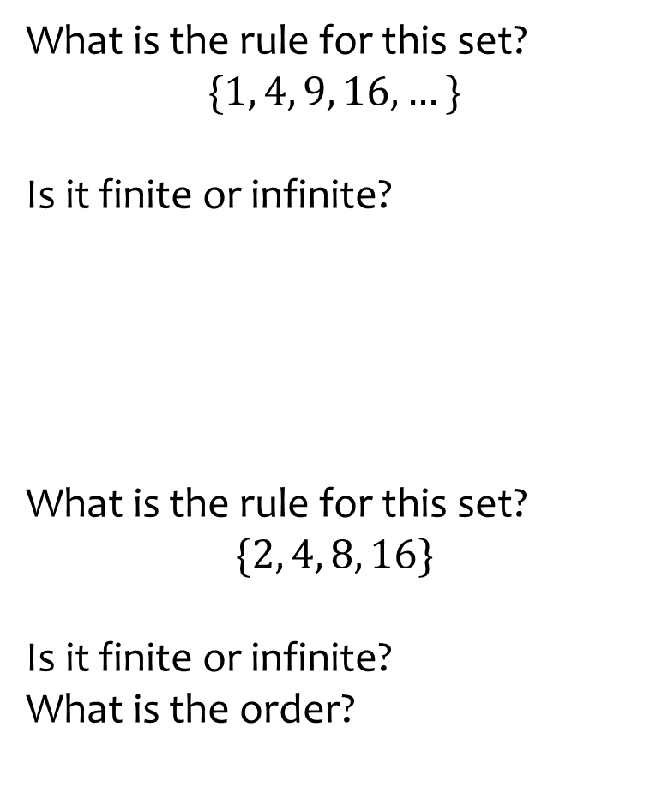
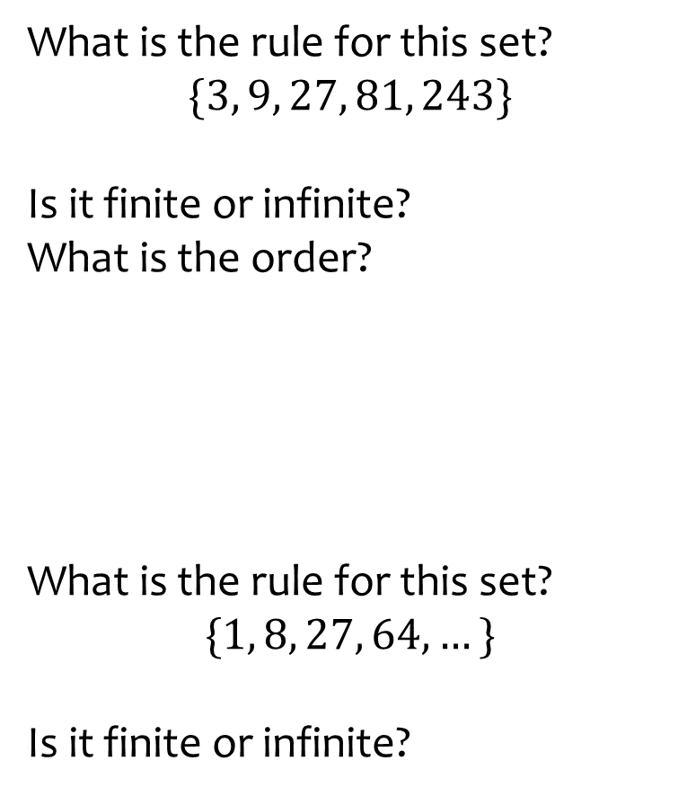
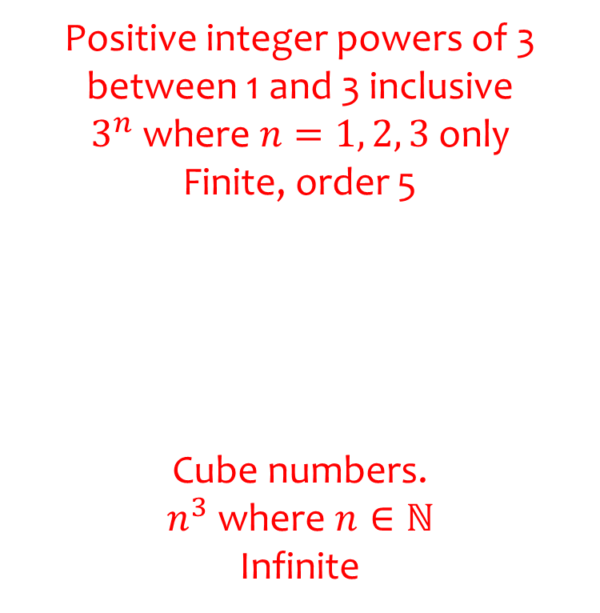
Worked example
Your turn
What is the rule for this set?
$$\{1, 4, 9, 16, …\}$$
Is it finite or infinite?
What is the rule for this set?
$$\{2, 4, 8, 16\}$$
Is it finite or infinite?
What is the order?
What is the rule for this set?
$$\{3, 9, 27, 81, 243\}$$
Is it finite or infinite?
What is the order?
What is the rule for this set?
$$\{1, 8, 27, 64, …\}$$
Is it finite or infinite?
Positive integer powers of 3 between 1 and 3 inclusive
$3^{n}$ where $n=1, 2, 3$ only
Finite, order 5
Cube numbers.
$n^{3}$ where $n∈ℕ$
Infinite

Slide 17
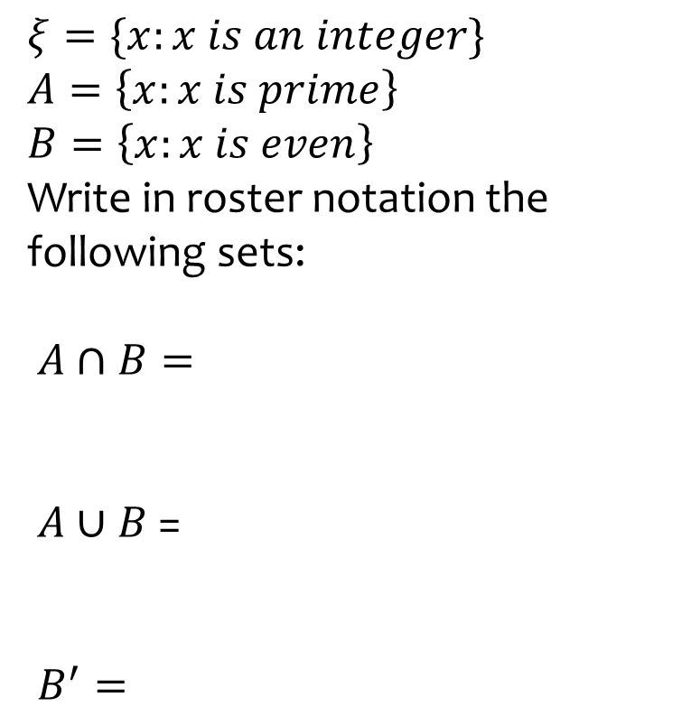
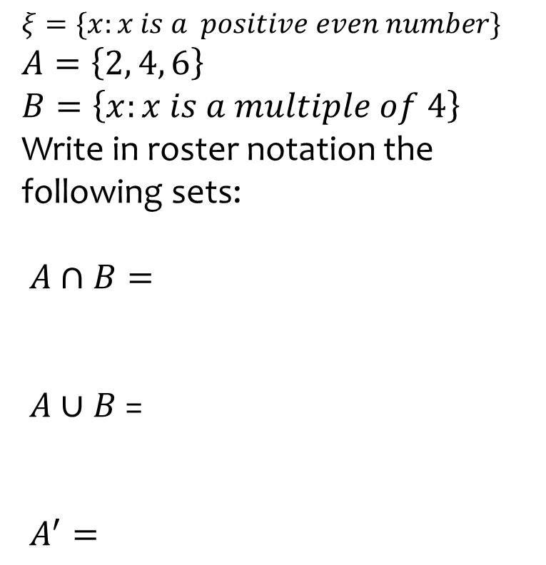
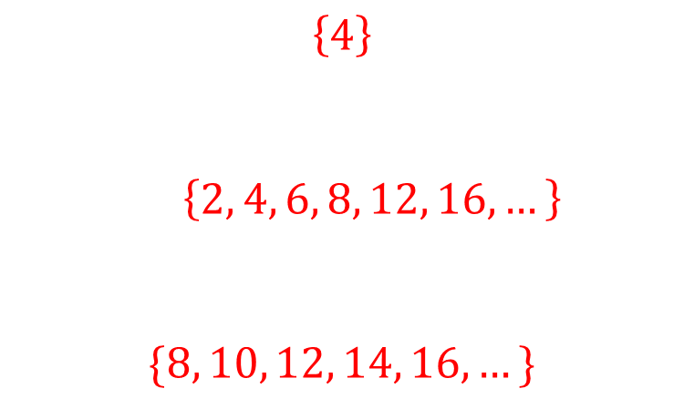
Worked example
Your turn
$$ξ=\{x:x is an integer\}$$
$$A=\left\{x:x is prime\right\}$$
$$B=\left\{x:x is even\right\}$$
Write in roster notation the following sets:
$A∩B=$
$A∪B$ =
$B^{′}=$
$$ξ=\{x:x is a positive even number\}$$
$$A=\left\{2, 4, 6\right\}$$
$$B=\left\{x:x is a multiple of 4\right\}$$
Write in roster notation the following sets:
$A∩B=$
$A∪B$ =
$A^{′}=$
$$\left\{4\right\}$$
$\left\{2, 4, 6, 8, 12, 16,…\right\}$
$$\{8, 10, 12, 14, 16,…\}$$

Slide 18
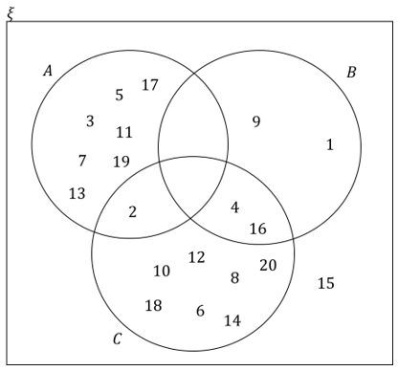
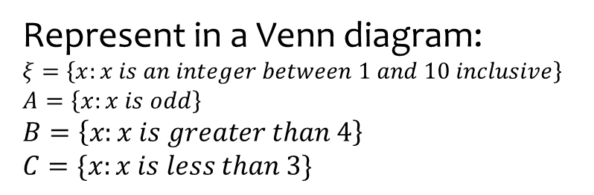
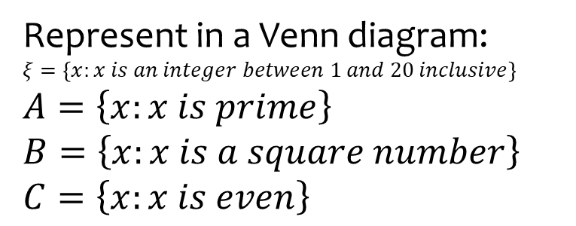
Worked example
Your turn
Represent in a Venn diagram:
$$ξ=\left\{x:x is an integer between 1 and 10 inclusive\right\}$$
$$A=\left\{x:x is odd\right\} \\ B=\left\{x:x is greater than 4\right\}$$
$$C=\{x:x is less than 3\}$$
Represent in a Venn diagram:
$$ξ=\left\{x:x is an integer between 1 and 20 inclusive\right\}$$
$$A=\left\{x:x is prime\right\} \\ B=\left\{x:x is a square number\right\} \\ C=\left\{x:x is even\right\}$$

Slide 19
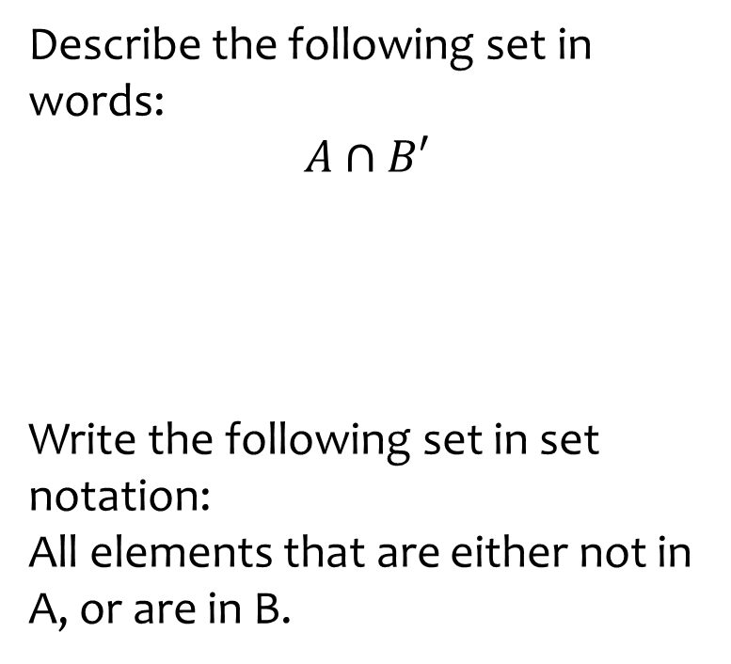
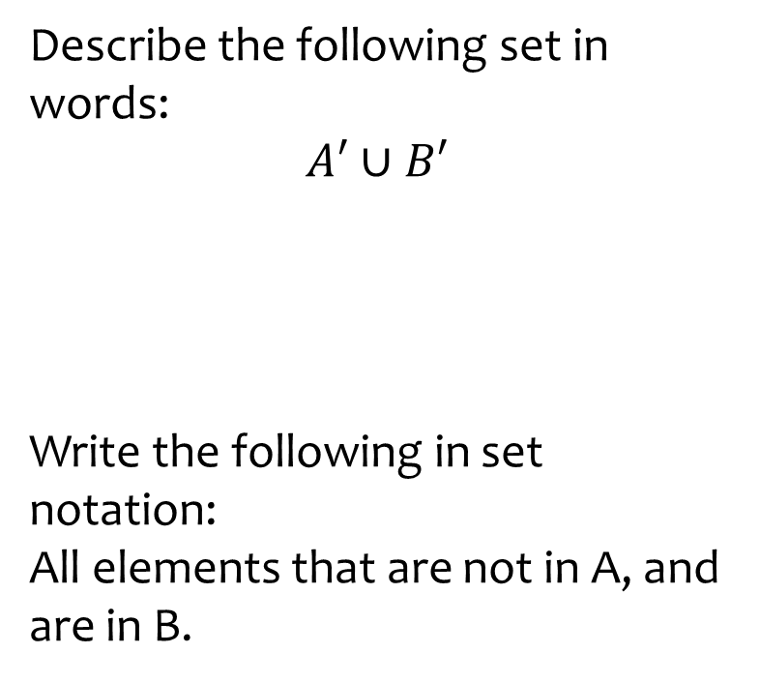
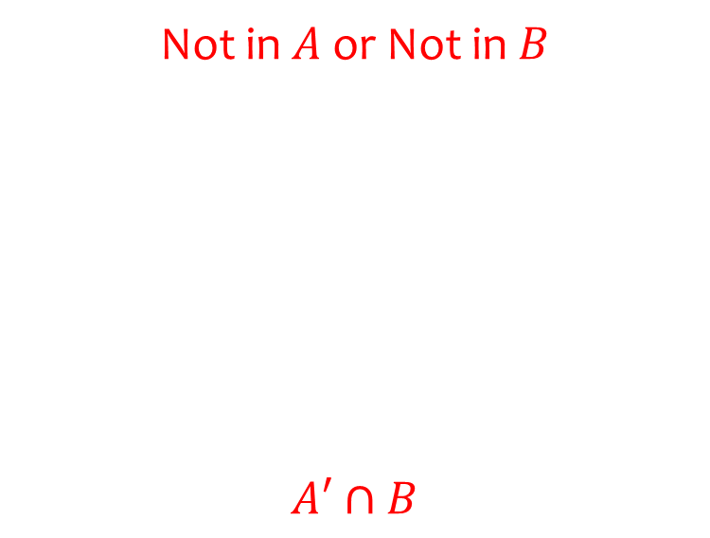
Worked example
Your turn
Describe the following set in words:
$$A∩B′$$
Write the following set in set notation:
All elements that are either not in A, or are in B.
Describe the following set in words:
$$A′∪B′$$
Write the following in set notation:
All elements that are not in A, and are in B.
Not in $A$ or Not in $B$
$$A′∩B$$

Slide 20
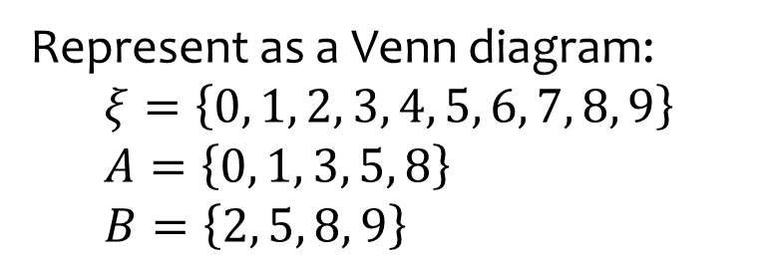
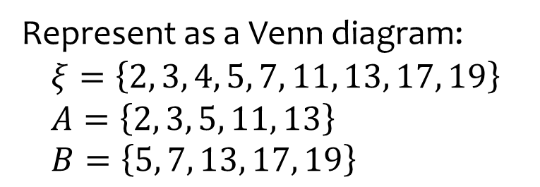









Worked example
Your turn
Represent as a Venn diagram:
$$ξ=\left\{0, 1, 2, 3, 4, 5, 6, 7, 8, 9\right\} \\ A=\left\{0, 1, 3, 5, 8\right\} \\ B=\left\{2, 5, 8, 9\right\}$$
Represent as a Venn diagram:
$$ξ=\left\{2, 3, 4, 5, 7, 11, 13, 17, 19\right\} \\ A=\left\{2, 3, 5, 11, 13\right\} \\ B=\left\{5, 7, 13, 17, 19\right\}$$
$$ξ$$
$$A$$
$$B$$
$$2$$
$$3$$
$$7$$
$$5$$
$$11$$
$$17$$
$$13$$
$$19$$
$$4$$

Slide 21




Worked example
Your turn
Represent as a Venn diagram:
$ξ=$Positive integers between $1$ and $10$ inclusive
$A=\{$Prime numbers$\}$
$B=\{$Even numbers$\}$
Represent as a Venn diagram:
$ξ=$ Integers between $0$ and $5$ inclusive
$A=\{$Prime numbers$\}$
$B=\{$Odd numbers$\}$
$$ξ$$
$$A$$
$$B$$
$$2$$
$$1$$
$$3$$
$$5$$
$$0$$
$$4$$

Slide 22







Worked example
Your turn
Represent as a Venn diagram:
$ξ=$Positive integers between $1$ and $10$ inclusive
$A=\{$Multiples of $2\}$
$B=\{$Multiples of $4\}$
Represent as a Venn diagram:
$ξ=$Positive integers between $10$ and $20$ inclusive
$A=\{$Multiples of $3\}$
$B=\{$Multiples of $6\}$
$$ξ$$
$$A$$
$$10$$
$$11$$
$$13$$
$$14$$
$$15$$
$$16$$
$$17$$
$$19$$
$$20$$
$$B$$
$$12$$
$$18$$

Slide 23

Worked example
Your turn
In a group of 28 scientists:
20 have degrees in Physics.
18 have degrees in Chemistry.
Some have degrees in both
4 scientists have degrees which are neither Physics nor Chemistry.
Find the number of scientists who have degrees in both Physics and Chemistry.
In a group of 30 mathematicians:
15 have studied Calculus.
22 have studied Topology.
Some have studied both.
3 mathematicians have not yet studied either Calculus or topology
Find the number of mathematicians who have studied both Calculus and Topology.
$$10$$

Slide 24

Worked example
Your turn
There are 150 pupils. The examinations available are: English, Maths and Science.
15 pupils are sitting English and Maths but not science
20 pupils are sitting Science and Maths but not English
18 pupils are sitting Science and English but not Maths
8 pupils are sitting all three exams.
55 are sitting English in total
72 are sitting Maths in total
65 are sitting Science in total
How many pupils do not sit any of the examinations?
There are 130 pupils. The examinations available are: English, Maths and Science.
10 pupils are sitting English and Maths but not science
20 pupils are sitting Science and Maths but not English
9 pupils are sitting Science and English but not Maths
13 pupils are sitting all three exams.
49 are sitting English in total
83 are sitting Maths in total
62 are sitting Science in total
How many pupils do not sit any of the examinations?
$$1$$

Slide 25



Worked example
Your turn
A = the set of days in the week that begin with the letter T:
$$A=$$
$$n\left(A\right)=$$
Tuesday $∈A$?
Friday $∈A$?
C = the set of days in the week that students do not have school:
$$C=$$
$$n\left(C\right)=$$
Tuesday $∈A$?
Sunday $∈A$?
$$\left\{Saturday, Sunday\right\}$$
$$2$$
True
False

Slide 26
















Worked example
Your turn
$ξ$ = $\left\{Days of the week\right\}$
$$A\text{ = }\left\{Tuesday, Thursday\right\}$$
B = $\left\{Days starting with S or T\right\}$
Draw a Venn diagram to represent this information.
$ξ$ = $\left\{Months of the year\right\}$
$$A\text{ = }\left\{Months starting with A\right\}$$
B = $\left\{Months with six letters\right\}$
Draw a Venn diagram to represent this information.
$$ξ$$
$$ξ$$
$$January$$
$$February$$
$$March$$
$$May$$
$$June$$
$$A$$
$$B$$
$$A$$
$$B$$
$$April$$
$$August$$
$$July$$
$$September$$
$$October$$
$$November$$
$$December$$

Slide 27





Worked example
Your turn
On the Venn diagram, shade the region representing:
$$C∩D$$
On the Venn diagram, shade the region representing:
$$A∩B$$
$$ξ$$
$$C$$
$$D$$
$$A$$
$$B$$

Slide 28



Worked example
Your turn
On the Venn diagram, shade the region representing:
$$C∪D$$
On the Venn diagram, shade the region representing:
$$A∪B$$
$$ξ$$
$$C$$
$$D$$
$$A$$
$$B$$

Slide 29



Worked example
Your turn
On the Venn diagram, shade the region representing:
$$D′$$
On the Venn diagram, shade the region representing:
$$A′$$
$$ξ$$
$$C$$
$$D$$
$$A$$
$$B$$

Slide 30



Worked example
Your turn
On the Venn diagram, shade the region representing:
$$C∩D′$$
On the Venn diagram, shade the region representing:
$$A′∩B$$
$$ξ$$
$$C$$
$$D$$
$$A$$
$$B$$

Slide 31



Worked example
Your turn
On the Venn diagram, shade the region representing:
$(C∪D)′$ or $C′∩D′$
On the Venn diagram, shade the region representing:
$(A∪B)′$ or $A′∩B′$
$$ξ$$
$$C$$
$$D$$
$$A$$
$$B$$

Slide 32









Worked example
Your turn
On the Venn diagram, shade the region representing:
$$D∩E∩F$$
On the Venn diagram, shade the region representing:
$$A∩B∩C$$
$$ξ$$
$$D$$
$$E$$
$$A$$
$$B$$
$$F$$
$$C$$

Slide 33



Worked example
Your turn
On the Venn diagram, shade the region representing:
$$D∪E∪F$$
On the Venn diagram, shade the region representing:
$$A∪B∪C$$
$$ξ$$
$$D$$
$$E$$
$$A$$
$$B$$
$$F$$
$$C$$

Slide 34



Worked example
Your turn
On the Venn diagram, shade the region representing:
$$D∩E′∩F$$
On the Venn diagram, shade the region representing:
$$A′∩B∩C$$
$$ξ$$
$$D$$
$$E$$
$$A$$
$$B$$
$$F$$
$$C$$

Slide 35



Worked example
Your turn
On the Venn diagram, shade the region representing:
$$(D∪E∪F)′$$
On the Venn diagram, shade the region representing:
$$(A∪B∪C)′$$
$$ξ$$
$$D$$
$$E$$
$$A$$
$$B$$
$$F$$
$$C$$

Slide 36



Worked example
Your turn
On the Venn diagram, shade the region representing:
$$(D∪E)∩F′$$
On the Venn diagram, shade the region representing:
$$(A∪B)∩C′$$
$$ξ$$
$$D$$
$$E$$
$$A$$
$$B$$
$$F$$
$$C$$

Slide 37



Worked example
Your turn
On the Venn diagram, shade the region representing:
$$(D∩F)∪(E∩F^{′})$$
On the Venn diagram, shade the region representing:
$$(B∩C)∪(A^{′}∩C)$$
$$ξ$$
$$D$$
$$E$$
$$A$$
$$B$$
$$F$$
$$C$$

Slide 38



Worked example
Your turn
On the Venn diagram, shade the region representing:
$$(D′∪F)∩(D∪E′)$$
On the Venn diagram, shade the region representing:
$$(A′∪B)∩(B^{′}∪C)$$
$$ξ$$
$$D$$
$$E$$
$$A$$
$$B$$
$$F$$
$$C$$

