Slide 1
Rounding
CONTENTS

Slide 2
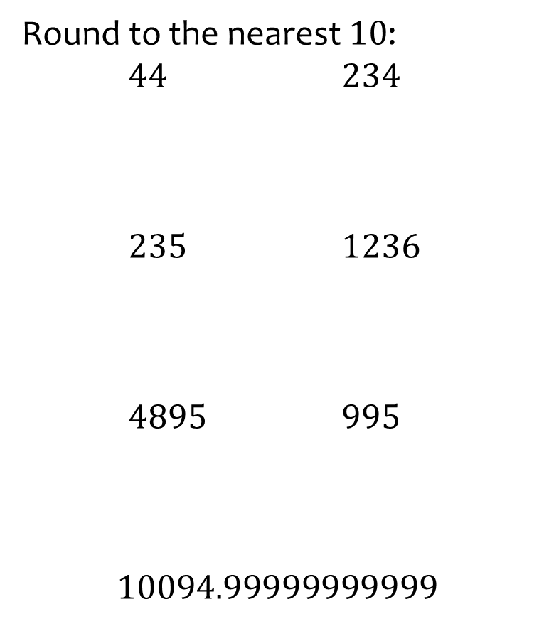
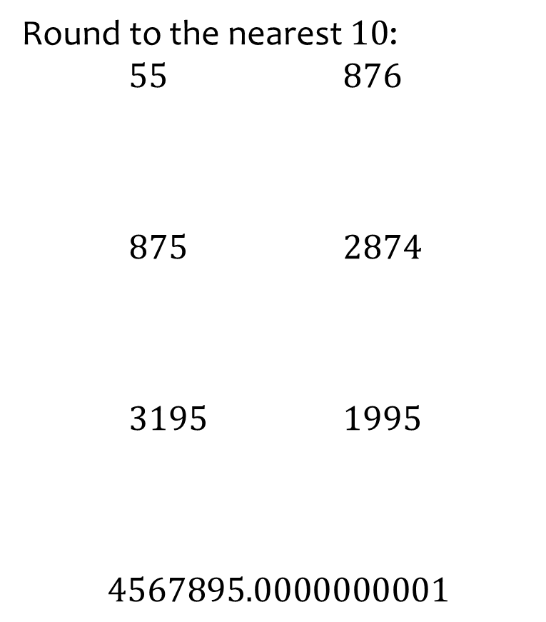
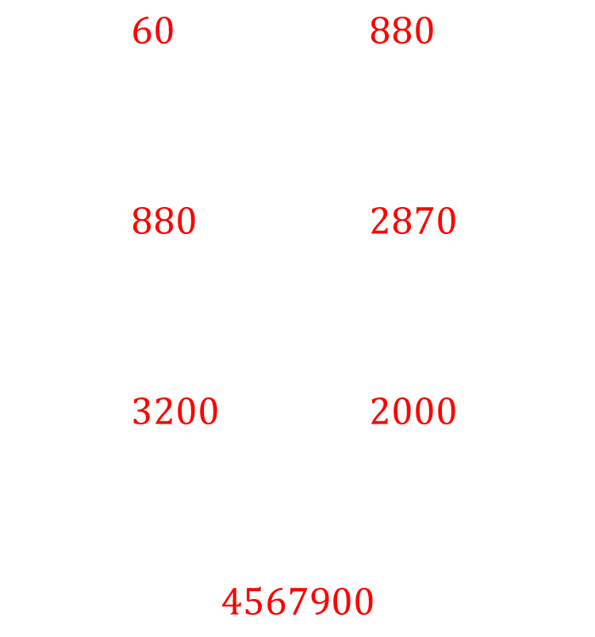
Worked example
Your turn
Round to the nearest $10$:
$44$ $234$
$235$ $1236$
$4895$ $995$
$$10094.99999999999$$
Round to the nearest $10$:
$55$ $876$
$875$ $2874$
$3195$ $1995$
$$4567895.0000000001$$
$60$ $880$
$880$ $2870$
$3200$ $2000$
$$4567900$$

Slide 3
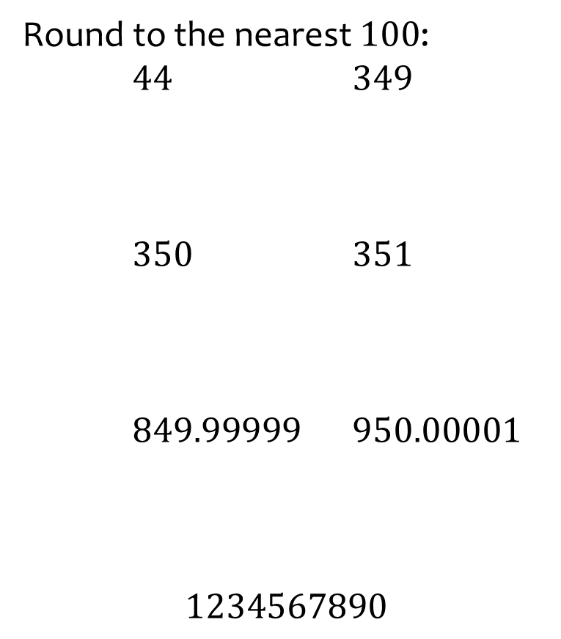
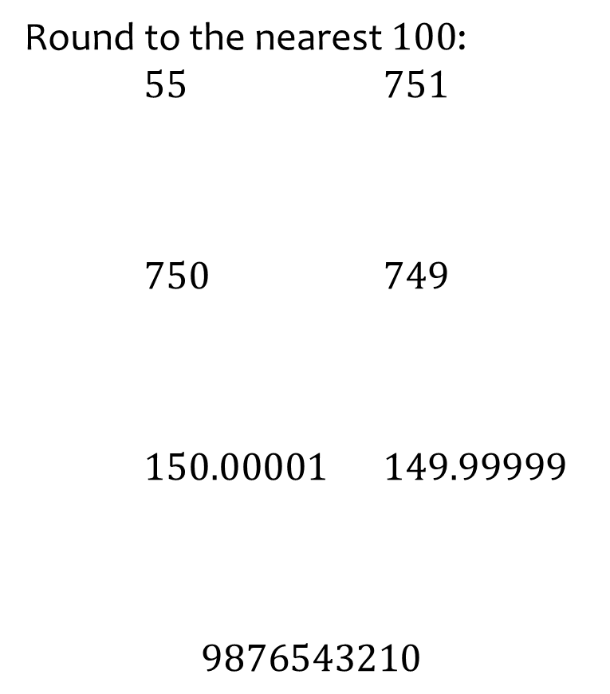
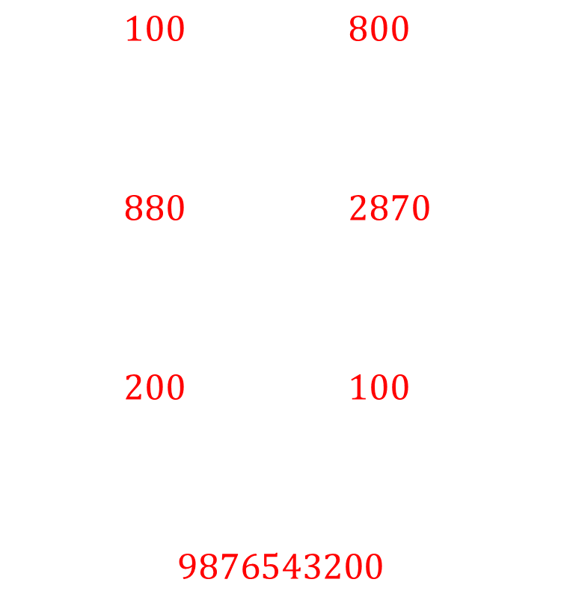
Worked example
Your turn
Round to the nearest $100$:
$44$ $349$
$350$ $351$
$849.99999$ $950.00001$
$$1234567890$$
Round to the nearest $100$:
$55$ $751$
$750$ $749$
$150.00001$ $149.99999$
$$9876543210$$
$100$ $800$
$880$ $2870$
$200$ $100$
$$9876543200$$

Slide 4
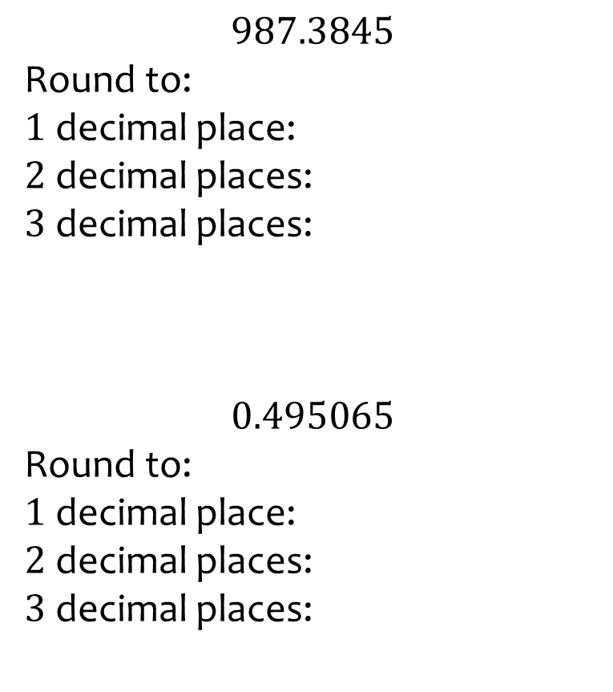
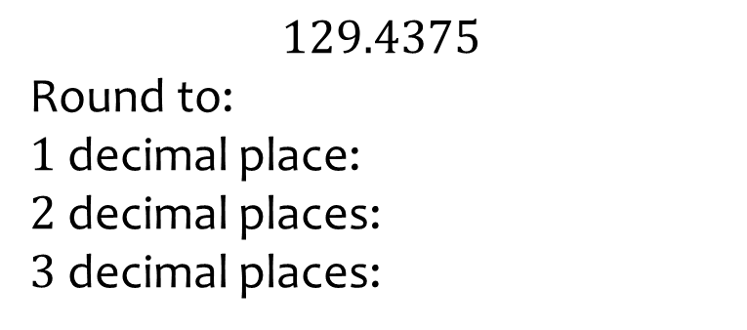
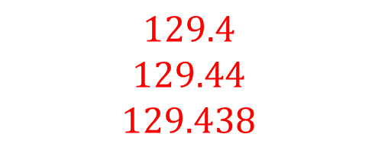
Worked example
Your turn
$$987.3845$$
Round to:
$1$ decimal place:
$2$ decimal places:
$3$ decimal places:
$$0.495065$$
Round to:
$1$ decimal place:
$2$ decimal places:
$3$ decimal places:
$$129.4375$$
Round to:
$1$ decimal place:
$2$ decimal places:
$3$ decimal places:
$$129.4$$
$$129.44$$
$$129.438$$

Slide 5
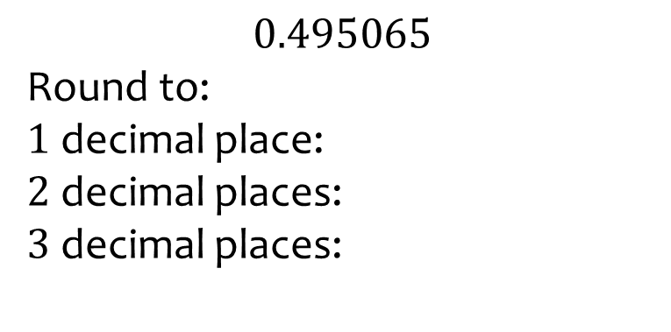
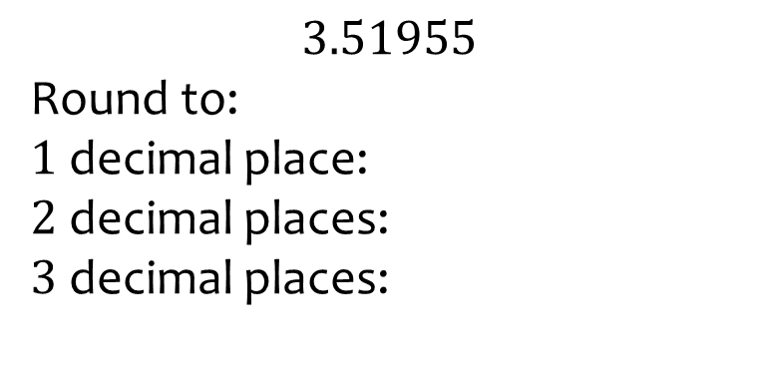

Worked example
Your turn
$$0.495065$$
Round to:
$1$ decimal place:
$2$ decimal places:
$3$ decimal places:
$$3.51955$$
Round to:
$1$ decimal place:
$2$ decimal places:
$3$ decimal places:
$$3.5$$
$$3.52$$
$$5.520$$

Slide 6
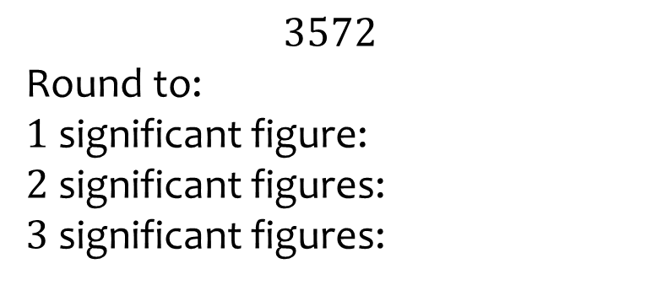
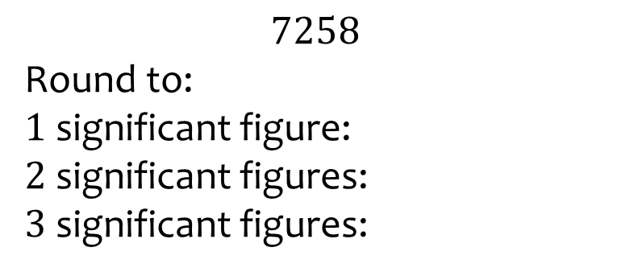

Worked example
Your turn
$$3572$$
Round to:
$1$ significant figure:
$2$ significant figures:
$3$ significant figures:
$$7258$$
Round to:
$1$ significant figure:
$2$ significant figures:
$3$ significant figures:
$$7000$$
$$7300$$
$$7260$$

Slide 7
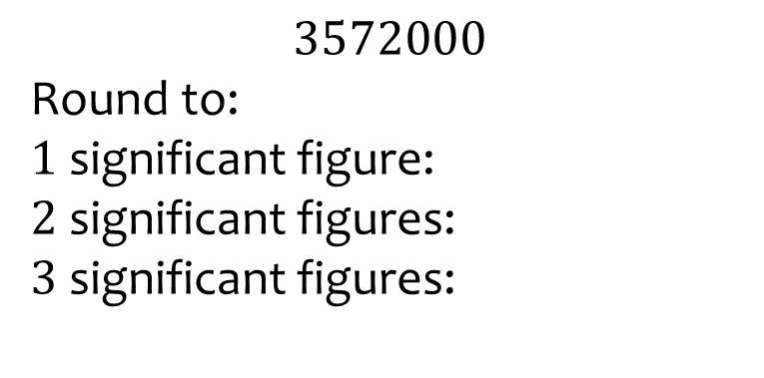
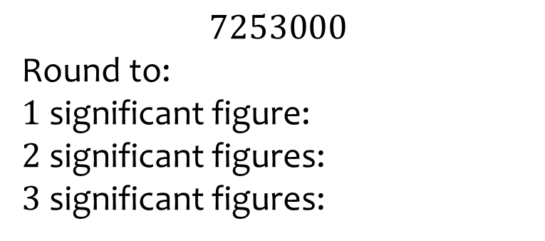
Worked example
Your turn
$$3572000$$
Round to:
$1$ significant figure:
$2$ significant figures:
$3$ significant figures:
$$7253000$$
Round to:
$1$ significant figure:
$2$ significant figures:
$3$ significant figures:
$$7000$$
$$7300$$
$$7260$$

Slide 8
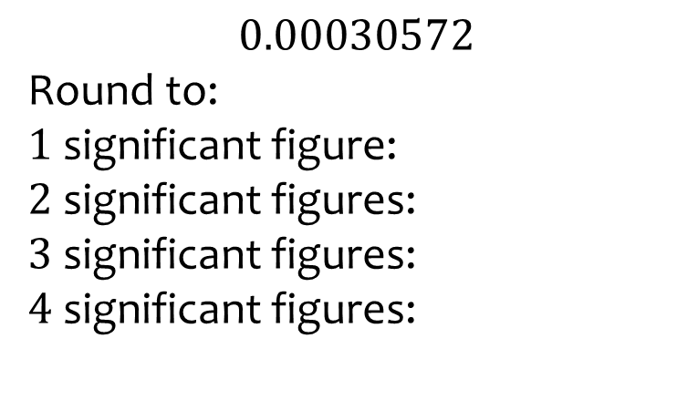
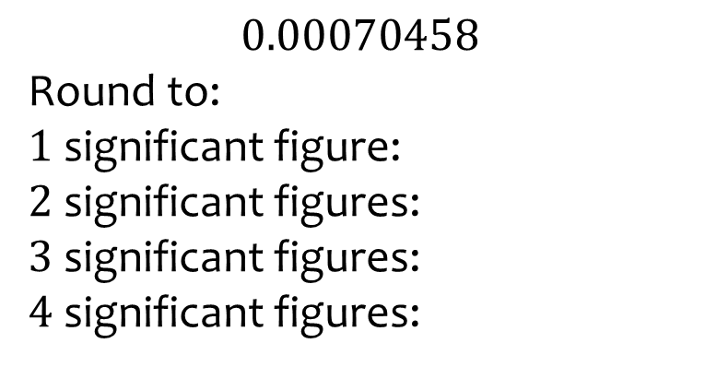
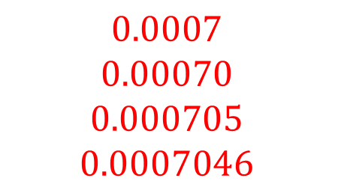
Worked example
Your turn
$$0.00030572$$
Round to:
$1$ significant figure:
$2$ significant figures:
$3$ significant figures:
$4$ significant figures:
$$0.00070458$$
Round to:
$1$ significant figure:
$2$ significant figures:
$3$ significant figures:
$4$ significant figures:
$$0.0007$$
$$0.00070$$
$$0.000705$$
$$0.0007046$$

