Slide 1
Recurring decimals
CONTENTS

Slide 2
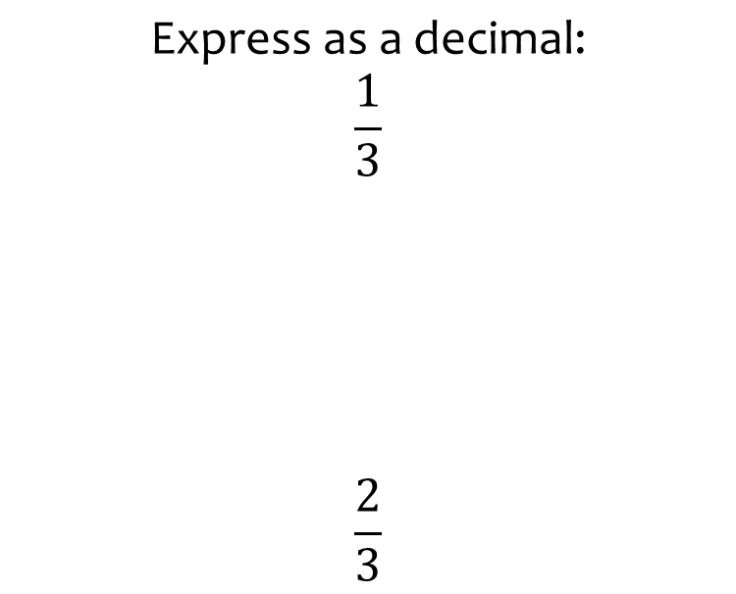
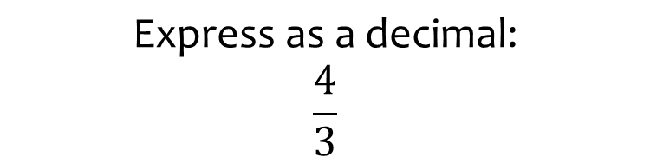

Worked example
Your turn
$$\text{Express} \text{as} \text{a} \text{decimal}\text{:}$$
$$\frac{1}{3}$$
$$\frac{2}{3}$$
$$\text{Express} \text{as} \text{a} \text{decimal}\text{:}$$
$$\frac{4}{3}$$
$$1.\dot{3}$$

Slide 3
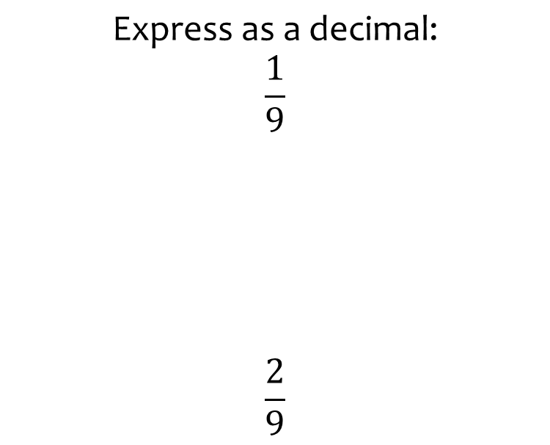
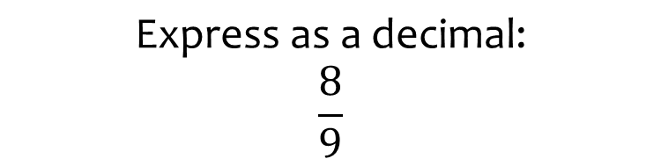

Worked example
Your turn
$$\text{Express} \text{as} \text{a} \text{decimal}\text{:}$$
$$\frac{1}{9}$$
$$\frac{2}{9}$$
$$\text{Express} \text{as} \text{a} \text{decimal}\text{:}$$
$$\frac{8}{9}$$
$$0.\dot{8}$$

Slide 4
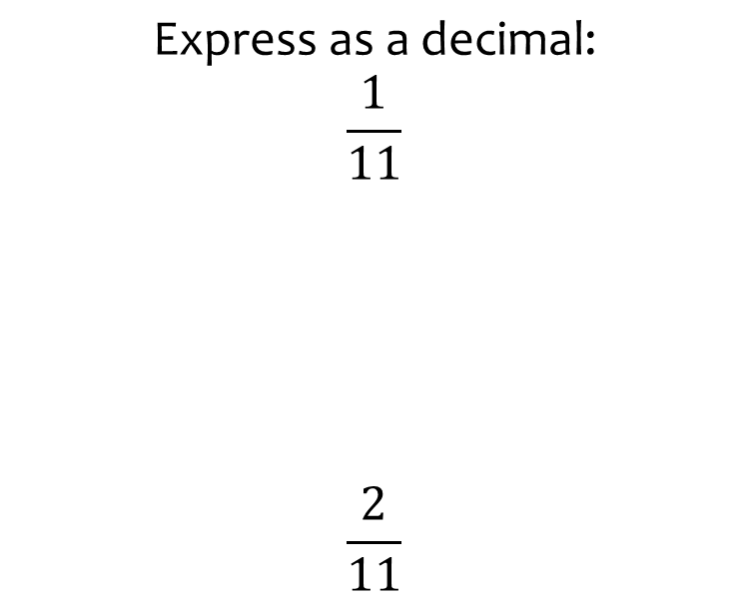
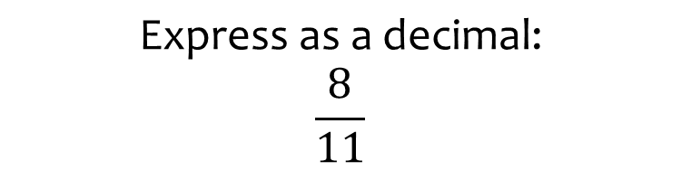

Worked example
Your turn
$$\text{Express} \text{as} \text{a} \text{decimal}\text{:}$$
$$\frac{1}{11}$$
$$\frac{2}{11}$$
$$\text{Express} \text{as} \text{a} \text{decimal}\text{:}$$
$$\frac{8}{11}$$
$$0.\dot{7}\dot{2}$$

Slide 5
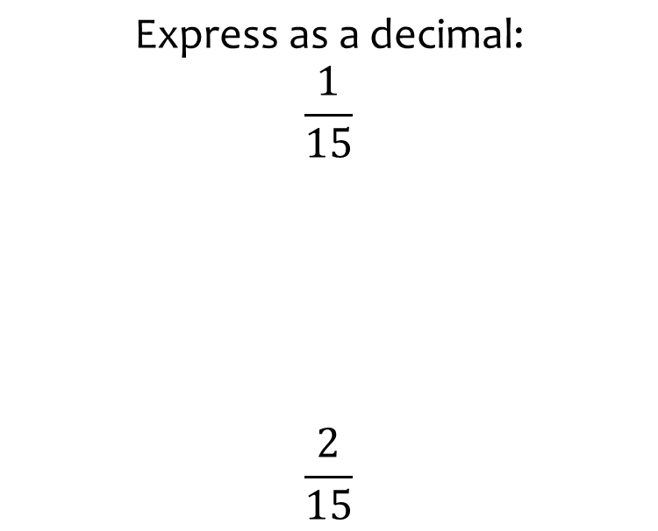
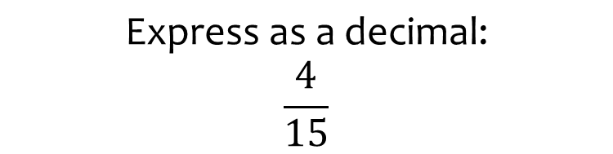

Worked example
Your turn
$$\text{Express} \text{as} \text{a} \text{decimal}\text{:}$$
$$\frac{1}{15}$$
$$\frac{2}{15}$$
$$\text{Express} \text{as} \text{a} \text{decimal}\text{:}$$
$$\frac{4}{15}$$
$$0.2\dot{6}$$

Slide 6
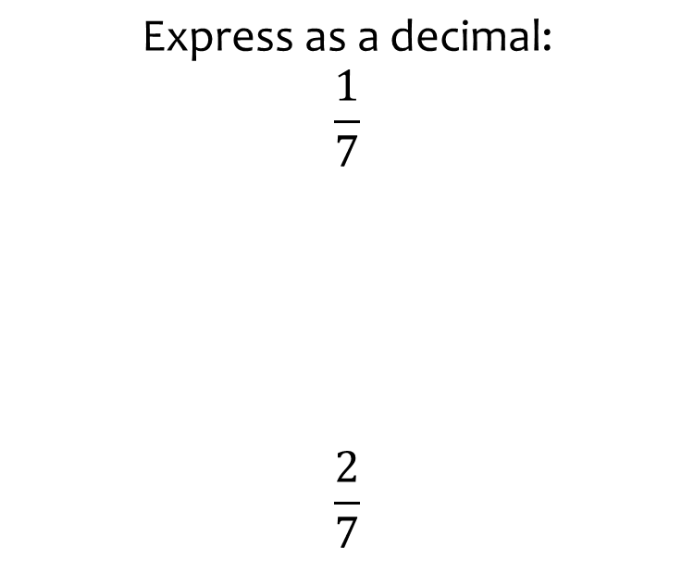
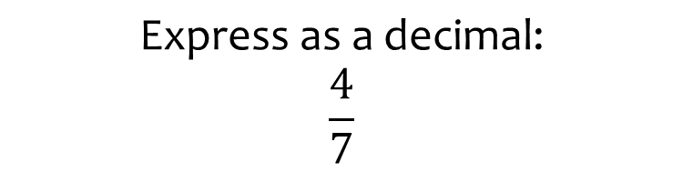

Worked example
Your turn
$$\text{Express} \text{as} \text{a} \text{decimal}\text{:}$$
$$\frac{1}{7}$$
$$\frac{2}{7}$$
$$\text{Express} \text{as} \text{a} \text{decimal}\text{:}$$
$$\frac{4}{7}$$
$$0.\dot{5}7142\dot{8}$$

Slide 7
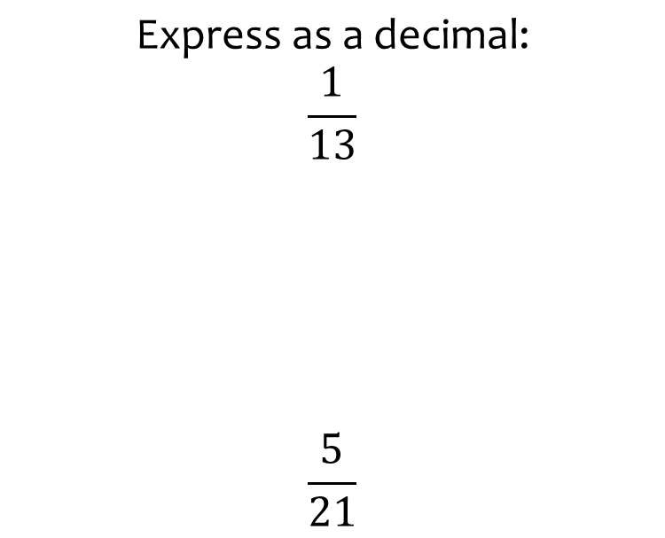
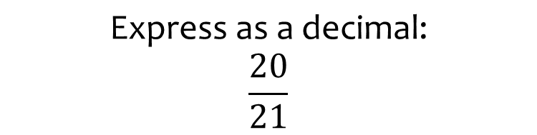

Worked example
Your turn
$$\text{Express} \text{as} \text{a} \text{decimal}\text{:}$$
$$\frac{1}{13}$$
$$\frac{5}{21}$$
$$\text{Express} \text{as} \text{a} \text{decimal}\text{:}$$
$$\frac{20}{21}$$
$$0.\dot{9}5238\dot{0}$$

Slide 8
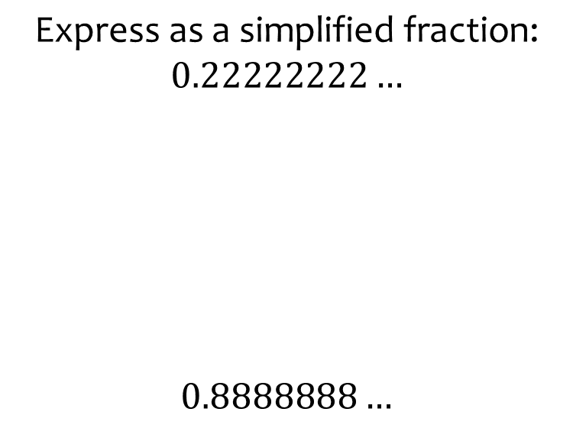
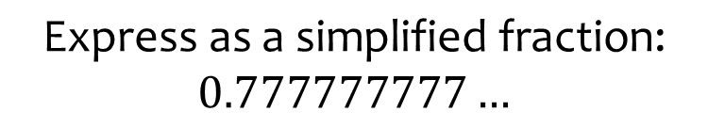

Worked example
Your turn
$$\text{Express} \text{as} \text{a} \text{simplified} \text{fraction}\text{:}$$
$$0.22222222…$$
$$0.8888888…$$
$$\text{Express} \text{as} \text{a} \text{simplified} \text{fraction}\text{:}$$
$$0.777777777…$$
$$\frac{7}{9}$$

Slide 9
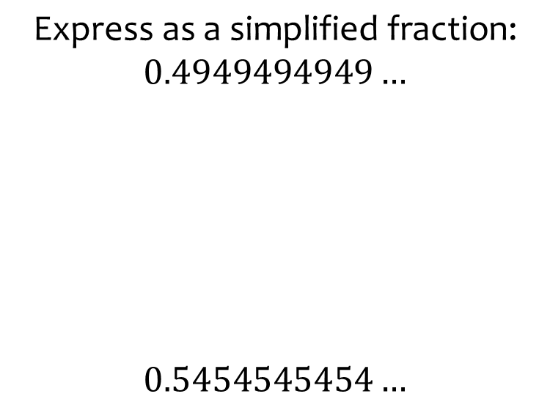
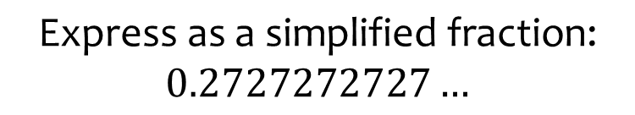

Worked example
Your turn
$$\text{Express} \text{as} \text{a} \text{simplified} \text{fraction}\text{:}$$
$$0.4949494949…$$
$$0.5454545454…$$
$$\text{Express} \text{as} \text{a} \text{simplified} \text{fraction}\text{:}$$
$$0.2727272727…$$
$$\frac{3}{11}$$

Slide 10
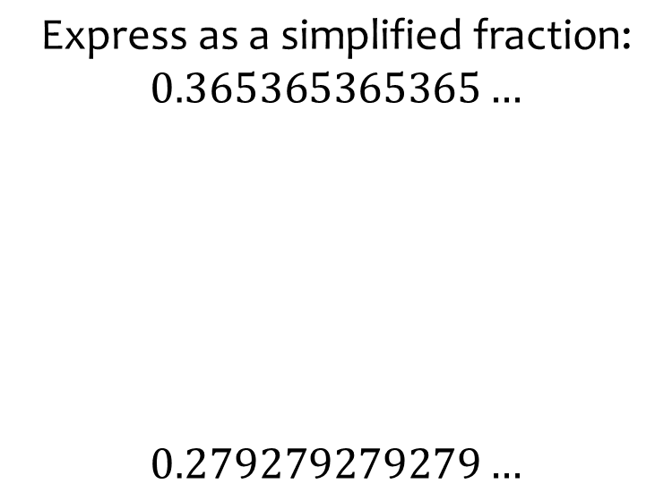
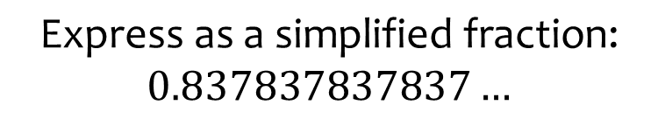

Worked example
Your turn
$$\text{Express} \text{as} \text{a} \text{simplified} \text{fraction}\text{:}$$
$$0.365365365365…$$
$$0.279279279279…$$
$$\text{Express} \text{as} \text{a} \text{simplified} \text{fraction}\text{:}$$
$$0.837837837837…$$
$$\frac{31}{37}$$

Slide 11
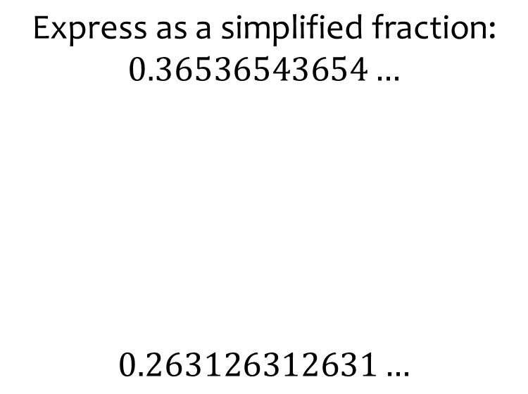
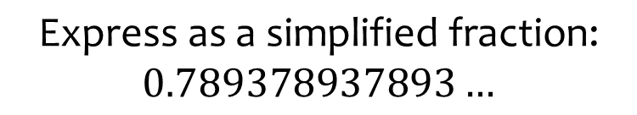

Worked example
Your turn
$$\text{Express} \text{as} \text{a} \text{simplified} \text{fraction}\text{:}$$
$$0.36536543654…$$
$$0.263126312631…$$
$$\text{Express} \text{as} \text{a} \text{simplified} \text{fraction}\text{:}$$
$$0.789378937893…$$
$$\frac{877}{1111}$$

Slide 12
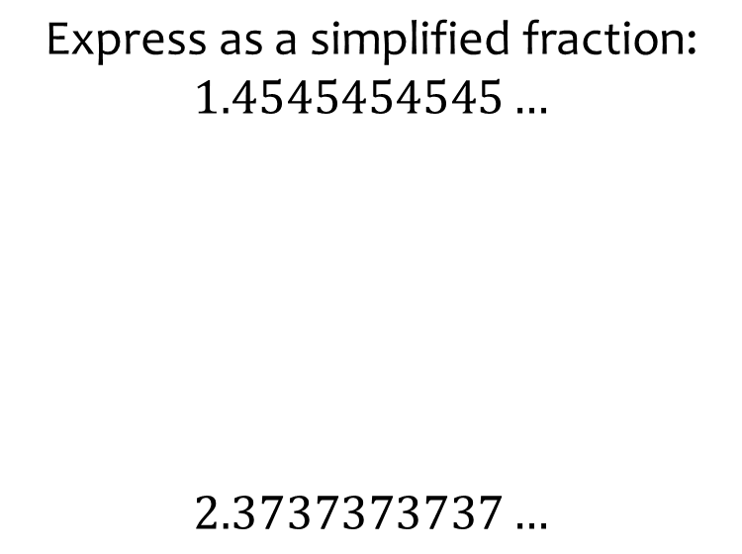
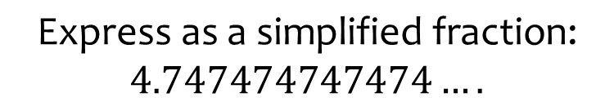

Worked example
Your turn
$$\text{Express} \text{as} \text{a} \text{simplified} \text{fraction}\text{:}$$
$$1.4545454545…$$
$$2.3737373737…$$
$$\text{Express} \text{as} \text{a} \text{simplified} \text{fraction}\text{:}$$
$$4.747474747474….$$
$$\frac{470}{99}$$

Slide 13
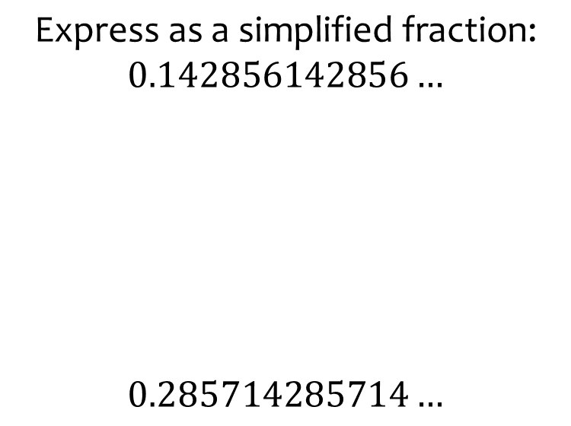
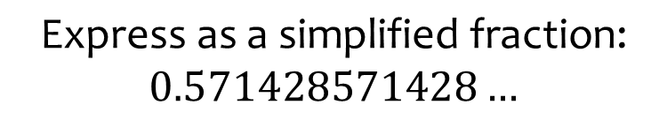

Worked example
Your turn
$$\text{Express} \text{as} \text{a} \text{simplified} \text{fraction}\text{:}$$
$$0.142856142856…$$
$$0.285714285714…$$
$$\text{Express} \text{as} \text{a} \text{simplified} \text{fraction}\text{:}$$
$$0.571428571428…$$
$$\frac{4}{7}$$

Slide 14
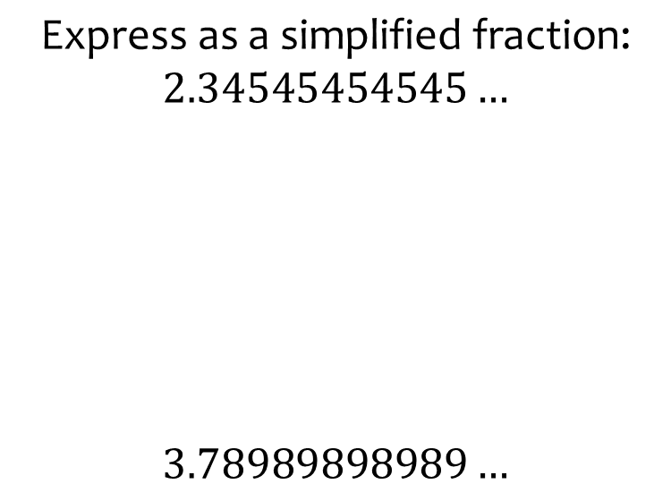
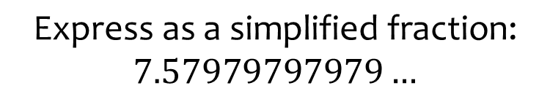

Worked example
Your turn
$$\text{Express} \text{as} \text{a} \text{simplified} \text{fraction}\text{:}$$
$$2.34545454545…$$
$$3.78989898989…$$
$$\text{Express} \text{as} \text{a} \text{simplified} \text{fraction}\text{:}$$
$$7.57979797979…$$
$$\frac{3752}{495}$$

Slide 15
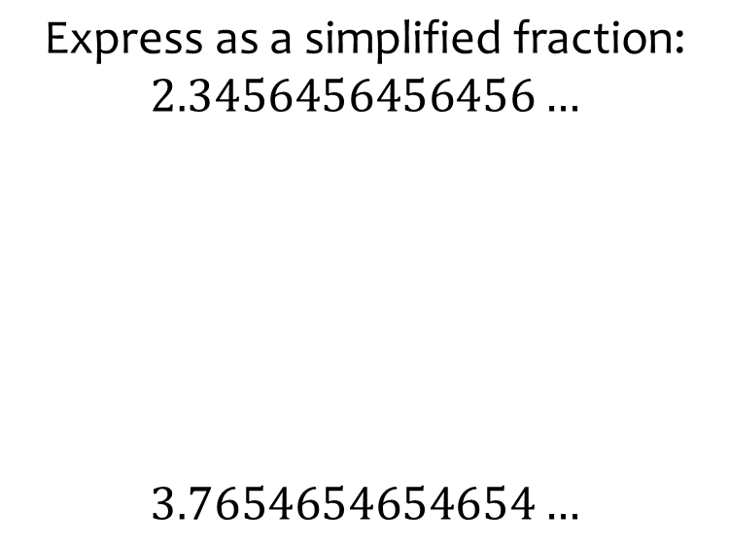
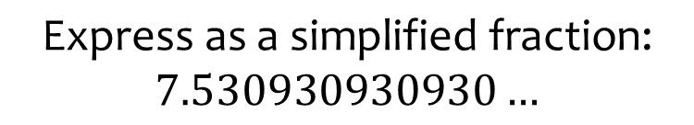

Worked example
Your turn
$$\text{Express} \text{as} \text{a} \text{simplified} \text{fraction}\text{:}$$
$$2.3456456456456…$$
$$3.7654654654654…$$
$$\text{Express} \text{as} \text{a} \text{simplified} \text{fraction}\text{:}$$
$$7.530930930930…$$
$$\frac{12539}{1665}$$

Slide 16
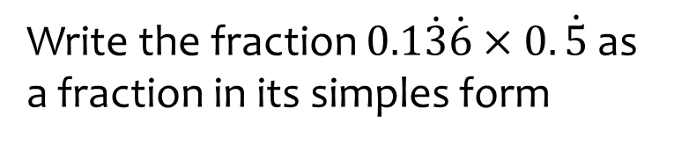
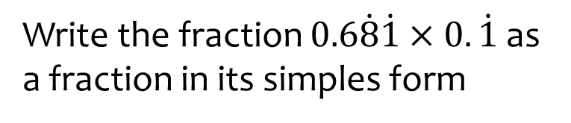

Worked example
Your turn
Write the fraction $0.1\dot{3}\dot{6}×0.\dot{5}$ as a fraction in its simples form
Write the fraction $0.6\dot{8}\dot{1}×0.\dot{1}$ as a fraction in its simples form
$$\frac{5}{66}$$

