Slide 1
Ratio
CONTENTS

Slide 2
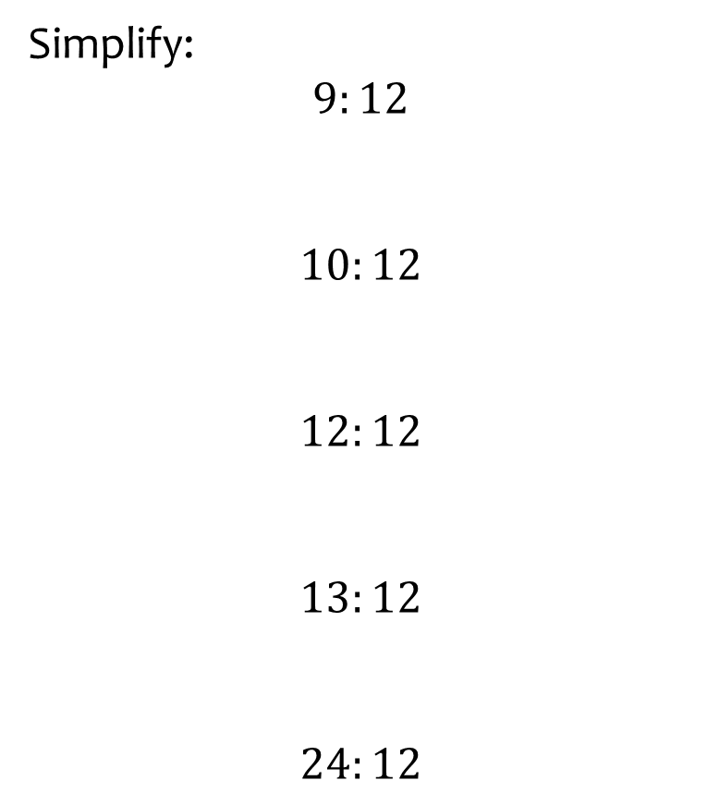
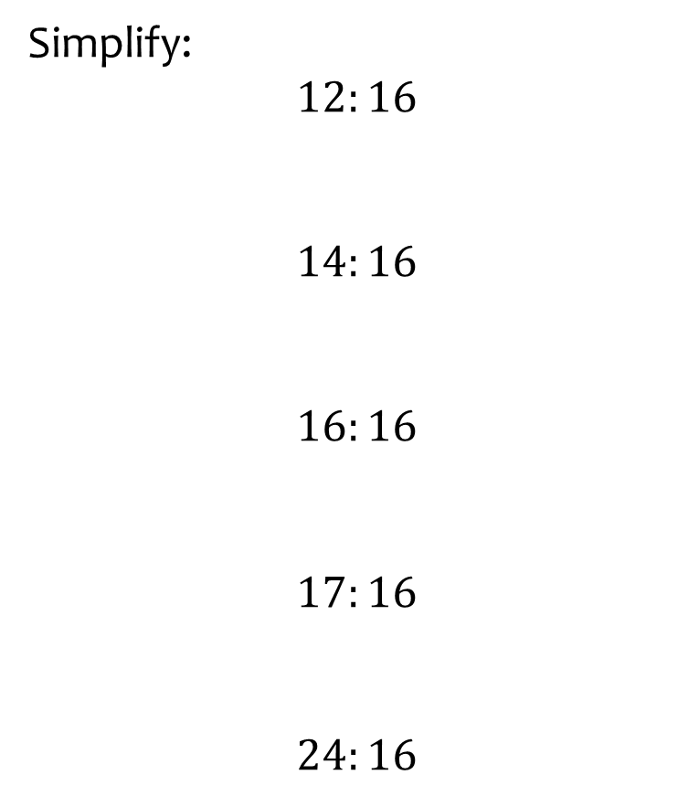
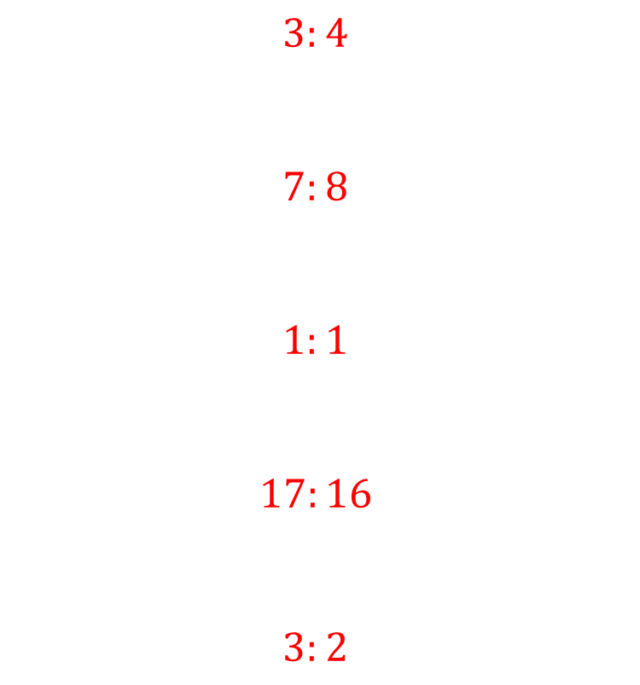
Worked example
Your turn
Simplify:
$$9:12$$
$$10:12$$
$$12:12$$
$$13:12$$
$$24:12$$
Simplify:
$$12:16$$
$$14:16$$
$$16:16$$
$$17:16$$
$$24:16$$
$$3:4$$
$$7:8$$
$$1:1$$
$$17:16$$
$$3:2$$

Slide 3
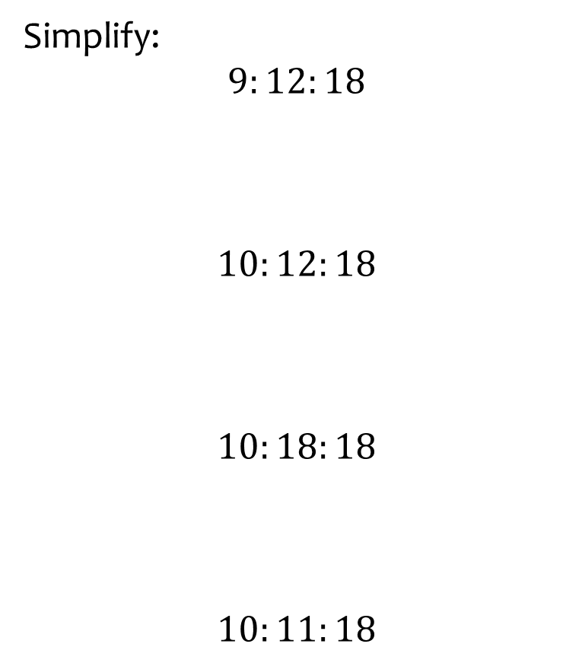
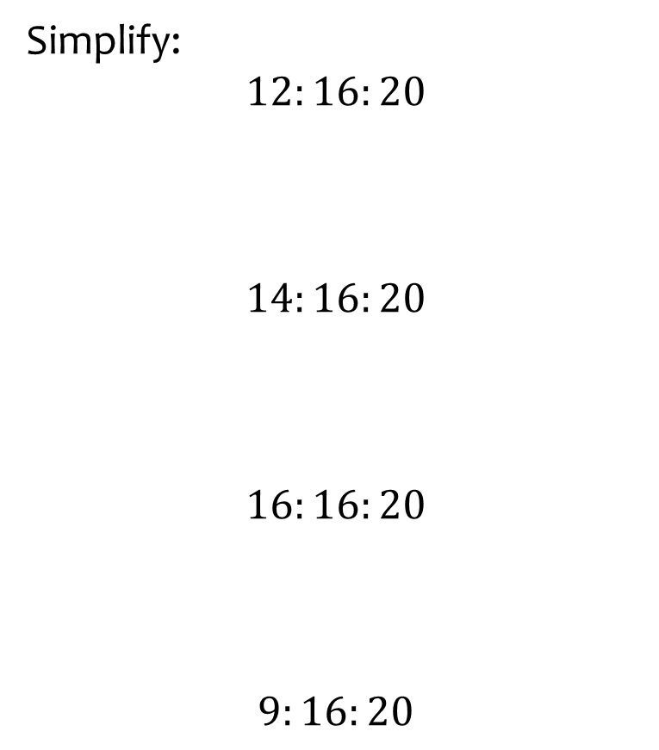
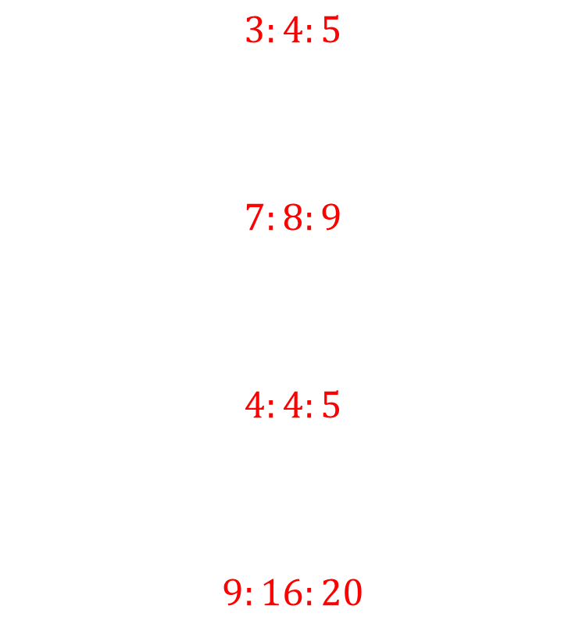
Worked example
Your turn
Simplify:
$$9:12:18$$
$$10:12:18$$
$$10:18:18$$
$$10:11:18$$
Simplify:
$$12:16:20$$
$$14:16:20$$
$$16:16:20$$
$$9:16:20$$
$$3:4:5$$
$$7:8:9$$
$$4:4:5$$
$$9:16:20$$

Slide 4
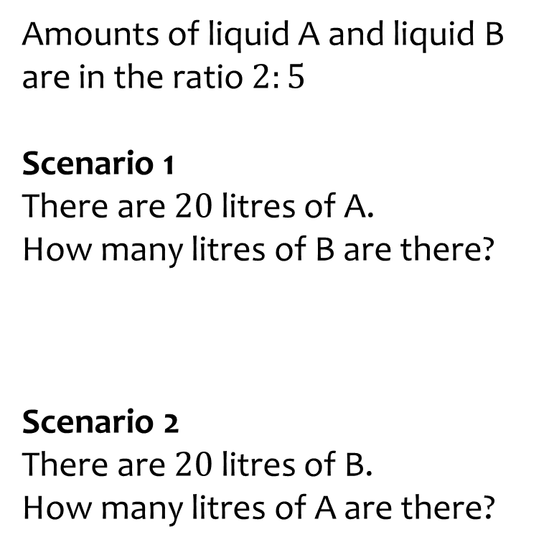
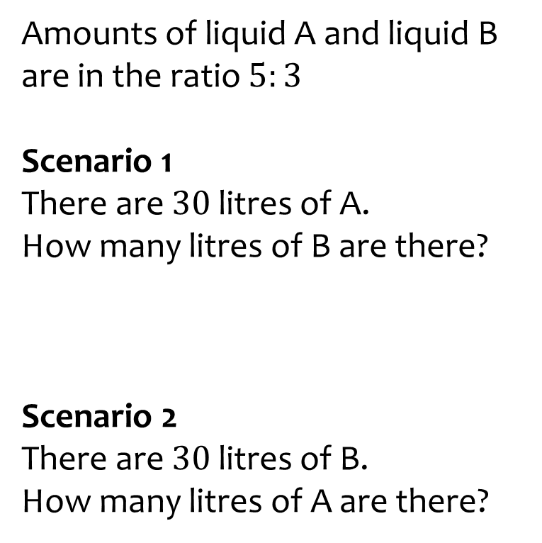
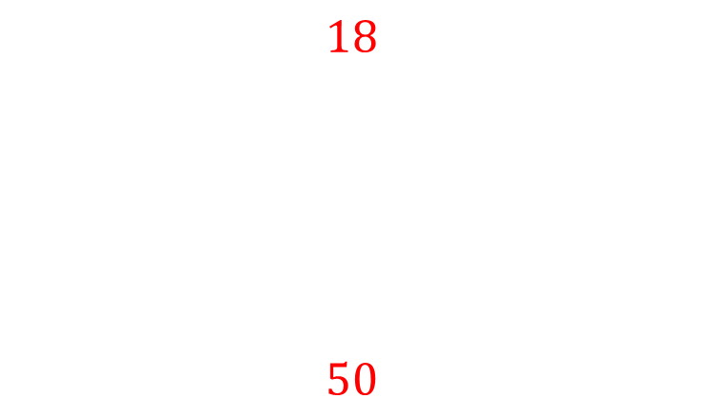
Worked example
Your turn
Amounts of liquid A and liquid B are in the ratio $2:5$
Scenario 1
There are $20$ litres of A.
How many litres of B are there?
Scenario 2
There are $20$ litres of B.
How many litres of A are there?
Amounts of liquid A and liquid B are in the ratio $5:3$
Scenario 1
There are $30$ litres of A.
How many litres of B are there?
Scenario 2
There are $30$ litres of B.
How many litres of A are there?
$$18$$
$$50$$

Slide 5
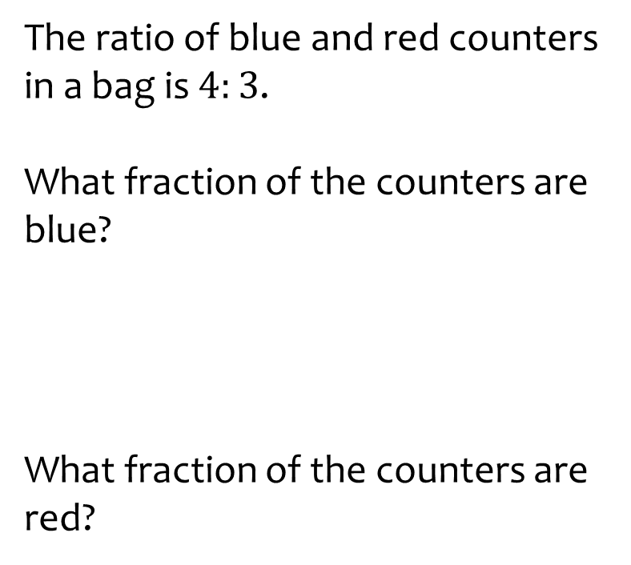
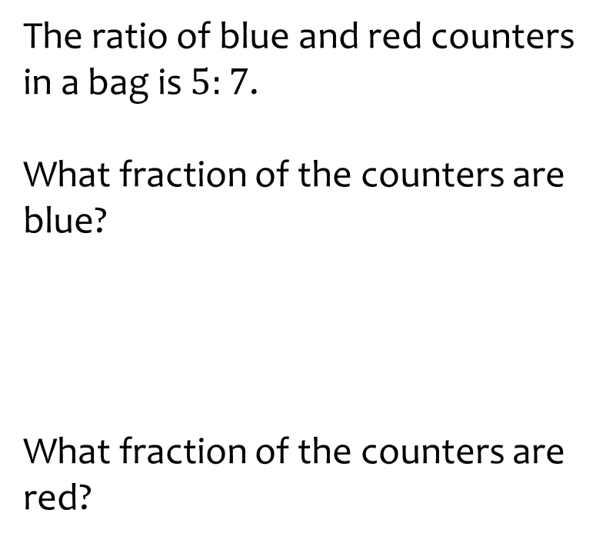
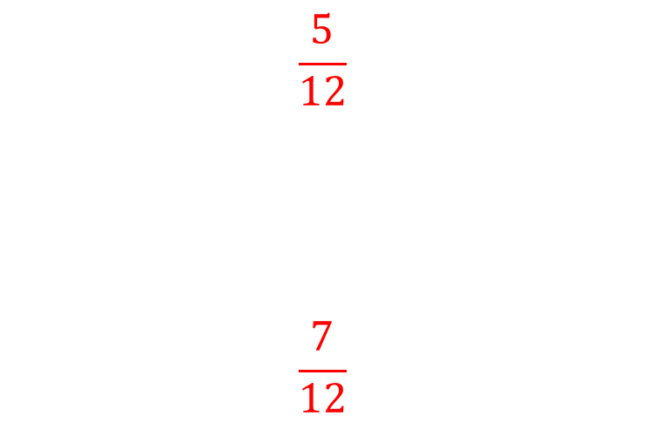
Worked example
Your turn
The ratio of blue and red counters in a bag is $4:3$.
What fraction of the counters are blue?
What fraction of the counters are red?
The ratio of blue and red counters in a bag is $5:7$.
What fraction of the counters are blue?
What fraction of the counters are red?
$$\frac{5}{12}$$
$$\frac{7}{12}$$

Slide 6
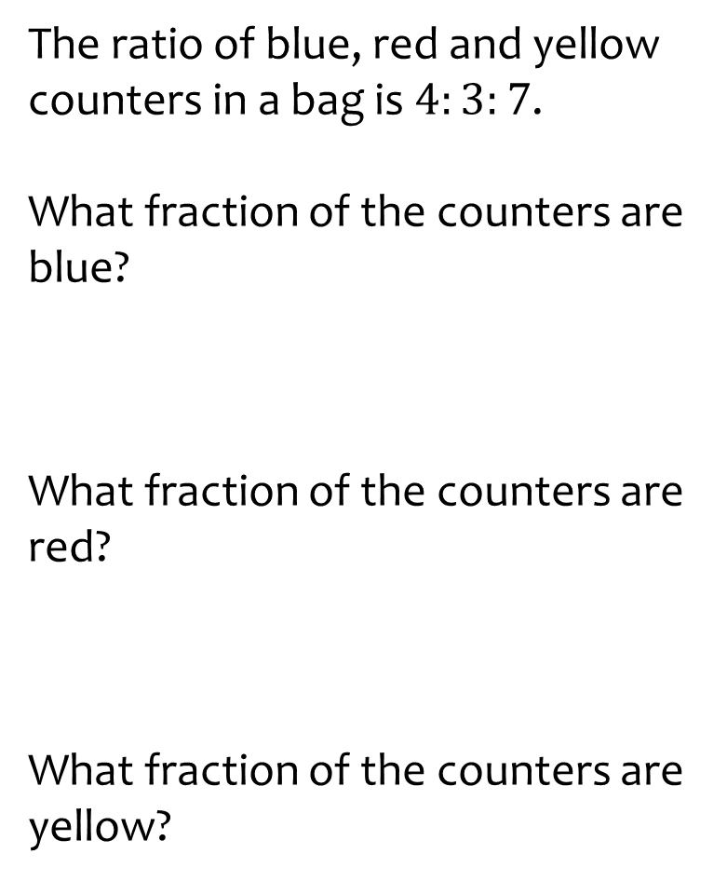
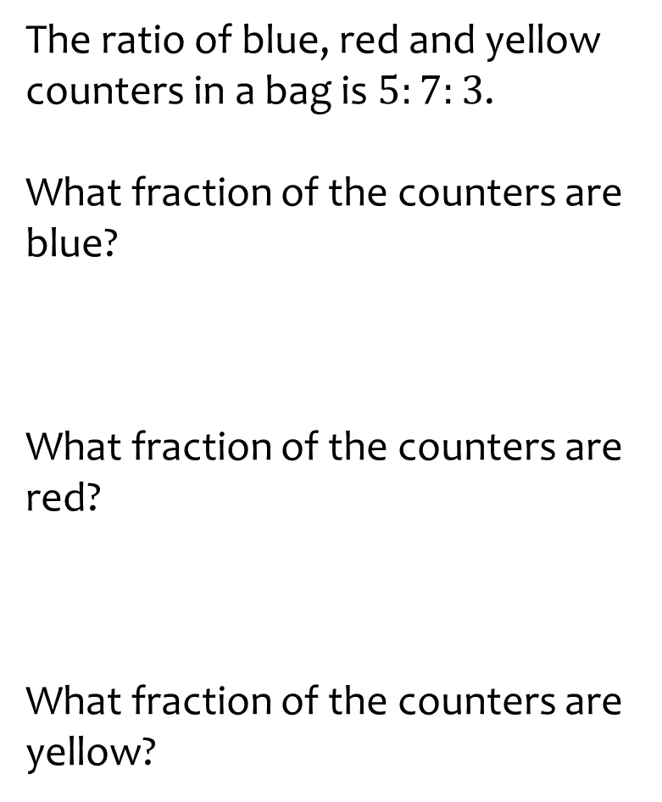
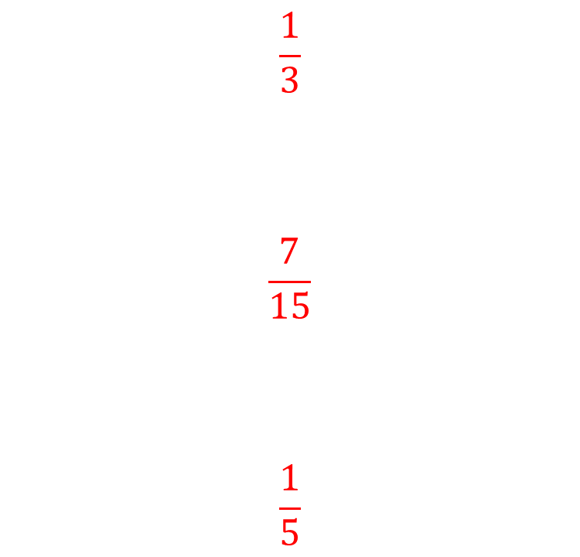
Worked example
Your turn
The ratio of blue, red and yellow counters in a bag is $4:3:7$.
What fraction of the counters are blue?
What fraction of the counters are red?
What fraction of the counters are yellow?
The ratio of blue, red and yellow counters in a bag is $5:7:3$.
What fraction of the counters are blue?
What fraction of the counters are red?
What fraction of the counters are yellow?
$$\frac{1}{3}$$
$$\frac{7}{15}$$
$$\frac{1}{5}$$

Slide 7
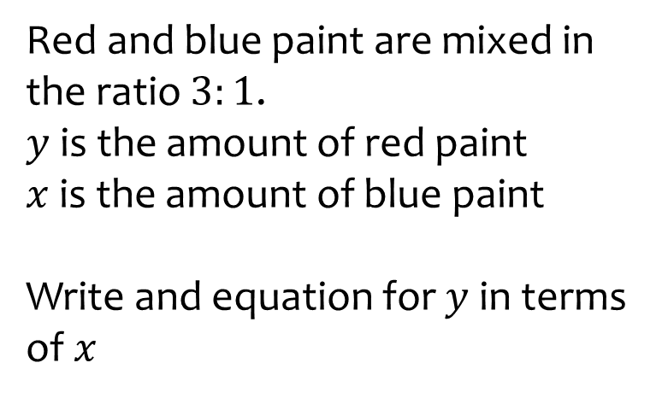
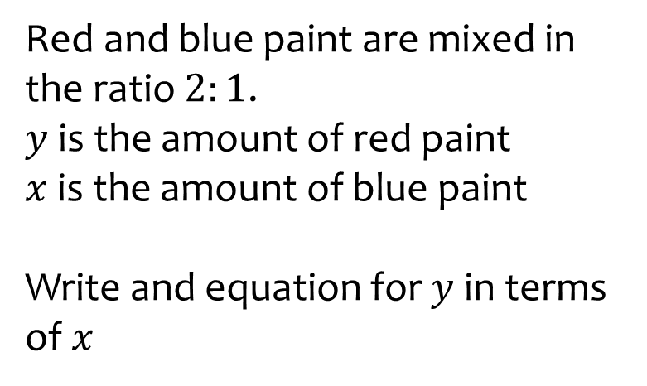

Worked example
Your turn
Red and blue paint are mixed in the ratio $3:1$.
$y$ is the amount of red paint
$x$is the amount of blue paint
Write and equation for $y$ in terms of $x$
Red and blue paint are mixed in the ratio $2:1$.
$y$ is the amount of red paint
$x$is the amount of blue paint
Write and equation for $y$ in terms of $x$
$$y=2x$$

Slide 8
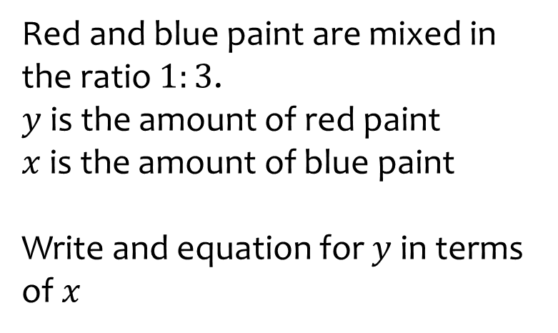
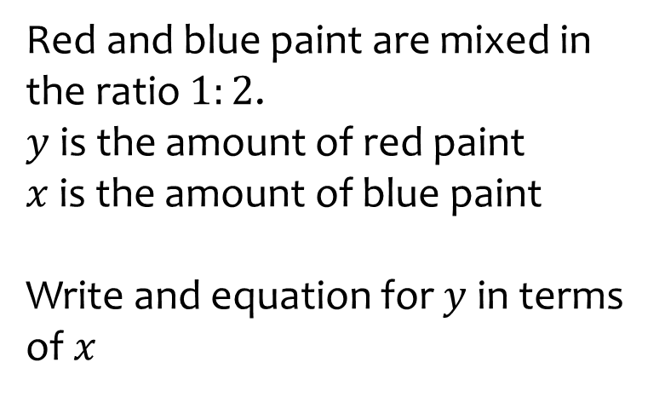

Worked example
Your turn
Red and blue paint are mixed in the ratio $1:3$.
$y$ is the amount of red paint
$x$is the amount of blue paint
Write and equation for $y$ in terms of $x$
Red and blue paint are mixed in the ratio $1:2$.
$y$ is the amount of red paint
$x$is the amount of blue paint
Write and equation for $y$ in terms of $x$
$$y=\frac{1}{2}x$$

Slide 9
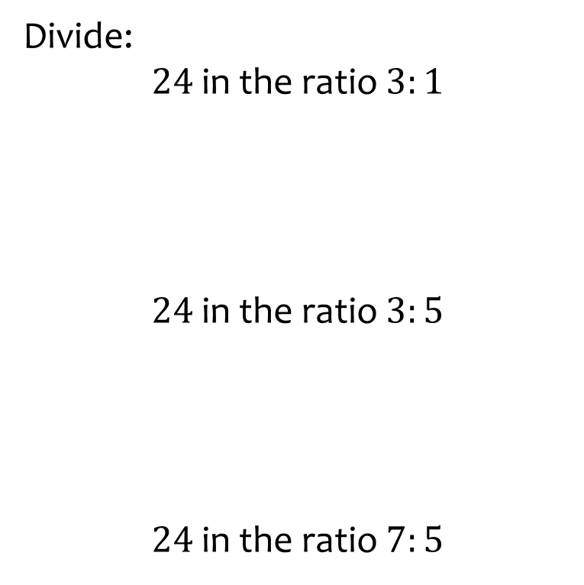


Worked example
Your turn
Divide:
$24$ in the ratio $3:1$
$24$ in the ratio $3:5$
$24$ in the ratio $7:5$
Divide:
$36$ in the ratio $2:7$
$$8:28$$

Slide 10
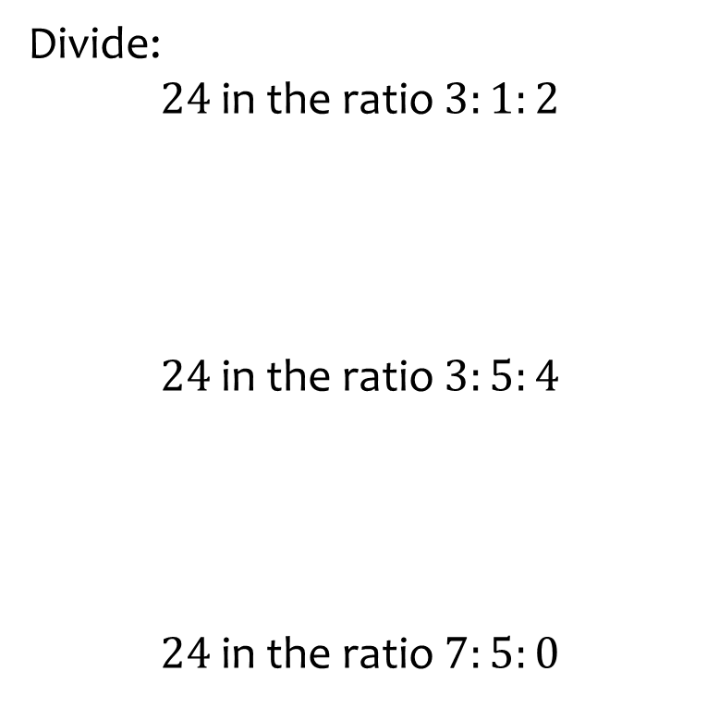
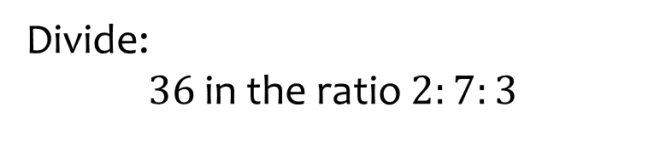

Worked example
Your turn
Divide:
$24$ in the ratio $3:1:2$
$24$ in the ratio $3:5:4$
$24$ in the ratio $7:5:0$
Divide:
$36$ in the ratio $2:7:3$
$$6:21:9$$

Slide 11
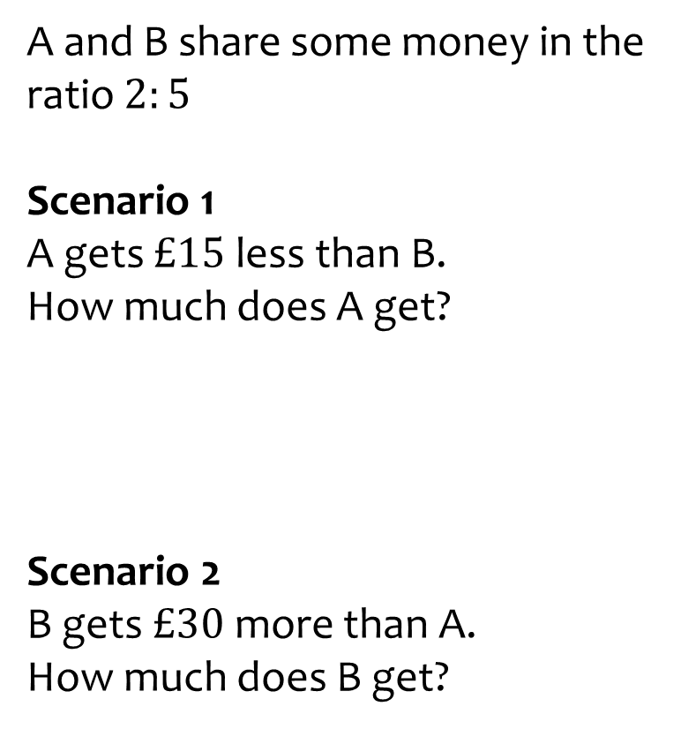
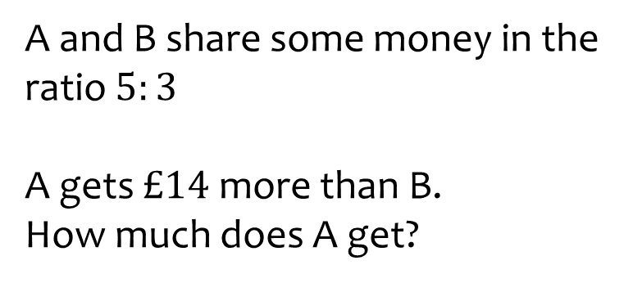

Worked example
Your turn
A and B share some money in the ratio $2:5$
Scenario 1
A gets $£15$ less than B.
How much does A get?
Scenario 2
B gets $£30$ more than A.
How much does B get?
A and B share some money in the ratio $5:3$
A gets $£14$ more than B.
How much does A get?
$$£35$$

Slide 12
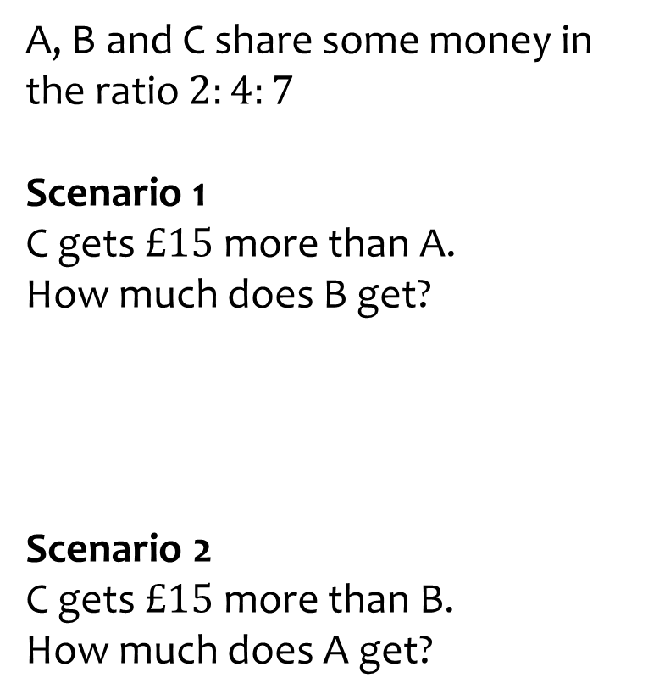
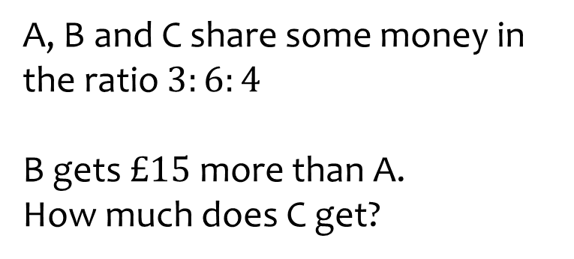

Worked example
Your turn
A, B and C share some money in the ratio $2:4:7$
Scenario 1
C gets $£15$ more than A.
How much does B get?
Scenario 2
C gets $£15$ more than B.
How much does A get?
A, B and C share some money in the ratio $3:6:4$
B gets $£15$ more than A.
How much does C get?
$$£20$$

Slide 13
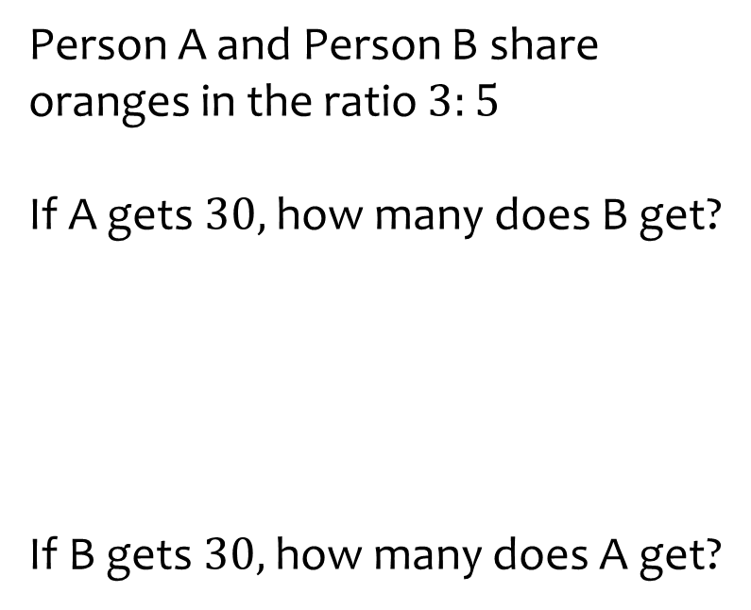
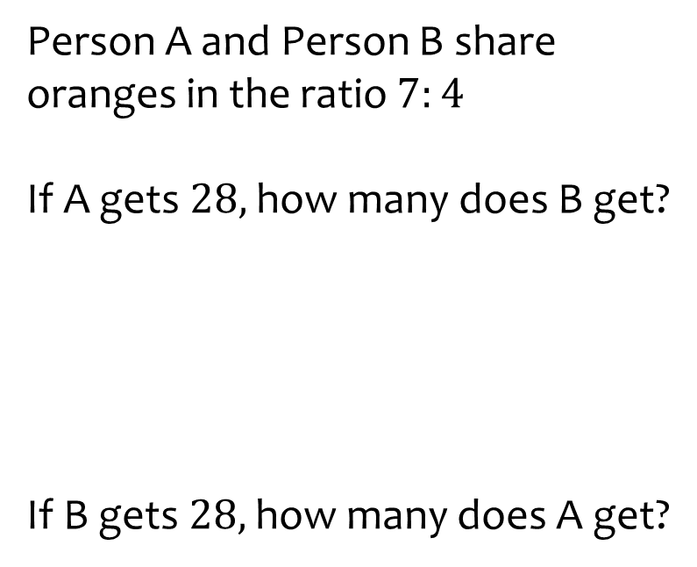
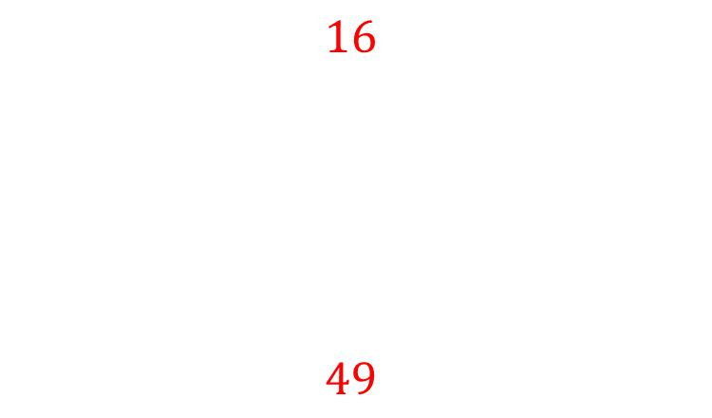
Worked example
Your turn
Person A and Person B share oranges in the ratio $3:5$
If A gets $30,$how many does B get?
If B gets $30,$how many does A get?
Person A and Person B share oranges in the ratio $7:4$
If A gets $28,$how many does B get?
If B gets $28,$how many does A get?
$$16$$
$$49$$

Slide 14
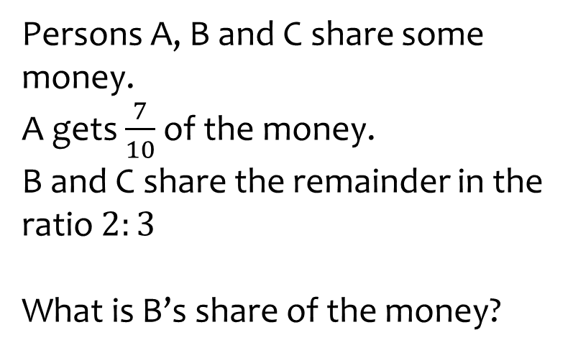
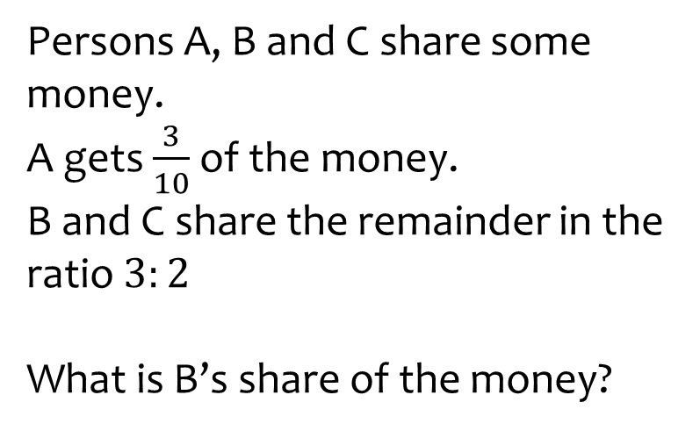

Worked example
Your turn
Persons A, B and C share some money.
A gets $\frac{7}{10}$ of the money.
B and C share the remainder in the ratio $2:3$
What is B’s share of the money?
Persons A, B and C share some money.
A gets $\frac{3}{10}$ of the money.
B and C share the remainder in the ratio $3:2$
What is B’s share of the money?
$$\frac{14}{50}=\frac{7}{25}$$

Slide 15
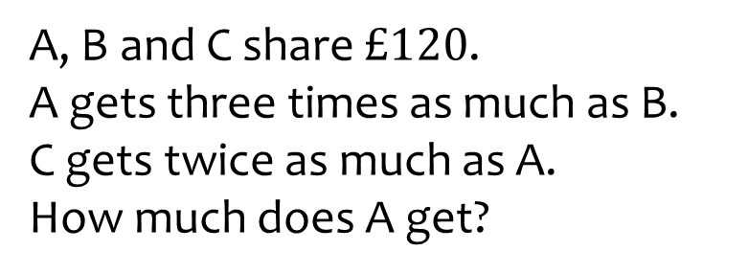
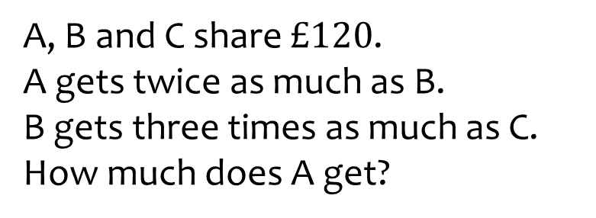

Worked example
Your turn
A, B and C share $£120$.
A gets three times as much as B.
C gets twice as much as A.
How much does A get?
A, B and C share $£120$.
A gets twice as much as B.
B gets three times as much as C.
How much does A get?
$$£60$$

Slide 16
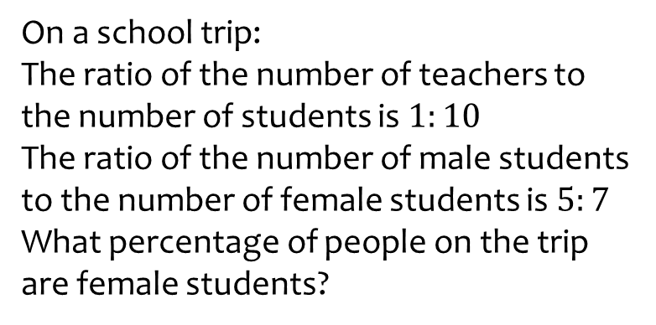
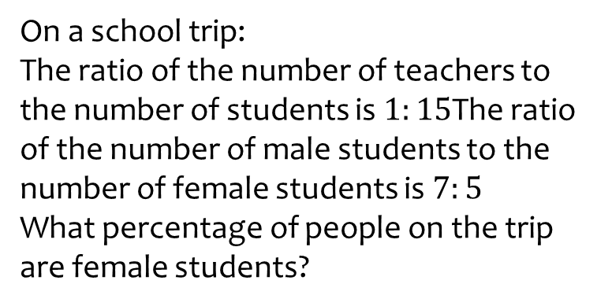

Worked example
Your turn
On a school trip:
The ratio of the number of teachers to the number of students is $1:10$
The ratio of the number of male students to the number of female students is $5:7$
What percentage of people on the trip are female students?
On a school trip:
The ratio of the number of teachers to the number of students is $1:15$The ratio of the number of male students to the number of female students is $7:5$
What percentage of people on the trip are female students?
$$39\%$$

Slide 17
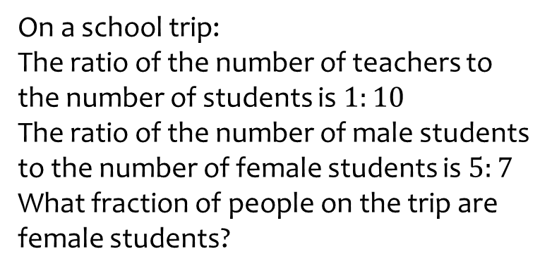
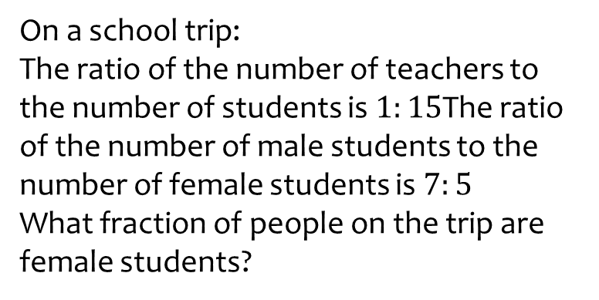

Worked example
Your turn
On a school trip:
The ratio of the number of teachers to the number of students is $1:10$
The ratio of the number of male students to the number of female students is $5:7$
What fraction of people on the trip are female students?
On a school trip:
The ratio of the number of teachers to the number of students is $1:15$The ratio of the number of male students to the number of female students is $7:5$
What fraction of people on the trip are female students?
$$\frac{39}{100}$$

Slide 18
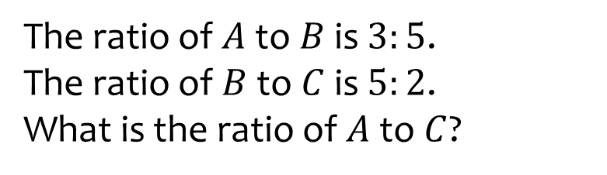
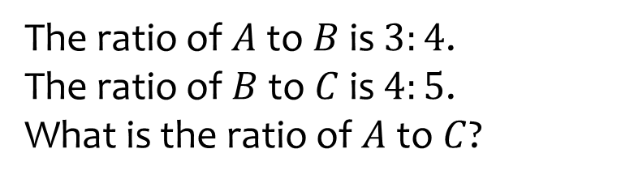

Worked example
Your turn
The ratio of $A$ to $B$ is $3:5$.
The ratio of $B$ to $C$ is $5:2$.
What is the ratio of $A$ to $C$?
The ratio of $A$ to $B$ is $3:4$.
The ratio of $B$ to $C$ is $4:5$.
What is the ratio of $A$ to $C$?
$$3:5$$

Slide 19
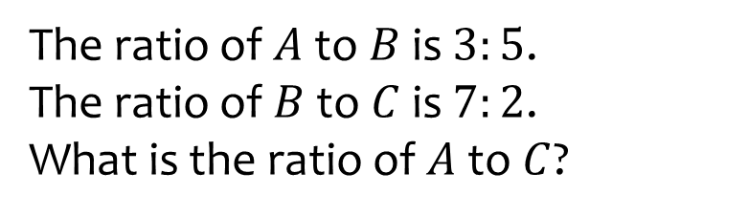
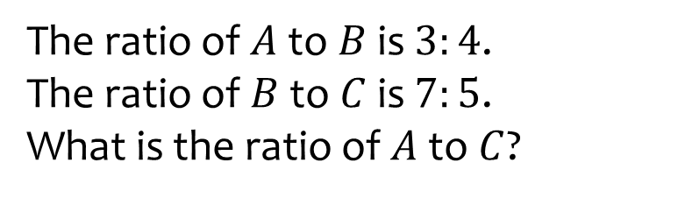

Worked example
Your turn
The ratio of $A$ to $B$ is $3:5$.
The ratio of $B$ to $C$ is $7:2$.
What is the ratio of $A$ to $C$?
The ratio of $A$ to $B$ is $3:4$.
The ratio of $B$ to $C$ is $7:5$.
What is the ratio of $A$ to $C$?
$$21:20$$

Slide 20

Worked example
Your turn
In a box, there are:
Two times as many red counters as blue counters
Three times as many blue counters as red counters
Write the ratio of the number of red pens to the number of green pens to the number of blue pens
In a box, there are:
Three times as many red counters as blue counters
Two times as many blue counters as red counters
Write the ratio of the number of red pens to the number of green pens to the number of blue pens
$$6:2:1$$

Slide 21
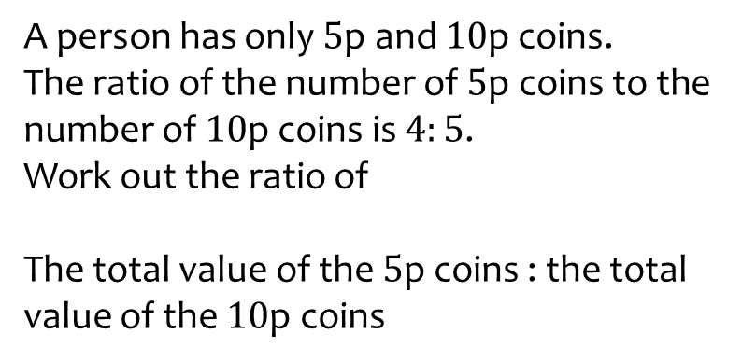
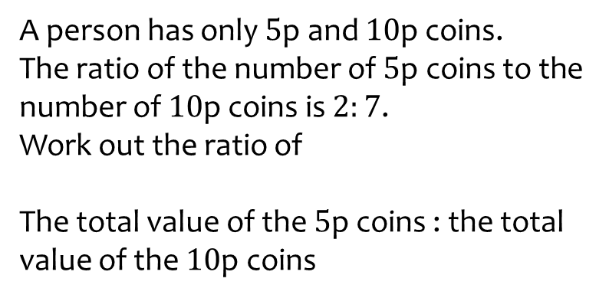

Worked example
Your turn
A person has only $5$p and $10$p coins.
The ratio of the number of $5$p coins to the number of $10$p coins is $4:5$.
Work out the ratio of
The total value of the $5$p coins : the total value of the $10$p coins
A person has only $5$p and $10$p coins.
The ratio of the number of $5$p coins to the number of $10$p coins is $2:7$.
Work out the ratio of
The total value of the $5$p coins : the total value of the $10$p coins
$$1:7$$

Slide 22
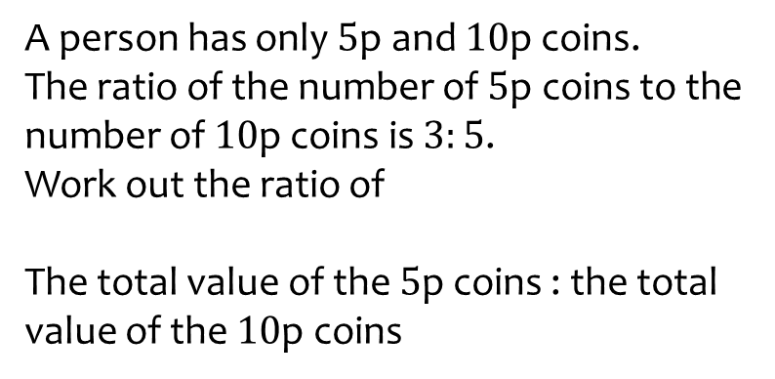
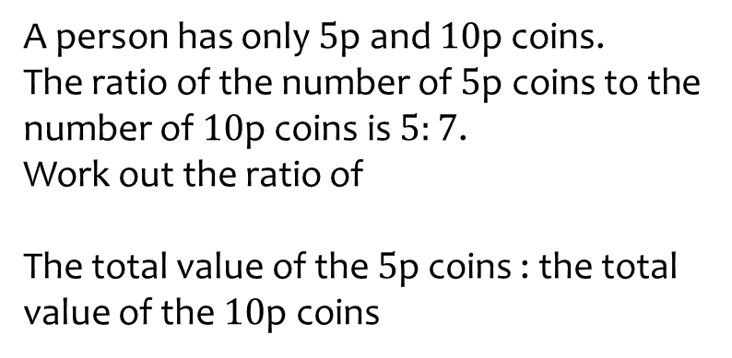

Worked example
Your turn
A person has only $5$p and $10$p coins.
The ratio of the number of $5$p coins to the number of $10$p coins is $3:5$.
Work out the ratio of
The total value of the $5$p coins : the total value of the $10$p coins
A person has only $5$p and $10$p coins.
The ratio of the number of $5$p coins to the number of $10$p coins is $5:7$.
Work out the ratio of
The total value of the $5$p coins : the total value of the $10$p coins
$$5:14$$

Slide 23
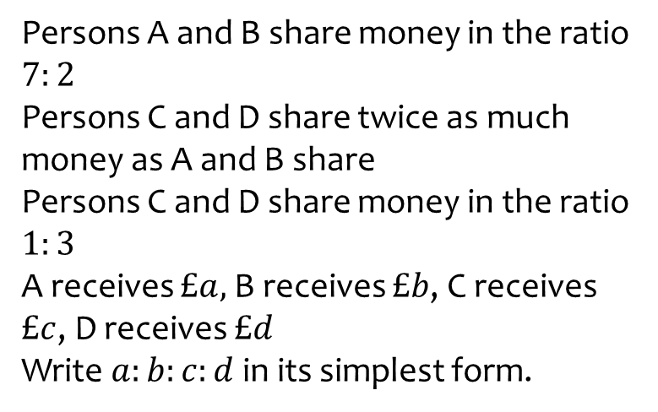
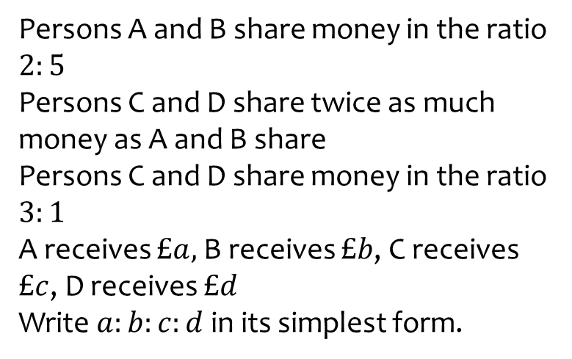

Worked example
Your turn
Persons A and B share money in the ratio $7:2$
Persons C and D share twice as much money as A and B share
Persons C and D share money in the ratio $1:3$
A receives $£a,$B receives $£b$, C receives $£c$, D receives $£d$
Write $a:b:c:d$ in its simplest form.
Persons A and B share money in the ratio $2:5$
Persons C and D share twice as much money as A and B share
Persons C and D share money in the ratio $3:1$
A receives $£a,$B receives $£b$, C receives $£c$, D receives $£d$
Write $a:b:c:d$ in its simplest form.
$$4:10:21:7$$

Slide 24
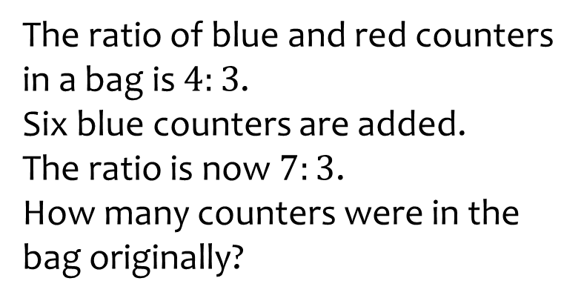
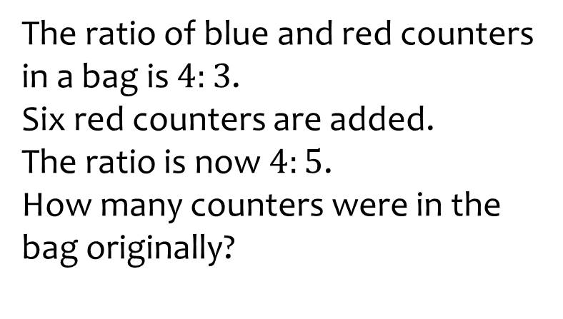

Worked example
Your turn
The ratio of blue and red counters in a bag is $4:3$.
Six blue counters are added.
The ratio is now $7:3$.
How many counters were in the bag originally?
The ratio of blue and red counters in a bag is $4:3$.
Six red counters are added.
The ratio is now $4:5$.
How many counters were in the bag originally?
$$21$$

Slide 25
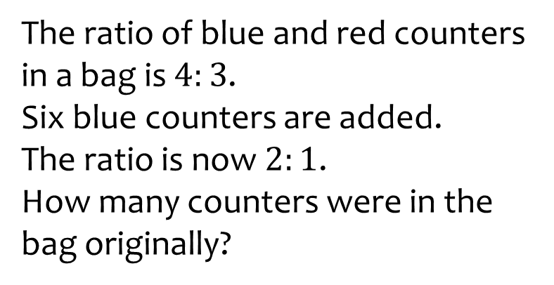


Worked example
Your turn
The ratio of blue and red counters in a bag is $4:3$.
Six blue counters are added.
The ratio is now $2:1$.
How many counters were in the bag originally?
The ratio of blue and red counters in a bag is $4:3$.
Six red counters are added.
The ratio is now $8:9$.
How many counters were in the bag originally?
$$28$$

Slide 26



Worked example
Your turn
The ratio of A’s age to B’s age is
$$2:5$$
In $4$ years time the ratio will be $5:11$.
How old is $B$?
The ratio of A’s age to B’s age is
$$3:4$$
In $7$ years time the ratio will be $4:5$.
How old is $B$?
$28$ years old

Slide 27



Worked example
Your turn
Work out the ratio $x:y$
$$x^{2}−4y^{2}=0$$
$$x^{2}−25y^{2}=0$$
Work out the ratio $x:y$
$$x^{2}−9y^{2}=0$$
$$3:1$$

Slide 28



Worked example
Your turn
The ratio of blue and red counters in a bag is $4:3$.
A counter is taken out of the bag at random.
What is the probability that the counter is blue?
What is the probability that the counter is red?
The ratio of blue and red counters in a bag is $5:7$.
A counter is taken out of the bag at random.
What is the probability that the counter is blue?
What is the probability that the counter is red?
$$\frac{5}{12}$$
$$\frac{7}{12}$$

Slide 29



Worked example
Your turn
The ratio of blue, red and yellow counters in a bag is $4:3:7$.
A counter is taken out of the bag at random.
What is the probability that the counter is blue?
What is the probability that the counter is red?
What is the probability that the counter is red?
The ratio of blue, red and yellow counters in a bag is $5:7:3$.
A counter is taken out of the bag at random.
What is the probability that the counter is blue?
What is the probability that the counter is red?
What is the probability that the counter is red?
$$\frac{1}{3}$$
$$\frac{7}{15}$$
$$\frac{1}{5}$$

Slide 30



Worked example
Your turn
The average exchange rate for Pound to Yen in June 2020 was $1:132$
How much would I get in return for exchanging:
$$£10$$
$$¥660$$
The exchange rate for Pound to Yen in June 2020 was $1:132$
How much would I get in return for exchanging:
$$£20$$
$$¥6600$$
$$¥2640$$
$$£50$$

Slide 31


Worked example
Your turn
The average exchange rates in June 2020 were:
Pound : Japanese Yen
$$1 :132$$
Pound : American dollar
$$1 :1.25$$
The same item costs $1000$ Yen in Tokyo and $\$10.50$ in New York.
Which city is selling the item for the best value?
The average exchange rates in June 2020 were:
Pound : Japanese Yen
$$1 :132$$
Pound : American dollar
$$1 :1.25$$
The same item costs $1500$ Yen in Tokyo and $\$14.25$ in New York.
Which city is selling the item for the best value?
Tokyo

Slide 32



Worked example
Your turn
A map is scaled down so that $5$ centimetres on the map represents a real distance of $1$ kilometer.
On the map, the distance between two points is $41$ cm.
Work out the real distance between these two points.
A map is scaled down so that $4$ centimetres on the map represents a real distance of $1$ kilometer.
On the map, the distance between two points is $14$ cm.
Work out the real distance between these two points.
$$3.5 km$$

Slide 33



Worked example
Your turn
A map is scaled down so that $5$ centimetres on the map represents a real distance of $1$ kilometer.
On the map, the distance between two points is $41$ cm.
Work out the scale of the map in the form $1:n$.
A map is scaled down so that $4$ centimetres on the map represents a real distance of $1$ kilometer.
On the map, the distance between two points is $14$ cm.
Work out the scale of the map in the form $1:n$.
$$1:25000$$

