Slide 1
Rates of flow/work
CONTENTS

Slide 2
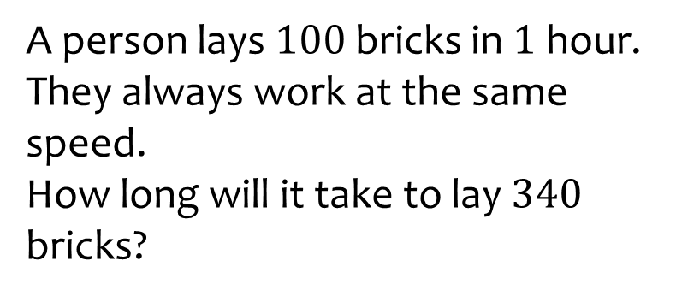

Worked example
Your turn
A person lays $100$ bricks in $1$hour. They always work at the same speed.
How long will it take to lay $340$ bricks?
A person lays 200 bricks in 1 hour. They always work at the same speed.
How long will it take to lay 680 bricks?
$3$ hours $24$ minutes

Slide 3
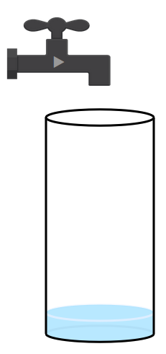
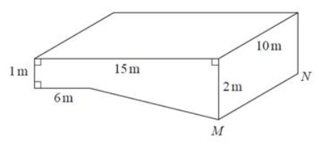

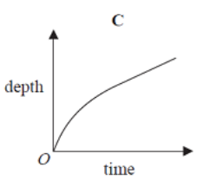
Worked example
Your turn
Sketch a graph to show how the depth of water in the container changes over time
The diagram shows a swimming pool in the shape of a prism.
The swimming pool is empty.
The swimming pool is filled up.
Sketch a graph to show how the depth of the water in the pool above the line MN changes over time, as the pool is filled with water?
Questions used with permission from DESMOS: https://www.desmos.com/

Slide 4
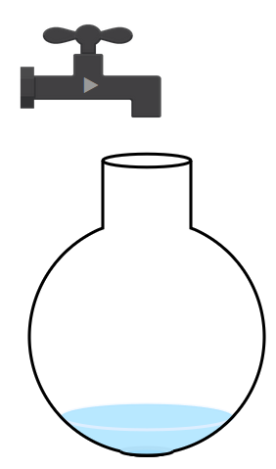
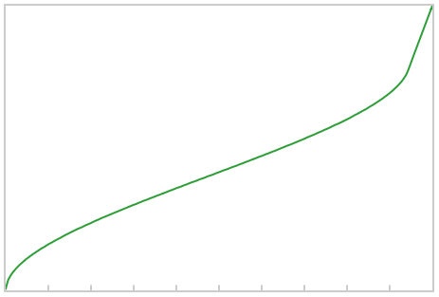
Worked example
Your turn
Sketch a graph to show how the depth of water in the container changes over time
Sketch a graph to show how the depth of water in the container changes over time
Questions used with permission from DESMOS: https://www.desmos.com/

Slide 5
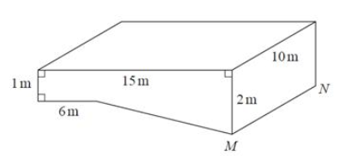

Worked example
Your turn
The swimming pool is empty.
It is filled with water at a constant rate of 20 litres per minute. How long will it take for the pool to be half-full of water?
The swimming pool is empty.
It is filled with water at a constant rate of 50 litres per minute. How long will it take for the pool to be completely full of water?
$65$ hours

